Slide 1


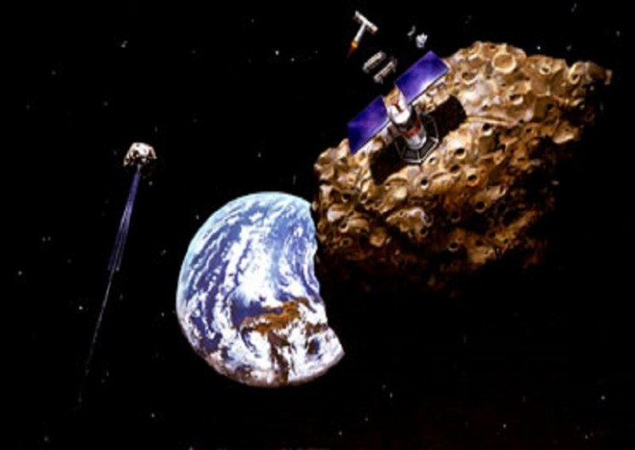
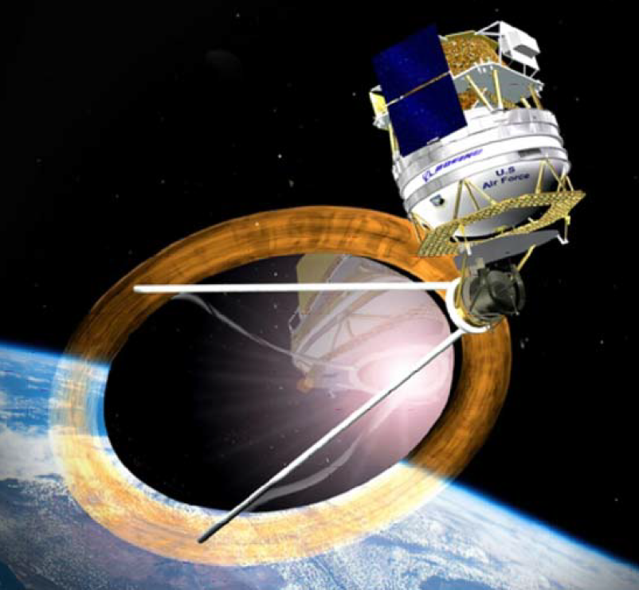
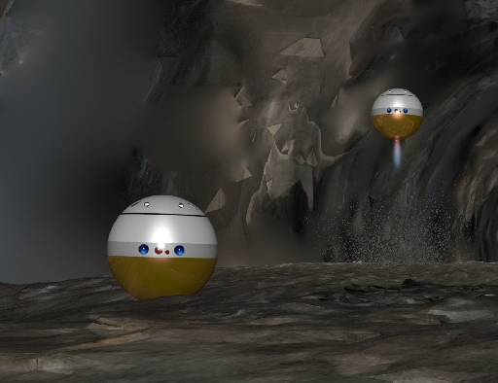
Water-enabled Propulsion Technologies for Interplanetary Travel and Surface Exploration and Prospecting
Jorge Martinez Dominguez
Space and Terrestrial Robotic Exploration (SpaceTREx) Laboratory
Aerospace and Mechanical Engineering Department
University of Arizona
Notes:
Hello everyone. My name is Jorge Martinez, and I am an international student here at the University of Arizona. I arrived last summer as part of an agreement with my home school in Madrid, Spain, and I joined the SpaceTREx laboratory to work on this project.
The purpose of this presentation is to show the work that I have been doing during this semester, based on Water-enabled Propulsion Technologies for Interplanetary Travel and Surface Exploration.

Slide 2
Outline
  Introduction
  Motivation
  Solar Thermal Steam Propulsion
  System Overview
  Analysis
  Performance
  Conclusion
Notes:
Firstly, I will start explaining the motivation of the project. Why are these technologies necessary in the near future?
This work is divided on two main projects, one system is a Solar Thermal Propulsion system for interplanetary travel, and the other is a Spherical robot for surface exploration.
In both of them, I will go over a quick system overview, and then analyze and explain the performance that can be expected for both systems.

Slide 3
Introduction
Why Space Exploration?
  Human need to understand where we came from
  Answer questions about habitability and astrobiology
Space Economy
  Activities and use of resources that benefits human beings
  Two factor for a sustainable space exploration
    The use of off-world resources during the mission (ISRU)
    The use of small, cheaper and expendable spacecrafts and robots
Notes:
So just for a little bit of background:
Why space exploration? Well obviously the first main reason is related to science and knowledge. Questions like how do the planets form, or what is the combination of initial conditions that led our planet to become the abode for innumerable lifeforms reflect a basic human need to understand who we are and where we came from.
The answer to these questions lies out there, and after having thoroughly explored our planet, we are trying to understand the geo-history and composition of all others.
This knowledge should answer questions about habitability and astrobiology
However, this is not the only reason. Resources in our planet are limited, and here is where the concept of space economy is growing in popularity. Space economy is the full range of activities that create value and benefit human beings in the course not only of exploring, but also utilizing space.
If a sustainable space economy, where humans live and work in space, is to be maintained, we have identified two key factors. First, we need to be able to use the off-world resources during the mission, so we don’t have to carry everything from Earth. And second, we need to reduce the cost. Launching cost, maintenance cost, at almost any cost can be reduced by using small spacecrafts and robots

Slide 4
ISRU
In-situ resources to sustain:
  Long Missions
  Lower the cost
  Routine movement
  Economic viability
Why water ?
  Multiple sources in the inner solar system.
Source: NASA
Notes:
In-situ resources utilization is just that, the collection and use of resources encountered in the course of human or robotic space exploration that replace materials that otherwise would have been carried from Earth. Neccesary for:
- Long missions, where a lot of power or thrust must be applied for long periods
- Lower cost: both the cost of the resources and also the cost of launching and carrying them
- Missions where a daily action is required or a routine movement has to be done, would mean a lot of resources that can be bring form Earth
- Then of course makes everything cheaper
Sunlight and water are the best examples of this. Many satellites use sunlight for powering, thanks to photovoltaics, and water is a resource that Water can be found in so many places in space, like C-class Near Earth Objects, the surface of Mars or its moons., and it can be used for multiple purposes, as we will see later

Slide 5
Small Satellites
Reduced launch costs
Reduced development times
Easily manufactured
Swarms of microsatellites to replace single large
Quicker response when replacing a damaged satellite
Workhorse for interplanetary travel
Notes:
So, why is the use of small satellites is growing in popularity?
- The miniaturization of electronics and all other systems has allowed us to develop the ever smaller spacecrafts.
Well they represent a huge reduction in lunching cost (weight), but also in development times and therefore project cost.
They can be easily manufactured,
And important: we can use a cloud of different microsatellites to replace a single large. This means that in some cases they are expendable, but also it is easier to replace them when damaged.
And therefore they represent a workhorse for interplanetary travel

Slide 6
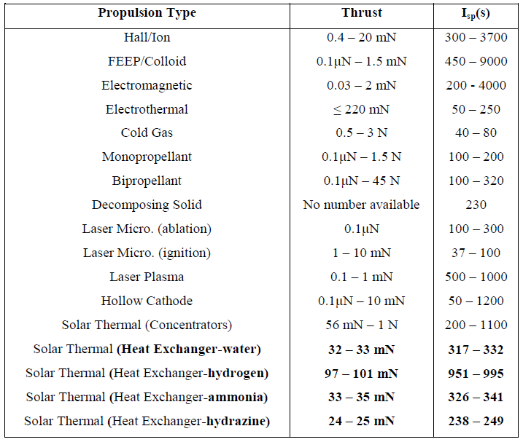
Small Satellites for Interplanetary Travel
High Isp solutions have been developed
Low thrust requires long waiting time, precise maneuvering and hard to achieve capture orbits
Solar Thermal Propulsion represents a medium-range solution
Source: Scharfe et. al. 2009
Notes:
Different propulsion technologies have been developed for small satellites, summarized in the following table.
-There are some solutions that can provide high Specific impulse, up to thousands of seconds (Point Hall or electric)
However, their thrust level requires long waiting times, a lot of precision for maneuvering and it is for that hard to achieve capture orbits
On the other side, bipropellant provides thrust but at low specific impulse
Solar Thermal technologies represent a medium-range solution for both (Point).

Slide 7
Need for Multifunctional Materials to Support Long Duration Missions
Adopting a common, high-performance yet green propulsion solution has major benefits
Maximal multi-functionality from few materials.
The resource can be readily replenished
Water is an excellent candidate
  Propulsion, power, thermal control, radiation shielding, life-support
  Compelling choice for fuel
Notes:
Well, so as we have seen all this missions require a lot of technology and resources, and that is why is necessary to try to use a multifunctional materials to support this long missions.
- Adopting a common high-performance but green propulsion. This would have major benefits
We need to also maximize the functionality of few materials. This is, trying to use materials that can be used for different things at the same time
And if possible that these resources can be actually replenished in space
What can fulfill all this?
-Water can be used not only to sustain human-life, but also for use in propulsion, power and radiation protection systems.
- Water is a compelling choice for fuel. It is a green monopropellant, that simplifies storing, handling and transportation, since is widely available, it requires smaller tanks (high density) and is no volatile

Slide 8
Objective
Detect market gap and improve capabilities
  ISRU
  Compact, small technology
Apply these concepts to refine previous model
  Interplanetary travel: STP
Propulsion systems modelling and performance analysis
Notes:
The objective of this work then to detect a market gap and improve capabilities of other systems, using ISRU and small compact technologies.
Both concepts were previously studied by other people in the Lab so my main objective was to
Find flaws
Refine a conceptual design: solar thermal steam propulsion for interplanetary planetary travel (STP) and SphereX for surface exploration
Develop a propulsion systems modelling and performance analysis

Slide 9
Approach
Analytical approach
Computer simulations
  Matlab
  ANSYS
Analyze performance

Slide 10
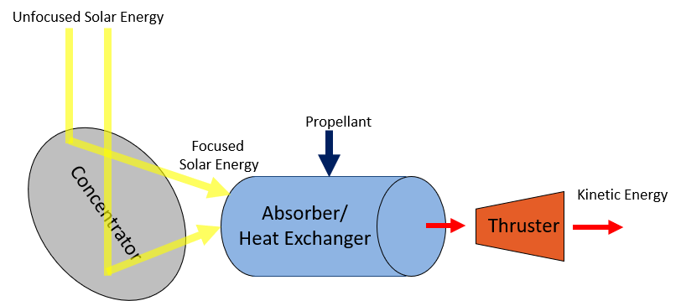
Solar Thermal Propulsion (STP)
Solar Concentrator
Volumetric Receiver
Convergent-Divergent Nozzle
Notes:
Solar Thermal Propulsion concept can be summarized in the following diagram. It uses a solar concentrator to focus all the solar energy into a receiver. There are different concepts developed about this receiver, but mainly they are based on absorbing the light directly, or using a heat exchanger to provide the heat to the propellant. Once the propellant is heated to the design temperatures, it is expanded through a convergent-divergent nozzle to create thrust.
In this project we used this concept, and showed that a technology like this can be used with water. It can be converted into superheated steam with the same procedure and expelled by the nozzle to produce thrust.
Previous technologies tried to use the water extracted from these worlds with an electrolysis procedure, decomposing water into hydrogen and oxygen and then produce a combustion. The problem however is that water extracted can have trace elements of sulfur and others, that poison the electrolysis cells. Superheating water however allows us to use the impure water extracted.

Slide 11
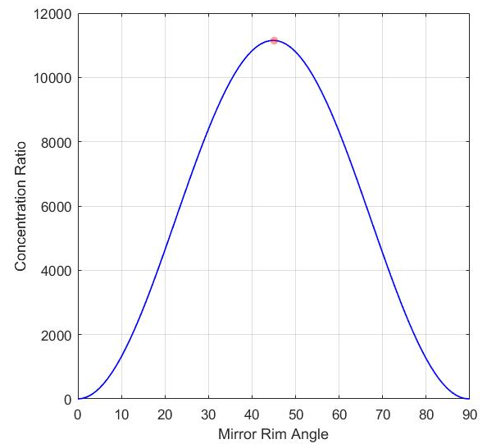
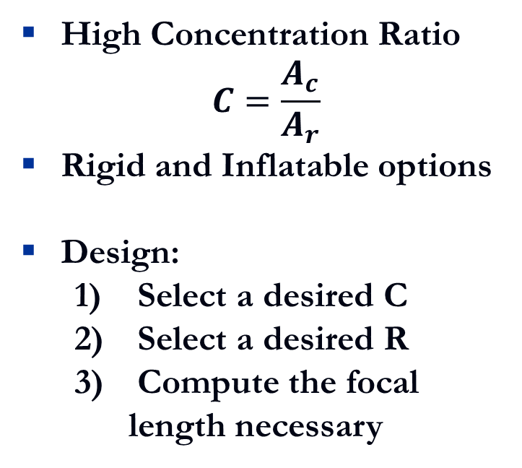
STP: System Overview
Parabolic Dish Concentrator
High Concentration Ratio
$$C=\frac{A_{c}}{A_{r}}$$
Rigid and Inflatable options
Design:
  Select a desired C
  Select a desired R
  Compute the focal length necessary
Notes:
In this design, a parabolic dish was employed as the solar concentrator technology. For being parabolic shape, the incoming rays coming parallel to the axis will be deflected to the focal point. Ideally they would be reflected into a point, but in reality, the light is not perfectly aligned with the axis and therefore the focal point ends up being a focal area.
The concentration ratio, which is the property that tells us how solar energy is concentrated, can be geometrically found as the relation between the concentrator and receiver areas, as the total energy hitting them both must be the same (lets suppose no losses).
Parabolic Dish was chosen instead of flat mirrors due to the fact that they can achieve higher concentrator ratios. As it is shown here, the concentrator ratio on this dishes can be as high as 11.000 if no optical error is taken into account. For being realistic in the calculations, we will say that the upper limit of this concentration ratio is around 10,000, which is about the maximum achieved by other technologies.
Parabolic concentrators for space use have been built and tested, although the technology has never flown. There are both rigid and inflatable options. Rigid structures are compact and they have a good performance. Densities of 1.5 km/m3 have been achieved and they don’t need a supportive structure.

Slide 12
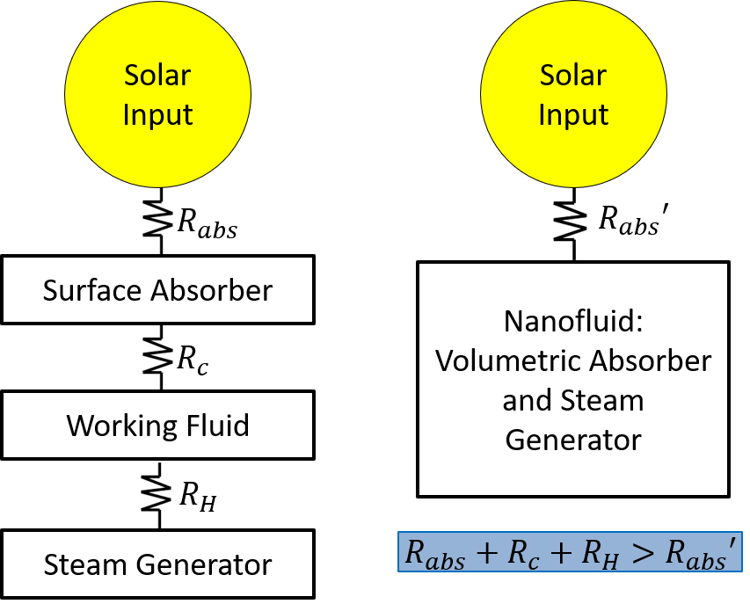
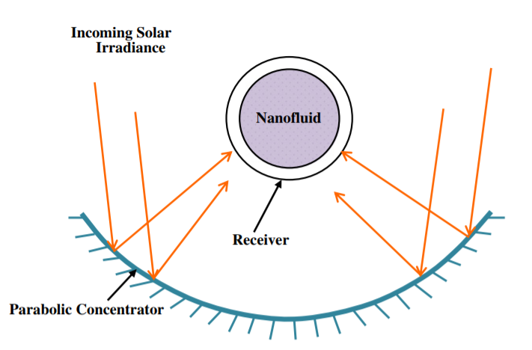

STP: System Overview
Solar Receiver
Indirect
Direct
$$R_{abs}+R_{c}+R_{H}>R_{abs}′$$
Notes:
Out of the two concepts explained for the solar receiver, we chose to use a volumetric solar absorber (DIRECT GAIN)
In the first concept, the energy is concentrated into the absorber surface, then it has to be transmitted to the working fluid, which will then heat the propellant through a heat exchanger. This means too many thermal resistances
The thermal resistance can be simplified if we directly concentrate the energy into a nanofluid that will work at the same time as the receiver and propellant. A nanofluid is just a mix between a fluid and nanoparticles to enhance the heat transfer properties.
In case of radiation: more surface radiated

Slide 13
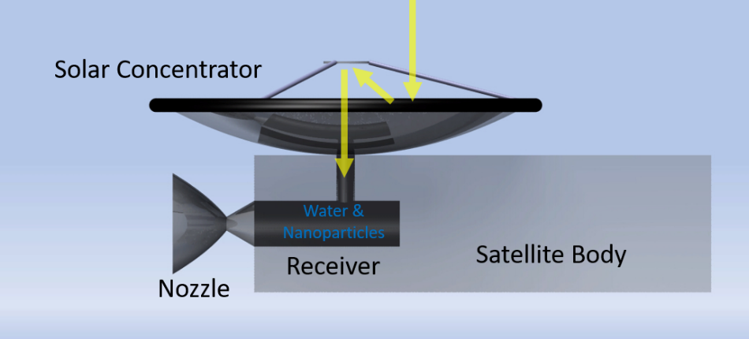
STP: System Overview
Solar Receiver
Direct Gain STP Concept
Volumetric heating
Thermal Isolation
Impure water
Notes:
Like it can be seen here. The sun is concentrated into the focal length, which then is reflected directly to the water and nanoparticles mixed.

Slide 14
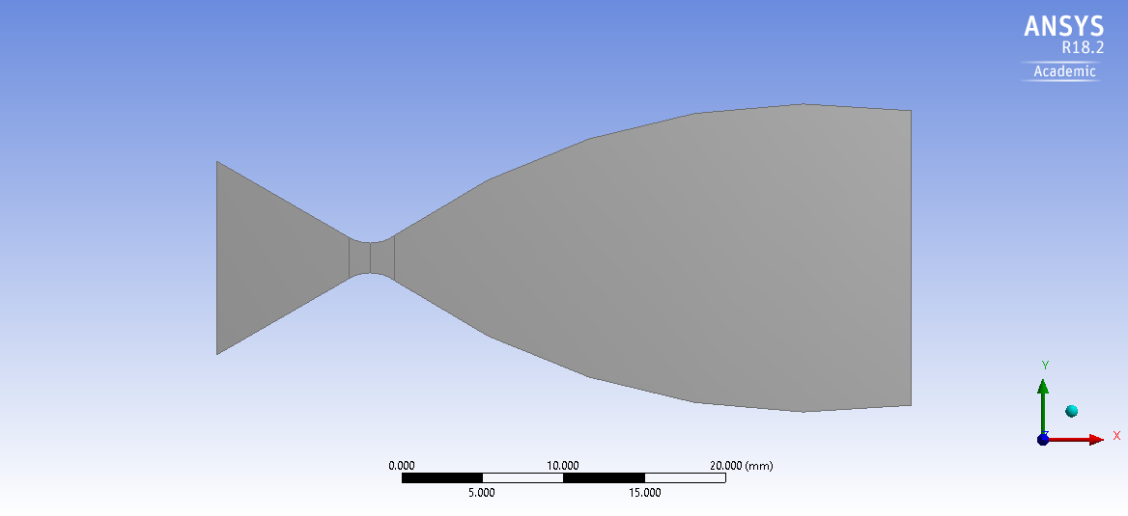
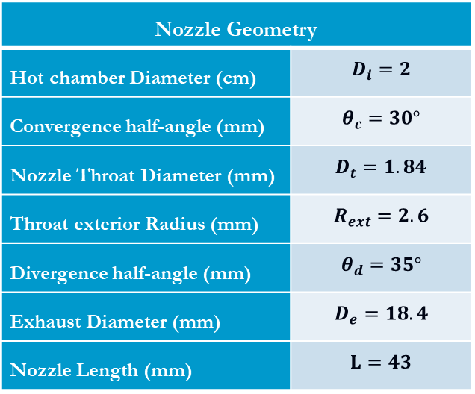
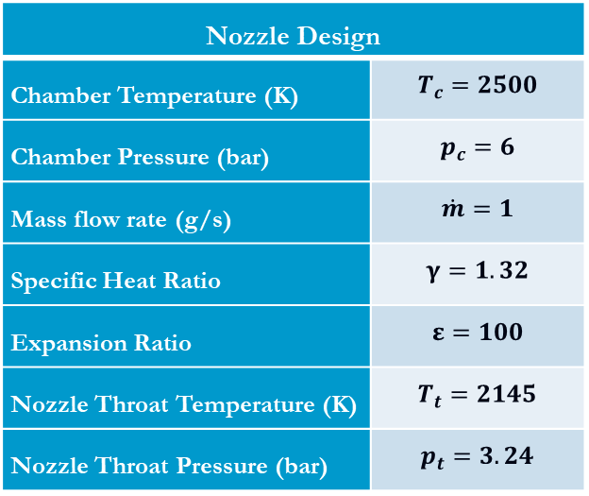
STP: System Overview
Thruster: Operating Conditions
Nozzle Design
Chamber Temperature (K) | $$T_{c}=2500$$
Chamber Pressure (bar) | $$p_{c}=6$$
Mass flow rate (g/s) | $$\dot{m}=1$$
Specific Heat Ratio | $$γ=1.32$$
Expansion Ratio | $$ε=100$$
Nozzle Throat Temperature (K) | $$T_{t}=2145$$
Nozzle Throat Pressure (bar) | $$p_{t}=3.24$$
Nozzle Geometry
Hot chamber Diameter (cm) | $$D_{i}=2$$
Convergence half-angle (mm) | $$θ_{c}=30°$$
Nozzle Throat Diameter (mm) | $$D_{t}=1.84$$
Throat exterior Radius (mm) | $$R_{ext}=2.6$$
Divergence half-angle (mm) | $$θ_{d}=35°$$
Exhaust Diameter (mm) | $$D_{e}=18.4$$
Nozzle Length (mm) | $$L=43$$

Slide 15
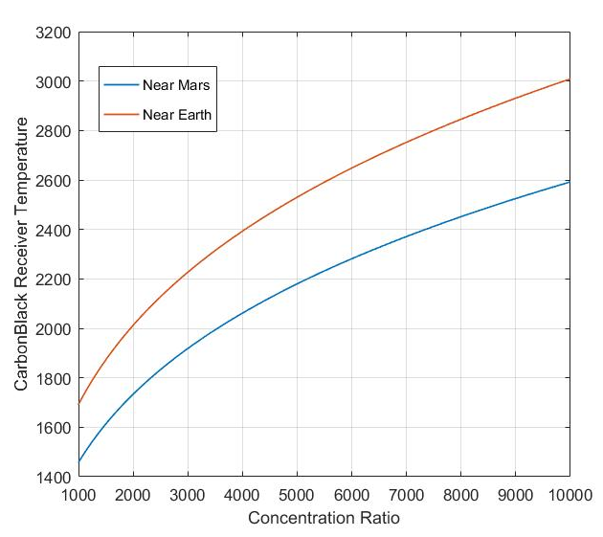
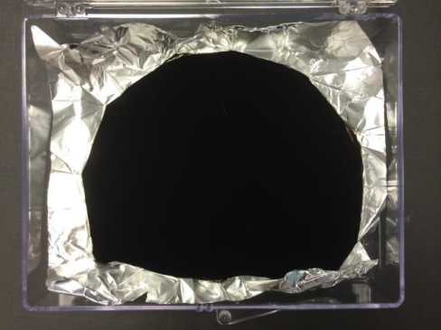
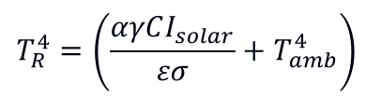
STP: Analysis
Carbon-black Receiver
-Thermal Equilibrium
$$\begin{aligned}&T_{R}^{4}=\left(\frac{αγCI_{solar}}{εσ}+T_{amb}^{4}\right)\#\end{aligned}$$
Source: Surrey Nanosystems
Up to 99% absorptivity
Notes:
We will analyze first how well these nanoparticles absorb the heat
Then how well they transmit these heat to the surrounding water
Receiver temperature function of concentrated light and nanoparticles radiative properties
We employed carbon nanoparticles (VANTABLACK) because it can absorb up to 99% of the incoming radiation
Here we show the temperatures that these particles could achieve in both near mars and earth environments. The change between them is actually the solar influx at both positions as mars is farther from the Sun
3000K!!

Slide 16
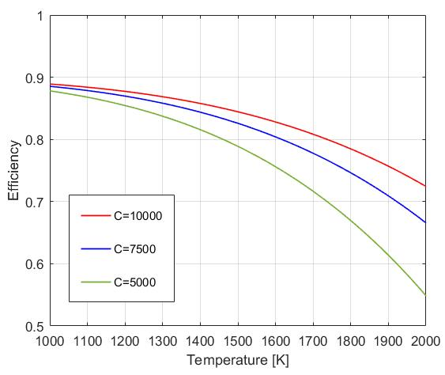

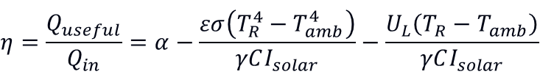
STP: Analysis
Carbon-black Receiver
Receiver Efficiency
$$\begin{aligned}&η=\frac{Q_{useful}}{Q_{in}}=α−\frac{εσ\left(T_{R}^{4}−T_{amb}^{4}\right)}{γCI_{solar}}−\frac{U_{L}\left(T_{R}−T_{amb}\right)}{γCI_{solar}}\#\end{aligned}$$
$$↑T_{r} ↓η$$
Higher radiation losses
Higher heating time
Notes:
Then we analyze these receiver efficiency in terms of how much heat it absorbs respect the incoming energy.
For that, we just do an energy balance where the Useful work is the absorbed one, minus the radiative losses and convective losses
We can see that at higher temperatures there will be higher radiation losses and therefore lower efficiencies.
We can also see that for a given receiver temperature, the efficiency is higher at high concentration ratios

Slide 17
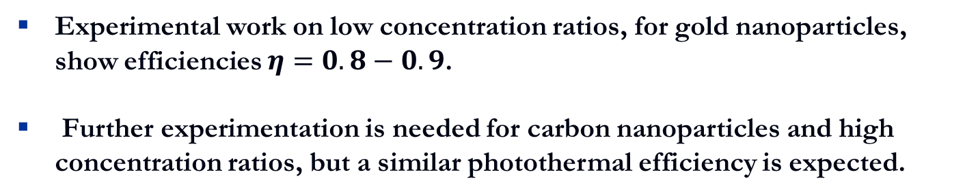
STP: Analysis
Steam generation
How efficiently do the nanoparticles transmit the heat to the water?
$$η\left(t\right)=\frac{\left({c_{p}}_{w}m_{w}+{c_{p}}_{n}m_{n}\right)ΔT+\int_{0}^{t}{m_{s}h_{lv}dt}+{c_{p}}_{s}m_{s}ΔT}{η_{c}\int_{0}^{t}{I_{solar}A_{ab}dt}}$$
Experimental work on low concentration ratios, for gold nanoparticles, show efficiencies $η=0.8−0.9$.
Further experimentation is needed for carbon nanoparticles and high concentration ratios, but a similar photothermal efficiency is expected.
Notes:
Then we have to analyze how well do the nanoparticles transmit the heat to the water.
- For that, we defined an efficiency in the process defined as the heat used in steam production and heating, divided by the incoming solar energy.
There are some experimental work on low concentration ratios, for gold nanoparticles, that shows that this efficiency ca be as high as 0.8-0.9
We could not do this measurements with our particles, but similar photothermal efficiency is expected

Slide 18
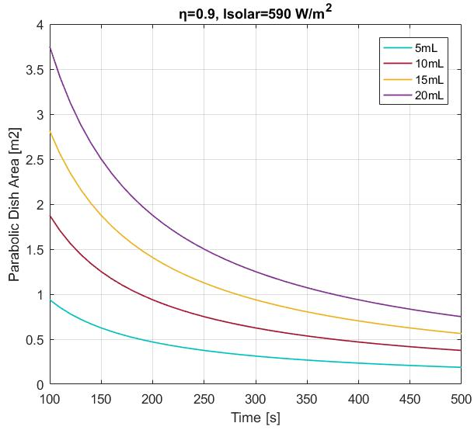
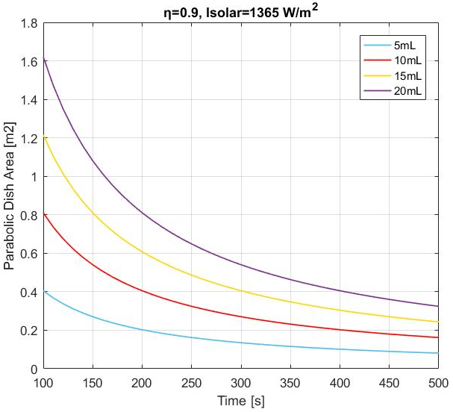
STP: Time Need to Achieve 2500 K
Mars
Earth
Notes:
With these values, we can find the time that we need to achieve 2500K for different propellant amounts.
Obviously, the bigger the parabolic dish is, the more energy it will absorb, and the less time it will take.
There is an important difference here due to the solar flux difference between earth and mars, but note that it might take less than minutes to heat up 15 grams of water to 2500K with a 1 meter square dish

Slide 19
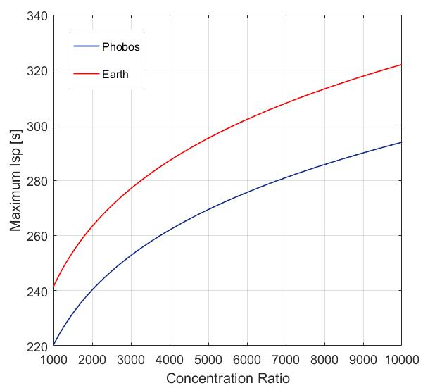
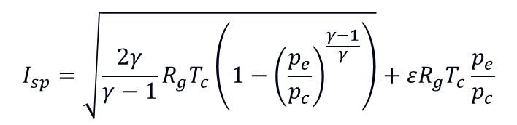

STP: Performance
Specific Impulse
ANSYS model showed only a 5% difference with the analytical work
$$I_{sp}=\sqrt{\frac{2γ}{γ−1}R_{g}T_{c}\left(1−{\left(\frac{p_{e}}{p_{c}}\right)}^{\frac{γ−1}{γ}}\right)}+εR_{g}T_{c}\frac{p_{e}}{p_{c}}$$
$I_{sp}=240−320$ s
Notes:
Now we will analyze how these results impact in the performance of the propulsion system.
First, we analyze the specific impulse, which is actually the change in linear momentum that a unit mass of the propellant can generate. This is, how good does the rocket use the propellant. Thrust/mass flow rate
-As you can see here, it is a function of the working temperature and pressure, the propellant, and the nozzle design
Again, we computed it for near earth and near mars environment, and we saw maximums about 290 and 320 s.

Slide 20
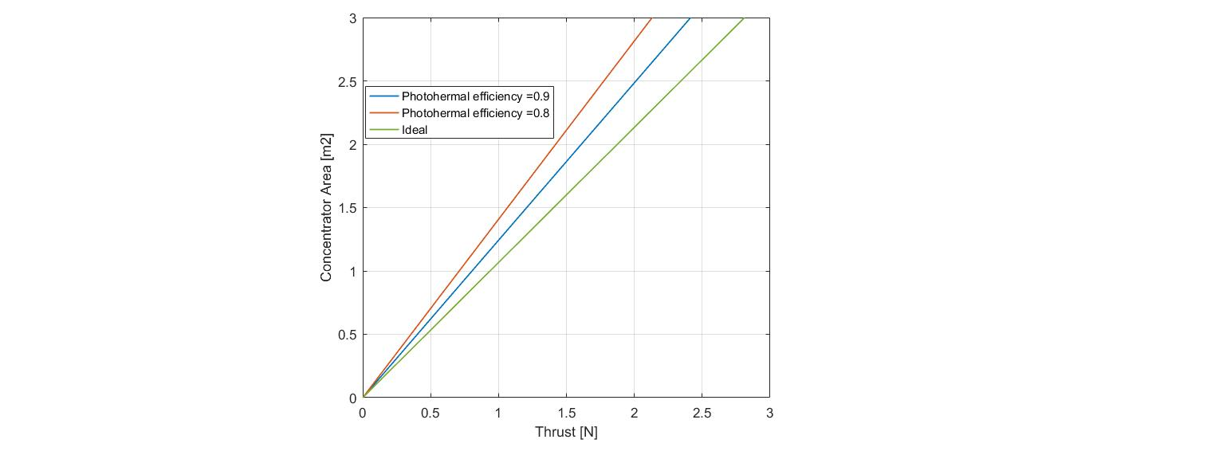

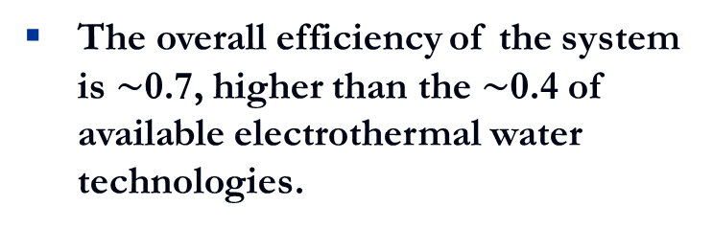
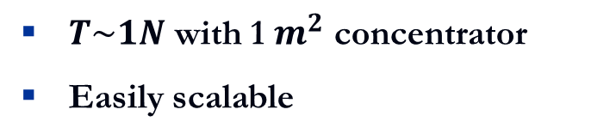
STP: Performance
Thrust
The components efficiency allows us to compute the thrust.
$$η_{opt}η_{pt}A_{c}I_{solar}=\frac{1}{2}Tv_{e}$$
$T\sim 1N$ with 1 $m^{2}$ concentrator
Easily scalable
The overall efficiency of the system is $\sim$0.7, higher than the $\sim$0.4 of available electrothermal water technologies.
Notes:
Remember that the other issue with the interplanetary technologies was the thrust. The thrust is actually the reaction force that is created in the rocket when the propellant is expelled. We computed the possible thrust achievable from the efficiencies of the particles of absorbing heat, the efficiency of the particles to transmit the heat to the fluid, and the exhaust velocity.
We found that a 1m2 concentrator is enough to achieve around 1N thrust.
The overall efficiency of the system, this is how well does it convert the incoming solar flux into kinetic energy, is around 0.7, way higher than electrothermal water technologies, around 0.4.

Slide 21
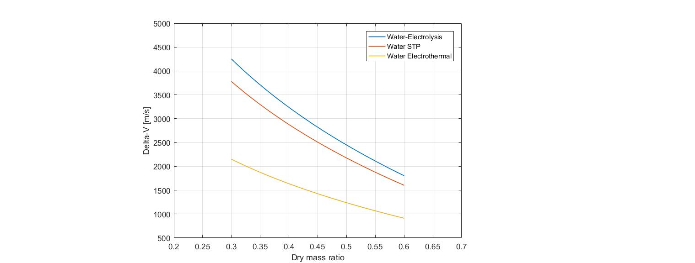

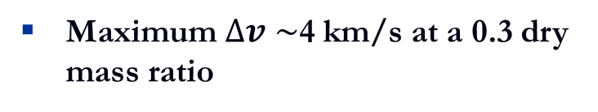
STP: Performance
Delta-v
Tsiolkovsky rocket equation
$$∆v=v_{e}\ln{\frac{m_{0}}{m_{f}}}$$
Maximum $∆v$ $\sim$4 km/s at a 0.3 dry mass ratio
It approaches water electrolysis propulsion systems
Offer a superior performance than water electrothermal propulsion
Notes:
Finally, the delta-v capabilities were analyzed. Delta-v is the total impulse that is needed to perform a maneuver.
This equation relates this total impulse with the amount of propellant mass that is needed to do it.
We can here compare these capabilities for different water-based technologies, and see that
- It approaches water electrolysis propulsion systems. BUT IT CAN USE IMPURE WATER. Don’t poison the cells with the Sulfure traces
- Offer a superior performance than water electrothermal propulsion.

Slide 22
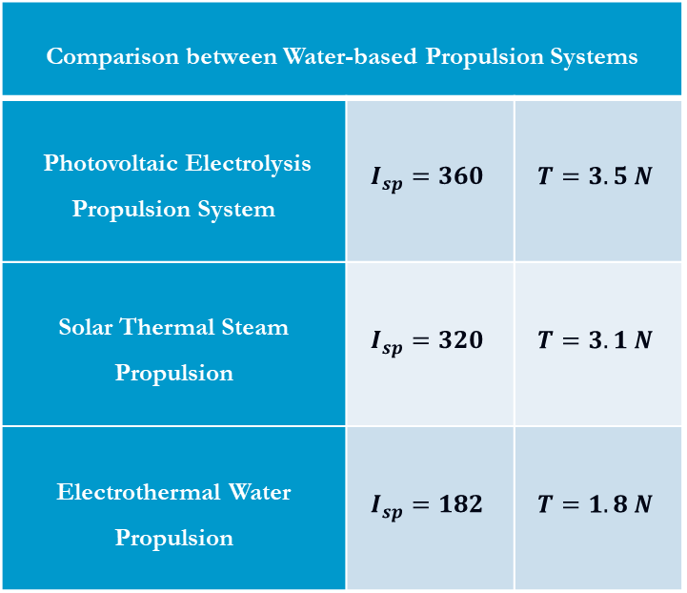
STP: Performance
Delta-v
Tsiolkovsky rocket equation
Comparison between Water-based Propulsion Systems
Photovoltaic Electrolysis Propulsion System | $$I_{sp}=360$$ | $$T=3.5 N$$
Solar Thermal Steam Propulsion | $$I_{sp}=320$$ | $$T=3.1 N$$
Electrothermal Water Propulsion | $$I_{sp}=182$$ | $$T=1.8 N$$
$$∆v=v_{e}\ln{\frac{m_{0}}{m_{f}}}$$
Maximum $∆v$ $\sim$4 km/s at a 0.3 dry mass ratio
It approaches water electrolysis propulsion systems
Offer a superior performance than water electrothermal propulsion

Slide 23
Conclusion
Developed a refined Solar Thermal Steam Propulsion concept for spacecraft
Better performance than water-based electrothermal technologies, and comparable to water electrolysis
  Major implications
Delta-v on the 4km/s range required from LEO to Phobos
  LEO to Earth-Mars transfer 3.6 km/s
  Aerocapture and aerobraking to Phobos transfer and 0.5 km/s to Phobos surface
Adapted the technology to power surface vehicles, and a ballistic hop mobility was shown for a quad-engine configuration
Delta-v Budget for a mission to Phobos/Deimos
Thermal storage?
Notes:
Developed a refined Solar Thermal Steam Propulsion concept for spacecraft
Better performance than water-based electrothermal technologies, and comparable to water electrolysis
Major implications
Delta-v on the 4km/s range required from LEO to Phobos
LEO to Earth-Mars transfer 3.6 km/s
Aerocapture and aerobraking to Phobos transfer and 0.5 km/s to Phobos surface
Adapted the technology to power surface vehicles, and a ballistic hop mobility was shown for a quad-engine configuration

Slide 24
Contributions
Refine understanding and analysis of STSP
Develop an scalable model for STSP
Develop a dynamic model for ballistic hopping of a quad-engine configuration robot
Notes:
Refine understanding and analysis of STSP
Develop an scalable model for STSP
Develop a dynamic model for ballistic hopping of a quad-engine configuration robot

Slide 25
Backup Slides

Slide 26
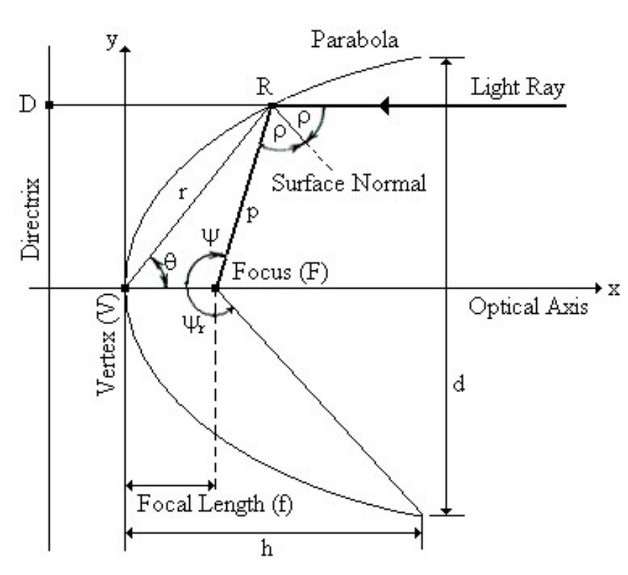
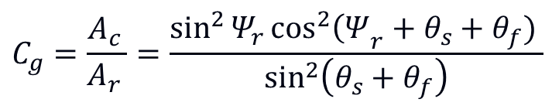
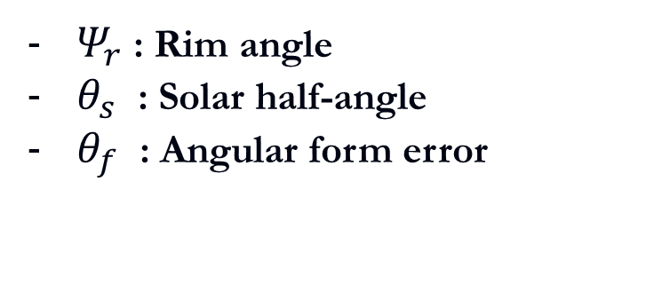
STP: System Overview
Parabolic Dish Concentrator
OPTICS
$$\begin{aligned}&C_{g}=\frac{A_{c }}{A_{r }}=\frac{\sin^{2}{Ψ_{r}}\cos^{2}{{\left(Ψ\right.}_{r}+θ_{s}+θ_{f}) }}{\sin^{2}\left(θ_{s}+θ_{f}\right)} \#\end{aligned}$$
$Ψ_{r}$: Rim angle
$θ_{s}$ : Solar half-angle
$θ_{f}$ : Angular form error

Slide 27
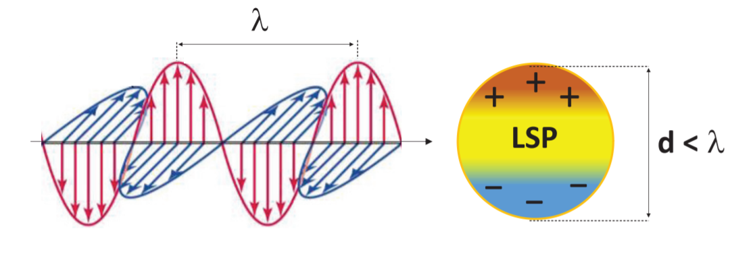
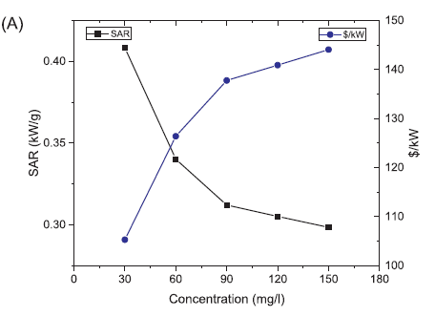
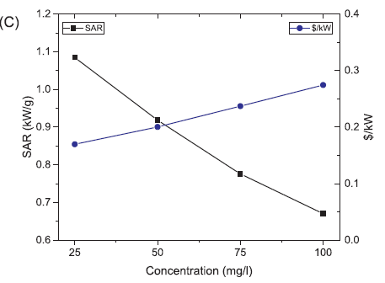
Gold vs Carbon Nanoparticles
Plasmonic Resonance
Notes:
Plasmonic resonance: by an external electromagnetic radiation, we can excite the free electrons on metals. With the right frequency excitation we will create oscillations of these negatively charged electron cloud and the positively charged ions.
In regular objects, not possible. Because the wavelength must be bigger than the size of the object.
Nanoparticles, tiny: 10e-09.
The main reason why these are used: Tunable with the shape and size
Carbon: absorptivity at all ranges. Better performance.

Slide 28
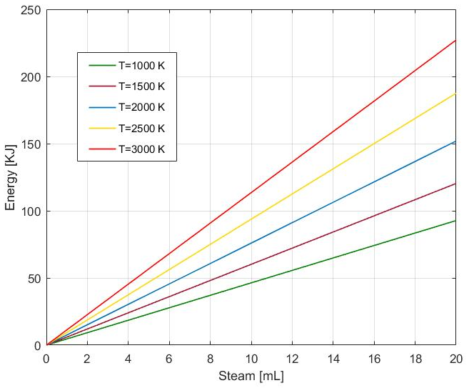
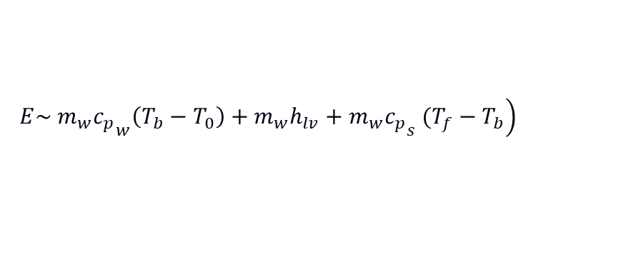
STP: Analysis
Steam generation
How much heat is needed to produce the desired superheated steam?
$$\left.E\sim m_{w}{c_{p}}_{w}\left(T_{b}−T_{0}\right)+m_{w}h_{lv}+m_{w}{c_{p}}_{s} (T_{f}−T_{b}\right)$$
Most of the energy is employed in the phase change
Nanofluids enhanced heat capacity
Notes:
To analyze how well they transmit the energy to the surrounding fluid, we first analyze how much heat is needed to

Slide 29
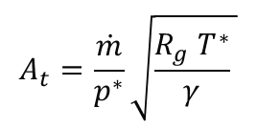

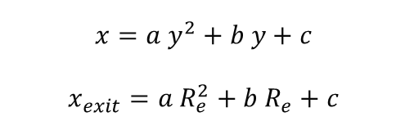
STP: System Overview
Thruster: Bell-shape nozzle
$$A_{t}=\frac{\dot{m}}{p^{∗}}\sqrt{\frac{R_{g} T^{∗}}{γ} }$$
$$\begin{aligned}x=a y^{2}+b y+c \#\end{aligned}$$
$$\begin{aligned}x_{exit}=a R_{e}^{2}+b R_{e}+c \#\end{aligned}$$
$$L=\frac{R_{g}\left(\sqrt{ε}−1\right)}{\tan{α_{c}}}+R_{ag}\frac{\cos\left(θ_{n}−α_{c}\right)−\cos{α_{c}}}{\sin{α_{c}}}$$
Performance Tested on ANSYS Fluent

Slide 30
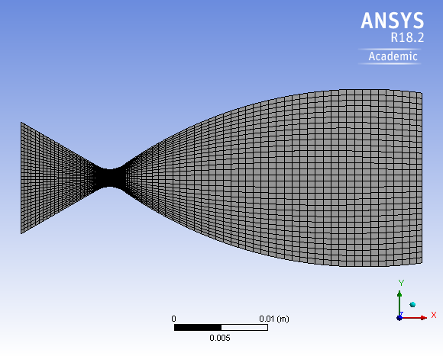
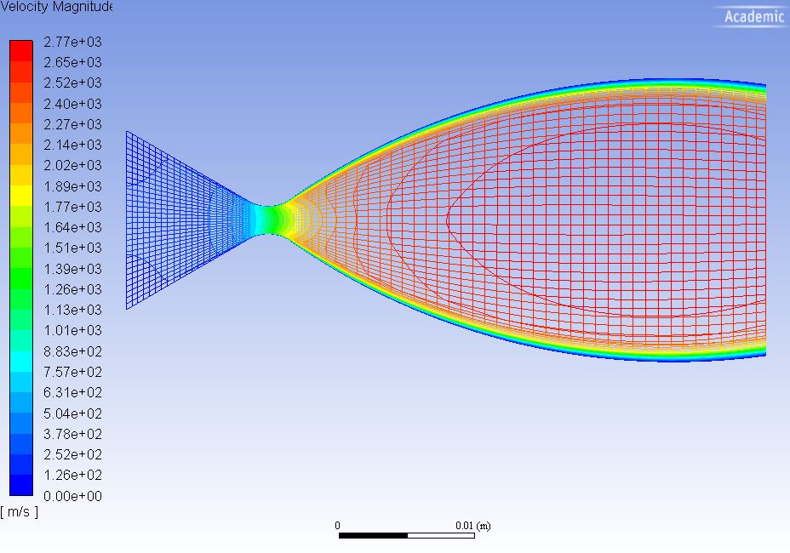
ANSYS Fluent Model

