Slide 1


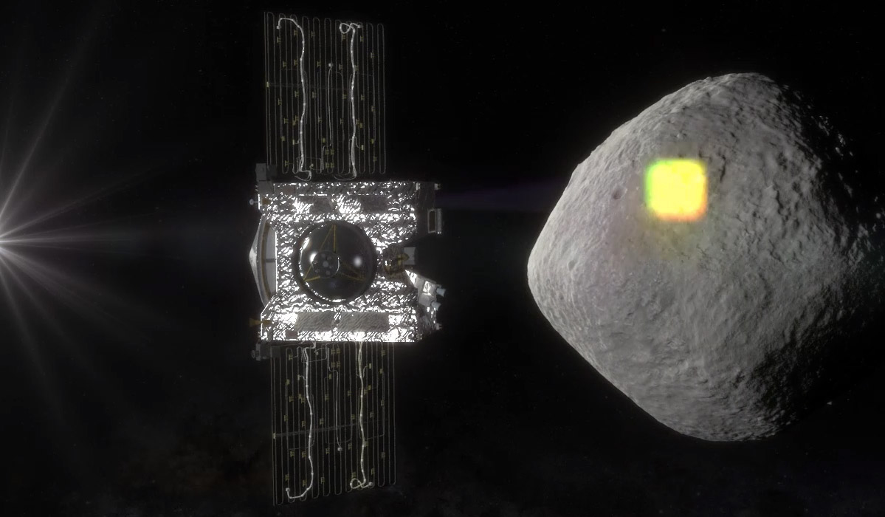
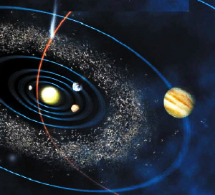
Trajectory design for asteroid surface mapping missions with flybys of spacecraft swarms
Ravi teja Nallapu,
Ph.D. Student,
Aerospace Engineering,
University of Arizona
Notes:
1

Slide 2
Outline
Motivation
Objective
Challenges
Approach
Simulation
Results
Discussion
Future work

Slide 3
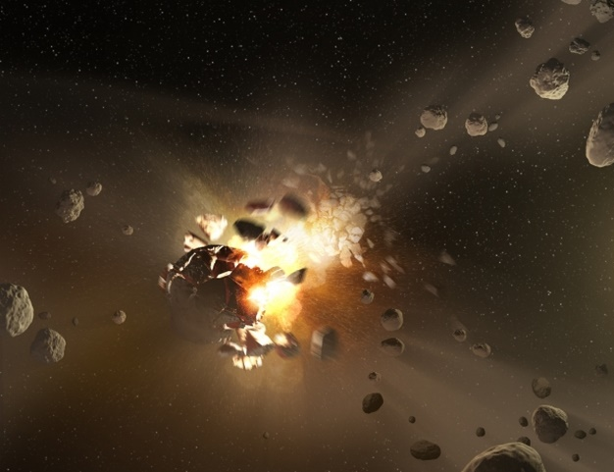
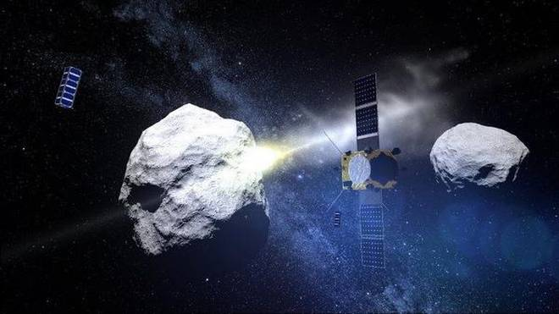
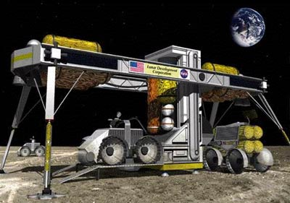

Motivation
Geo-history
Security/Deflection
ISRU
Asteroid exploration is tied to planetary science, security, space economy.
3

Slide 4
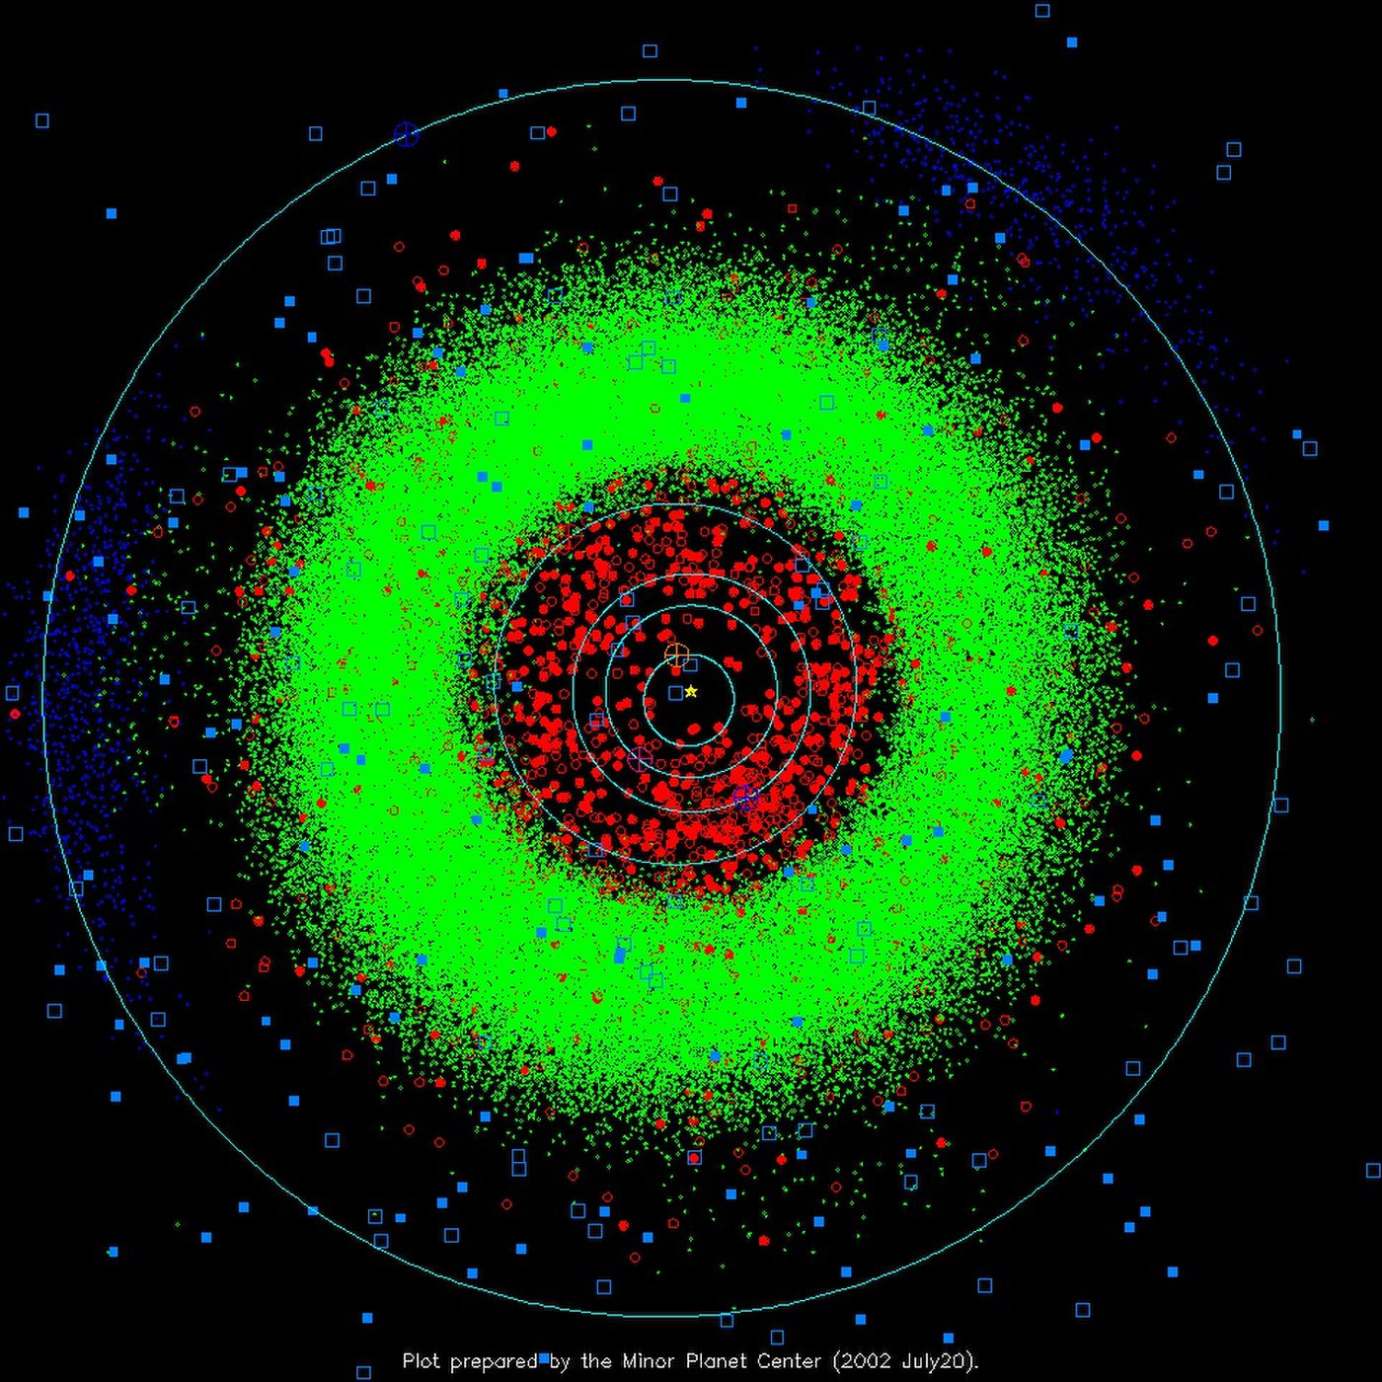
Motivation
2 million asteroids estimated in the main asteroid belt.
17,000 asteroids found near earth.
They hold valuable resources such as water, carbon and rare metals that may one day support a spacefaring civilization.
Main belt and near-Earth Asteroids
Asteroids can be pitstops for interplanetary travel
4

Slide 5
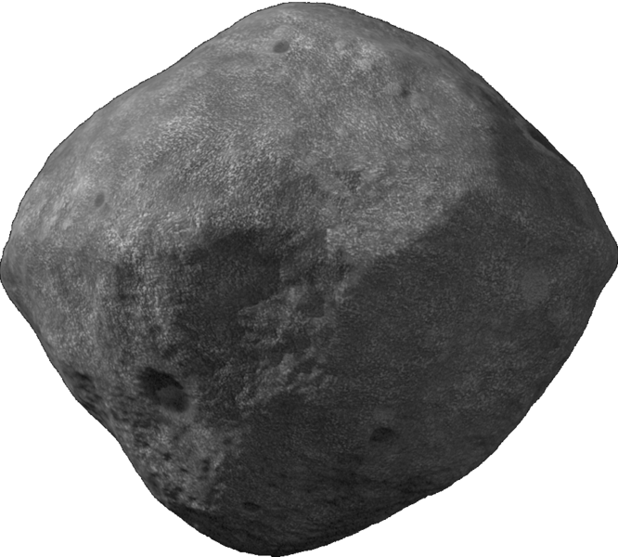
Motivation
Surface maps yield crucial geological information of the asteroid:
  Orbit
  Composition
  Density
  Shape
  Gravity field
Asteroid Bennu
Surface mapping missions pave the way for surface exploration missions

Slide 6
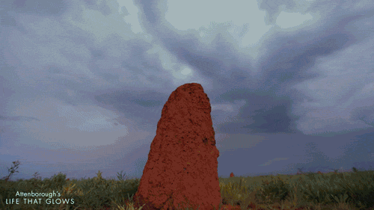
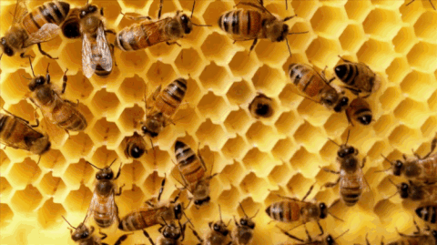
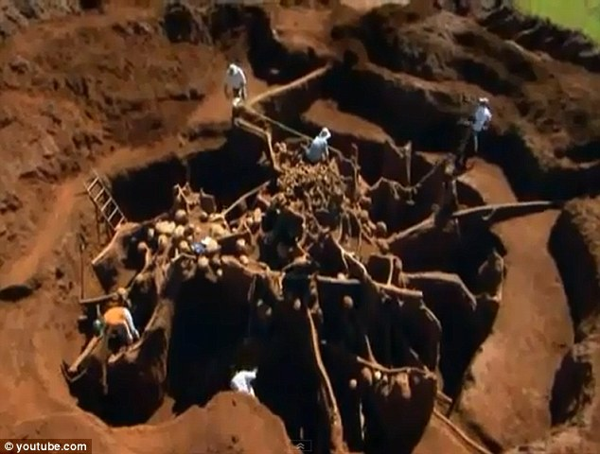
The Swarm approach
“Whole greater than the sum of the parts”
Solve a complex task using many individuals.
Individuals are simple, low-cost, disposable.
6

Slide 7
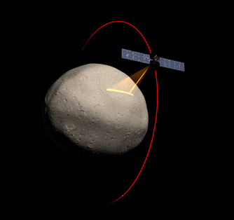
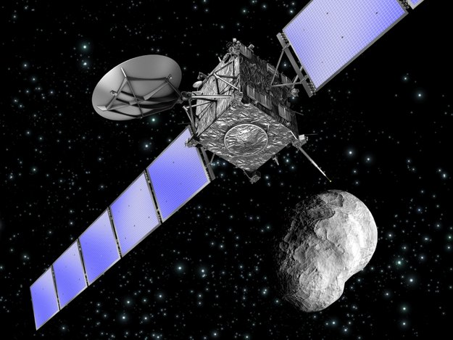
Mapping trajectories
The mapping trajectories of the spacecraft, can be broadly classified into 2 types, when surface interactions are not considered:
  Orbits
  Flybys
DAWN’s orbit around Vesta
Rosetta’s flyby of Steins

Slide 8
Trajectory comparison
Flyby | Orbits
Pros: Ideal for short period observations Relatively fuel efficient Single spacecraft design can be used for multiple targets Can be extended to observe multiple targets Swarm deployment is easier compared to orbital operations Cons: Sun vector is a crucial factor for visual observations Shorter inspection times Multiple flybys may be required to completely observe the target | Pros: Dedicated to single target body observations Suitable for long term observations Sun vector is not a crucial factor Cons: Orbit insertion burns are fuel expensive Susceptible to gravitational instabilities Spacecrafts need to be separately designed for different target bodies Difficult to deploy an orbiting constellation
Flybys are suitable for low cost, low thrust missions; can be deployed on a spacecraft swarm

Slide 9
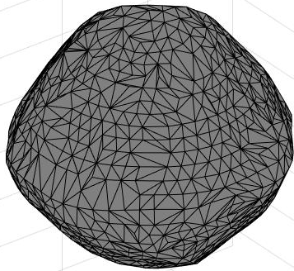
Trajectory design
X
Point B
t = t_{f}
?
Point A
t = 0
Objective is to find a trajectory that connects the current position to its destination in desired time

Slide 10
Trajectory design
X
Point B
t = t_{f}
Natural trajectory
Point A
t = 0
Trajectories allowed by the dynamics minimize fuel

Slide 11
Objective
To find the trajectories allowed by local gravity field, which takes a spacecraft from its current location to a desired location with in a given time.
Extend this to find trajectories for spacecraft swarm, so that all spacecrafts reach their destinations within specified times.

Slide 12
Challenges
Complex dynamics around around the asteroid.
Each asteroid exhibits different dynamics.
Solar radiation is a significant perturbation
Keplerian tools cannot be used to design trajectories.

Slide 13
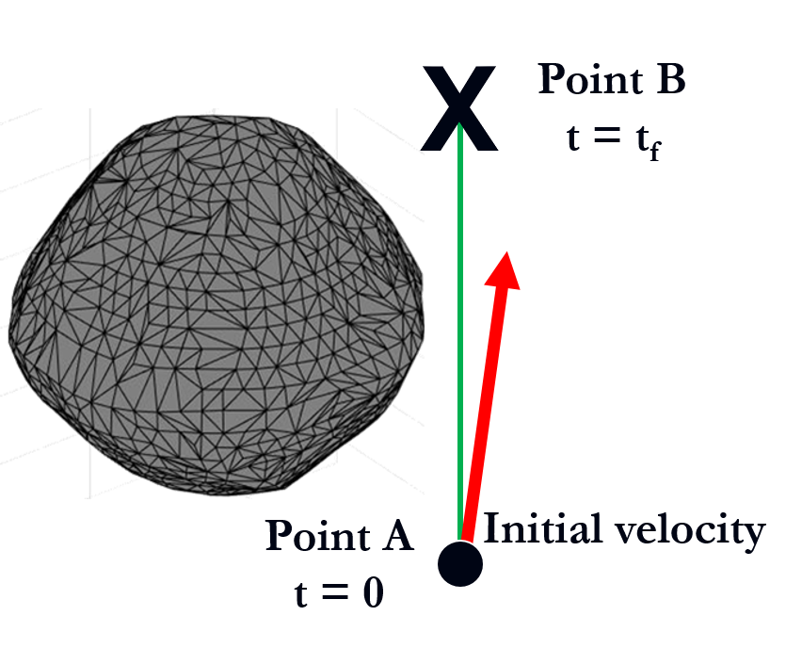
Problem reduction
For a given initial and final positions, and a flyby time, the trajectory is specified by finding the required initial velocity.

Slide 14
Approach
Iterative schemes to search for the desired initial condition are developed.
The schemes are performed over the entire swarm population to obtain required initial conditions
The initial conditions are then propagated forward in time to obtain the trajectories
Gravity, solar tide, and SRP are used to model the dynamics

Slide 15
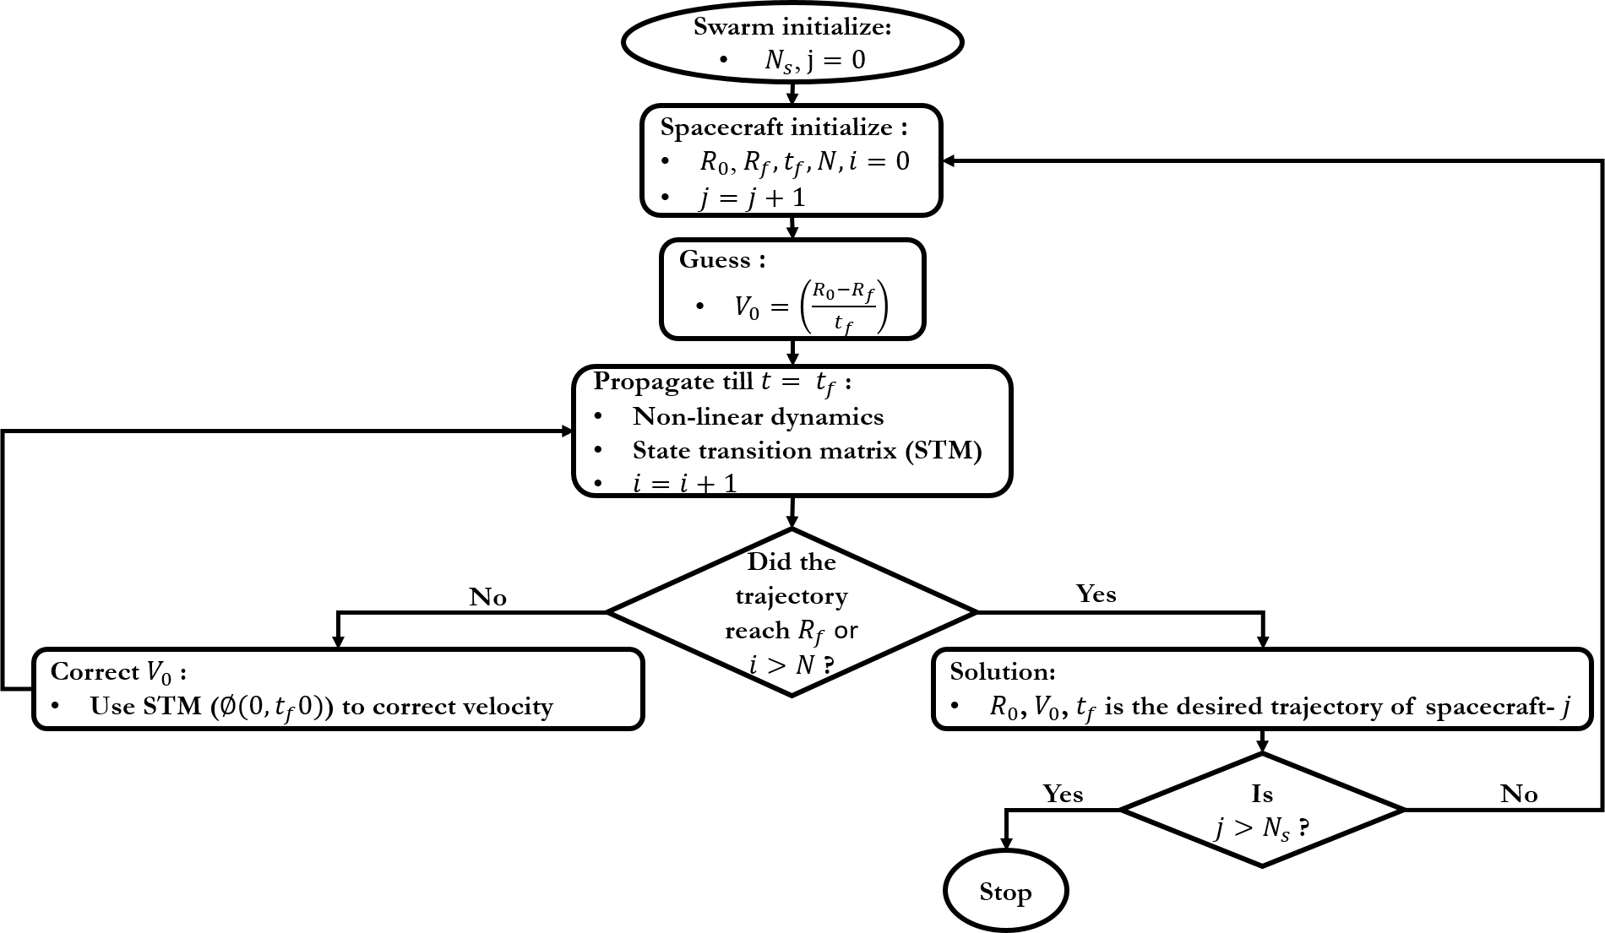
Trajectory design algorithm

Slide 16
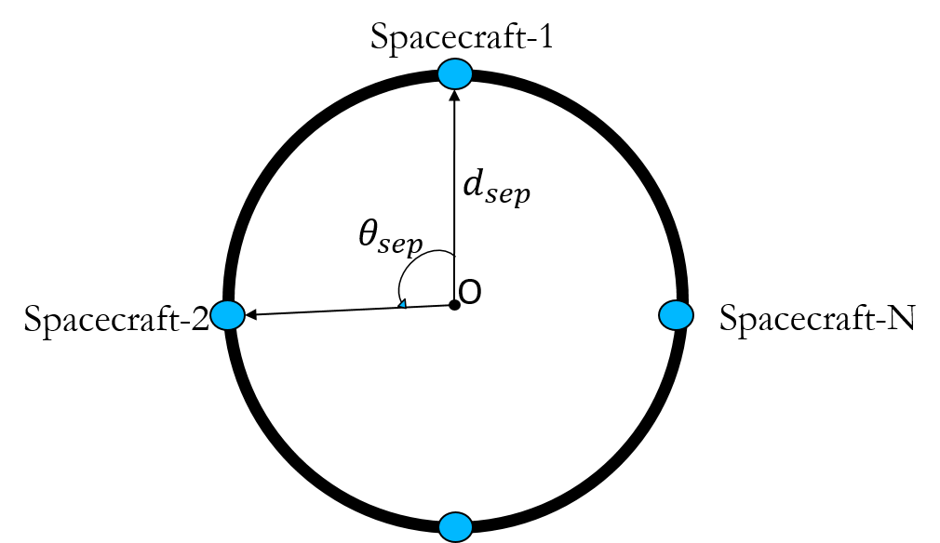
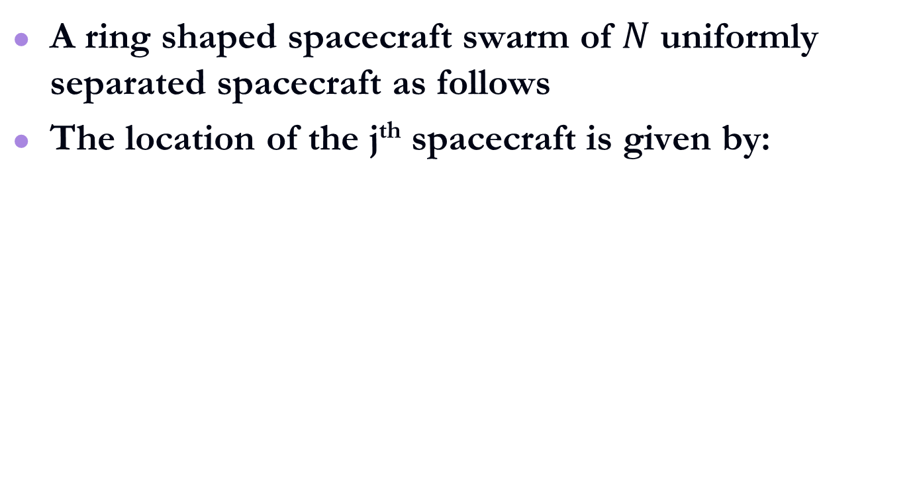
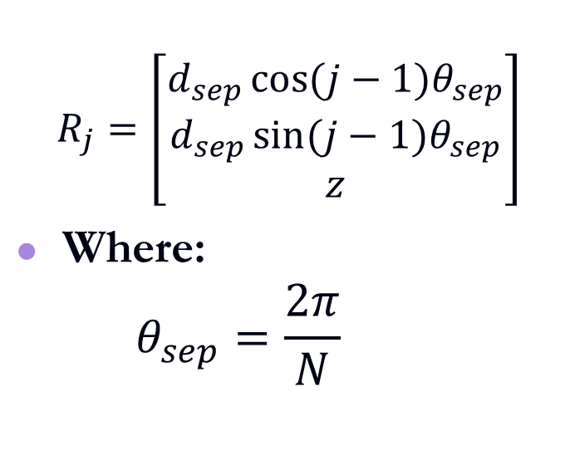
Spacecraft swarm
A ring shaped spacecraft swarm of $N$ uniformly separated spacecraft as follows
The location of the j^{th} spacecraft is given by:
$$R_{j}=\left[\begin{matrix}d_{sep}\cos{(j−1)θ_{sep}} \\ d_{sep}\sin{(j−1)θ_{sep}} \\ z\end{matrix}\right]$$
Where:
  $$θ_{sep}=\frac{2π}{N}$$
Swarm layout

Slide 17
Simulations
The trajectory design algorithm is demonstrated for the ring shaped swarm.
The Swarm is desired to fly by the asteroid 433 Eros
The spacecrafts need to maintain a radial separation of 50 Km from the center of the asteroid
The spacecrafts are desired to travel a distance of 60 km along the spin axis of the asteroid in 10 minutes
Nominal 12U CubeSat parameters are used for the spacecraft model

Slide 18
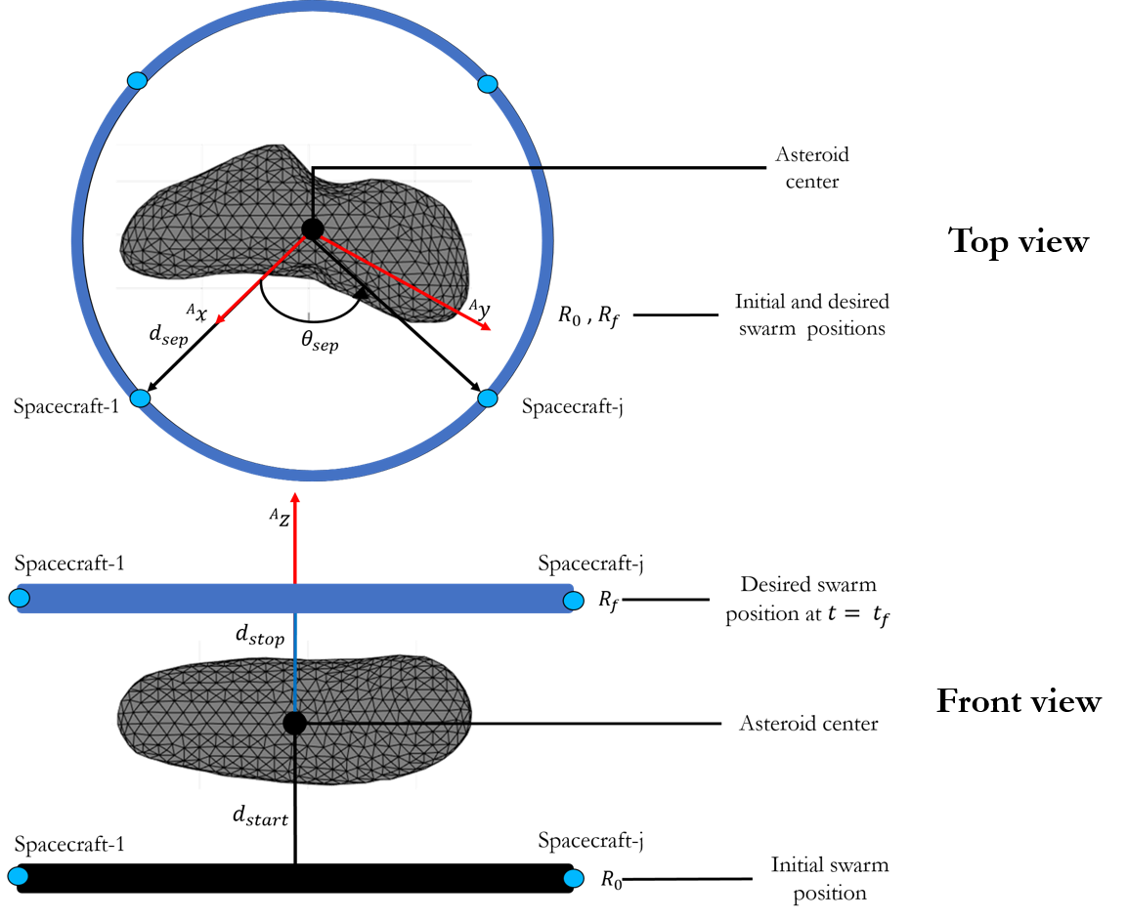
Swarm simulations
The following parameters were used for simulating the flyby with the spacecraft swarm
Parameter | Value
Asteroid | 433 Eros
Number of spacecraft | 3, 4, 5
Radial separation (Km) | 50
Starting distance (Km) | -30
Stopping distance (Km) | 30
Flyby duration (mins) | 10
Targeting geometry with the spacecraft swarm

Slide 19
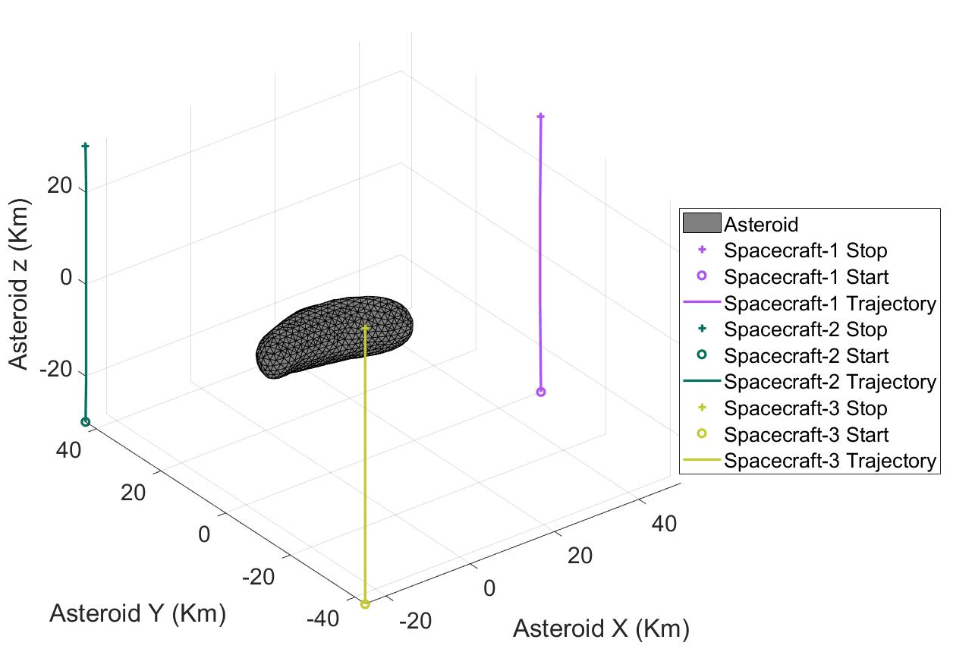
3 spacecraft trajectories
The trajectories generated for 3 spacecrafts

Slide 20
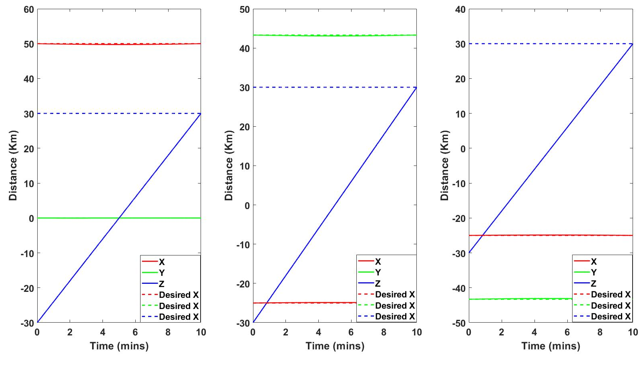
Spacecraft positions
The algorithm yields desired flyby trajectories, with in the desired 10 minutes time

Slide 21
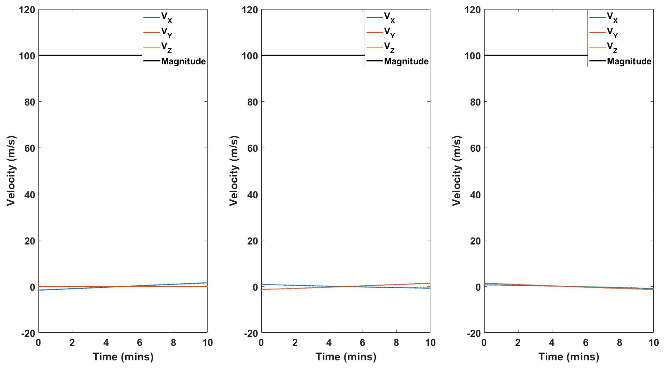
3 spacecraft flyby
All the spacecrafts fly with a 100 m/s velocity during the flyby

Slide 22
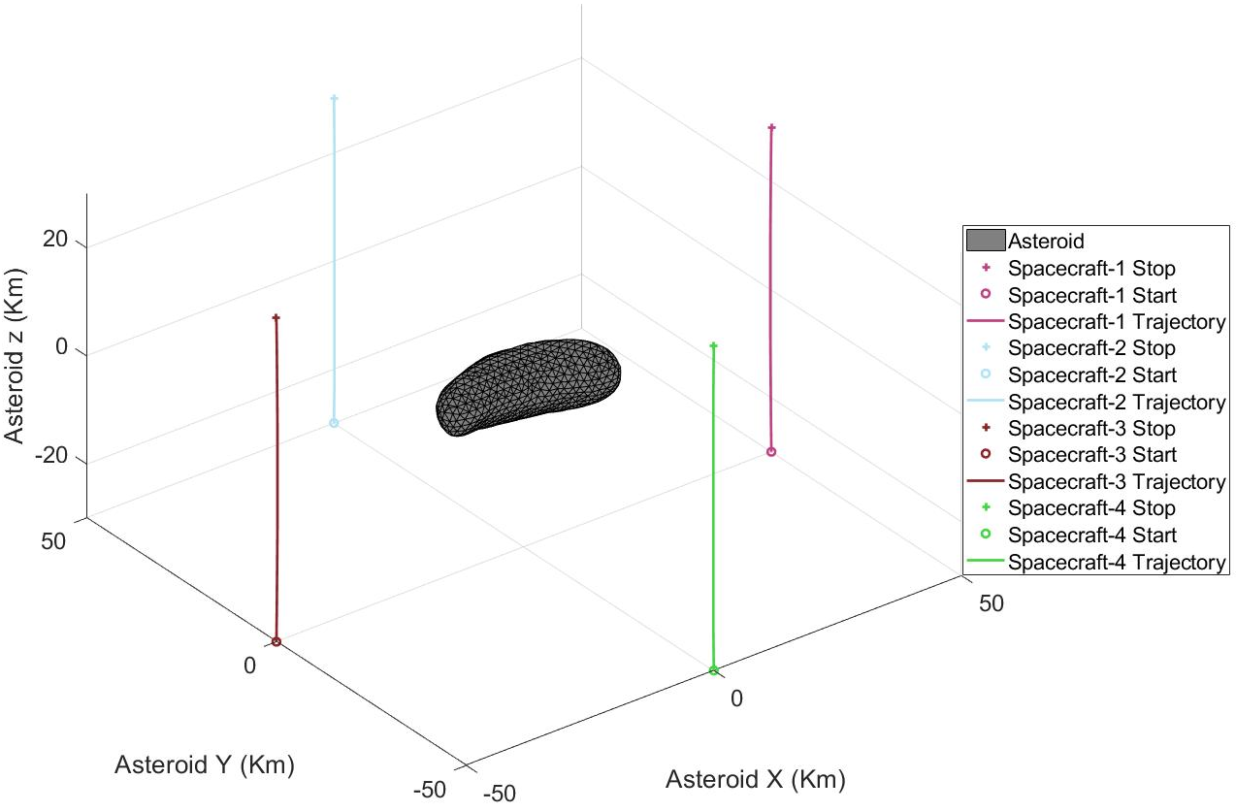
4 Spacecraft trajectories
The trajectories generated for 4 spacecrafts

Slide 23
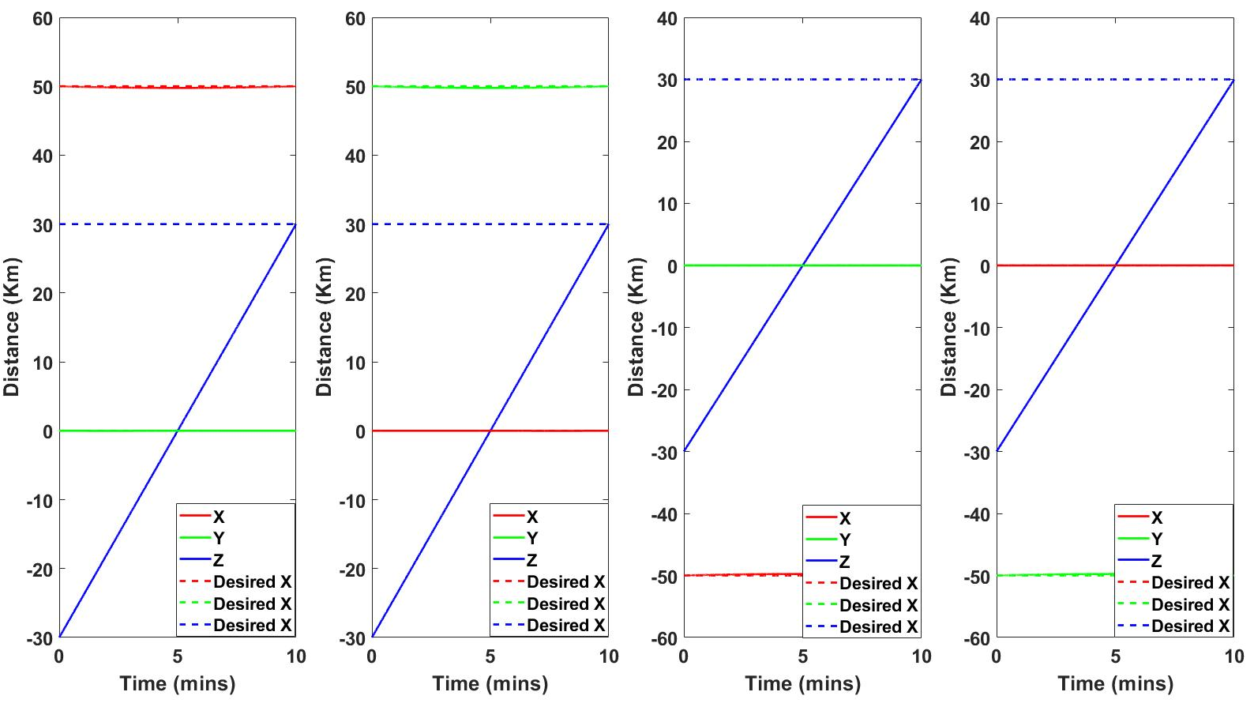
Spacecraft positions
The algorithm yields desired flyby trajectories, with in the desired 10 minutes time

Slide 24
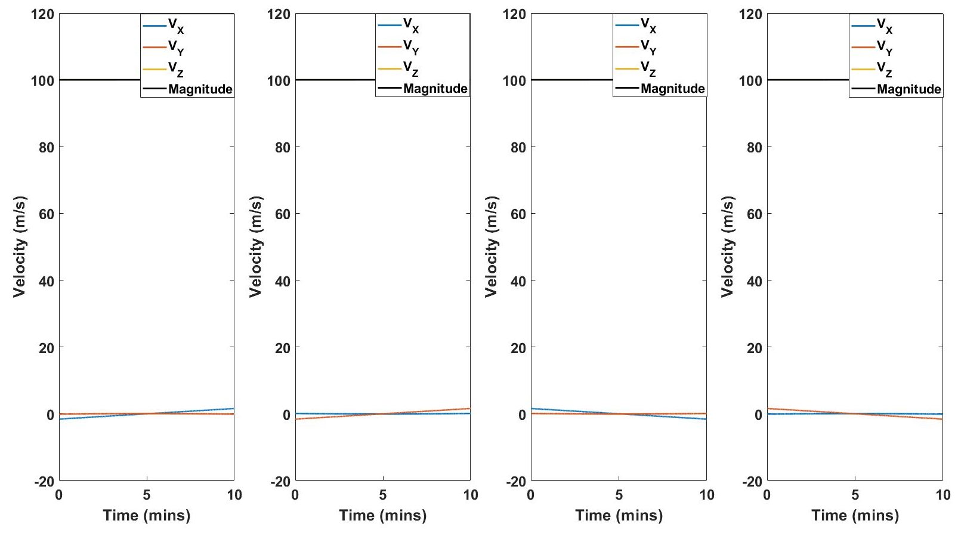
Flyby velocities
All the spacecrafts fly with a 100 m/s velocity during the flyby

Slide 25
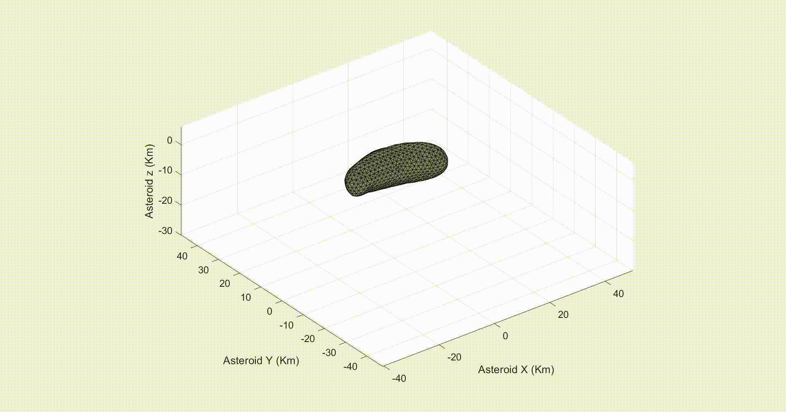
Results
The trajectories generated for 5 spacecrafts

Slide 26
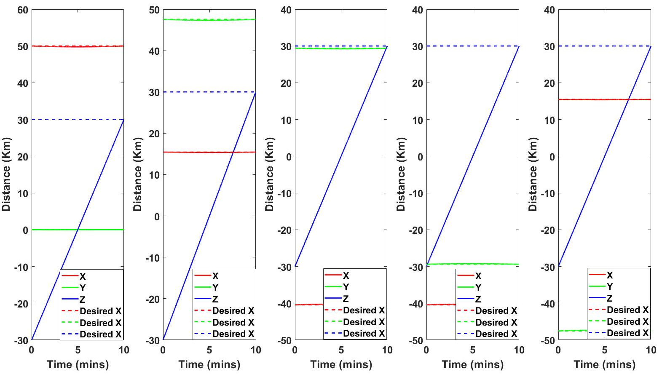
Spacecraft positions
The algorithm yields desired flyby trajectories, with in the desired 10 minutes time

Slide 27
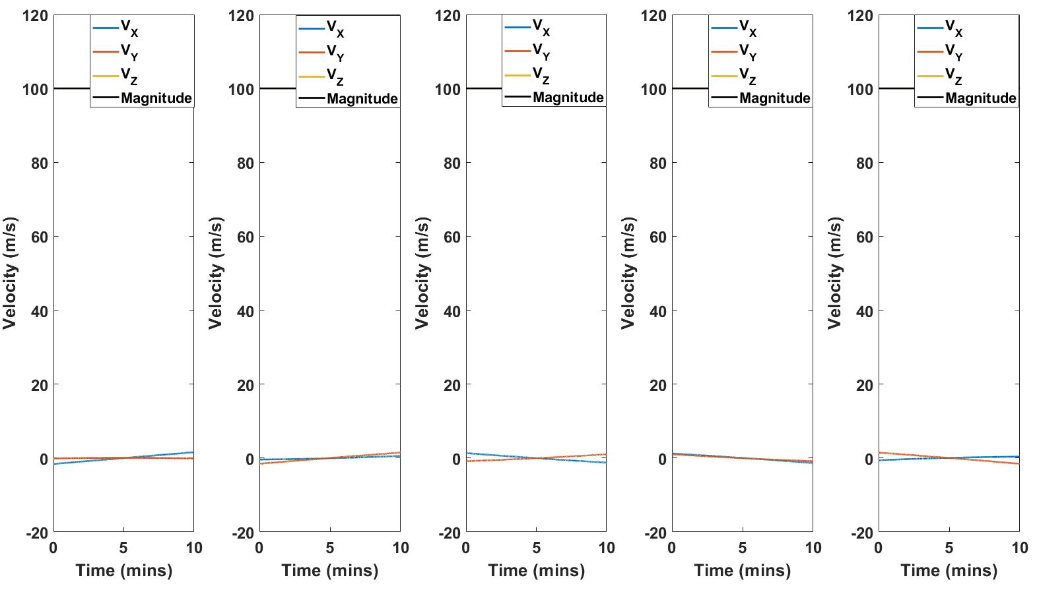
Flyby velocities
All the spacecrafts fly with a 100 m/s velocity during the flyby

Slide 28
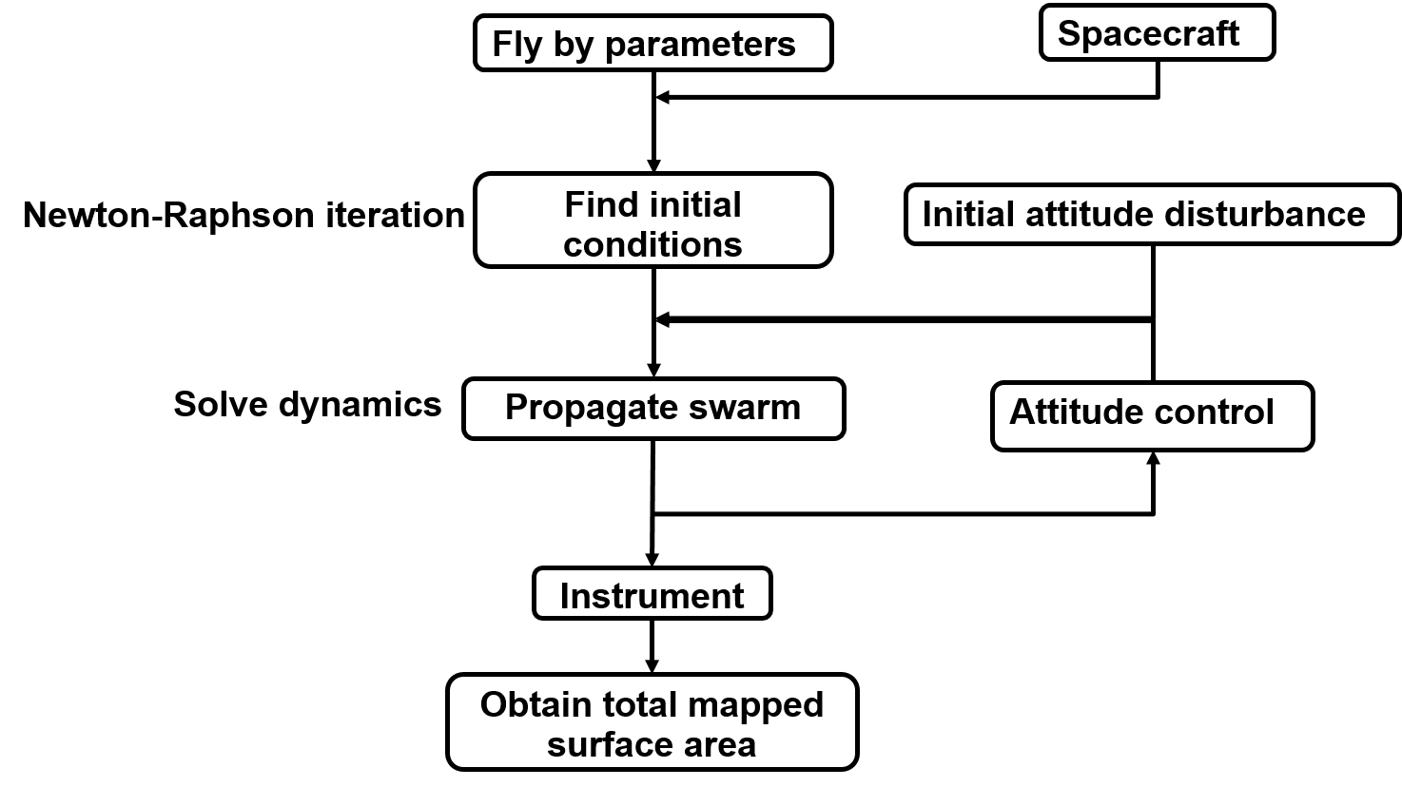
Mapping demonstration
A mapping simulator which couples the trajectory and attitude control with the following architecture

Slide 29
Results
The simulator is demonstrated with 2 sets of attitude control strategies:
  Nadir pointing
  Field of view Sweeping
In both the cases, the area mapped by the instrument is noted

Slide 30
Instrument parameters
The following are the parameters of the onboard instrument on the
Parameter | Value
FOV | 15
Near distance (m) | 0.1
Far distance (Km) | 500,000
Frame rate (fps) | 5
A pinhole camera model is used to simulate the instrument

Slide 31
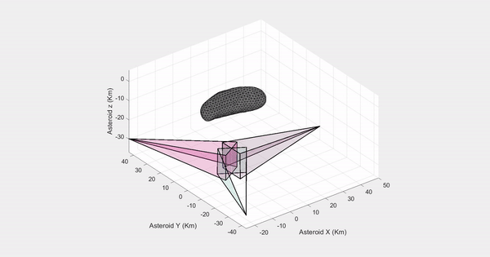
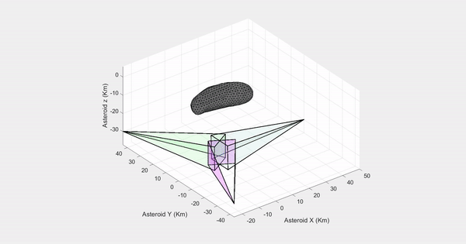
3 Spacecraft mapping
Nadir pointing
Observed Area (Km²) | 698.01
% Observed Area | 63.26
FOV Sweeping
Observed Area (Km²) | 1103.34
% Observed Area | 100

Slide 32
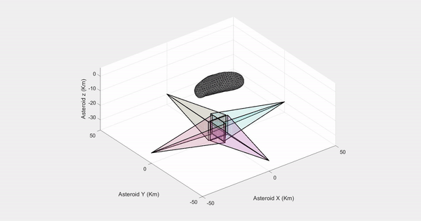
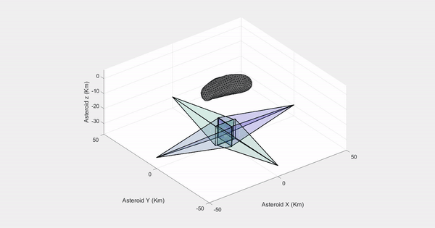
4 Spacecraft mapping
Nadir pointing
Observed Area (Km²) | 965.89
% Observed Area | 87.54
FOV Sweeping
Observed Area (Km²) | 1103.34
% Observed Area | 100

Slide 33
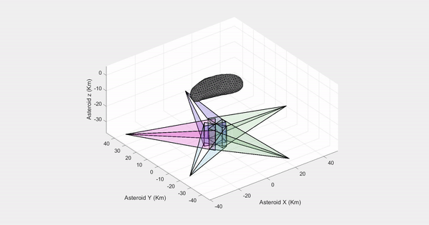
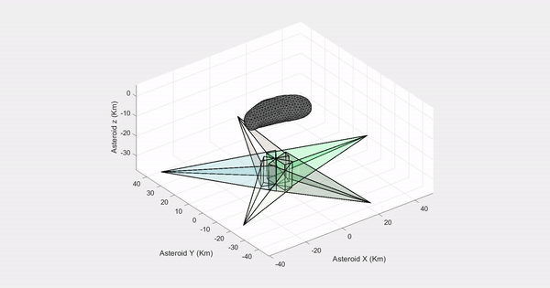
5 Spacecraft mapping
Nadir pointing
Observed Area (Km²) | 852.30
% Observed Area | 76.24
FOV Sweeping
Observed Area (Km²) | 1103.34
% Observed Area | 100

Slide 34
Discussion
Surface mapping missions of asteroids yield rich geological information.
Flyby trajectories performed by spacecraft swarm are better suited for surface mapping than orbits
This work presented a trajectory design algorithm for a swarm of spacecrafts around asteroids
The algorithm uses an iterative numerical scheme using the state transition matrix, to find the desired natural trajectories

Slide 35
Discussion
The algorithm is demonstrated for a circularly symmetric swarm consisting of 3, 4,& 5 spacecrafts.
The demonstrations showed a flyby around the asteroid 433 Eros, where the spacecrafts are required to travel at a speed of 100 m/s.
These trajectories are then coupled with attitude control strategies to 100% surface mapping coverage.

Slide 36
Future work
Integrate with strategies to search for optimal mapping locations.
Integrate with optimal attitude tracking strategies to improve coverage with minimal energy.
Design flyby sequences to map multiple asteroids.

Slide 37
Thank You
45

Slide 38
Questions ?
46

Slide 39
References
Scheeres, Daniel J. Orbital Motion in Strongly Perturbed Environments : Applications to Asteroid, Comet and Planetary Satellite Orbiters. Springer, Berlin, Heidelberg, 2011;2012;, doi:10.1007/978-3-642-03256-1.
Hamilton, Douglas P., and Joseph A. Burns. "Orbital Stability Zones about Asteroids." Icarus, vol. 92, no. 1, 1991, pp. 118-131.
Scheeres, D. J. "Dynamics about Uniformly Rotating Triaxial Ellipsoids: Applications to Asteroids." Icarus, vol. 110, no. 2, 1994, pp. 225-238.
Scheeres, D. J. "Satellite Dynamics about Small Bodies: Averaged Solar Radiation Pressure Effects." Journal of the Astronautical Sciences, vol. 47, no. 1-2, 1999, pp. 25-46.
D.J, Scheeres. "Orbit Mechanics about Asteroids and Comets." Journal of Guidance, Control, and Dynamics, vol. 35, no. 3, 2012, pp. 987-997.
Melman, J. C. P., E. Mooij, and R. Noomen. "State Propagation in an Uncertain Asteroid Gravity Field." Acta Astronautica, vol. 91, 2013, pp. 8-19.
Chanut, T. G. G., O. C. Winter, and M. Tsuchida. "3D Stability Orbits Close to 433 Eros using an Effective Polyhedral Model Method." Monthly Notices of the Royal Astronomical Society, vol. 438, no. 3, 2014, pp. 2672-2682.
Xian-Yu Wang Sheng-Ping Gong Jun-Feng Li. "A Method for Classifying Orbits Near Asteroids." 力学学报：英文版, vol. 30, no. 3, 2014;2017;, pp. 316-325.
Niedling, Julian, et al. Development of a Tool for Analyzing Orbits Around Asteroids, vol. 158, 2016.
Werner, Robert A., and Daniel J. Scheeres. "Exterior Gravitation of a Polyhedron Derived and Compared with Harmonic and Mascon Gravitation Representations of Asteroid 4769 Castalia." Celestial Mechanics and Dynamical Astronomy, vol. 65, no. 3, 1996, pp. 313-344.
García Pardo, Diego. Analysis and implementation of gravity field models for planets and asteroids. BS thesis. 2014.
Cangahuala, L. A. Augmentations to the Polyhedral Gravity Model to Facilitate Small Body Navigation, vol. 120, 2005
Hu, W., and D. J. Scheeres. "Numerical Determination of Stability Regions for Orbital Motion in Uniformly Rotating Second Degree and Order Gravity Fields." Planetary and Space Science, vol. 52, no. 8, 2004, pp. 685-692.

