Slide 1


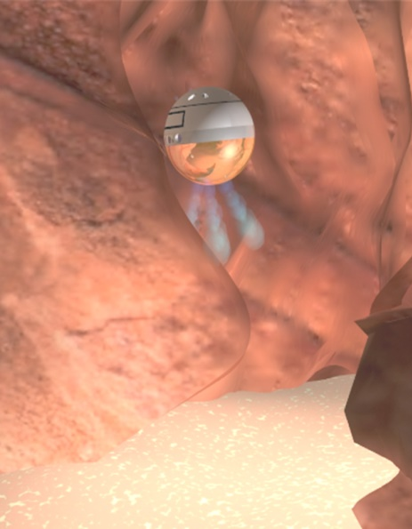
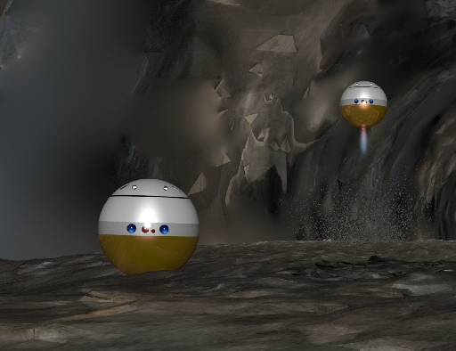
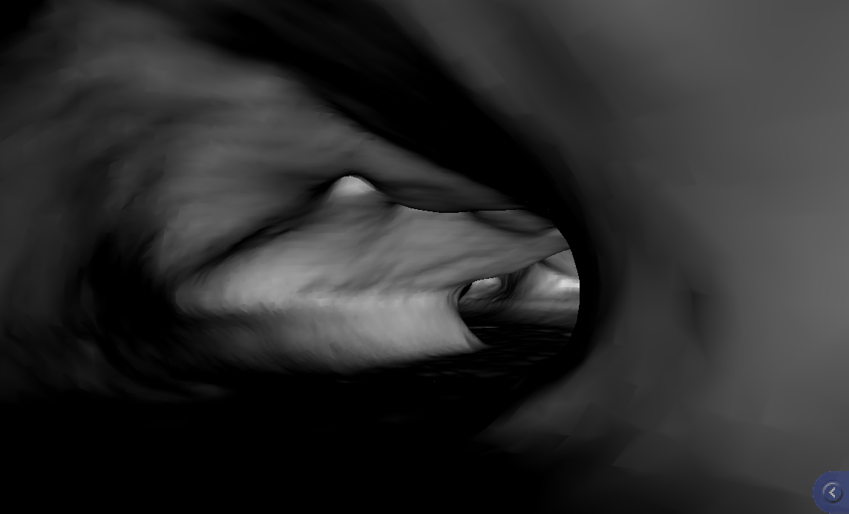
Exploring Off-World Lava Tubes and Caves Using Small Robots
Himangshu Kalita, Jekan Thangavelautham
Space and Terrestrial Robotic Exploration (SpaceTREx) Laboratory
Aerospace and Mechanical Engineering Department
University of Arizona

Slide 2
Outline
Introduction
Motivation
System Overview of SphereX
Ballistic Hopping Dynamics and Control
Multi-robot algorithm for Navigation and Path-planning inside lava tubes
Simulations
Discussions
Conclusion

Slide 3
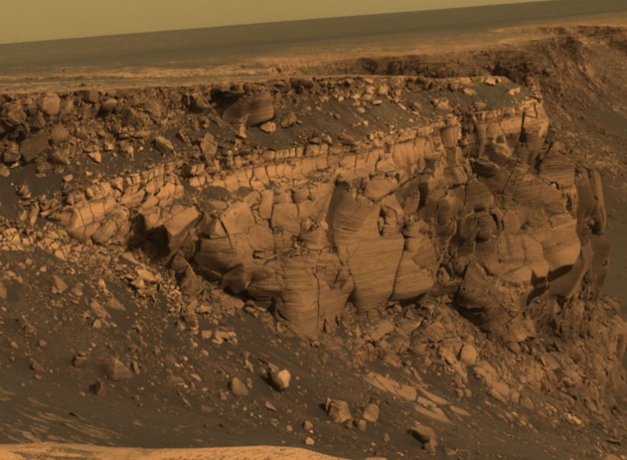
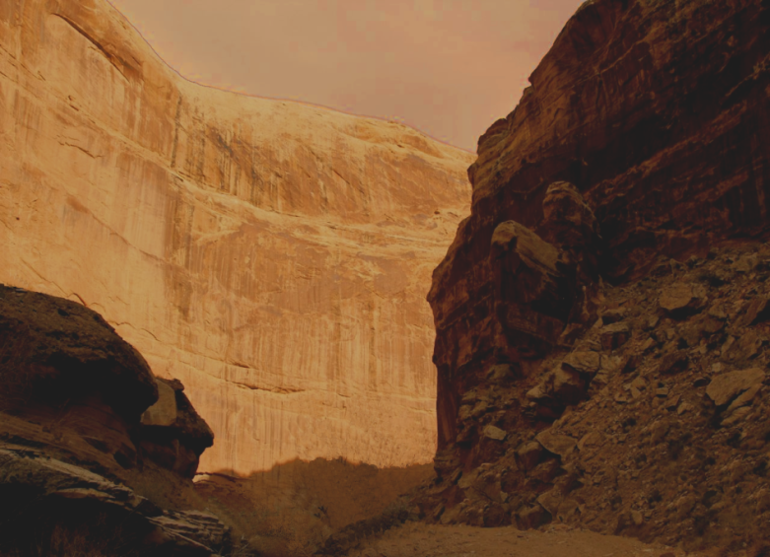
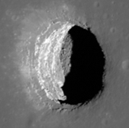
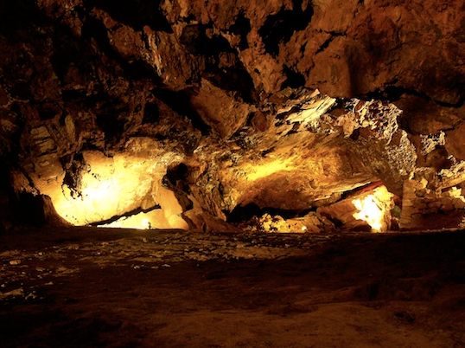
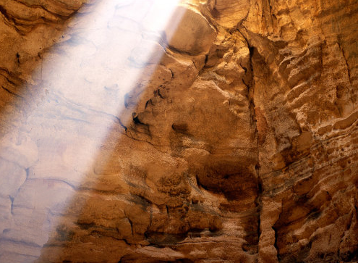
Introduction
Cliffs
Canyons
Robotic exploration of extreme environments
Caves
Skylights

Slide 4
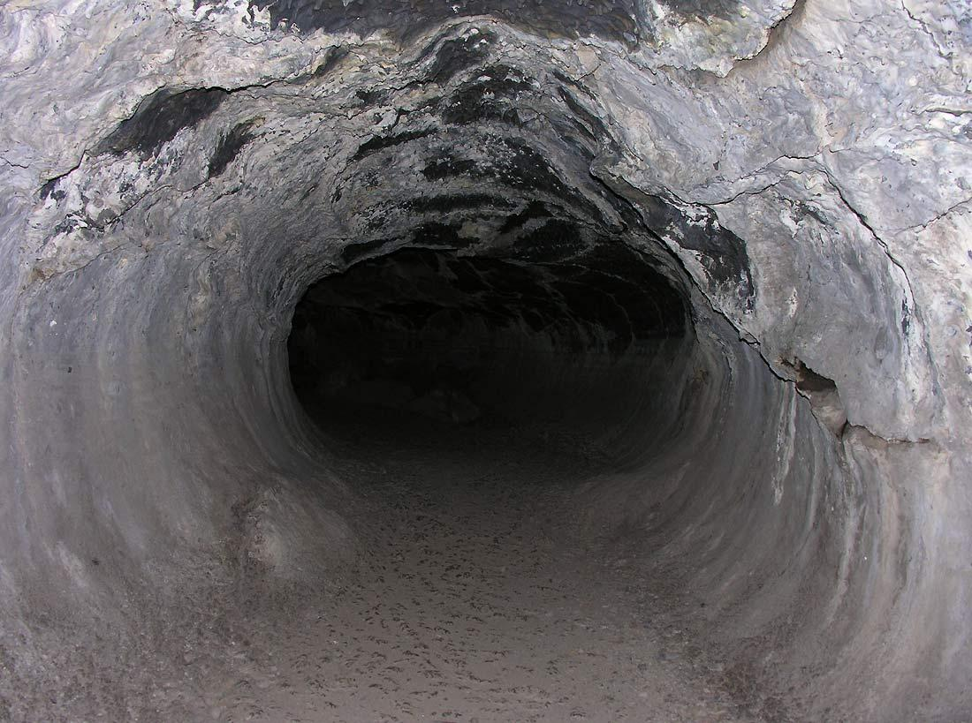
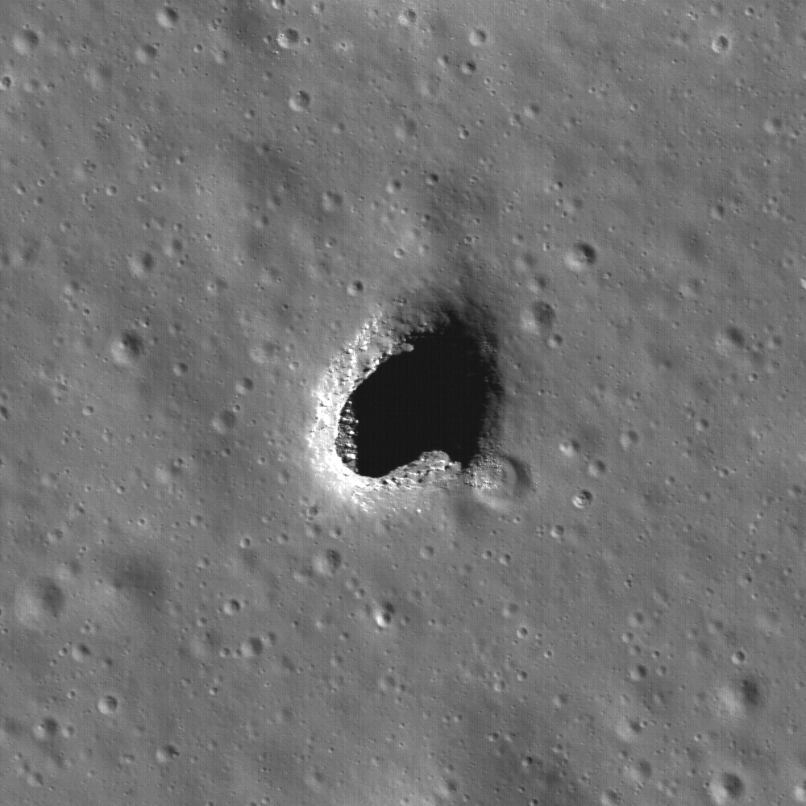
Science Focused
Hundreds of pits such as Mare Ingenni have been found on the Moon by LRO and also on Mars by MRO.
Determine early geo-history, composition
Answer questions about habitability and astrobiology
Look for fossilized remains!?
These caves are likely to be much like the lava-tubes of Arizona and New Mexico.
Source: www.nasa.gov

Slide 5
Challenges
Mars, Moon
  Low-gravity, low traction
Surface Contact Risks
  Fine dust, static charge, porosity
Planning, Navigation, Comms., Tracking
  Unknown terrain, limited field of view
Tackling all of these challenges using a systems engineering approach

Slide 6
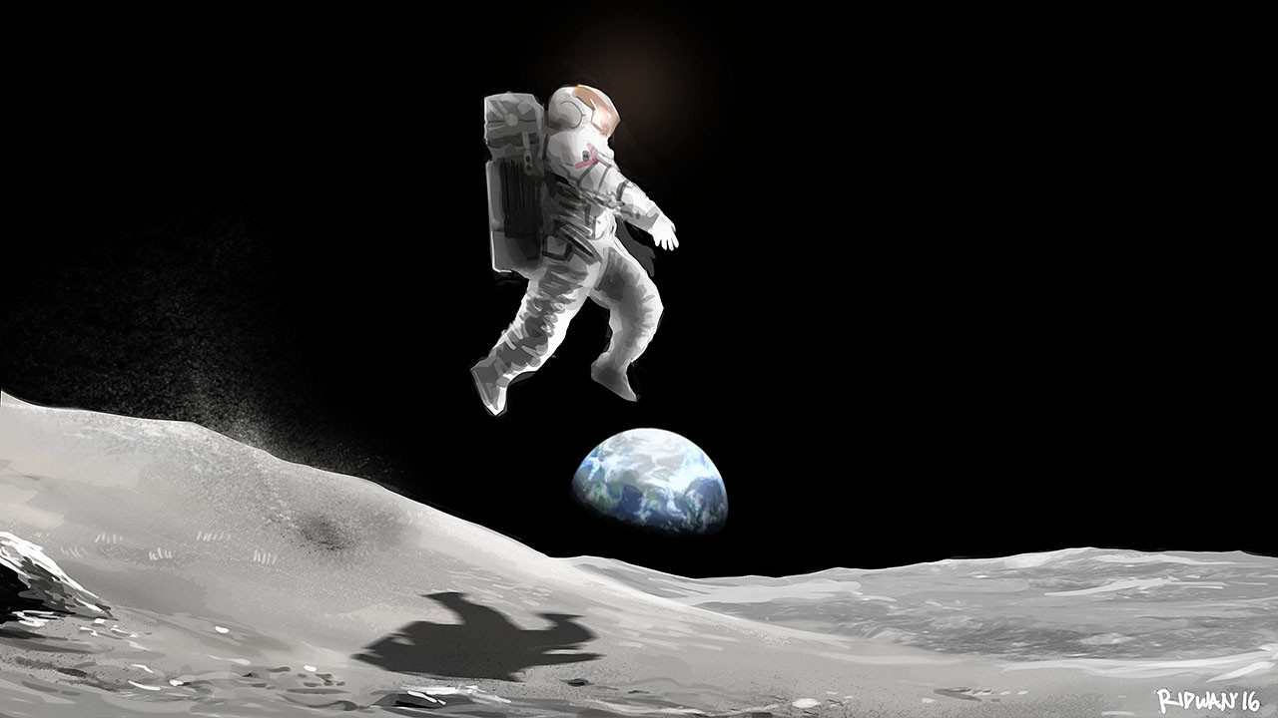
Low-Gravity Environments
Ease of mobility by hopping…

Slide 7

Approach
The high risk involved all but eliminates use of a large lander to do it all.
Use swarms of disposable robots that perform distributed science.
“Failure is an Option!”

Slide 8
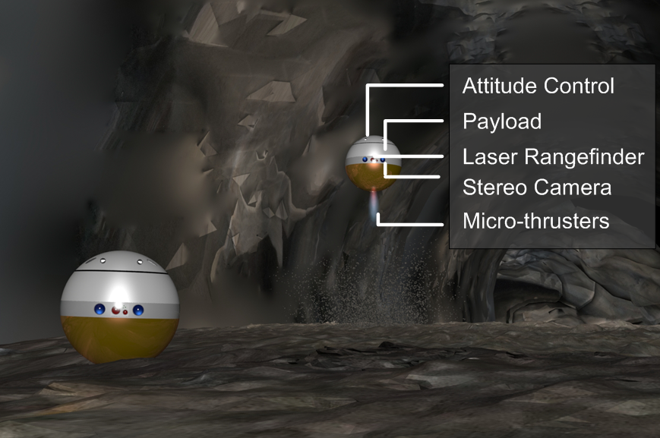
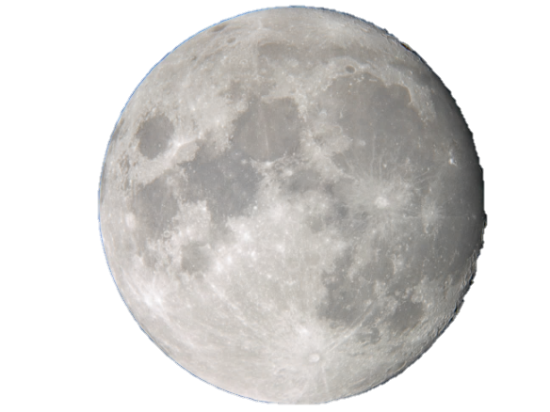
SphereX Robots
Moon
3 kg mass, 30 cm diameter robot that can fly, hop and roll

Slide 9
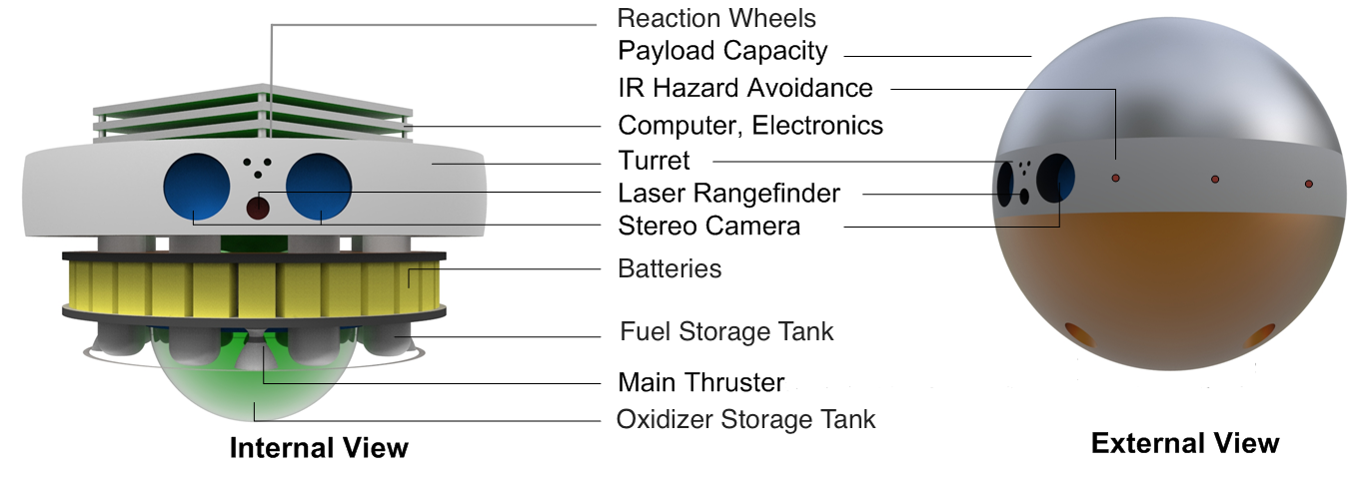
SphereX Robots
Attitude Control: Reaction-wheels, IMU
Smartphone powered drone for off-world environments

Slide 10
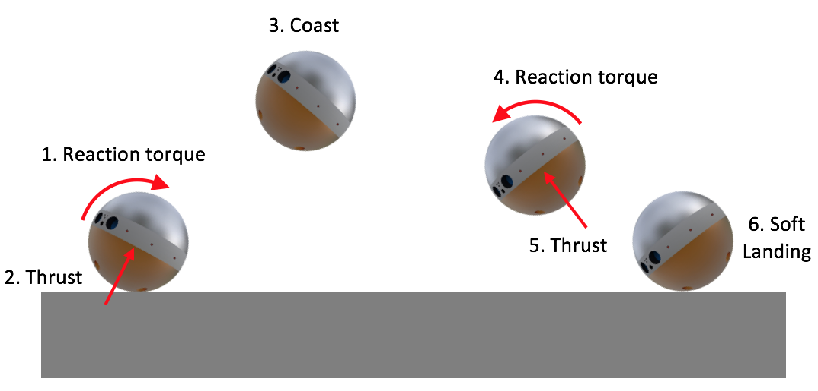
Ballistic Hopping

Slide 11
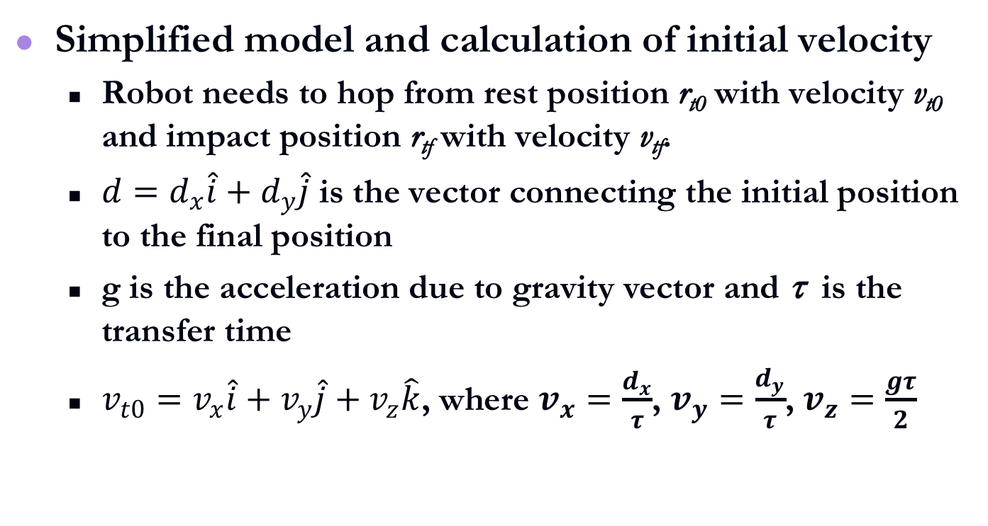
Ballistic Hopping Dynamics
Simplified model and calculation of initial velocity
  Robot needs to hop from rest position r_{t0} with velocity v_{t0} and impact position r_{tf} with velocity v_{tf}.
  $d=d_{x}\hat{i}+d_{y}\hat{j}$ is the vector connecting the initial position to the final position
  g is the acceleration due to gravity vector and τ is the transfer time
  $v_{t0}=v_{x}\hat{i}+v_{y}\hat{j}+v_{z}\hat{k}$, where $v_{x}=\frac{d_{x}}{τ}$, $v_{y}=\frac{d_{y}}{τ}$, $v_{z}=\frac{gτ}{2}$

Slide 12
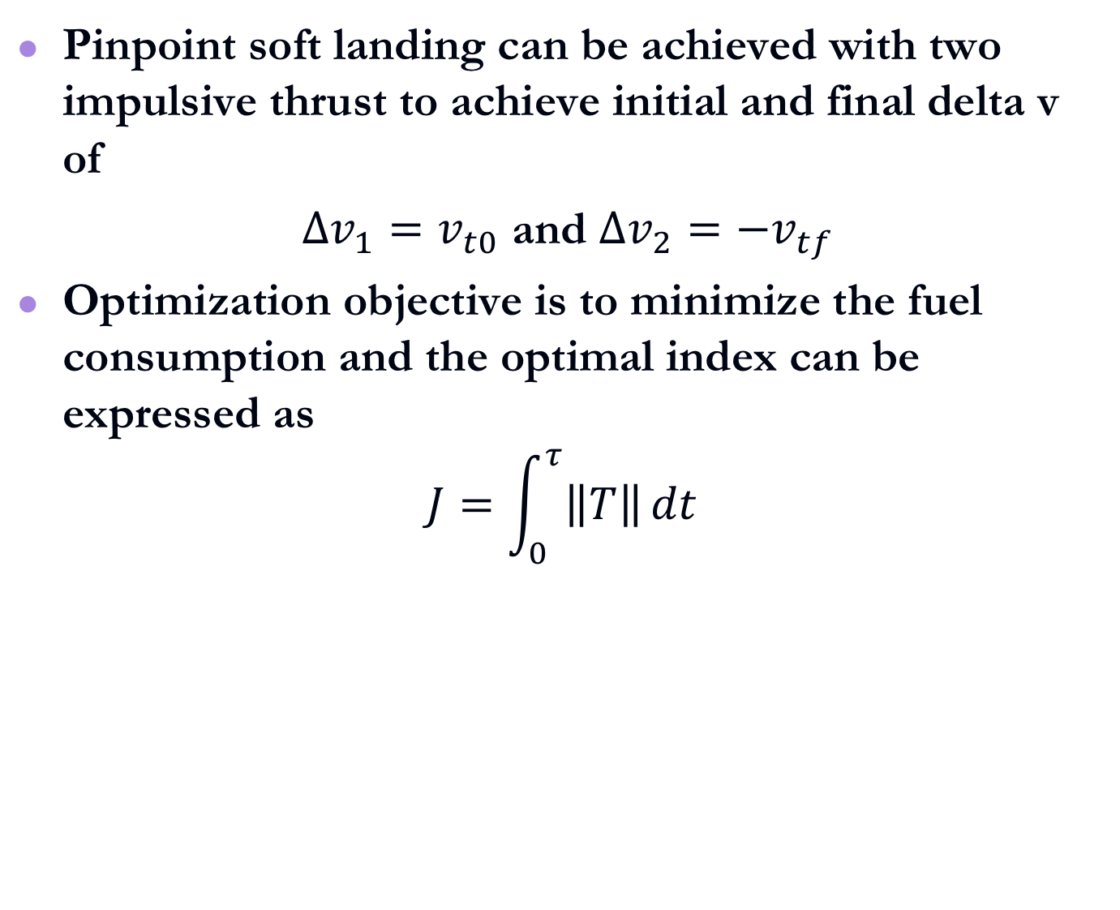
Trajectory Optimization
Pinpoint soft landing can be achieved with two impulsive thrust to achieve initial and final delta v of
$∆v_{1}=v_{t0}$ and $∆v_{2}={−v}_{tf}$
Optimization objective is to minimize the fuel consumption and the optimal index can be expressed as
$$J=\int_{0}^{τ}{\left\|T\right\|}dt$$

Slide 13
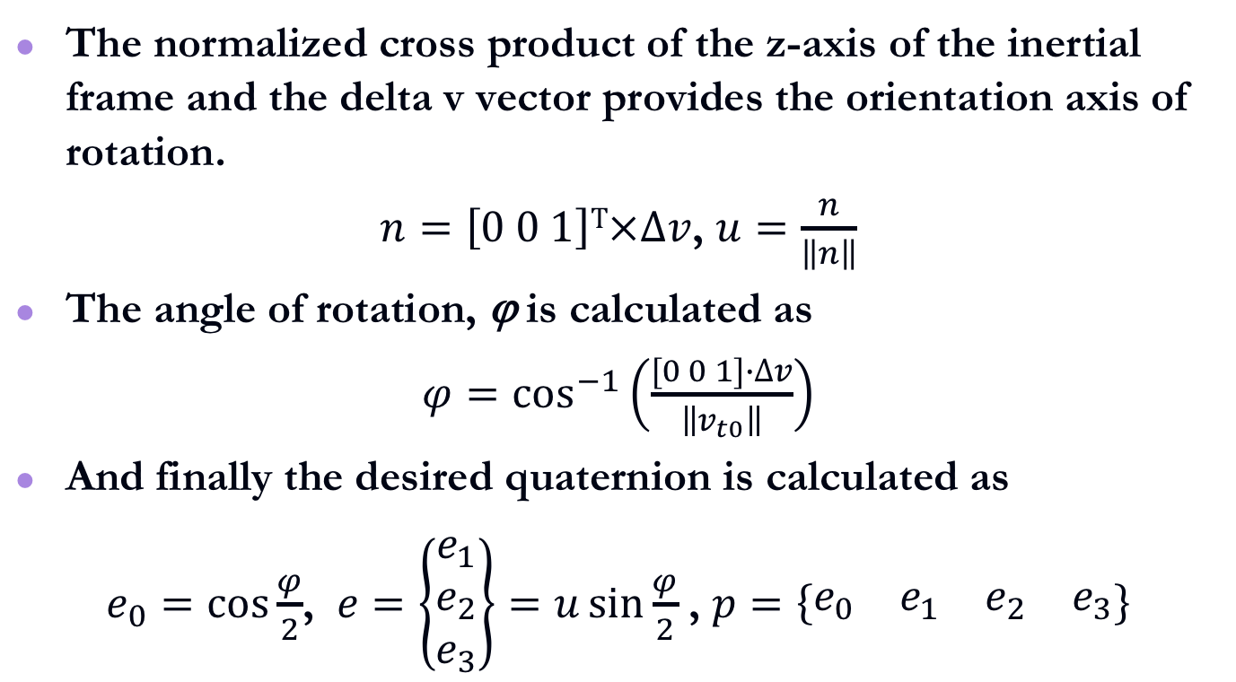
Desired Orientation
The normalized cross product of the z-axis of the inertial frame and the delta v vector provides the orientation axis of rotation.
$n=\left[0 0 1\right]T×∆v$, $u=\frac{n}{\left\|n\right\|}$
The angle of rotation, ϕ is calculated as
$φ=\cos^{−1}\left(\frac{[0 0 1]∙∆v}{\left\|v_{t0}\right\|}\right)$
And finally the desired quaternion is calculated as
$e_{0}=\cos{\frac{φ}{2}}$, $e=\left\{\begin{matrix}e_{1} \\ e_{2} \\ e_{3}\end{matrix}\right\}=u\sin{\frac{φ}{2}}$ , $p=\left\{\begin{matrix}e_{0} & e_{1} & e_{2} & e_{3}\end{matrix}\right\}$

Slide 14
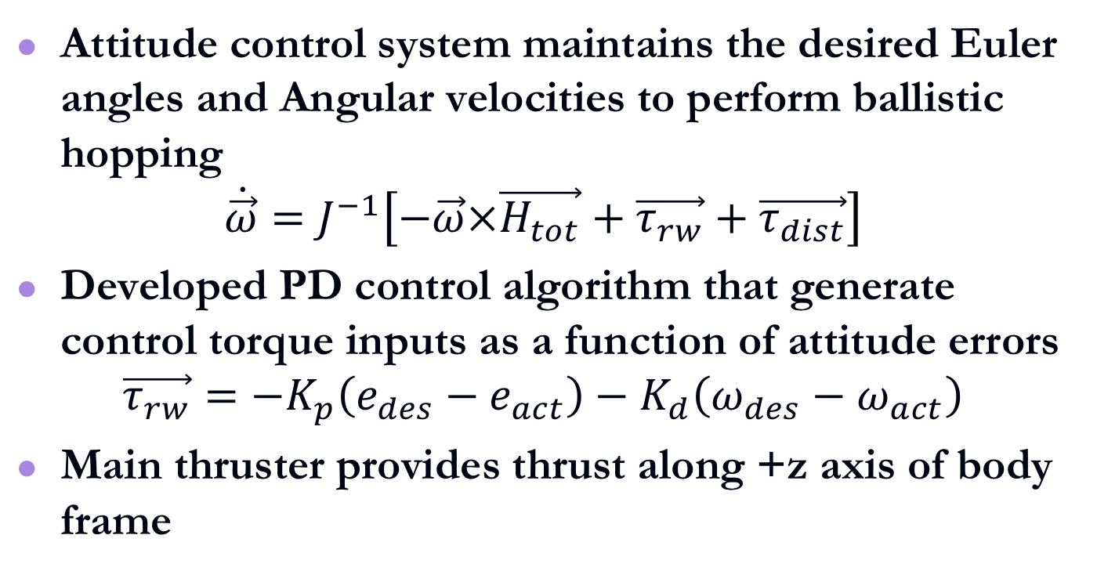
Ballistic Hopping Dynamics
Attitude control system maintains the desired Euler angles and Angular velocities to perform ballistic hopping
$$\dot{\vec{ω}}=J^{−1}\left[−\vec{ω}×\vec{H_{tot}}+\vec{τ_{rw}}+\vec{τ_{dist}}\right]$$
Developed PD control algorithm that generate control torque inputs as a function of attitude errors
$$\vec{τ_{rw}}=−K_{p}\left(e_{des}−e_{act}\right)−K_{d}\left(ω_{des}−ω_{act}\right)$$
Main thruster provides thrust along +z axis of body frame

Slide 15
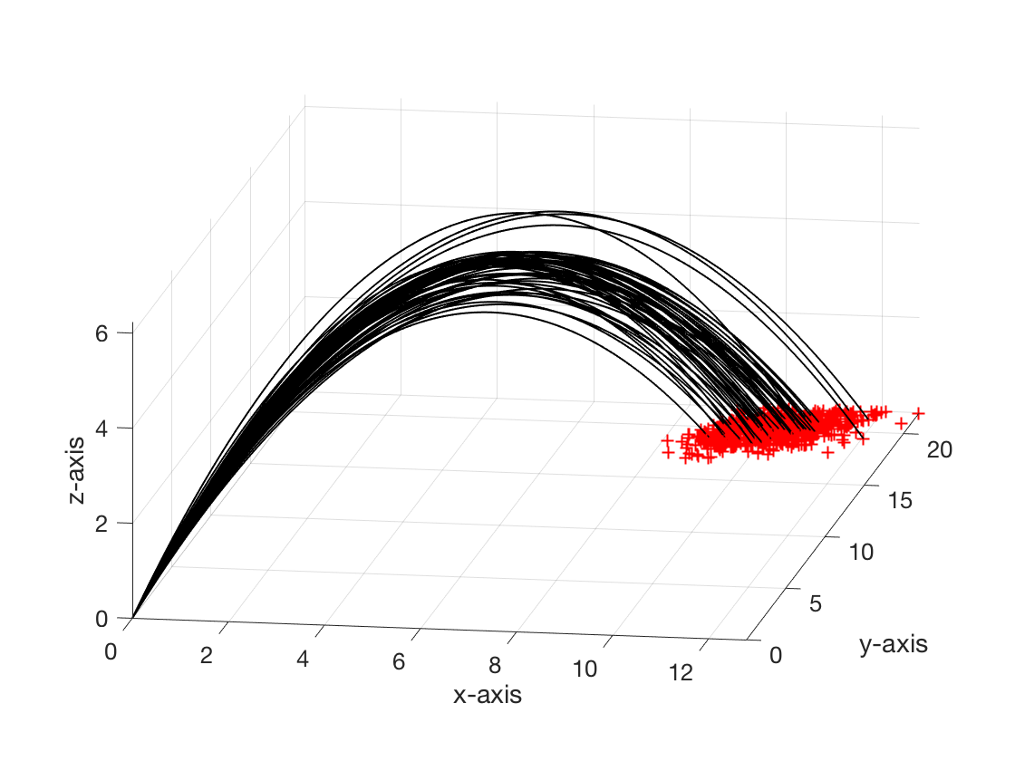
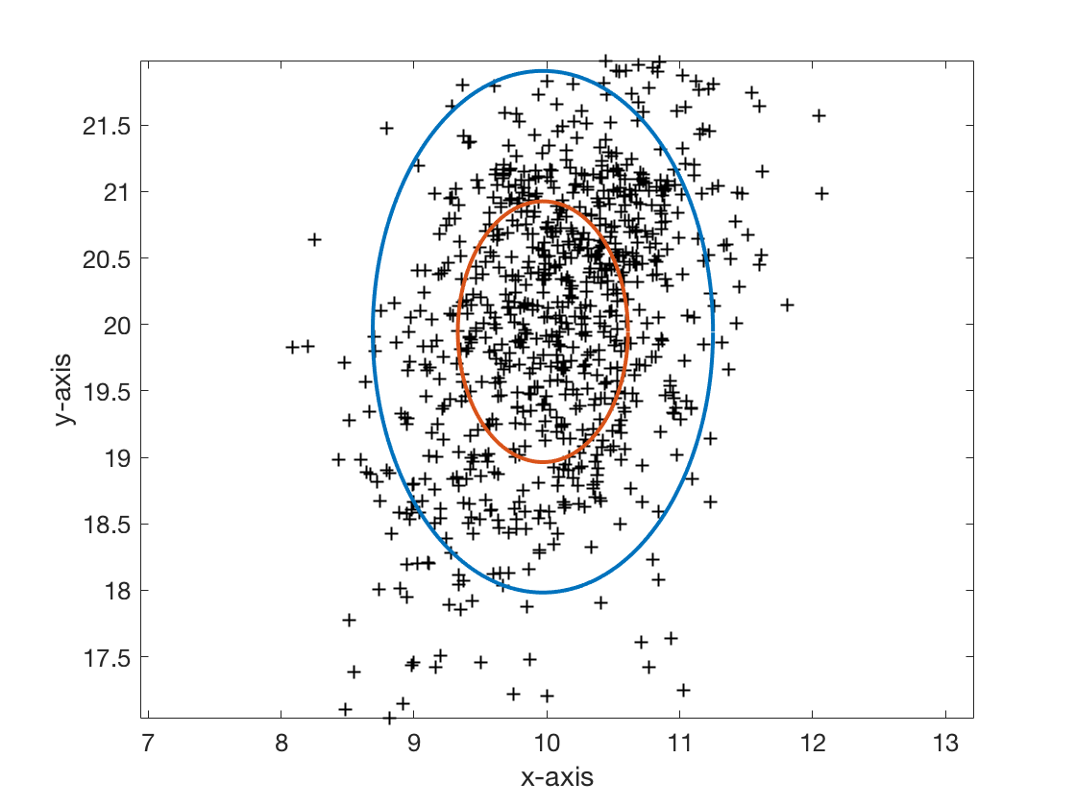
Ballistic Hopping Dynamics
Monte Carlo histories: (left) three-dimensional ballistic hopping trajectories, (right) landing ellipse (1σ and 2σ values)

Slide 16
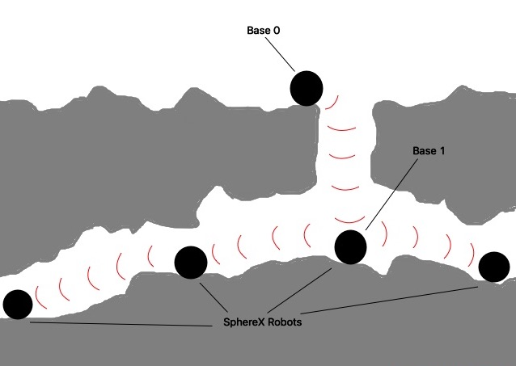
Navigation Inside Caves/Lava Tubes
No line of sight
Communication signals are blocked due to rocks in the way
Requires setting up communication relays
We envision that the robots need to cooperate in the form of a bucket brigade to establish a multi-hop communication link
Multi-hop communication link strategy

Slide 17
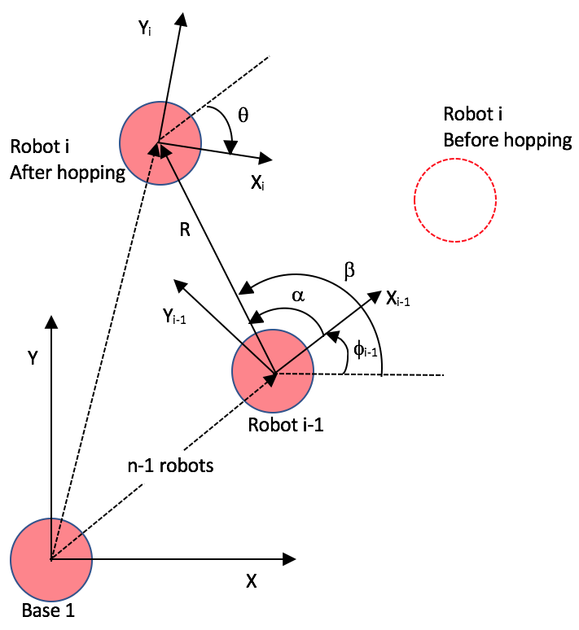
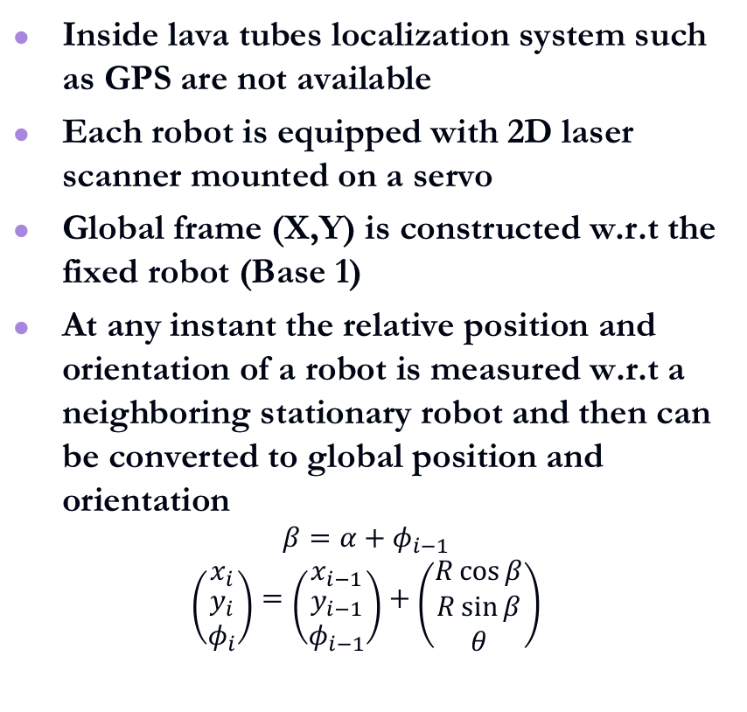
Robot Position Measurement and Localization
Inside lava tubes localization system such as GPS are not available
Each robot is equipped with 2D laser scanner mounted on a servo
Global frame (X,Y) is constructed w.r.t the fixed robot (Base 1)
At any instant the relative position and orientation of a robot is measured w.r.t a neighboring stationary robot and then can be converted to global position and orientation
$$β=α+φ_{i−1}$$
$$\left({x_{i} \atop \begin{aligned}y_{i} \\ φ_{i}\end{aligned}}\right)=\left({x_{i−1} \atop \begin{aligned}y_{i−1} \\ φ_{i−1}\end{aligned}}\right)+\left({R\cos{β} \atop \begin{aligned}R\sin{β} \\ θ\end{aligned}}\right)$$

Slide 18
Multi-robot Algorithm
A network of robots uses data from the already explored area for path planning and moves forward one at a time
The network has to maintain communication link with the base station
The cave environment is modeled as a grid with circular obstacles of different size
Each cell of the grid is termed explored once it falls within the sensing radius of any robot
The exploration is directed through the selection of free boundaries from a given configuration

Slide 19
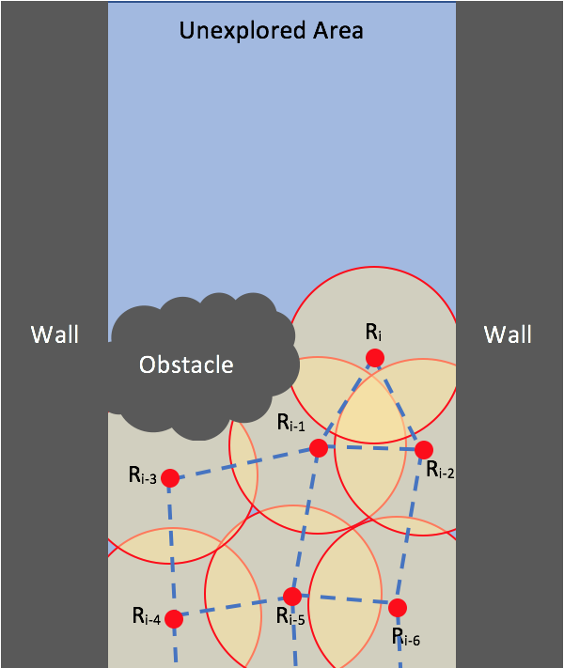
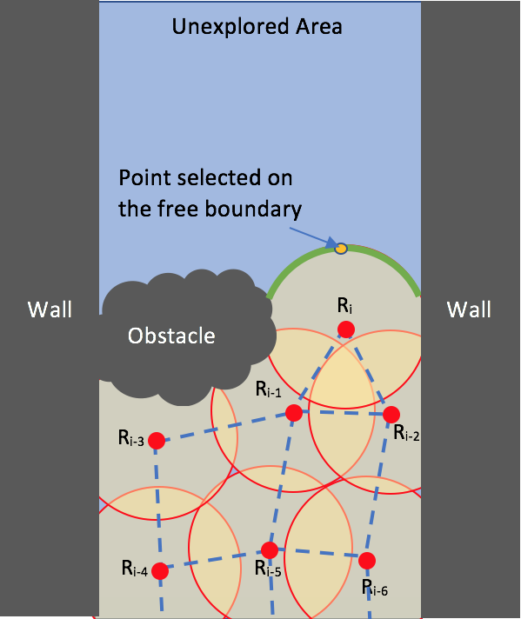
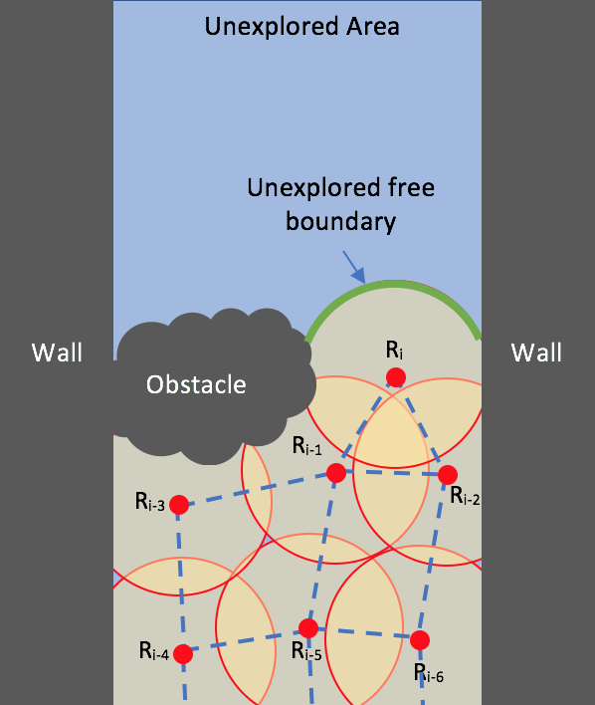
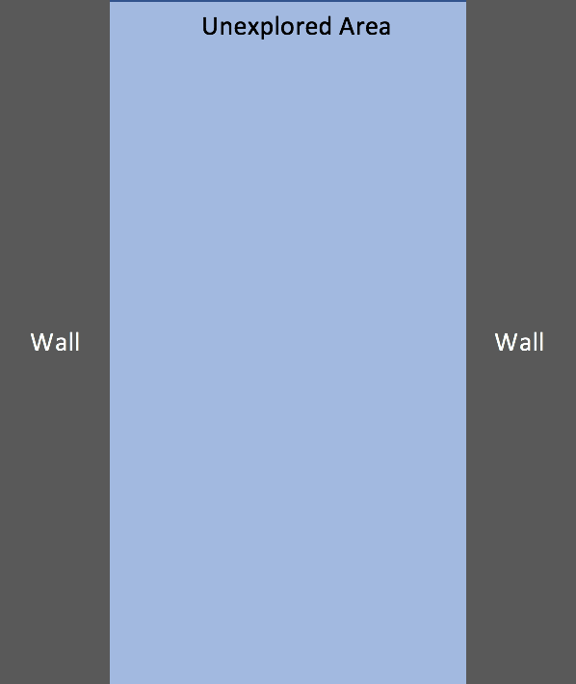
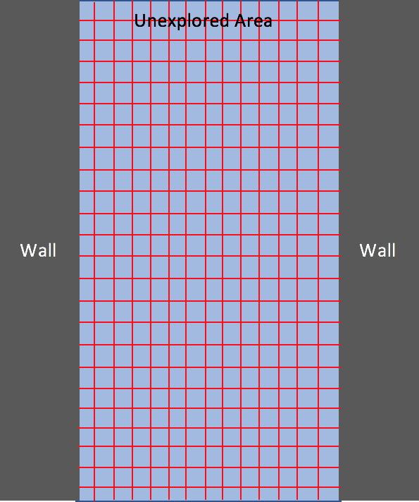
Multi-robot Algorithm
Cave Environment built and modeled as a grid
Robot sensors detects surrounding
Unexplored free boundary identified
Random point selected on free boundary

Slide 20
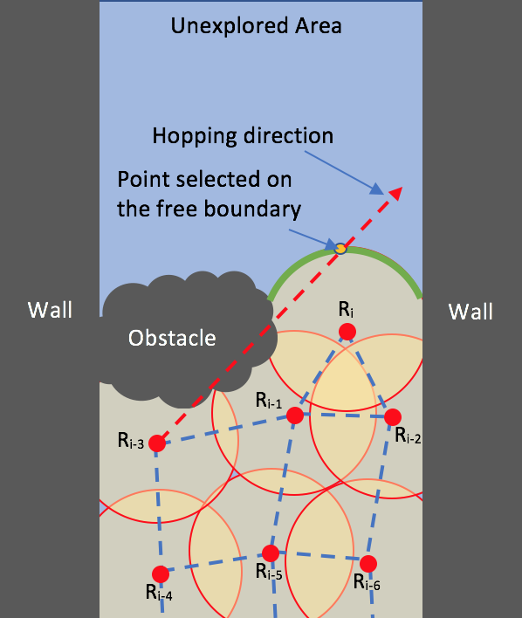
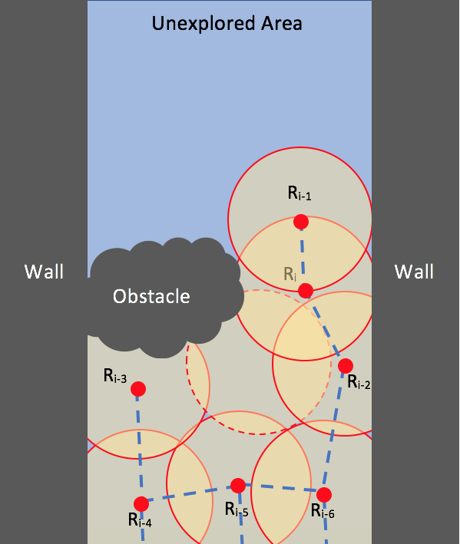
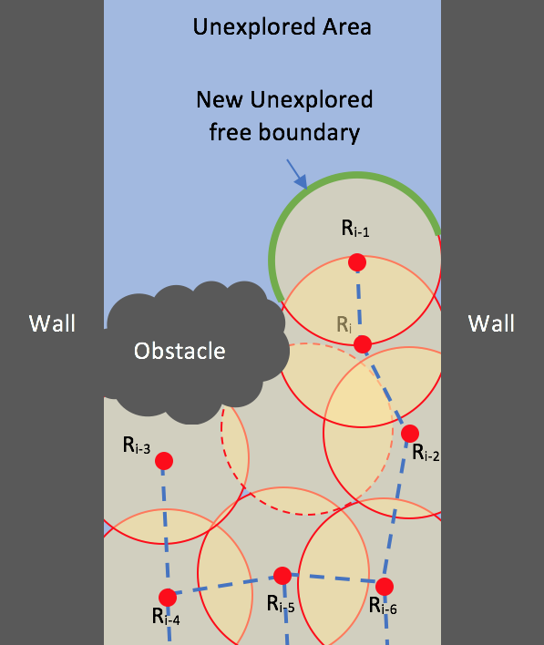
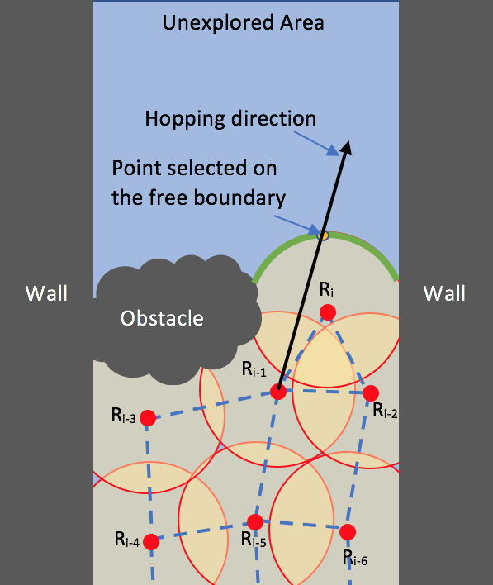
Multi-robot Algorithm
Unit vector between selected point and robot defines hopping direction
Robot hops to its new position
The unexplored free boundary is updated
Moreover, at every instant, the algorithm validates its hopping direction and distance.
Next the hopping distance is calculated such that
  The communication graph is connected
  The final position must lie within the explored area
  The hopping distance should be within the hopping range of SphereX
The algorithm computes the optimized initial and final velocity v_{t0} and v_{tf}

Slide 21
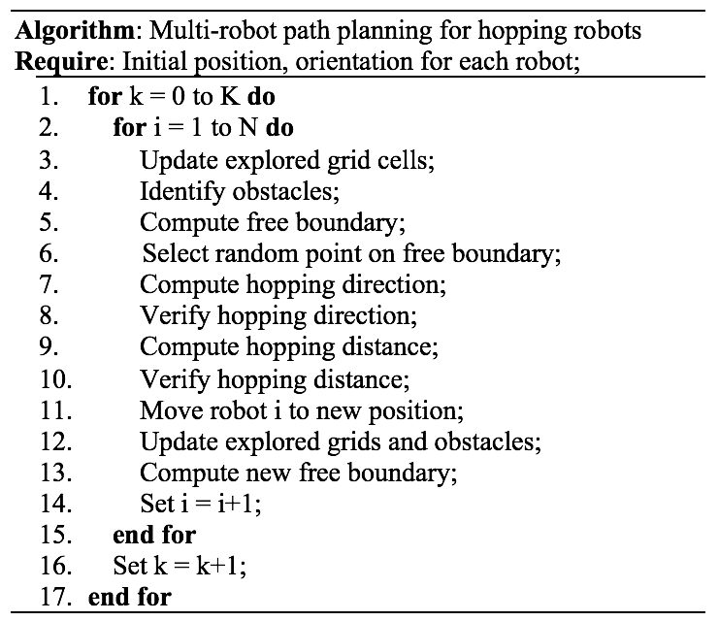
Multi-robot Algorithm

Slide 22
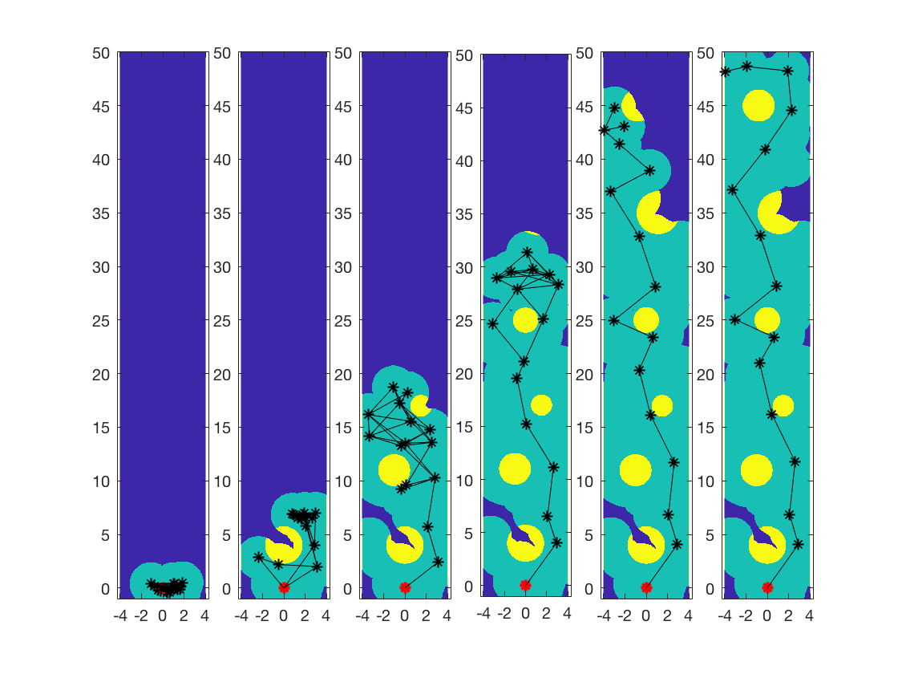
Simulations
Scenario I: The robots should always be in connection with the base robot
The environment is built as a grid structure of length 50 units and width 8 units represented by 800x5000 grids.
It consists of 6 circular obstacles of different radius.
Each robot is considered to have a vision radius of 2 units, communication range of 5 units and a hopping range of 7 units
Simulation of a system of 15 robots and a base robot at timestep 0, 2, 5, 10, 15 and 20

Slide 23

Simulations

Slide 24
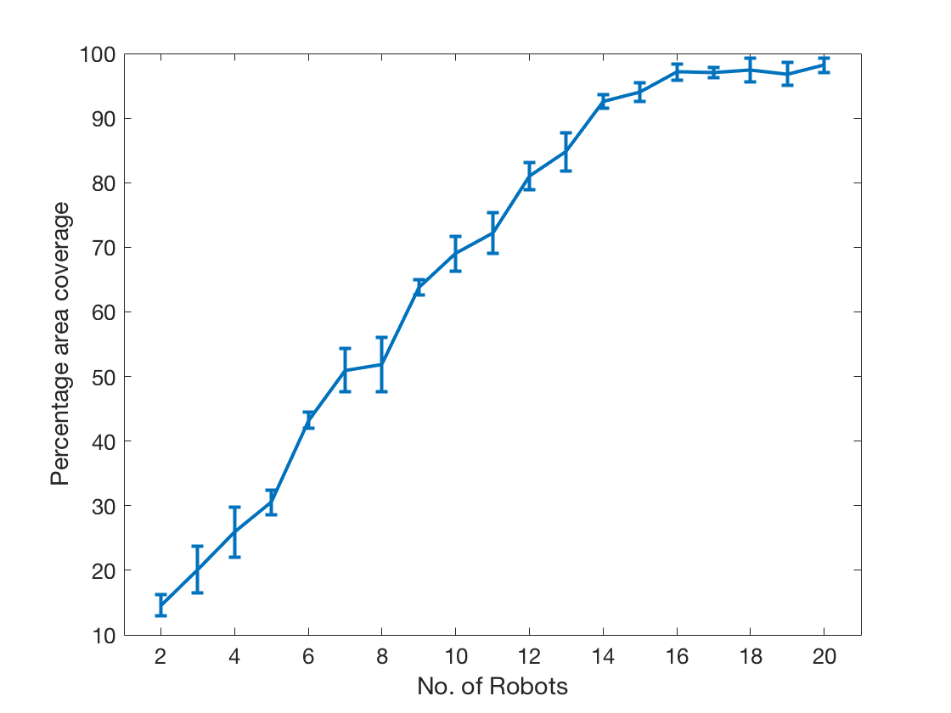
Simulations
Average percentage of area covered and standard deviation over 10 runs

Slide 25
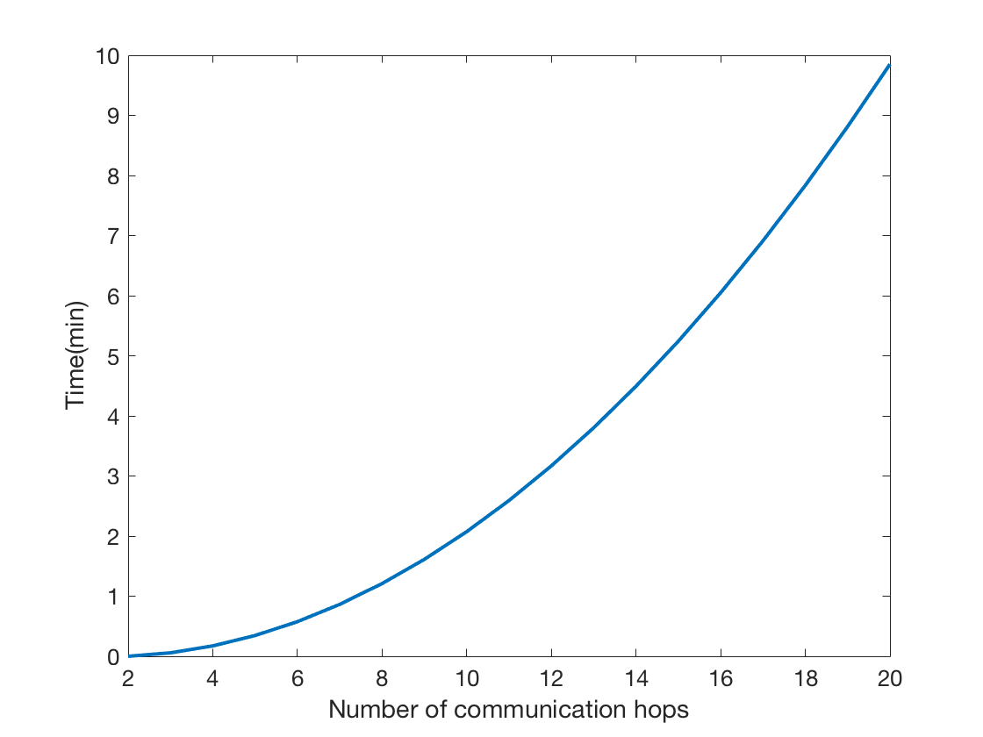
Multi-robot Algorithm
Parameter | Value
No. of Communication hops | 2-20
Data size | 1 MB
System Noise Temperature | 200 K
Minimum Eb/No for reception | 10 dB
Antenna range | 500 m
Channel bandwidth | 20 kHz
Pointing loss of antenna | 18 dB
Data packet size | 1024 bits
Transmission time for 1MB data through multiple hops

Slide 26
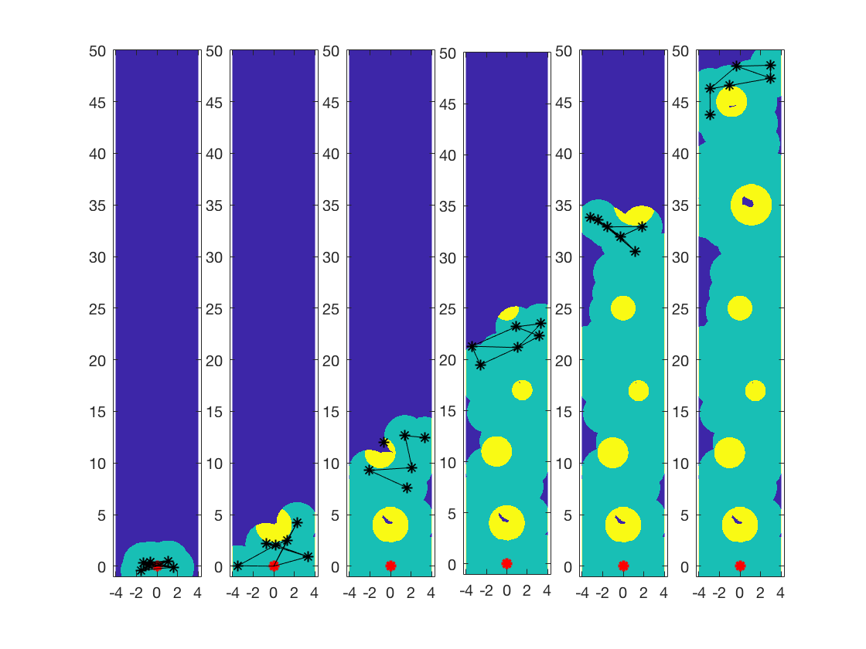
Multi-robot Algorithm
Case II: The robots can explore as a swarm without maintaining connection with the Base robot
Simulation of a system of 6 robots at timestep 0, 2, 6, 11, 15 and 21

Slide 27

Simulations

Slide 28
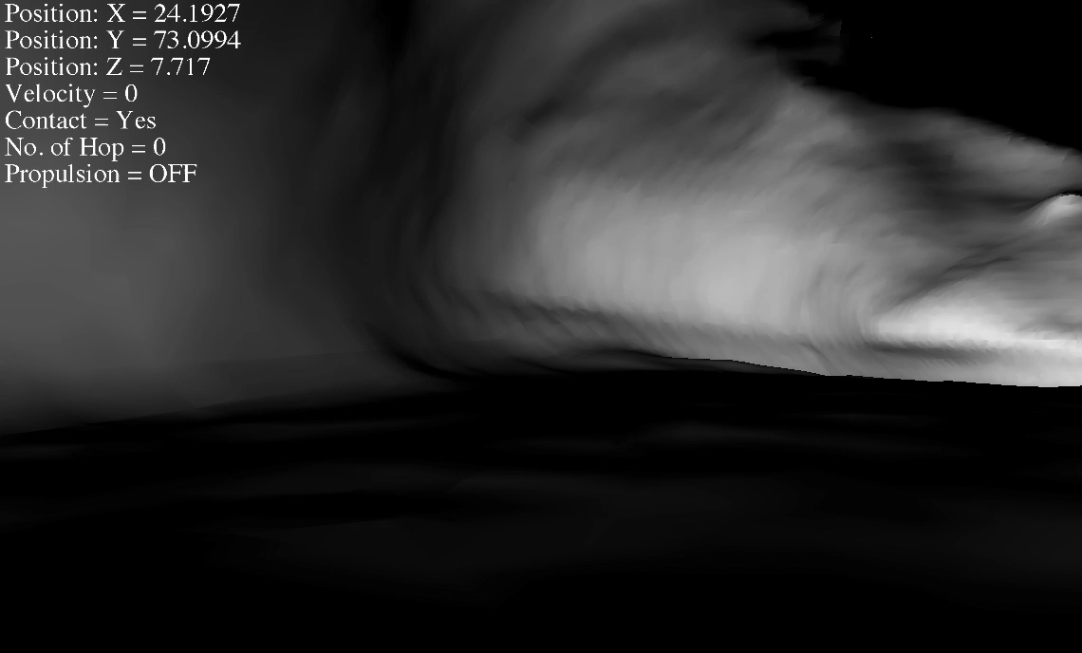
Animation

Slide 29
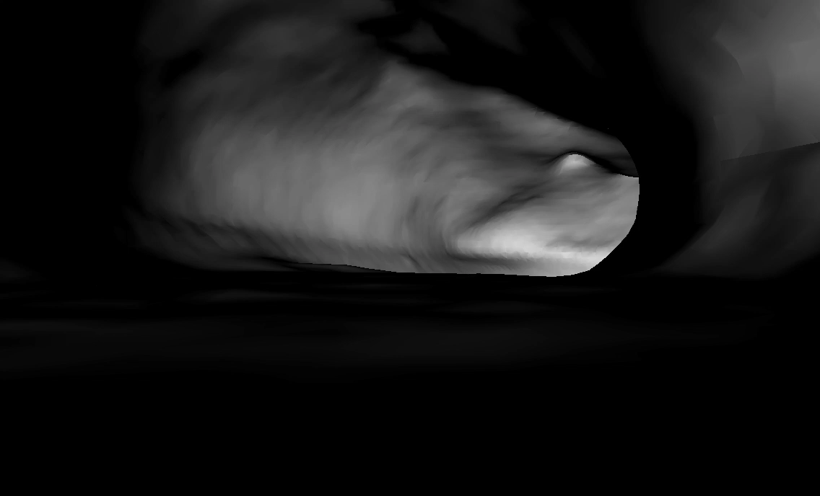
Animation

Slide 30
Conclusions
Presented a spherical robotic platform (SphereX)
Detailed dynamics and control for mobility
Proposed an algorithm for multi-robot navigation and path-planning in unknown environments like caves and lava tubes
The proposed concept will allow mapping of these extreme environments compiled into a 3D point cloud
Future work will include testing the algorithm on real cave environments along with hardware demonstrations

Slide 31
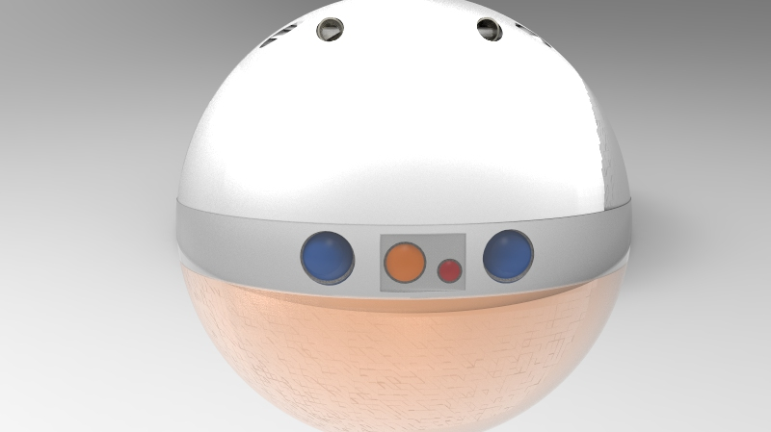
Thank You

Slide 32
Questions ?

Slide 33
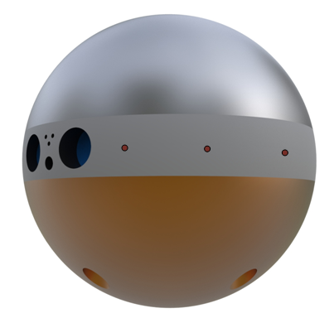
Mass Budget for Each SphereX
Major Subsystem | Mass (kg)
Computer, Comms, Electronics | 0.2
Power | 0.3
Stereo Camera, Laser Rangefinder | 0.3
Propulsion | 1.2
ADCS | 0.4
Payload | 0.6
Total | 3.0
Smartphone-class electronics, sensors

Slide 34
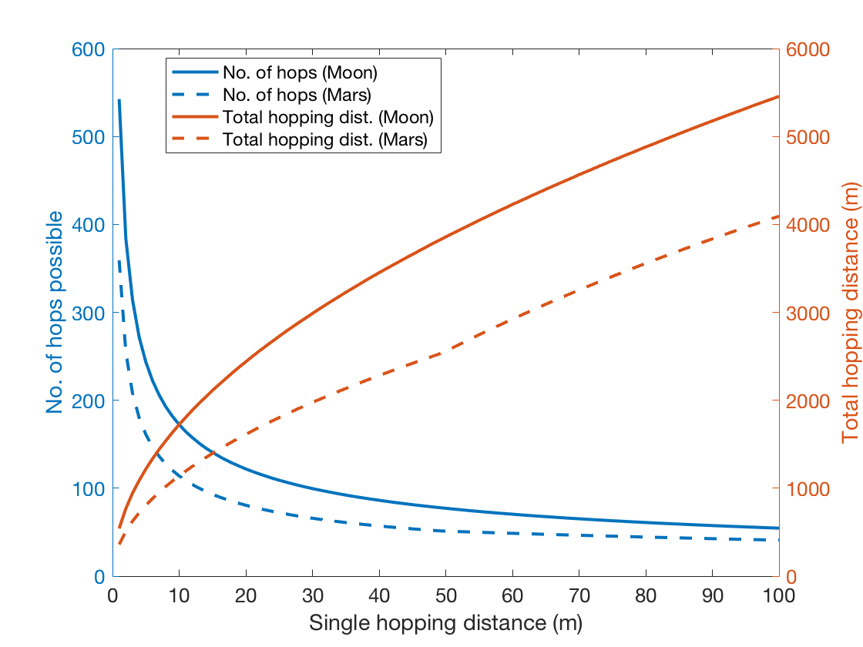
Trajectory Optimization
Distance travelled per hop has a huge impact on the number of hops possible and the total distance covered.
Fig. for 1 Kg of propellant with Isp 350s on Moon and Mars.

