Slide 1
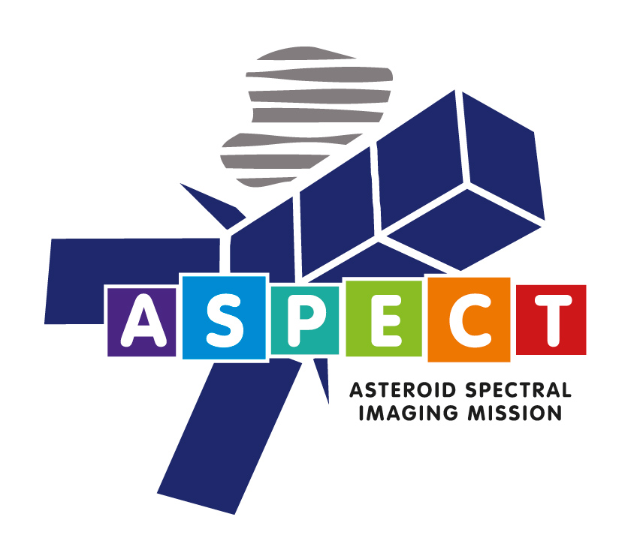
ASPECT
Cubesat Instrumentation Concept for Asteroid Exploration: The ASPECT Platform
Antti Näsilä
VTT Technical Research Centre of Finland Ltd
Notes:
2. Otsikkosivu/aloitussivu

Slide 2
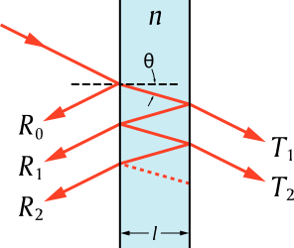
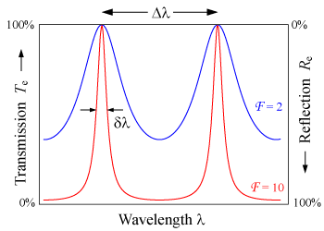
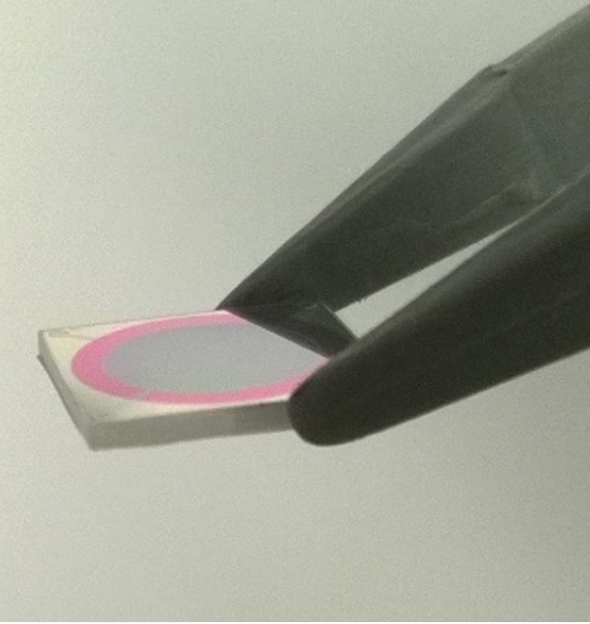
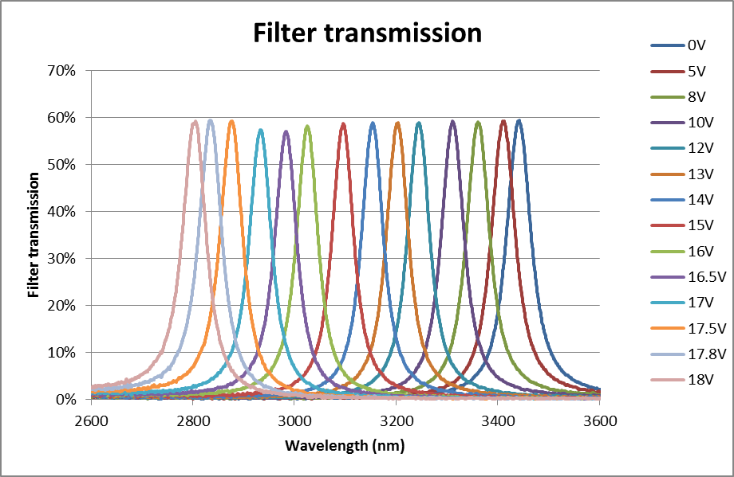
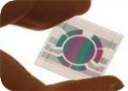
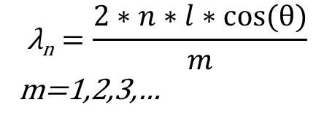
Fabry-Perot Interferometer
Two parallel mirrors separated by a cavity
Acts as an optical resonator
Can be used as a tunable passband filter
m+1
m
$$\text{λ}\text{n}=\frac{2∗n∗l∗cos⁡(\text{θ})}{m}$$
m=1,2,3,…

Slide 3
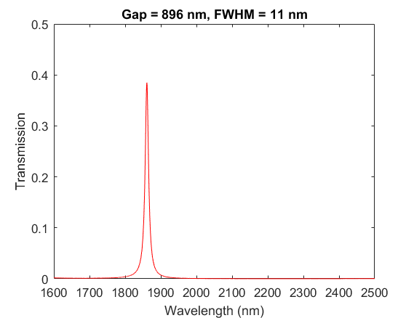
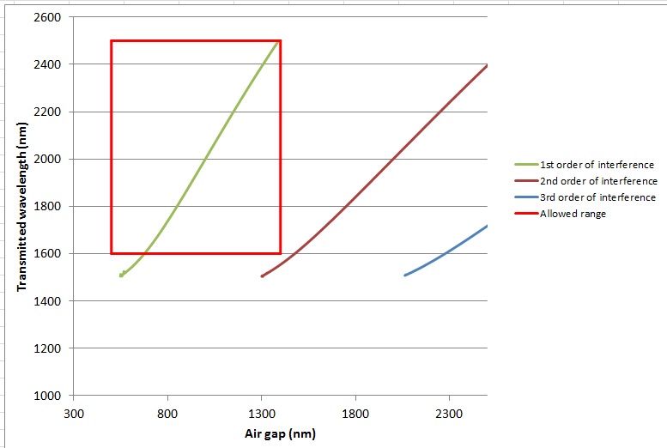
Fabry-Perot Interferometer

Slide 4

FPI platforms and examples of realized filters
Pharma,
Food,
Agriculture
Material science
Biology
Forestry
Gases,
Plastics
Minerals
Minerals
Medical, Anticounterfeit,
Space, Remote sensing, PoC
Dielectric mirrors
PIEZO
Metallic mirrors
MEMS process
platforms:
MEMS
Existing MEMS FPI’s
ALD MFPI
MCT
PolySi-SiN/SiO2 MFPI
InSb
PbSe
InGaAs
Si-air MFPI
CMOS & CCD Image Sensors
Metal MFPI
λ
0,2
0,3
0,4
0,6
0,8
1
2
3
4
5
6
7
8
10
11
12
13
14
µm
UV
Visible
NIR
SWIR
MWIR
LWIR

Slide 5
Different mirror solutions
SWIR mirror structure
Bragg mirror, optimized for a certain wavelength
VIS/NIR mirror structure
Simple metallic mirror
Poly-Si (λ/4)
SiO₂ (50 nm)
SiO₂ (λ/4)
Poly-Si (λ/4)
Ag (VIS 45 nm, NIR 20 nm)
SiO₂ (λ/4)
Al₂O₃ (5 nm)
Poly-Si (λ/4)
Fused silica substrate
Fused silica substrate
Not to scale

Slide 6
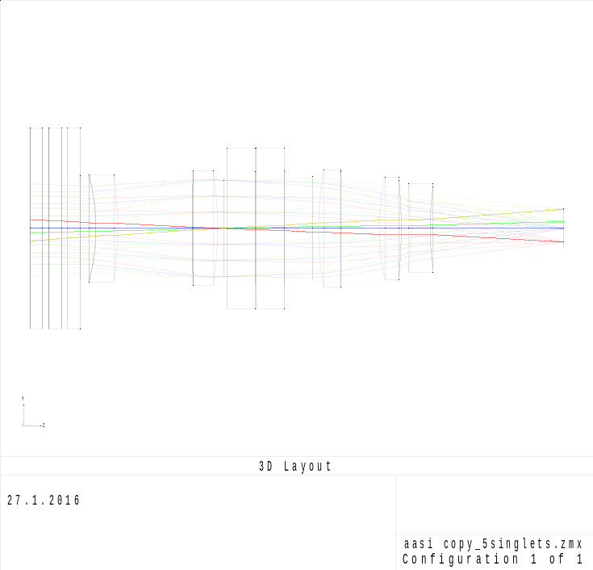
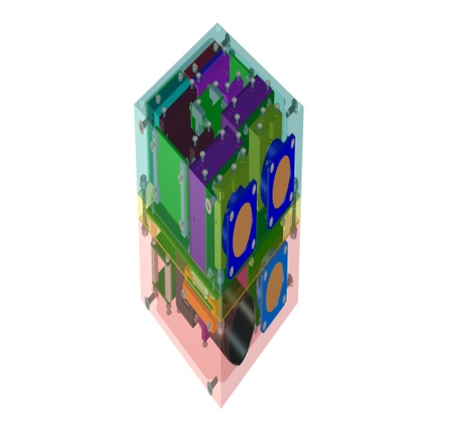
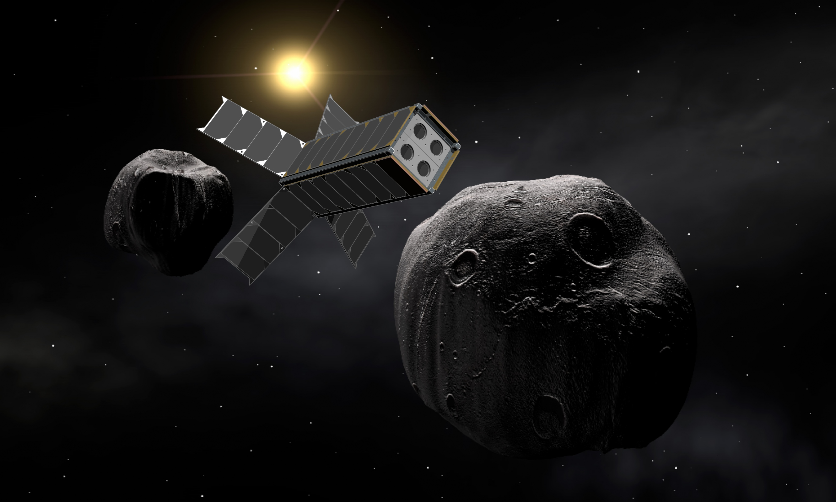
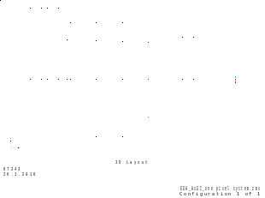
First ASPECT concept
Developed originally for ESA’s Asteroid Impact Mission during 2015 – 2017
Originally for a 3U cubesat
1U envelope for the instrument
2 spectral imagers measuring from 500 nm to 1600 nm
1 spectrometer measuring from 1600 nm to 2500 nm
Optics model for the VIS channel
Optics model for the SWIR spectrometer

Slide 7
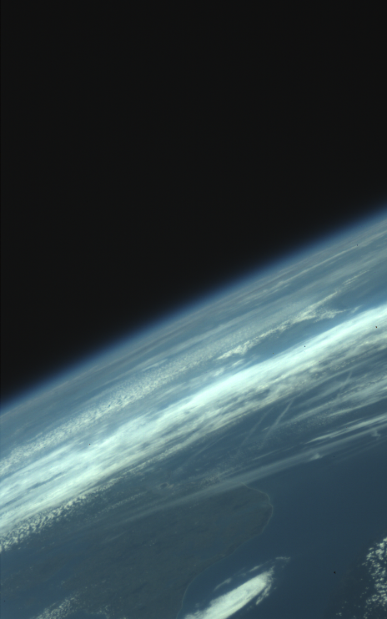
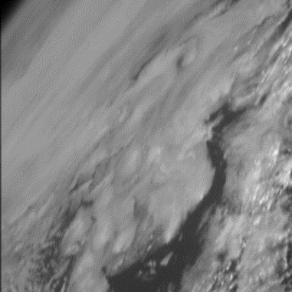
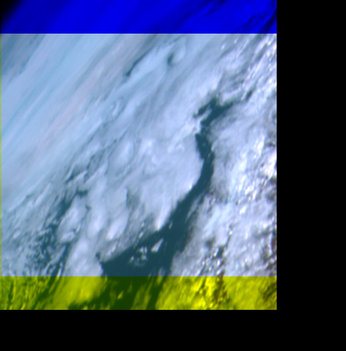
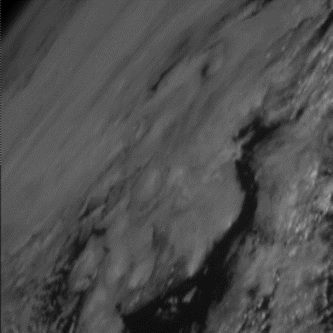
Example: First images from Aalto-1 Spectral Imager
RGB image
Spectral images
False color image: red pixels show 711 nm, green pixels 536 nm, blue pixels 509 nm.

Slide 8
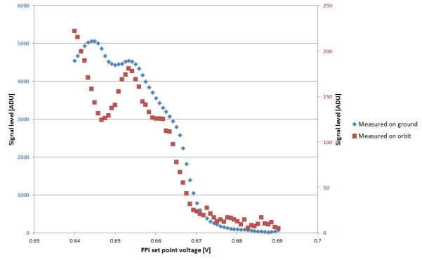
Example: First images from Aalto-1 Spectral Imager
Spectral image (509 nm, 536 nm, 711 nm)
August 3, 2017
RGB image
July 5, 2017
Calibration spectrum
September 5, 2017

Slide 9
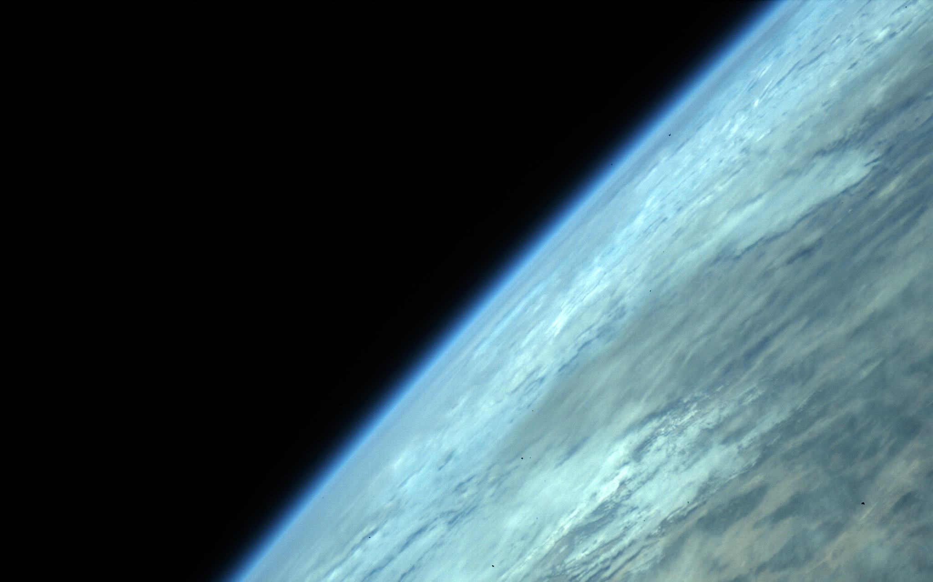
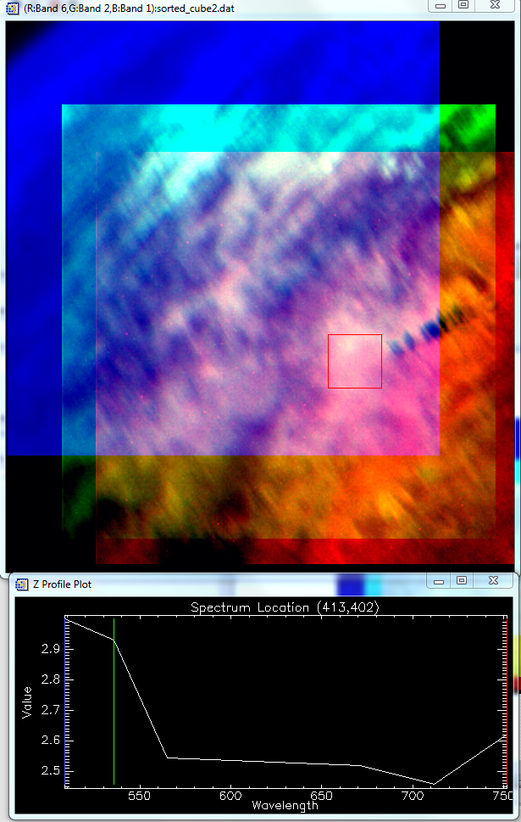
Next images from Aalto-1 Spectral Imager
November 21, 2017

Slide 10
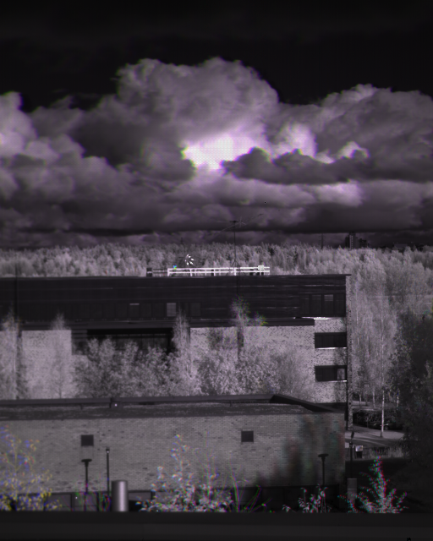
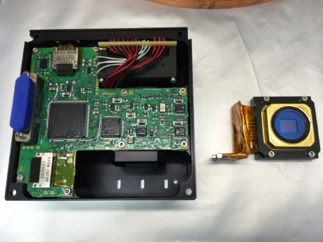
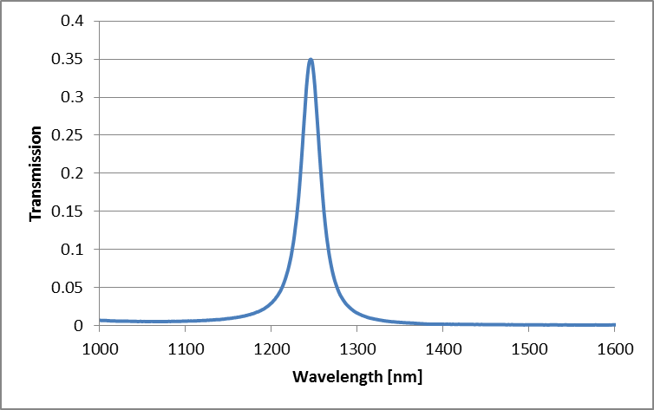
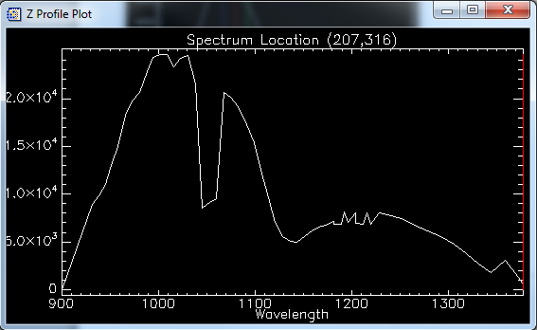
Example: NIR Spectral Imager for nanosatellites
NIR spectral imager weighing less than 500 g
Measuring from 900 nm to 1400 nm (1000 nm – 1600 nm also possible)
To be launched in Q2-Q3/2018 on the Reaktor Hello World Satellite

Slide 11
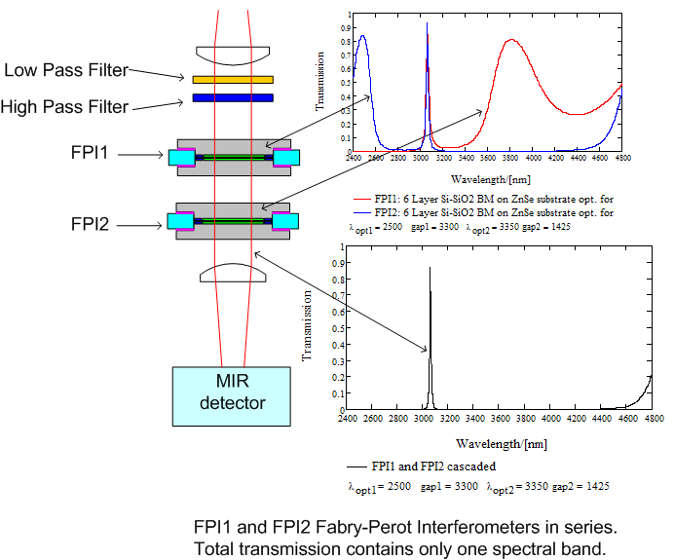
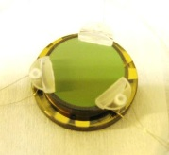
3 um concept
Si-SiO2 Bragg mirrors on ZnSe substrate
Single instrument measuring from 2.5 um to 4.0 um
Single point detectors enable low cost devices
Very compact instrument: ~0.25 U
Spectral resolution ~20 – 30 nm
Optical apertures up to 25 mm
The same concept can also be used with imaging detectors if available for use
High SNR!

