Slide 1
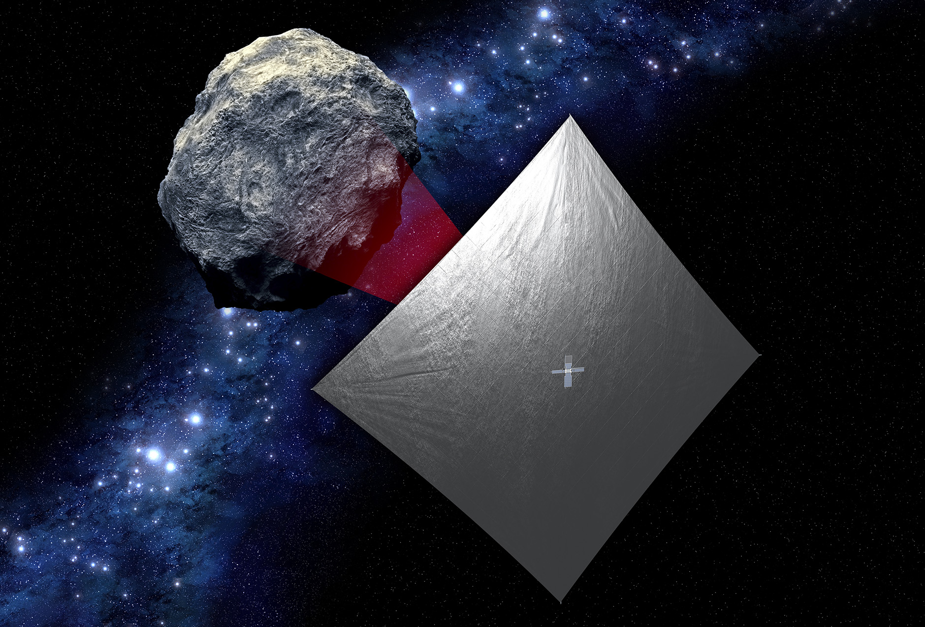
Near Earth Asteroid (NEA) Scout
Les Johnson, Tiffany Lockett, & Alex Few
NASA George C. Marshall Space Flight Center
Julie Castillo-Rogez
  NASA Jet Propulsion Laboratory

Slide 2
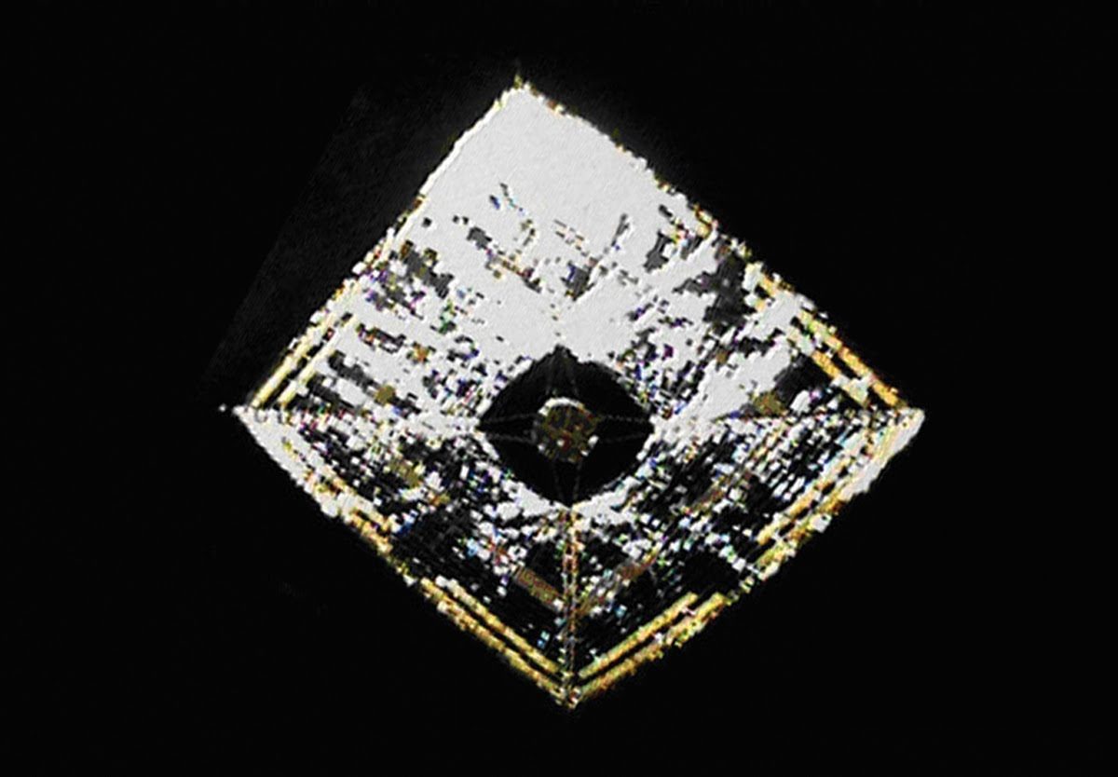
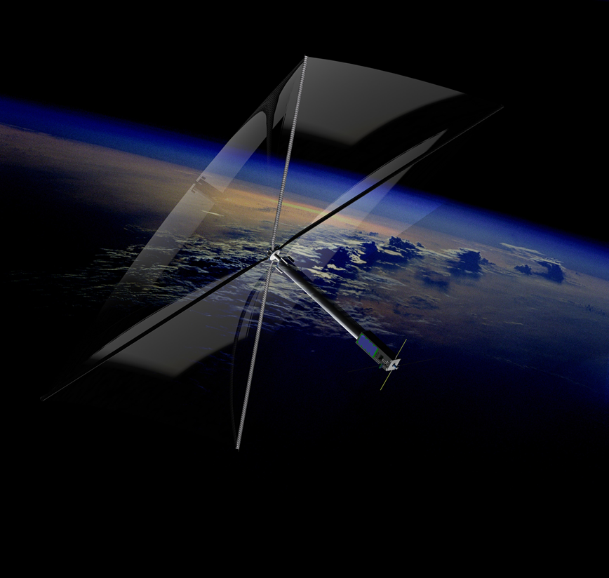
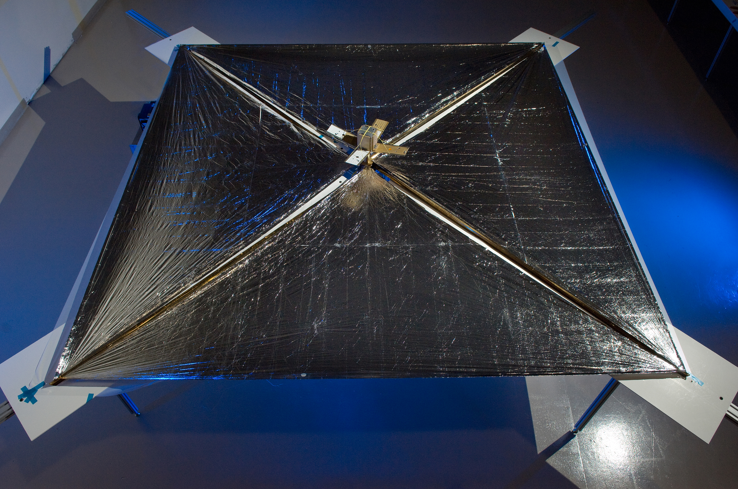
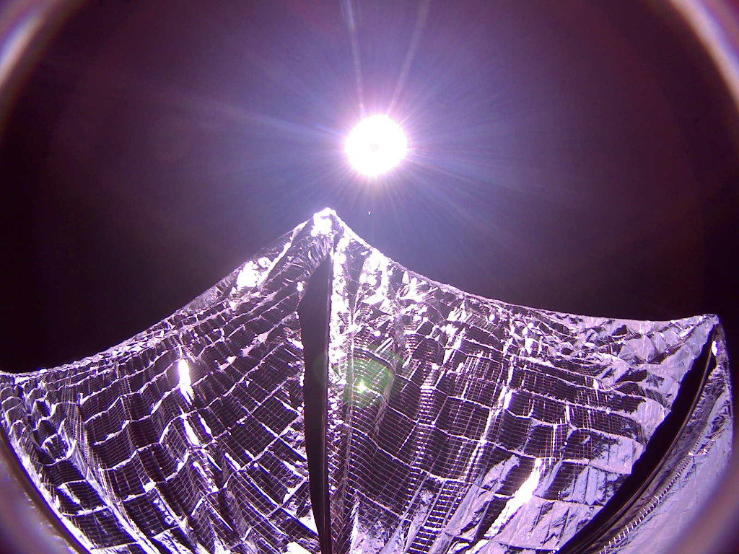
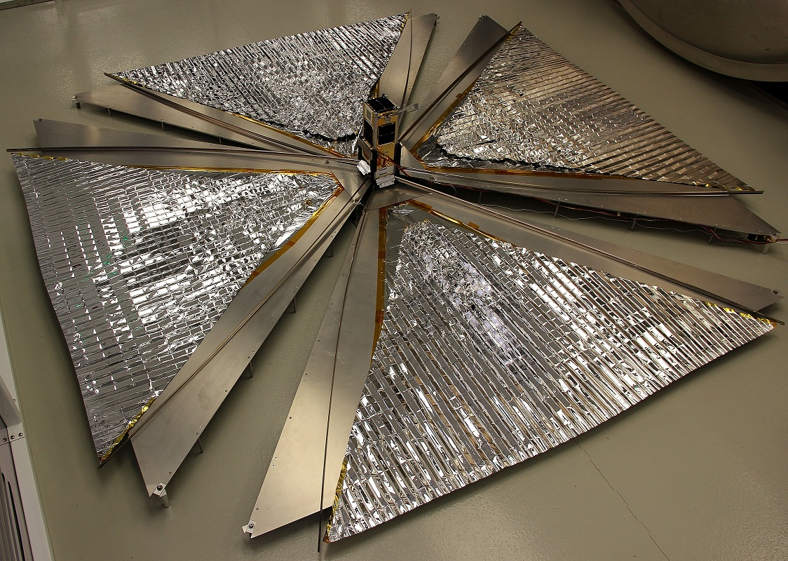
Solar Sail Missions Flown (as of April 11, 2018)
NanoSail-D (2010)
NASA
Earth Orbit
Deployment Only
3U CubeSat
10 m²
IKAROS (2010)
JAXA
Interplanetary
Full Flight
315 kg Smallsat
196 m²
LightSail-1 (2015)
The Planetary Society
Earth Orbit
Deployment Only
3U CubeSat
32 m²
CanX-7 (2016)
Canada
Earth Orbit
Deployment Only
3U CubeSat
<10 m²
InflateSail (2017)
EU/Univ. of Surrey
Earth Orbit
Deployment Only
3U CubeSat
10 m²

Slide 3

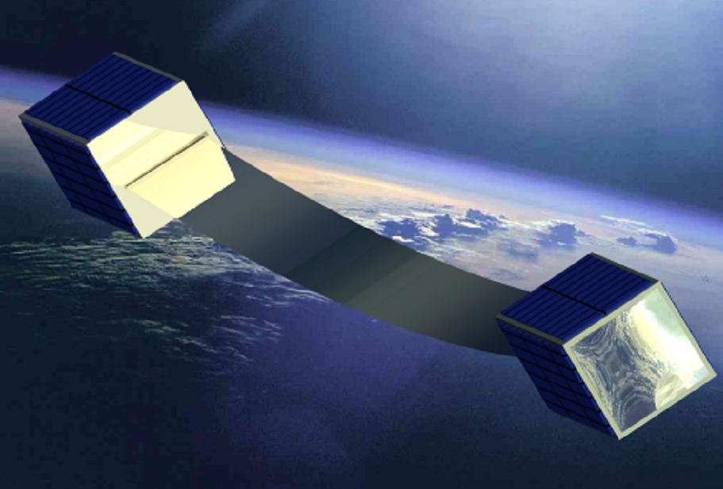
Planned Solar Sail Missions (as of April 11, 2018)
CU Aerospace (2018)
Univ. Illinois / NASA
Earth Orbit
Full Flight
3U CubeSat
20 m²
LightSail-2 (2018)
The Planetary Society
Earth Orbit
Full Flight
3U CubeSat
32 m²
Near Earth Asteroid Scout (2019) NASA
Interplanetary
Full Flight
6U CubeSat
86 m²

Slide 4

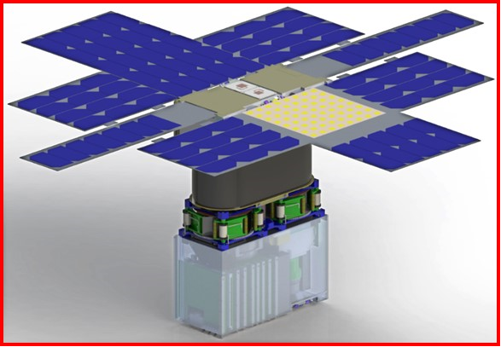
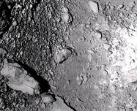
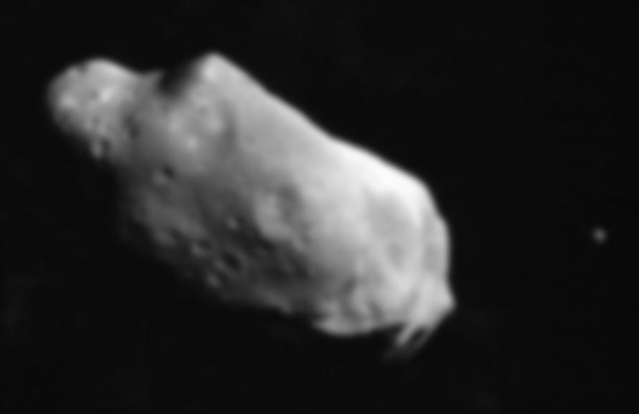
Near Earth Asteroid Scout
The Near Earth Asteroid Scout Will
Image/characterize a NEA during a slow flyby
Demonstrate a low cost asteroid reconnaissance capability
Key Spacecraft & Mission Parameters
6U cubesat (20cm X 10cm X 30 cm)
~86 m² solar sail propulsion system
Manifested for launch on the Space Launch System (EM-1/2019)
1 AU maximum distance from Earth
Leverages: combined experiences of MSFC and JPL with support from GSFC, JSC, & LaRC
Close Proximity Imaging
Local scale morphology, terrain properties, landing site survey
Target Reconnaissance with medium field imaging
Shape, spin, and local environment

Slide 5
NEA Scout Goals & Objectives
Design, develop, integrate and operate a spacecraft for the purpose of demonstrating a low cost reconnaissance capability
Enable asteroids as potential destinations for human exploration
Characterize a candidate NEA with an imager to address key SKG’s
    “Precursor robotics, robotic missions that investigate candidate destinations and provide vital information to prepare for human explorers, will lay the groundwork for humans to achieve new milestones in deep space.”
HEOMD/AES Strategic Goals/Objectives
(Strategic Goal 1, Objective 1.1)
    “Robotic exploration is the principal method we use to explore the solar system, and is an essential precursor to human exploration of space.”
SMD Strategic Goals/Objectives
(Strategic Goal 1, Objective 1.5)

Slide 6
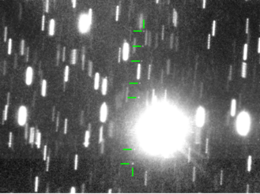
Baseline Target Asteroid: 1991 VG
Diameter ~ 5 -12 meters
Rotation period between a few minutes and less than 1 hour
Unlikely to have a companion
Unlikely to retain an exosphere or dust cloud
  Solar radiation pressure sweeps dust on timescales of hours or day
Near-Earth Asteroid 1991VG (marked with green lines) on 2017 May 30. This is a composite of several images obtained with the ESO VLT. The images have been combined in 7 stacks tracking the position of the asteroid, resulting in the object appearing as 7 dots as it moves in front of the background stars. The stars appear trailed due to the motion of the asteroid during each series. Credit Hainaut/Micheli/Koschny

Slide 7
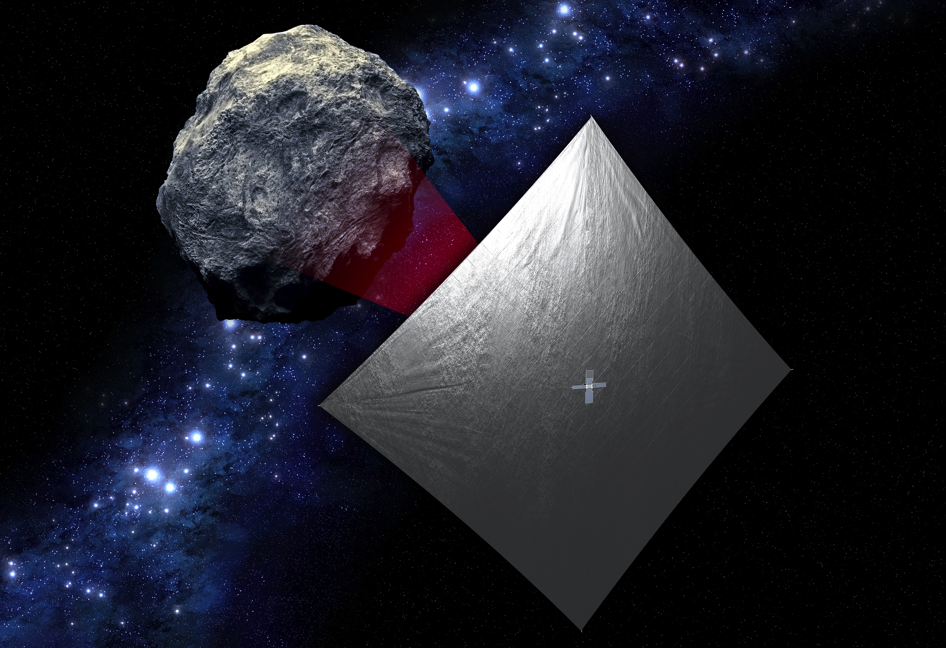
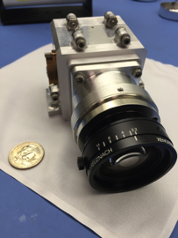
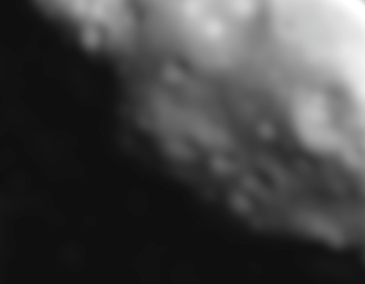

Near Earth Asteroid Scout Mission Overview
Close Proximity Science
High-resolution imaging,
10 /px over >30% surface
SKGs: Local morphology Regolith properties
JPL
NEA Reconnaissance
<100 km distance at encounter
50 cm/px resolution over 80% surface
SKGs: volume, global shape, spin properties, local environment
Target
Reference
stars
Target Detection and Approach:
50K km, Light source observation
SKGs: Ephemeris determination and composition assessment
Notes:
Update background pic with new one. Update camera pic. Took science pieces from design iteration review charts for science.

Slide 8

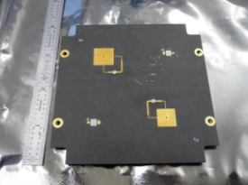
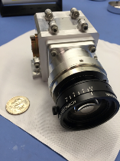

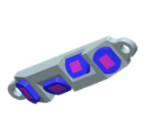
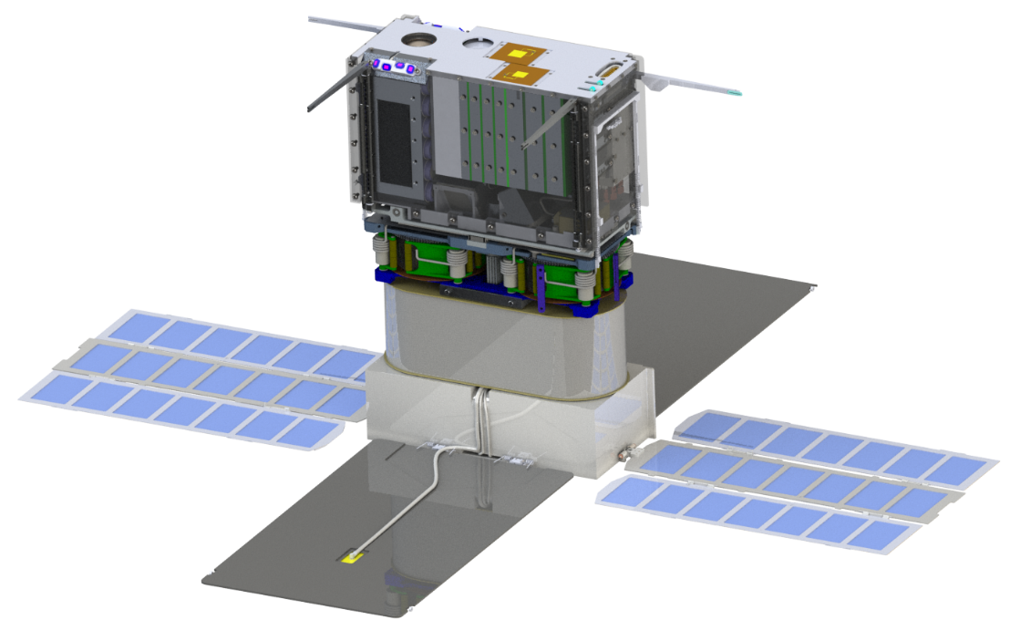




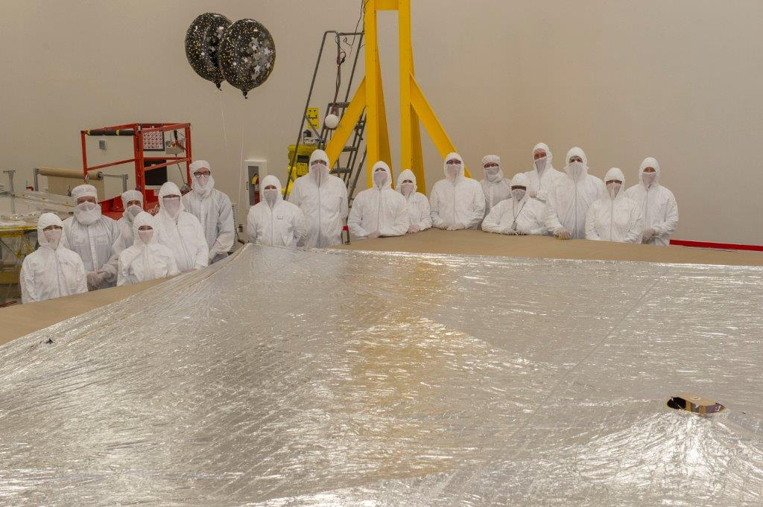

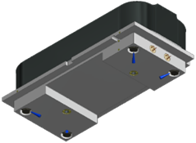
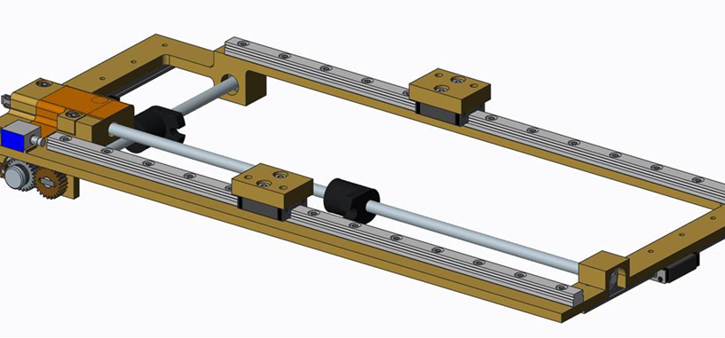
Flight System Overview
NEA Imager
(JPL)
Payload | Context Camera
Mechanical& Structure | “6U” CubeSat form factor <14 kg total launch mass Modular flight system concept
Propulsion | ~86 m² aluminized CP-1 solar sail (based on NanoSail-D2)
Avionics | Radiation tolerant architecture
Electrical Power System | Trifold deployable solar arrays with GaAs cells (~51.2 W EOL at 1 AU solar distance) 6.2 Ah Battery 10 -12.3 V unregulated, 5 V/3.5 V regulated
Telecom | JPL Iris 2.0 X-Band Transponder; 4 W RF output power supports doppler, ranging, and D-DOR 2 pairs of INSPIRE-heritage LGAs (RX/TX) 8x8 element microstrip array MGA (TX); ~1 kbps to 34m DSN at 0.8 AU
Attitude Control System | 15 mNm-s (x3) & 100 mNm-s RWAs Active mass translation system VACCO R-236fa (refrigerant gas) ‘warm gas’ RCS system Nano StarTracker, Coarse Sun Sensors & MEMS IMU for attitude determination
Star Tracker
(BCT)
LGA
(JPL)
Rad Tolerant Avionics
(JPL)
Sun Sensors
(BCT)
Iris 2.0 Transponder
(JPL)
18650 Lithium Batteries
(SDL/Panasonic)
RWA
(BCT)
TRAC Boom Assembly
(MSFC)
Solar Sail - Stowed
(MSFC)
A fully functional planetary spacecraft in a shoebox
Translating Table
(MSFC)
Solar Panels & MGA
(BCT & MMA)
RCS
(VACCO)

Slide 9
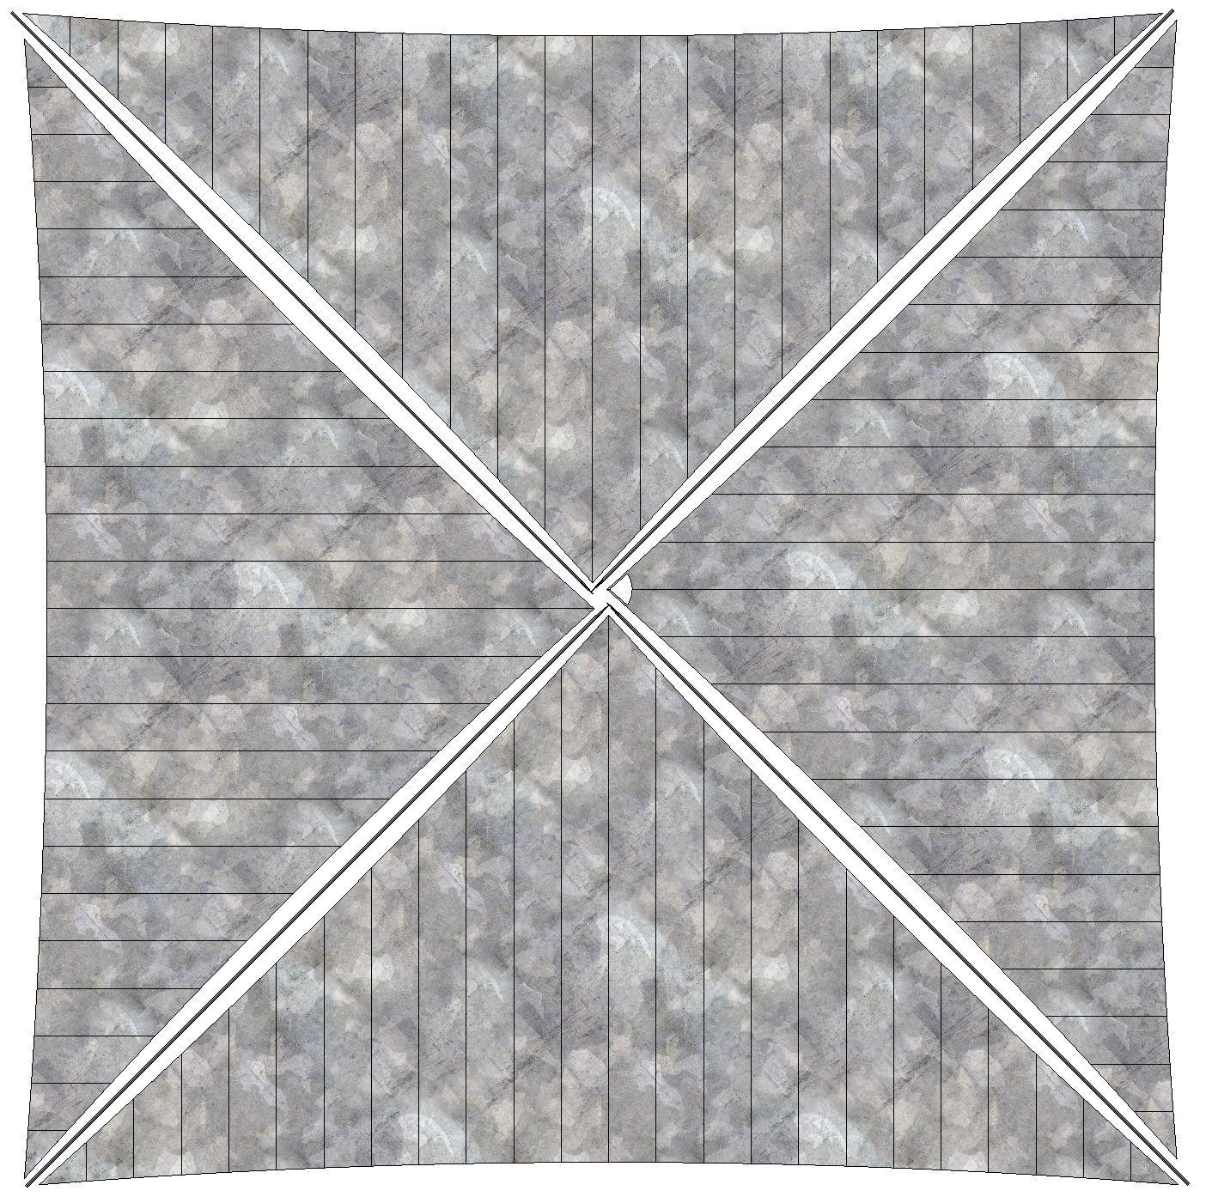


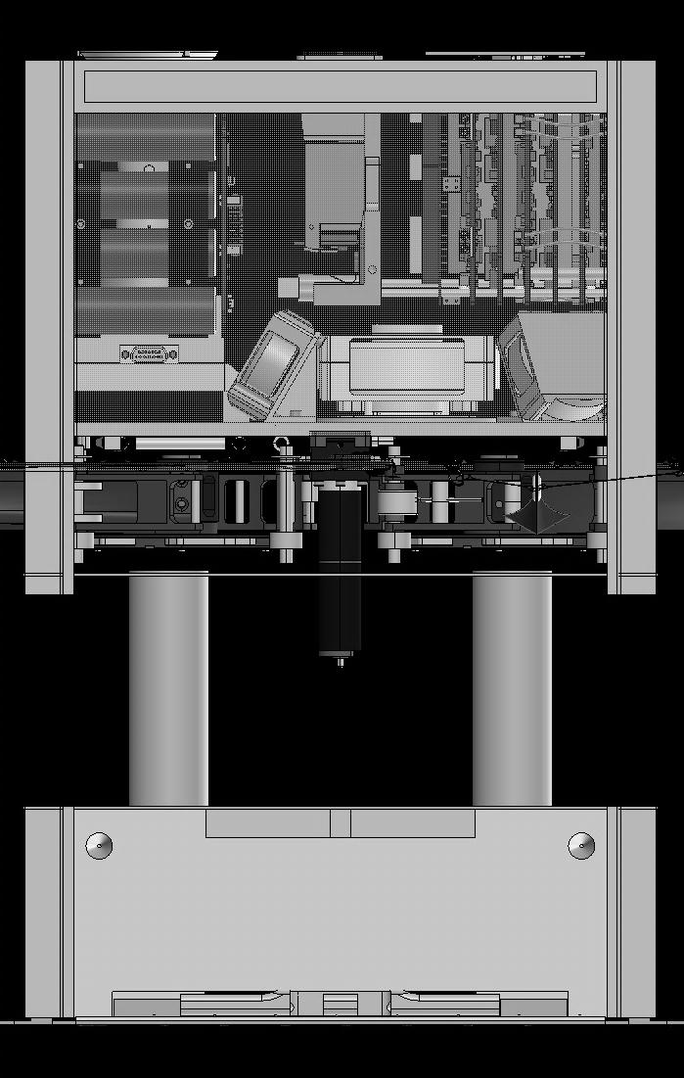
NEA Scout Approximate Scale
Deployed Solar Sail
Deployed Solar Sail
Folded, spooled and packaged in here
Human
6U Stowed Flight System
School Bus

Slide 10
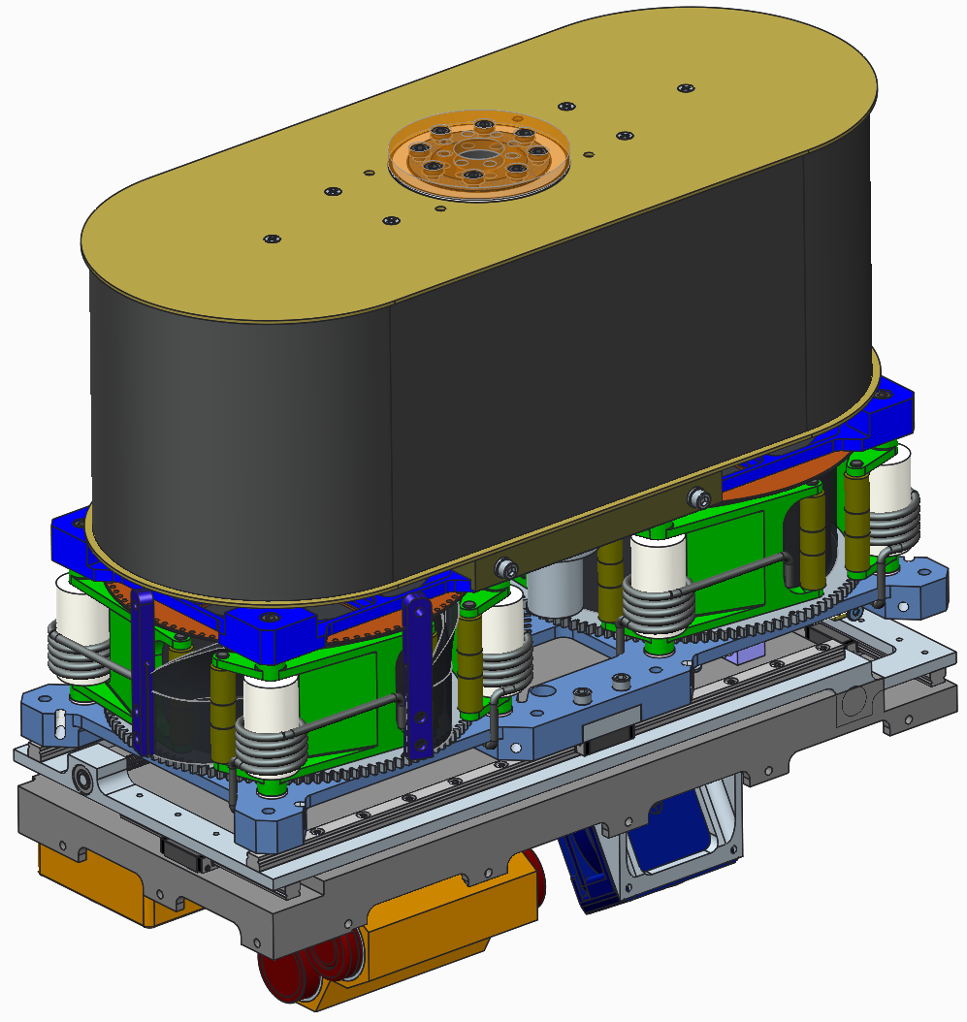
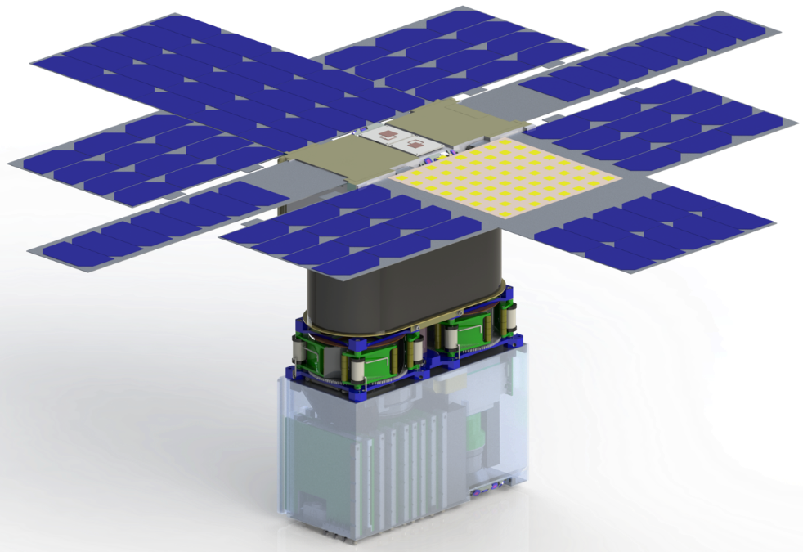
Active Mass Translation (AMT) Overview
Problems and Challenges
  NEA Scout’s center of mass (CM) and center of pressure (CP) are not collinear with the estimated thrust vector. This creates a disturbance torque. Furthermore, the CP is fore of the CM, creating a naturally unstable vehicle and necessitating an active control mechanism.
  Little mass and volume available. This challenge is compounded by the vehicle’s total mass (14 kg) and volume (6 Liters) requirement. The AMT was originally given 250 grams and a volume of 226 x 105 x 17 mm (400 cc). This volume and mass will include: an X-Y translation stage, thermal controls, limit switches, and a wire harness. The wire harness must pass through the AMT and survive exposure to deep space environments.
KEY
Thrust
CP
CM
Disturbance Torque

Slide 11
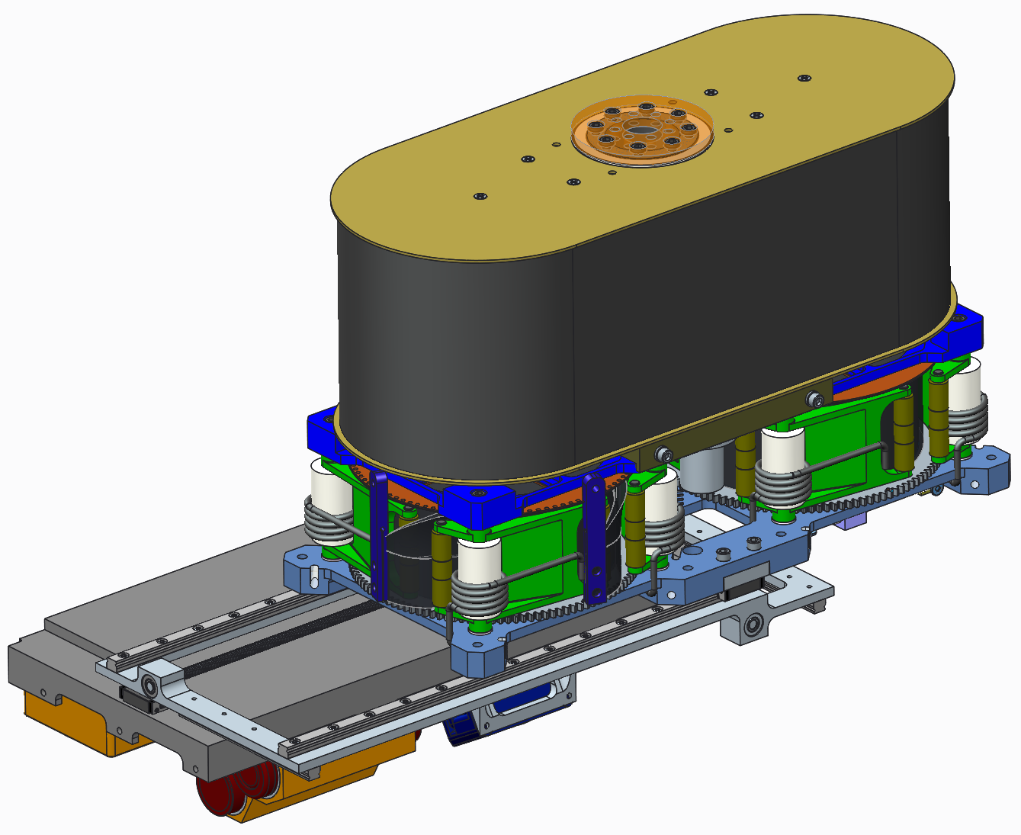

AMT Overview
Nominal State
Trimmed State
AMT
KEY
Thrust
CP
CM
Disturbance Torque

Slide 12
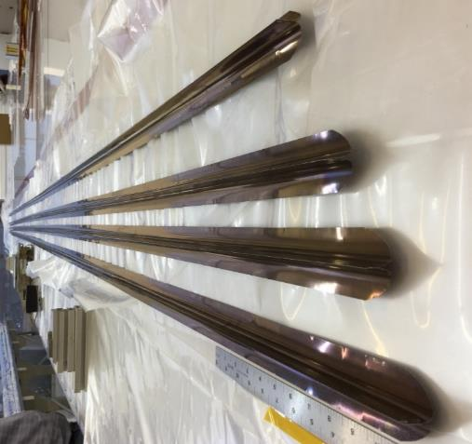
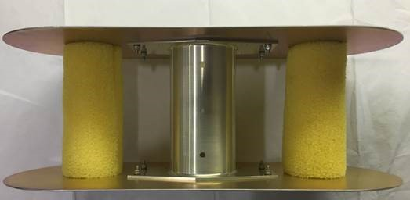
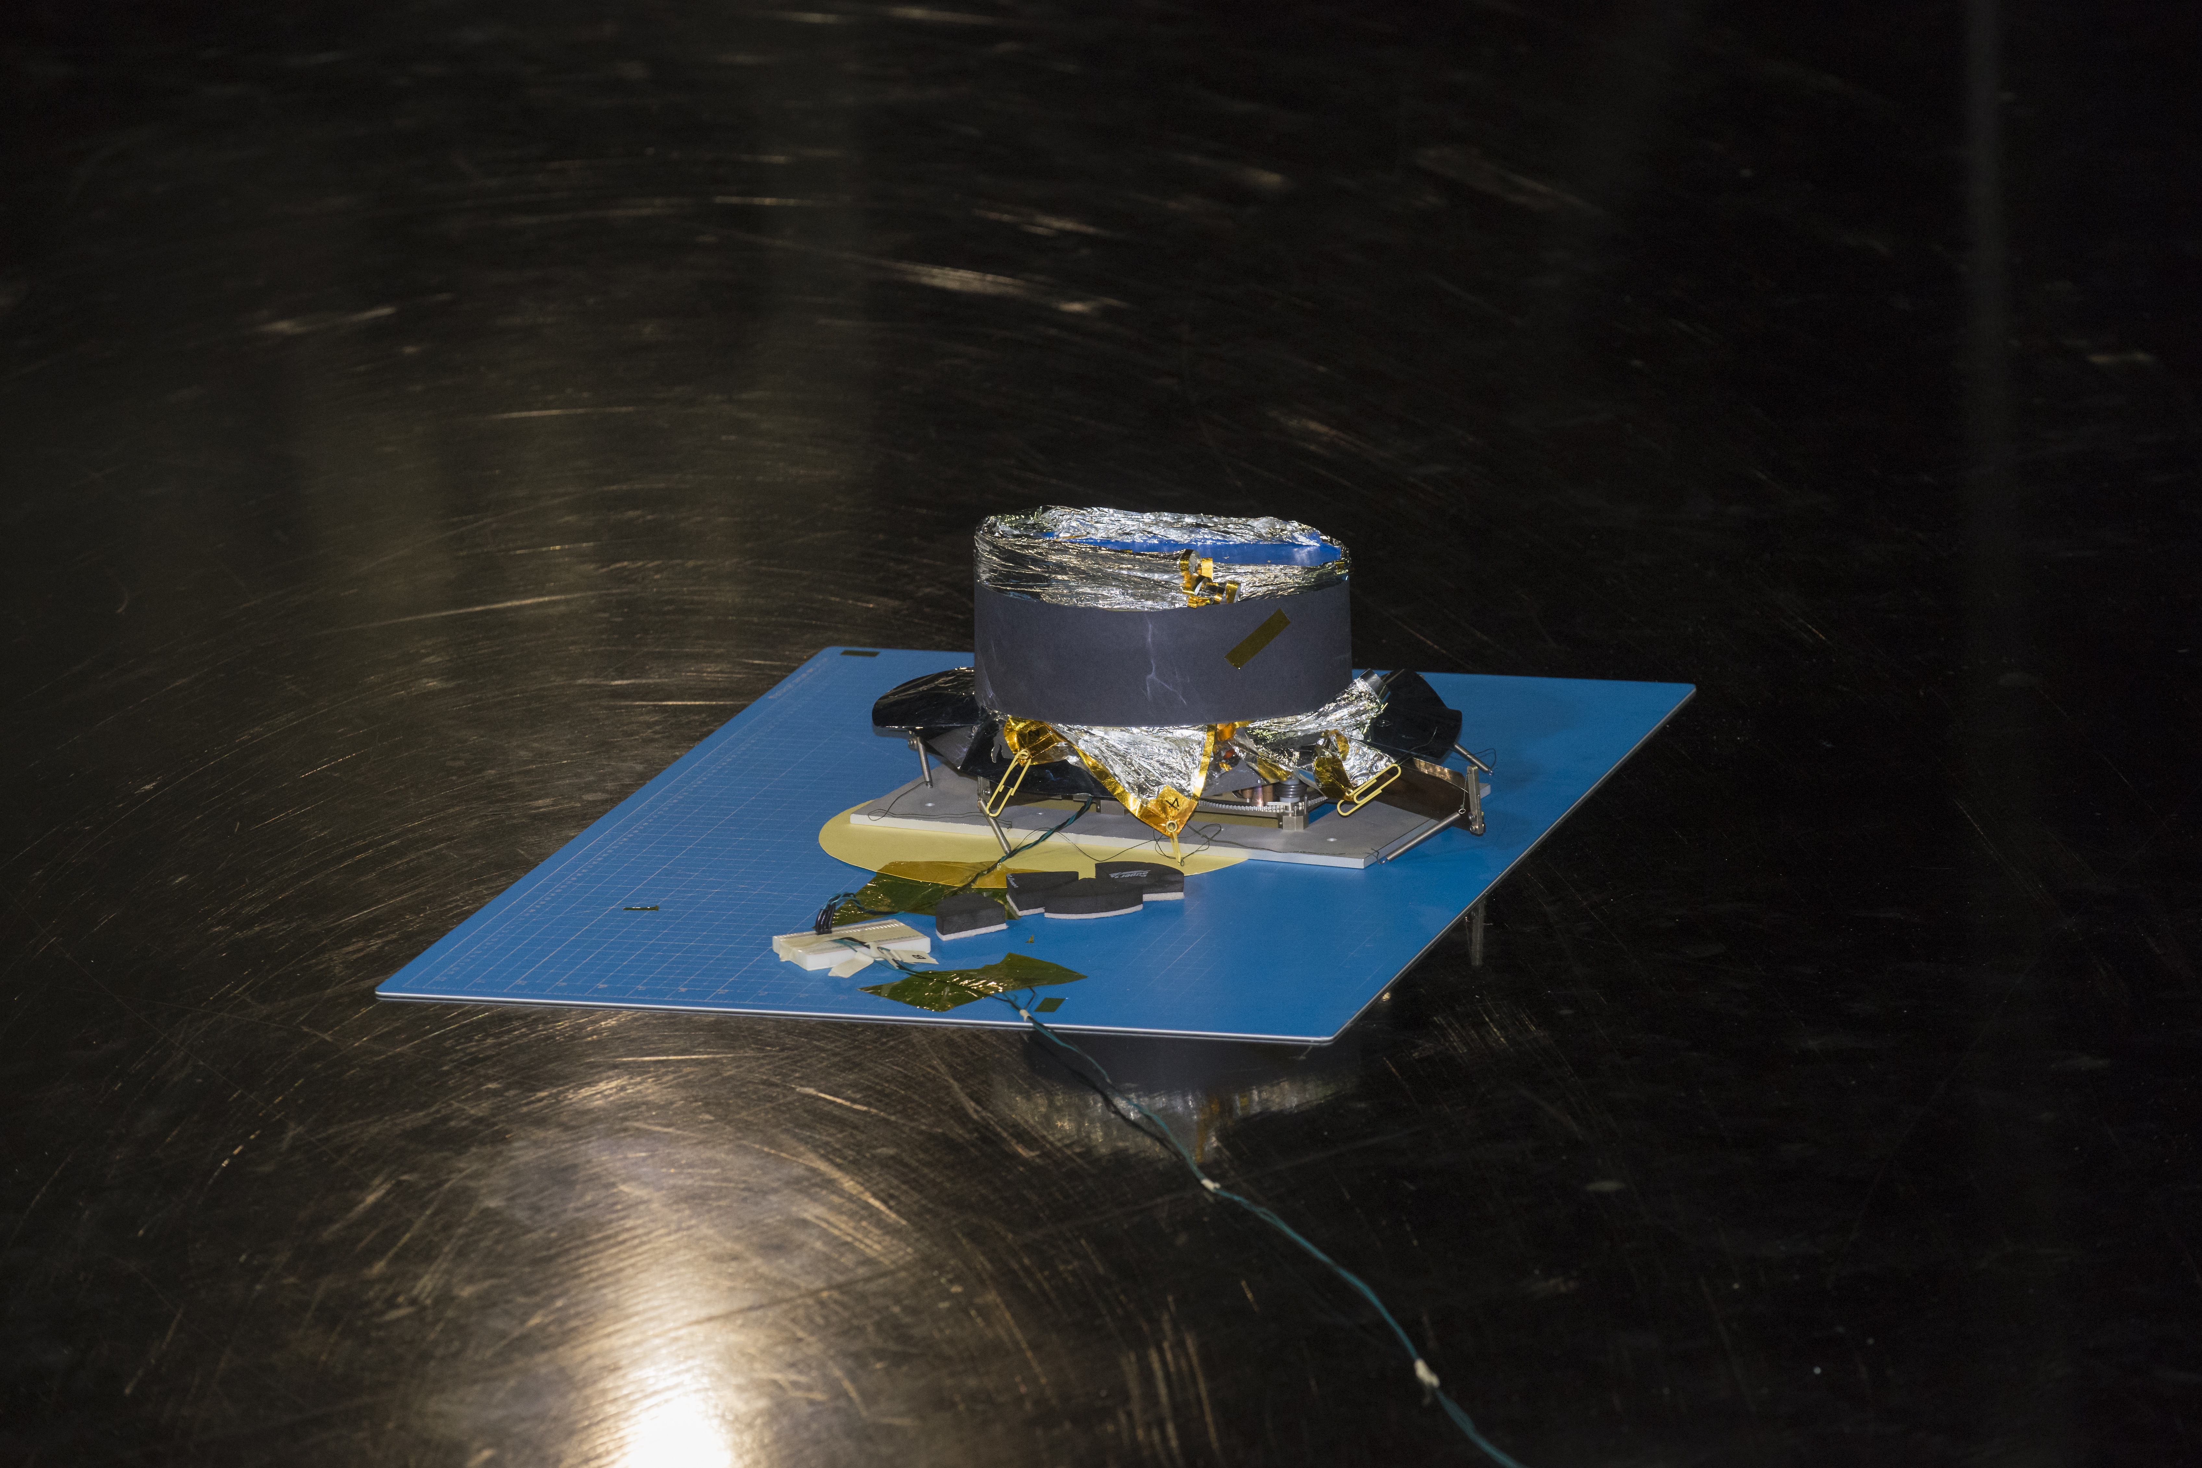
On Schedule to Deliver Spacecraft

Slide 13
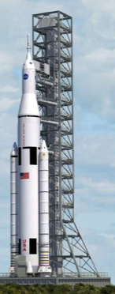
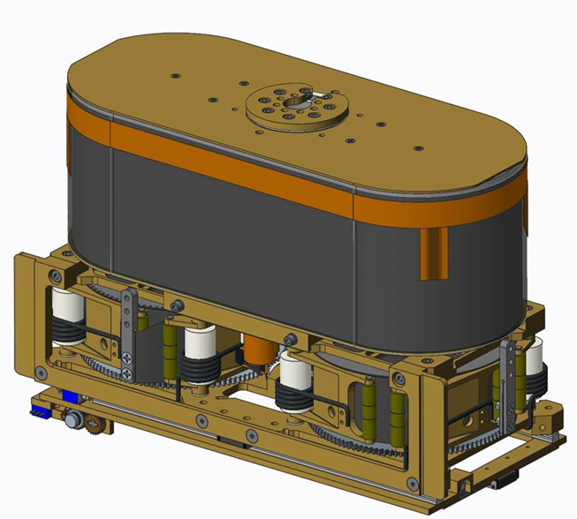
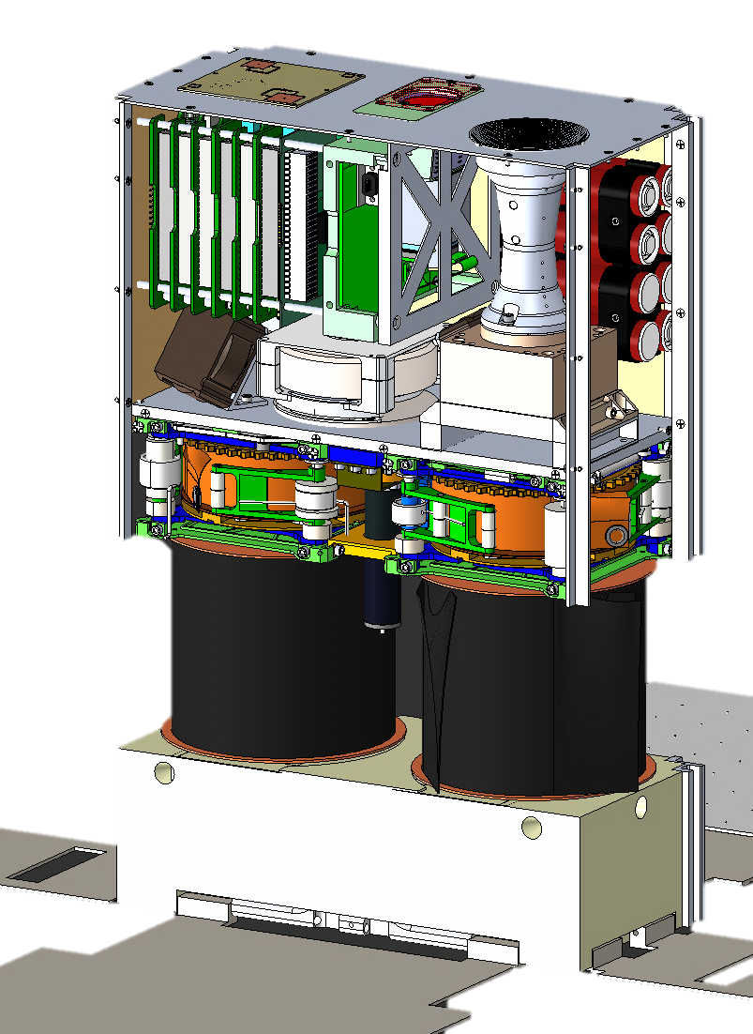
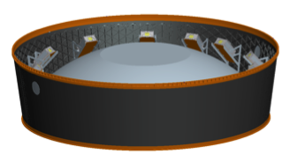
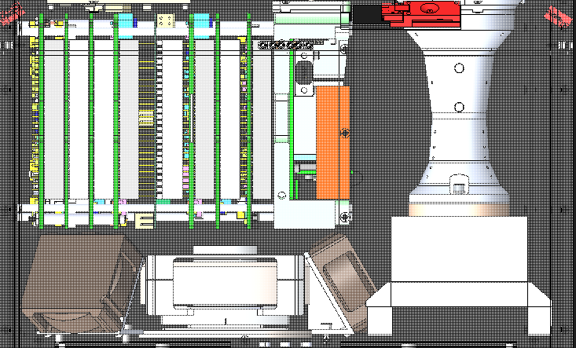
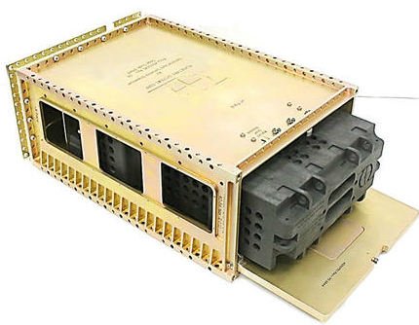
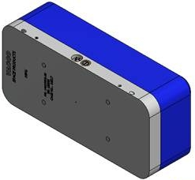
Assembly, Integration, and Test (AI&T) Overview
Solar Sail Assembly
Flight System Integrated
Install into MSA
KSC
MSFC
KSC
SHIP/HANDOVER
Integrate Dispenser & Flight System & Acceptance Test
Upper Assembly
SHIP
Lower Assembly
MSFC
Dispenser Vendor
SHIP
Functional and Environmental Testing
DSN Compatibility Test / ETE Testing
MSFC
SHIP
JPL

Slide 14
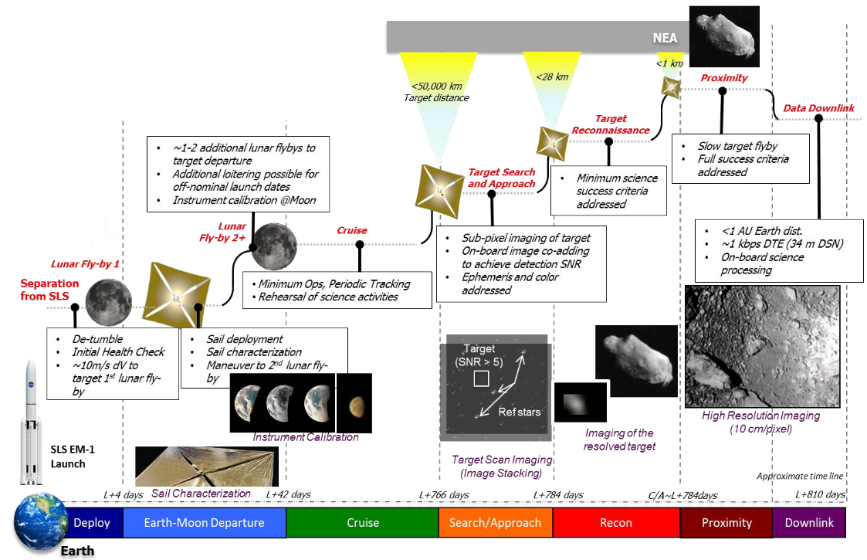
Concept of Operations Overview

Slide 15
Questions?

Slide 16
Backup Information

Slide 17
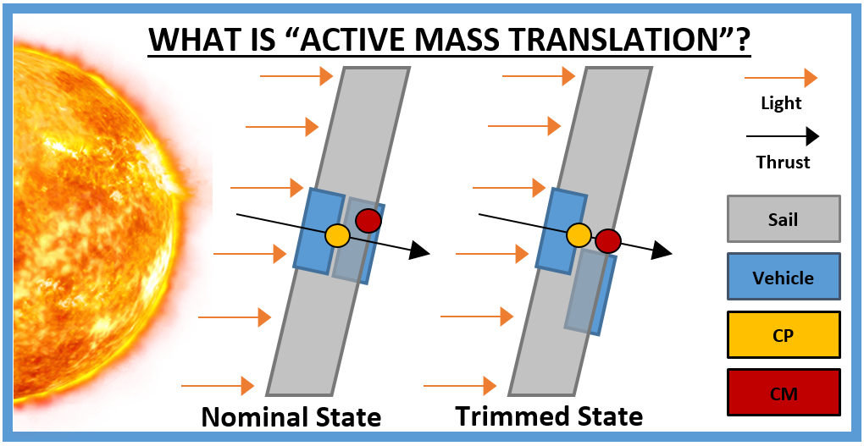
The Need for CM/CP Adjustment
The AMT will move one portion of the NEA Scout relative to the other. This translation of mass will alter the inertial properties of the vehicle and align the CP and CM

Slide 18
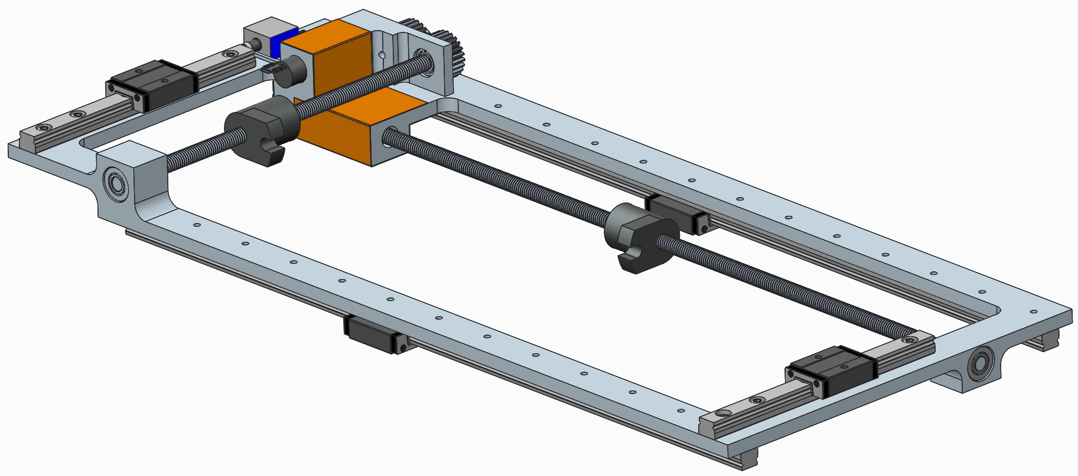
AMT Overview
Current Design State
CAPABILITIES
Translation: 160 X 68 mm (X & Y respectively)
Speed: 0.3 and 0.1 mm/s (X & Y respectively)
Precision: 0.01 mm
Volume: 220 x 99 x 14 mm (300 cc)
Mass: < 350 grams (including control board)
2X Limit Switch
2X Stepper Motors*
Tape Heater
Y
X
2X Stainless Lead Screws
Harness Feedthrough Volume
4X Steel Rail and Carriages
Aluminum Chassis
4X Bearings
* Stepper Motors are housed inside of the aluminum block and are not readily visible

