Slide 1
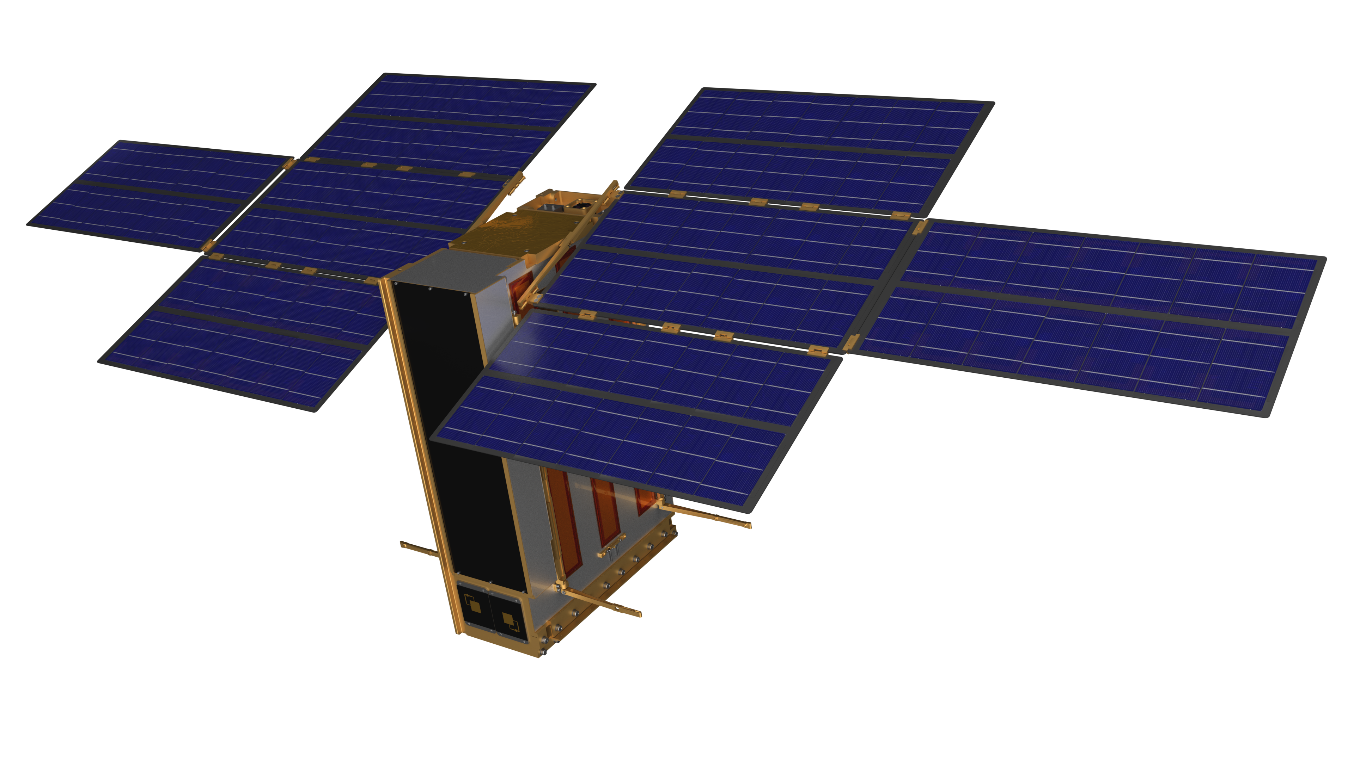

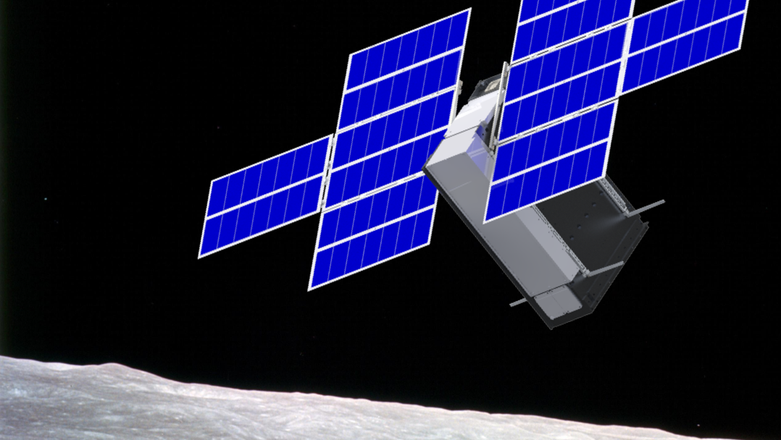

Development of the Lunar Polar Hydrogen Mapper Mission
Craig Hardgrove: Principal Investigator, Assistant Professor, ASU
ISSC 2018 – Caltech, Pasadena CA
May 7, 2018
Notes:
Introduce as grad student/PSE

Slide 2
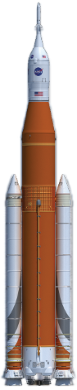
LunaH-Map Mission Overview
NASA SMD SIMPLEx 2015 mission led by ASU
6U+ CubeSat form factor to launch on SLS EM-1
Science Objective: Map hydrogen enrichments within PSRs at the lunar south pole
Tech Objectives: Demonstrate neutron spectroscopy, deep space operations & propulsion from a small sat

Slide 3
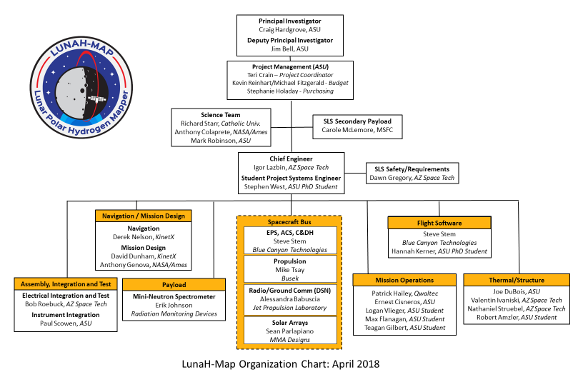

Slide 4
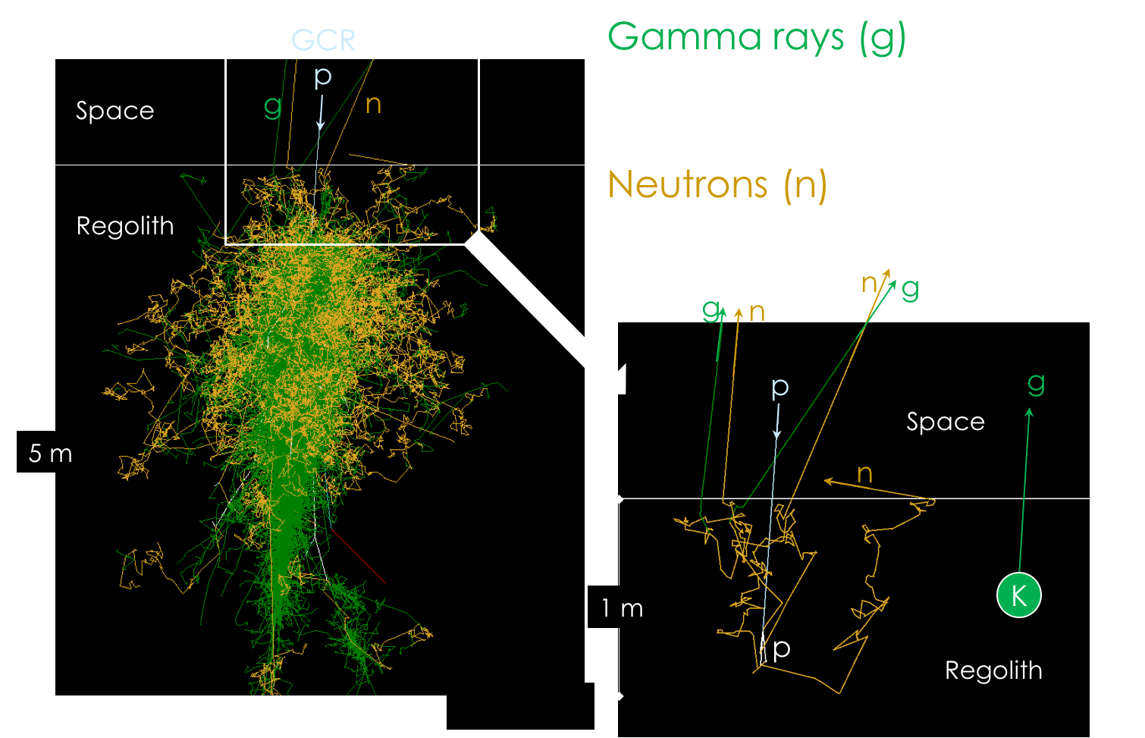
Neutron Detection Physics
Notes:
Move to before LPNS/LEND
"hydrogen" -- hydrogen bound in water ice
Actually show the energy spectrum for FAN at altitude with 50 ppm and 500 ppm

Slide 5
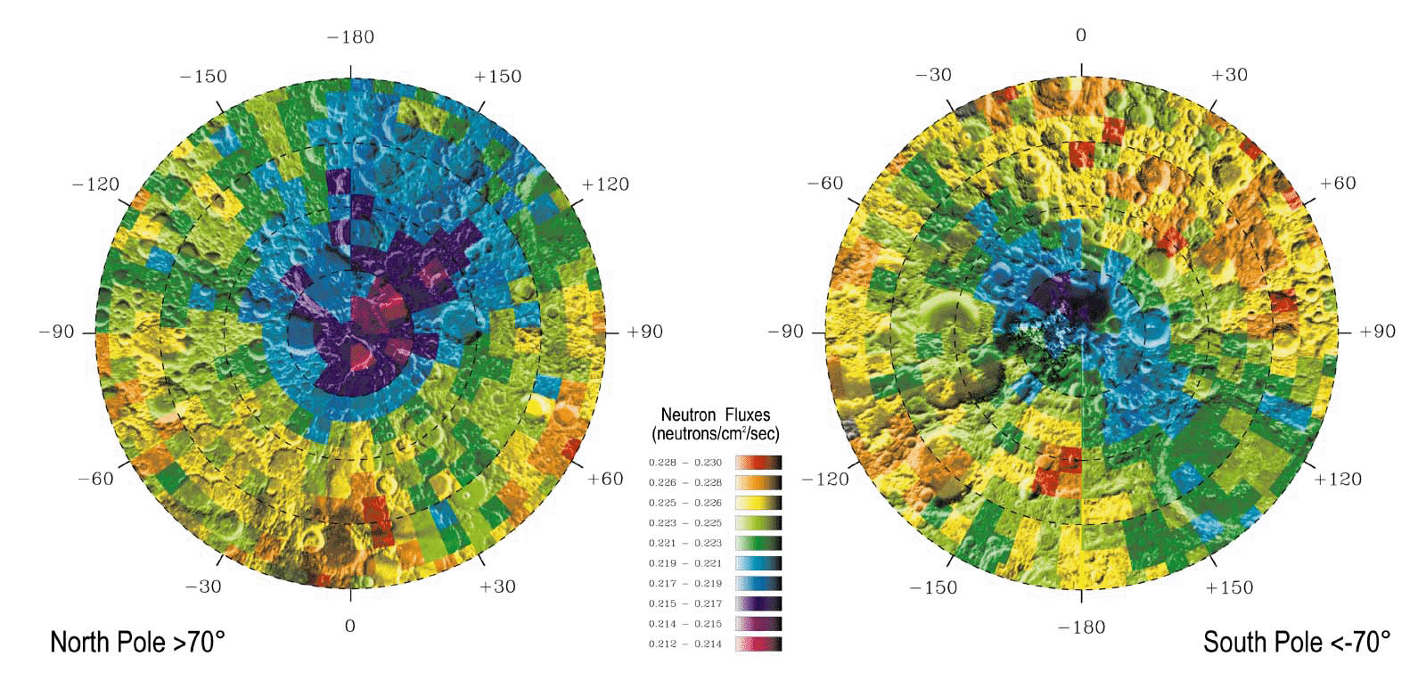
Polar Volatile Distributions from Neutron Spectroscopy
150 km² pixels
Neutron measurements are sensitive to bulk hydrogen distributions at 1 meter depth
Uncollimated neutron detector ‘footprints’ are approximately 1½ times orbital altitude
Lunar hydrogen abundances within PSRs broadly ranging from 200 ppm up to almost 40 wt% could be consistent with LPNS data depending on spatial distribution, extent of coverage, and burial depth [Lawrence et al 2006].
*Feldman et al., Science, 281, 1496, 1998
Notes:
LP – launch 1998, 30/100 km, 19 mos (12 @ 100, 7 @ 30)
LRO – launch 2009, 50/100km as low as 30

Slide 6
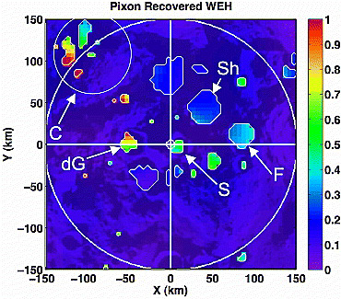
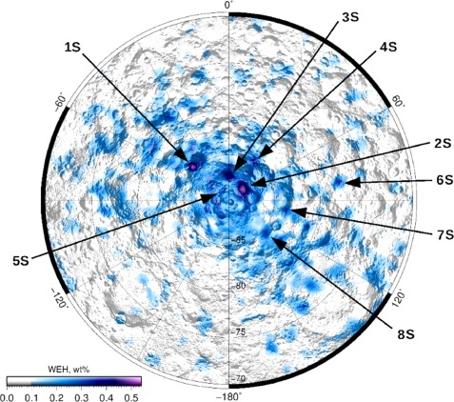
Lunar Neutron Spectroscopy
35 km² pixels
15 km² pixels
Pixon-based reconstruction of LPNS data (Elphic et al 2007) reveals high WEH abundances in Cabeus (near 1 wt%) and lower abundances in Shoemaker, Haworth, and Faustini (~0.3 wt%)
Analysis of LEND data (Sanin et al 2017) reveals higher WEH abundances (~0.5 wt%) in south polar craters Shoemaker, Haworth, and Faustini
Notes:
LP – launch 1998, 30/100 km, 19 mos (12 @ 100, 7 @ 30)
LRO – launch 2009, 50/100km as low as 30

Slide 7
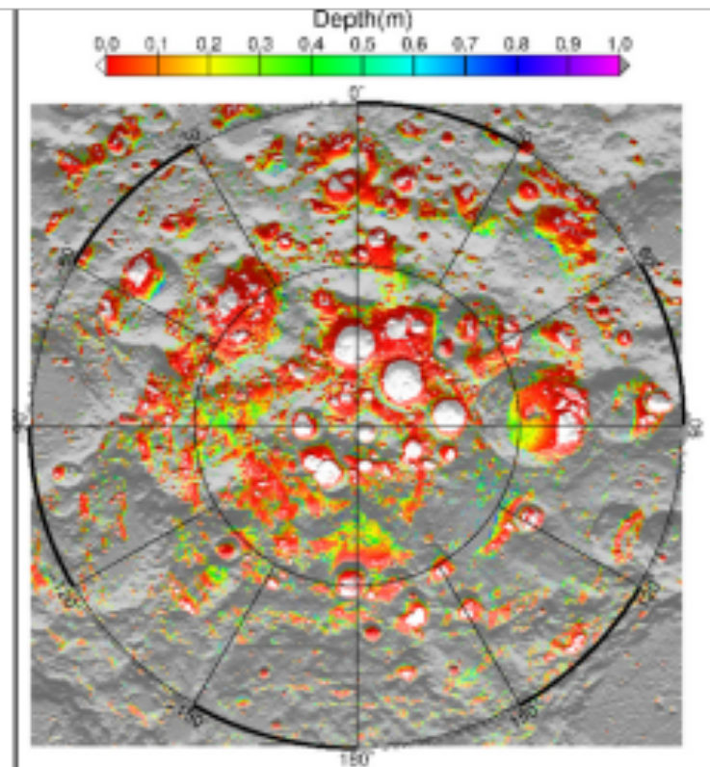
Lunar Neutron Spectroscopy
Pixon-based reconstruction of LPNS data (Elphic et al 2007) reveals high WEH abundances in Cabeus (near 1 wt%) and lower abundances in Shoemaker, Haworth, and Faustini (~0.3 wt%)
Analysis of LEND data (Sanin et al 2017) reveals higher WEH abundances (~0.5 wt%) in south polar craters Shoemaker, Haworth, and Faustini
Figure 1 Map of current day ice stability depth from Siegler et al [2015] as used in constraint map development
Notes:
LP – launch 1998, 30/100 km, 19 mos (12 @ 100, 7 @ 30)
LRO – launch 2009, 50/100km as low as 30

Slide 8
Neutron Measurements of the Moon
Low-altitude (< 20 km) uncollimated measurements of lunar neutrons can be used to:
  Determine the bulk hydrogen content and depth within PSRs (Diameter < ~35km)
These data can be used to constrain:
  Sources and sinks for polar volatiles
LunaH-Map measures only epithermal neutrons:
  Using a large (200 cm²) detector array
  To constrain abundance of hydrogen within PSRs
  To provide complementary data to LP-NS and LRO LEND
Notes:
LP – launch 1998, 30/100 km, 19 mos (12 @ 100, 7 @ 30)
LRO – launch 2009, 50/100km as low as 30

Slide 9
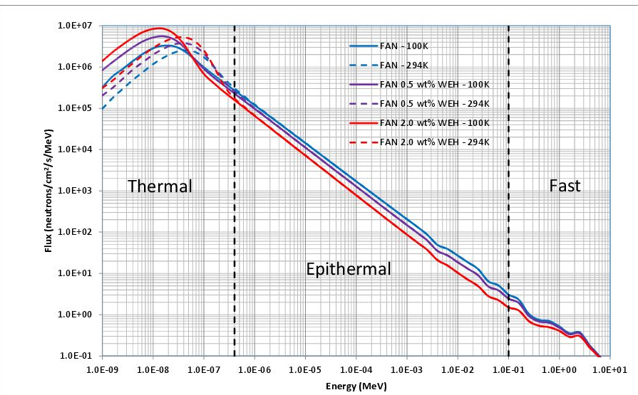
FAN Neutron Energy Spectrum
Increased hydrogen suppresses epithermal neutrons (E > 0.4 eV) and increases thermal neutrons (E < 0.4 eV)
LunaH-Map’s signal is the difference between dry epithermal count rate and enriched epithermal count rate

Slide 10
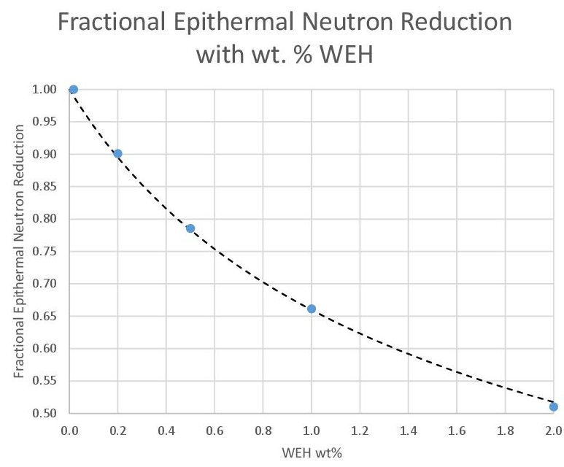
Increased hydrogen suppresses epithermal neutrons (E > 0.4 eV) and increases thermal neutrons (E < 0.4 eV)
LunaH-Map’s signal is the difference between dry epithermal count rate and enriched epithermal count rate

Slide 11
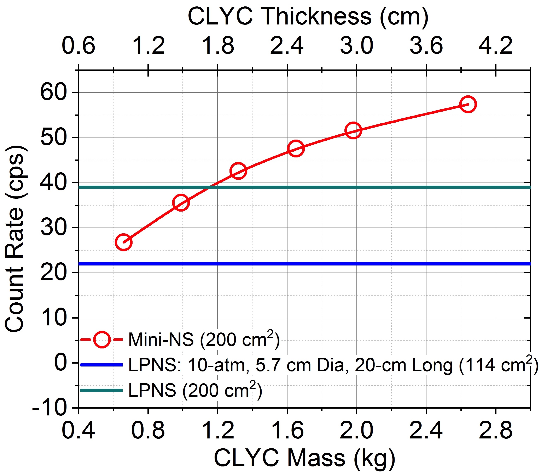
Increased hydrogen suppresses epithermal neutrons (E > 0.4 eV) and increases thermal neutrons (E < 0.4 eV)
LunaH-Map’s signal is the difference between dry epithermal count rate and enriched epithermal count rate

Slide 12
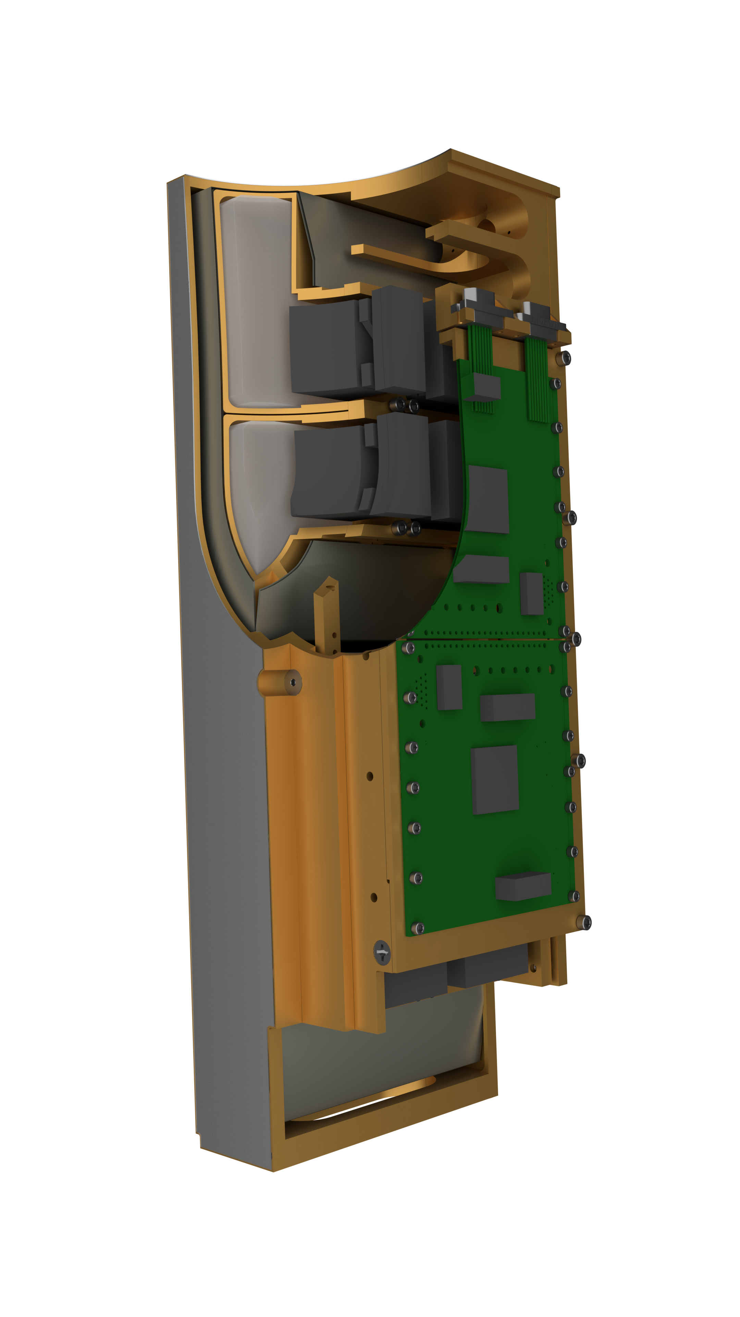
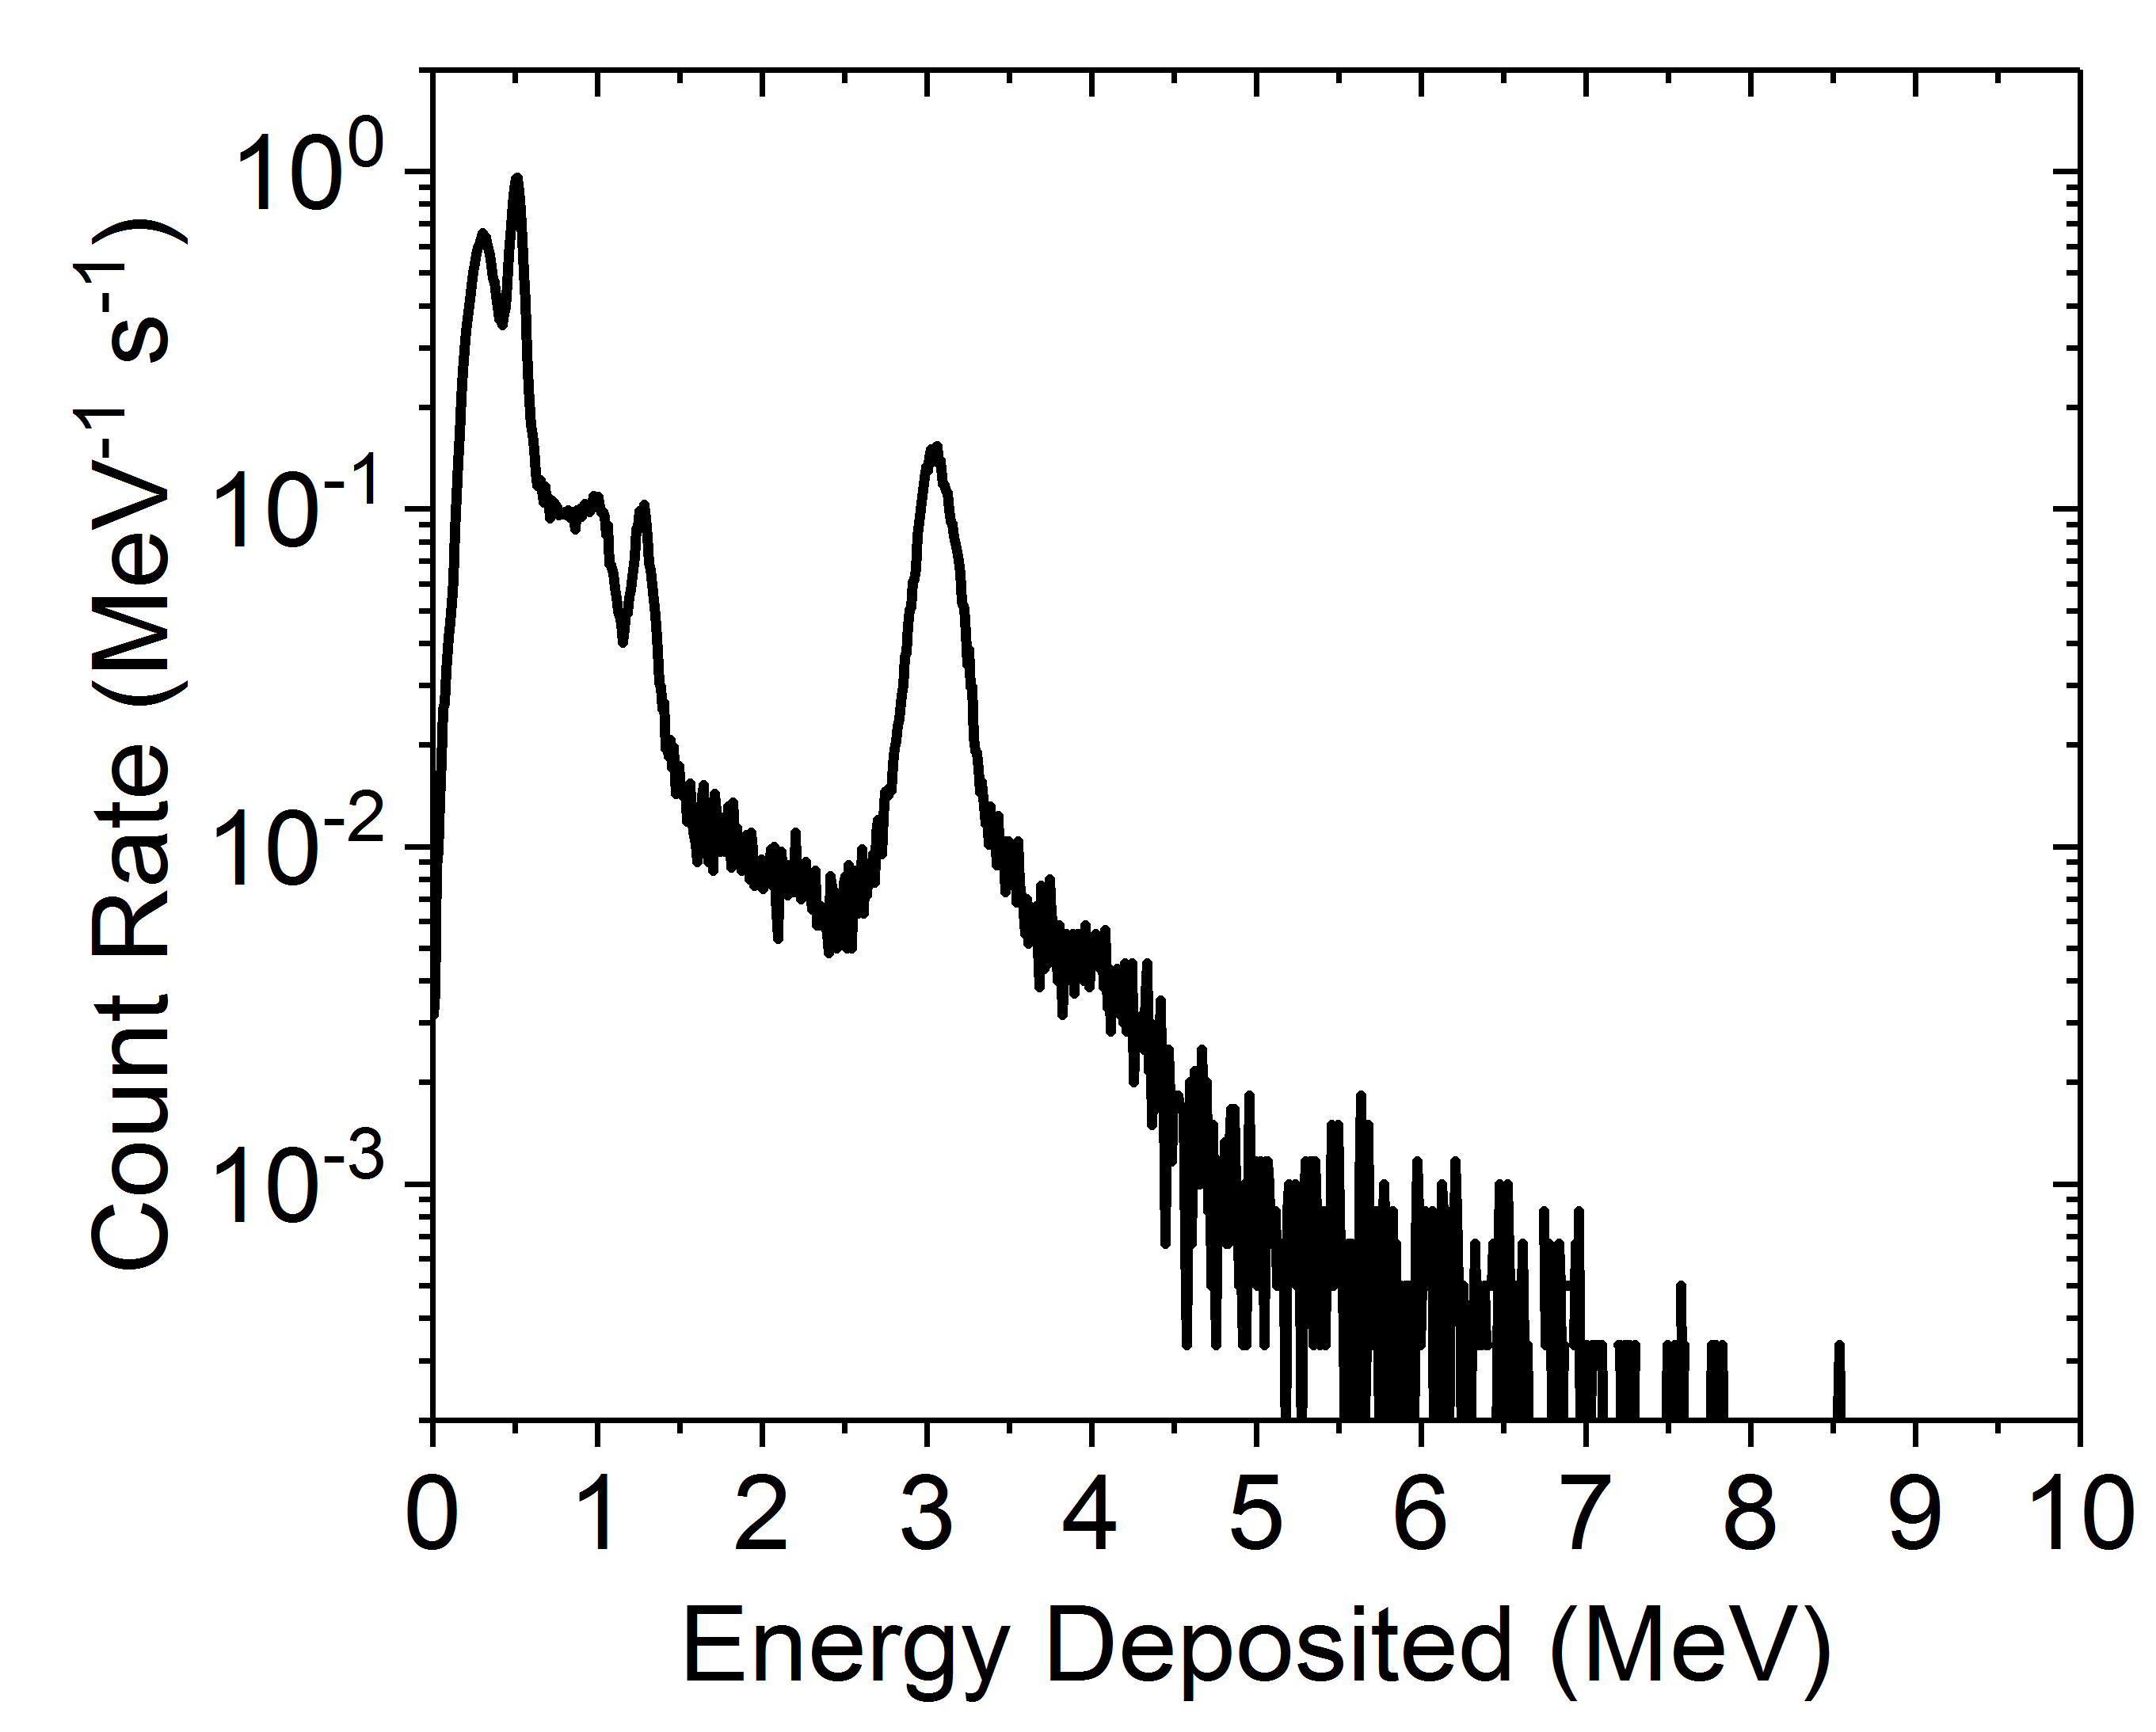

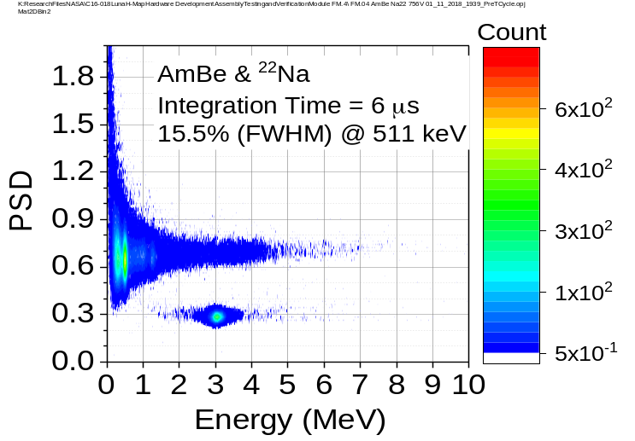
Miniature Neutron Spectrometer
Detector | 2x4 array of CLYC (elpasolite scintillator, Cs₂LiYCl₆:Ce) crystals, each crystal 4 cm x 6.3 cm x 2 cm
Dimensions | 25 cm x 10 cm x 8 cm
Mass | 3.3 kg
Power | 10W (min), 22W (max)
Data Acquisition | Counts binned every 1 sec
CLYC Module
Instrument Housing and Electronics

Slide 13
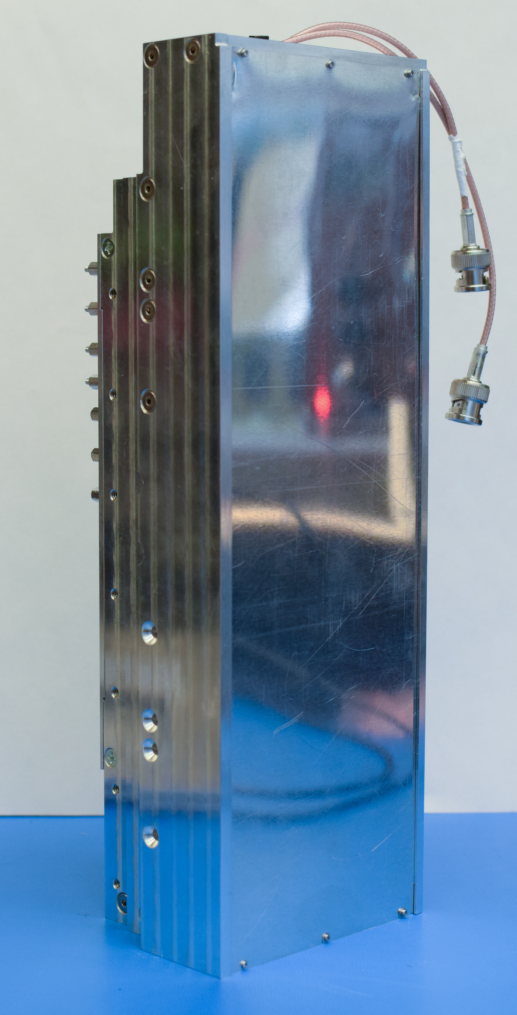
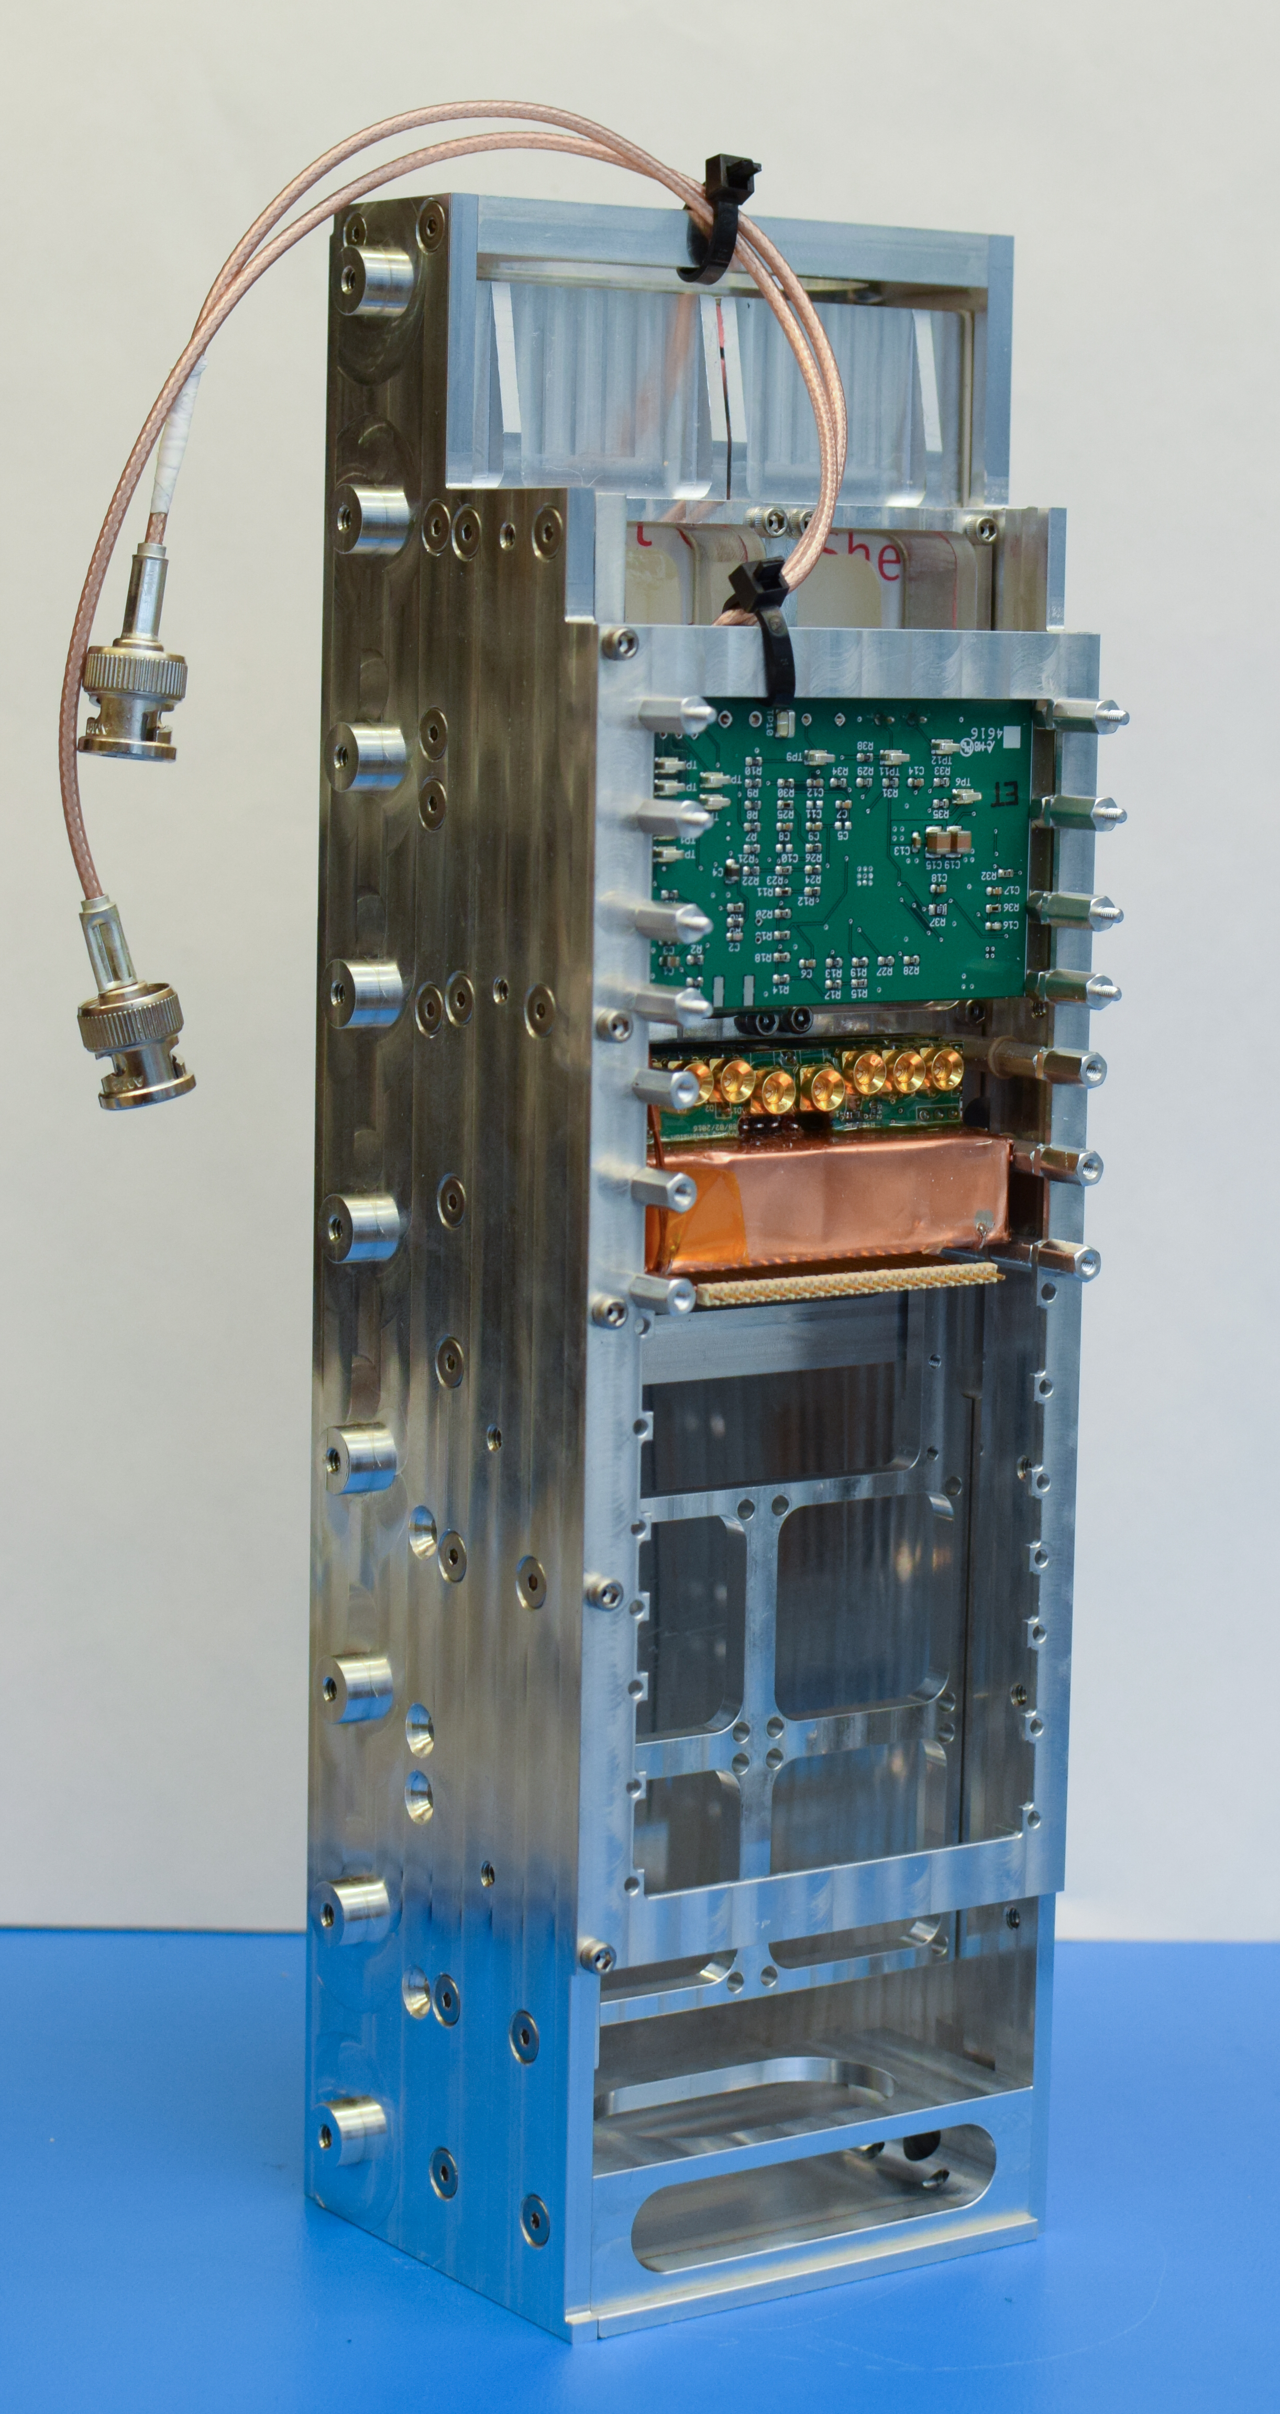
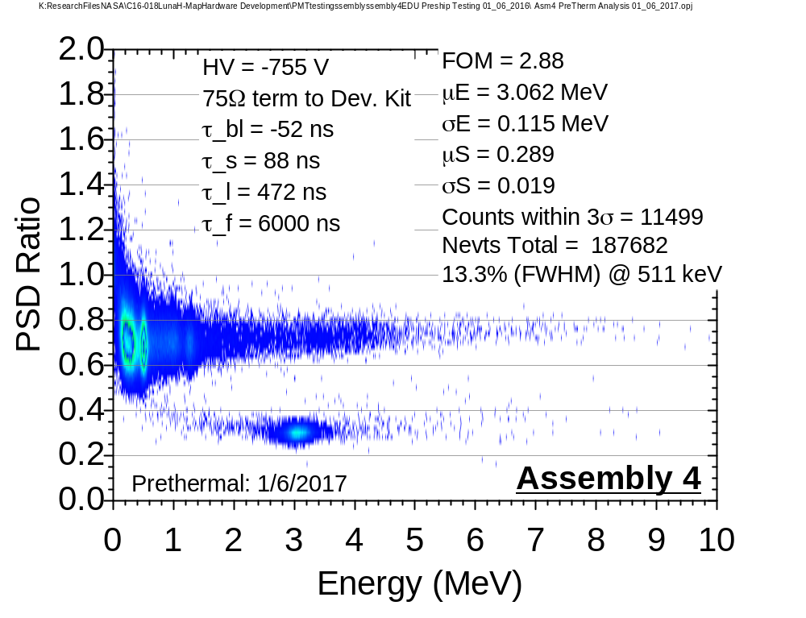
Mini-NS EDU
Test results from single EDU module exposed to Na-22 and AmBe
Notes:
Yes add graphic

Slide 14
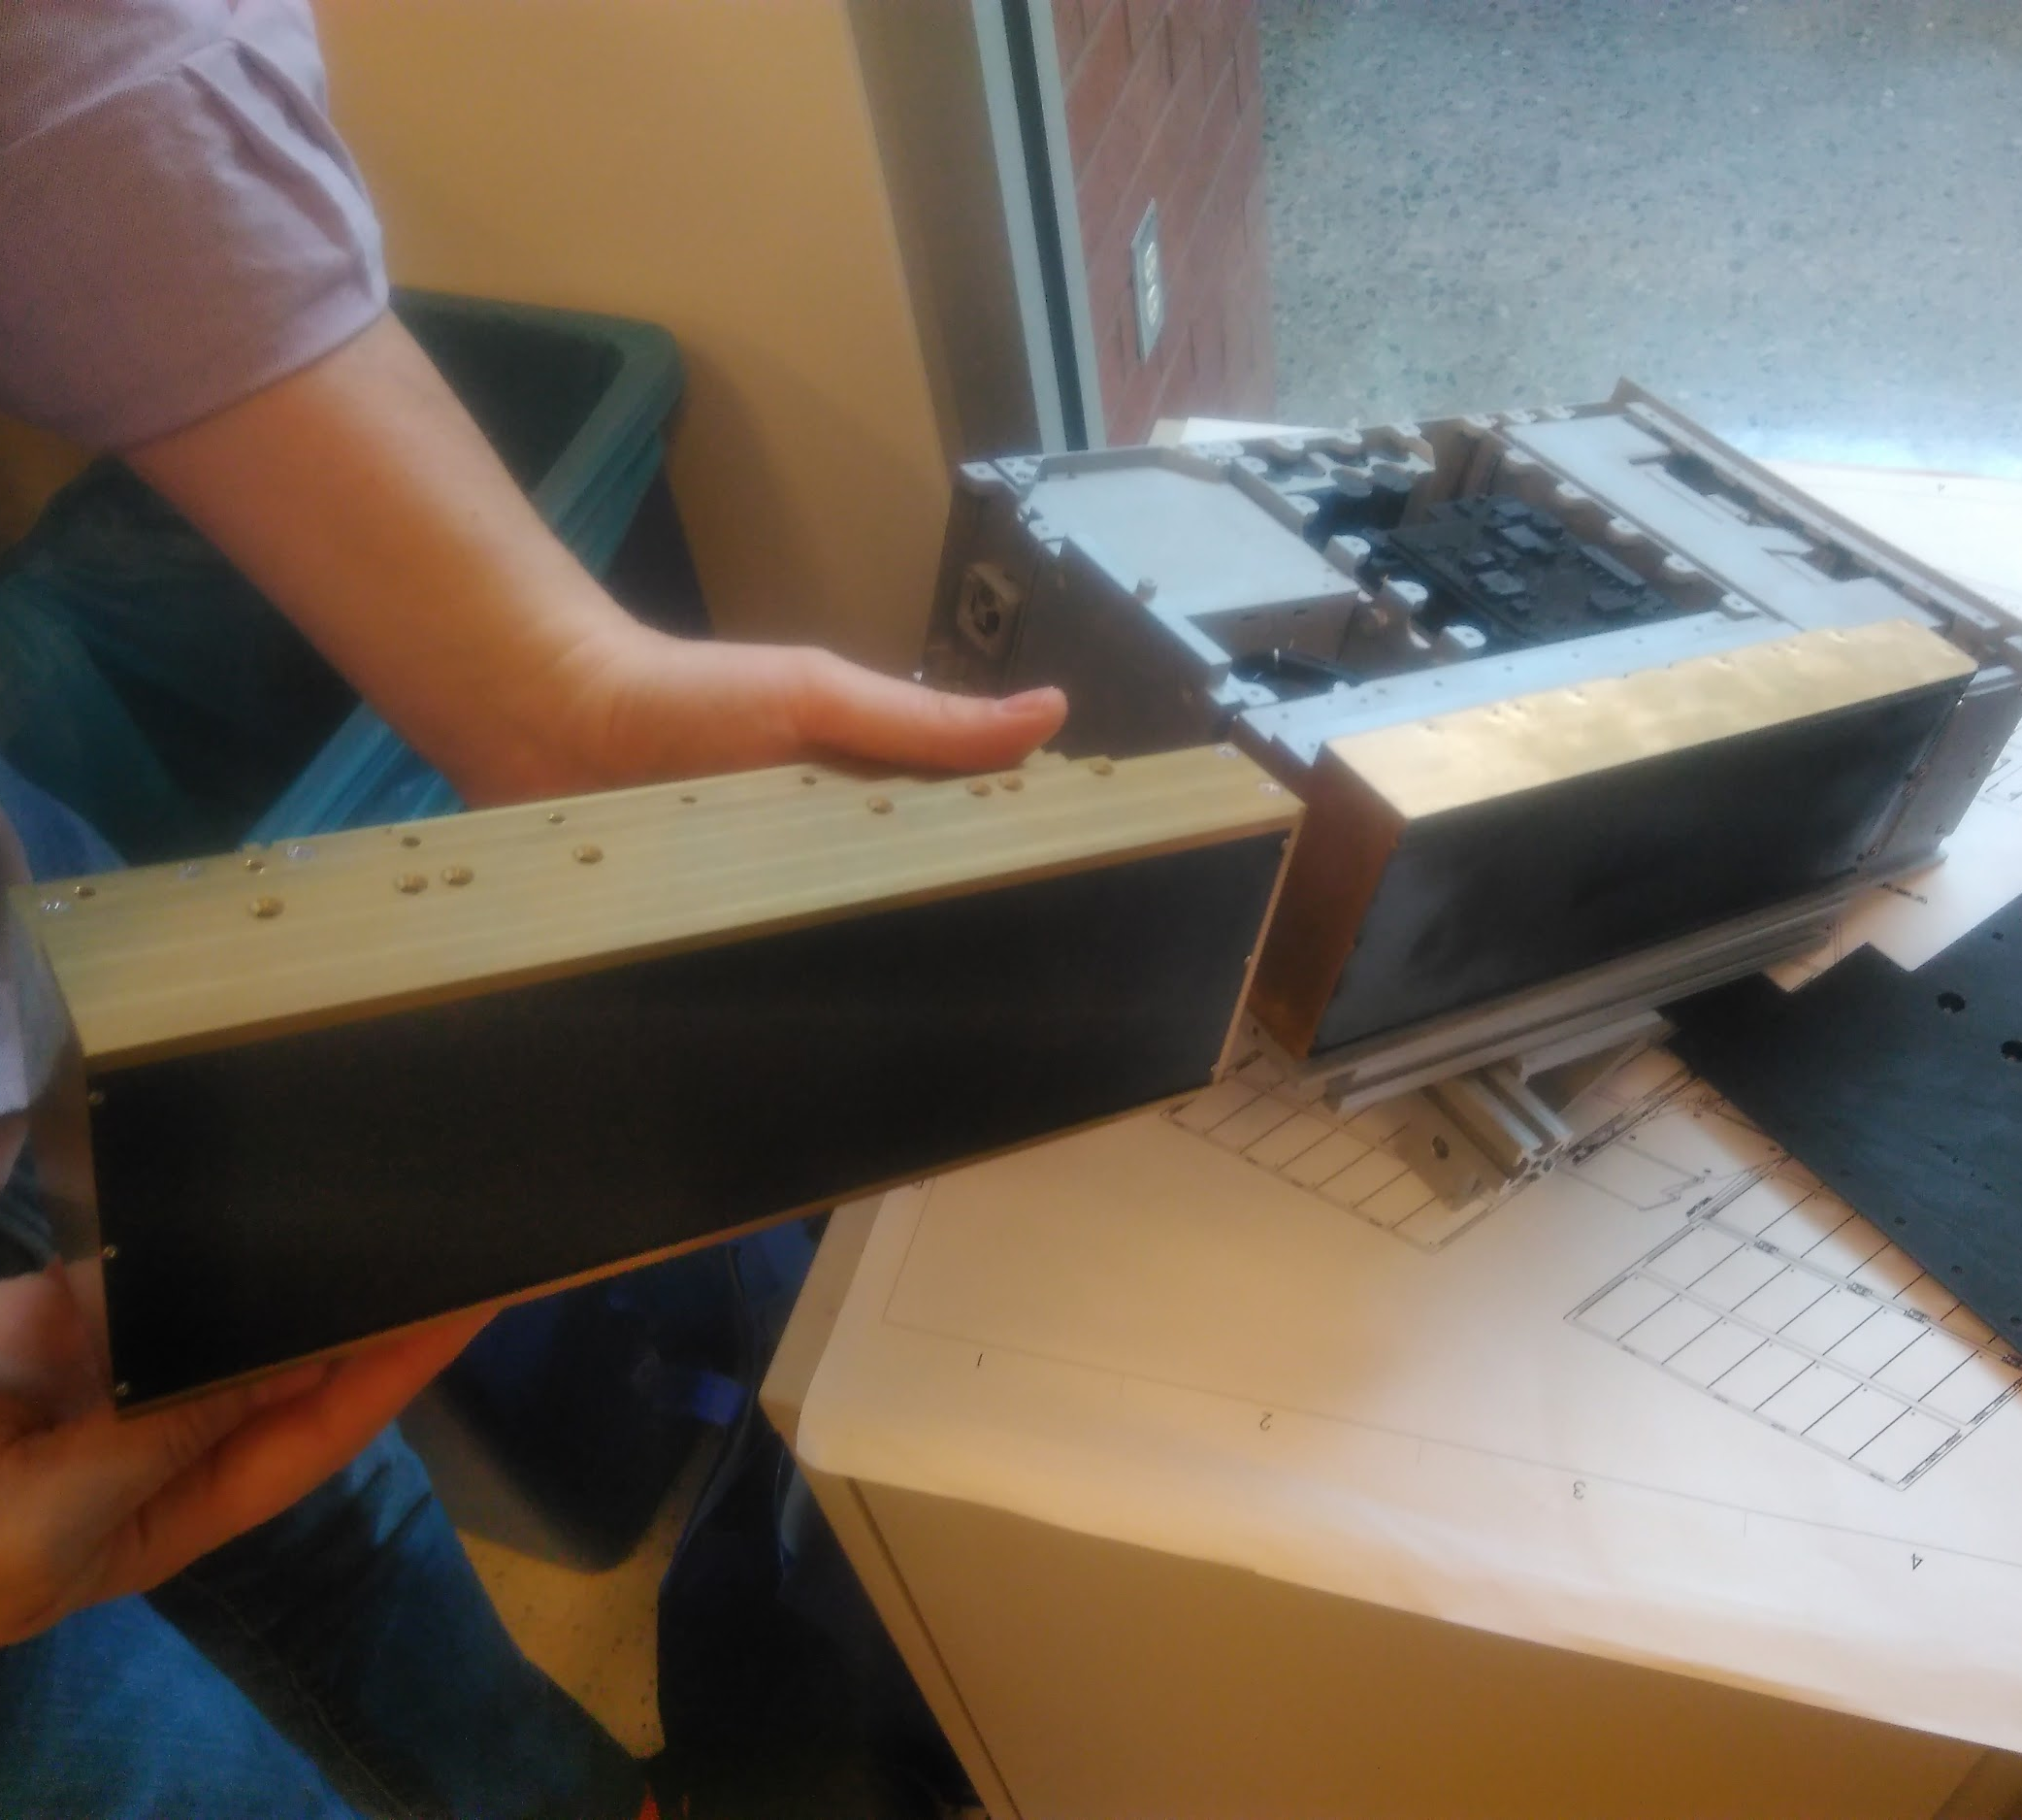
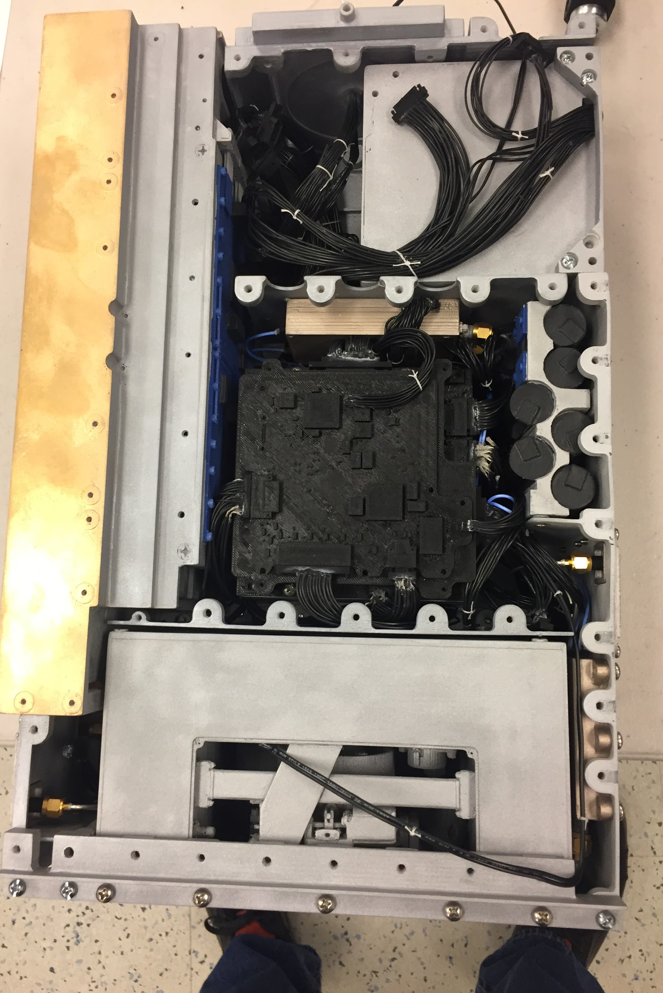
Mini-NS Flight Unit and Calibration
Flight instrument chassis machined for fit checks in spacecraft EDU at ASU
Mini-NS Flight Unit delivery in early summer 2017
Mini-NS Flight Unit calibration at Los Alamos National Lab Neutron Free In-Air (NFIA) facility in late summer
Notes:
Yes add graphic

Slide 15
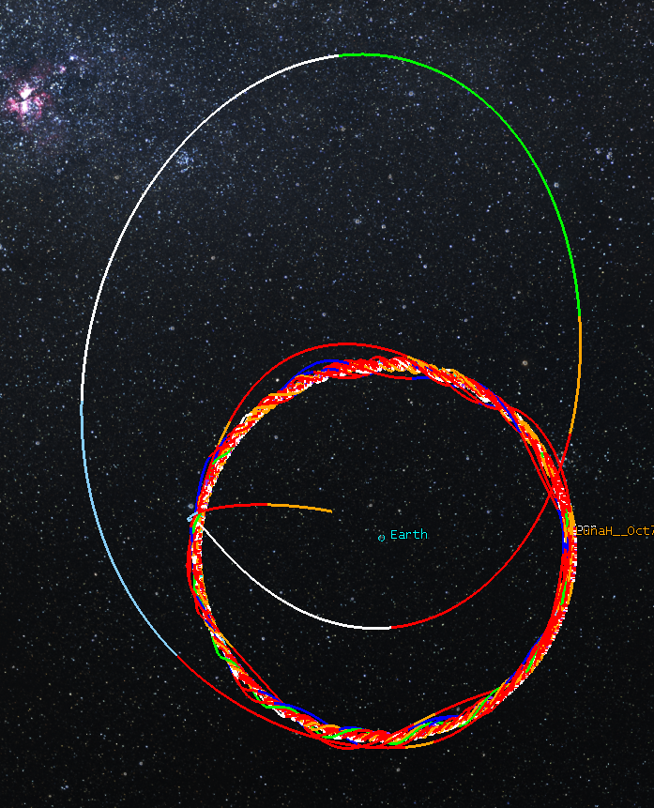
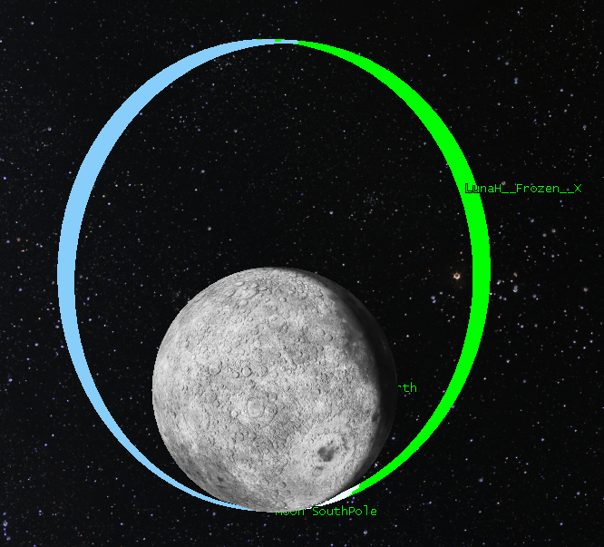
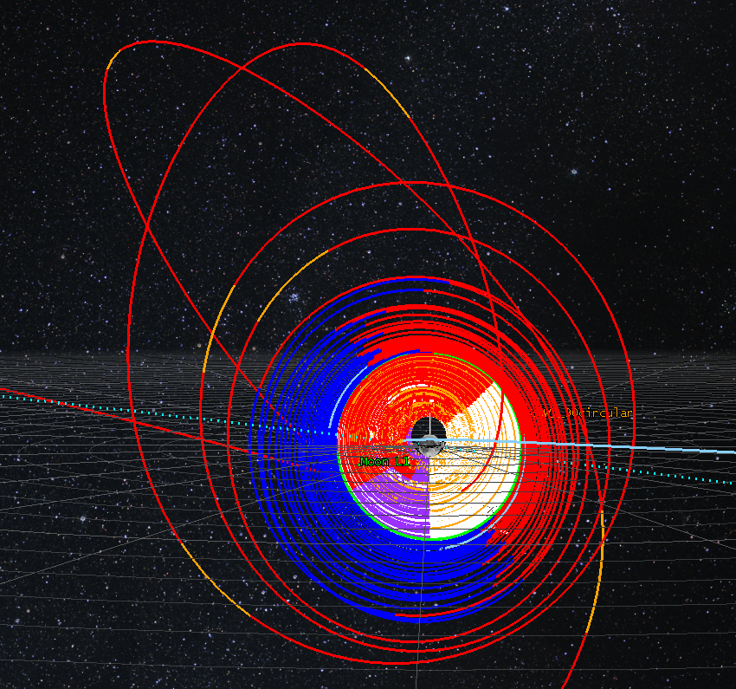
Trajectory Design
1
3
Period | 4.76 hour
Aposelene Altitude | 3150 km
Periselene Altitude | RAAN dependent 15-25 km
Inclination | 90°
Argument of Periselene | 273.5°
2
Genova, A. L. and Dunham, D. W. (2017) 27th AAS/AIAA Space Flight Mechanics Meeting 17-456.

Slide 16
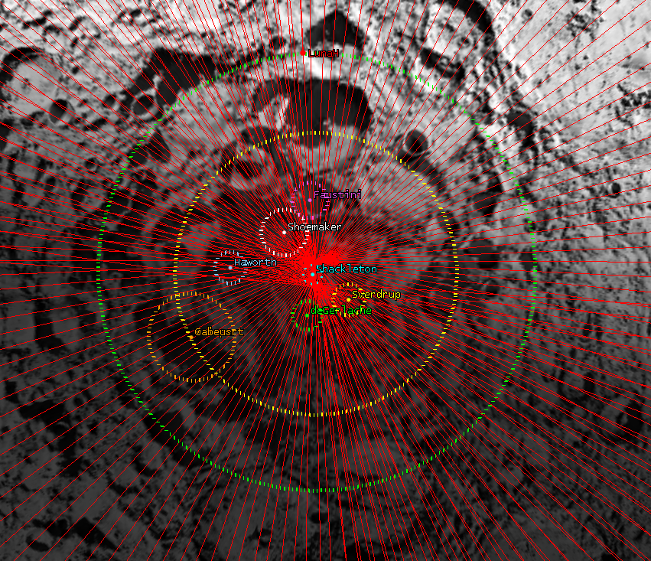
Science Phase
Period | 4.76 hour
Aposelene Altitude | 3150 km
Periselene Altitude | RAAN dependent 15-25 km
Inclination | 90°
Argument of Periselene | 273.5°
Genova, A. L. and Dunham, D. W. (2017) 27th AAS/AIAA Space Flight Mechanics Meeting 17-456.

Slide 17
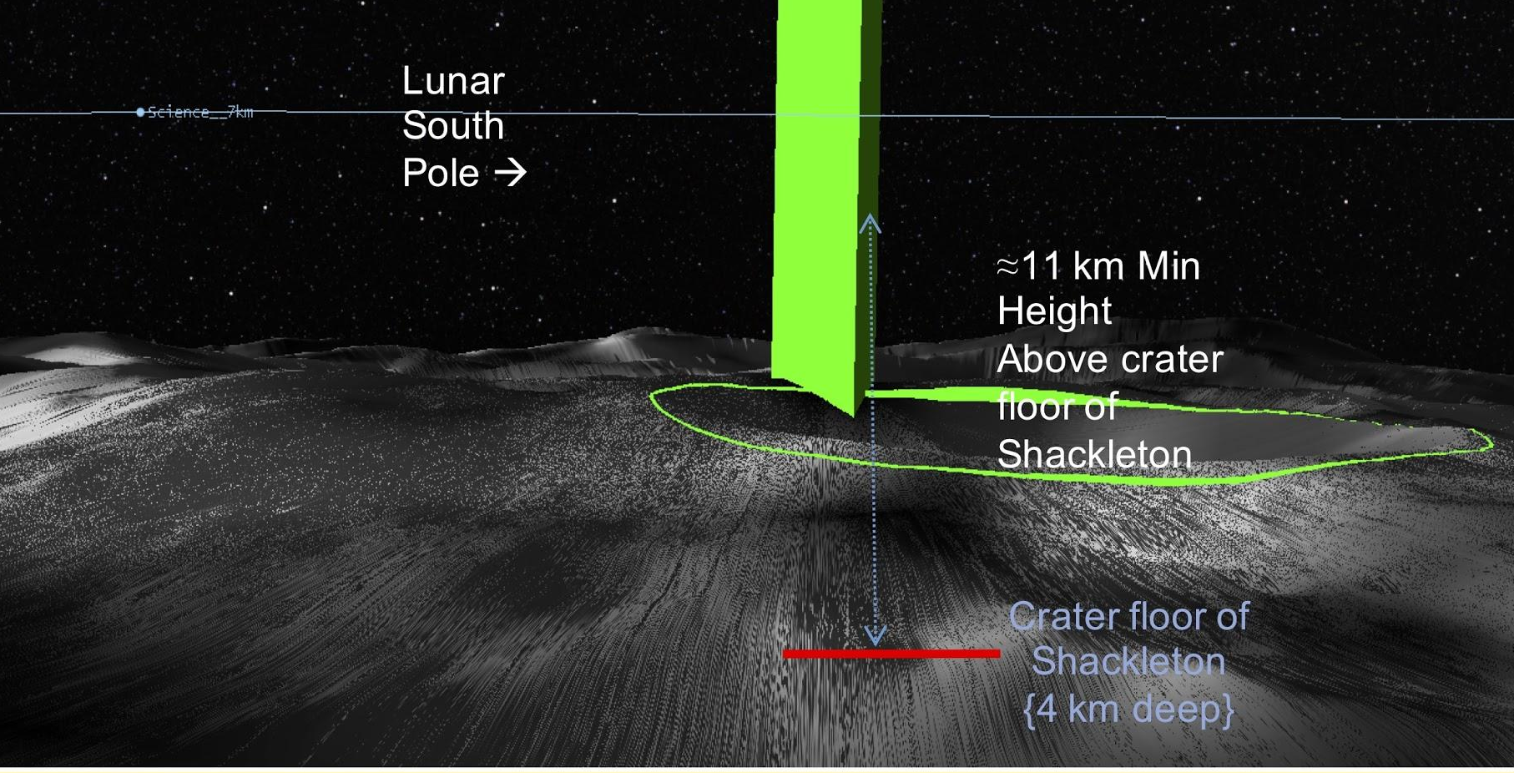
Science Phase

Slide 18
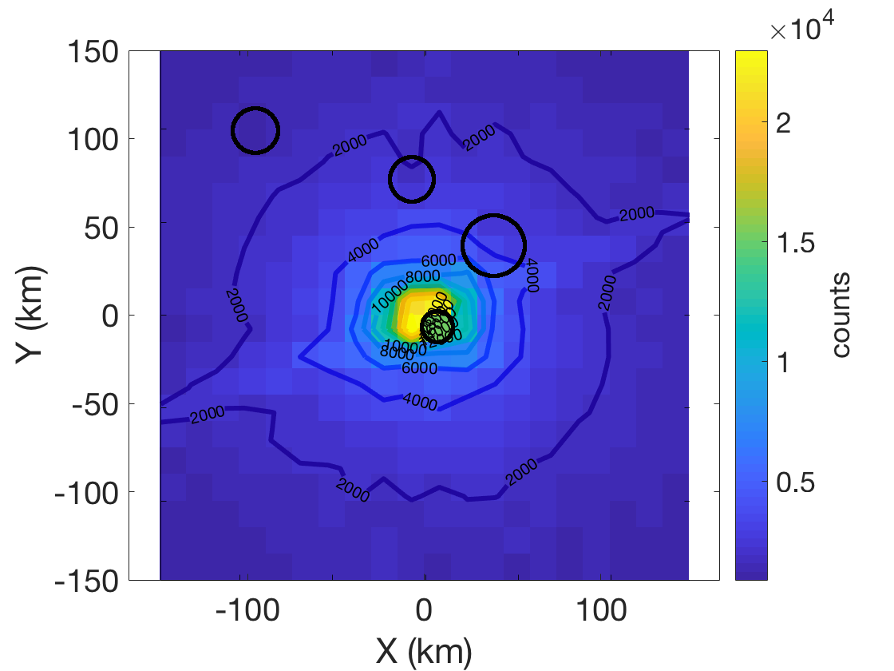
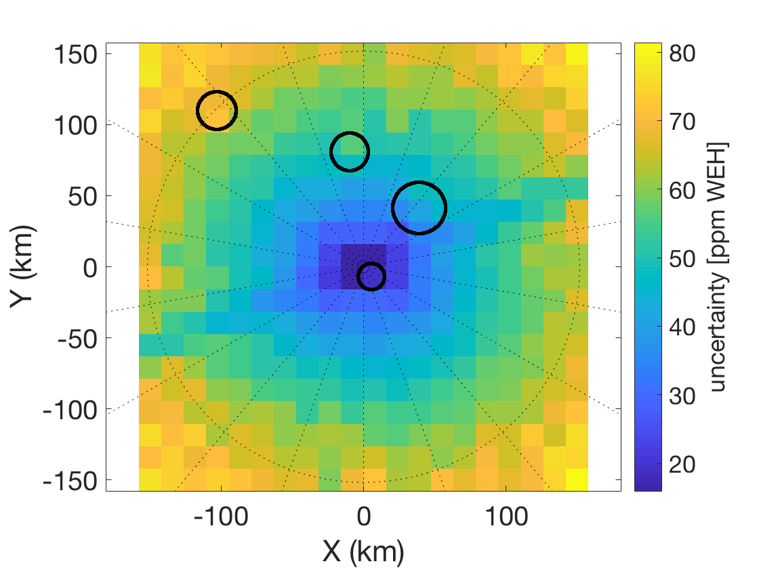
LunaH-Map Sensitivity
Enrichments of 600 ppm +/- 120 ppm WEH are detectable for ~94% of the surface poleward of 85°S in spatial bins of 15km x 15km.
Notes:
Graphic from LPSC microsymposium - LP SNR compared to ours
Maybe show count/s over mission duration

Slide 19
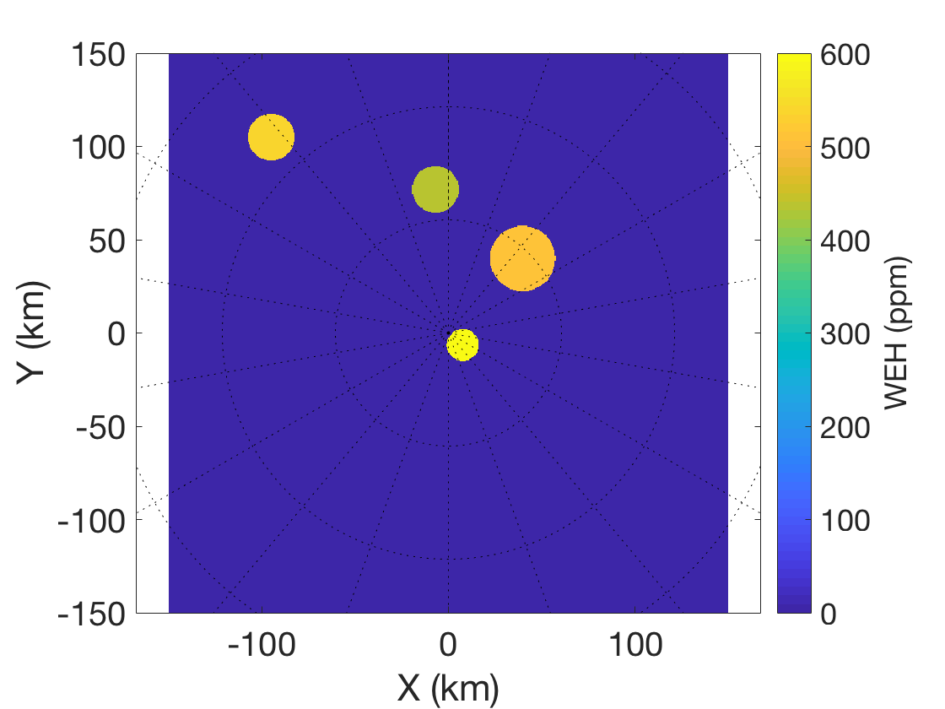
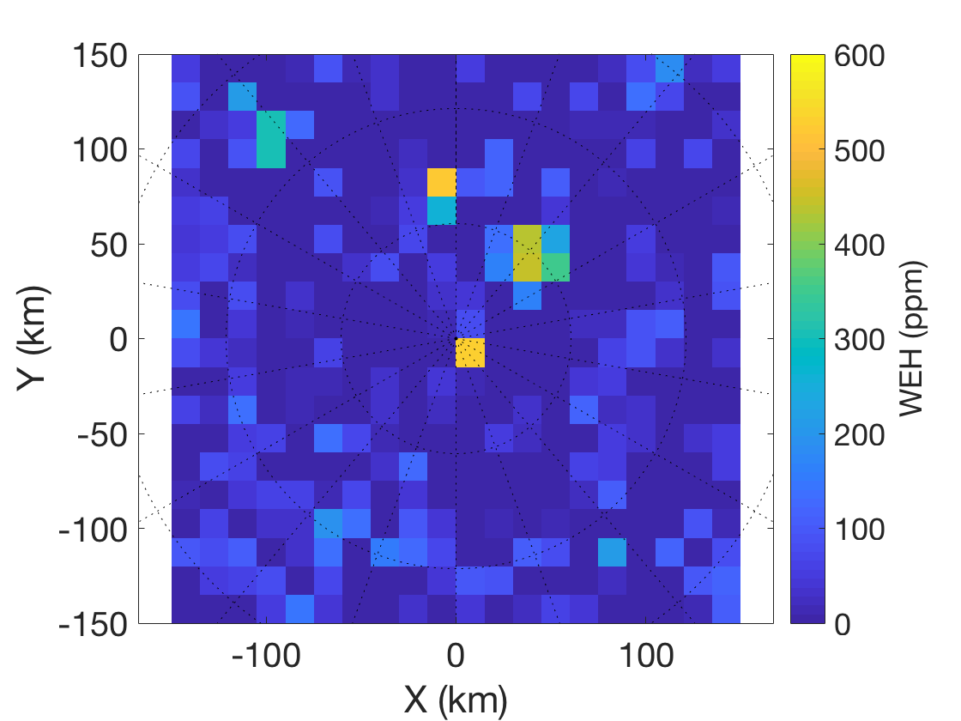
South Polar Volatile Mapping
C
H
Sh
S
Simulations of maps made from 15x3150km science orbit. Basemap combines LEND high H regions (Sanin et al., 2017) and the Shackleton enrichment from pixon-reconstructed LPNS data (Elphic et al, 2007) to illustrate the type of map LunaH-Map will be able to create.

Slide 20
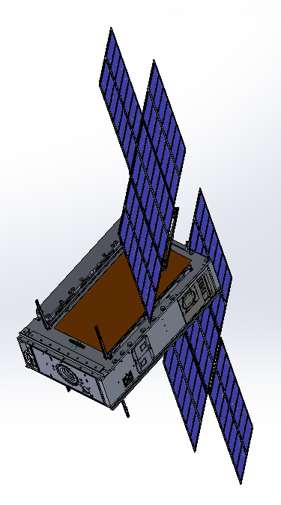
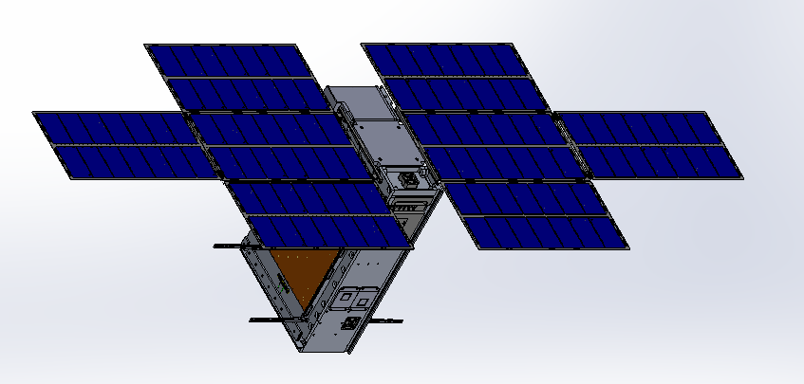
LunaH-Map Spacecraft
Single Axis
Solar Array Drive
Mini-NS
Instrument
1:1 3D Printed Model of LunaH-Map Flight System
LGA
XB1-50 /
Star Tracker
Solar Array
Hold Down
Arms
Primary Coarse
Sun Sensor
LGA
Separation
Connector
BIT-3 Thruster
Coarse Sun Sensor

Slide 21
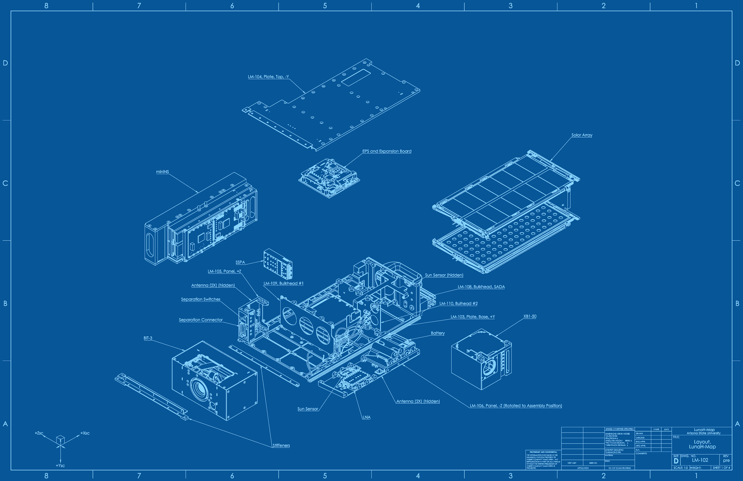
Spacecraft Specs
Dimensions: (stowed) | 10x20x30cm
Mass | 14 kg
Power | 90W BOL 56W-hr Battery
Propulsion | Busek BIT-3 Ion Thruster
Comm. | JPL Iris Deep Space Transponder
C&DH / GN&C | BCT XB1-50

Slide 22
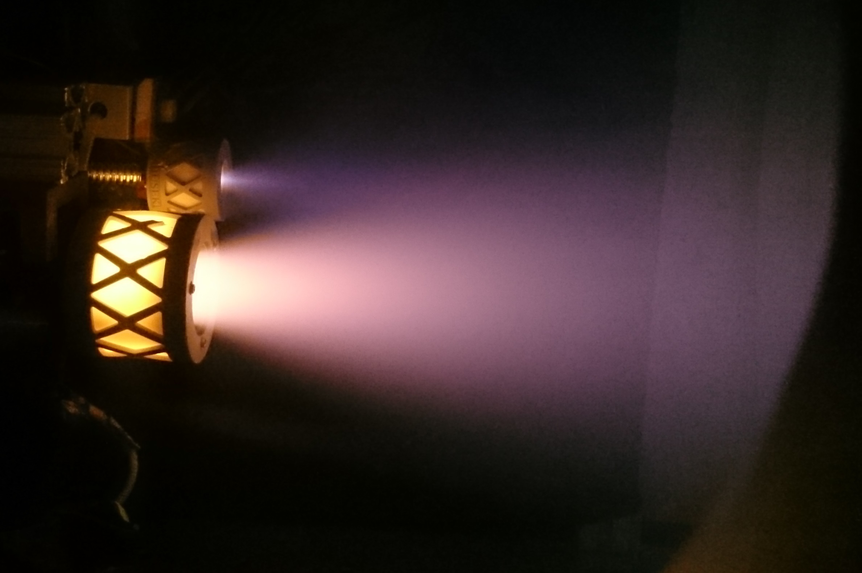
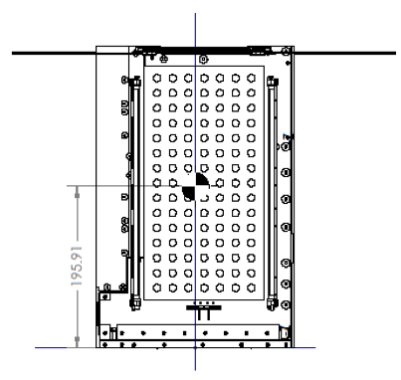
Propulsion
Busek BIT-3 ion thruster
Iodine propellant
10° gimbal for momentum management

Slide 23
Propulsion
Busek BIT-3 ion thruster
Iodine propellant
10° gimbal for momentum management

Slide 24
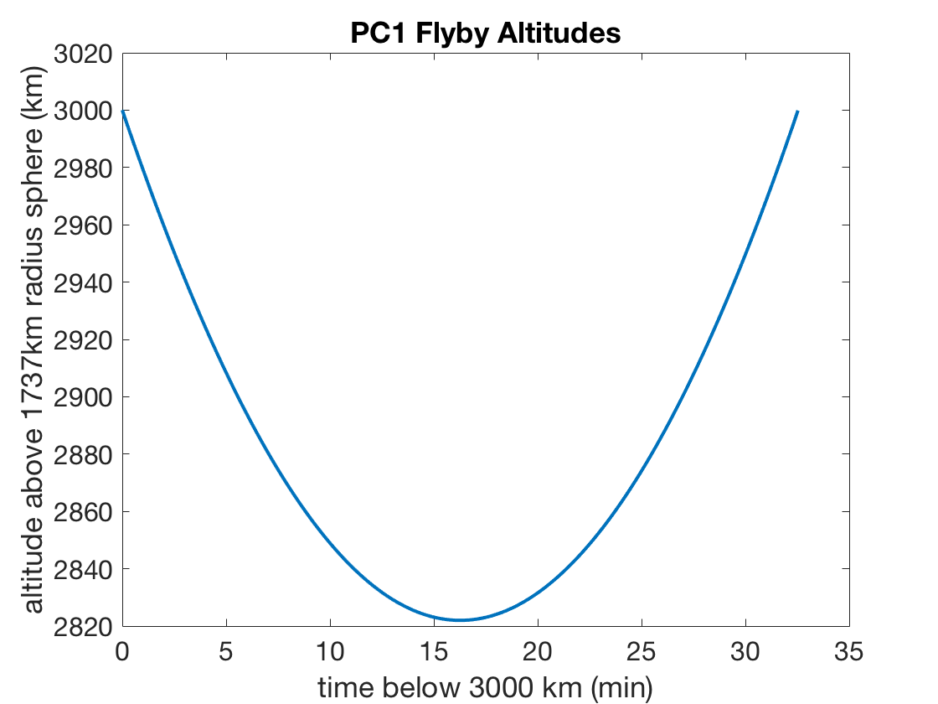
PC1 – Instrument Qualification
During first lunar flyby, LunaH-Map will observe the lunar neutron count rate of ~3.15 cps at the PC-1 flyby altitude of ~2800 km.
LunaH-Map is below 3000 km altitude for >30 minutes. The predicted epithermal neutron count rate of 3.15 cps can be measured to +/-0.04 cps.
An integration time of 8 hours enables LunaH-Map to measure the >10MeV protons (high energy bin) to an uncertainty of <1%.
Demonstrate Mini-NS operation in the lunar environment
Notes:
Double check TRL-9

Slide 25
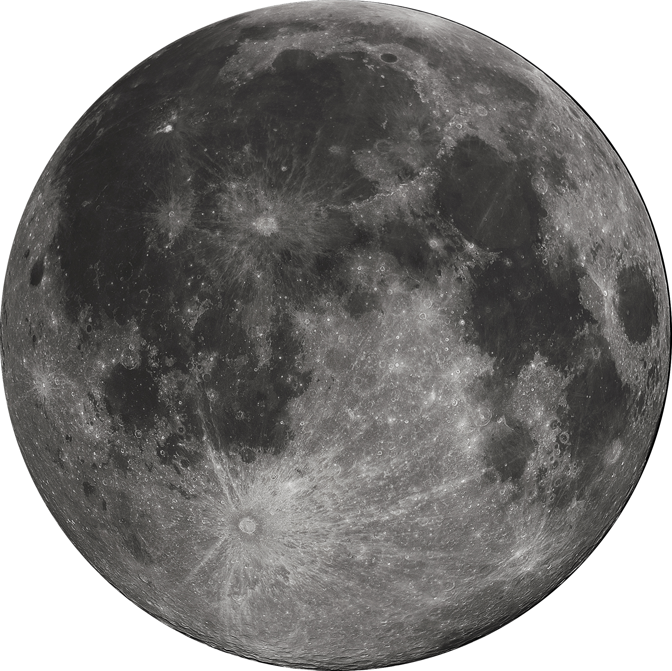
Day in the Life - Science
Statistical aposelene manuever (every 3-5 days)
Tracking/Communication
Tracking/Communication
Eclipse (beta angle dependent) – no operations
Mini-NS active ~30 min centered around periselene
Notes:
Shorten blue bar....
Highlight stuff

Slide 26
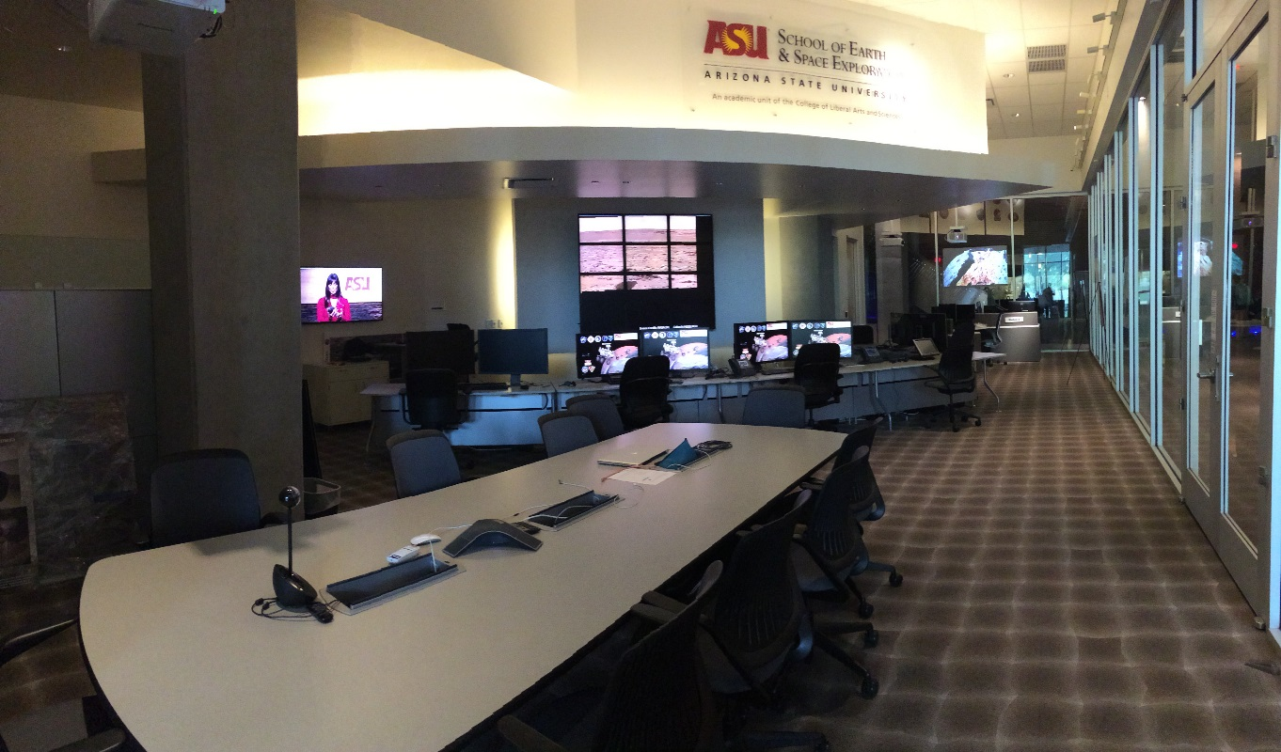
Mission/Science Operations
Co-located in ASU’s shared operations facility
JPL AMMOS/AMPCS for uplink and downlink
Science/instrument ops heritage from MER, LROC, and MSL
Science/instrument ops development coincident with Mars 2020 and Psyche missions

Slide 27
Road to Launch
LunaH-Map Program Milestones to Date
IAA | 11 December 2015 | Δ-IAA REQUIRED
Δ-IAA | 24 February 2016 | PASSED with RFAs
SRR | 8 April 2016 | PASSED with RFAs
I-PDR | 9 June 2016 | PASSED with RFAs
Phase 1 SR | 21 June 2016 | PASSED
M-PDR | 25 July 2016 | PASSED with RFAs
CDR | 29 June 2017 | COMPLETED
Phase 2 SR | 11 Nov 2017 | COMPLETED
Integration Workshop | 8 Dec 2017 | COMPLETED
Critical Design Review – Completed June 29, 2017
Phase 2 Safety Review – August 8, 2017
Enter Assembly, Integration, and Test – Q4 2017
  AI&T Review/Workshop with review board
Launch – SLS EM-1, December 2019
Review Board Members: Dr. Andrew Klesh, Jet Propulsion Laboratory (Review Board Chair), Dr. Thomas Werne, JPL, Dr. Travis Imken, JPL, Dr. Juergen Mueller, JPL, Dr. Eric Gustafson, JPL, Dr. Thomas Prettyman, Planetary Sciences Institute, Dr. James Bell, Arizona State University, Dr. Jordi Puig-Suari, California Polytechnic State University, Richard Elphic, NASA Ames.

Slide 28
Twitter: @lunahmap
lunahmap.asu.edu/foldyourown_lunahmap.pdf

