Slide 1
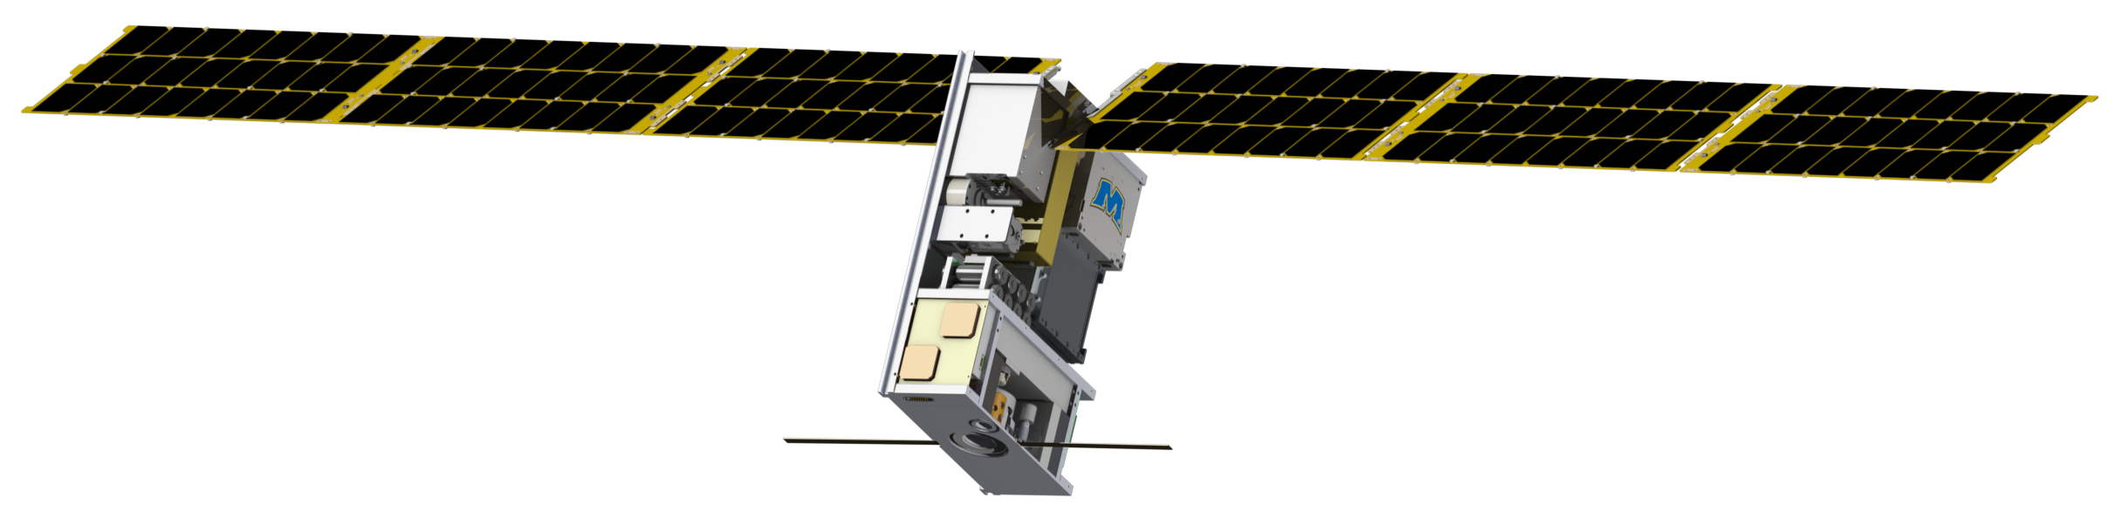
The Lunar Ice Cube Missions
P.E. Clark (CalTech/JPL),
B.Malphrus (Morehead State University),
W. Farrell, N. Petro, R. MacDowall, T. Hurford, and C. Brambora (NASA/GSFC)
and members of the Lunar ICe Cube Team
National Aeronautics and Space Administration
Jet Propulsion Laboratory
California Institute of Technology
Pasadena, California
www.nasa.gov
© 2016. All rights reserved.
Government sponsorship acknowledged.
Jet Propulsion Laboratory
California Institute of Technology

Slide 2
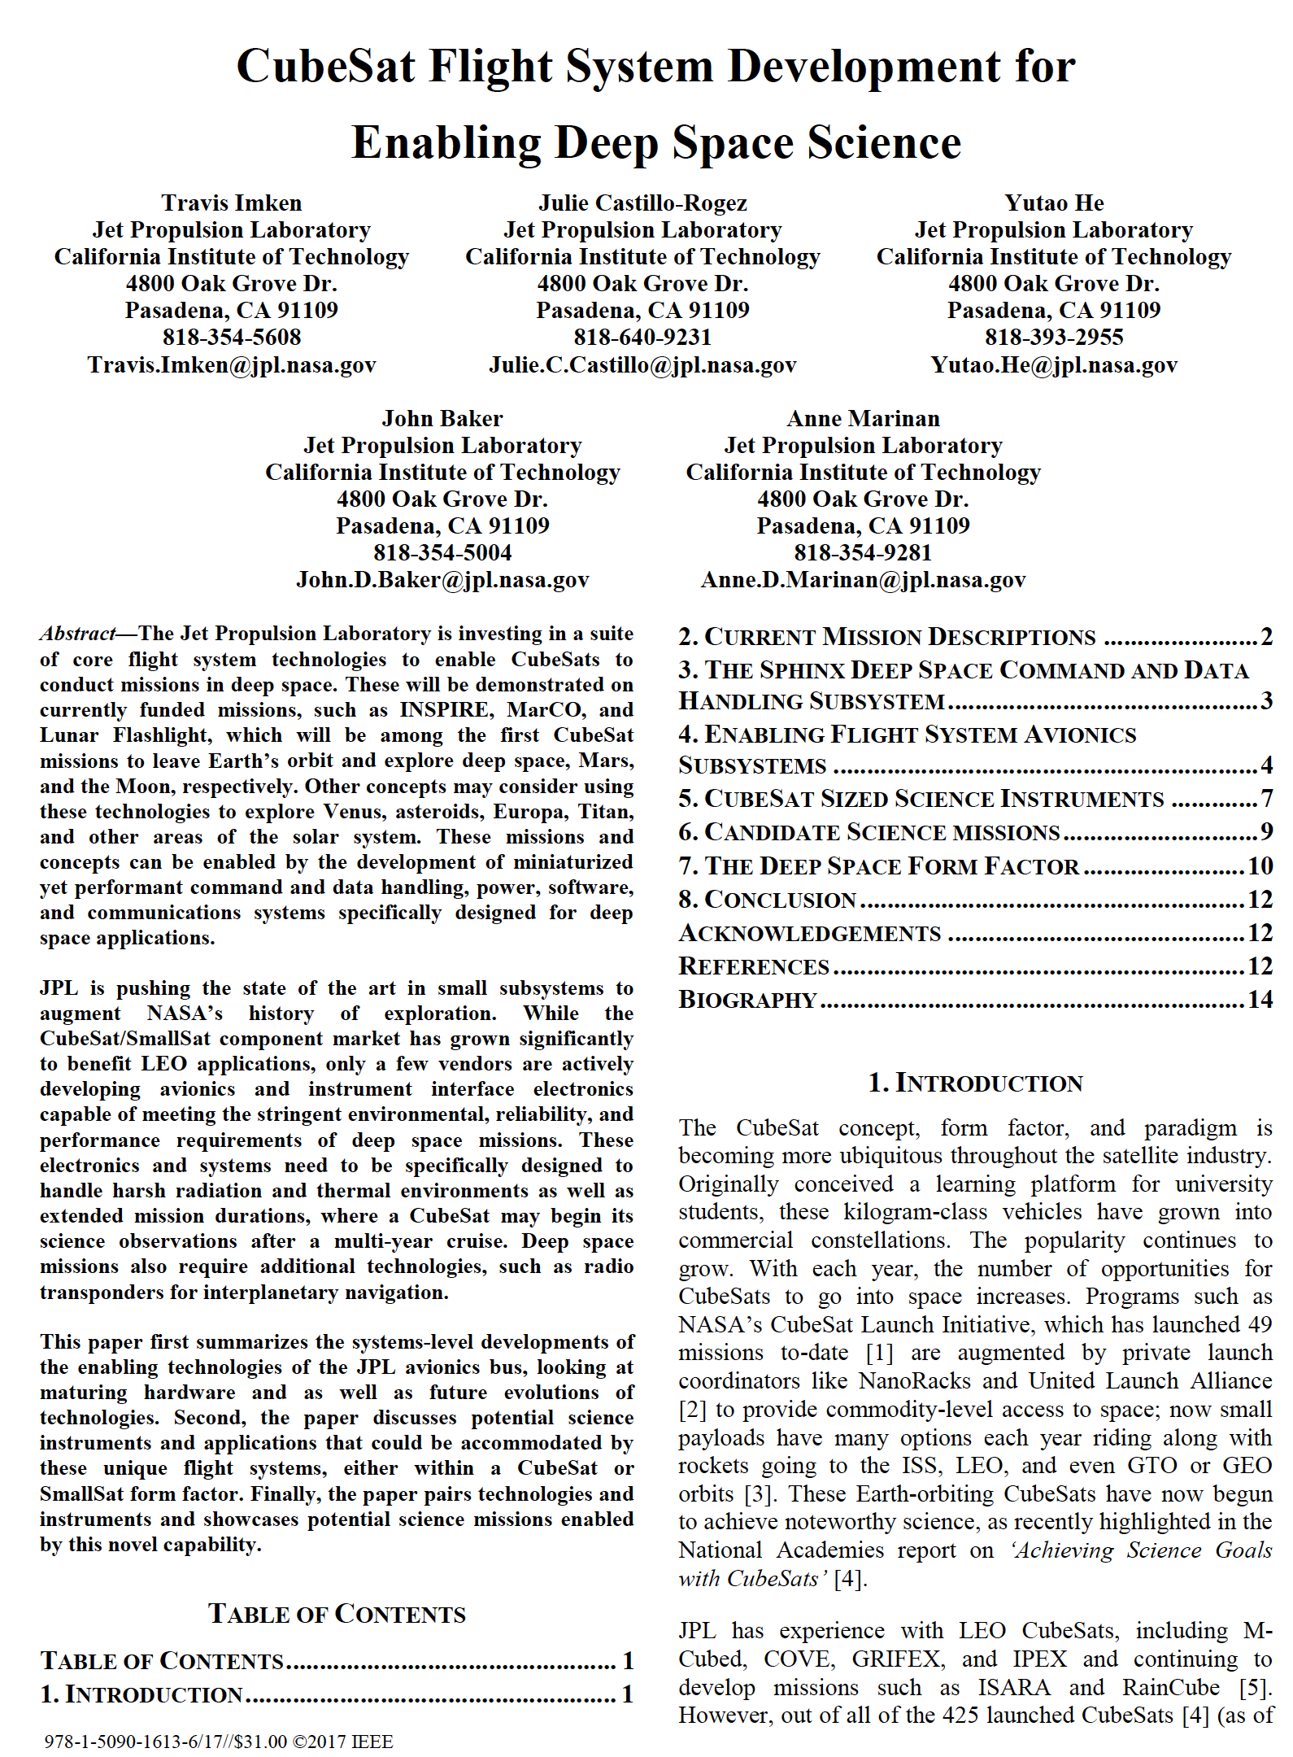
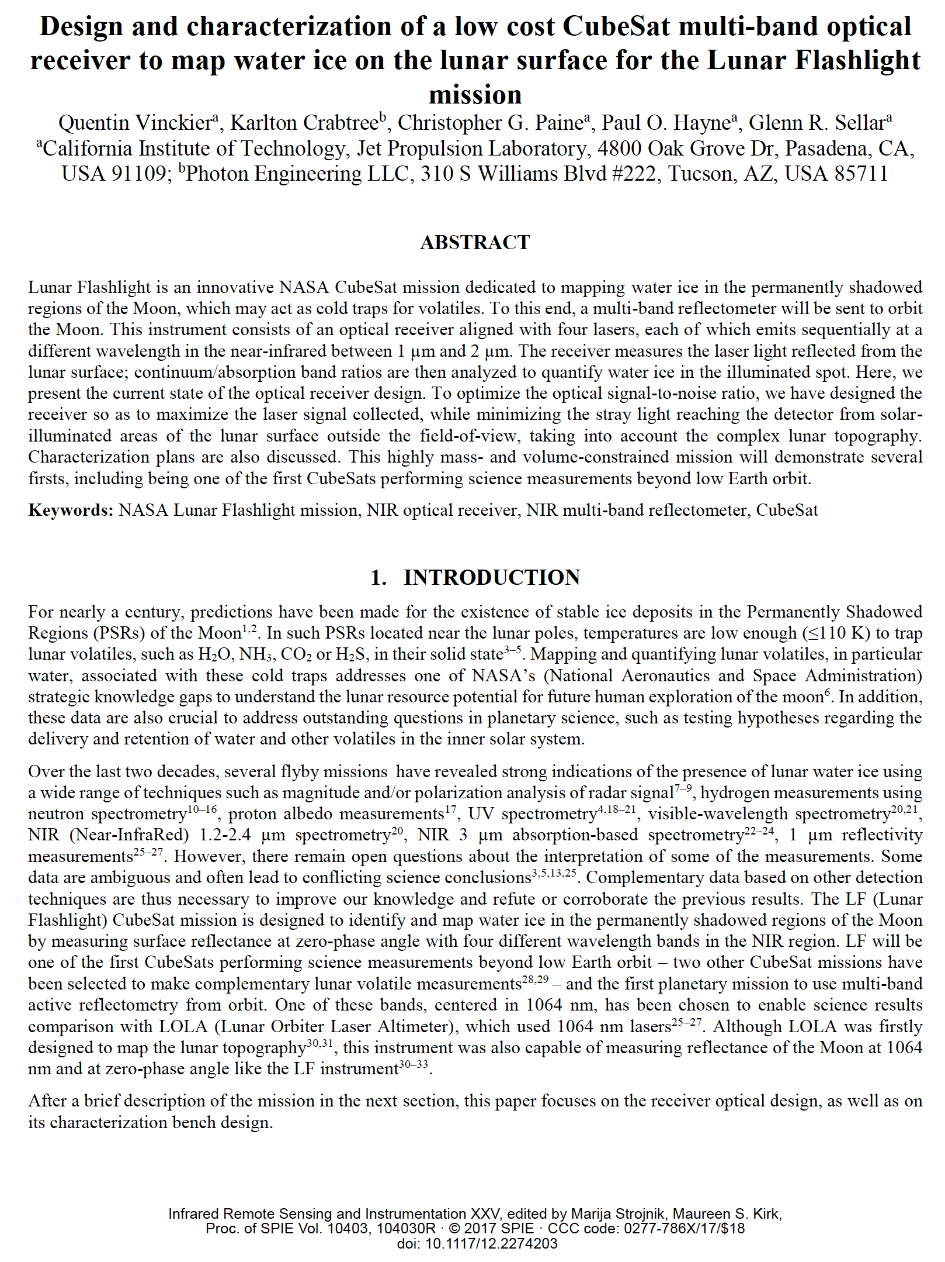
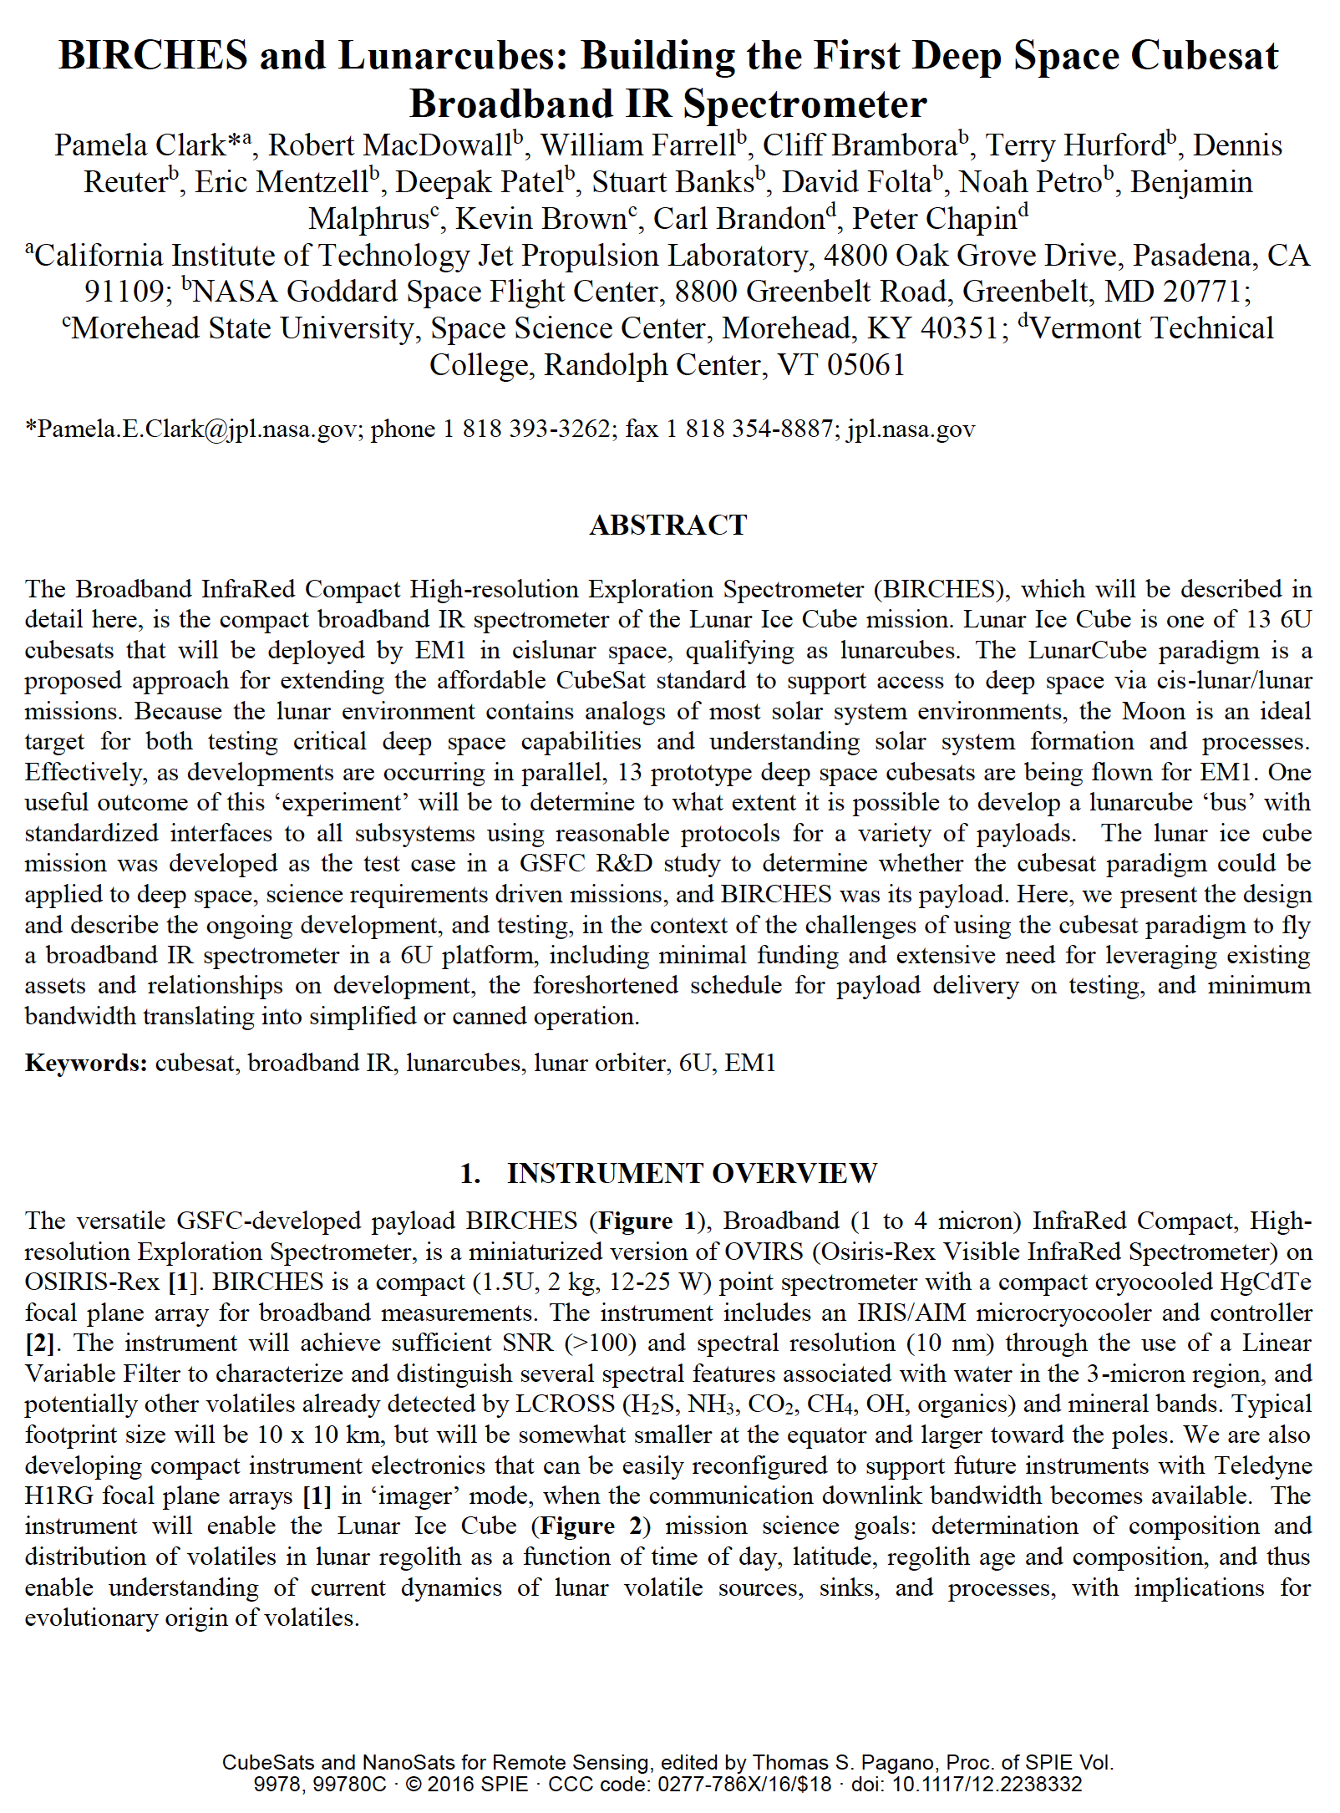
Current Status
EM1 Launch now 2020.
Lunar Ice Cube, Lunar Flashlight, LunaHMap all passed CDR.
Publications (Source): Online Presentations, Short papers for all three from 2015 at LPSC, LEAG, and Interplanetary SmallSat Conference. Papers, Clark et al, 2016, SPIE Optics on Lunar Ice Cube; Vinckier et al, 2017, SPIE Optics, and Imken et al, 2017, IEEE on Lunar Flashlight.
For Lunar Ice Cube Science:
All critical / long-lead Flight hardware has been ordered.
FlatSat with non rad-hard subsystems and emulators is close to completion.
Development and testing Data System beginning this summer.

Slide 3
Significance of Water
Relevance to NASA | Growing Evidence for Global Distribution
HEOMD Strategic Knowledge Gaps: 1) Temporal Variability and Movement Dynamics of Surface-Correlated OH and H2O deposits toward permanently shadowed area retention (Lunar Ice Cube) 2) Composition, Form and Distribution of Polar Volatiles (Lunar Flashlight, LunaH Map) 3)Quality/quantity/distribution/form of H species and other volatiles in mare and highlands regolith (Lunar Ice Cube) SMD Decadal Survey: understanding solar system formation, and evolution of the lunar surface and atmosphere by further establishing the role of surface volatiles SMD Scientific Context for Exploration of the Moon: Using the Moon to study regolith, exosphere (including water vapor) processes on airless bodies | Evidence for surface ice near both poles (cold traps). Evidence for bound water in volcanic deposits. Evidence for hydroxyl (OH) and water varying as function of of temperature (local time of day) and illumination (slope orientation) in 100's of PPM range.

Slide 4
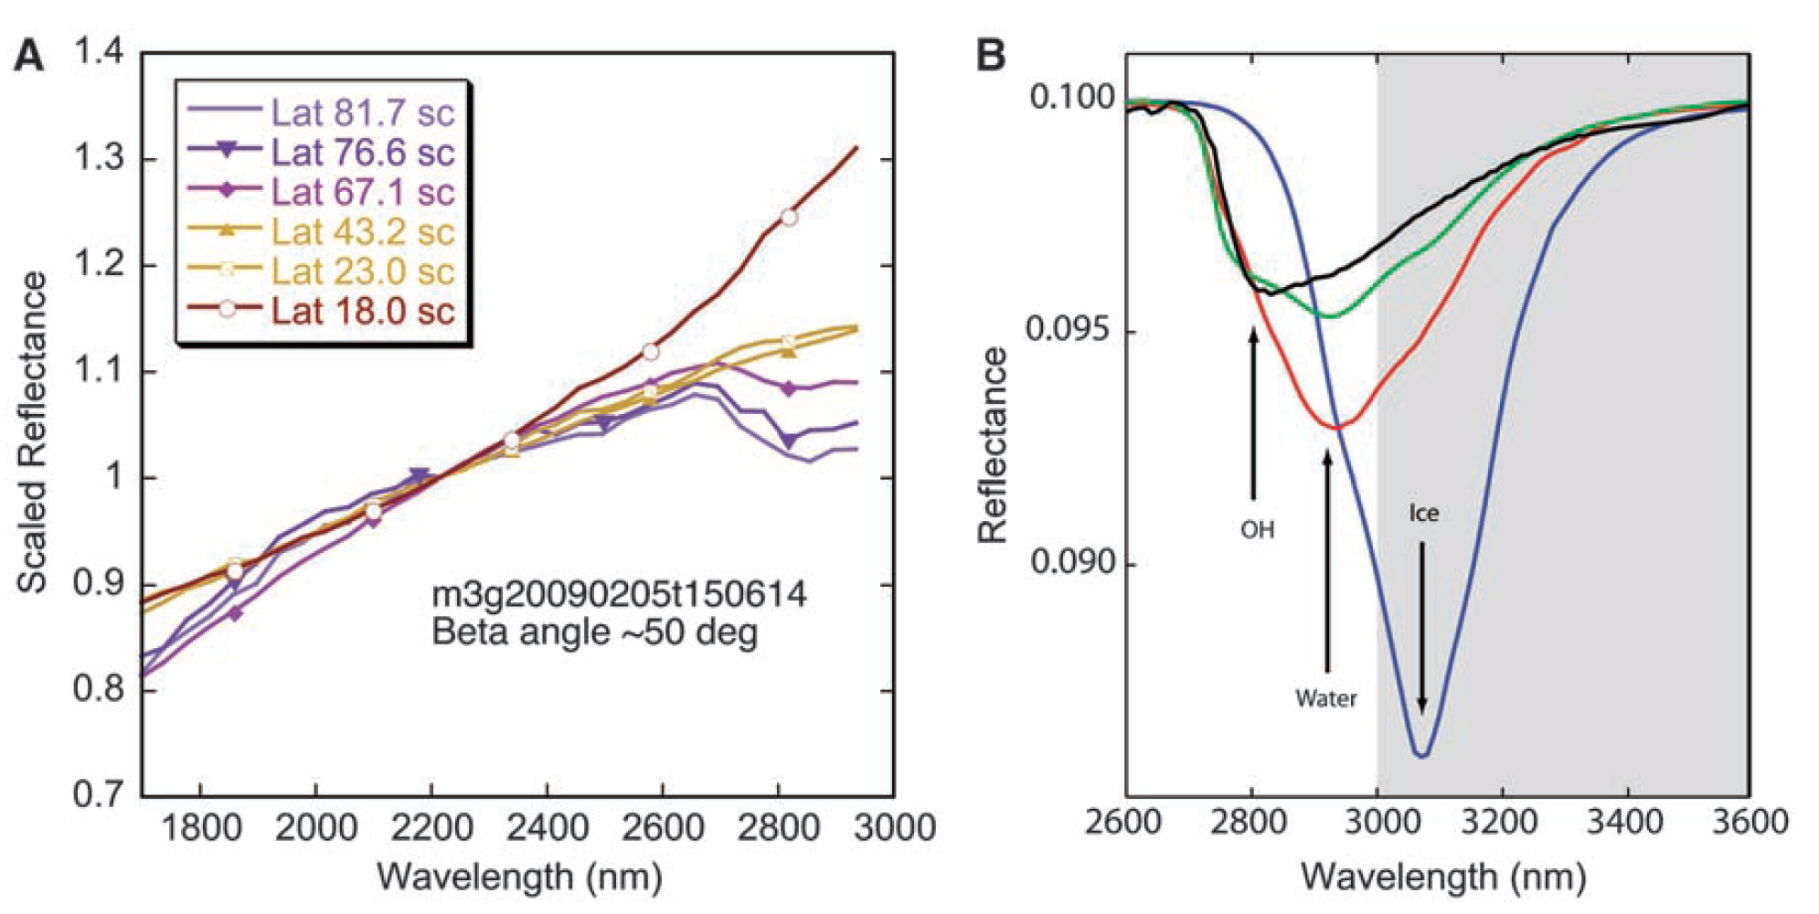
Evidence for Water
Reflectance spectra showing water and hydroxyl aborption features (near 3 microns) depth as a function of latitude. Chandrayaan M3, Pieters et al 2009
Water and Hydroxyl on Moon. Combined Red (Pyroxene), Green (Reflectance continuum), Blue (water and hydroxyl absorption) bands. Blue, Cyan, Magenta, Pink water indicators. Chandrayaan M3, Pieters et al 2009
Reflectance spectra with absorption feature strength correlated with time of day. Deep Impact Epoxi. Sunshine et al 2009

Slide 5
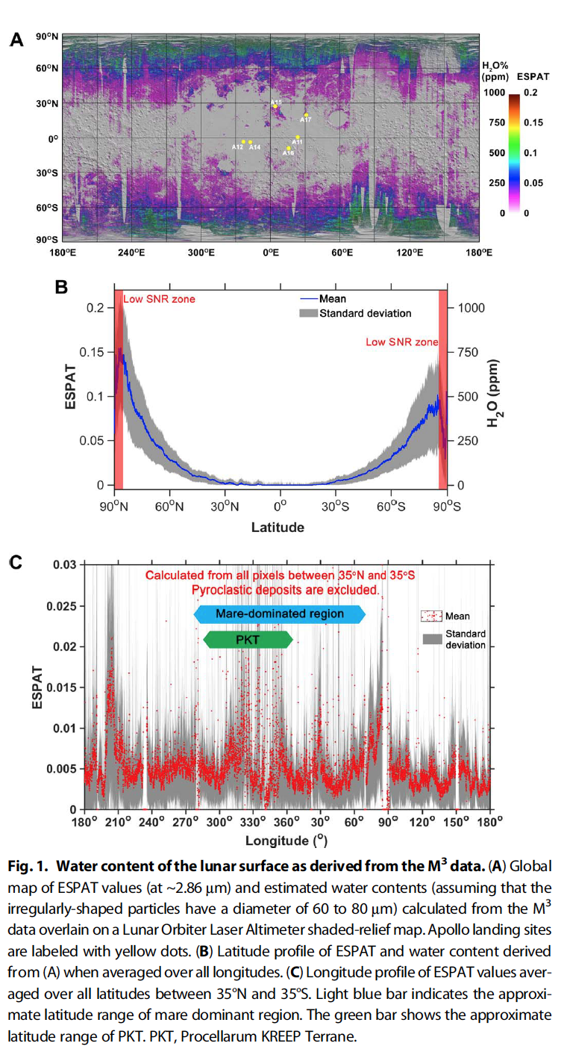
Evidence for Water
Map of 2.85 u Effective Single Particle Absorption Thickness (ESPAT) derived from M3 at low lunar latitudes. Features apparently associated with pyroclastic deposits, lending credence to hypothesis of volatile-rich (hundreds ppm) sources in mantle. A aristarchus; O orientale, RB Rima Bode, SG Sulpicius Gallus, TL Taur-Littrow. Milliken and Li, 2017.
M3 calculated ESPAT estimated water content (Apollo landing sites in yellow) map (A), all longitude-averaged latitude profile (B), and +/- 35 degree latitude-averaged longitude profile (C). Li and Milliken, 2017.
M3 calculated ESPAT estimated water content (Apollo landing sites in yellow) map (A), all longitude-averaged latitude profile (B), and +/- 35 degree latitude-averaged longitude profile (C). Li and Milliken, 2017.

Slide 6
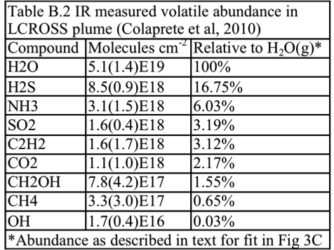
Evidence for Water

Slide 7
Technology Goals
Demonstrate Enabling Technologies for Interplanetary Cubesats
Lunar Ice Cube and LunaH Map Busek BIT 3 - High isp RF Ion Engine
BIRCHES Miniaturized (from OVIRS) broadband IR Spectrometer with integrated microcryocooler completely capturing the 3 micron region with several features of interest.
Space Micro C&DH- Inexpensive Radiation-tolerant Subsystem
Lunar Ice Cube and LunaH Map: BCT- XACT/-XB1 bus ADCS (Star Tracker, Reaction Wheels
Lunar Ice Cube and LunaH Map: JPL Iris v. 2.1 Ranging Transceiver
Planetary (PDS) Archiving on a limited budget

Slide 8
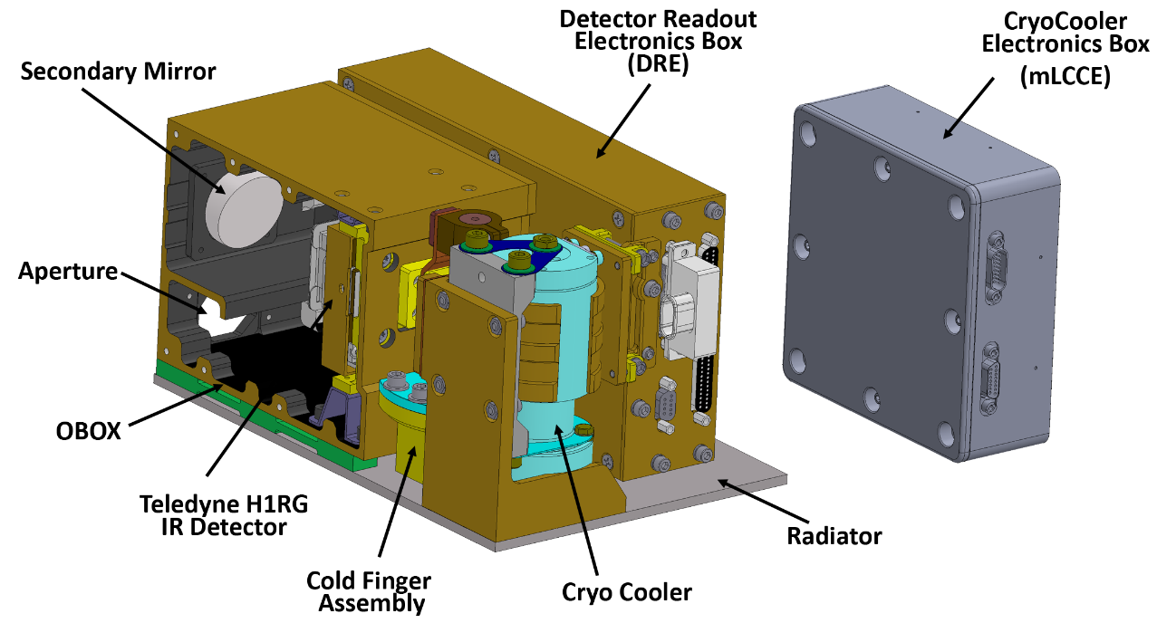
Lunar Ice Cube Instrument - BIRCHES IR SPECTROMETER
BIRCHES compactness
Property | Ralph | BIRCHES
Mass kg | 11 | 3
Power W | 5 | #10-20 W
Size cm | 49 x 40 x 29 | 10 x 10 x 15
# includes 3 W detector electronics, 1.5 W AFS controller, 5-10 W cryocooler

Slide 9
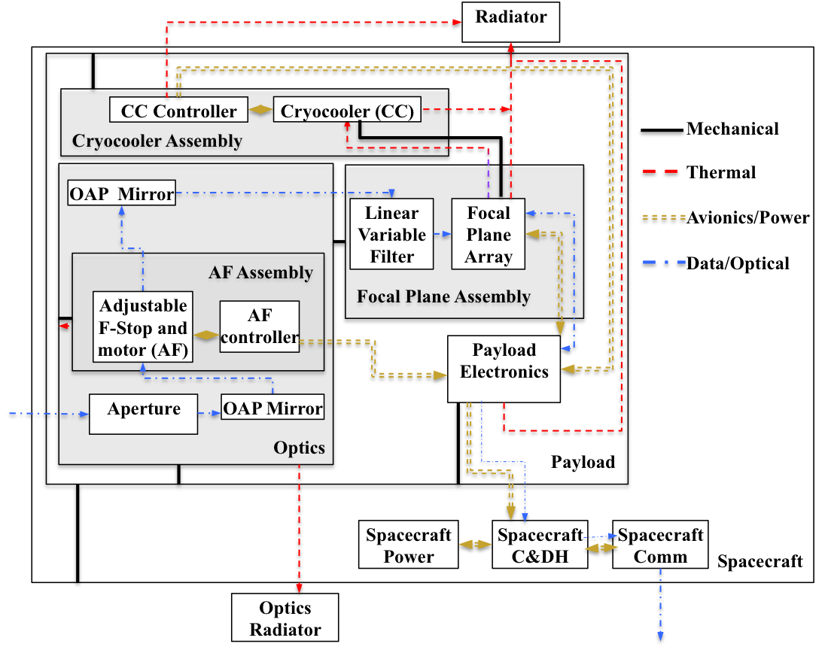
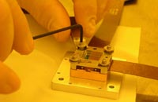
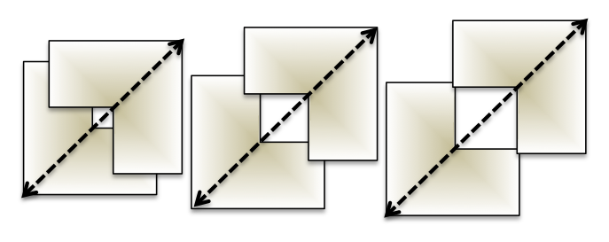
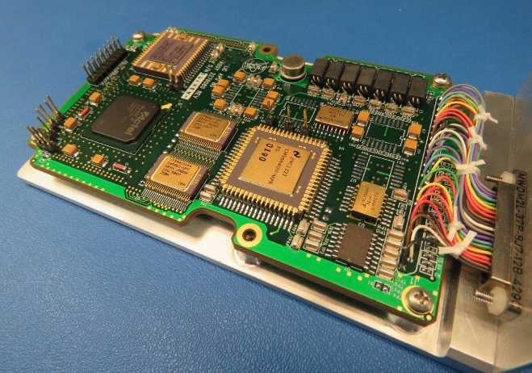
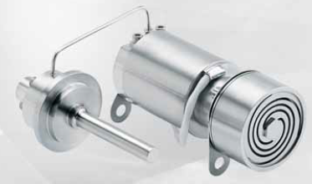
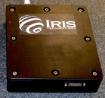
Spectrometer Schematic and Components
BIRCHES utilizes a compact Teledyne H1RG HgCdTe Focal Plane Array and JDSU linear variable filter leveraging OSIRIS REx OVIRS.
Adjustable Iris maintains footprint size at 10 km by varying FOV regardless of altitude
BIRCHES Analog Processing Unit (APU) (top)
COTS AFRL developed AIM SX030 microcryocooler with cold finger to maintain detector at ≤115K and iris controller

Slide 10
Species | μm | description
Water Form, Component
water vapor | 2.738 | OH stretch
 | 2.663 | OH stretch
liquid water | 3.106 | H-OH fundamental
 | 2.903 | H-OH fundamental
 | 1.4 | OH stretch overtone
 | 1.9 | HOH bend overtone
 | 2.85 | M3 Feature
 | 2.9 | total H2O
hydroxyl ion | 2.7-2.8 | OH stretch (mineral)
 | 2.81 | OH (surface or structural) stretches
 | 2.2-2.3 | cation-OH bend
 | 3.6 | structural OH
bound H2O | 2.85 | Houck et al (Mars)
 | 3 | H2O of hydration
 | 2.95 | H2O stretch (Mars)
 | 3.14 | feature w/2.95
adsorbed H2O | 2.9-3.0 | R. Clark
ice | 1.5 | band depth-layer correlated
 | 2 | strong feature
 | 3.06 | Pieters et al
Other Volatiles
NH3 | 1.65, 2. 2.2 | N-H stretch
CO2 | 2, 2.7 | C-O vibration and overtones
H2S | 3
CH4/organics | 1.2, 1.7, 2.3, 3.3 | C-H stretch fundamental and overtones
Mineral Bands
pyroxene | 0.95-1 | crystal field effects, charge transfer
olivine | 1, 2, 2.9 | crystal field effects
spinels | 2 | crystal field effects
iron oxides | 1 | crystal field effects
carbonate | 2.35, 2.5 | overtone bands
sulfide | 3 | conduction bands
hydrated silicates | 3-3.5 | vibrational processes
anticipate wavelength of peak for water absorption band to be structural<bound<adsorbed<ice

Slide 11
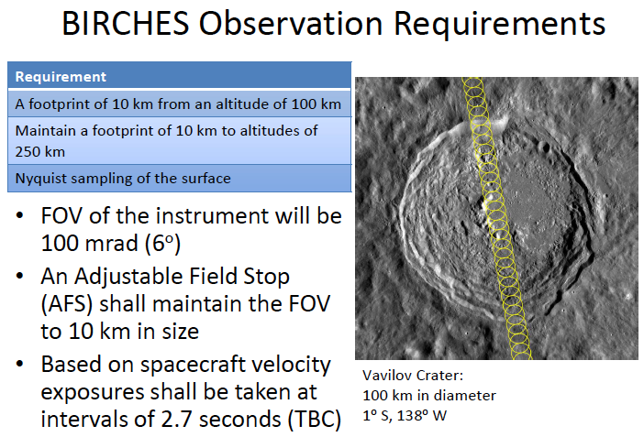
Footprint 10 km in along track direction regardless of altitude, consecutive observations separated by a couple of kilometers; greater overlap of consecutive tracks at poles, separted by a couple of kilometers

Slide 12
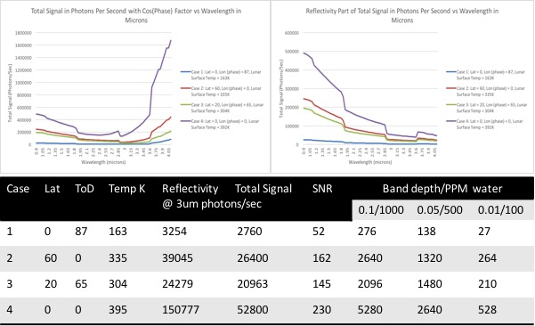

Slide 13
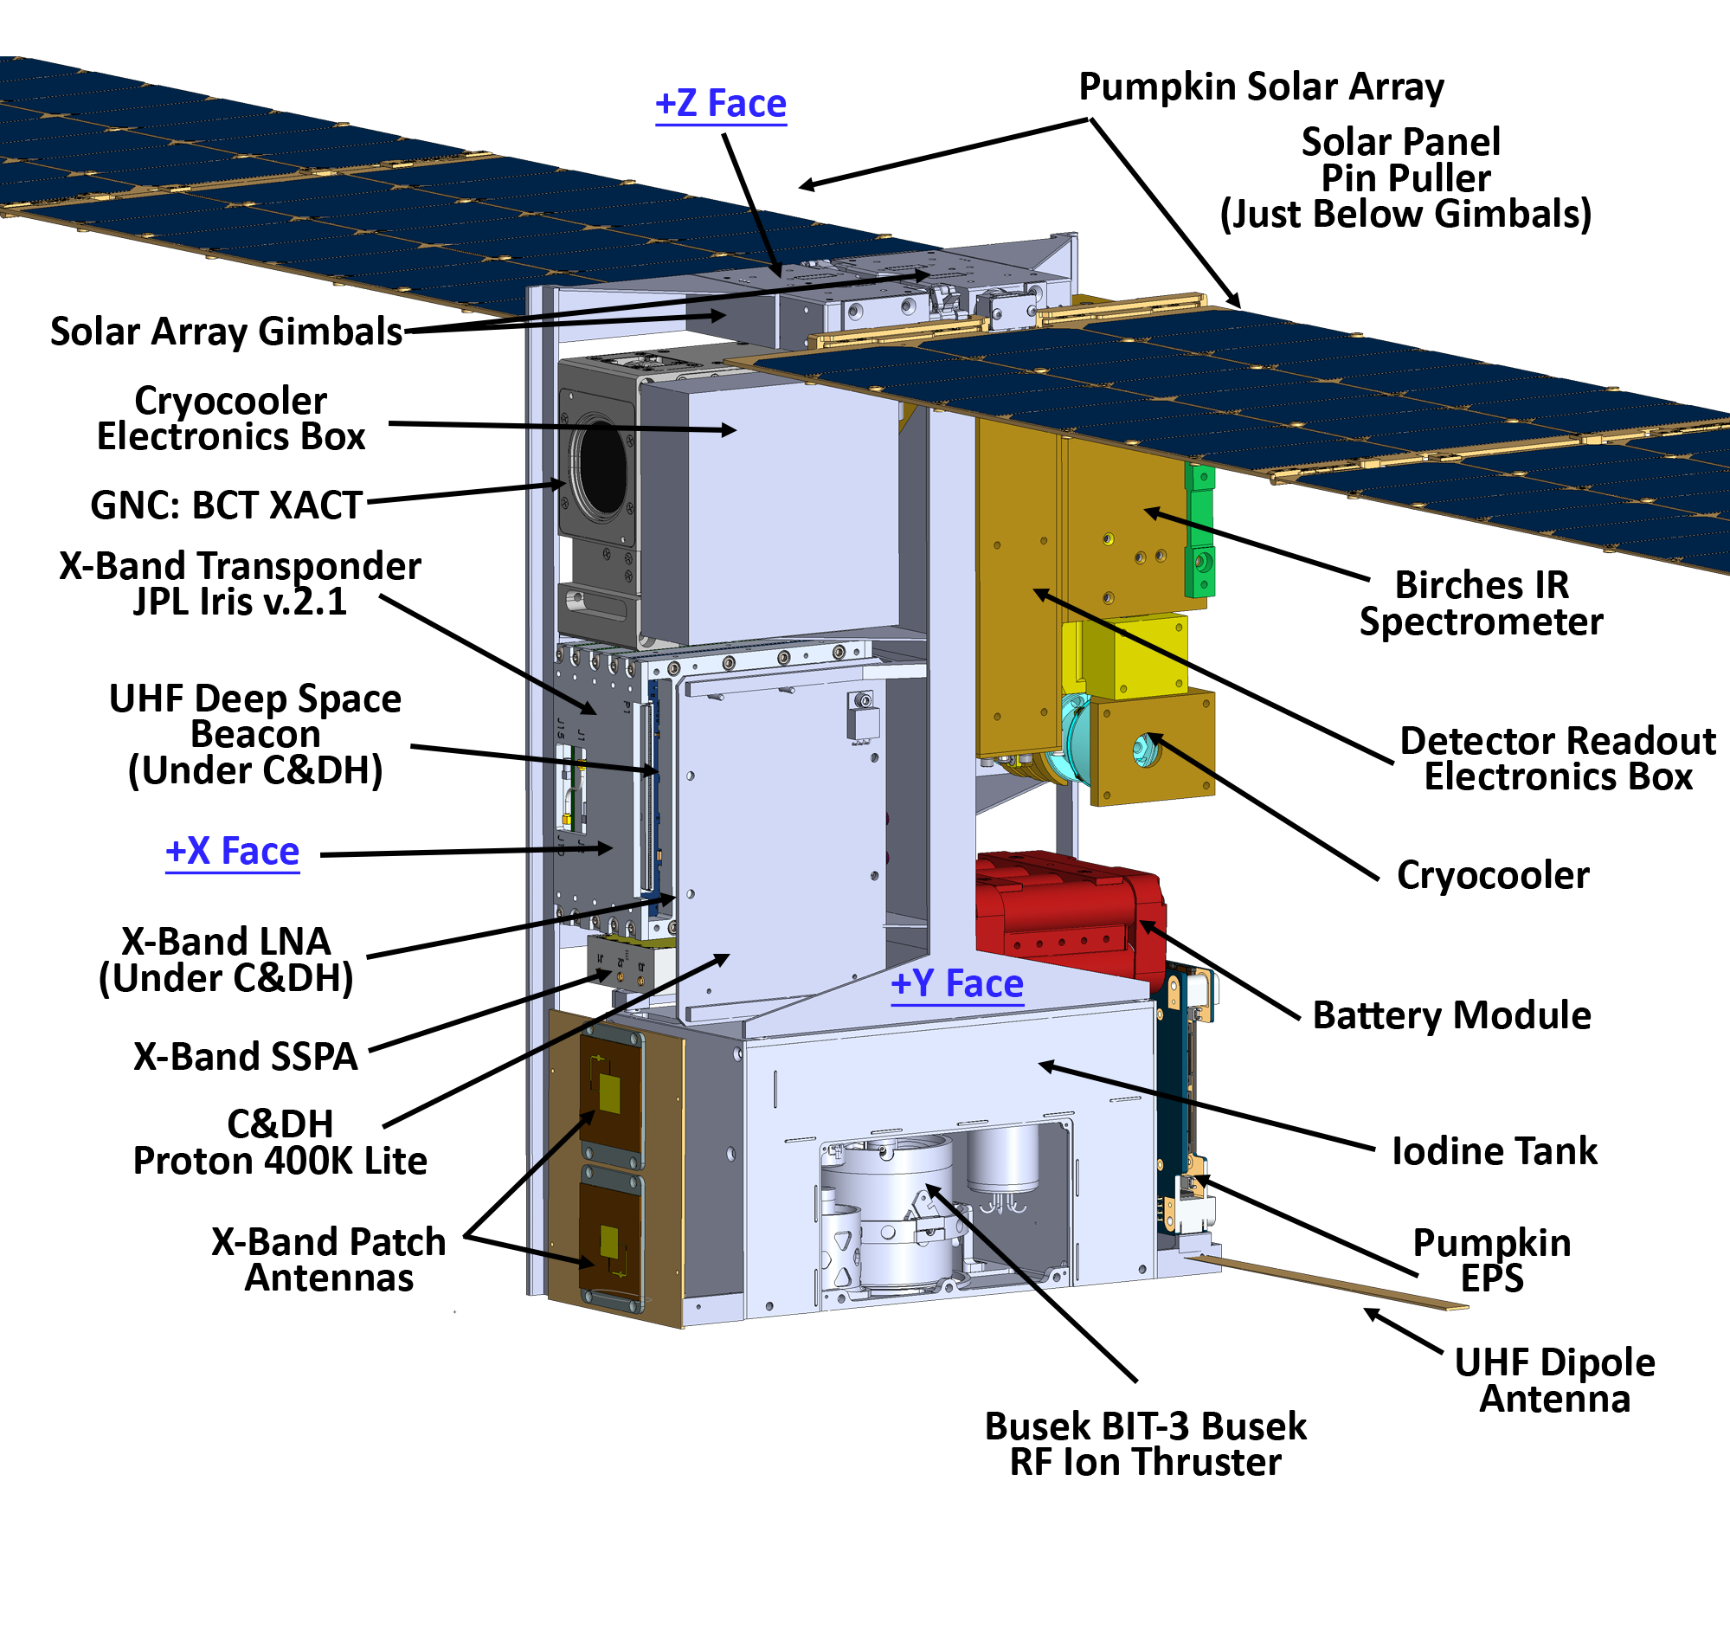
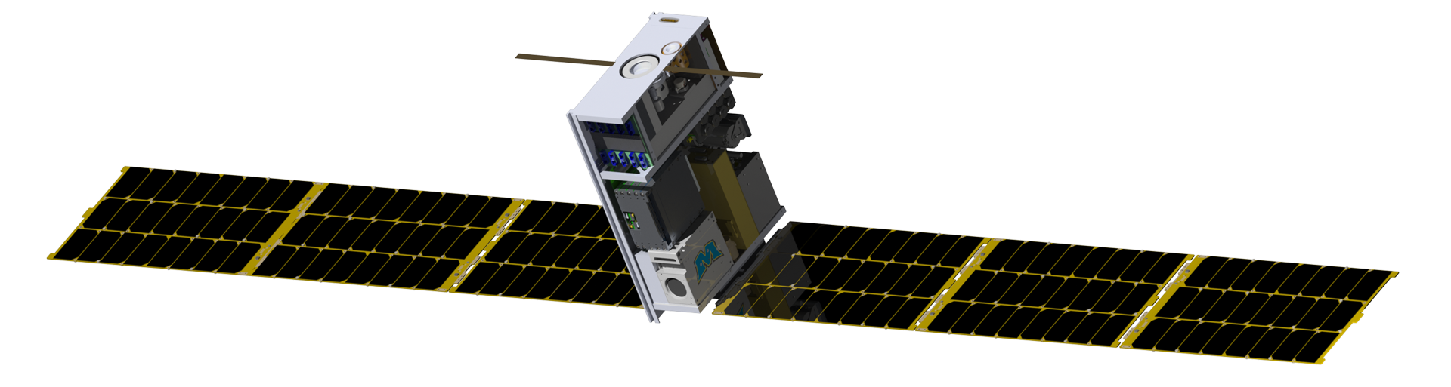
Lunar Ice Cube Bus
Pumpkin Solar Arrays
Cryocooler Electronics Box
GNC: BCT XACT
Solar Arrays Gimbals
Proton 400K Lite (Under Transponder)
X-Band Transponder
Pumpkin EPS
UHF Deep Space Beacon
UHF Dipole Antenna
Busek Bit-3 RF Ion Thruster
BIRCHES IR Spectrometer
Iodine Tank
Cryocooler
Battery Module
X-Band LNA
X-Band SSPA

Slide 14
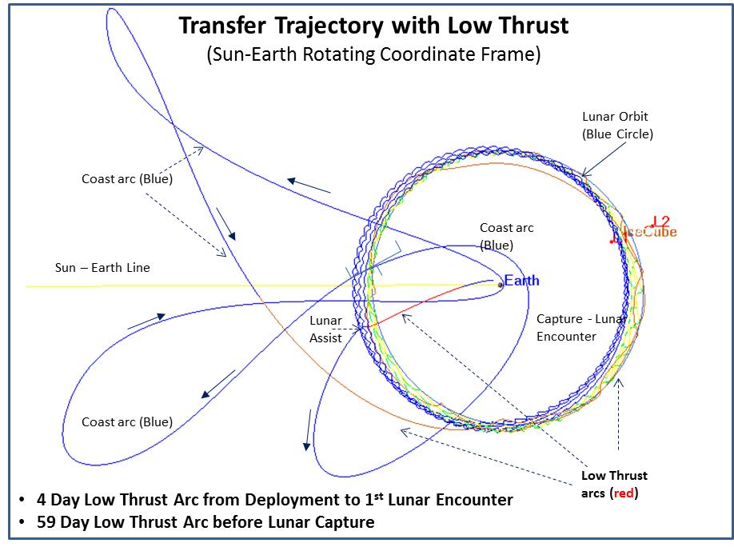
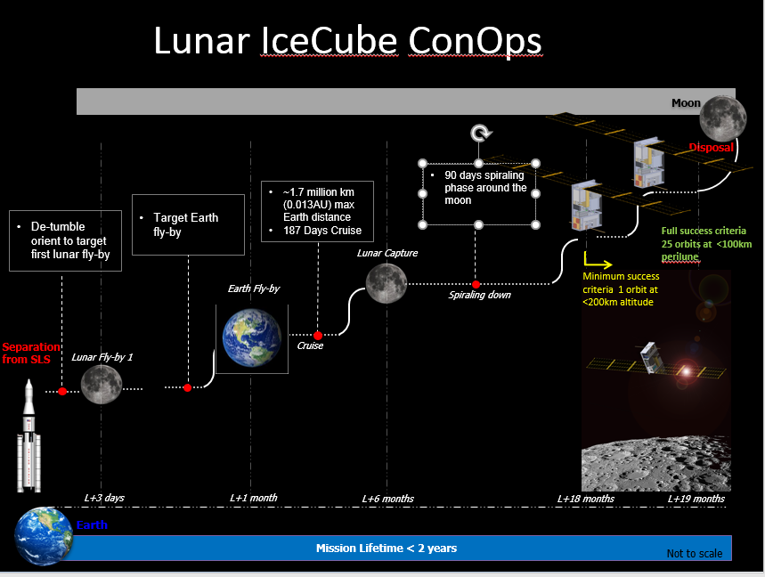
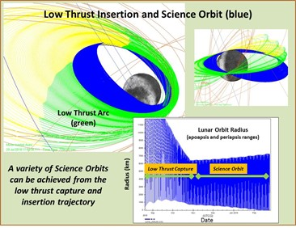
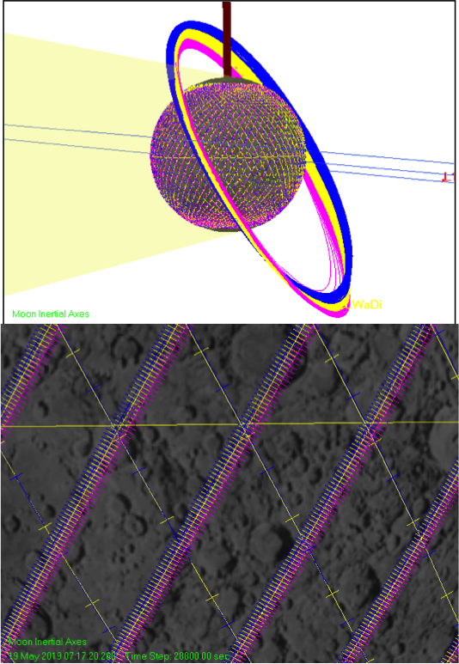
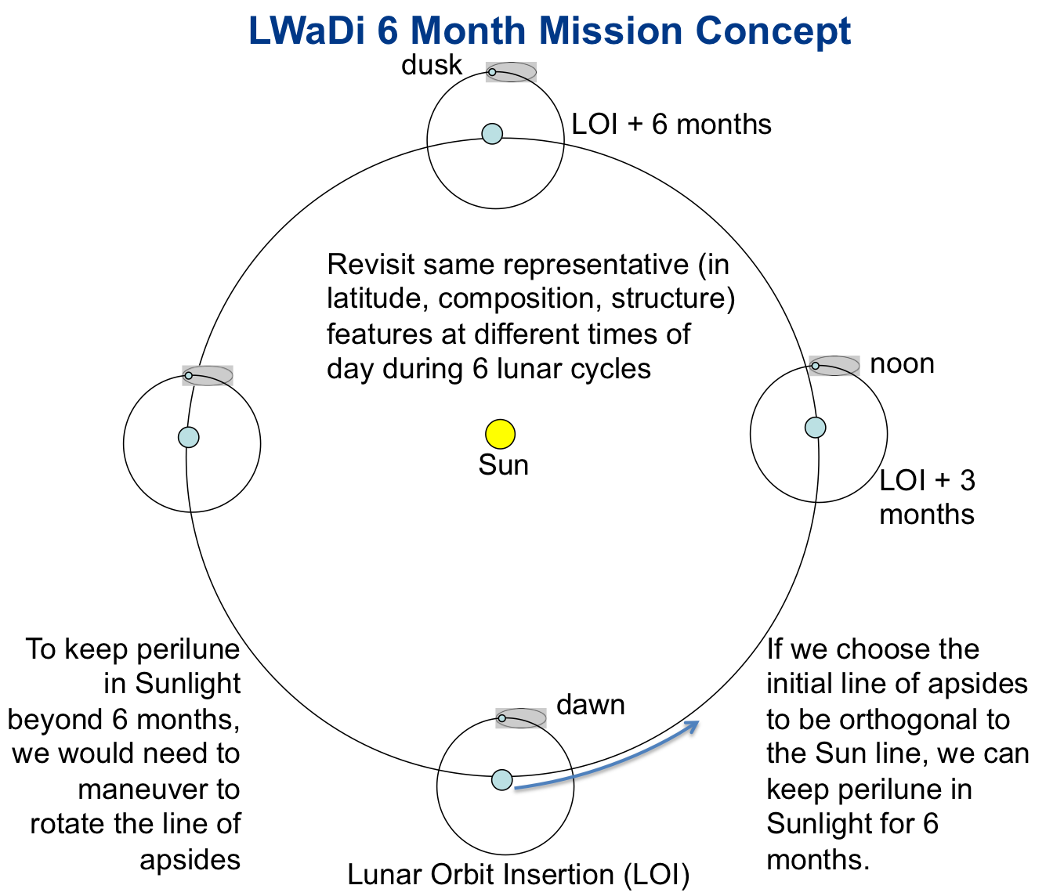
Lunar Ice Cube MIssion Concept

Slide 15
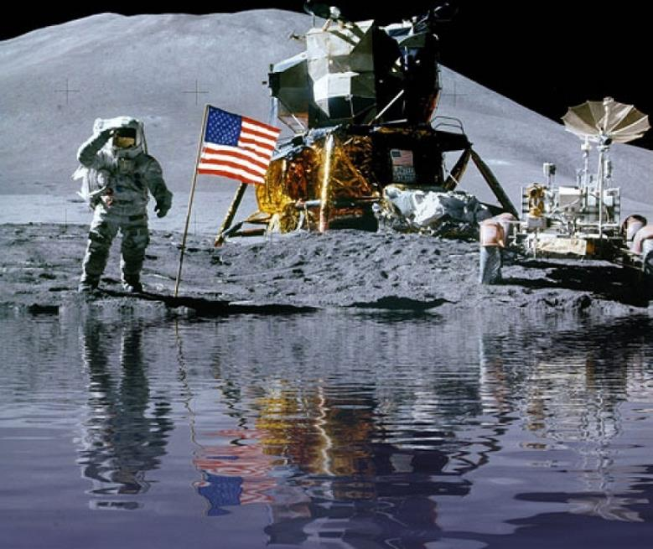
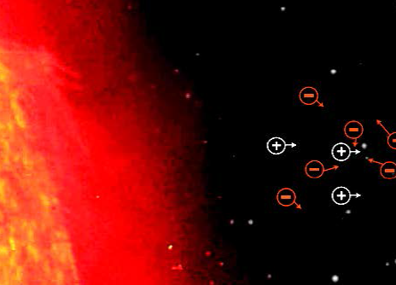
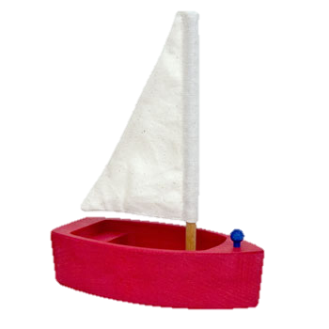
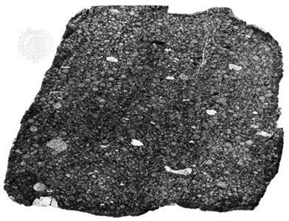
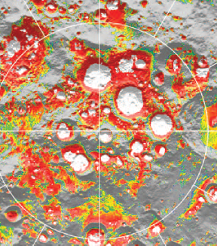
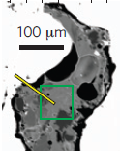
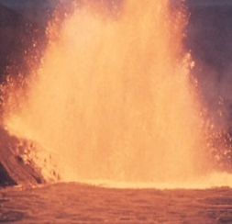
A Lunar Water System
∂ W/∂t + ∇• (Wv) = S_{SW} + S_{infall} + S_{poles}
- R_{desorp} – R_{photodiss} – R_{sputter} – R_{impactvapor}
W water V volatile S source R remove
IC Lunar Ice Cube LM LunaH-Map LF Lunar Flashlight
LM
LF
Solar
Wind (H+)
Meteoric
Infall (W, OH, V)
H⁺
Hydrogen
Sub-Cycle
W, OH, V
H
IC
LM
LF
H₂
W
V
OH
Thermal
Migration
W V V W OH OH
W
Poles
(W, OH,V)
W
W V OH W OH
IC
LM
LF
W V V
W OH
W V V
W OH
LM
LF
Mineralogy (OH)
W V OH
W OH
IC
Modified from Farrell et al, 2017, LEAG
IC
Pyroclastics
(Bound H2O)

Slide 16
Conclusions
Lunar Ice Cube will provide measurements for liquid water, ice, OH distribution across the lunar surface as function of time of day (temperature and illumination) for several lunar cycles for pole to pole swaths of the lunar surface to provide a basis for understanding global water dynamics.
Lunar Flashlight will provide direct measurements of surface ice near the poles at the highest resolution (1 km), and LunaH-Map measurements from which surface and subsurface ice (down to 10's of cm) can be inferred at the poles.
Some temporal overlap between LunaH-Map and Lunar Ice Cube will be useful in constraining the water migration process. Spatial overlap between LunaH-Map and Lunar Flashlight will be useful in constraining cold trap evolutionary processes.
Regardless of the degree of overlap in space or time, these measurements when combined will provide far more systematic understanding of the water cycle, and the accessibility of water as a resource on the Moon.
The three missions will act as a de facto multi-platform cluster for measuring lunar volatiles, yet another way in which the first deep space cubesats are demonstrating not only new technologies but new approaches to scientific exploration.
We are doing what cubesats are supposed to do: creating an innovative and tailored solution with a standard platform.

Slide 17
LunarCubes Still Around!!!!
Your challenging science mission requirements needed
pamela.e.clark@jpl.nasa.gov

Slide 18
Backup Slides

Slide 19
LunaH-Map Instrument
Hardgrove et al, 2017, LEAG and 2nd GSFC planetary cubesat workshop

Slide 20
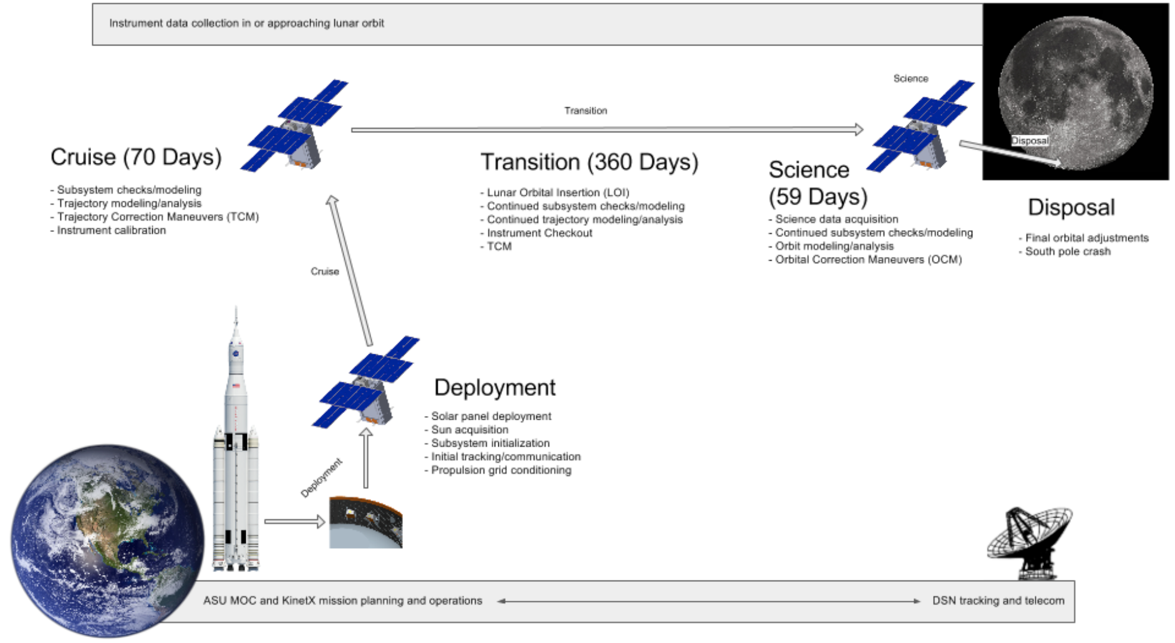
LunaH-Map Mission Concept
Hardgrove et al, 2017, LEAG and 2nd GSFC planetary cubesat workshop

Slide 21
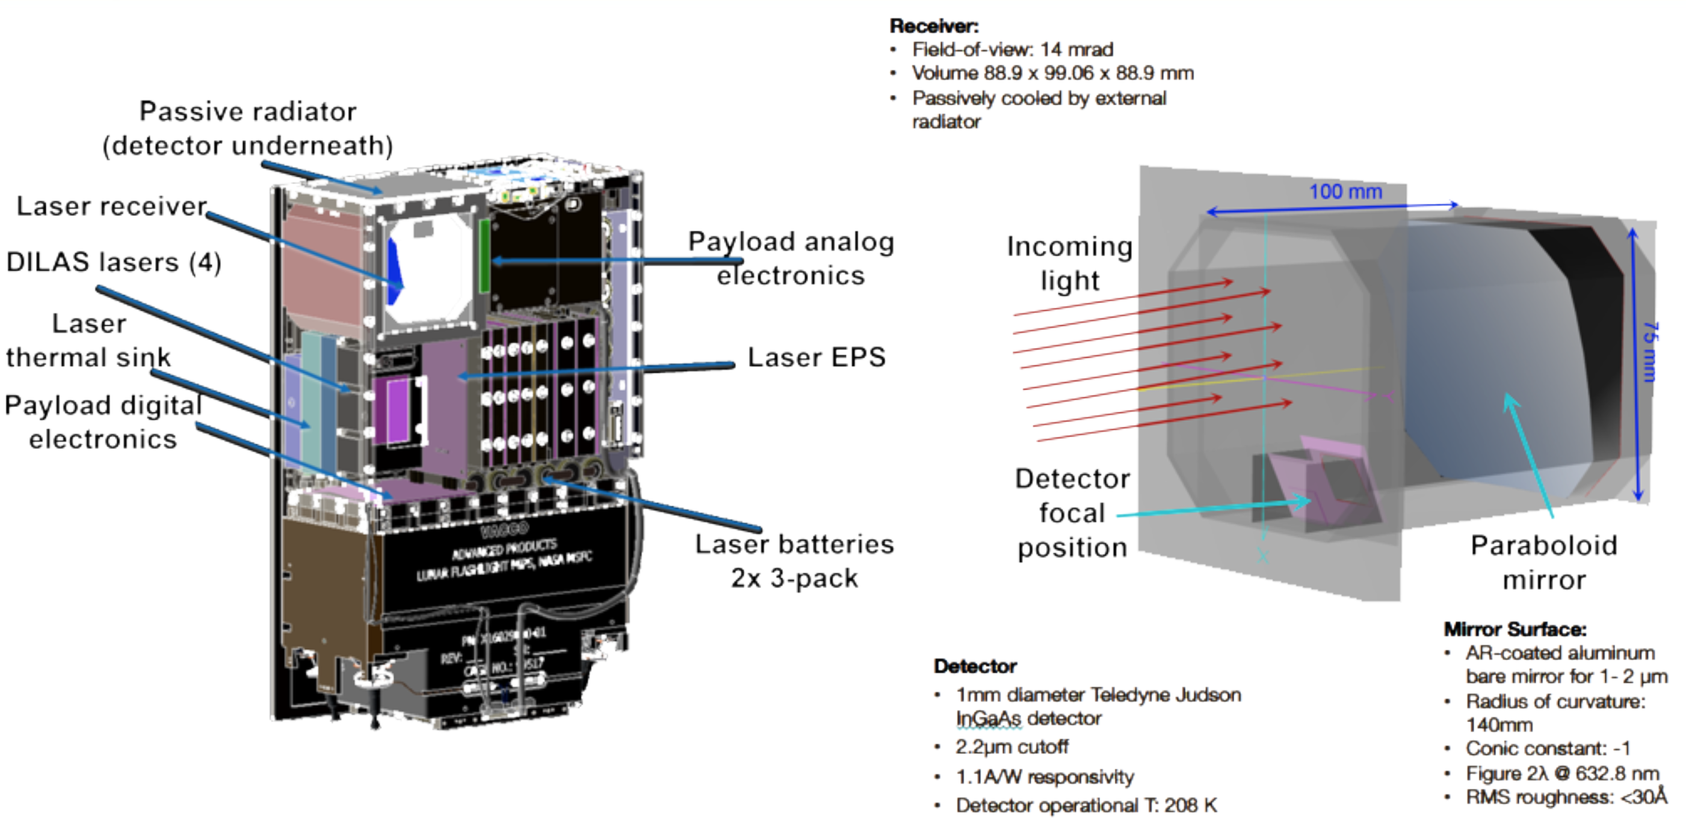
Lunar Flashlight Instrument
Cohen et al, 2017, LEAG

Slide 22
Lunar Flashlight Instrument
Cohen et al, 2017, LEAG

