Slide 1

Characterization of the Blue Canyon Technologies Nano Star Tracker Performance
By Kevin Lo, Laura Jones, Swati Mohan
Jet Propulsion Laboratory
California Institute of Technology
4/26/16
© 2016 California Institute of Technology. Government sponsorship acknowledged.

Slide 2
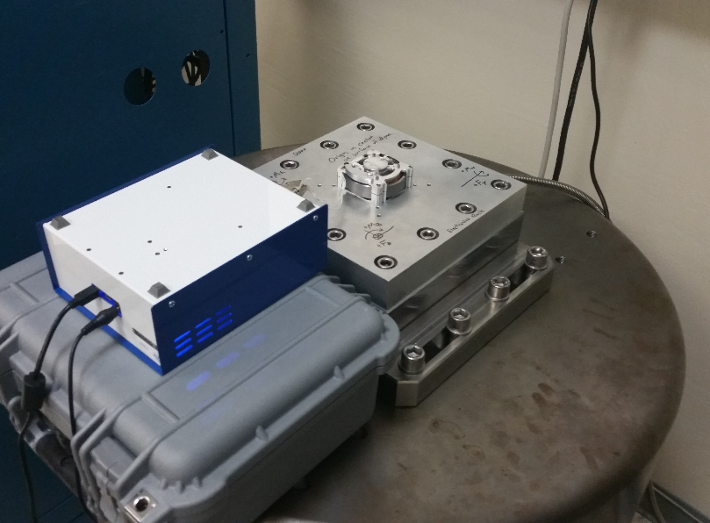
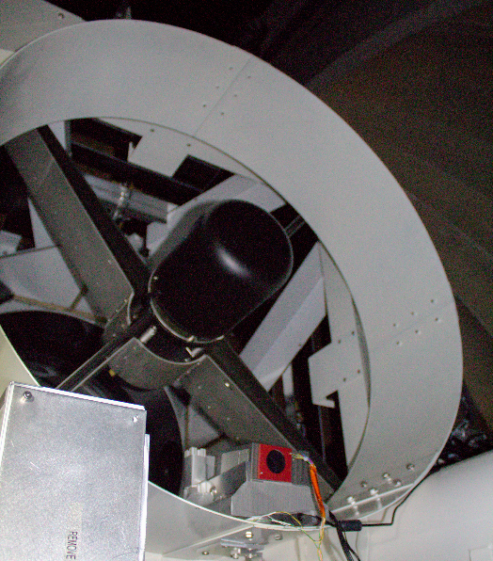
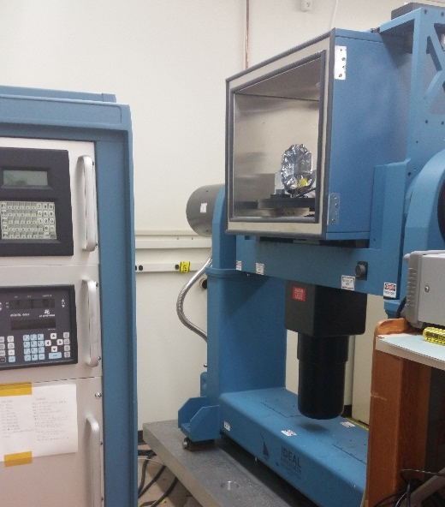
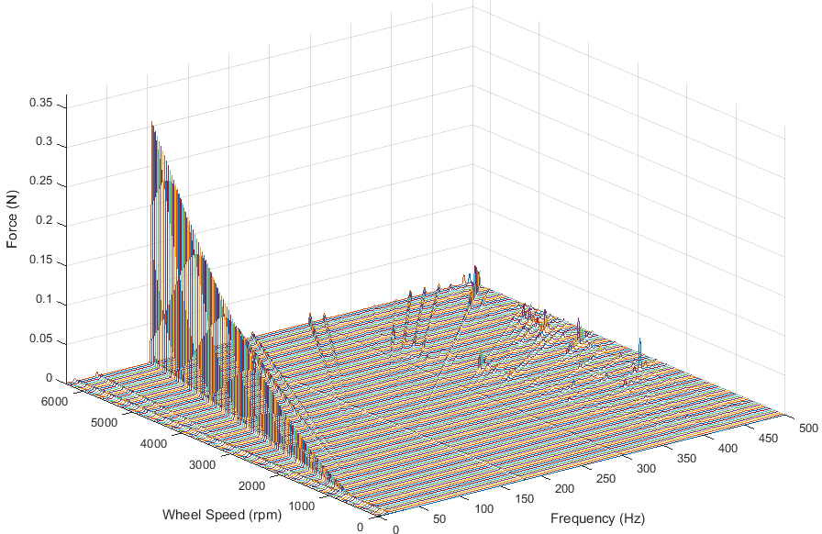
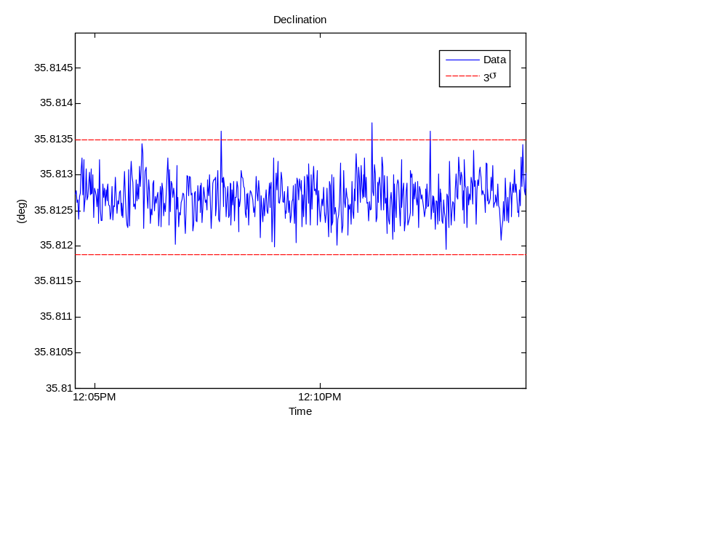
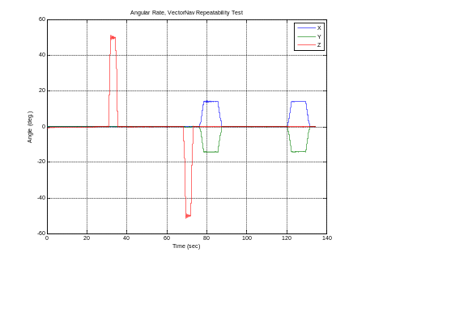
JPL’s SmallSat Dynamics Testbed (SSDT)
Gyro Characterization
Reaction Wheel Characterization
Star Tracker Characterization
Angle random walk,
Rate random walk,
Angle white noise,
Quantization,
Bias repeatability,
Scale factor
Sense axis
Force amplitudes as a function of wheel speed and frequency content
Torque amplitudes as a function of wheel speed and frequency content
Noise equivalent angle,
Low frequency error,
Acceleration/velocity limits on tracking

Slide 3
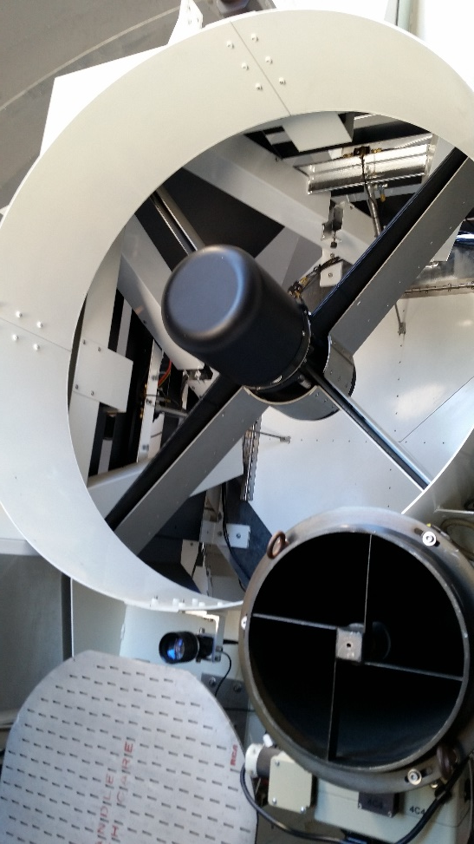
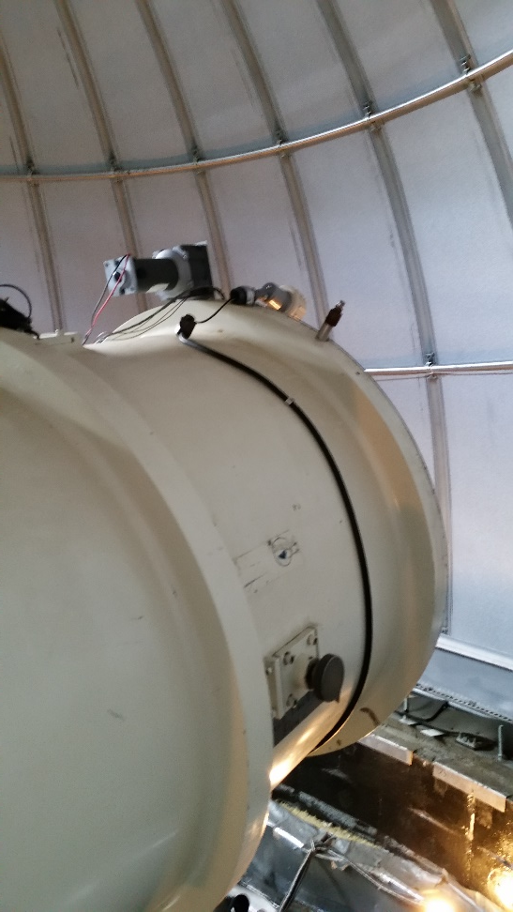
Test Facility: Table Mountain Observatory
Parameter | Optical Communication Telescope (OCTL) | Table Mount Observatory 0.6m Telescope
Mount | Azimuth-Elevation | Equatorial
Error | 3.1 arcseconds | 0.5 arcseconds
Max. Slew Rate | Az: 19 deg/s El: 10 deg/s | 1 deg/s
Tests Conducted with this Facility | Rate and Acceleration Limits | Noise Equivalent Angle (NEA) Low Frequency Error (LFE)
Test Dates | August 31st, 2015 10 PM to 4 AM | August 26st, 2015 10 PM to 4 AM
Mounted star tracker to secondary mirror assembly of facility telescope
  Did not directly measure hardware mounting errors
Pointed the facility telescope in profiles designed to evaluate specific components of star tracker error
  Large inertias and capable slewing platform enabled tests unavailable to the broader community
OCTL
0.6m Tel.

Slide 4
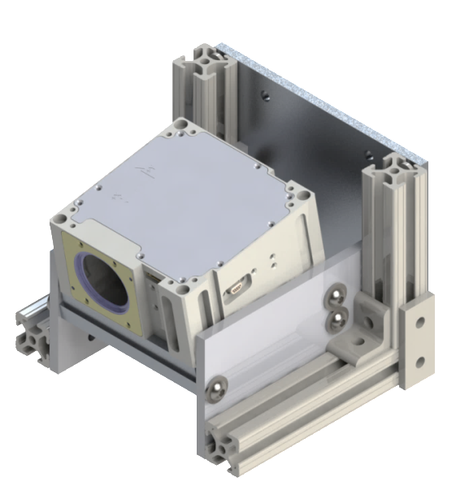
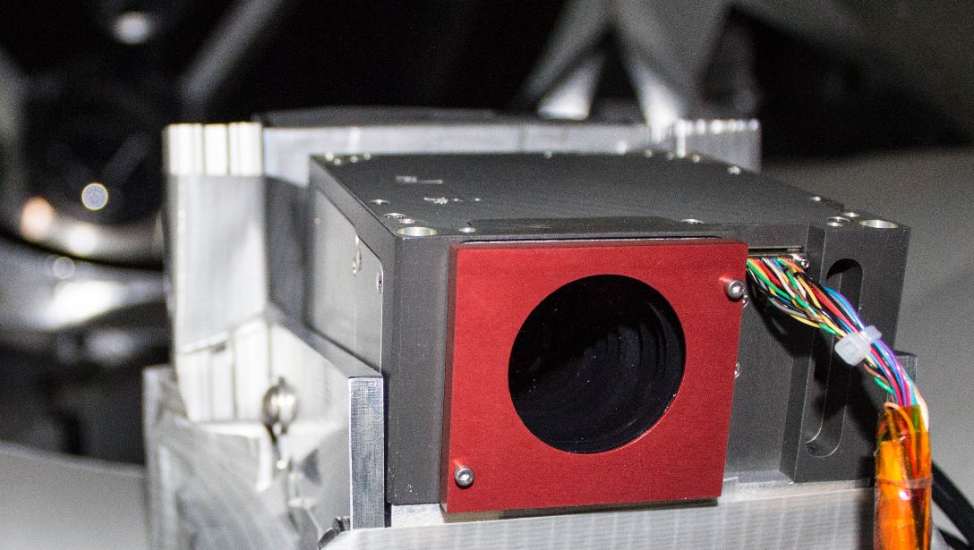
Test Article: BCT’s Nano Star Tracker
Vendor | Blue Canyon Technologies
Configuration | Nano Star Tracker, Embedded in XACT unit
Year of Purchase | 2014
Software Version Build Date | 3IMG1063D August 26, 2015
Attitude Solution Update Rate | 5 Hz
Field of View | 10° x 12°
Keep Out Zone | +/- 45°
Interfacing Software | BCT MATLAB GUI
Vendor-Specified Boresight Accuracy | 6 arcseconds (1-σ)
Vendor-Specified Roll Axis Accuracy | 40 arcseconds (1-σ)
Catalog Epoch | 2016.5 (Julian Date)
Nominal Stars Tracked | 30 to 50 Stars
Boresight has a 10° cant that is taken into account in the mechanical interface to approximately align the facility telescope boresight and the star tracker boresight.
10cm
17.5cm
14.5cm
Unit owned by JPL’s SmallSat Dynamics Testbed
Testing was performed independently by the SSDT over the course of a year, with software updates from BCT installed over that duration
  Results were discussed with vendor
Removed SRU Cover before Tests

Slide 5
Star Tracker Error Types
Noise Equivalent Angle (NEA)
Stare at a field with a bright star on a pixel
Track the star to compensate for Earth’s rotation and maintain the star on a single pixel
Obtain the noise in the measurement over time
The standard deviation of the error is the NEA
Low Frequency Error (LFE)
Optical calibration residual errors
Point tracker towards local zenith
Detect star movement across FOV of the SRU camera through the rotation of the Earth
Obtain noise in the measurement over time
The standard deviation of the error is a roll up of the NEA and LFE.
High Frequency Error (HFE)
Errors due to stars moving across pixel edges

Slide 6
Star Tracker Error Types
Noise Equivalent Angle (NEA)
Stare at a field with a bright star on a pixel
Track the star to compensate for Earth’s rotation and maintain the star on a single pixel
Obtain the noise in the measurement over time
The standard deviation of the error is the NEA
Low Frequency Error (LFE)
Optical calibration residual errors
Point tracker towards local zenith
Detect star movement across FOV of the SRU camera through the rotation of the Earth
Obtain noise in the measurement over time
The standard deviation of the error is a roll up of the NEA and LFE.
High Frequency Error (HFE)
Errors due to stars moving across pixel edges

Slide 7
Star Tracker Error Types
Noise Equivalent Angle (NEA)
Stare at a field with a bright star on a pixel
Track the star to compensate for Earth’s rotation and maintain the star on a single pixel
Obtain the noise in the measurement over time
The standard deviation of the error is the NEA
Low Frequency Error (LFE)
Optical calibration residual errors
Point tracker towards local zenith
Detect star movement across FOV of the SRU camera through the rotation of the Earth
Obtain noise in the measurement over time
The standard deviation of the error is a roll up of the NEA and LFE.
High Frequency Error (HFE)
Errors due to stars moving across pixel edges

Slide 8
Noise Equivalent Angle Performance
Conditions of Test
Target | Bright star on a pixel
Duration of Each Test | 10 – 15 minutes
Pointing Conditions | Inertially pointed, Elevation angle > 60°
Number of Tests | 6 tests
Date of Tests | August 26, 2015
Facility | 0.6m Telescope
Data used for Analysis | SRU Declination
Test 9
NEA Results (1σ)
Test 2 | 1.3452 arcseconds | 19 Stars Tracked
Test 3 | 3.5073 arcseconds | 20 Stars Tracked
Test 4 | 1.2873 arcseconds | 8 Stars Tracked
Test 5 | 1.3054 arcseconds | 8 Stars Tracked
Test 9 | 0.9704 arcseconds | 12 Stars Tracked
Test 10 | 4.3556 arcseconds | 16 Stars Tracked
Test Mean | 2.1285 arcseconds | 13 Stars Average

Slide 9
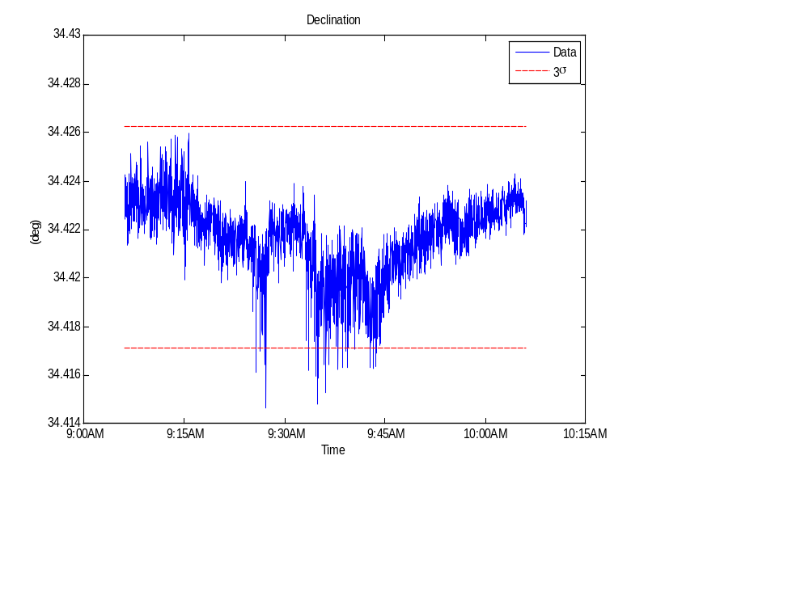
NEA+LFE+HFE Boresight & Roll Performance
Conditions of Test
Target | Local Zenith
Duration of Each Test | ~60 minutes
Pointing Conditions | Zenith pointed
Number of Tests | 2 tests
Date of Tests | August 26, 2015
Facility | 0.6m Telescope
Data used for Analysis | SRU Declination
Test 6
NEA+LFE+HFE Results (1σ)
 | Boresight | Roll | # Stars Tracked
Test 1 | 2.1424 arcseconds | 31.9468 arcseconds | 19 Stars Tracked
Test 6 | 5.4779 arcseconds | 48.5696 arcseconds | 9 Stars Tracked
Test Mean | 3.8102 arcseconds | 40.2321 arcseconds | 14 Stars Average

Slide 10
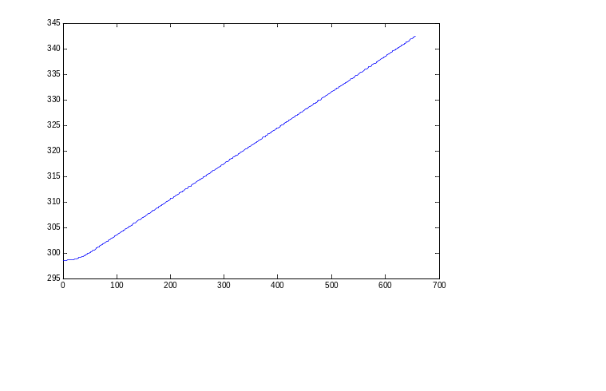

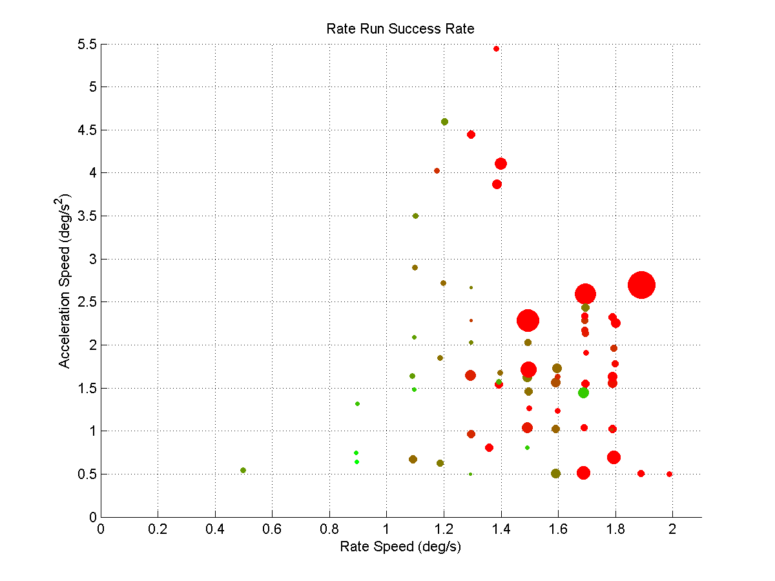
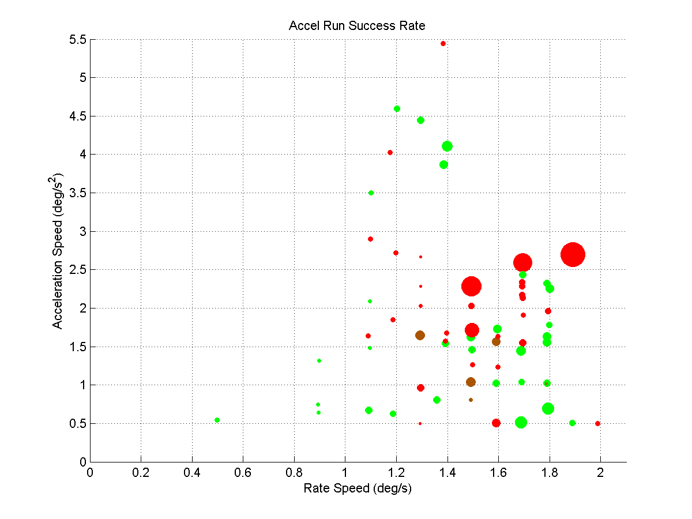
Rate and Acceleration Limits
Conditions of Test
Target | Unobstructed sky
Duration of Each Test | 1 minute
Pointing Conditions | Programmed acceleration and rate curve
Average Stars Tracked | 9 Stars Tracked
Number of Tests | 110
Date of Tests | August 31, 2015
Facility | OCTL
Marker Size
Difference from SRU to OCTL
Attitude Profile
Low Diff.
High Diff.
Rate Portion
Low Track %
Marker Color
High Track %
Accel Portion

Slide 11
Conclusions
NST Performance | Vendor-Specified Performance | Measured (Average from Tests)¹
Noise Equivalent Angle (NEA) Boresight | None Specified | 2.13 arcseconds (1σ)
NEA + LFE + HFE Boresight | None Specified, but Boresight Accuracy reported as 6 arcseconds (1σ) | 3.81 arcseconds (1σ)²
NEA + LFE + HFE Roll | None Specified, Roll Accuracy reported as 40 arcseconds (1σ) | 40.23 arcseconds (σ)³
Slew Rate Tracking Threshold | >= 0.5 deg/s | Minimal Degradation at 1 °/s Variable performance up to 2 °/s
Slew Acceleration Limit | None Specified | Varies between 1 °/s² to 5 °/s²
Natural environmental factors not included in analysis numbers. These include ground/space differences, telescope error, quality of night sky, # of stars tracked, thermal alignments, etc.
The best test resulted in 2.14 arcseconds for accuracy, but the average between 2 tests of the NEA+LFE+HFE accuracy was used to obtain this value
The best test resulted in 31.95 arcseconds for accuracy, but the average between 2 tests of NEA+LFE+HFE accuracy as used to obtain this value

