Slide 1

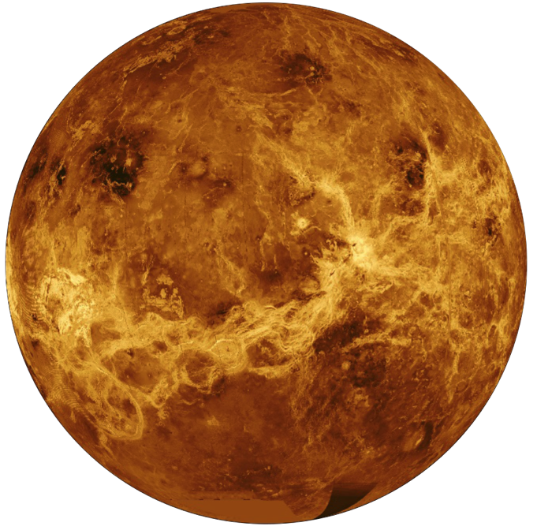
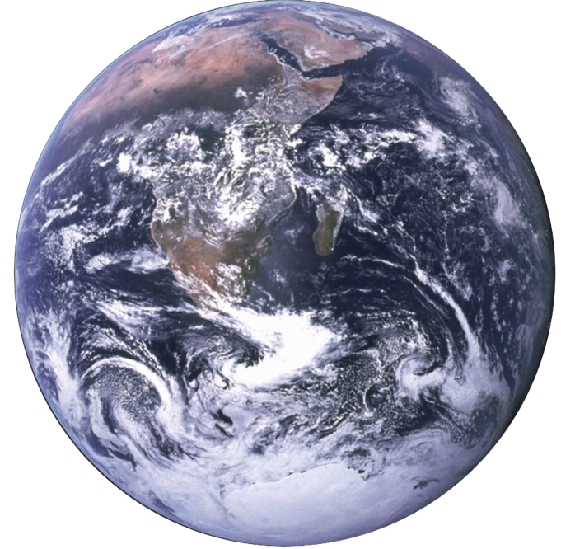
Sampling Venus’ atmosphere with a low-cost, free-flying Smallsat probe mission concept
Tony Freeman, Christophe Sotin, Murray Darrach, John Baker
Jet Propulsion Laboratory
April 2016
National Aeronautics and Space Administration
Copyright 2015 California Institute of Technology
Government sponsorship acknowledged

Slide 2

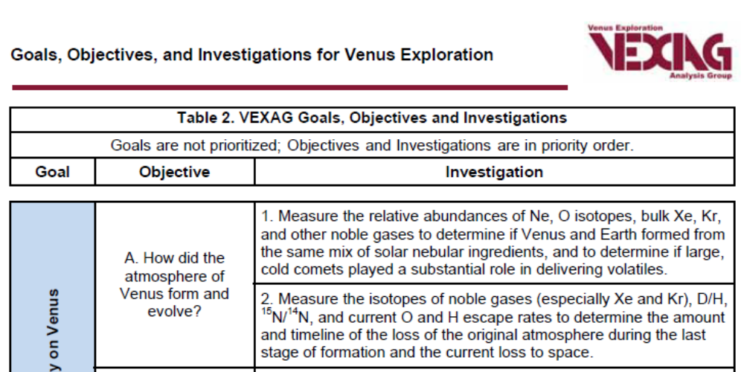
Goal I: Atmospheric formation, evolution and climate history
Notes:
At a time where we discover exoplanets and are looking for Earth #2, it is crucial to understand the reasons why Earth and Venus have evolved so differently although having very similar properties. One of the key feature of the Earth is the presence of plate tectonics.

Slide 3
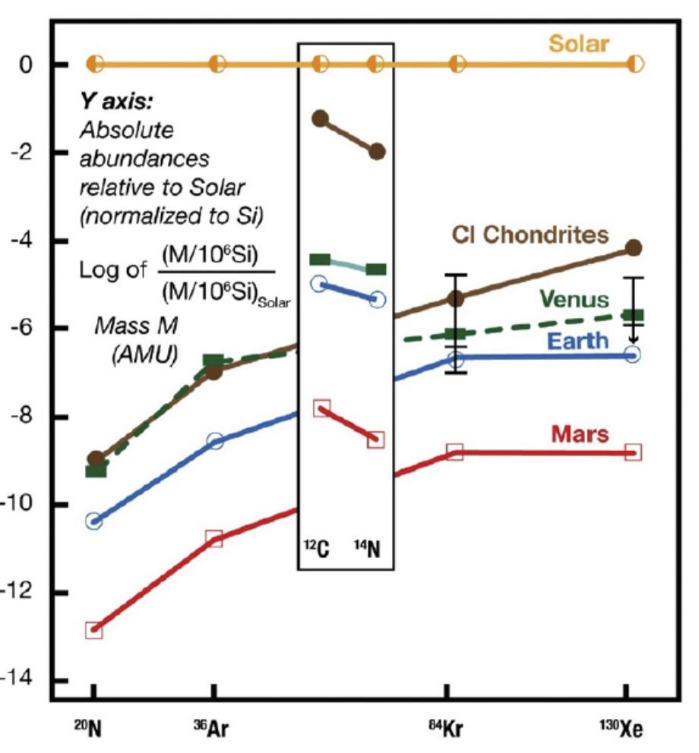
Noble gases are tracers of the evolution of planets
They trace:
The supply of volatiles from the solar nebula
the supply of volatiles by asteroids and comets
the escape rate of planetary atmospheres
the degassing of the interior (volcanism)
the timing of these events
For example Xe (9 isotopes):
Depleted / Kr
Fractionated in mass
Comparative planetology will help determine the processes involved in the distribution of noble gases
Pepin et al., 1991; Chassefiere et al., 2012)
Notes:
It is Ne and not N. Bernard Marty call it the Rosetta stone of planetary science. Xe is depleted relative to Krypton – however the nine isotopes of Xe show mass fractionation. 3 isotopes come from the decay of 129I and 244Pu, and 235,238U

Slide 4
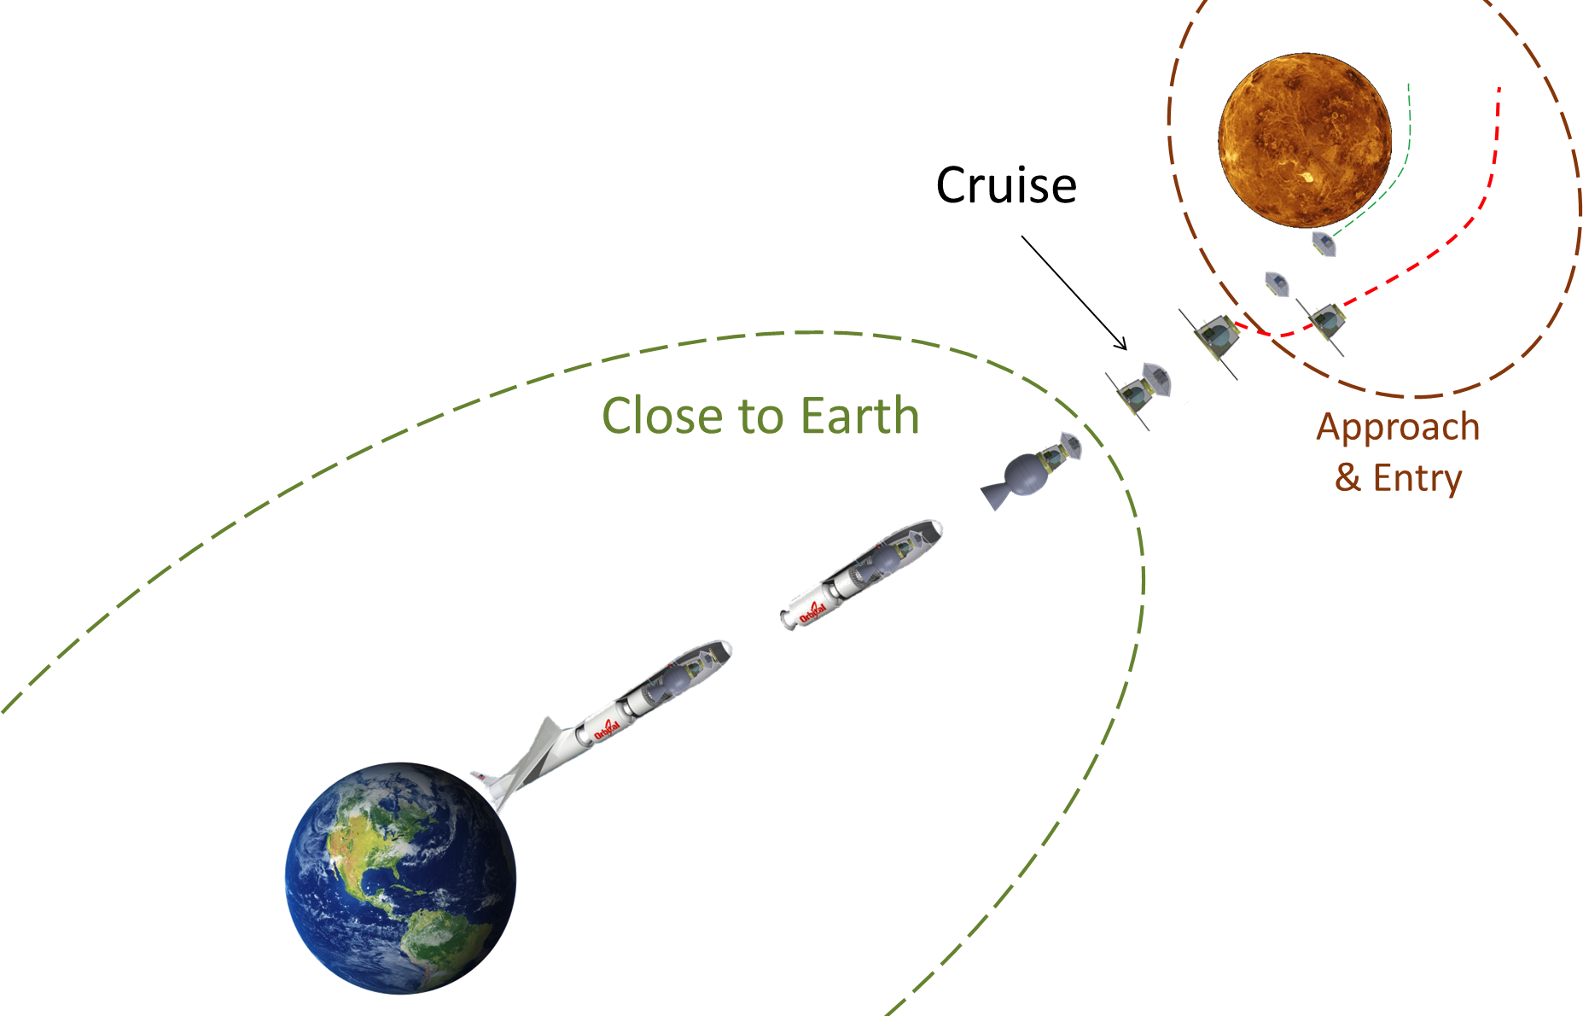
Mission-Level ConOps

Slide 5
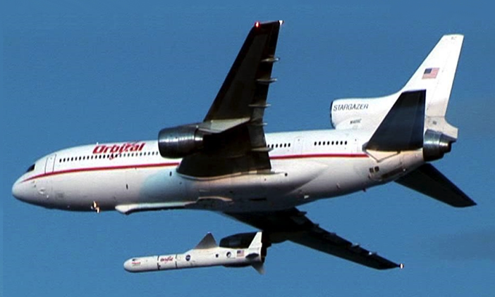
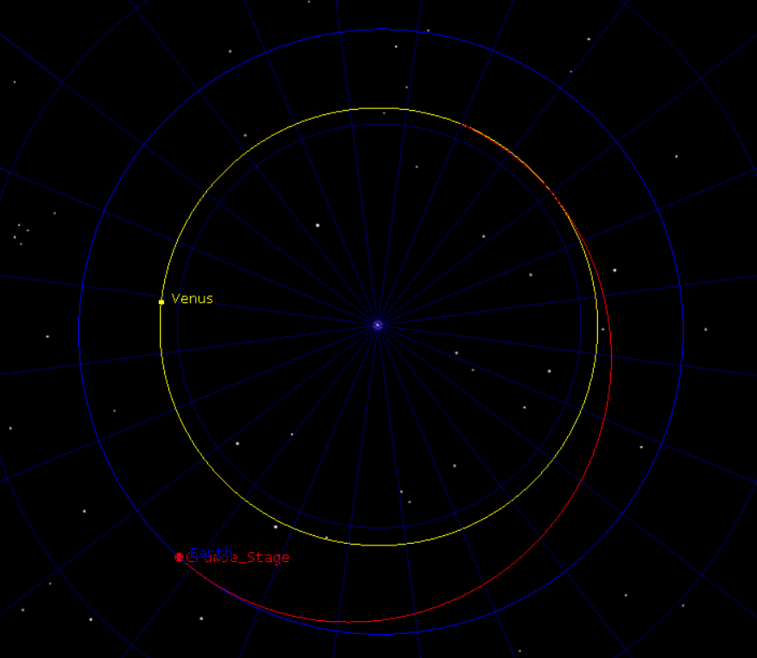
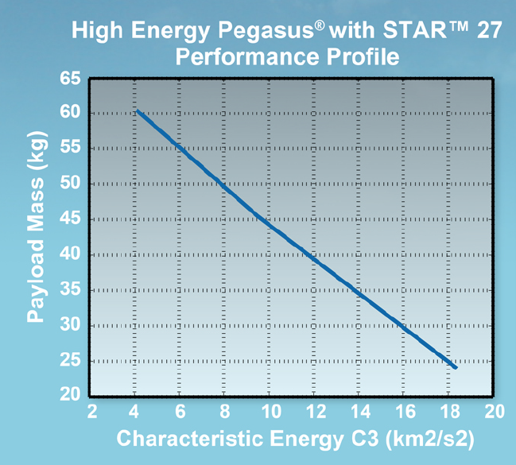
L/V + Trajectory
OSC Pegasus XL L/V with a STAR27H motor*
Nominal Launch Date: 05/18/23 12:00 UTCG
C3 = 6.1km²/s² for a 55 kg payload
Type II direct transfer
Venus @ Arrival
Venus @ Launch
Earth @ Launch
    *Source: Warren Frick, et. al., “Micro High Energy Upper Stage,” SmallSat Conf., Logan, Utah, (2014).
5

Slide 6
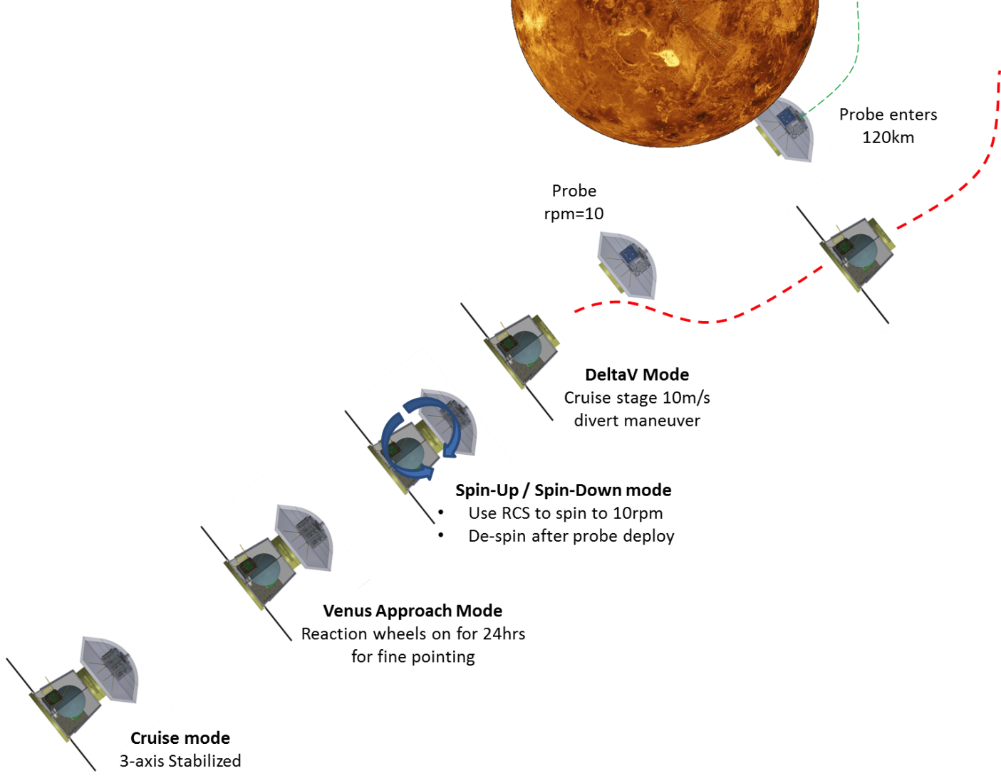
Near-Venus ConOps
5 month cruise phase
10 m/s ΔV for TCMs
10 m/s ΔV for divert maneuver
Spin up to 10 rpm on approach

Slide 7
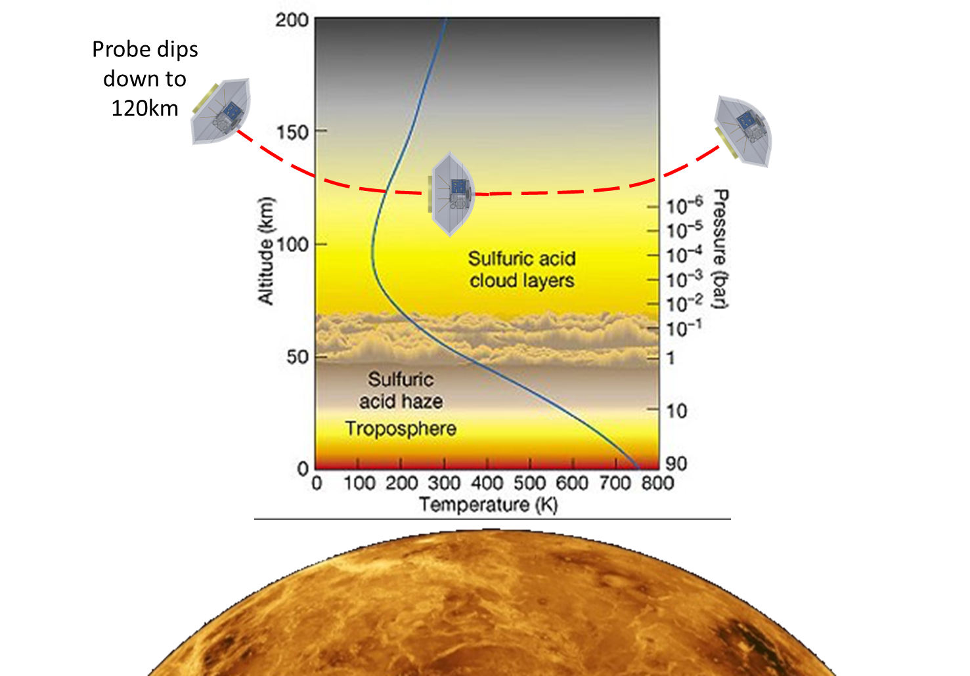
Atmospheric Entry Conditions

Slide 8
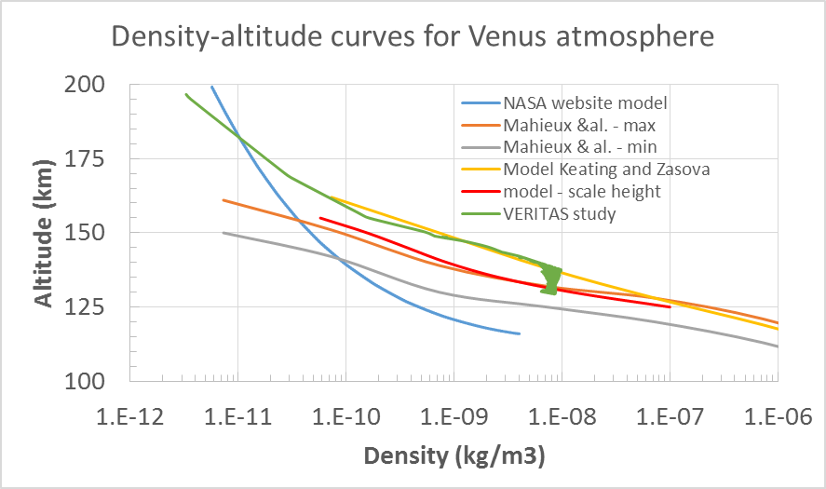
Density profile
The values of density are required for the instrument performance model and for the design of the probe

Slide 9
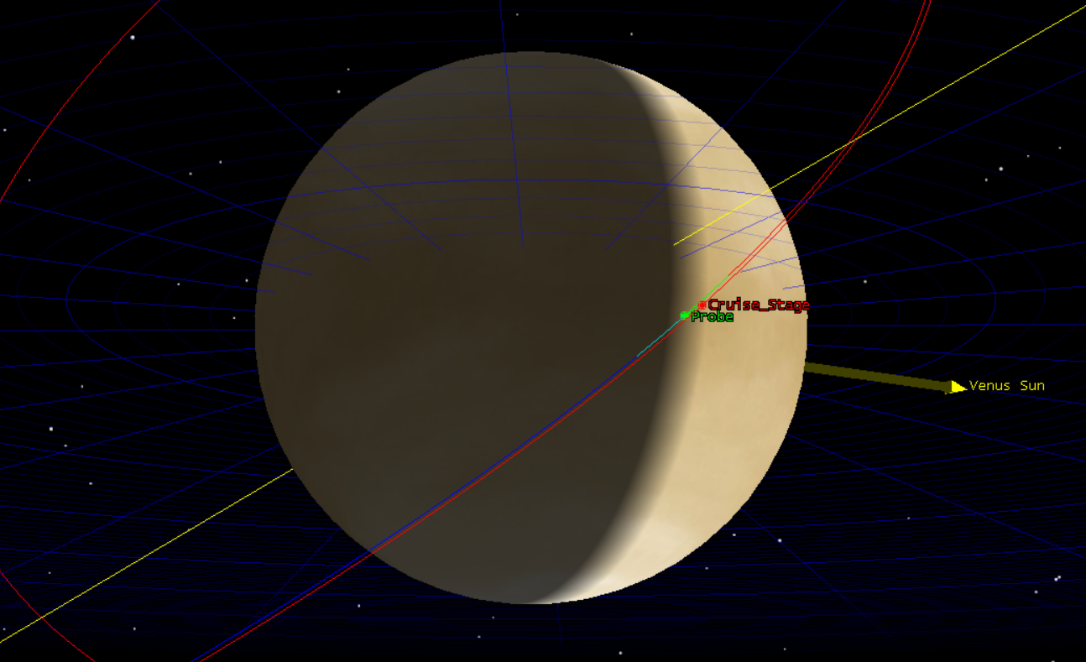
Mission Design
Encounter: 24 Oct 2023 19:10:05.000 UTCG
Atmospheric Entry
Atmospheric Departure
Direction of Motion
9

Slide 10
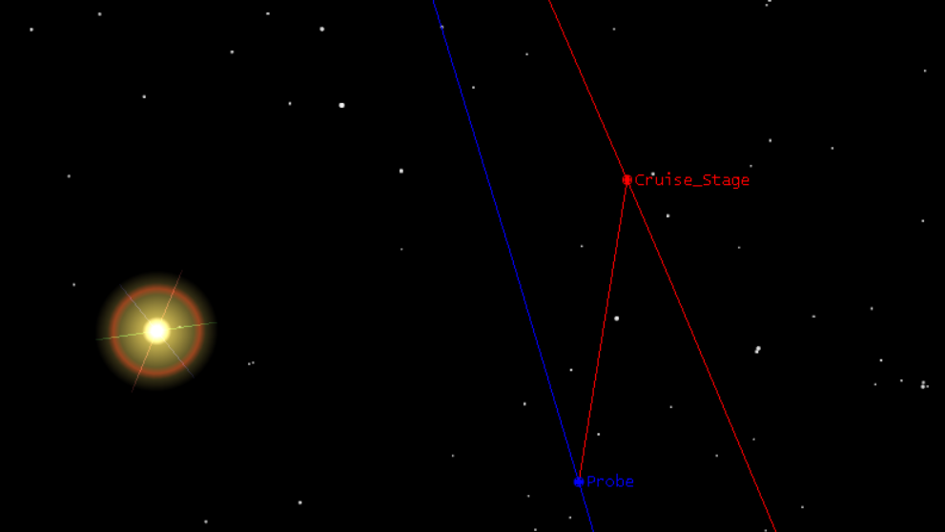
Mission Design
Processing/crosslink/downlink takes place entirely in view of Sun & Earth, maximum separation: ~1310 km
Crosslink Range
10

Slide 11
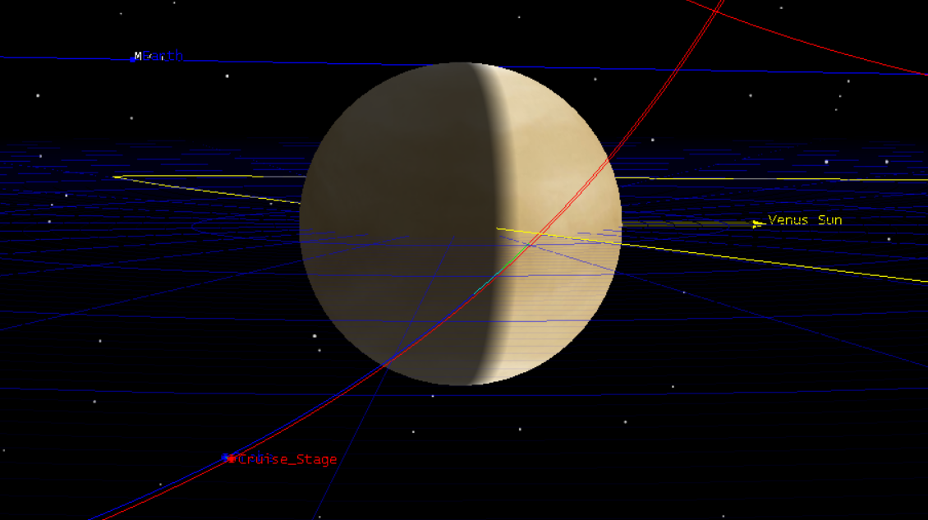
Mission Design
Processing/crosslink/downlink takes place entirely in view of Sun & Earth, maximum separation: ~1310 km
Earth Line of Sight
Sun Line of Sight
11

Slide 12
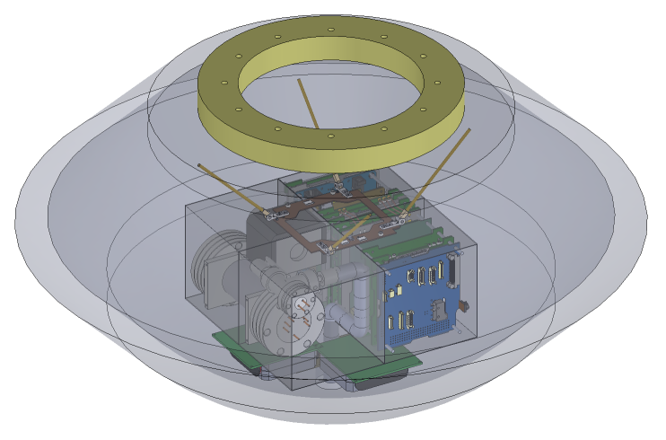
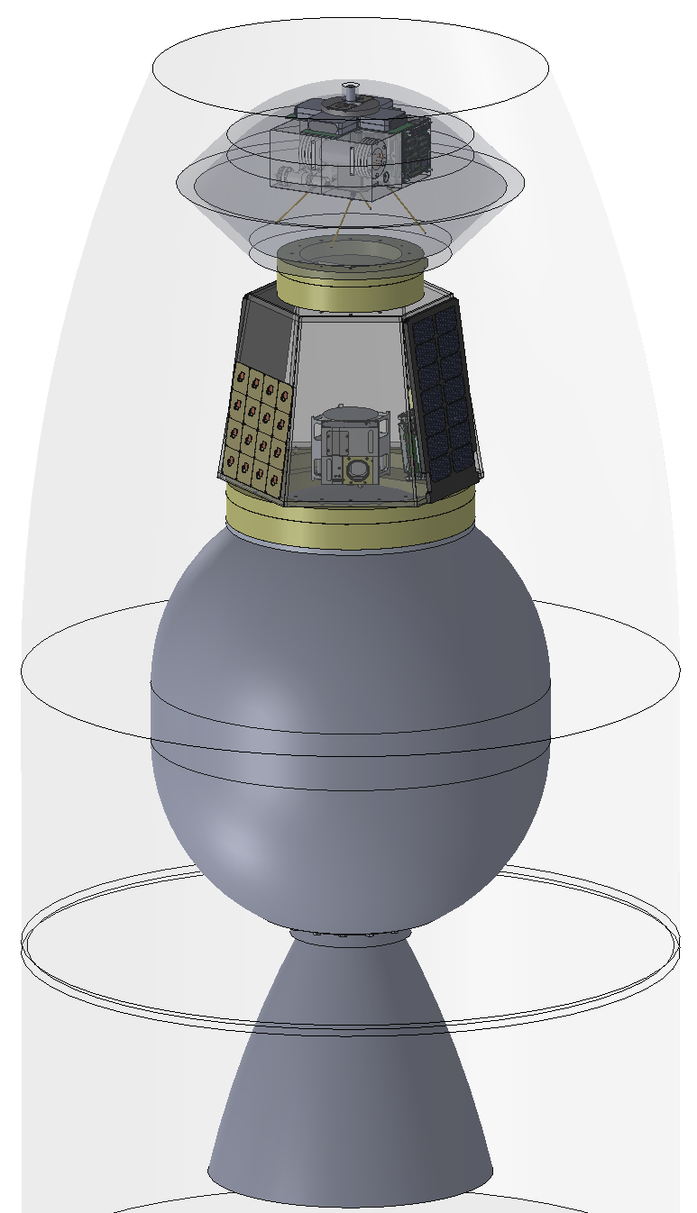
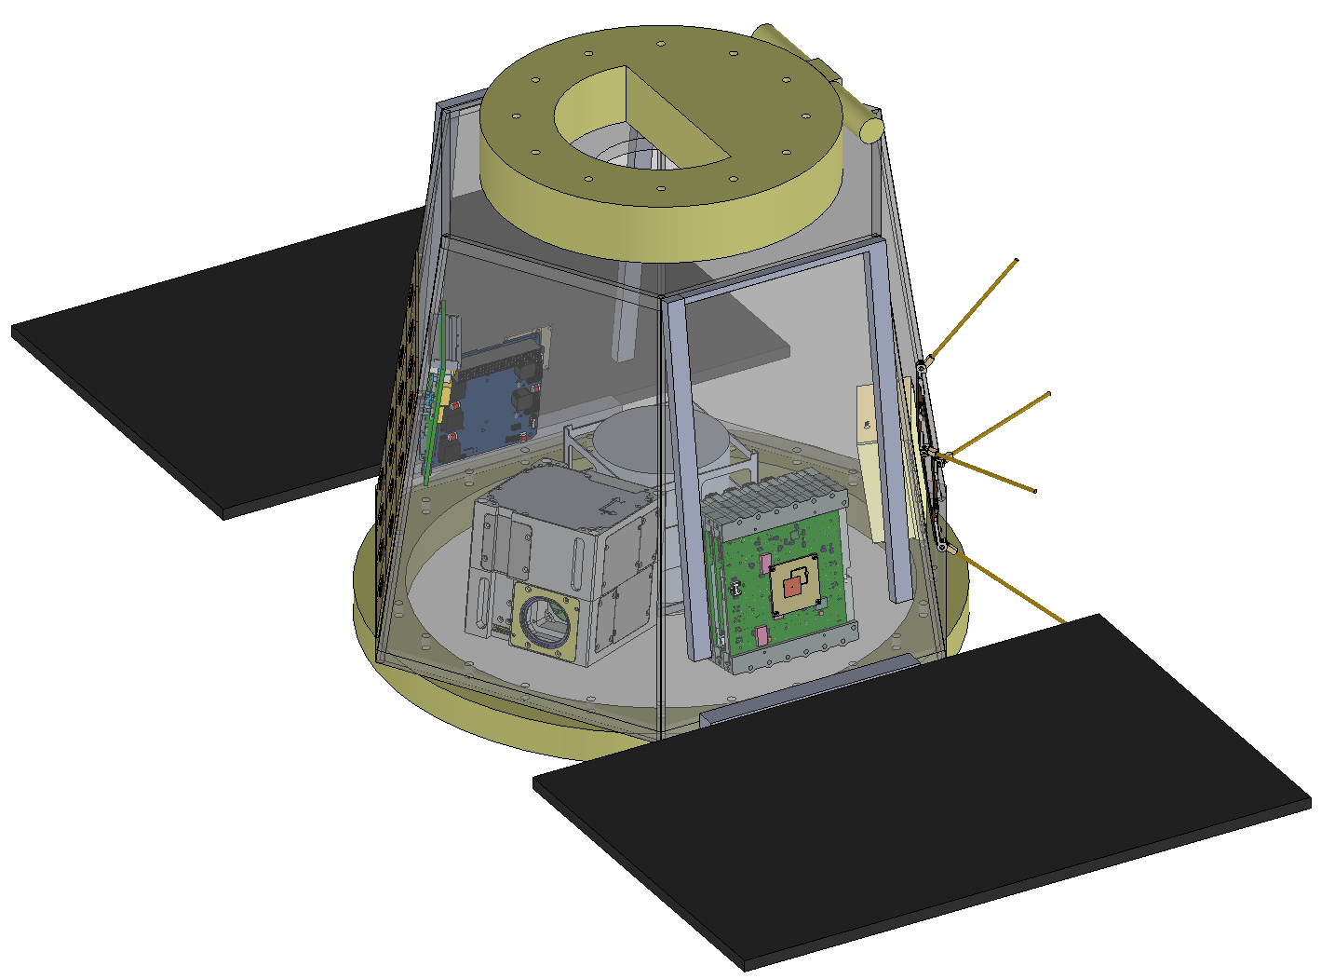
Design Configuration
Probe
STAR27H
SRM
Entire Stack in
Pegasus XL Launch Fairing
Cruise Stage

Slide 13
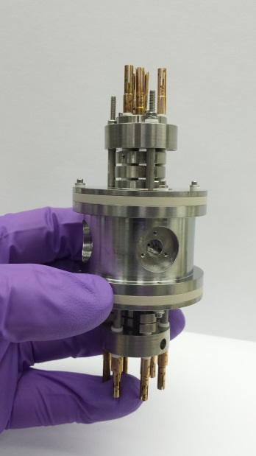
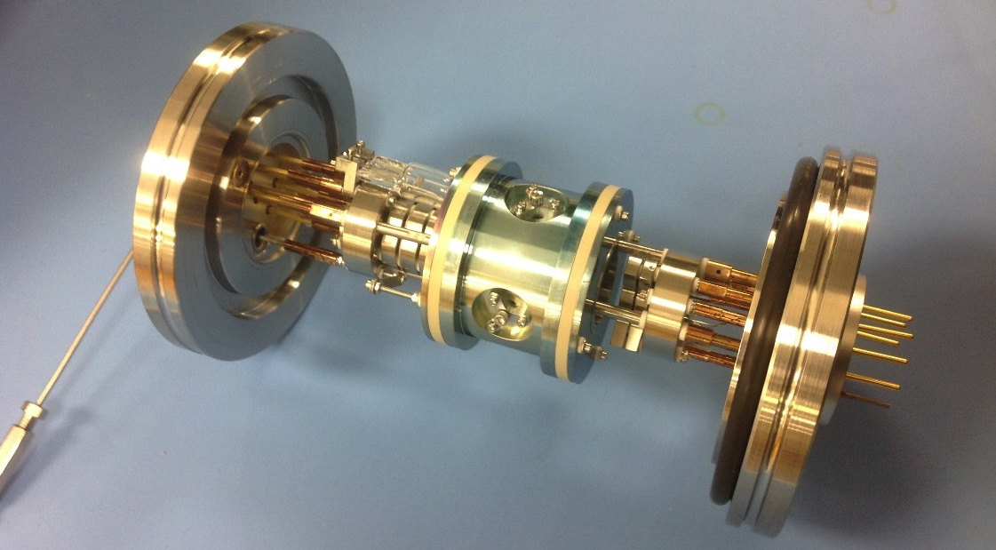
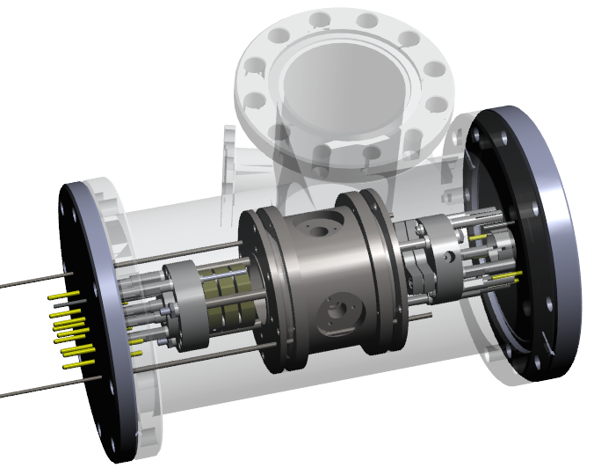
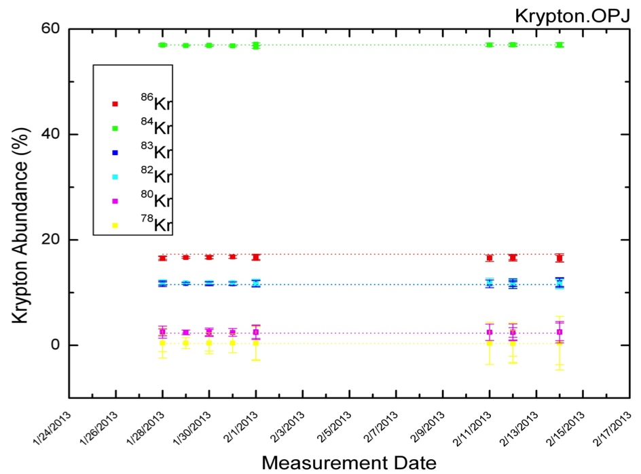
Cupid’s Arrow Quadrupole Ion Trap Mass Spectrometer (QITMS)
Compact QITMS
No discrete wires to make electrical connections to mass spectrometer parts.
7.3 kg mass; 4U volume
Extremely robust against shock/vibe loads
QITMS Isotopic Precision is 3-5 times better than required

Slide 14
Instrument Requirements vs. Performance
Performance versus requirements for noble gases ratio
 |  | Expected Intensity (cnts)
Approximate Isotopic Ratios | Assumed Fractional Abundance | Major] | Minor | Precision [%] | Requirement*
3He / 4He | 0.0003 | 2.80E+08 | 8.39E+04 | 0.345 | 5 to 10
20Ne / 22Ne | 12 | 1.63E+08 | 1.36E+07 | 0.028 | 1
36Ar / 40Ar | 0.9 | 9.32E+08 | 8.39E+08 | 0.005
36Ar / 38Ar | 5.4 | 1.08E+08 | 2.00E+07 | 0.024 | 1
82,83,86Kr / 84Kr | 1 | 1.63E+05 | 1.63E+05 | 0.350 | 1
129, 136 Xe / 130Xe | 1 | 2.33E+04 | 2.33E+04 | 0.926 | 1
124-128Xe / 130Xe | 0.2 | 2.33E+04 | 4.66E+03 | 1.605 | 5
Measurements integrated over 5 mins
*Chassefiere et al., 2012
Notes:
Measure the relative abundances of Ne, O isotopes, bulk Xe, Kr, and other noble gases to determine if Venus and Earth formed from the same mix of solar nebular ingredients, and to determine if large, cold comets played a substantial role in delivering volatiles

Slide 15
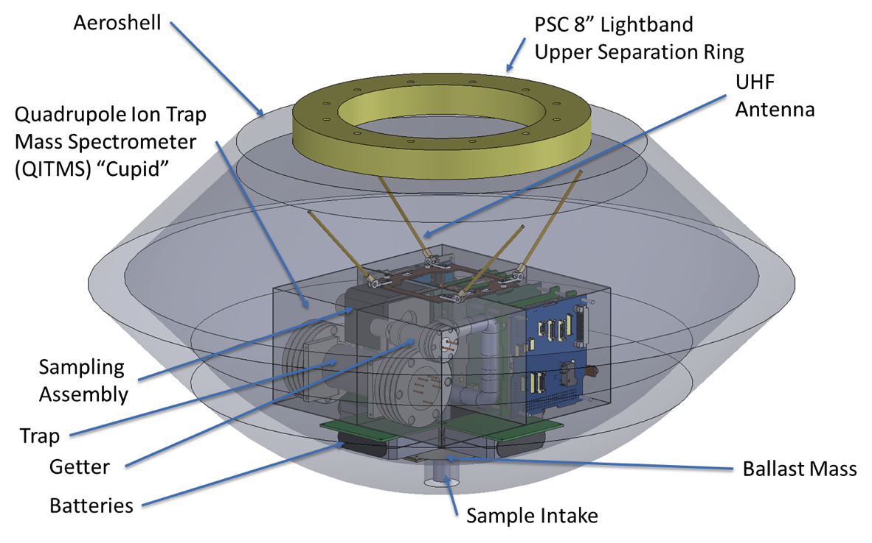
Design Summary - Probe
Instrument
  8 kg Quadrupole Ion Trap Mass Spectrometer (QITMS)
  Pressure transducer
Telecom
  Vulcan UHF transceiver
  NanoCom ANT430 UHF dipole antenna
Mechanical
  4kg aeroshell structure
    UHF transparent material allows crosslink through the backshell
  3kg TPS
  2.5kg internal structure
  1kg harness
  0.5kg balance mass
  0.5kg for upper half of Lightband
Total Mass 21.6 kg
Total Volume: 17 liters
C&DH
  JPL Sphinx Avionics
Thermal
  MLI and Heaters
Power
  10 Saft LO30SHX primary battery cells
  0.1kg Custom EPS
15

Slide 16
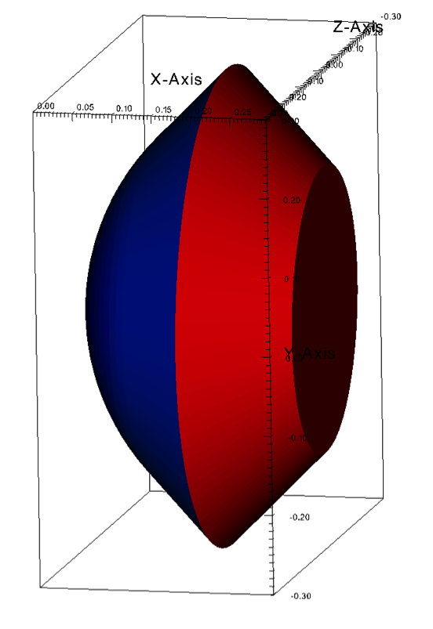
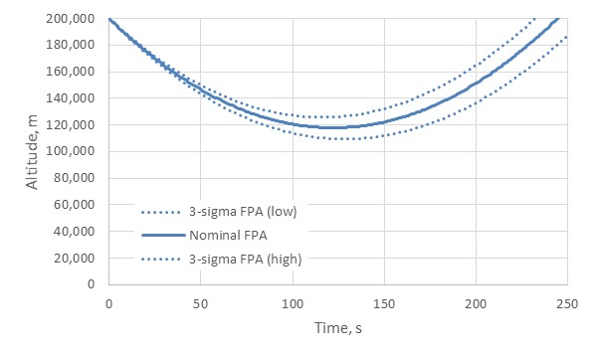
Probe Design
Entry probe shape
  45 deg sphere-cone
    Scaled-up version of Hayabusa probe; Pioneer-Venus also 45 deg s-c
  D = 60 cm (diameter), Rn = 30 cm (nose radius)
  Assumed constant drag coefficient of 1.12 based on Hayabusa data
  Design for worst-case altitude of 110 km
16

Slide 17
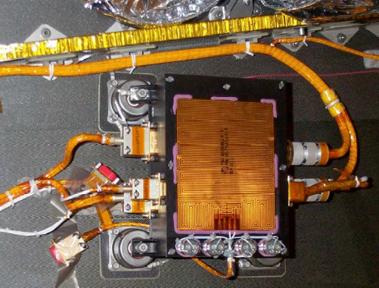
Probe Thermal Design
Simplified heatshield TPS stackup:
  PICA, RTV-560 adhesive, Aluminum
3-sigma low altitude (~110 km) drives TPS design
  (Margined) Peak heat flux is ~150 W/cm²
  (Margined) Max heat load is >9200 J/cm²
Tayco custom film heaters for survival circuits
Backshell
Backshell Interior MLI
Aeroshell
Payload MLI
Payload
Aeroshell Interior MLI
Low Conductance Ti6Al4V Bipods

Slide 18
Cruise Stage Design
Aerojet Rocketdyne CHAMPS Hydrazine Propulsion System
PSC 8” Lightband Lower Separation Ring
Space Dynamics Lab Pearl EPS
+ NanoPower BP4 battery pack
Iris v2 Radio
Sphinx C&DH Board
GomSpace
NanoCom
UHF Antenna
E-HAWK Solar Panels
Vulcan UHF Transceiver
4x4 Patch Array Transmit Antenna
Patch Antenna
Blue Canyon ACS System
PSC 15” Lightband Upper Separation Ring
Total Mass: 18 kg

Slide 19
Venus Probe Free-Flyer
Key Technical Parameters
Mass | Probe Mass 22 kg; Cruise stage Mass 18 kg; Mass Margin 14 kg
Dimensions | Aeroshell is a 45-degree sphere cone; Diameter 60 cm; Cone radius 30 cm
Power | 63 W BOL eHawk arrays on cruise stage (margin 43%); 28 V dc, 2W supplied to heater and battery charger prior to deployment; batteries supply 37 watt-hours after release of probe
Instrument | Mass 7.3 kg; volume (incl. electronics) 4U
Data Interface | RS422, SPC, I2C, or GPIOs for command/telemetry; SpaceWire for data
Thermal | Max heat load on probe is >9200 J/cm2
Data Volume/rate | 16 Mb; crosslinked over UHF 60 kbps link for 5 minutes; X-band return to Earth via 34 m DSN station over ~ 9 hours
Range for comms | Communication between carrier and probe at ranges < 1310 km
Mechanical | Lightband COTS deployer used
Payload | Ultra-compact Quadrupole Ion Trap Mass Spectrometer (QITMS)
CubeSat Avionics | Radiation tolerant Sphinx C&DH; Blue Canyon ACS
Deployment | On approach, spin up to 10 rpm, then release probe with -1.25 m/s Delta-V; Cruise stage then executes 10 m/s divert maneuver for flyby
Aeropass | Minimum Altitude is less than or equal to 120 km; duration 3-4 mins; lat/long -11/-71 deg; entry angle ~ 7 deg
Environmental Conditions | 11 km/sec velocity at entry, density <10⁻⁶ kg/m³; max heating rate 150 W/cm²,

Slide 20
Conclusions
A free-flying SmallSat probe with mass < 55 kg could deliver high-priority science at Venus for a fraction of the cost of a conventional Discovery mission
Same approach could be adapted to other environments: Titan’s atmosphere, Enceladus’ plume, possible plume at Europa, …
The authors would like to thank Team Xc for their help in advancing the maturity of this concept

