Slide 1
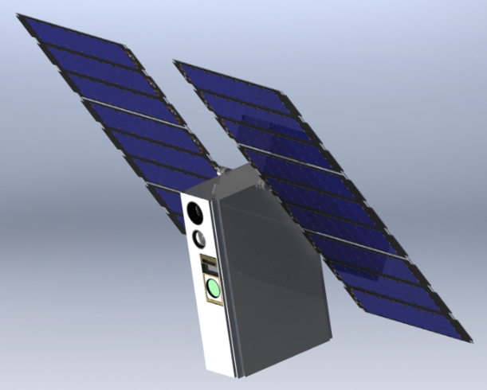
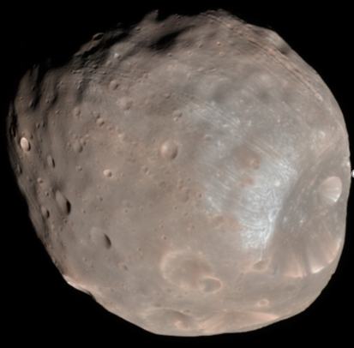
Devil’s LOGIC: Mission Description
6U CubeSat
Hosted payload mission to Phobos
  Nominal Launch: Mars 2020
Thermal and visible camera payload
2 year mission life
  Potential for extended mission (3 years)
Impulsive maneuver for Mars capture
7 month science mission studying Phobos
  15+ flyby’s achievable within 7 months
  Minimum of 5 flyby’s for science mission

Slide 2
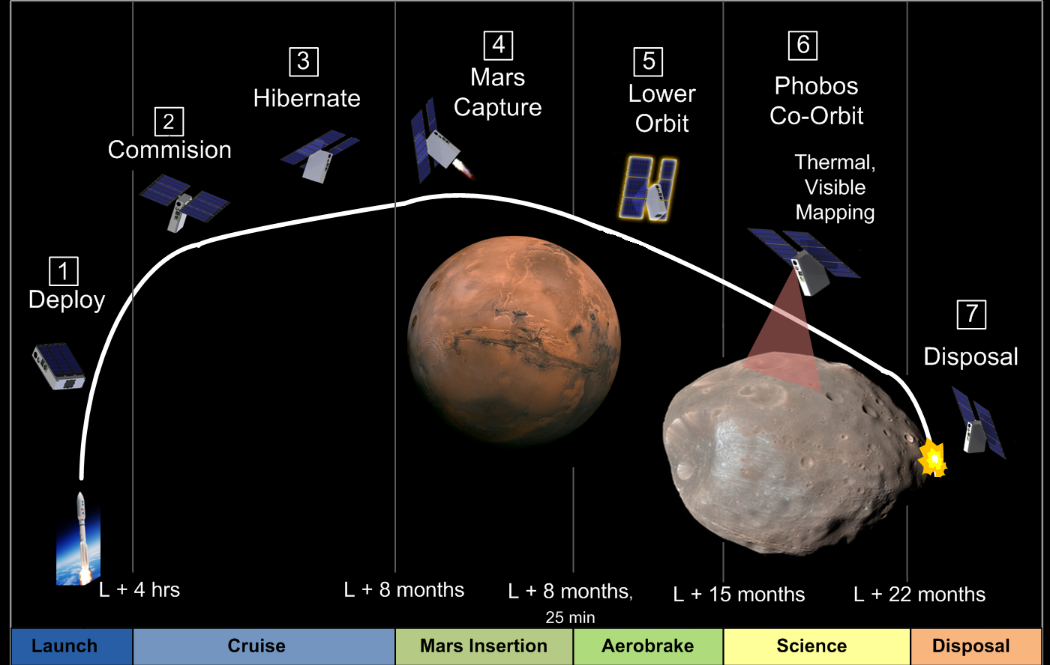
Concept of Operations

Slide 3
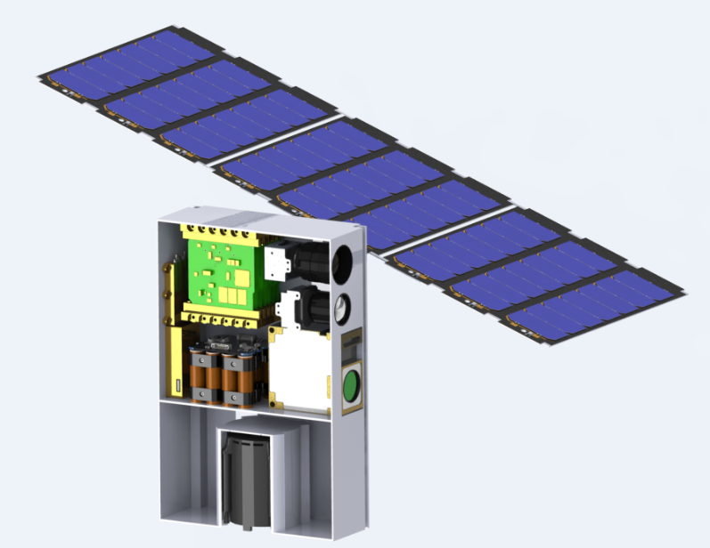
LOGIC Section View
MMA E-HaWK Solar and
X-Band Reflect Array
Hybrid
FLIR Tau-2 Thermal Camera
e2V Cires Visual Camera
JPL IRIS V2 X-Band Radio
SpaceCube MINI CPU
Blue Canyon Tech EPS
GomSpace BPX Batteries
Fuel Tank – 2400 cc
MPS-130 Green
Monopropellant Thruster
Blue Canyon Tech
XACT ADCS

Slide 4
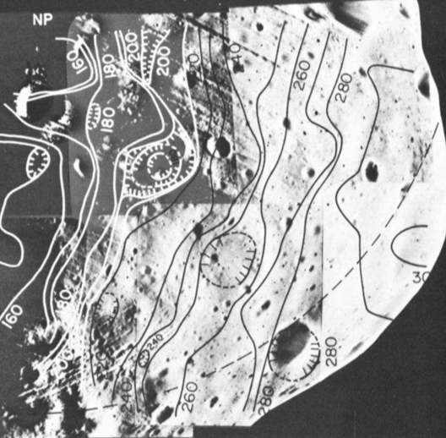
Science
Primary: Geo-structural features
  3 temperature measurements at different times of day with 50 % coverage
  Best data : Viking-IRTM (300m/pixel)
Secondary: Chronology of striation formation
  Stereo imaging at less than 1/10th of average striation width resolution with 50% coverage
  Best data: Mars Express-HiRise (3m/pixel)
Lunine et al. IR Observations of Phobos and Deimos
ESA/DLR/FU Berlin (G. Neukum)

Slide 5
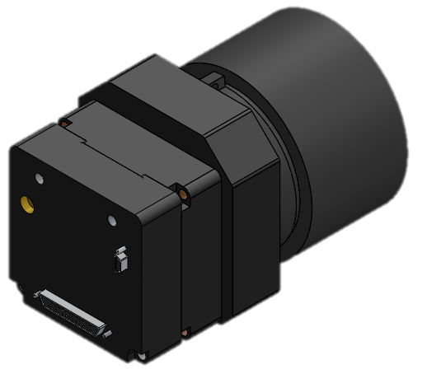
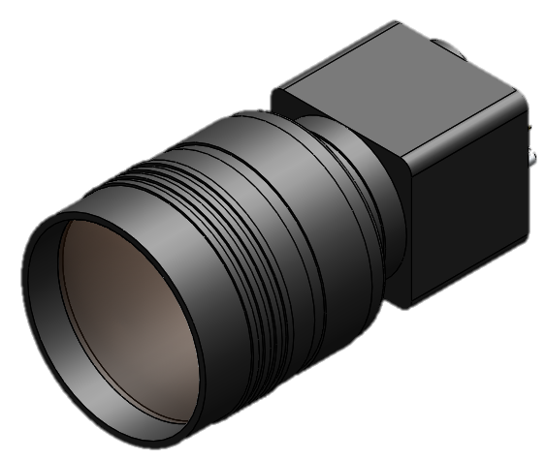
Science Instruments
Thermal Camera
  Flir Tau 2 (Cameralink module & 35 mm lens)
    24.75 m/pixel achievable at 50 km altitude
    18° x 14° Field of View
    NEΔT 50 mK
  Data Return
    96 images nominal (40 MB)/ 48 images min (20 MB)
Visual Camera
  E2V Cires (Pentax B5014A 50 mm lens)
    5.29 m/pixel achievable at 50 km altitude
    7° x 6° Field of View
    SNR 39 dB & DNR 60 dB
  Data return:
    224 images nominal (367 MB)/ 112 images min (184 MB)
NFOV 35 mm lens
Tau 2 core
Cameralink module
Cires core
Pentax 50mm lens

Slide 6
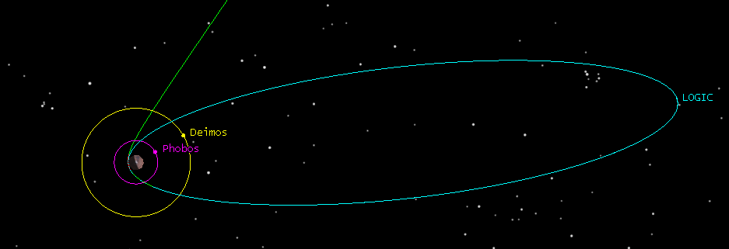
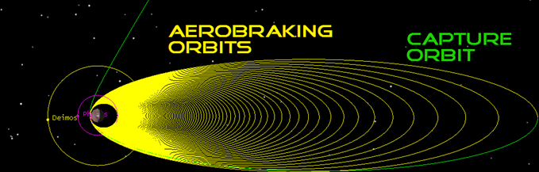
Spacecraft Trajectory
Mars Transfer Orbit
  7 month cruise
Elliptical Capture Orbit
  25 min burn to capture
  Period: 13 Days 17 Hours
Aerobraking
  6 – 9 Months
  1 - 4 m/s per pass
Phobos Intercept
  7 Month Science Mission
    5 – 10 encounters achievable without fuel
    Capable of 35+ encounters using propellant

Slide 7
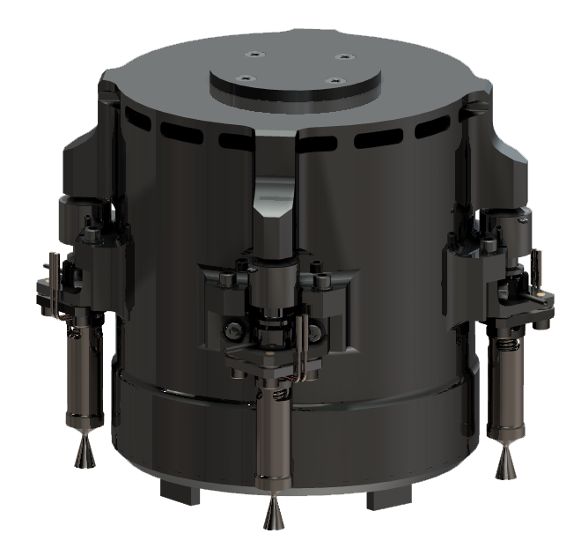
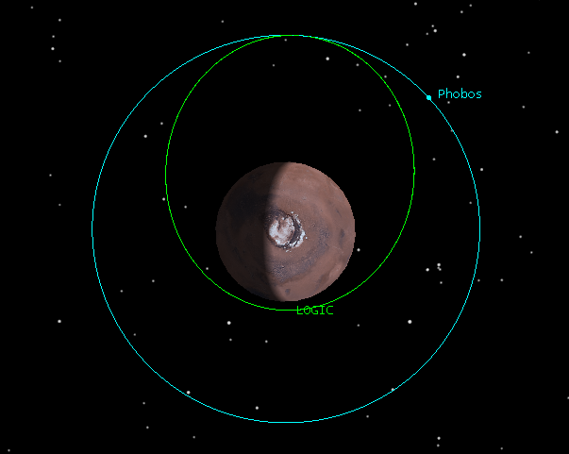
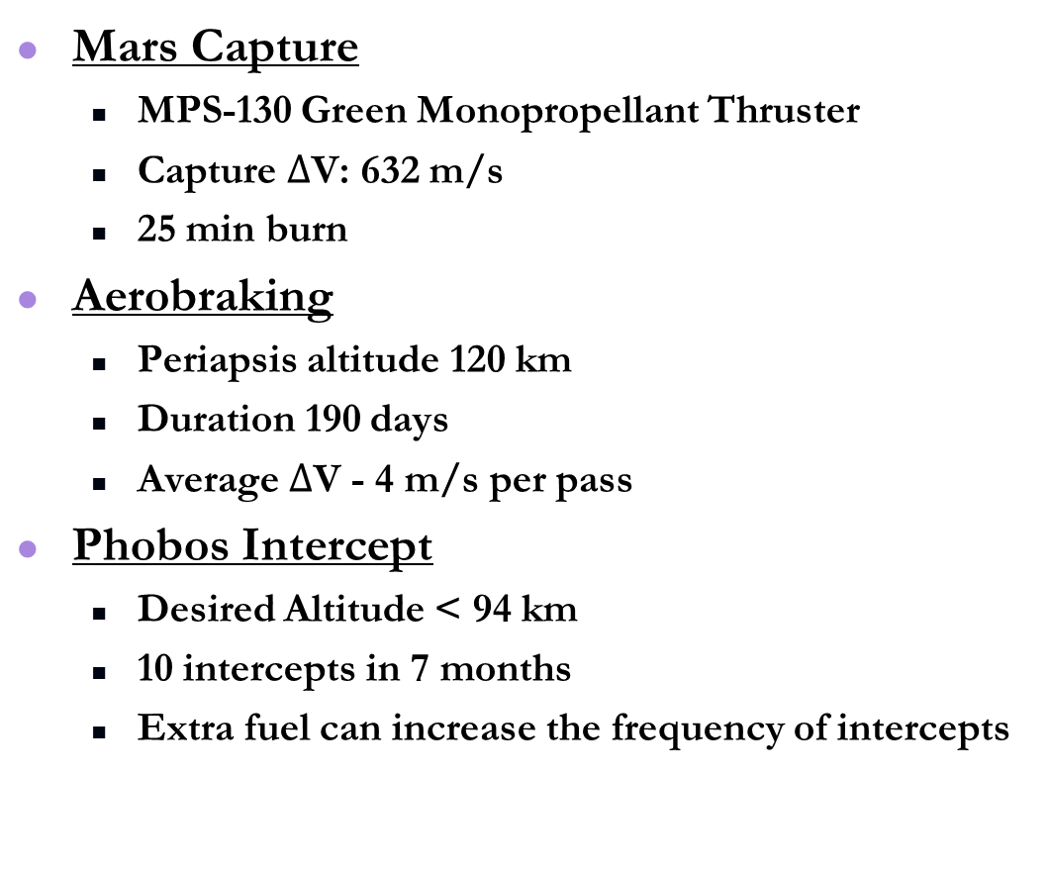
Critical Maneuvers
Mars Capture
  MPS-130 Green Monopropellant Thruster
  Capture $∆$V: 632 m/s
  25 min burn
Aerobraking
  Periapsis altitude 120 km
  Duration 190 days
  Average $∆$V - 4 m/s per pass
Phobos Intercept
  Desired Altitude < 94 km
  10 intercepts in 7 months
  Extra fuel can increase the frequency of intercepts

Slide 8
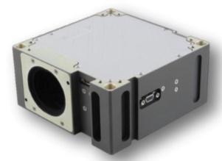
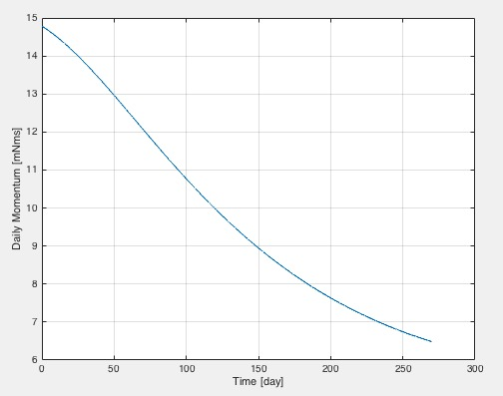
Attitude Determination & Control
Component Summary
Mass | 0.91 kg
Volume | 500 cc
Power | 2 - 5 W
Radiation Tol. | 16 krad
Pointing Accuracy | +- 0.007 deg
Max. Slew Rate | 4.1 deg/sec
Selected Component
  XACT (Blue Canyon Tech)
  Space Heritage (MinXSS)
Requirements
  Pointing within 1 degree
    Image Accuracy
  Slew Rate of 1 deg/sec
    Image Stabilization
Desaturation Schedule
  Thruster Desaturation
    Delta V 90 m/s
Daily Momentum Accumulation

Slide 9
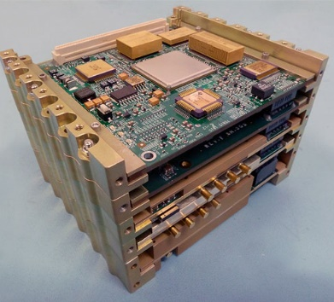
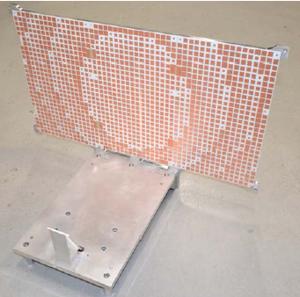
Communications - Type and Selection
Iris V2 X band Transponder
High Gain Reflectarray
DSN compatibility
  X-Band
  UHF relay potential
EIRP - 35 dB
NASA JPL (MarCO)
NASA JPL (MarCO)
Link budget to Earth (X band)
Scenario | Distance (million km) | Downlink
Worst | 200 | 6.4 kbps
Nominal | 250 | 9.3 kbps
Best | 300 | 14.5 kbps

Slide 10
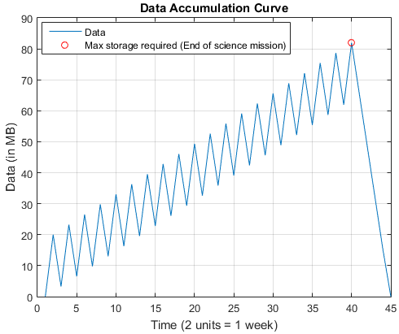
Communications - Operations
Total Science Data
  406 MB
  Downlink time
    4 hrs/week - 6 months
    8 hrs/week - 3 months
Methods to Improve Performance
  MRO UHF Relay
  70-m DSN antenna
  Ka-band
  Longer DSN time
Communications Summary
Mass | 1.7 kg
Volume | 801.06 cc
Power | 35 W
Data downlinked within 7 months of start of science mission

Slide 11
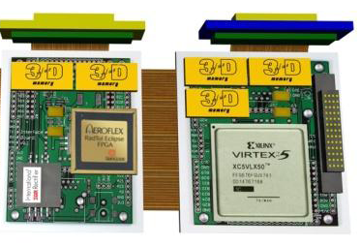
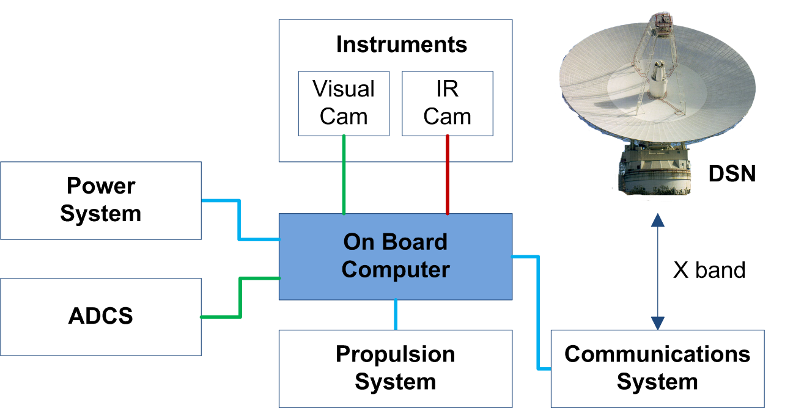

Command and Data Handling
SpaceCube MINI
  2000 IPS
  Built in watchdog
  Rad tolerance
    Up to 700 krad
Architecture
C&DH Summary
Mass | 0.2 kg
Volume | 100 cc
Power | 5 W
System | Interface
Iris V2 | SPI
ADCS | RS-422
Camera | RS-422
IR Camera | LVDS
Prop | SPI
EPS | SPI

Slide 12
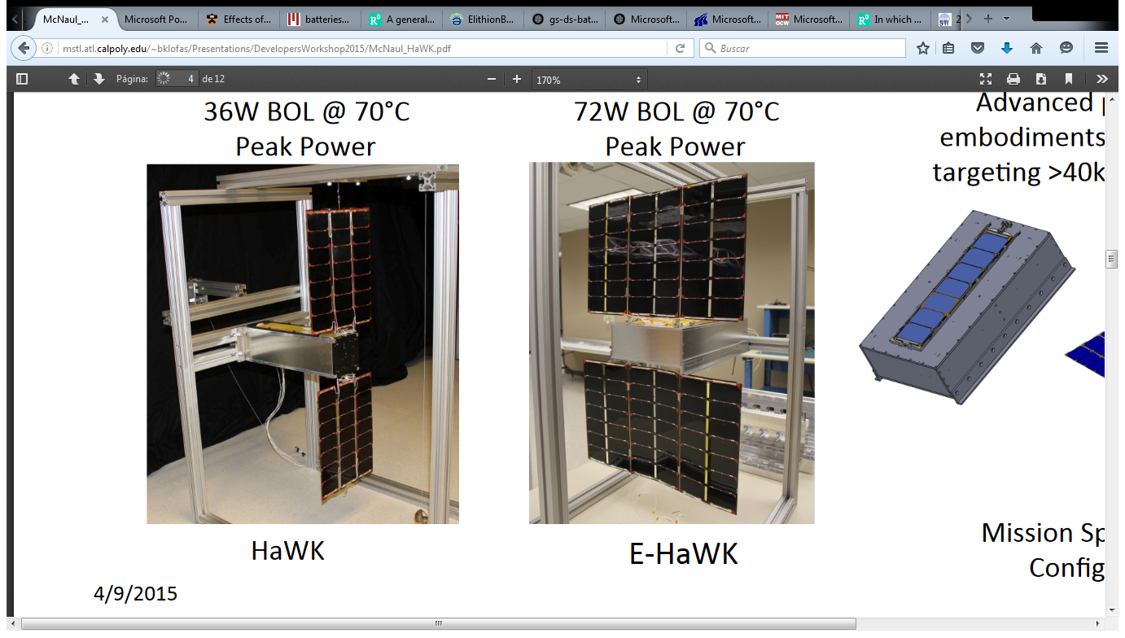
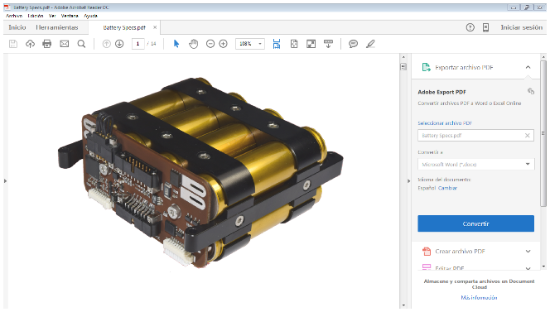
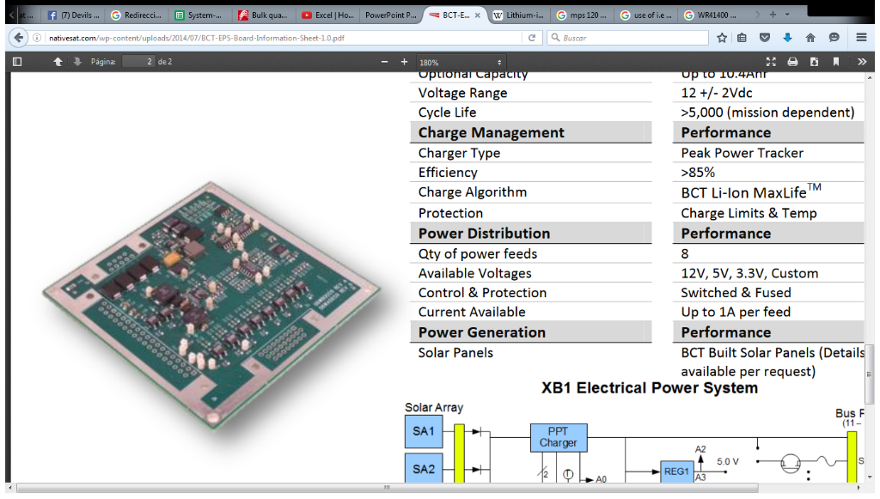
Power Overview
MMA E-HaWK Solar Array
  75 W AOP (Earth)
  24 W AOP (Mars)
  850 g
Gomspace NanoPower BPX
  154 Wh Capacity
  500 g / 320 cc
Blue Canyon Tech EPS
  65 g / 75 cc
System Mass and Volume
  1.415 kg
  395 cc

Slide 13
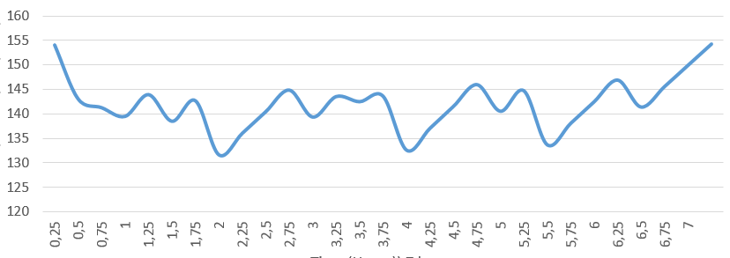
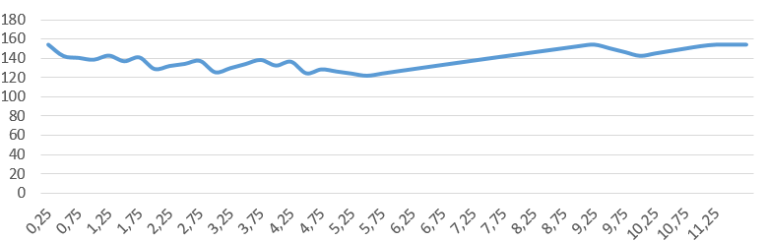
Modes of Operation
Capture
Capture: -5 % Margin
  Propulsion
  Comms Send /Rcv
  Maximum DoD 36 %
Science: 29% Margin
  Comms Send /Rcv
  Attitude Control
  Instrument Payload
Hibernate: 38% Margin
  Comms Rcv Only
  CPU Standby
State of Charge (Wh)
Time (hrs)
Science
State of Charge (Wh)
Time (hrs)

Slide 14
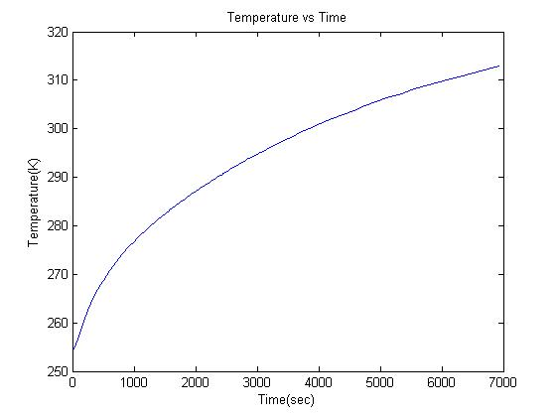
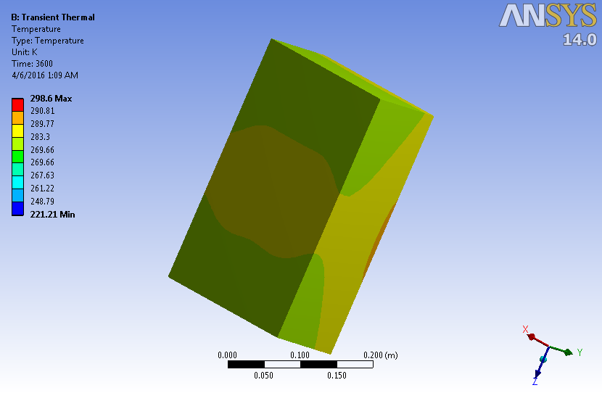
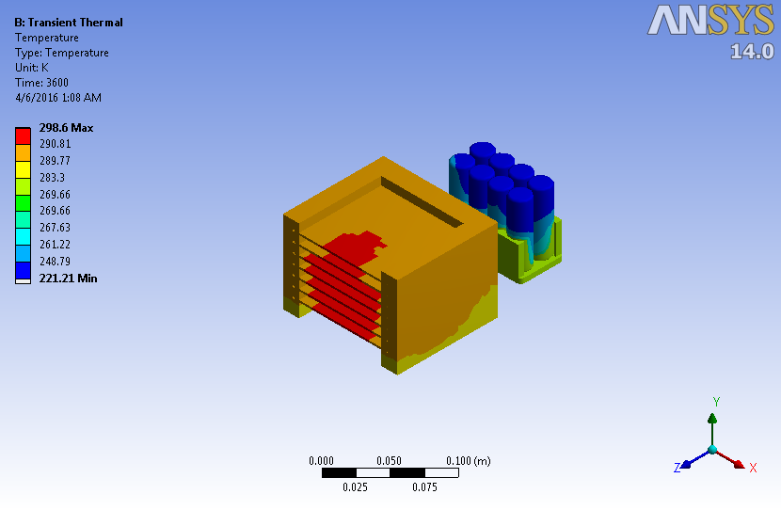
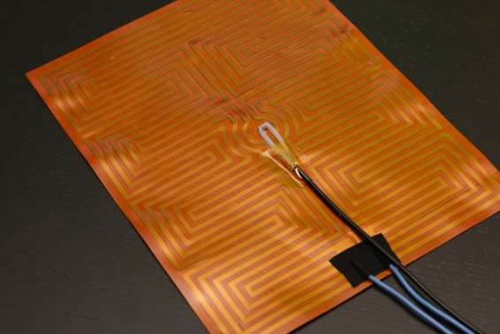
Thermal
Hot Case at Mars
  4 hr Comms window
  X-Band Transponder
    26 W heat generated
  CPU, EPS & Batteries
    15 W heat generated
Cold Case at Mars
  Mars Eclipse at Apoapsis
  Patch Heaters (0.5 W each)
    2 for Propellant, 1 for CPU and 1 for ADCS
    2 integrated into batteries
  Aluminized Kapton (200 mil)
    ε = 0.55
    α = 0.35 - 0.51

