Slide 1
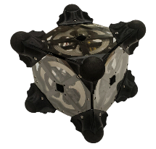
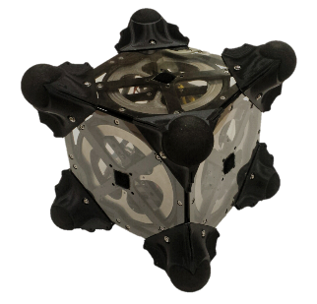

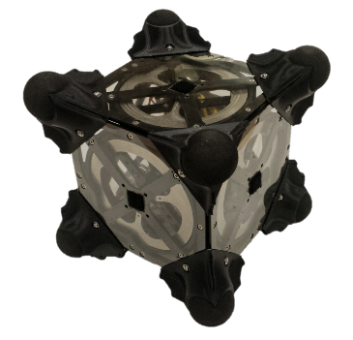
Spacecraft/Rover Hybrids for the Exploration of Small Solar System Bodies
Benjamin Hockman, Stanford University
Our Team:
Marco Pavone (PI)
Julie Castillo, Issa Nesnas, Jeffrey Hoffman,
Andreas Frick, Robert Reid (Co-Is)
Stanford University, Jet Propulsion Laboratory, MIT

Slide 2
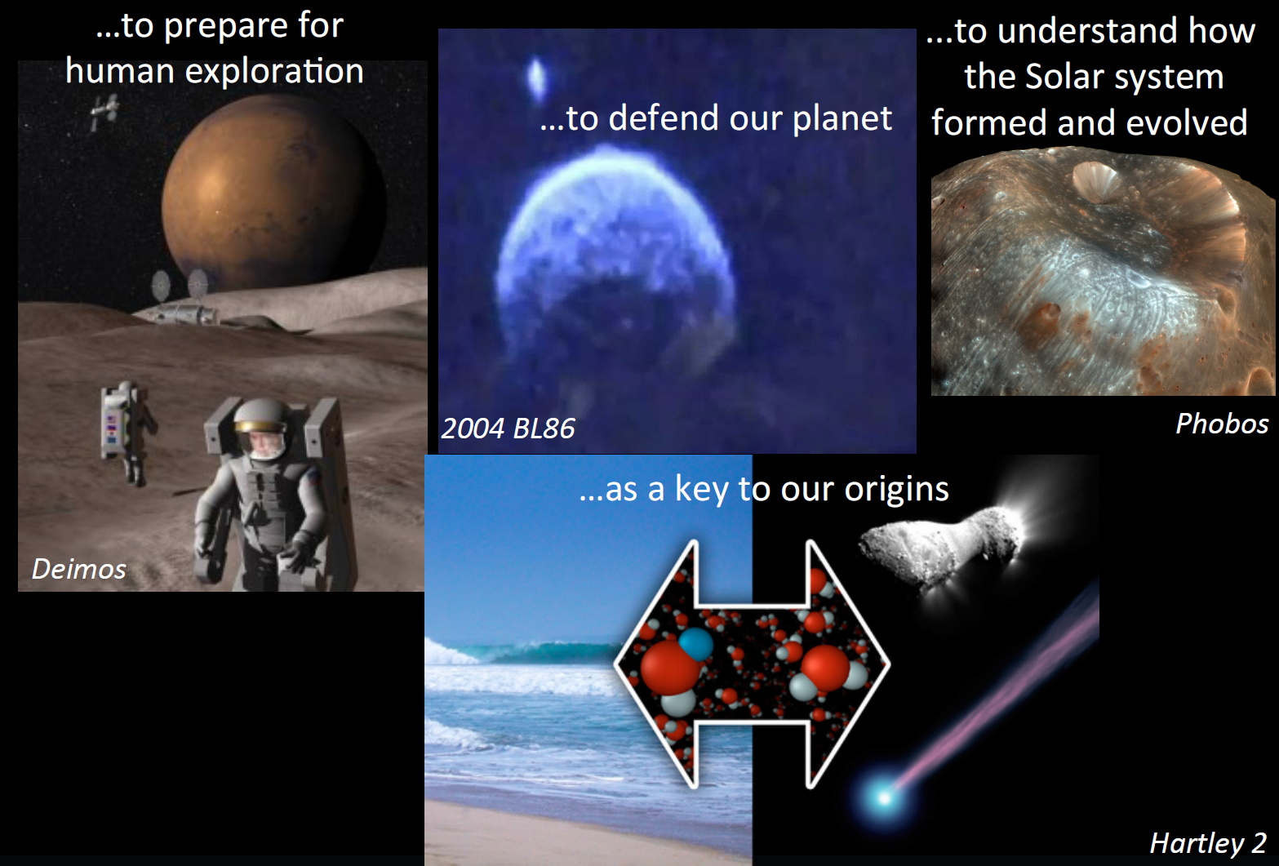
Small Bodies Exploration

Slide 3
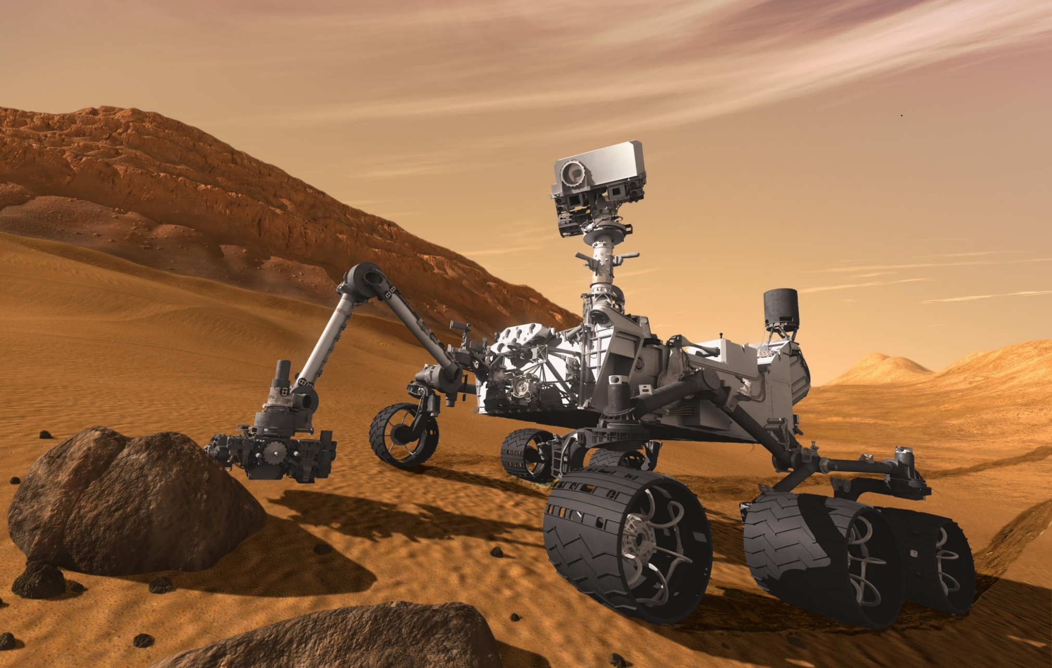
The Big Question
How would you change the design for LOW gravity environments?

Slide 4
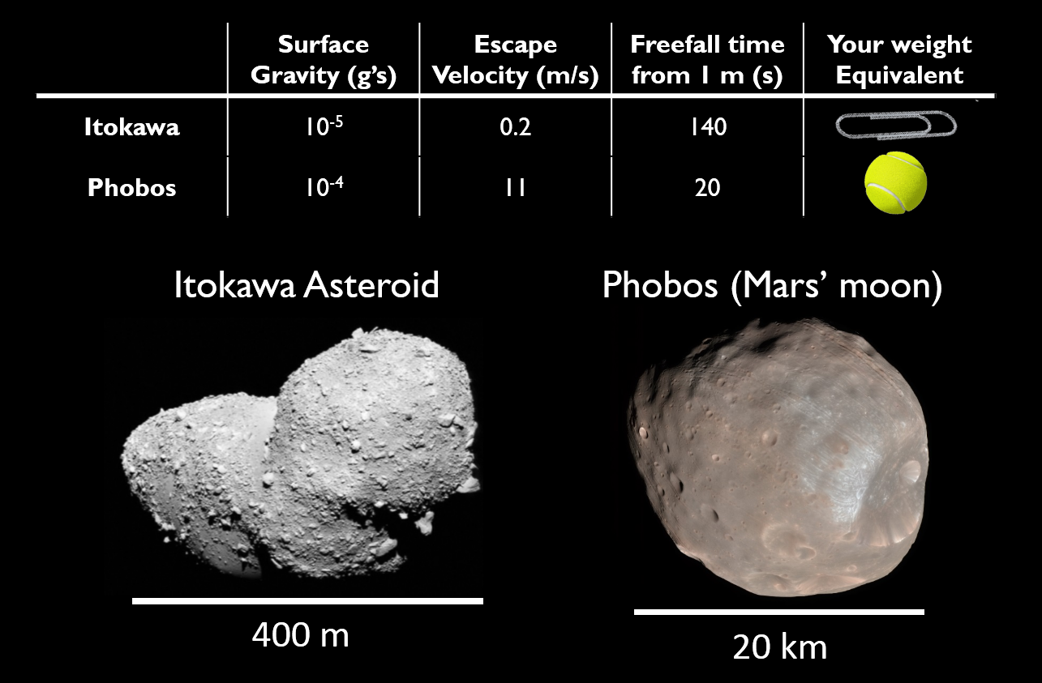
Motion in Low Gravity Worlds

Slide 5
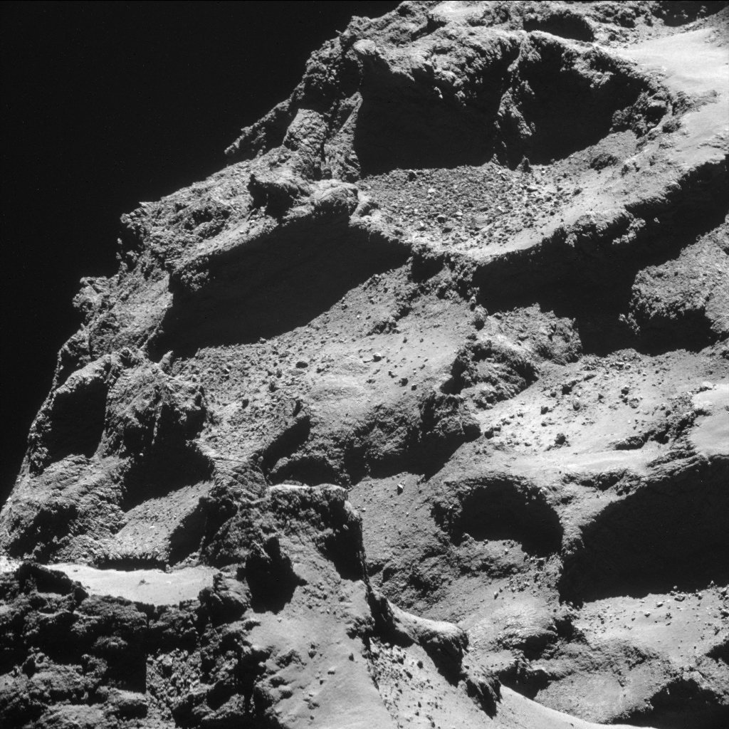
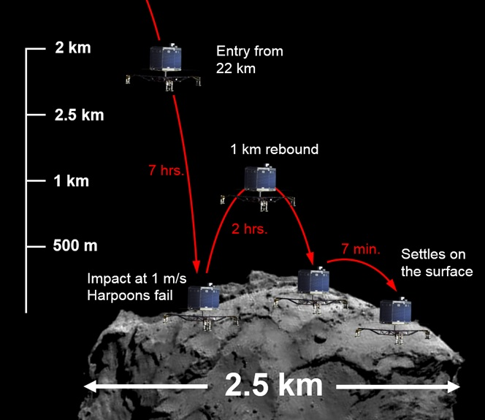
Mobility Challenges in Microgravity
Very limited traction
Remaining “attached”
Uneven/uncertain terrain
100 m

Slide 6
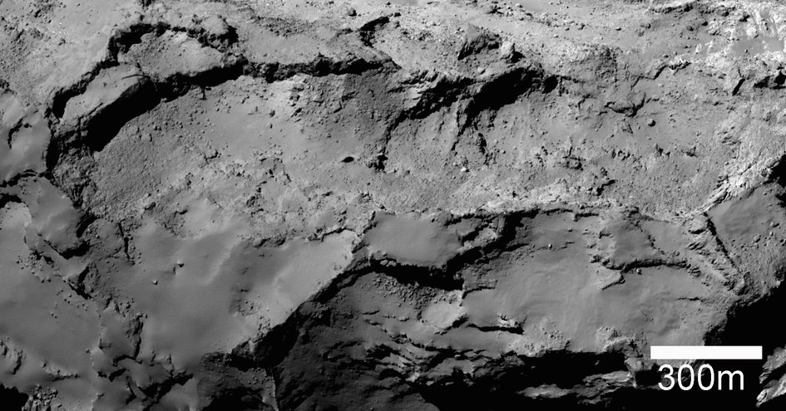

Slide 7
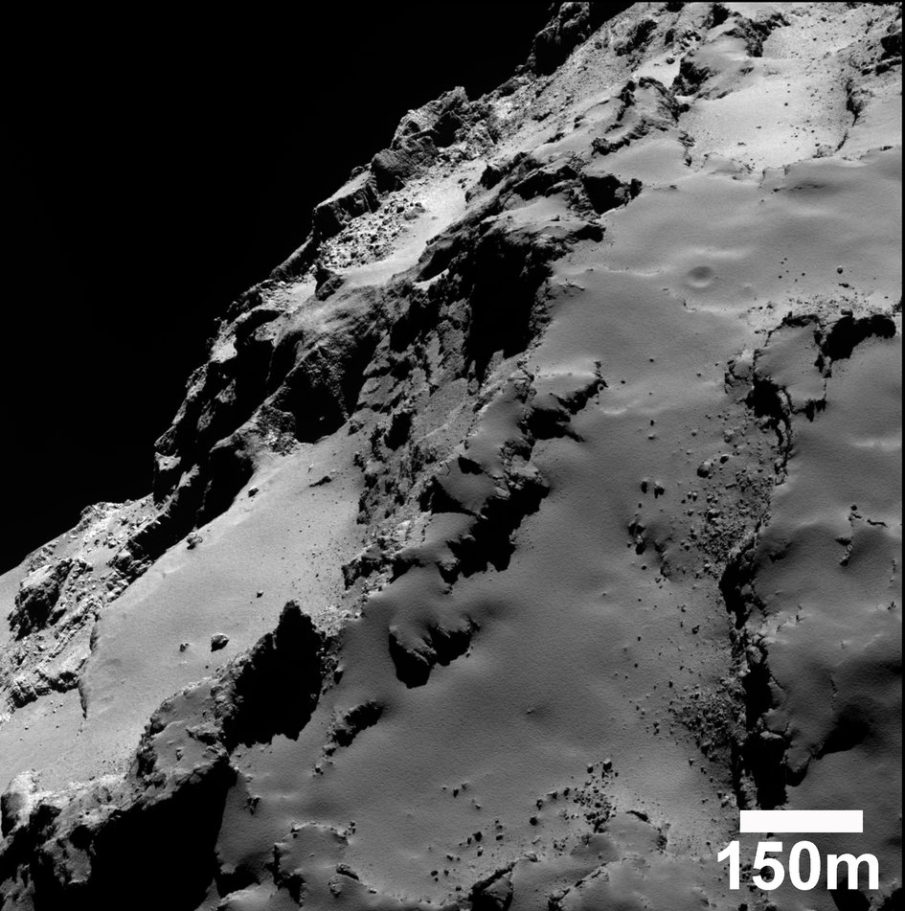

Slide 8
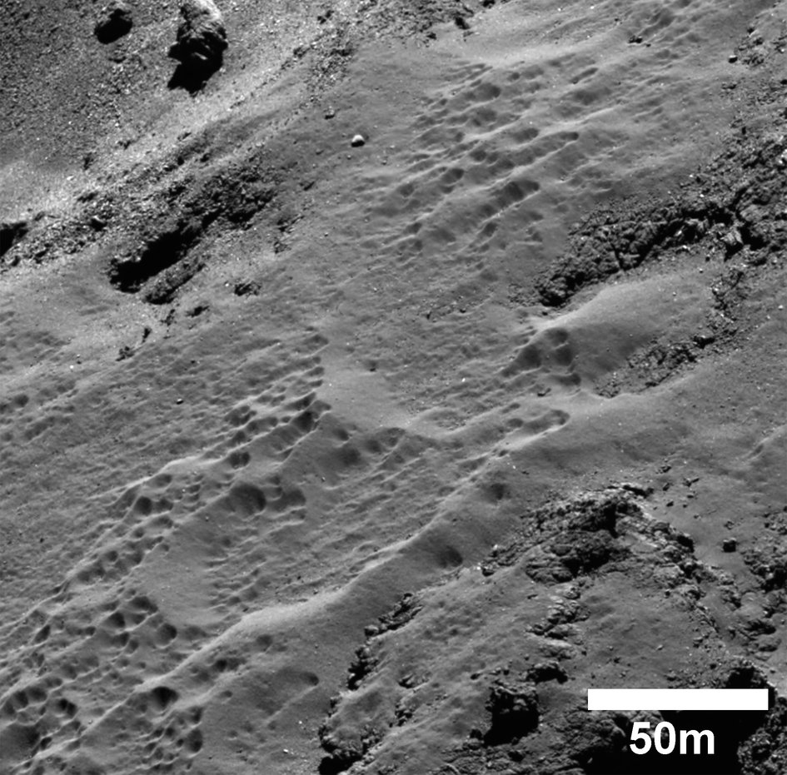

Slide 9
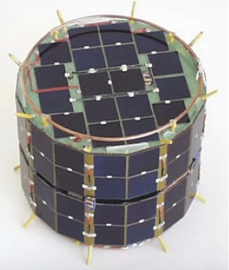
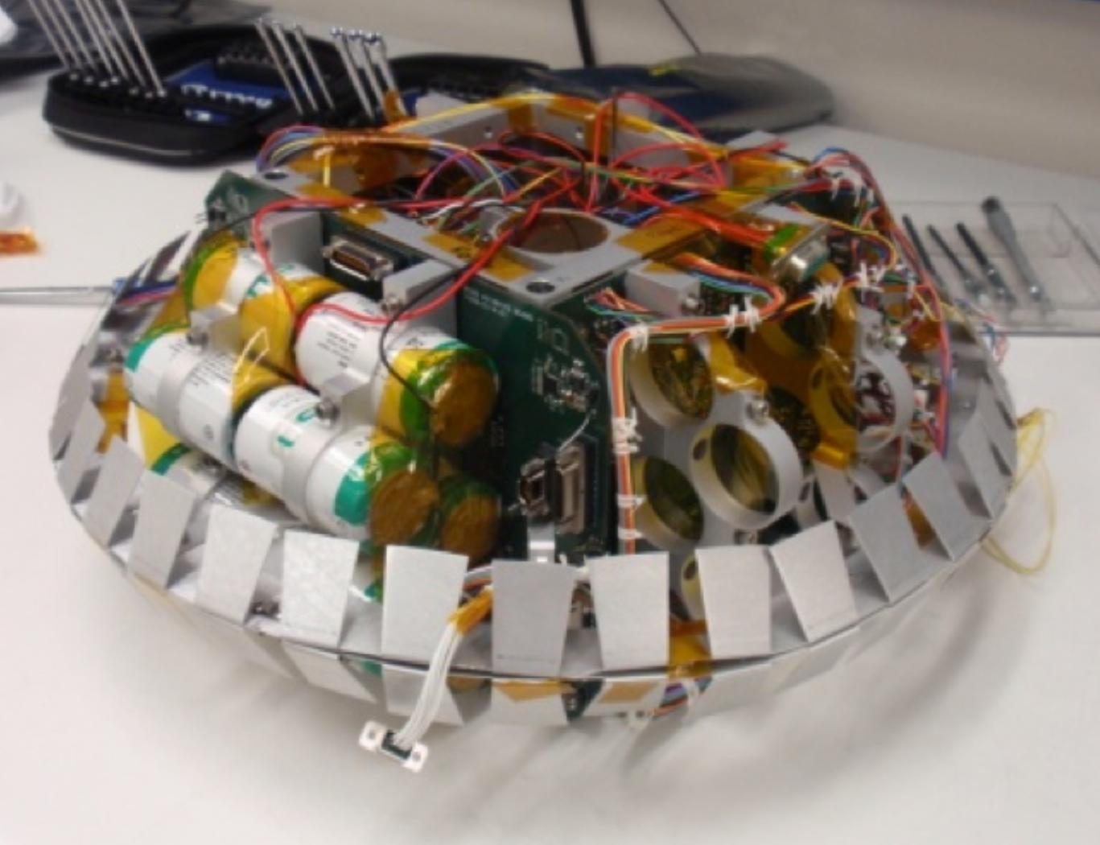
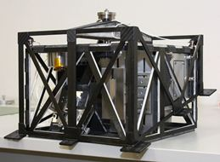
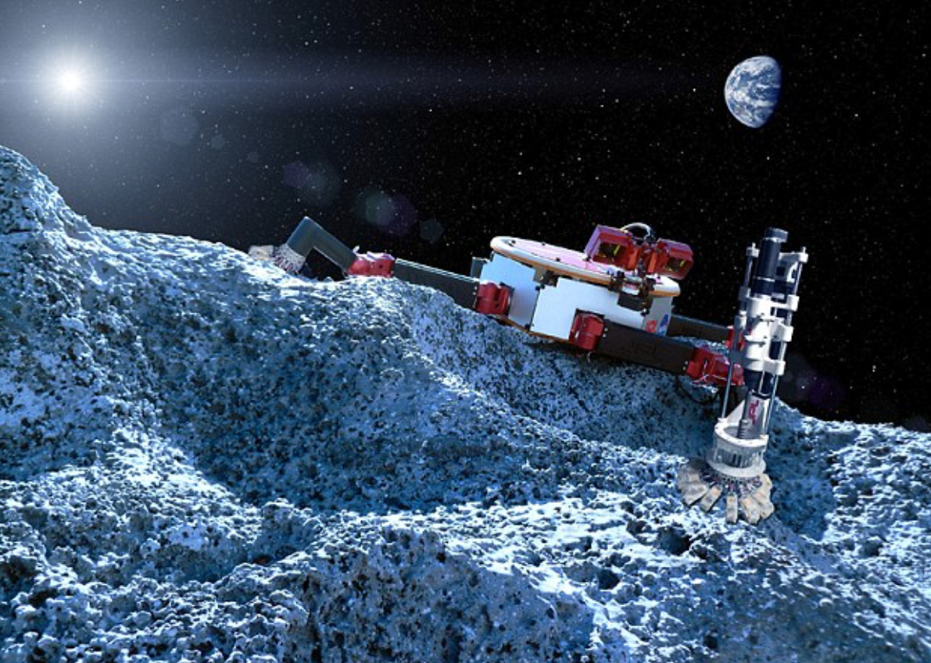
Micro-Gravity Space Rovers
Four classes of mobility:
Hopping
Wheels
Legs
Thrusters

Slide 10
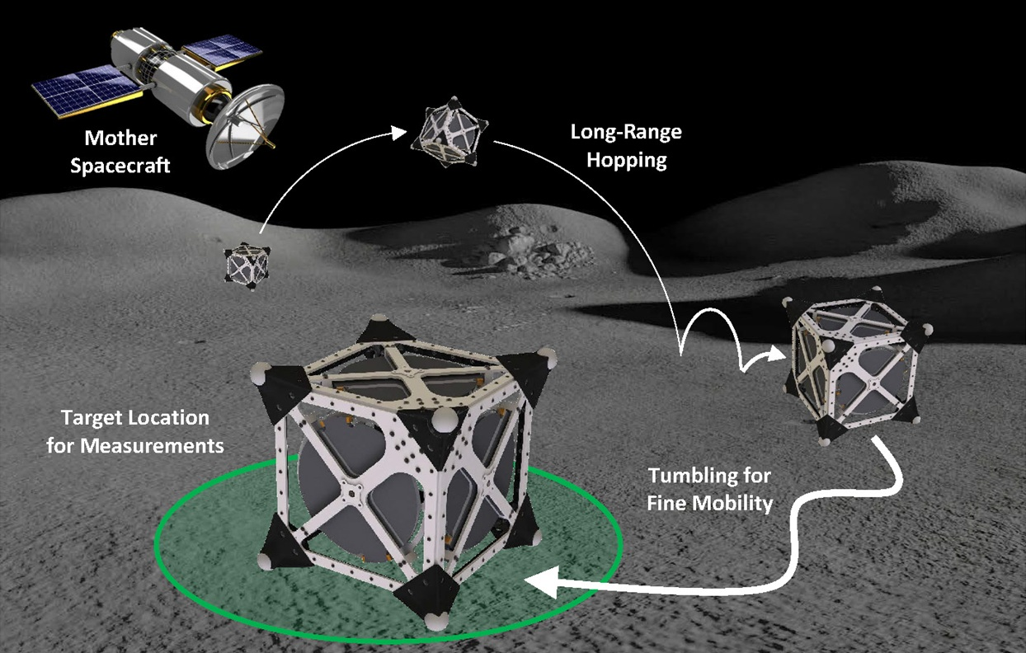
Spacecraft/Rover Hybrids
A mission architecture that allows the systematic and affordable in-situ exploration of small Solar System bodies.
Key philosophy: Exploit low gravity

Slide 11
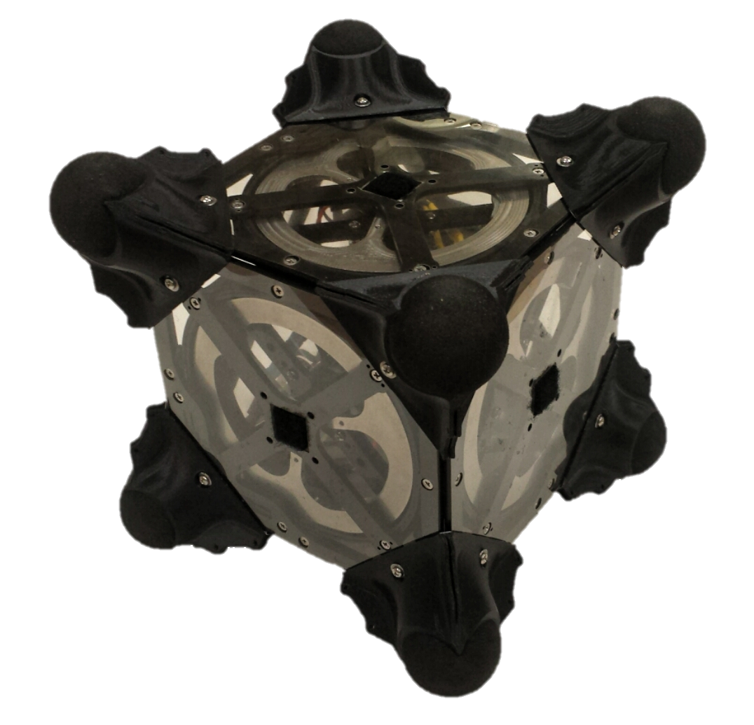
General Features
Mobility Components
Key Features
Three internal flywheels for mobility
Mechanically and thermally sealed from environment
Symmetric design allows mobility in any configuration
Motors and brakes generate controlled and abrupt torques on flywheels
Large internal volume for scientific payload
Minimalistic
Spikes on each corner protect from terrain and act as feet for hopping
Scalable

Slide 12
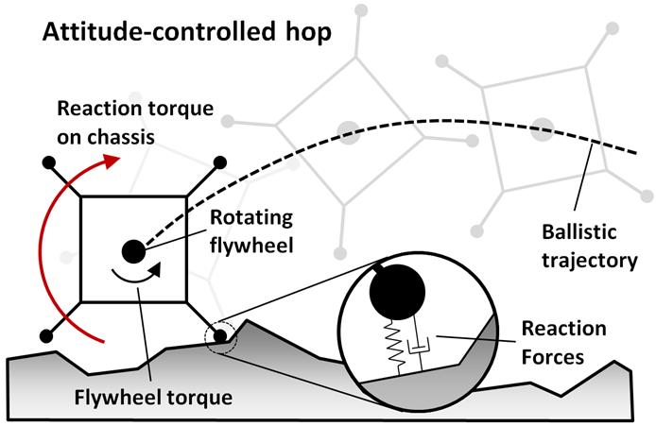
Basic Concept
Spin up flywheels to desired speed
Key idea: Swapping angular momentum
Hit the brakes!
Generates large braking torque
Angular momentum
transferred to chassis
Reaction forces of spikes
on the ground
Rover hops in a forward ballistic trajectory

Slide 13
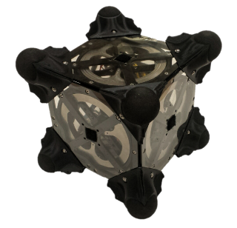
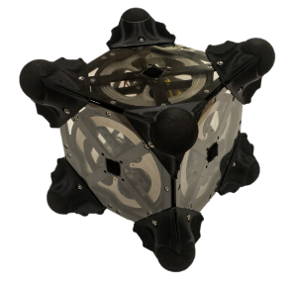
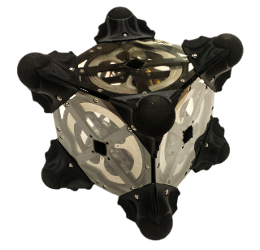
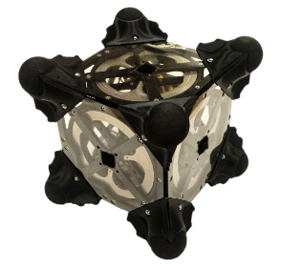
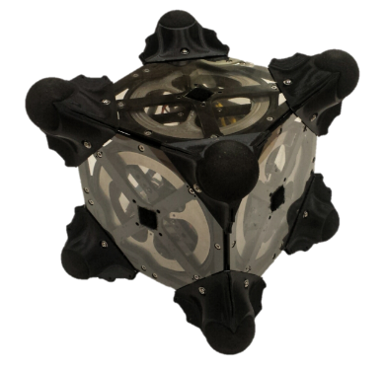


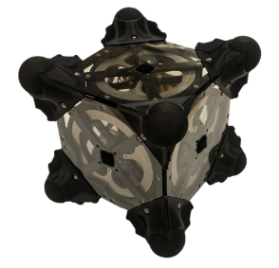
Motion Primtives
Escape Maneuvers (Tornado)
Hopping
Tumbling
Yaw / Pointing
Oblique Hopping

Slide 14

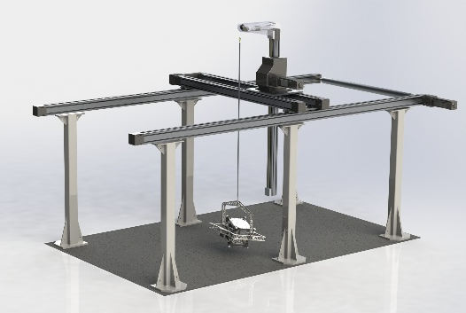
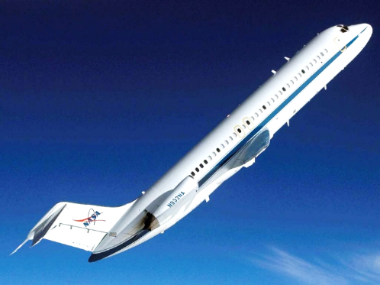
There’s just one problem…
How do you test a microgravity rover on Earth?
Overdesign it for Earth
Gravity offload test beds
Parabolic flights

Slide 15

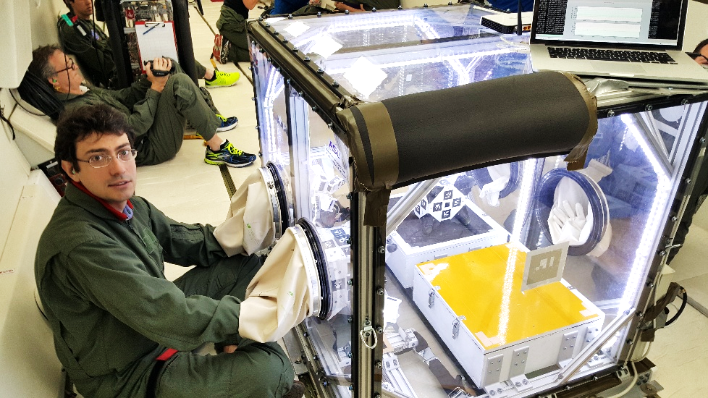
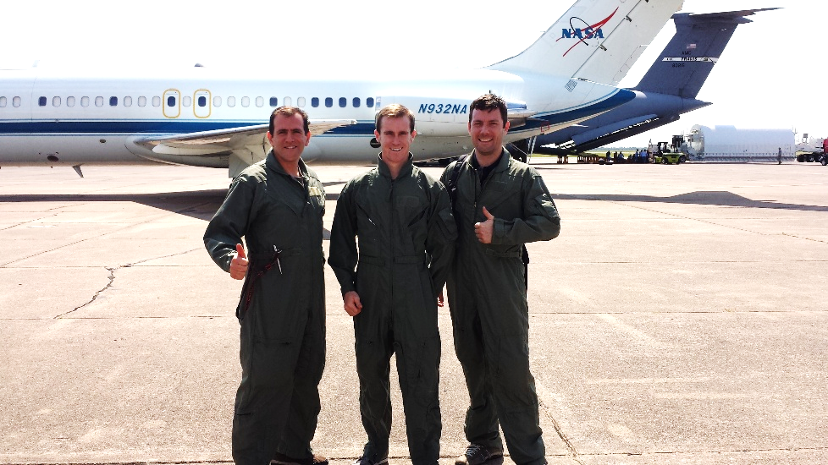
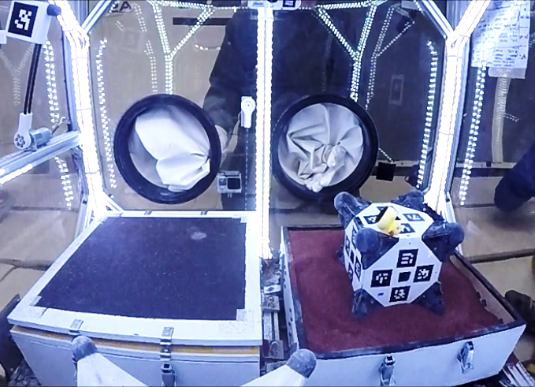
Zero-g parabolic flight experiments

Slide 16
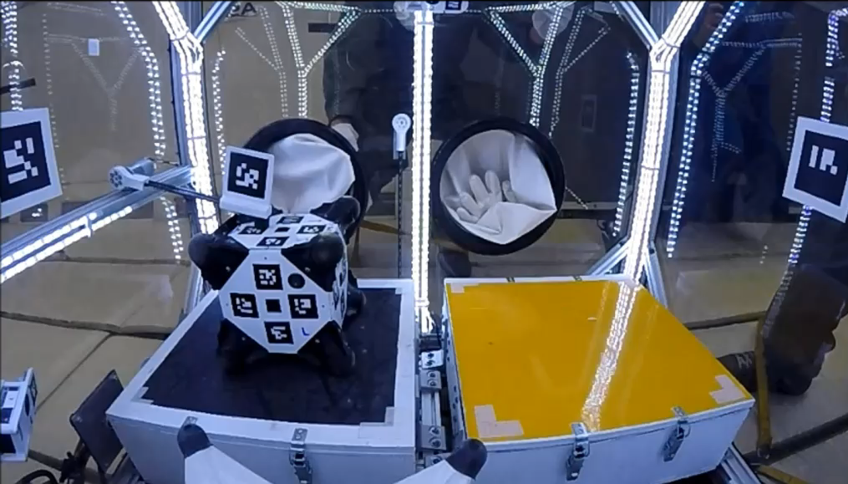
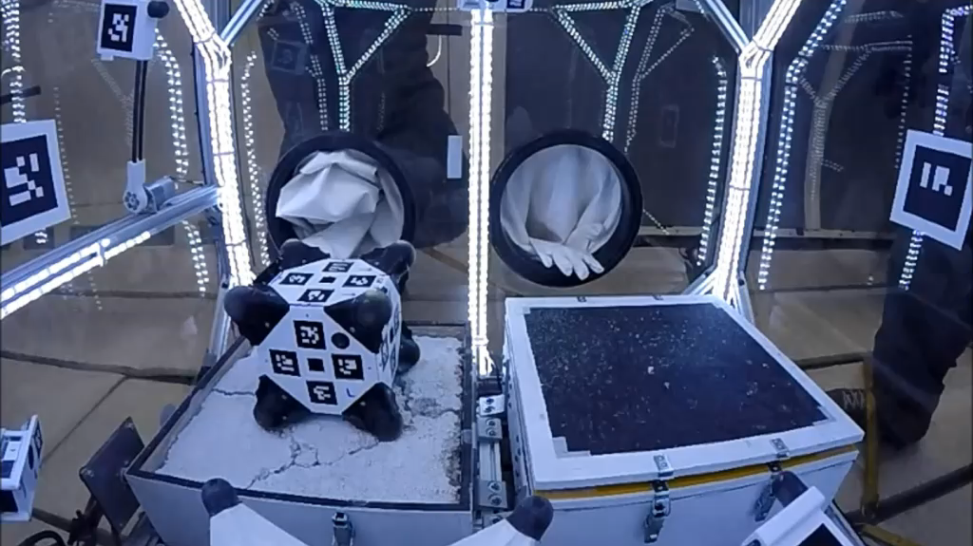
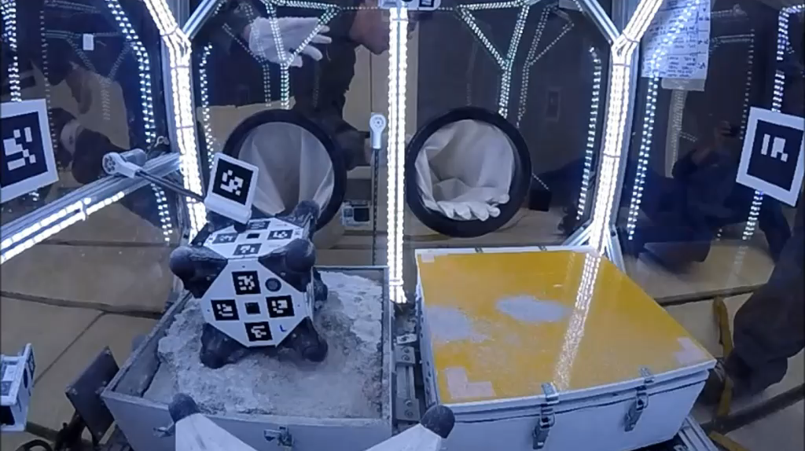

Zero-g parabolic flight experiments
Hopping on various surfaces …
Rough sand paper surface
Pumicite regolith simulant
Hopping on uneven surfaces
Government sponsorship acknowledged

Slide 17
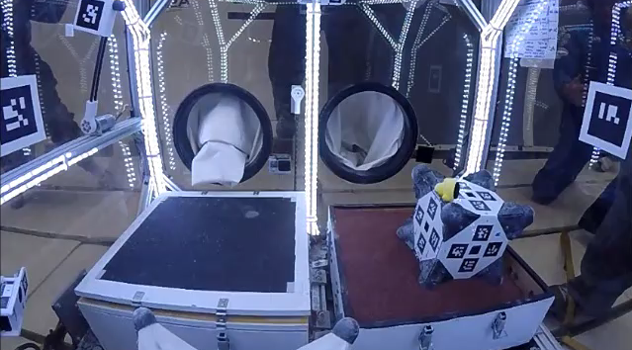
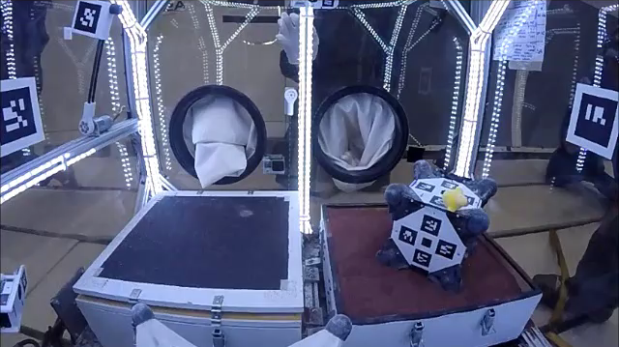
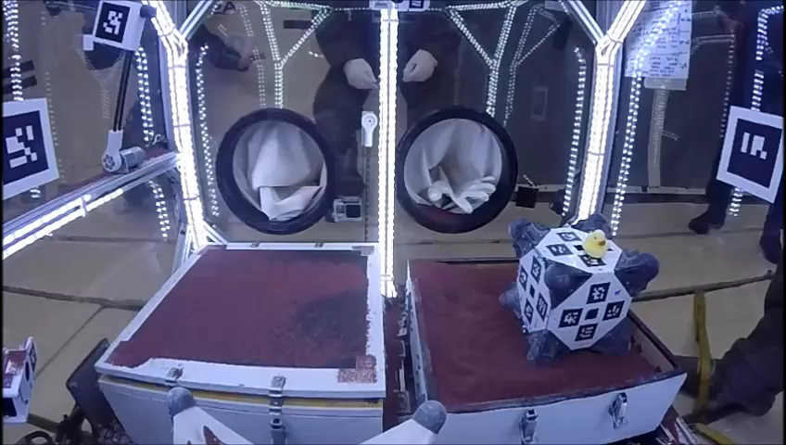
Zero-g parabolic flight experiments
Hopping on granular media …
Straight hop (single axis)
45º hop (two axes)
Even hopping on the moon!
Government sponsorship acknowledged

Slide 18
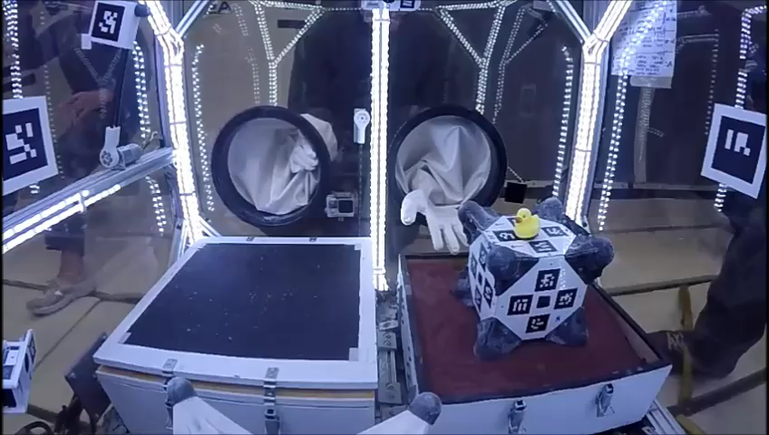
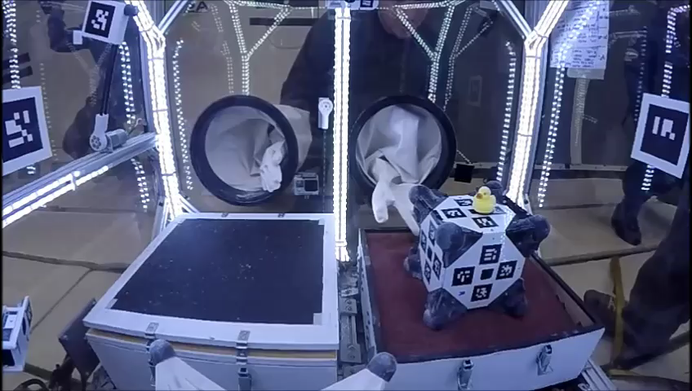
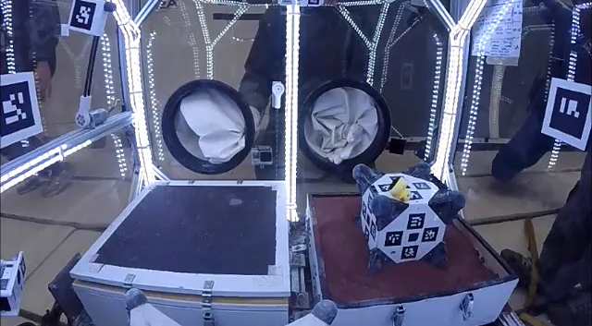
Zero-g parabolic flight experiments
Trying some more advanced maneuvers …
Tumbling
Yaw/Pointing
“Tornado” Escape Maneuver
Government sponsorship acknowledged

Slide 19
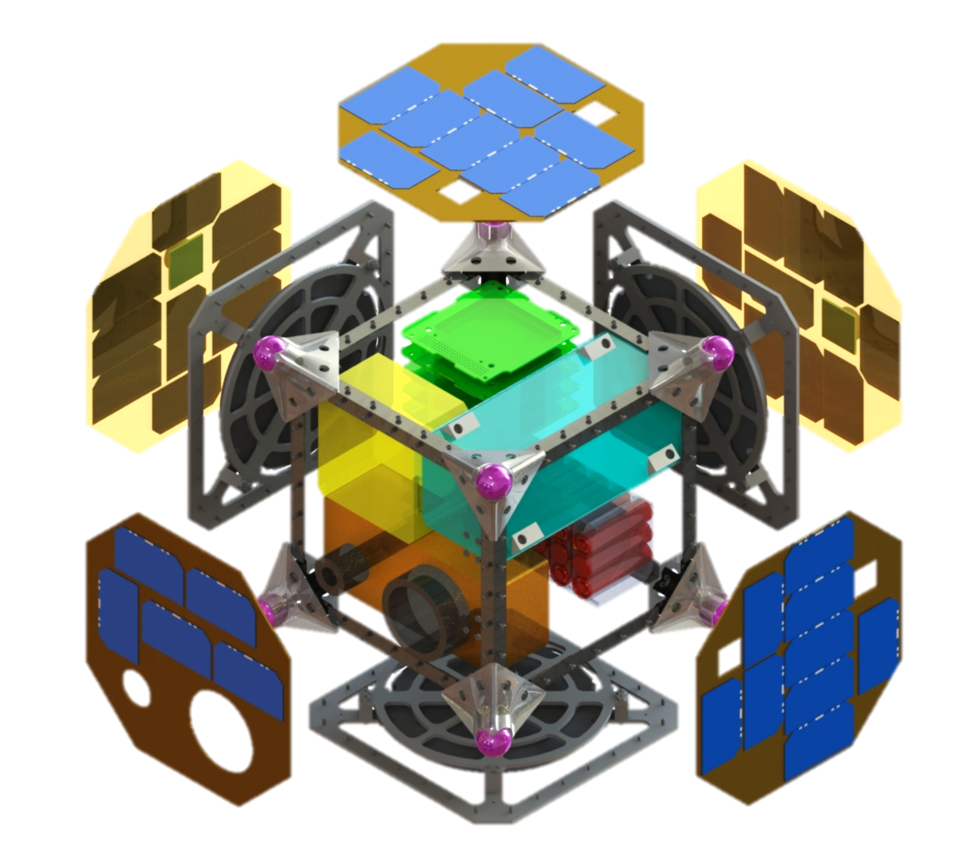
System Architecture
Baselined for Phobos mission
Leverages subsystems designed for JPL’s interplanetary CubeSats
8U design, scalable from 1U to 27U
1. C&DH/Avionics
JPL Interplanetary CubeSat C&DH Board
Processing capability for semi-autonomous ops and agile science
Leverages: NEA Scout
2. Cold Gas Propulsion (Optional)
For soft landing from ~20m/s deployment
Alternatively, volume can be used for payload or more batteries
Leverages: INSPIRE, MarCO, NEAS
3. Telecom
UHF or S band Relay to Mothership
antennas embedded in frame
Leverages: INSPIRE
4. GNC Sensors/Actuators
3 flywheels
3+ wide angle cameras
Sun Sensors + IMU
Star Tracker
Leverages: JPL Visual Odometry frameworks & VSLAM algorithms
1
3
2
5. Science Instruments
X-Ray Spectrometer
Thermocouple
Microscope
Cameras + Accelerometers
Leverages: APXS (Pathfinder/MER/MSL)
6
5
6. Electrical Power System
Lithium primary and secondary batteries ( >1000 W-h @12V)
Optional solar panels
Leverages: INSPIRE, MarCO, NEA Scout
4

Slide 20
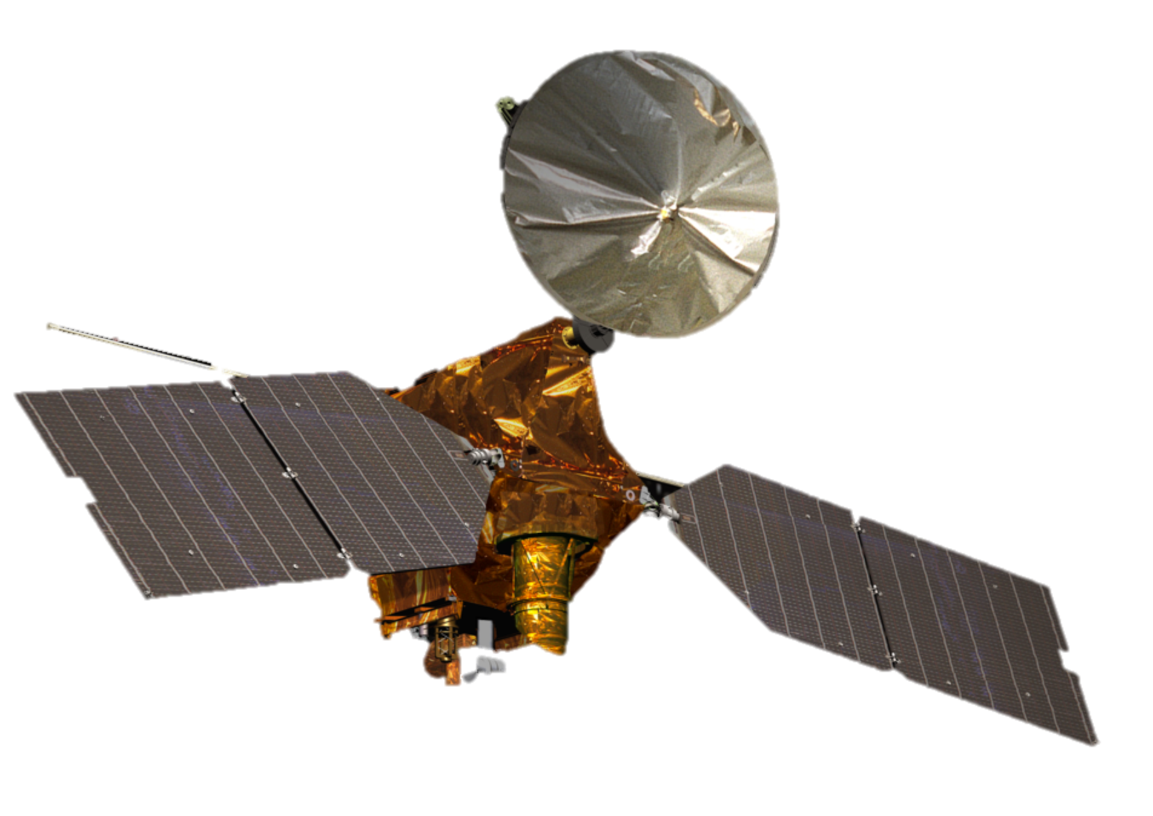

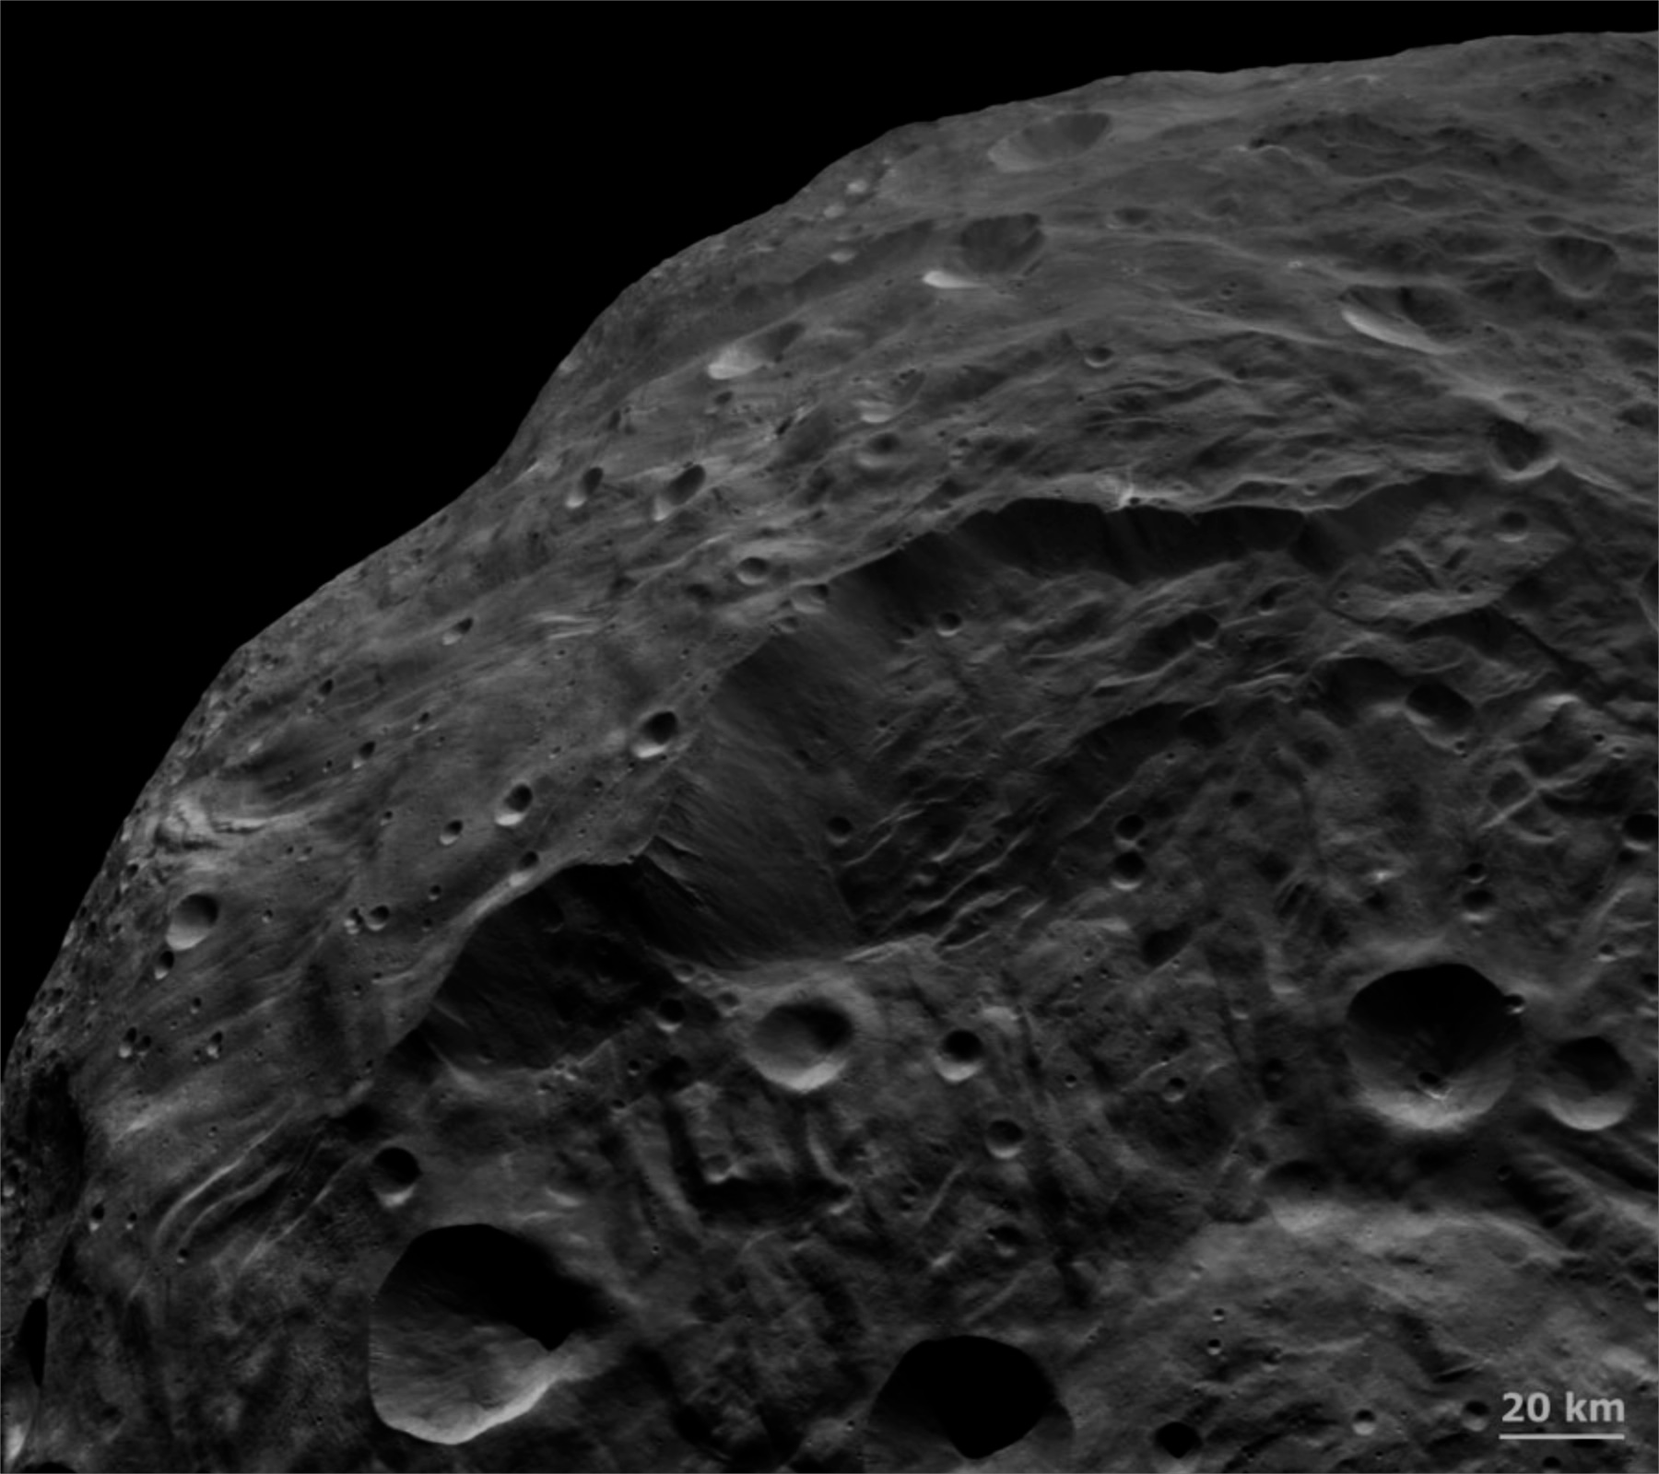


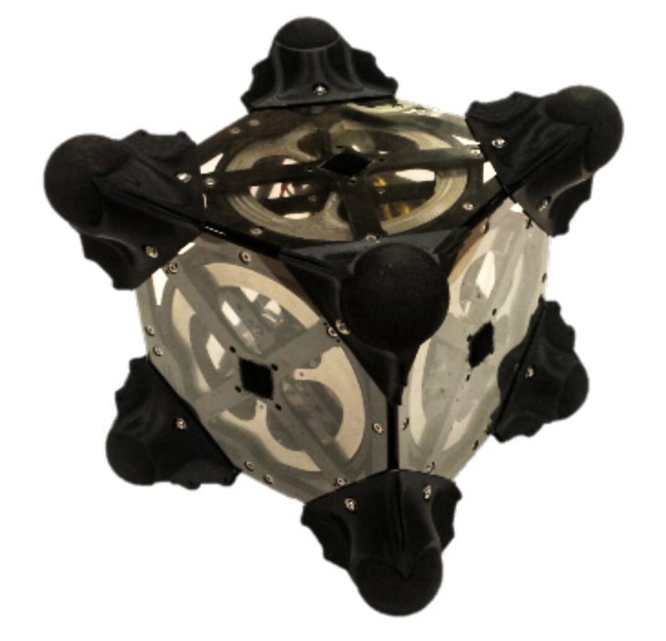
Example CONOPS
1. Deployment
Separation
Optional Propulsive Maneuvers
Mothership Support
Relay Telecom
Assisted Localization
Science Planning from Orbit
3. Mobility Sequence #1
Regional relocation (hop)
Stabilizing/Imaging
2. Science Sequence #1
Uprighting
Initial Science Measurements
Localization
Path Planning
4. “Quick” Science
Context & Localization only
Path planning
6. Science Sequence #3
Full characterization at targeted site
Repeat activities 2-6 as desired until battery is depleted
5. Mobility Sequence #2
Local relocation (tumbles)
Ground in the loop?
Phase II Progress: System Architecture
Pre-Decisional - for Planning and Discussion Purposes Only. Government Sponsorship Acknowledged.

Slide 21
Conclusions
Robotic Exploration of Small Bodies:
Will be one of NASA’s main focuses in years to come
Requires disruptively new mobility approaches for microgravity environments
Spacecraft / Rover Hybrids:
New paradigm for in-situ exploration of small bodies
Technology to obtain new science at an affordable cost
Proof of concept successfully demonstrated in simulations and experiments
Ongoing and Future Work:
Planning and control for fine mobility on various surfaces
(Synergistic) localization and navigation strategies for small body environments
Mobility experiments in microgravity test bed and parabolic flights
Mission formation trade studies

Slide 22
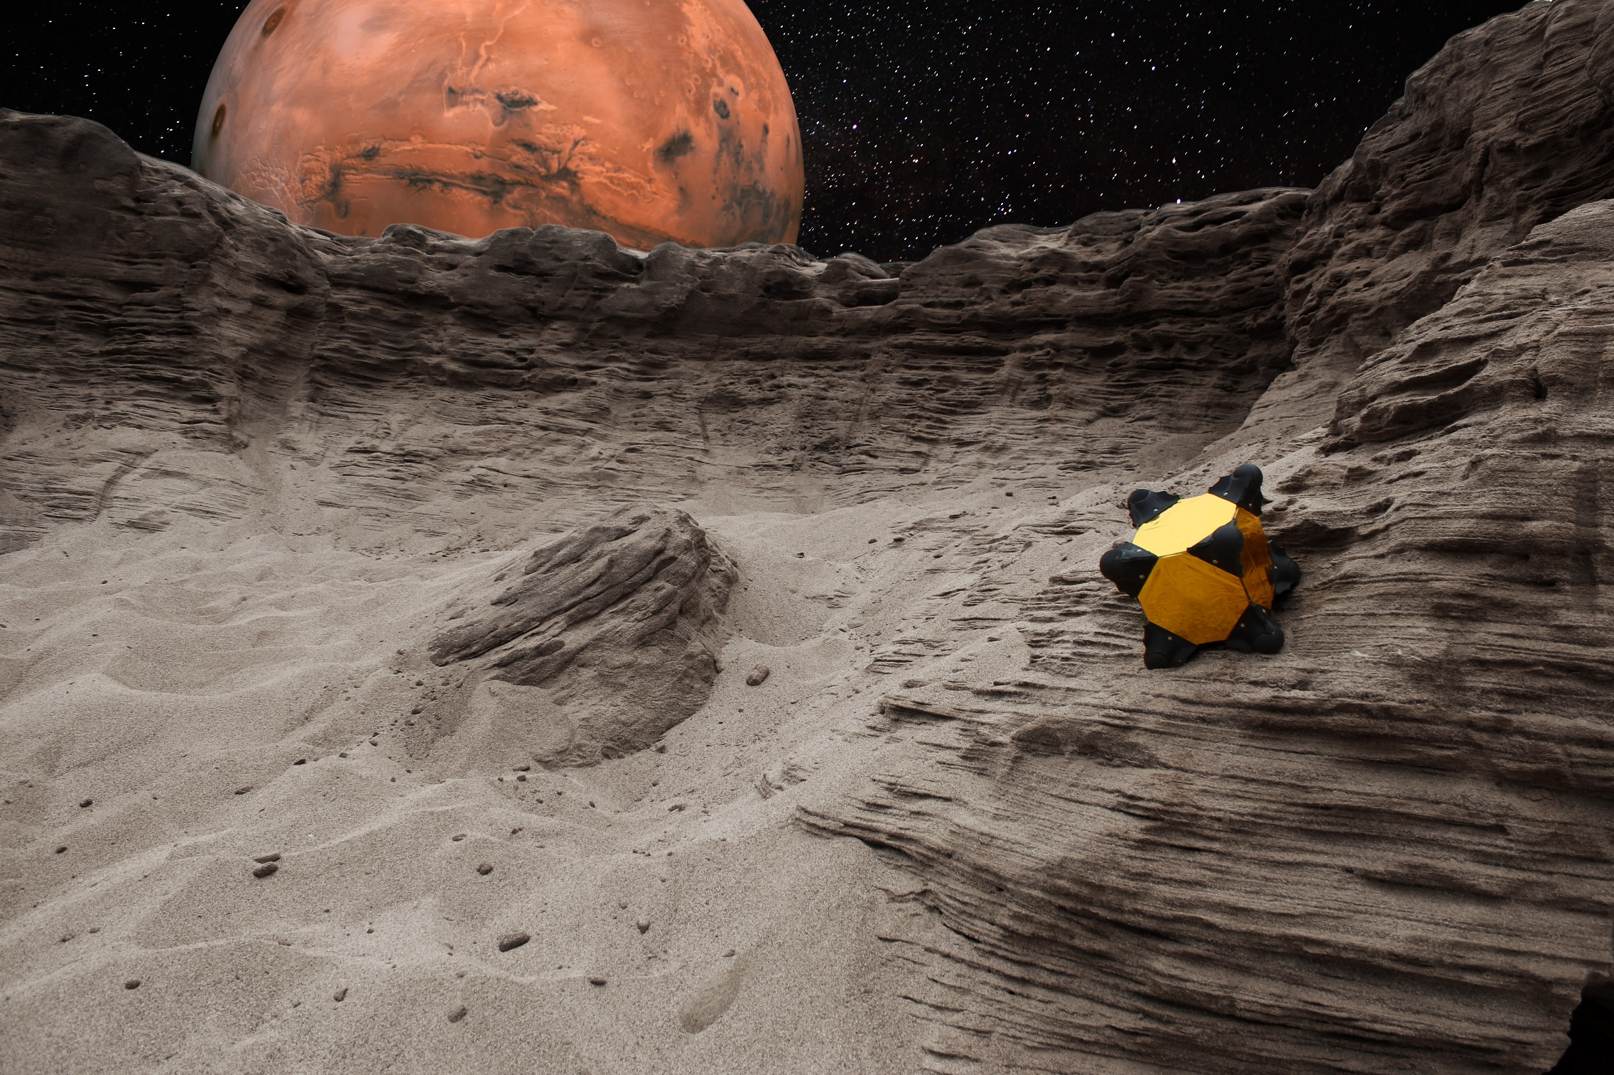
Questions
Publications
B. Hockman, R. Reid, I. A. D. Nesnas, and Marco Pavone. Experimental Methods for Mobility and Surface Operation of Microgravity Robots. International Symposium on Experimental Robotics, October 2016 (in review)
B. Hockman, A. Frick, I. Nesnas, and M. Pavone. Design, control, and experimentation of internally-actuated rovers for the exploration of low-gravity planetary bodies. In Conf. on Field and Service Robotics, Toronto, Canada, June 2015. Best Student Paper Award
R. Reid, L. Roveda, I. Nesnas, and M. Pavone. Contact dynamics of internally-actuated platforms for the exploration of small Solar System bodies. In Proc. International Symposium on Artificial Intelligence, Robotics and Automation in Space, Montreal, Quebec, June 2014.
A. Koenig, M. Pavone, J. Castillo, and I. Nesnas. A dynamical characterization of internally-actuated microgravity mobility systems. In Proc. IEEE Int. Conf. Robotics and Automation, Hong Kong, China, June 2014.
R. Allen, M. Pavone, C. McQuin, I. Nesnas, J. Castillo, T. N. Nguyen, and J. Homan. Internally-actuated rovers for all access surface mobility: Theory and experimentation. In Proc. IEEE Int. Conf. Robotics and Automation, Karlsruhe, Germany, May 2013.
M. Pavone, J. Castillo, I. Nesnas, J. Homan, and N. Strange. Spacecraft/rover hybrids for the exploration of small Solar system bodies. In Proc. IEEE Aerospace Conference, Big Sky, Montana, March 2013.
J. Castillo, M. Pavone, I. Nesnas, and J. Homan. Observational strategies for the exploration of small Solar system bodies. In Proc. IEEE Aerospace Conference, Big Sky, Montana, March 2012.
Current work funded by NSF and NASA under NIAC Phase II award
Previous work funded by NASA under JPL RTD, CIF, FOP, and NIAC Phase I award
Contact: bhockman@stanford.edu

Slide 23
