Slide 1

Evaluation of stable periodic orbits about non-spherical objects
Jason C. Swenson
Dr. E. Glenn Lightsey
Dr. Marcus J. Holzinger

Slide 2
Outline
Introduction & Motivation
Background
  Controls
  Optimization
Methodology
  Dynamic Environment Model
  Gravitational Potential Field Model
  Propagator Algorithm
  Periodic Orbit Solvers
Simulation and Results
  433 Eros
  Chaos
  Orbit Analysis
Ongoing Efforts
Conclusions / Lessons Learned

Slide 3
Introduction & Motivation
Non-spherical objects with non-uniform mass distribution and density
  Guidance, Navigation, and Control (GNC) of spacecraft
    Future missions to asteroids: small orbiting satellite(s)?
      OSIRUS-Rex
    Humans to asteroids: orbiters?
  Origin studies
Why are periodic or quasi-periodic orbits interesting?
Notes:
Relate more to NASA – what missions are going to asteroids? Why do we need periodic orbits about these asteroids?

Slide 4
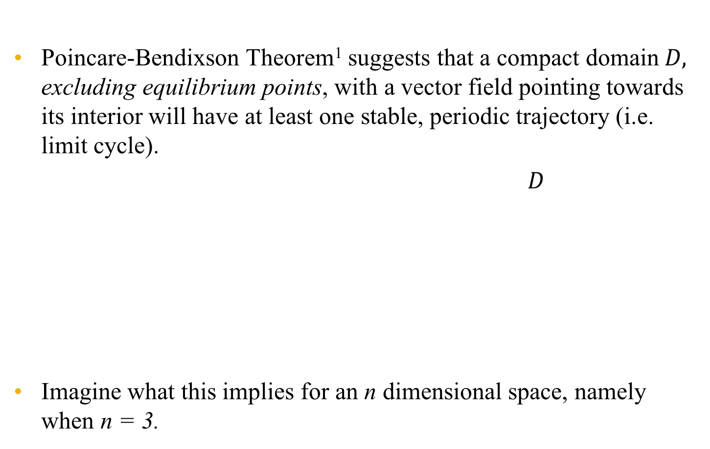
Background: Controls
Poincare-Bendixson Theorem¹ suggests that a compact domain$D,$ excluding equilibrium points, with a vector field pointing towards its interior will have at least one stable, periodic trajectory (i.e. limit cycle).
        $D$
Imagine what this implies for an n dimensional space, namely when n = 3.
Figure 1: Poincare-Bendixson Theory

Slide 5
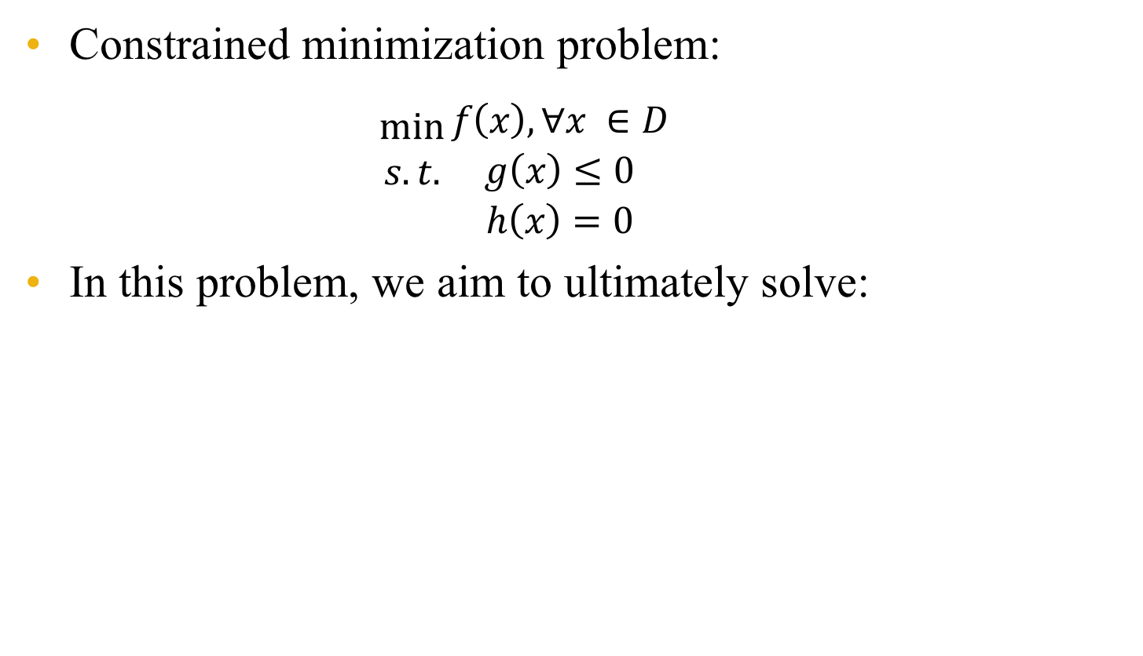
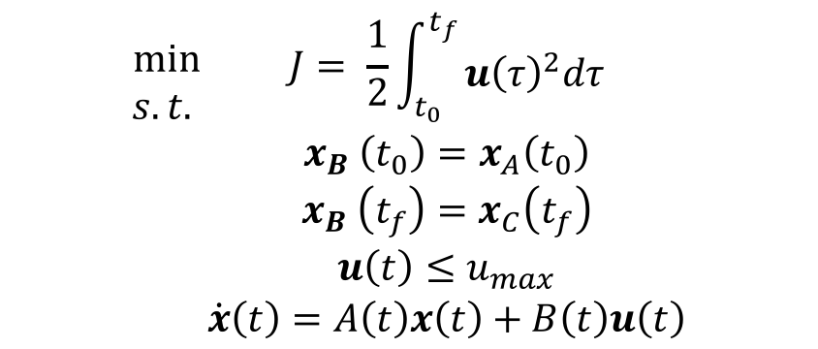
Background: Optimization
Constrained minimization problem:
$\begin{aligned}min \\ s.t. \\ \end{aligned}{\begin{aligned}f\left(x\right), ∀x ∈D \\ g\left(x\right)≤0 \\ h\left(x\right)=0\end{aligned}}$
In this problem, we aim to ultimately solve:
$$\begin{aligned}min \\ s.t. \\ \\ \\ \\ \end{aligned}{\begin{aligned}\begin{aligned}J= \frac{1}{2}\int_{t_{0}}^{t_{f}}{\begin{aligned} \\ {u\left(τ\right)}^{2}dτ\end{aligned}} \\ x_{B} \left(t_{0}\right)=x_{A}\left(t_{0}\right)\end{aligned} \\ x_{B} \left(t_{f}\right)=x_{C}\left(t_{f}\right) \\ u\left(t\right)≤u_{max} \\ \dot{x}\left(t\right)=A\left(t\right)x\left(t\right)+B\left(t\right)u\left(t\right)\end{aligned}}$$

Slide 6



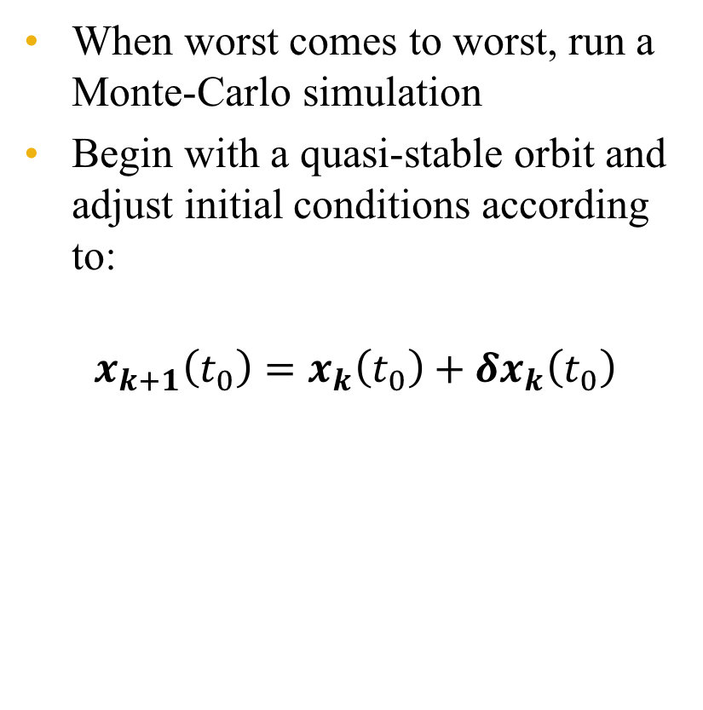
Background: Optimization
When worst comes to worst, run a Monte-Carlo simulation
Begin with a quasi-stable orbit and adjust initial conditions according to:
$$x_{k+1}\left(t_{0}\right)=x_{k}\left(t_{0}\right)+{δx}_{k}\left(t_{0}\right)$$
Uniform Grid
Random Grid
Figure 2: Randomization of Initial Condition Vectors

Slide 7
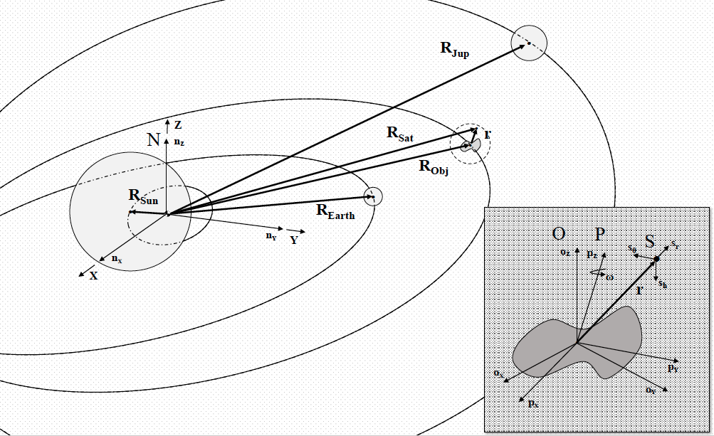
Methodology: Dynamic Environment Model
Figure 3: Dynamic Environment Model.
Notes:
Discuss 4 reference frames and bodies involved

Slide 8
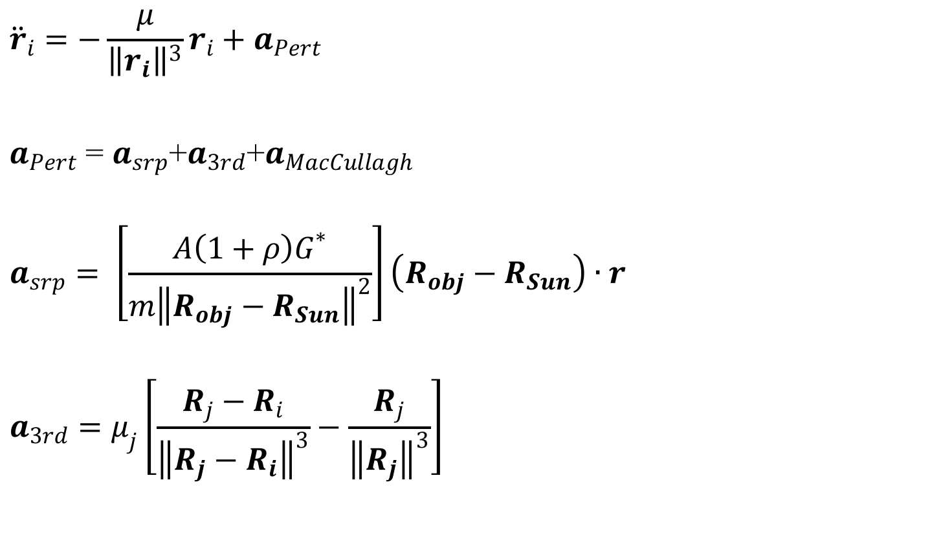
Methodology: Dynamic Environment Model
$${\ddot{r}}_{i}=−\frac{μ}{{\left\|r_{i}\right\|}^{3}}r_{i}+a_{Pert}$$
$a_{Pert}$ = $a_{srp}$+$a_{3rd}$+$a_{MacCullagh}$
$$a_{srp}= \left[\frac{A\left(1+ρ\right)G^{∗}}{{m\left\|R_{obj}−R_{Sun}\right\|}^{2}}\right]\left(R_{obj}−R_{Sun}\right)∙r$$
$$a_{3rd}=μ_{j}\left[\frac{R_{j}−R_{i}}{{\left\|R_{j}−R_{i}\right\|}^{3}}−\frac{R_{j}}{{\left\|R_{j}\right\|}^{3}}\right]$$
“Cannonball” Method²
Third Body Forces

Slide 9
Methodology: Dynamic Environment Model
$${\ddot{r}}_{i}=−\frac{μ}{{\left\|r_{i}\right\|}^{3}}r_{i}+a_{Pert}$$
$a_{Pert}$ = $a_{srp}$+$a_{3rd}$+$a_{MacCullagh}$
$$a_{srp}= \left[\frac{A\left(1+ρ\right)G^{∗}}{{m\left\|R_{obj}−R_{Sun}\right\|}^{2}}\right]\left(R_{obj}−R_{Sun}\right)∙r$$
$$a_{3rd}=μ_{j}\left[\frac{R_{j}−R_{i}}{{\left\|R_{j}−R_{i}\right\|}^{3}}−\frac{R_{j}}{{\left\|R_{j}\right\|}^{3}}\right]$$
“Cannonball” Method²
Third Body Forces

Slide 10
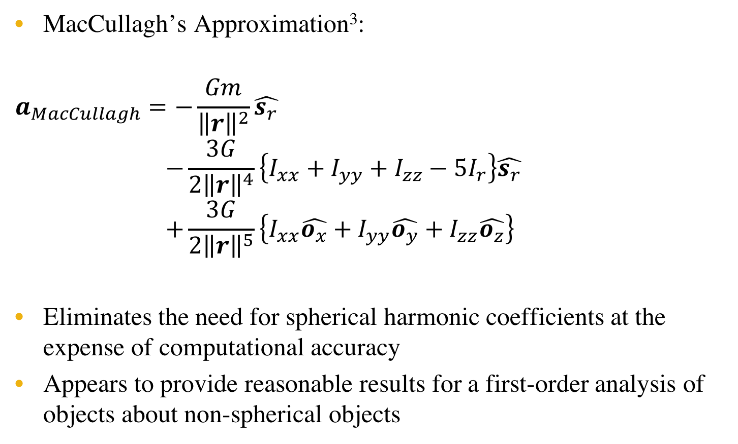
Methodology: Gravitational Potential Field Model
MacCullagh’s Approximation³:
$$a_{MacCullagh}=−\frac{Gm}{{\left\|r\right\|}^{2}}\hat{s_{r}}$$
$$−\frac{3G}{{2\left\|r\right\|}^{4}}\left\{I_{xx}+I_{yy}+I_{zz}−5I_{r}\right\}\hat{s_{r}}$$
$$+\frac{3G}{{2\left\|r\right\|}^{5}}\left\{I_{xx}\hat{o_{x}}+I_{yy}\hat{o_{y}}+I_{zz}\hat{o_{z}}\right\}$$
Eliminates the need for spherical harmonic coefficients at the expense of computational accuracy
Appears to provide reasonable results for a first-order analysis of objects about non-spherical objects
Point-mass contribution
Polar moment of inertia contribution
Moment of inertia contribution

Slide 11
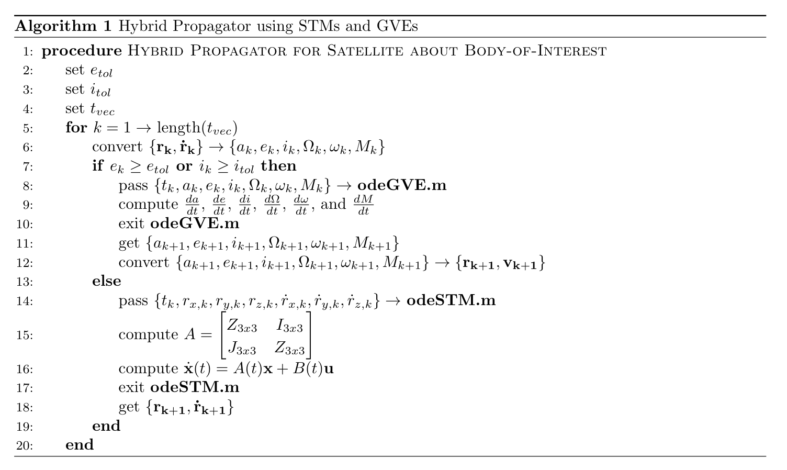
Methodology: Propagator Algorithm
Figure 4: Hybrid Propagator using STMs and GVEs.

Slide 12
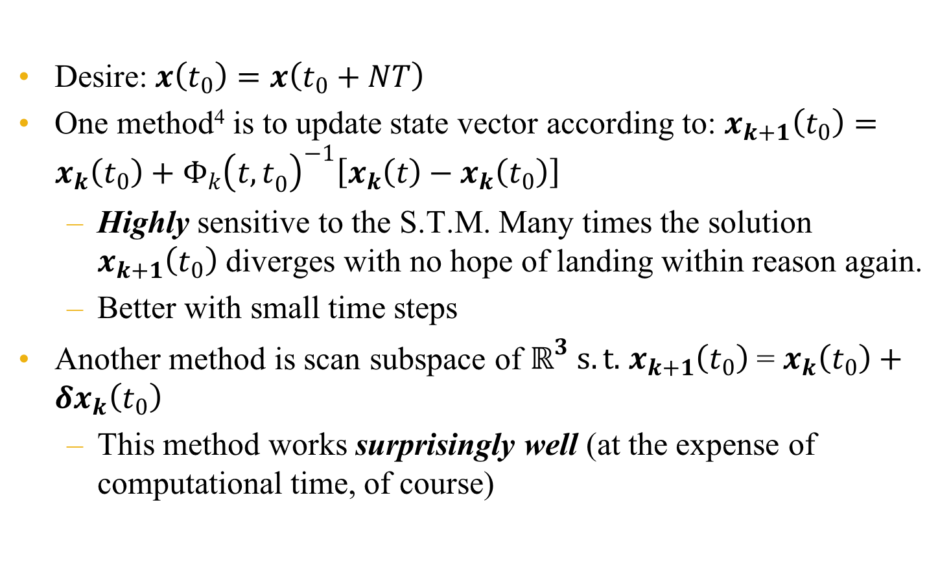
Methodology: Periodic Orbit Solvers
Desire:$x\left(t_{0}\right)=x\left(t_{0}+NT\right)$
One method⁴ is to update state vector according to: $x_{k+1}\left(t_{0}\right)=x_{k}\left(t_{0}\right)+{Φ_{k}\left({t,t}_{0}\right)}^{−1}\left[x_{k}\left(t\right)−x_{k}\left(t_{0}\right)\right]$
  Highly sensitive to the S.T.M. Many times the solution $x_{k+1}\left(t_{0}\right)$ diverges with no hope of landing within reason again.
  Better with small time steps
Another method is scan subspace of $ℝ^{3} s.t.$ $x_{k+1}\left(t_{0}\right)$ = $x_{k}\left(t_{0}\right)+{δx}_{k}\left(t_{0}\right)$
  This method works surprisingly well (at the expense of computational time, of course)

Slide 13
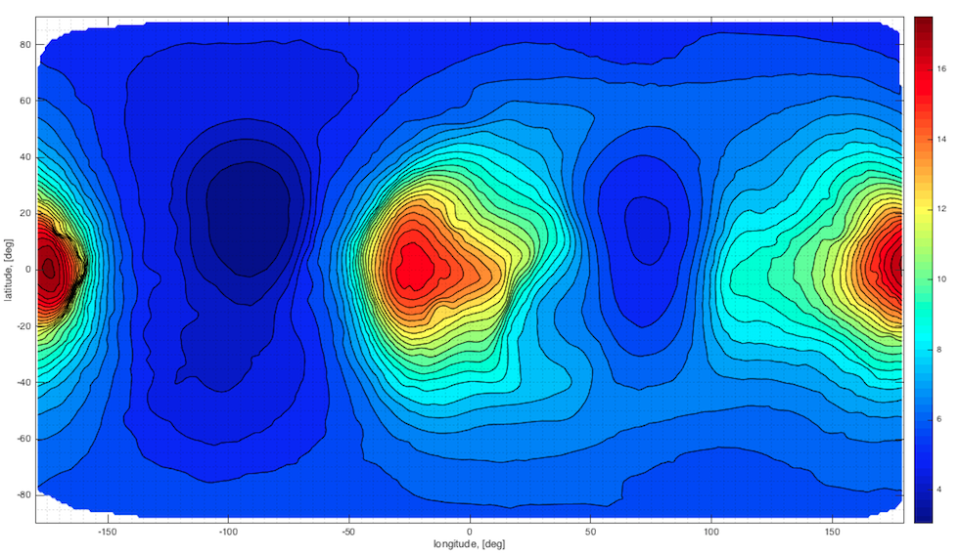
Simulation and Results: 433 Eros
Figure 5: 433 Eros Radii Contour Map. Shape model adapted from Gaskell⁵.

Slide 14
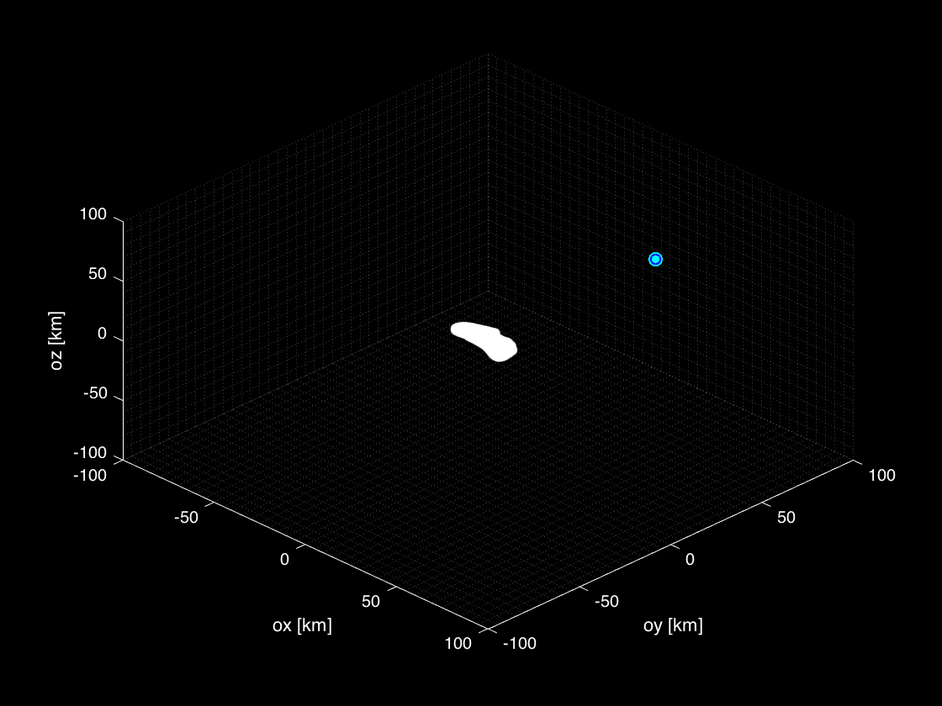
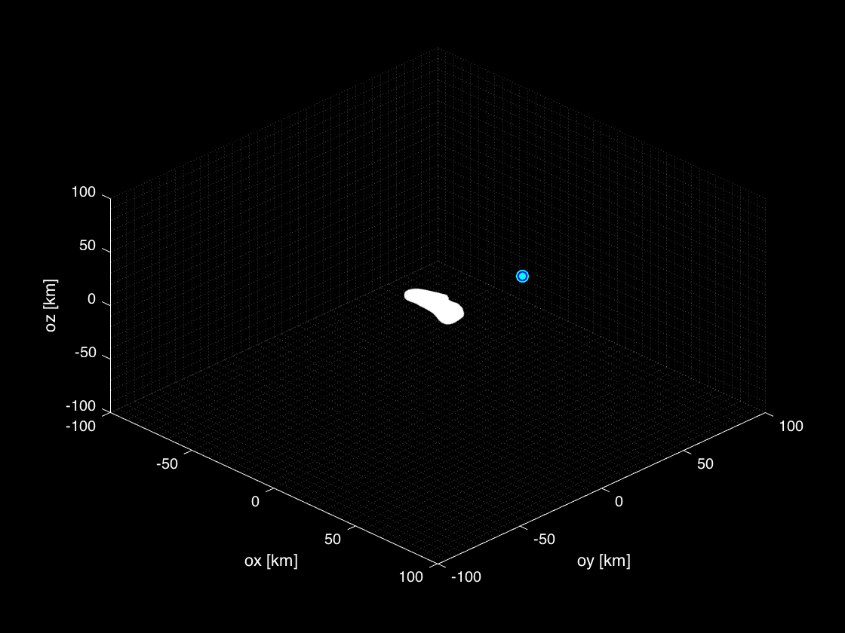
Simulation and Results: Chaos
Chaotic orbits are common about the non-spherical object.
Collision
Diversion
(a)
(b)
Figure 6: (a) Unstable Collision Trajectory, (b) Unstable Diverging Trajectory.

Slide 15
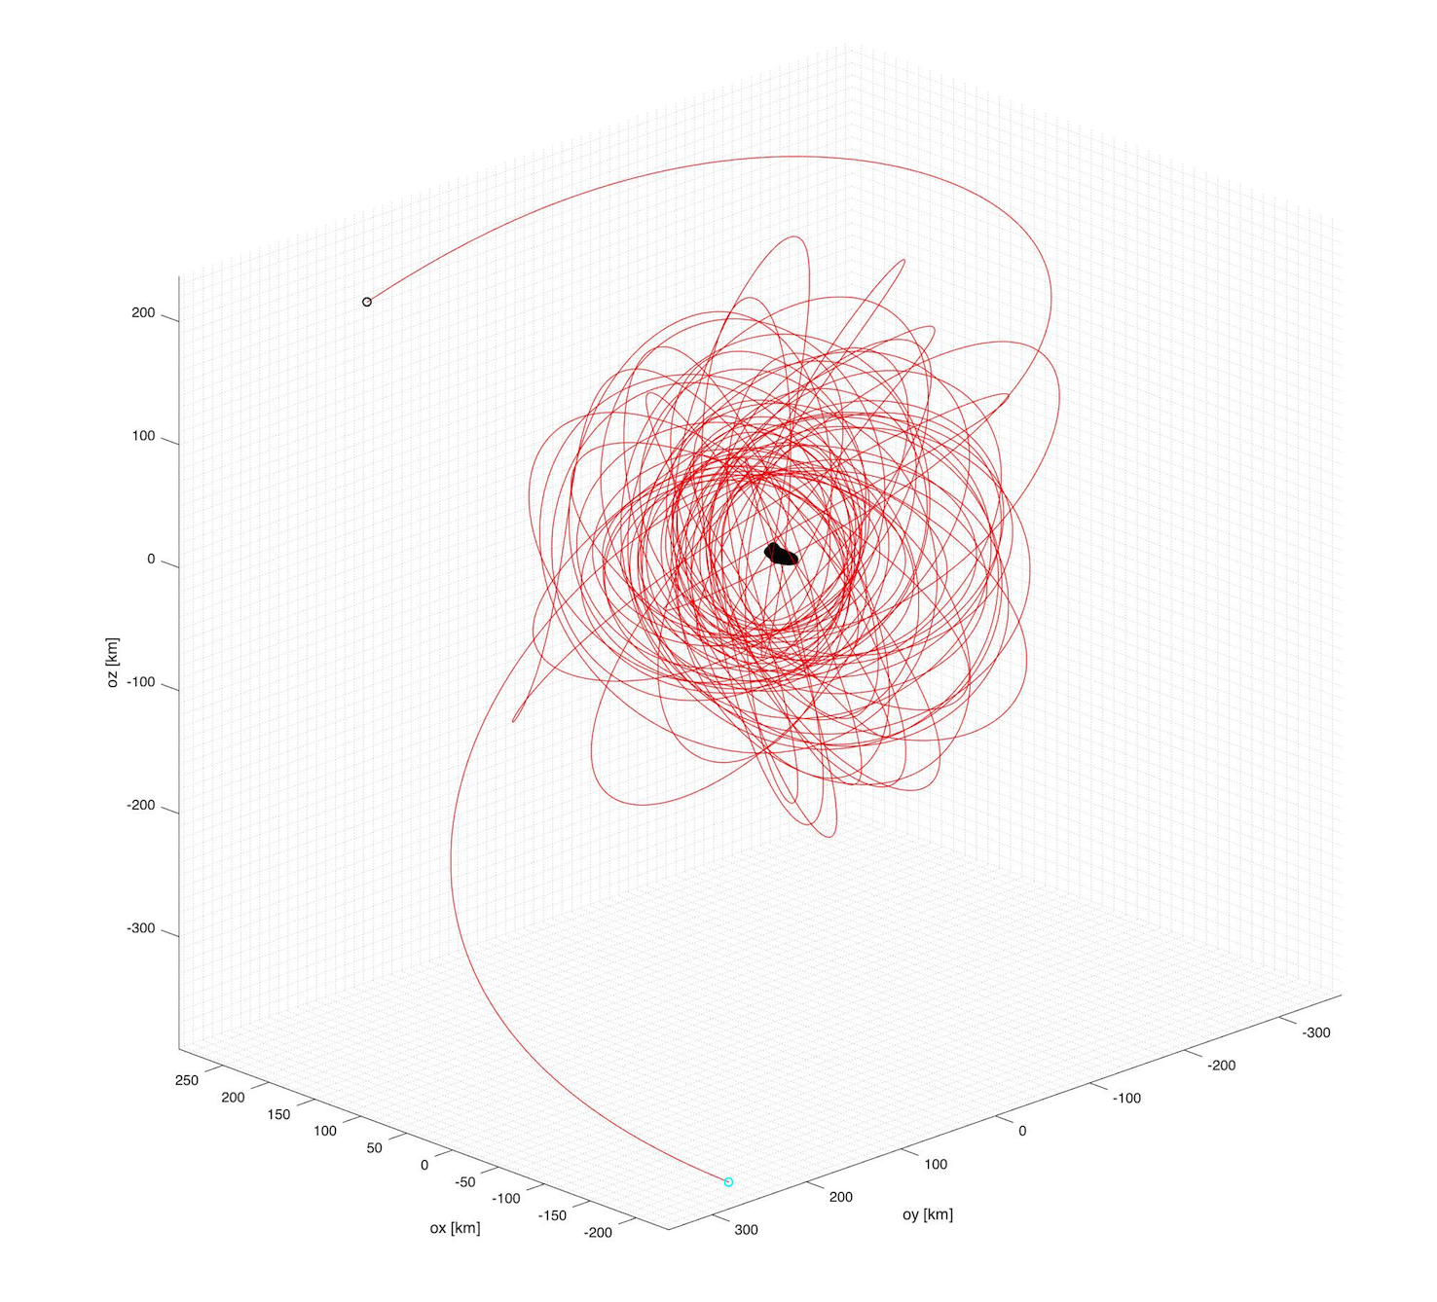
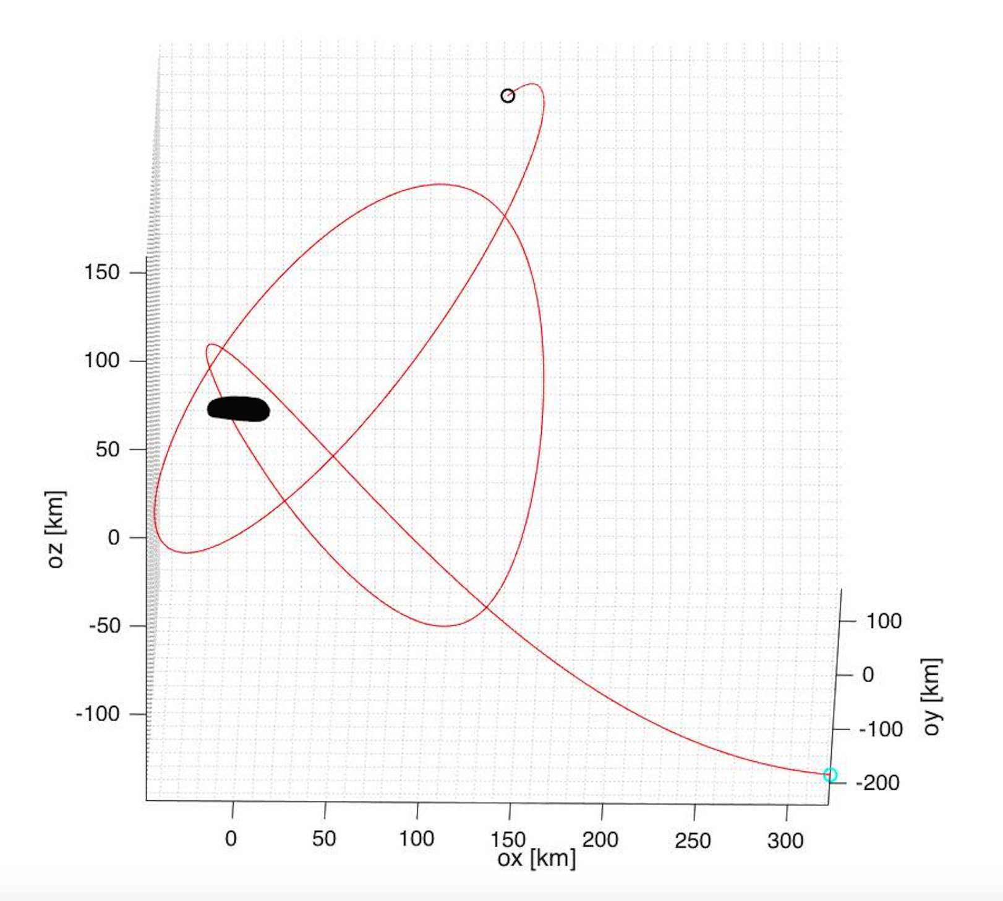
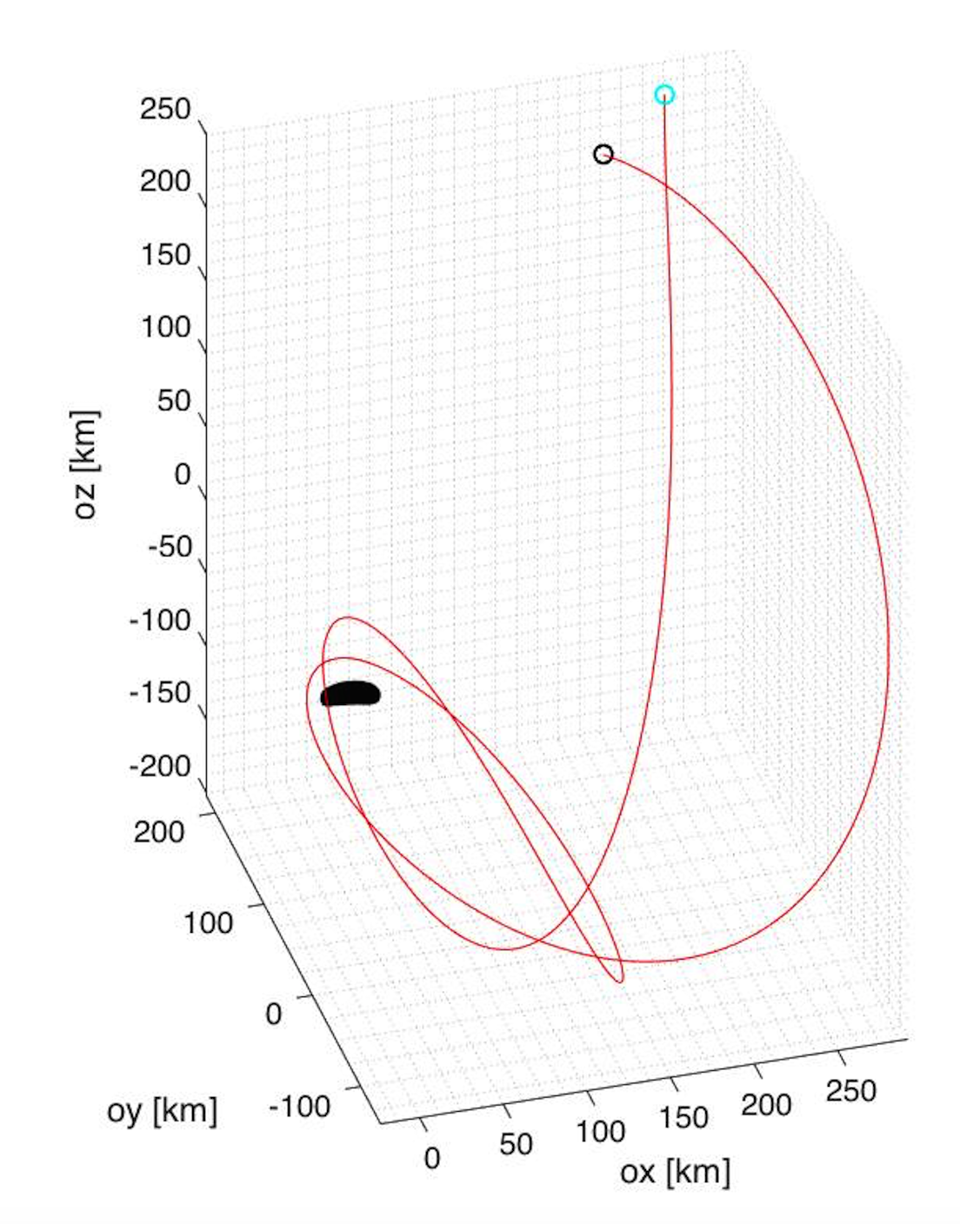
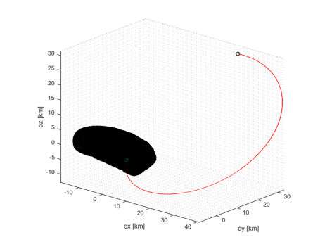
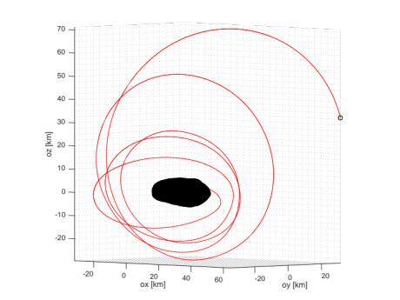
Simulation and Results: Chaos
Sometimes the spacecraft orbit diverges…
And sometimes the orbit crashes into the body…
(a)
(b)
(c)
(d)
(e)
Figure 7: (a) - (c) Diverging Trajectories, (d) - (e) Collision Trajectories.

Slide 16
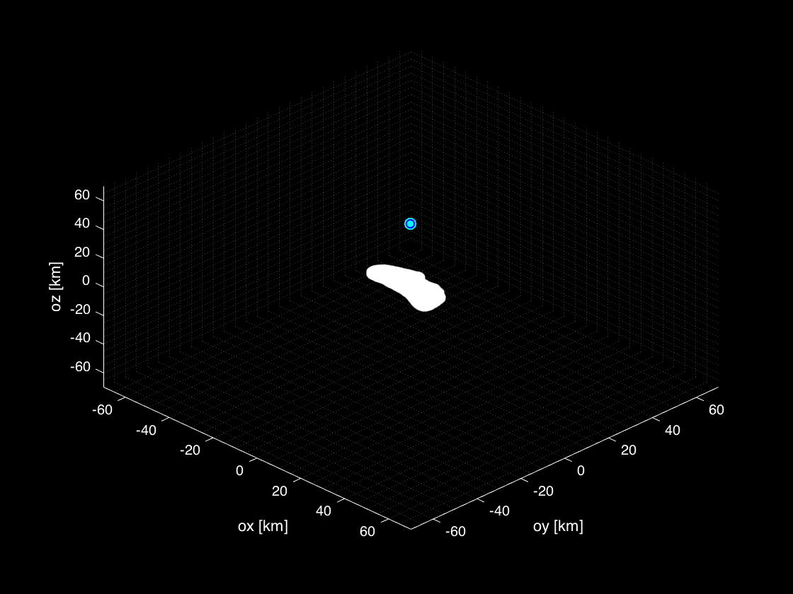
Simulation and Results: Orbit Analysis
SRP, Third Body, and Gravity Field Approximation
Figure 8: Stable, Quasi-Periodic Terminator Orbit about 433 Eros.

Slide 17
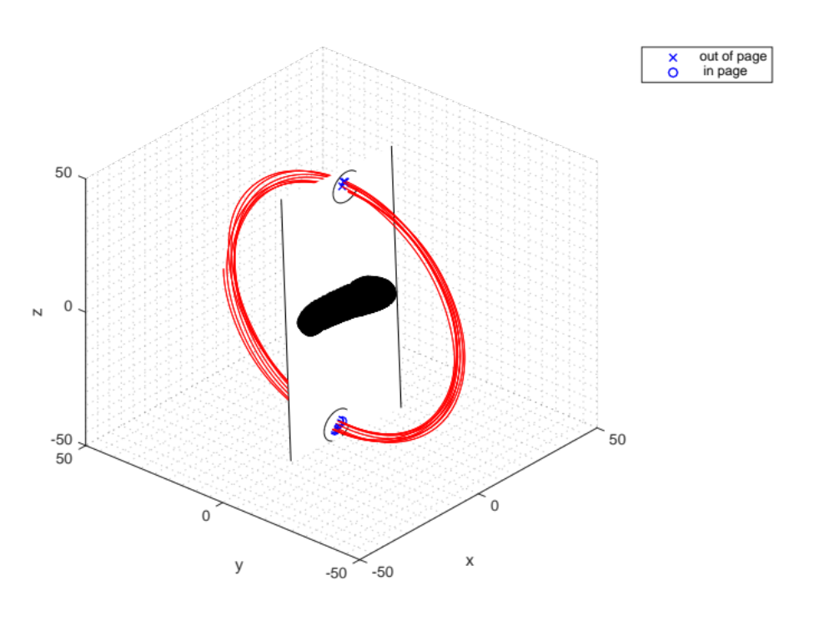
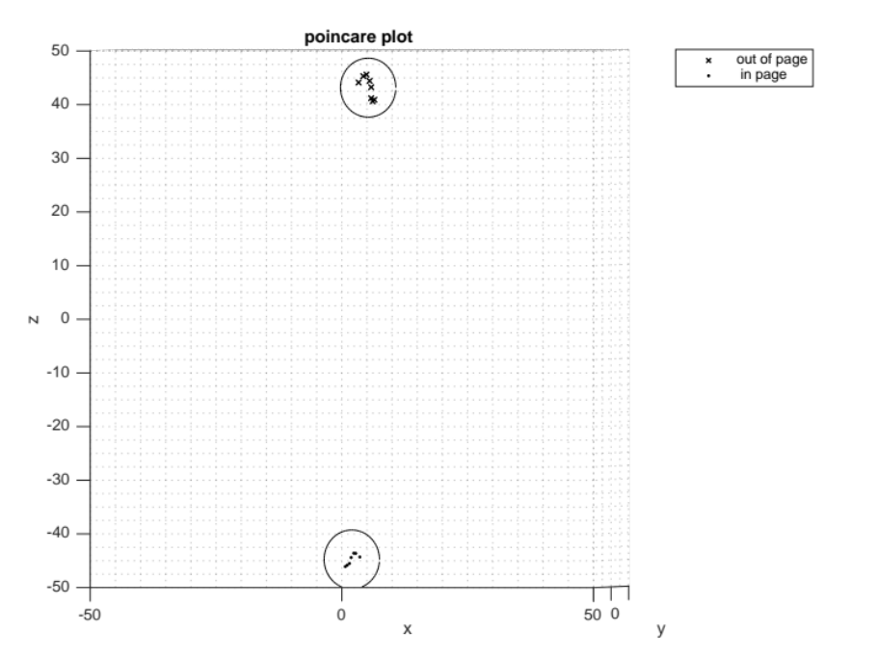
Simulation and Results: Orbit Analysis
Figure 9: 3D View with Poincare Plane.
Figure 10: Poincare Plot.

Slide 18
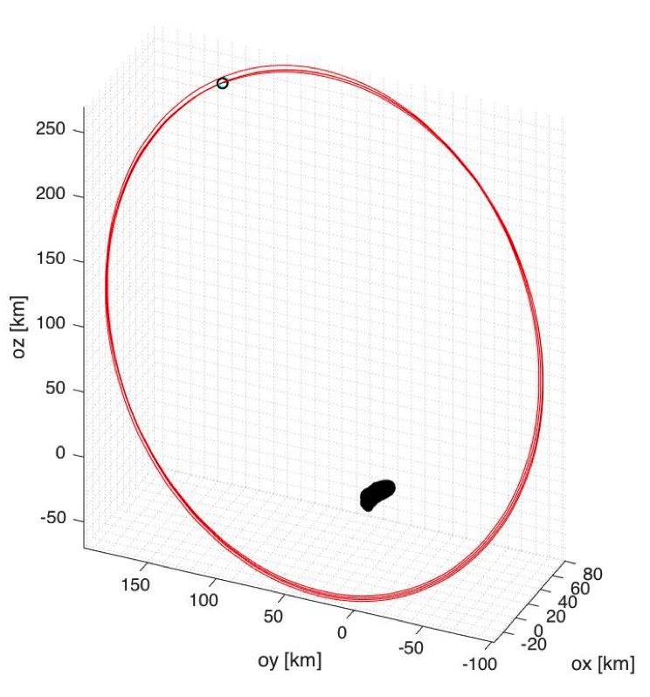
Simulation and Results: Orbit Analysis
MacCullagh approximation yields two distinct terminator orbits of varying eccentricities, both stable, quasi-periodic.
Scheeres et. al. predicted these to be unstable orbit solutions about 433 Eros, using a complete set of equations of motion.
Figure 11: Another Terminator Orbit.

Slide 19
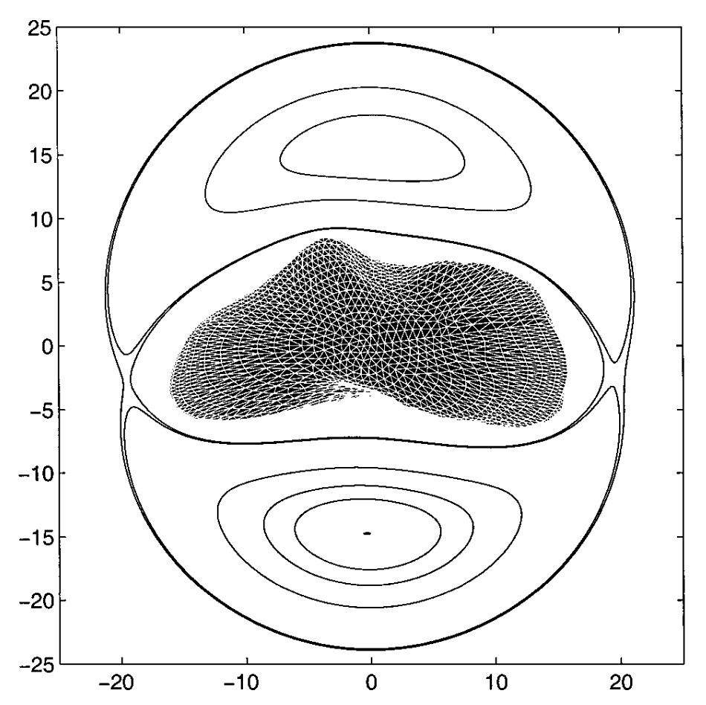
Simulation and Results: Orbit Analysis
What is going on here?
MacCullagh’s approximation is still valid
Limitations in MacCullagh’s approximation involved with apriori knowledge of only the moment of inertia matrix.
Existing force models
Figure 12: Scheeres’ Zero-Velocity Plot.⁶

Slide 20
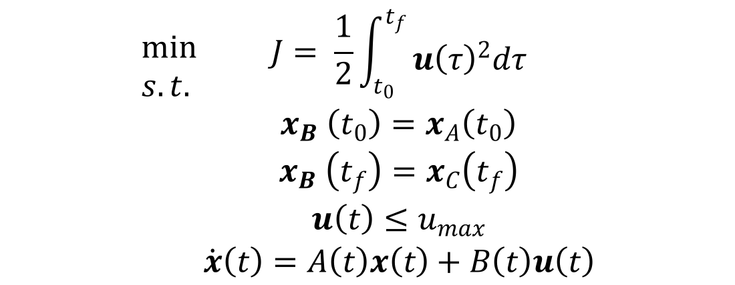
Ongoing Efforts
Revisit current gravitational potential field model
  Is there a method for approximating spherical harmonic coefficients?
Solve the two-point boundary problem with variable specific impulse using SQP:
$$\begin{aligned}min \\ s.t. \\ \\ \\ \\ \end{aligned}{\begin{aligned}\begin{aligned}J= \frac{1}{2}\int_{t_{0}}^{t_{f}}{\begin{aligned} \\ {u\left(τ\right)}^{2}dτ\end{aligned}} \\ x_{B} \left(t_{0}\right)=x_{A}\left(t_{0}\right)\end{aligned} \\ x_{B} \left(t_{f}\right)=x_{C}\left(t_{f}\right) \\ u\left(t\right)≤u_{max} \\ \dot{x}\left(t\right)=A\left(t\right)x\left(t\right)+B\left(t\right)u\left(t\right)\end{aligned}}$$

Slide 21
Conclusions / Lessons Learned
Results are only as good as the model approximation.
Orbit approximations are only good for ~7 days.
Addition of perturbations yield quasi-periodic orbits.
Apriori information increases model fidelity.

Slide 22
Questions
Thank you for your attention.

Slide 23
References
[1] H. Khalil. Nonlinear Systems. Prentice Hall, New Jersey, USA, 3rd edition, 2001.
[2] D.A. Vallado. Fundamentals of Astrodynamics and Applications. Microcosm Press and Kluwer Academic Publishers, El Segundo, CA, USA, 2001.
[3] H. Schaub and J.L. Junkins. Analytical Mechanics of Space Systems. AIAA Education Series. 2003.
[4] Scheeres, D.J. Dynamics of Asteroids close to 4179 Toutatis. Icarus. Vol. 132, No. 1, p. 53 – 79, 1998.
[5] R. Gaskell. Shape Models. http://sbn.psi.edu/pds/archive/shape.html, 2004
[6] Williams B.G., Scheeres, D.J., and J.K. Miller. Evaluation of the dynamics environment of an asteroid: Applications to 433 Eros. Journal of Guidance, Control, and Dynamics. Vol. 23, No. 3, p. 466 – 475, 2000.

