Slide 1
Mars Telecommunications
CubeSat Constellation Relay
April 26th, 2016
Swapnil Pujari

Slide 2



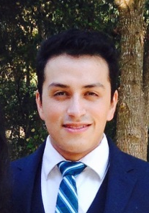
Mars Telecom Investigation Team
David Spencer, Aerospace Engineering
Space systems, mission design
The Mars Telecom Investigation Team would like to acknowledge and thank the following people for their input and support during this study:
JPL: Tom Komarek, Robert Lock, Chad Edwards, Ryan Woolley, Sara Spangelo, Courtney Duncan
Georgia Tech: Glenn Lightsey, Adam Snow, Sean Chait, Terry Stevenson
Rohan Deshmukh, Aerospace Engineering
Packaging, system engineering
Swapnil Pujari, Aerospace Engineering, Telecommunications, data volumes
Giovanny Guecha, Aerospace Engineering, Subsystem trade studies

Slide 3
Concept Overview
A constellation of four 6U CubeSats in high inclination Mars orbit augments telecom relay capability for landed assets
  Benefits include increased frequency of command (forward link) opportunities, and increased return data volumes from surface assets
  Constellation utilizes both DTE/DFE relay as well as UHF cross-link relay with existing telecommunication orbiters
Concept is targeted for 2022 launch opportunity, deployed from 2022 Mars Orbiter
  4-CubeSat constellation established with 350 km circular altitude, high inclination orbit, with evenly phased RAAN
  Study team also evaluated constellation performance in an equatorial orbit
    Two aerocapture delivery systems deployed during Mars approach capture into equatorial Mars orbit; each aerocapture system deploys two CubeSats into low-Mars orbit.
    CubeSats deployed from launch vehicle upper stage at launch, use ion propulsion for interplanetary transfer and orbit capture. This approach was found to be infeasible with current CubeSat-class ion propulsion systems.

Slide 4
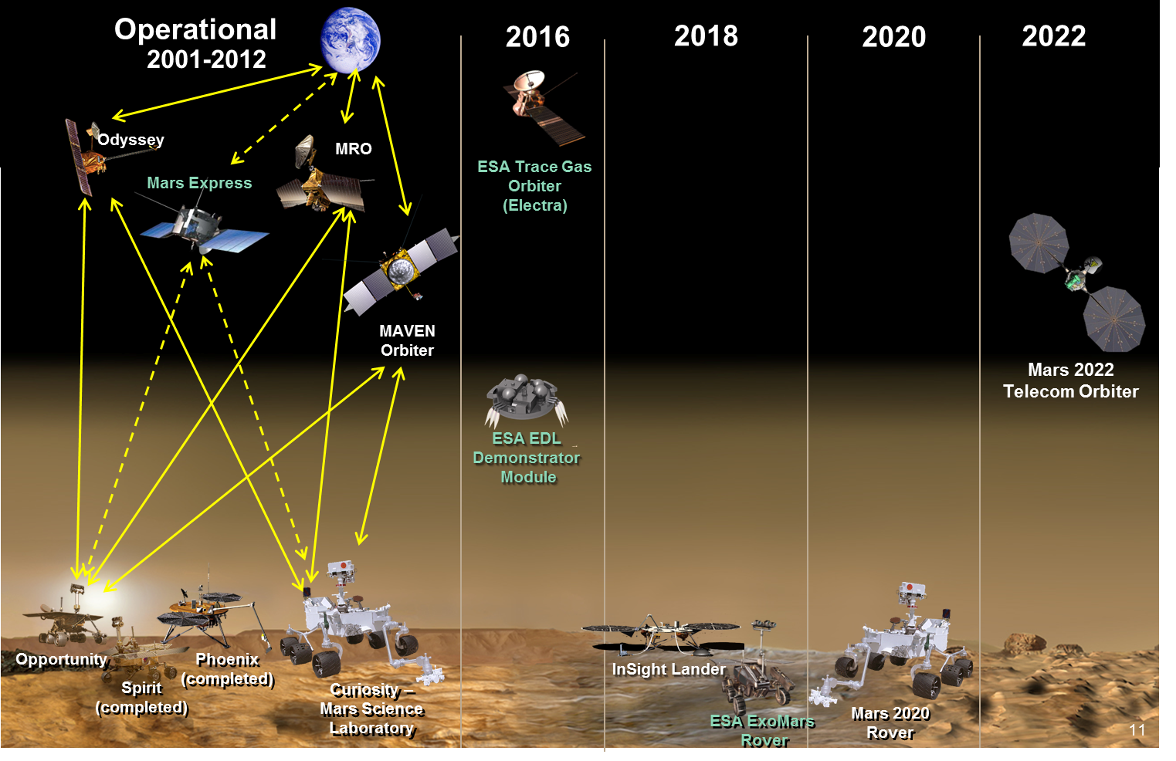
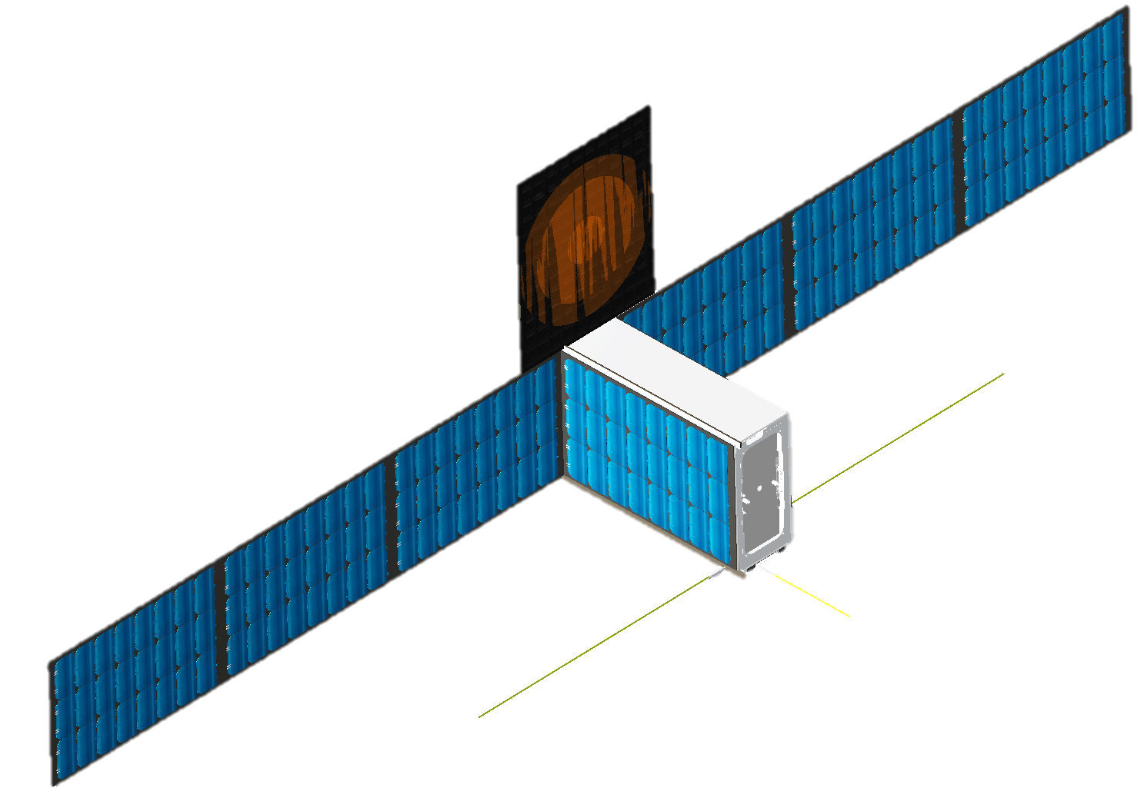
Mars Mission Architecture
Telecom CubeSat Constellation
Credit: Chad Edwards – Jet Propulsion Lab
Notes:
Final Consideration: Cubesats have very focused missions. Not enough space to accommodate communications. Develop infrastructure using off-the shelf components to provide lower costs while increasing performance.

Slide 5
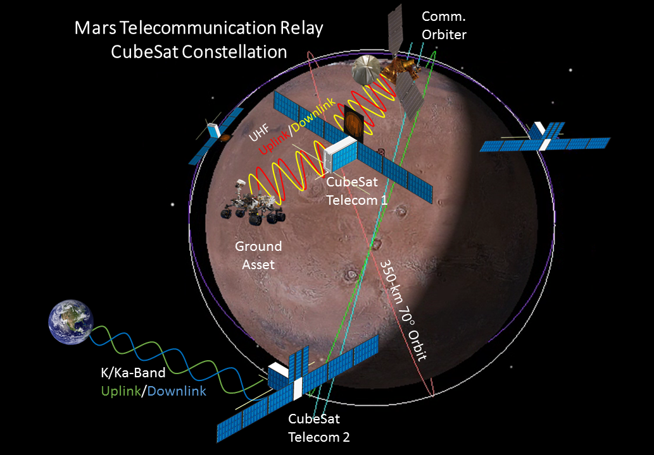
Telecom Relay Architecture
Notes:
MSL -> Ground asset
MRO -> Comm Orbiter
2020 Rover -> Equitorial orbit
4 cubesats in constellation phased 90 deg apart
Telecom -> cubesat 1,2

Slide 6
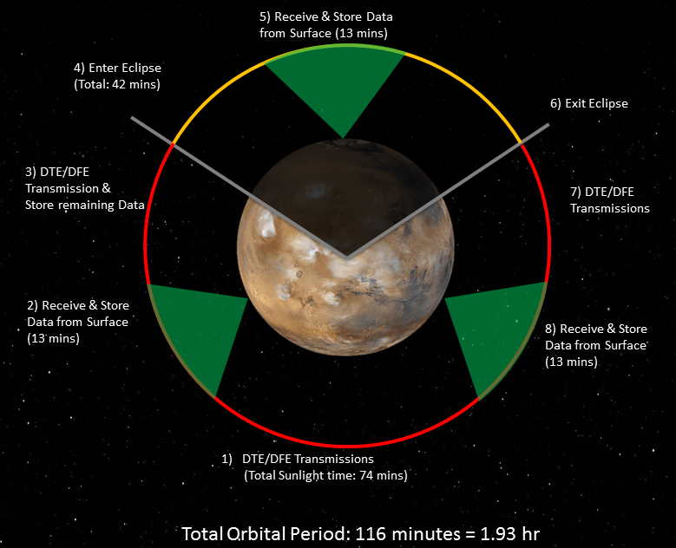
Orbit Timeline & Data Return Strategy

Slide 7
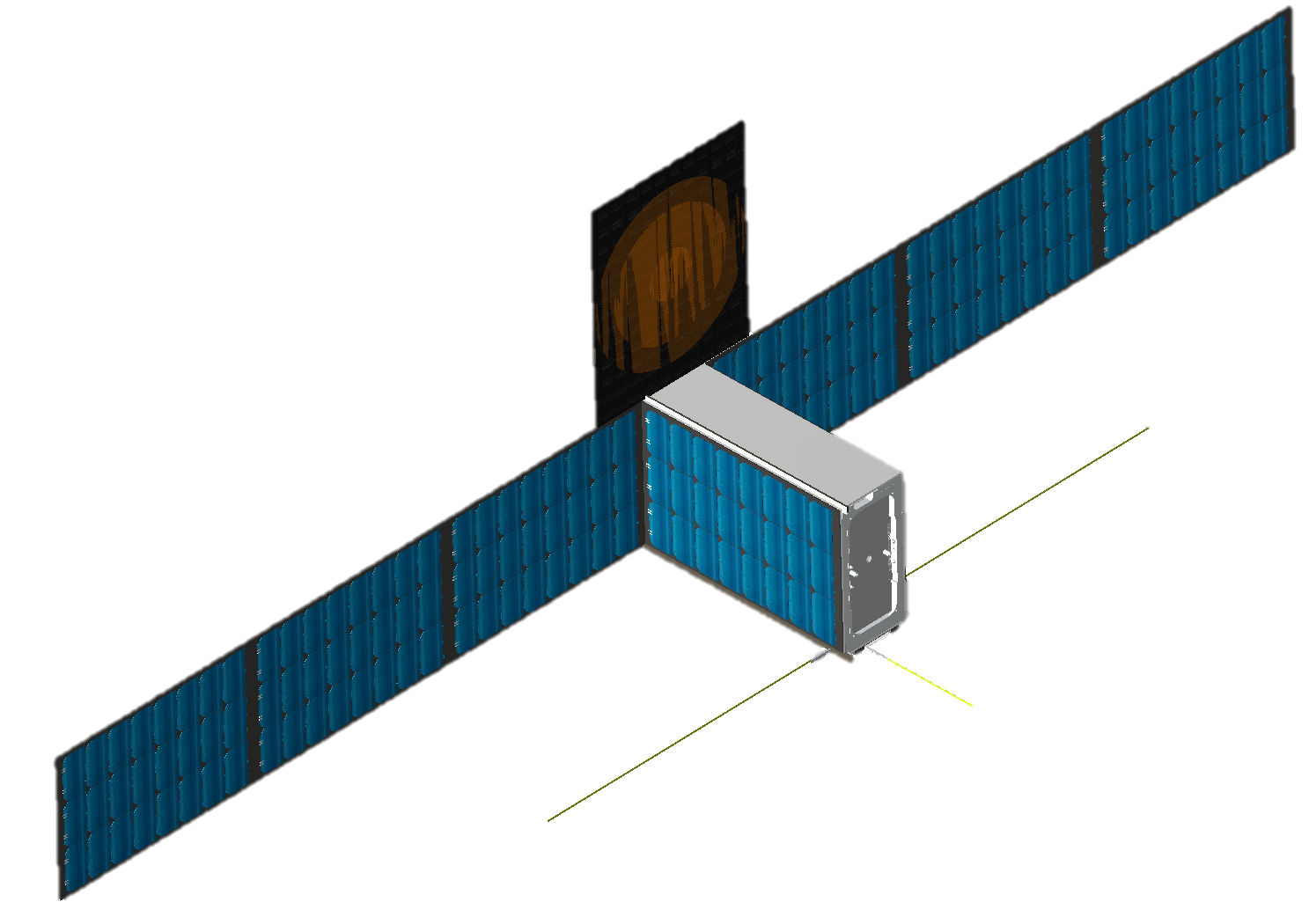
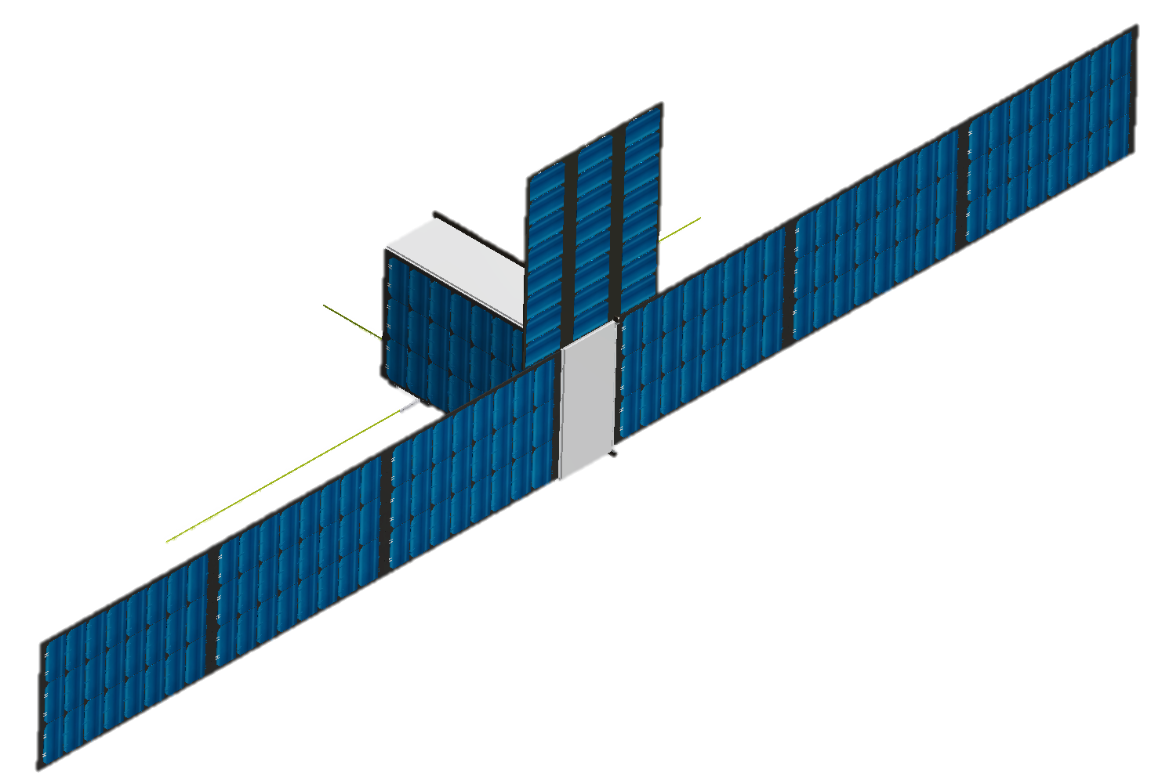
Flight System Deployed Configuration
K/Ka-Band Reflectarray
Solar Panel Array
Front Isometric View
UHF Dipole Antenna
Back Isometric View
Notes:
Here is a CAD model of the overall CubeSat in its deployed configuration with its respective front and back isometric views. The callouts represent the deployed system including the solar panel array, K/Ka-Band reflectarray, and UHF dipole antenna. The solar panel array, consisting of a total of 6 panels, deploys from the 3x2 U face shown where the existing body-mounted solar panel is. The reflectarray is stowed on the 1x3 U face and consists of 3 deployable panels. The UHF dipole antenna deploys on the bottom 1x3 U face through a spring-loaded mechanism.

Slide 8
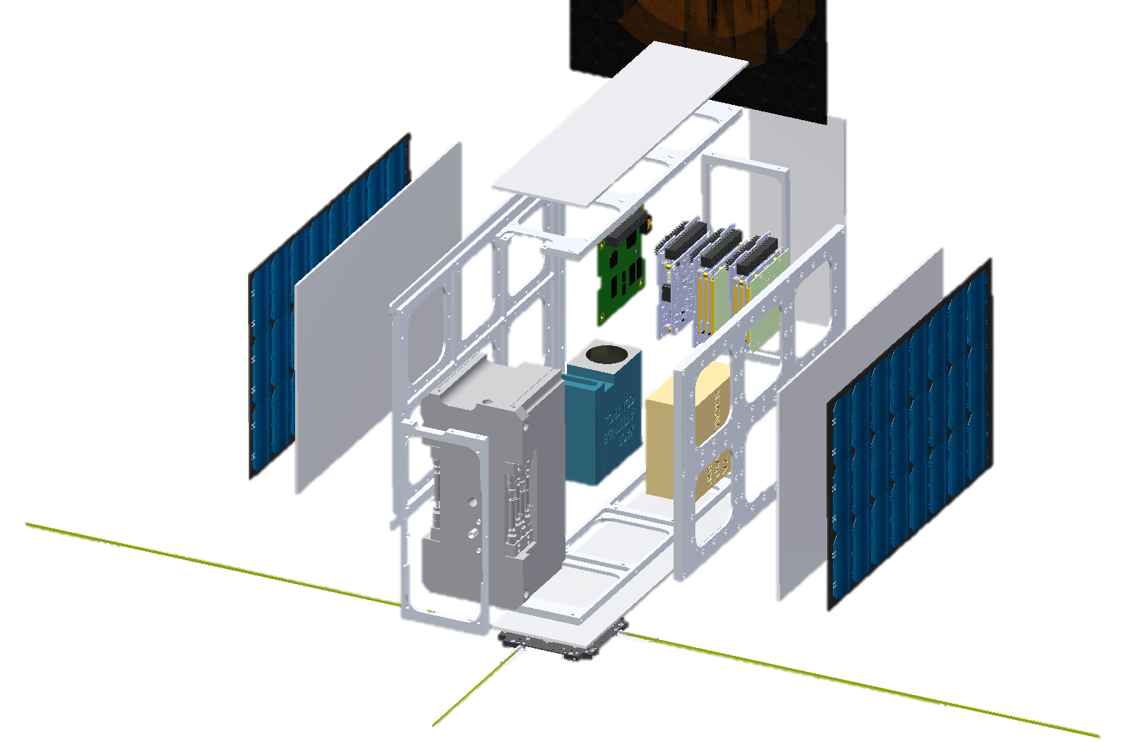
Flight System Exploded View
Telecommunications
Shielding
EPS
CD&H
Structure
ADCS
Telecommunications
Propulsion
Notes:
Here is an exploded view of the cubesat’s s/c bus. All major subsystems are highlighted by respective callouts. Note: deployable solar panel array not shown here.

Slide 9
Master Equipment List
Subsystem | Component Name | Quantity | CBE Mass (g) | Contingency | MEV Mass (g)
ADCS | BCT-XACT Module | 1 | 850 | 5% | 893
Telecom | IRIS v2 Transponder | 1 | 1200 | 15% | 1380
 | UHF Monopole Antenna (ISIS) | 1 | 100 | 5% | 105
 | Ka-Band Reflectarray | 1 | 500 | 15% | 575
Propulsion | Cold Gas Thruster (dry) | 1 | 1500 | 15% | 1725
Structures | 6U CubeSat Structure | 1 | 1640 | 5% | 1722
 | Aluminum Shielding | 1 | 990 | 5% | 1039
C&DH | Proton 200k Lite Processor | 1 | 200 | 5% | 210
EPS | Clyde Space FLEX EPS | 1 | 173 | 5% | 182
 | CS 30 W-hr Battery | 2 | 260 | 5% | 546
 | CS Deployable 6U Panels | 6 | 290 | 15% | 2001
 | CS 6U Body Mounted Solar Panels | 2 | 290 | 15% | 667
Thermal | Heaters | 2 | 10 | 10% | 22
 | MLI | 1 | 200 | 5% | 210
 |  |  |  | MEV Dry Mass | 11,276
 |  |  |  | Propellant Mass | 920
 |  |  |  | MEV Wet Mass | 12,196
 |  |  |  | Mass Margin | 1,803 (15%)
 |  |  |  | MPV Mass | 14,000
Notes:
Mass budget here provides a preliminary estimate of the total mass of each 6U CubeSat. The mass of each component is provided (based on technical specs sheet) and a contingency factor was added in order to account of things such as custom manufacturing costs, additional weightage due to electrical wiring, harnesses, material selection, etc. For components which a know mass is given but may require further development (e.g. cold gas thruster, IRIS v2 Transponder), a 15% contingency was added. For components which the mass was not fully know and based off an analogous component (e.g. 6U solar panels and heaters), a 20% contingency was added. As you can see, our CubeSat weights around 12.2 kg, which is well below the maximum payload value (MPV) of 14 kg set by the Planetary Deployer. The 13% margin allows for adequate flexibility for future developments.

Slide 10
Telecom Analysis Assumptions
DTE downlink data volume calculations based on Earth-to-Mars range (1 AU)
Transmit DTE/DFE when not in eclipse
  Transmit 1.23 hours per orbit
8 hours DSN (34 m BWG) pass per sol, 3 times per week
  Multiple Spacecraft Per Antenna (MSPA) capability
  Up to four simultaneous downlinks
UHF crosslink to MAVEN/TGO/MTO based upon orbit geometries, data rates consistent with average range

Slide 11
Communications Opportunities
4-CubeSat constellation provides 15 overflights per sol with respect to an equatorial surface asset
  2022 orbiter offers four overflights per sol
  MAVEN offers two overflights per sol
70° inclination orbit with RAAN of 0°, 90°, 180°, 270° enables no greater than ~ 3.5 hours communications “blackout” periods
  Constrained due to constellation orbit geometry

Slide 12
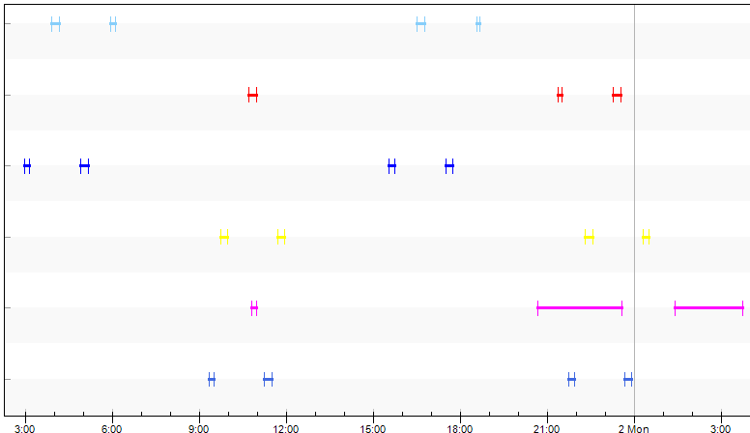
Equatorial Surface Asset Coverage Plot
CubeSat 1
CubeSat 2
CubeSat 3
CubeSat 4
MAVEN
MTO
Time (UTCG)

Slide 13
4-CubeSat Constellation
Return Link Capability
CubeSat Constell. Inclination (deg) | Surface Asset Latitude (deg N) | CubeSat Constell. Avg # of Passes/Sol | CubeSat Avg. Pass Duration (min) | Surface to CubeSat Constell. Avg. Data Volume (Mb/Sol) | CubeSat Constell. Avg. Data Volume Per Sol via MAVEN (Mb/Sol) | CubeSat Constell. Avg. Data Volume Per Sol via TGO/MTO (Mb/Sol) | CubeSat Constell. Avg. Data Volume Per Sol DTE (Mb/Sol)
70 | 0 | 14.3 | 13.0 | 547 | 45 | 589 | 342
70 | 10 | 14.6 | 13.0 | 556 | 45 | 589 | 342
70 | 20 | 15.5 | 13.1 | 589 | 45 | 589 | 342
0 | 0 | 45.7 | 17.5 | 3647 | 64 | 298 | 342
0 | 10 | 45.7 | 16.1 | 2373 | 64 | 298 | 342
0 | 20 | 45.7 | 10.8 | 914 | 64 | 298 | 342
UHF
MAVEN
Surface Asset on Mars
UHF
CubeSat Constellation
Ka-Band
Earth
UHF
TGO/MTO
Notes:
Cubesat <-> Earth: Worst Case is 2% of Best Case Total Data Throughput
Cubesat <-> Surface: Worst Case is 62% of Best Case Total Data Throughput
CubeSat <-> Orbiter: Worst Case is 20% of Best Case Total Data Throughput

Slide 14
Technical Risks
 |  | 2
 |  | 3, 5, 6 | 4 | 1
1 – Solar panel deployment
2 – Radiation tolerance
3 – DTE Pointing accuracy
4 – Propulsion system performance
5 – Ka-band reflect array deployment
6 – UHF antenna deployment
Likelihood
Consequence

Slide 15
Conclusions
CubeSat constellation provides a dramatic increase in the frequency of communications opportunities with landed assets
  Frequent uplink opportunities would be a major benefit to operations teams scheduling the building and transmission of command products
  Allows > 500 Mb/sol surface-to-cubesat data volume
  No greater than 3.5 hour communications “blackout” periods with equatorial surface assets
Allows an average of 342 Mb/sol DTE capability
Technical resource budgets show that 6U CubeSat design is feasible for Mars telecommunications relay application
Notes:
Mass/Structure: Optimized configuration meets CSD deployer requirements
Telecom:
Performed Link Budget to see if DTE/DFE was possible. Ka Band + KaPDA (high gain) allow for communication
UHF capability to talk with other assets (mainly Electra Radio compatible)
Power:
Optimized to meet power requirements of s/c bus (mostly dictated by telecom subsystem in operational mode)
Considered shading effects (both body and shadow) due to Ka Antenna primarily
Using ephemeris data, found max solar angle and optimized Solar Cell system based off worst case scenario

Slide 16
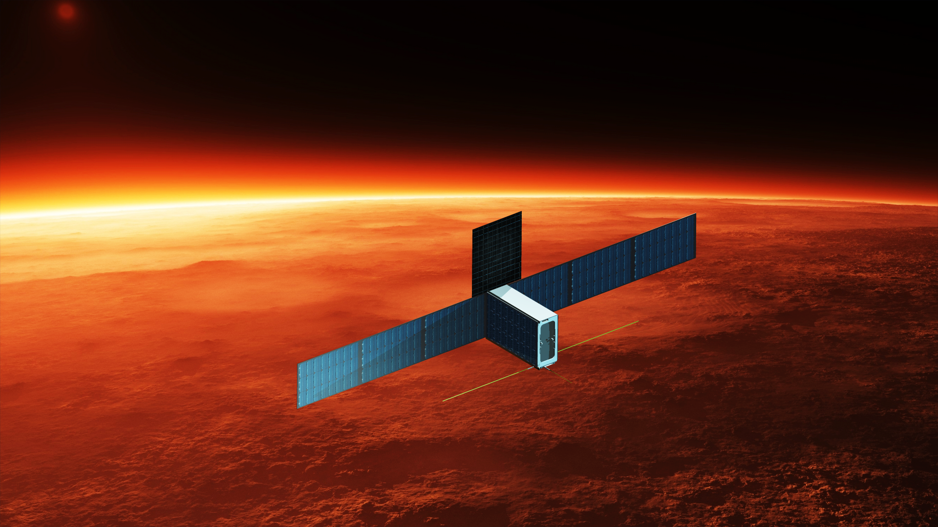
Questions?

Slide 17
Backup Slides

Slide 18
Key Driving Requirements
The telecommunications relay constellation shall consist of four 6U CubeSats.
  36 cm x 24 cm x 12 cm 6U form factor, maximum CubeSat mass 14 kg.
The CubeSats shall be deployed from MTO into low-Mars orbit, and shall maneuver into the constellation configuration.
The constellation orbit shall have a 350 km altitude, with an inclination equal to that of the 2022 Mars Telecom Orbiter (MTO).
The CubeSats shall be phased 90 deg apart along the orbit.
The constellation shall provide direct-from-Earth (DFE) forward link and direct-to-Earth (DTE) return link relay for near-equatorial surface assets.
The constellation shall provide UHF forward- and return-link relay between surface assets and MAVEN/TGO/MTO.
The CubeSats shall be capable of operating for two Mars years in the Mars environment.

Slide 19
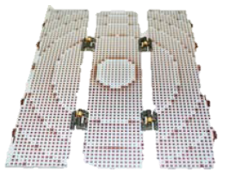
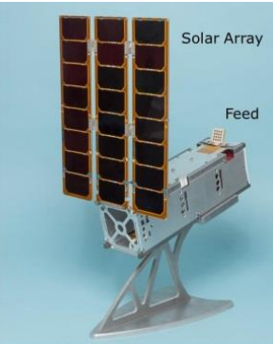
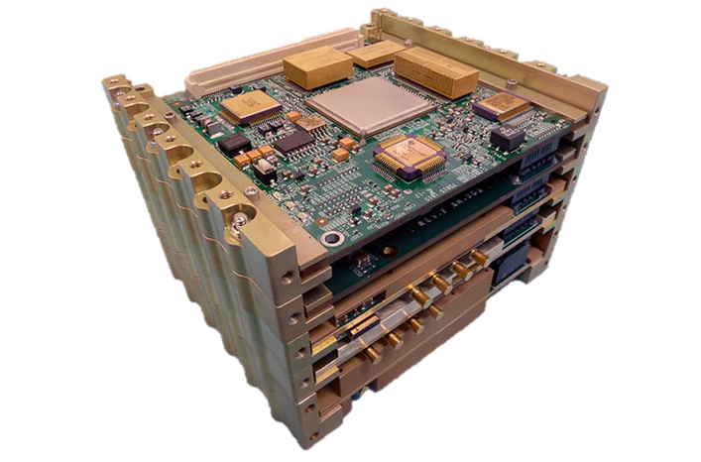
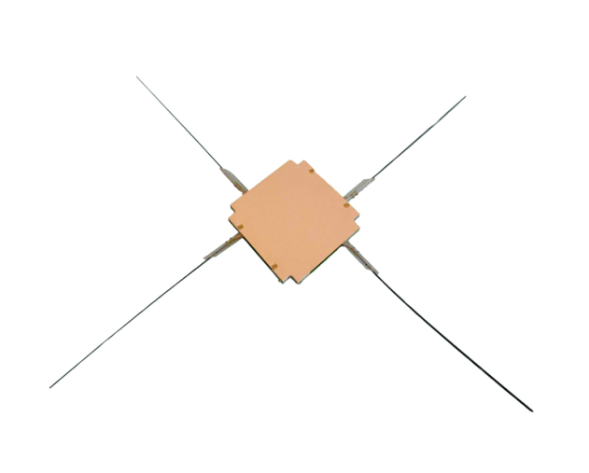
Telecommunications
Subsystem | Component Name | Quantity
Telecom | IRIS Transponder v2 | 1
 | K/Ka-Band Reflectarray | 1
 | UHF 4 Monopole Antenna (ISIS) | 1
K/Ka-Band Reflectarray Antenna¹
Telecommunications Characteristics | Value
Patched Area | 33 x 27 x 0.24 cm
Antenna Gain | 33.5 dBi
Frequency² | 32 GHz
Stowed Area | 30 x 10 x 0.72 cm
IRIS Transponder v2 (NASA JPL):
  Currently: X-Band (Rx/Tx)
  Capabilities: UHF, Ka (both Rx/Tx)
  Max 5W RF Output Power
  Radiation Tolerant
  BPSK Modulation
UHF 4-Way Monopole Antenna
1. Antenna characteristics are based off existing ISARA Reflectarray Antenna
2. Frequency modified to meet DSN specifications/ IRIS v2 capabilities
Sources: CubeSat Antenna Datasheet, NASA
IRIS V2 CubeSat Deep Space Transponder, NASA
Notes:
Using the two aforementioned table for current and future satellites around Mars, it can be seen that NASA is moving towards a standardization in Proximity operations around Mars through their Electra system and continuation of utilizing X-Band as their DS link. However, there is also a push to test K/Ka-Band communication links at Mars to satisfy the growing communication needs. Using these as driving factors, our proposal strives to not only meet current telecom needs, but improve on them by providing alternate cost-effective ways and test novel concepts in improving telecom performance.
Notes for IRIS Transponder v2:
X-Band Uplink Frequency Range: 7.145 – 7.190 GHz (compatibility verified in Version 1 and/or Version 2)
X-Band Downlink Frequency Range: 8.4 – 8.45 GHz (compatibility verified in Version 1 and/or Version 2)
Ka-Band: 32/34 GHz Deep Space, 26 GHz near Earth (capability under development)
UHF Frequency Range: 390 – 450 MHZ (Receive supported on Version 2 but not yet verified, transmit capability under development)
Notes for ISARA High Gain Antenna:
HGA 0 Tx/Rx RHCP reflectarray at K/Ka-band
26 GHz comm antenna (100 MHz BW, min)
Deployed on 3U P-POD bus / 3 deployable panels
>33.0 dBi gain (max pointing error ±45° Az, ±35° El)
Elevation pointing angle: 0.00°
Solar Power: 24 solar cells (~24 W BOL LEO)

Slide 20
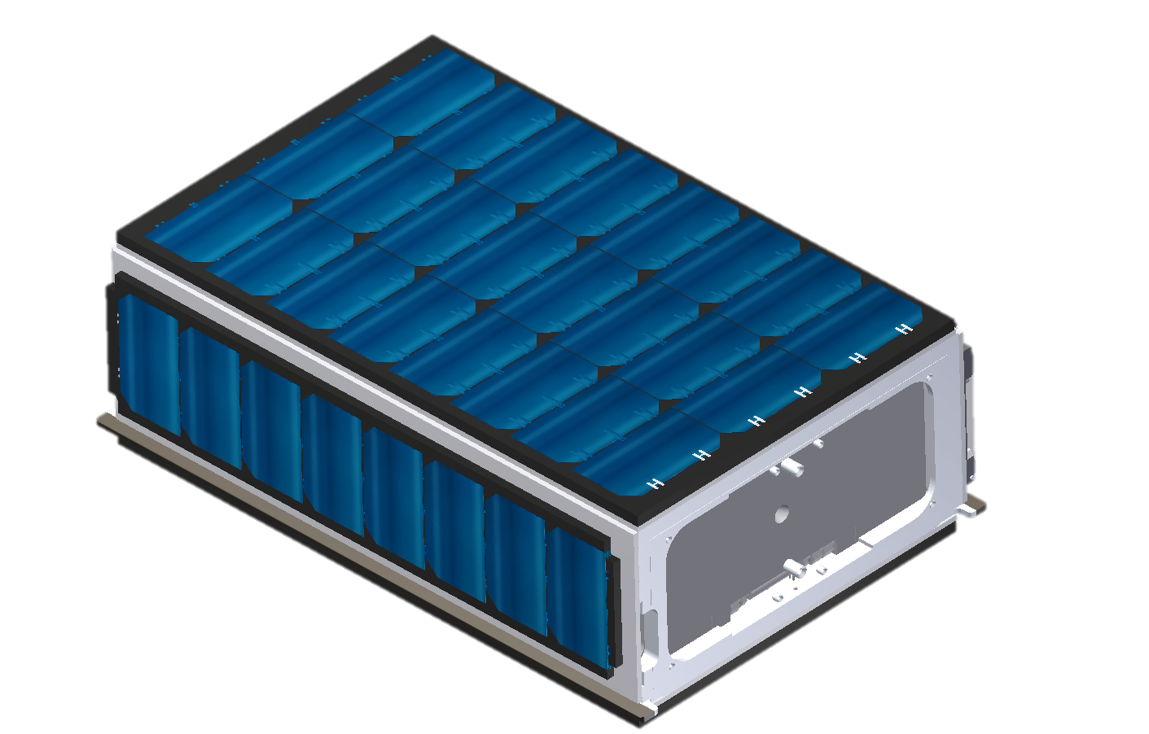
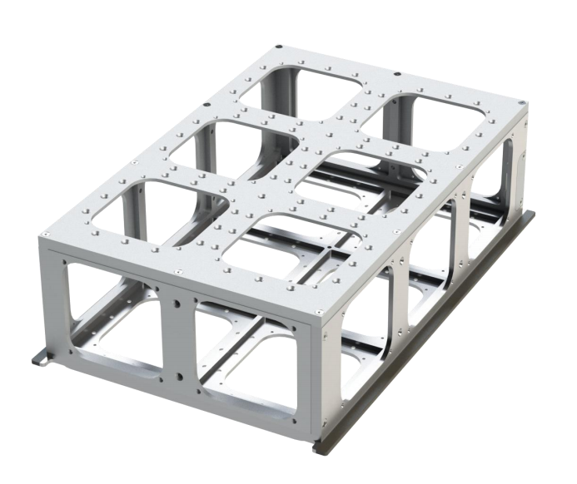
Structure
Pumpkin Supernova 6U aluminum structure provides mounting locations for all subsystem components
6U CubeSat structure complies with CubeSat deployer standards
  12 cm x 24 cm x 36 cm
  MPV Mass: 14 kg
Subsystem | Component Name | Quantity
Structure | Pumpkin Supernova 6U | 1
 | Aluminum Shielding¹ | 5
Stowed CubeSat Configuration
MEV Mass: 12.2 kg
12.4 cm
35.7 cm
Pumpkin Supernova
6U aluminum structure
23.9 cm
1. Shielding assumed to be 1.5 mm thick and covers all structure sides except cold gas thruster
Notes:
When selecting external components for Cubesat, structure and sizing limitation must be put into consideration. Nevertheless, these constraints acted as driving factors in various trade studies in selection components (in particular EPS and Telecom Subsystems).
As you can see, the Deployable/Foldable components to fit 6U limitation set by the CubeSat deployment system (CSD). Note: These CSD limitations are current limitations as NASA is currently trying to expand the CSD system to accommodate for 6U Cubesats up to 14kg.

Slide 21

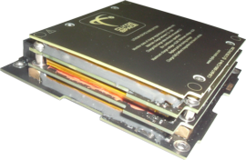
Electrical Power Subsystem
Subsystem | Component Name | Quantity
EPS | Clyde Space FLEX EPS | 1
 | CS 30 Whr Battery | 2
 | CS Deployable Double Sided 6U Panels | 6
 | CS 6U Body Mounted Solar Panels | 2
 | K/Ka-Band Reflectarray | 1
Clyde Space Customized Solar Panels
24 cells per face
  48 cells on one panel (double-sided)
Solar Cell Efficiency: 28.3%
Customization Required
Clyde Space FLEX EPS
12 BCR inputs, enough for many solar panels
On board over/under charge protection
Placed in vault for radiation mitigation
Clyde Space Batteries
  30 Whr batteries, sync with PDM board
  Built in heaters
K/Ka-Band Reflectarray (ISARA)
24 cells integrated into reflectarray
Notes:
Using the aforementioned analysis of Solar Flux, a simple solar cell sizing was conducted in order to determine what area of solar cells were needed in order to provide power to all critical subsystems. Through the solar cell sizing, it was determined that a total solar cell area of 0.518 m^2 is required, which corresponds to a total of 188 solar cells (assuming CS solar panel dimensions). Nevertheless, a modular solar panel configuration shown above was selected to provide a total of 240 solar cells. The configuration consists of 8 deployable double-sided solar panels and 2 body mounted solar panels. The deployable 6U panels will have to be custom made by CS and be tested for magazine stacked deployment (24 cells vs 18 cell current configuration).
Area of one solar cell (CS): 0.00275 m²
Total Solar Cell Area: 0.66 m² (greater than solar sizing requirement for margin)

Slide 22
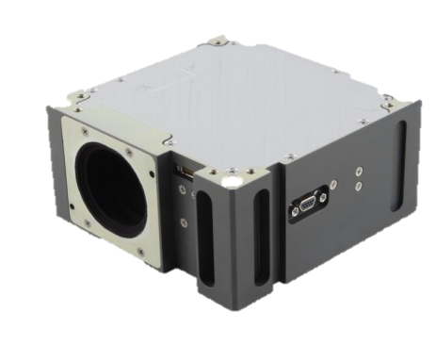
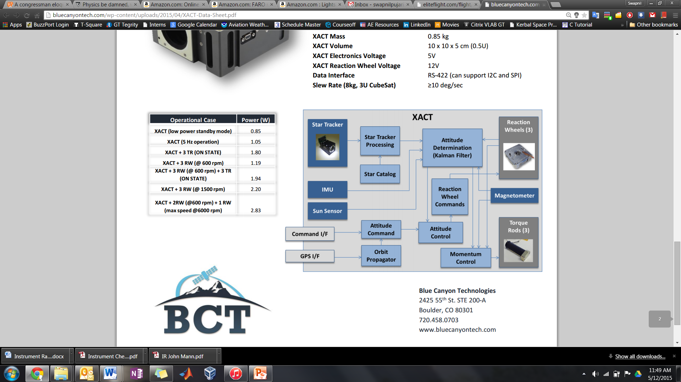
Attitude Determination & Control
Subsystem | Component Name | Quantity
ADCS | BCT-XACT Module | 1
Size: 0.5U
Pointing Accuracy: ±0.003° (2 axes)
±0.007° (3rd axis)
Low jitter 3-axis reaction wheel control
  Desaturation with cold gas thruster
Customizable software
Source: Blue Canyon Technologies
Notes:
Pointing accuracy is 1 sigma confidence for all axes

Slide 23
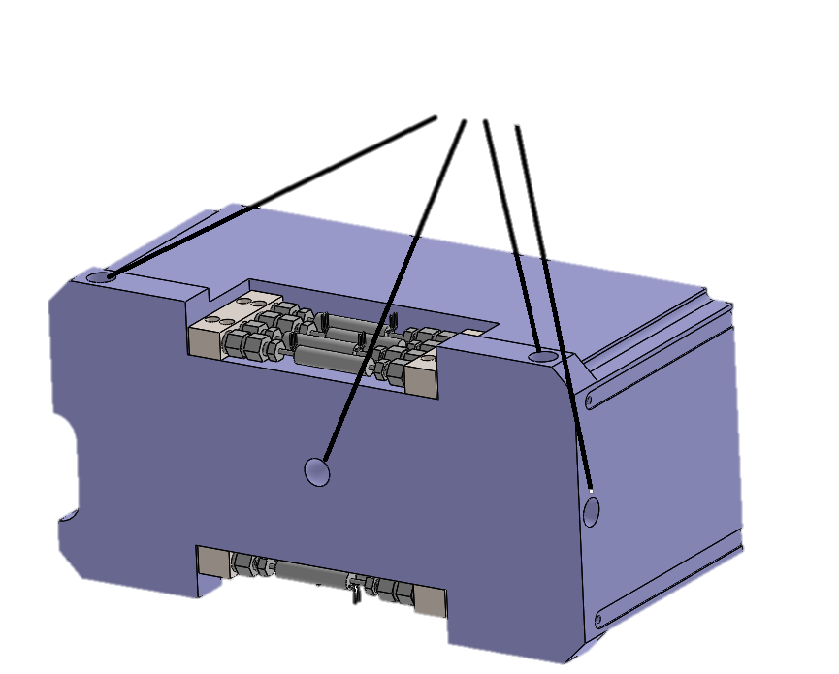
Propulsion
Subsystem | Component Name | Quantity
Propulsion | 2U Cold Gas Thruster | 1
Thruster Characteristics | Value
Dimensions (mm) | 21x10x10
Dry Mass (kg) | 1.5
Propellant Mass (kg) | 0.92
Propellant | R-236fa
Power (W) | 0.85 (nominal) 14** (startup)
BOL Thrust* (mN) | 40
Number of Nozzles | 7
ΔV Capability (m/s) | 31.5
I_{sp} (s) | 50
Nozzles
Cold Gas Thruster CAD Model¹
¹currently being developed by Georgia Tech Space Systems Design Laboratory
*per nozzle
** 2ms to open valve
Notes:
Chemical propulsion chosen over electrical propulsions due to thrust as well as power requirements
With baseline mission

Slide 24
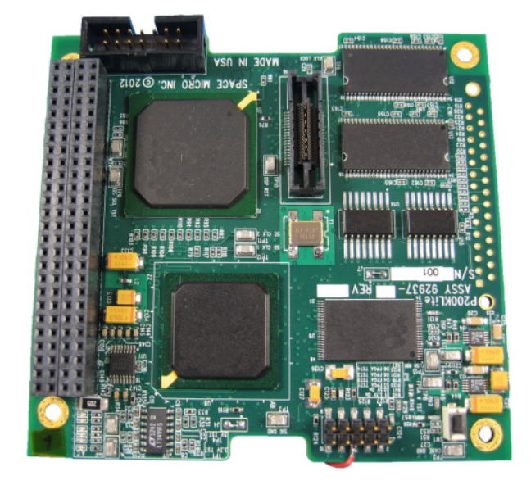
Command & Data Handling
Proton 200k-L (Space Micro)
  Flight heritage on TACSAT-2
  1 GHz processor
  512 Mbyte SDRAM
  1.5W power draw
  UART and GPIO interfaces
Radiation Hardening
  TID: 100krad (Si)
  SEFI: 100% recoverable
  SEL: > 63 LET
  SEU: <1 per 1000 days in GEO
FSW Architecture
  Redundant software modules
  Memory scrubbing
  SEL and SEU detection
  Reprogrammable on orbit

Slide 25
Propellant Budget
Maneuver | ΔV (m/s) | Propellant (g)
Orbit Transfer | 22 | 614
Orbit Phasing | 0.5 | 14
Orbit Maintenance | 2.5 | 68
RW Desaturation | N/A | 50
Reserves | 6.5 | 222
Total | 31.5 | 920
Assumptions
Orbit transfer from 400 x 400 km orbit (injection from MTO) to 350 x 350 km orbit
CubeSats phased 90 deg apart in orbit
Orbit trim maneuvers once/month
Reaction wheel desaturation allocation 50 g

Slide 26
Power Budget
Subsystem | Component Name | Contingency (%) | Safe Mode Power Draw (mW) | Maneuvering Power Draw (mW) | UHF Rx/Tx Power Draw (mW) | DTE/DFE Power Draw (mW)
ADCS | BCT-XACT Module | 10% | 202 | 2024 | 2024 | 2024
Telecom | UHF Antenna | 10% | 220 | 0 | 2200 | 0
 | IRIS v2 Transponder | 25% | 1475 | 1475 | 14750 | 14750
Propulsion | Cold Gas Thruster | 25% | 0 | 2706 | 0 | 0
C&DH | Proton 200k Lite | 10% | 1375 | 1375 | 1375 | 1375
EPS | CS FLEX EPS | 10% | 165 | 165 | 165 | 165
 | CS 30 Whr Battery | 10% | 110 | 110 | 110 | 110
Thermal | Heaters | 15% | 1150 | 288 | 288 | 288
 |  | MEV Total (W) | 4.70 | 8.14 | 20.91 | 18.71
On-board Average Power Generation (W) | 33.42
Notes:
Safe Mode: Mode occurs when CubeSat enters eclipse. DTE communication link, EPS system, and flight computer are all on at full power, UHF communications and ADCS are operating at minimal duty cycle, thermal running at half duty cycle.
UHF RX/TX Mode: Mode occurs when CubeSat enters the UHF Transmit & Receive portion of operations mode. This mode will occur while the CubeSat is in eclipse and will operate UHF portion of telecom subsystem at full power.
Mars Telecom Mode :Mode occurs when CubeSat enters the mars telecom portion of operations mode. telecom, flight computer, EPS System all operates at full power. ADCS operates at half duty cycle power as the CubeSat must be frequently reoriented to face Earth for DTE transmission.
Maneuvering Mode: Mode occurs when CubeSat needs to perform a TCM or orbital maitainence maneuver.

Slide 27
Battery Charge Cycle DoD Analysis
Results:
  13% Battery Margin above DoD (5.25 Ahr)
  Clyde Space estimates 35000 cycle life → potentially over 4 year lifetime
Daylight
Eclipse
Daylight
Battery Specs (Clyde Space 30Whr):
Quantity: 2
Capacity: 7.5 Ahr
Voltage: 8.2 V DC
Rated DoD: 30% = 5.25 Ahr
(lab tested for 5000 cycles)
Operation Mode | Power Draw (W) | Power Generation (W)
UHF Rx/Tx | 20.91 | 33.42 / 0
Safe (Eclipse) | 4.70 | 0
DTE/DFE | 18.71 | 33.42
Maneuvering | 8.14 | 33.42
Notes:
1 Orbit Battery Charge Simulation
Assumes orbit-average power generation through daylight period
Can see various operation modes in detail
Specific Power Draw
Orbit-in-a-life duty cycle
Surface asset time of 13 minutes (occurs twice in daylight, once in eclipse)

Slide 28
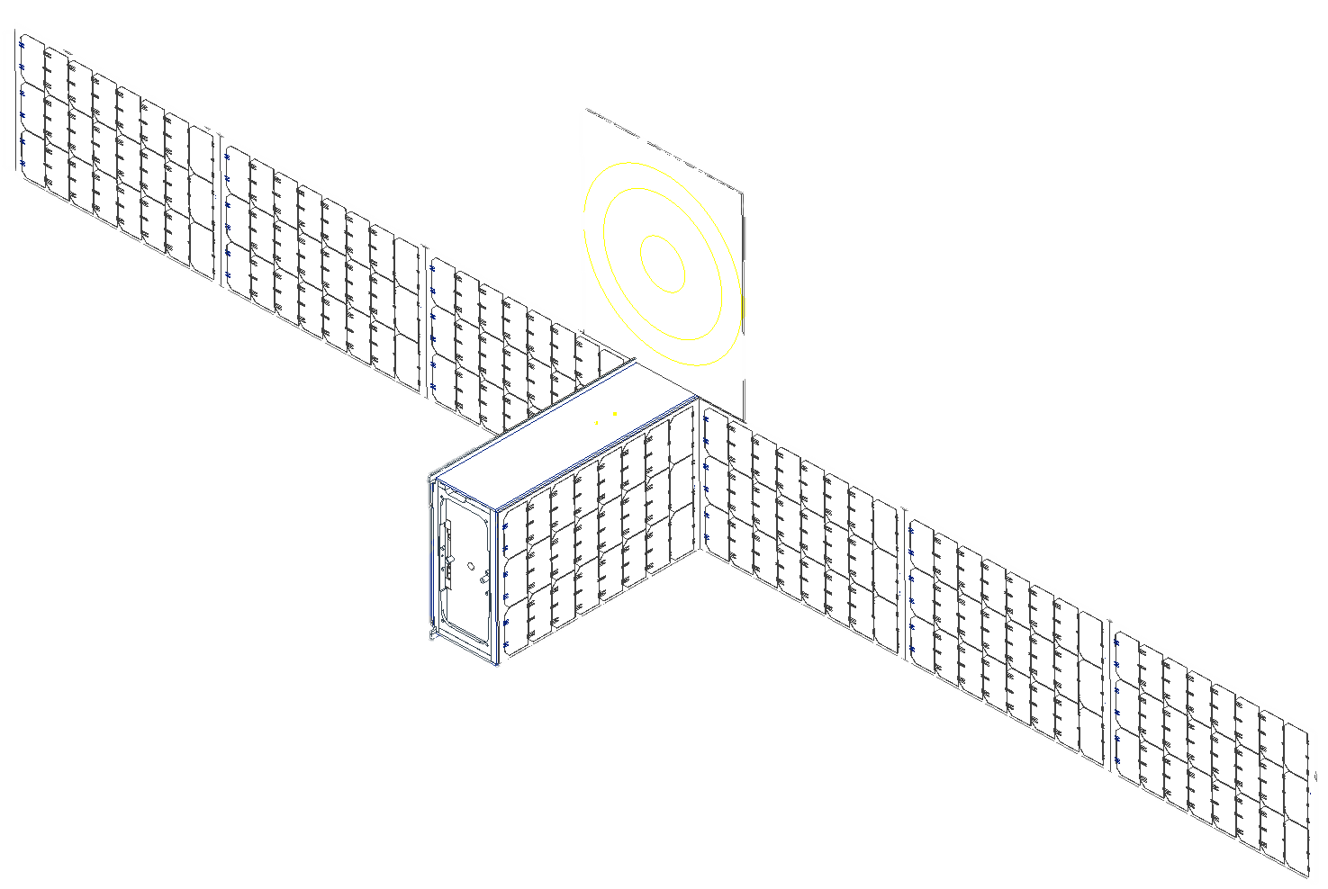
Thermal Control
3-Node thermal model applied at Mars
  Finite differencing used to model temperature change with time
Active thermal control provided by temp sensors and heaters
  Single Mars Eclipse (42 min) during mission operation
  1 W Heaters applied when below -0° C
Paint selection, MLI used to establish desired passive thermal characteristics
Large deployable solar panels must be thermally isolated (kA ~ 4J/K)
Parameter | 1 | 2 | 3
Primary Material | Aluminum | GaAs | Silicon
Surface Area (m²) | 0.266 | 0.912 | 0.178
Mass (kg) | 8.67 | 2.00 | 0.59
Cp (J/kg*K) | 897 | 350 | 700
Power (W) | 33.42 | 0 | 0
Absorptivity | 0.031 | 0.637 | 0.11
Emissivity | 0.039 | 0.85 | 0.05
Thermal Conductivity (W/m*K) | 167 | 52 | 148
Component Temperature Limit (°C) | 0 - 40
2
3
1
2
Source: Thermal Design and Analysis of Spacecraft, AFRL

Slide 29
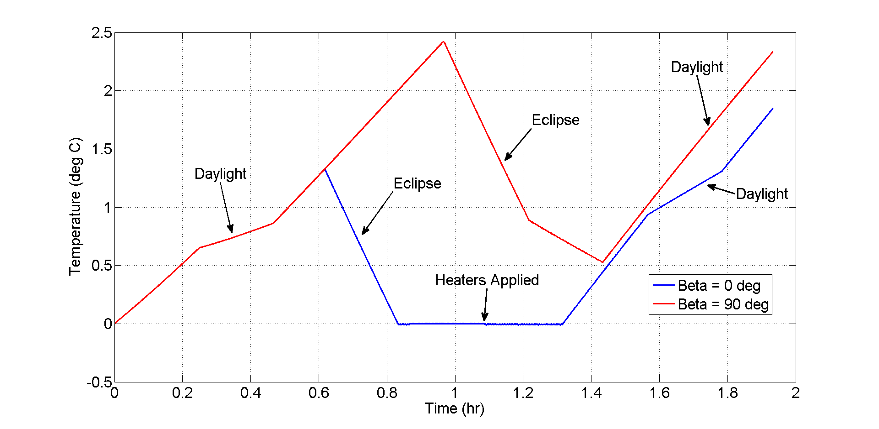
Thermal Control – Orbit In A Life Analysis

Slide 30
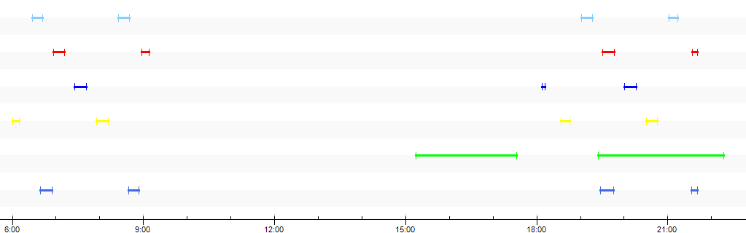
Equatorial Surface Asset Coverage Plot
CubeSat 1
CubeSat 2
CubeSat 3
CubeSat 4
MAVEN
MTO
Time (UTCG)
Coverage Period (approx. 3.5 hours)
Coverage Period (approx. 3.5 hours)
2 x Blackout Period (approx. 8.5 hours)
Variation in True Anomaly

Slide 31
4-CubeSat Constellation
Return Link Capability
Variation in True Anomaly
CubeSat Constell. Inclination (deg) | Surface Asset Latitude (deg N) | CubeSat Constell. Avg # of Passes/Sol | CubeSat Avg. Pass Duration (min) | Surface to CubeSat Constell. Avg. Data Volume (Mb/Sol) | CubeSat Constell. Avg. Data Volume Per Sol via MAVEN (Mb/Sol) | CubeSat Constell. Avg. Data Volume Per Sol via TGO/MTO (Mb/Sol) | CubeSat Constell. Avg. Data Volume Per Sol DTE (Mb/Sol)
70 | 0 | 14.3 | 13.0 | 543 | 94 | 1142 | 342
70 | 10 | 14.6 | 13.0 | 553 | 94 | 1142 | 342
70 | 20 | 15.5 | 13.1 | 584 | 94 | 1142 | 342
0 | 0 | 45.7 | 17.5 | 3647 | 64 | 298 | 342
0 | 10 | 45.7 | 16.1 | 2373 | 64 | 298 | 342
0 | 20 | 45.7 | 10.8 | 914 | 64 | 298 | 342
UHF
MAVEN
Surface Asset on Mars
UHF
CubeSat Constellation
Ka-Band
Earth
UHF
TGO/MTO
Notes:
Cubesat <-> Earth: Worst Case is 2% of Best Case Total Data Throughput
Cubesat <-> Surface: Worst Case is 62% of Best Case Total Data Throughput
CubeSat <-> Orbiter: Worst Case is 20% of Best Case Total Data Throughput

Slide 32
DTE Return Link Budget
Best Case: 0.41 AU
Worst Case: 1 AU
Parameter | Value
Frequency (GHz) | 32
RF Output (W) | 2
CubeSat Antenna Gain (dBi) | 33.5
Path Length (km) | 6E07
34 m DSN Receive Gain (dBi) | 79.5
Noise Temperature (K) | 31
Data Rate (kbps) | 28
Eb/No (dB) | 7
Required Eb/No (dB) | 2
Link Margin (dB) | 4
Parameter | Value
Frequency (GHz) | 32
RF Output (W) | 2
CubeSat Antenna Gain (dBi) | 33.5
Path Length (km) | 4E08
34 m DSN Receive Gain (dBi) | 79.5
Noise Temperature (K) | 31
Data Rate (kbps) | 4.7
Eb/No (dB) | 7
Required Eb/No (dB) | 2
Link Margin (dB) | 4
Notes:
CubeSat <-> Earth: Worst Case is 2% of Best Case Total Data Throughput
CubeSat <-> Surface: Worst Case is 62% of Best Case Total Data Throughput
CubeSat <-> Orbiter: Worst Case is 20% of Best Case Total Data Throughput

Slide 33
DFE Forward Link Budget
Best Case: 0.41 AU
Worst Case: 1 AU
Parameter | Value
Frequency (GHz) | 32
RF Output (W) | 800
34m DSN Gain (dBi) | 79.5
Path Length (km) | 6E07
CubeSat Receive Gain (dBi) | 33.5
Noise Temperature (K) | 80
Data Rate (kbps) | 100
Eb/No (dB) | 7
Required Eb/No (dB) | 2
Link Margin (dB) | 20.3
Parameter | Value
Frequency (GHz) | 32
RF Output (W) | 800
34m DSN Gain (dBi) | 79.5
Path Length (km) | 4E08
CubeSat Receive Gain (dBi) | 33.5
Noise Temperature (K) | 80
Data Rate (kbps) | 100
Eb/No (dB) | 7
Required Eb/No (dB) | 2
Link Margin (dB) | 12.6
Notes:
CubeSat <-> Earth: Worst Case is 2% of Best Case Total Data Throughput
CubeSat <-> Surface: Worst Case is 62% of Best Case Total Data Throughput
CubeSat <-> Orbiter: Worst Case is 20% of Best Case Total Data Throughput

Slide 34
UHF Crosslink Return Link Budget
TGO/M22 → CubeSat
MAVEN → CubeSat
Parameter | Value
Frequency (MHz) | 435
RF Output (W) | 1
Orbiter Antenna Gain (dBi) | 3
Average Path Length (km) | 1,513
CubeSat Receive Gain (dBi) | 0
Noise Temperature (K) | 500
Data Rate (kbps) | 25.7
Eb/No (dB) | 12.6
Required Eb/No (dB) | 9.6
Link Margin (dB) | 2
Parameter | Value
Frequency (MHz) | 435
RF Output (W) | 1
Orbiter Antenna Gain (dBi) | 3
Average Path Length (km) | 5,286
CubeSat Receive Gain (dBi) | 0
Noise Temperature (K) | 500
Data Rate (kbps) | 2.1
Eb/No (dB) | 12.6
Required Eb/No (dB) | 9.6
Link Margin (dB) | 2
Notes:
CubeSat <-> Earth: Worst Case is 2% of Best Case Total Data Throughput
CubeSat <-> Surface: Worst Case is 62% of Best Case Total Data Throughput
CubeSat <-> Orbiter: Worst Case is 20% of Best Case Total Data Throughput

Slide 35
UHF Crosslink Forward Link Budget
CubeSat → TGO/M22
CubeSat → MAVEN
Parameter | Value
Frequency (MHz) | 435
RF Output (W) | 0.5
CubeSat Antenna Gain (dBi) | 0
Average Path Length (km) | 1,513
Orbiter Receive Gain (dBi) | 3
Noise Temperature (K) | 500
Data Rate (kbps) | 12.9
Eb/No (dB) | 12.6
Required Eb/No (dB) | 9.6
Link Margin (dB) | 2
Parameter | Value
Frequency (MHz) | 435
RF Output (W) | 0.5
CubeSat Antenna Gain (dBi) | 0
Average Path Length (km) | 5,286
Orbiter Receive Gain (dBi) | 3
Noise Temperature (K) | 500
Data Rate (kbps) | 1.1
Eb/No (dB) | 12.6
Required Eb/No (dB) | 9.6
Link Margin (dB) | 2
Notes:
CubeSat <-> Earth: Worst Case is 2% of Best Case Total Data Throughput
CubeSat <-> Surface: Worst Case is 62% of Best Case Total Data Throughput
CubeSat <-> Orbiter: Worst Case is 20% of Best Case Total Data Throughput

Slide 36
Surface-to-CubeSat Return Link Budget
Best Case: 0° Surface Asset
Worst Case: 20° Surface Asset
Parameter | Value
Frequency (MHz) | 435
RF Output (W) | 1
Electra Antenna Gain (dBi) | 3
Path Length (km) | 1101
CubeSat Receive Gain (dBi) | 0
Noise Temperature (K) | 500
Data Rate (kbps) | 48.6
Eb/No (dB) | 12.6
Required Eb/No (dB) | 9.6
Link Margin (dB) | 2
Parameter | Value
Frequency (MHz) | 435
RF Output (W) | 1
Electra Antenna Gain (dBi) | 3
Path Length (km) | 1108
CubeSat Receive Gain (dBi) | 0
Noise Temperature (K) | 500
Data Rate (kbps) | 48.0
Eb/No (dB) | 12.6
Required Eb/No (dB) | 9.6
Link Margin (dB) | 2
Notes:
CubeSat <-> Earth: Worst Case is 2% of Best Case Total Data Throughput
CubeSat <-> Surface: Worst Case is 62% of Best Case Total Data Throughput
CubeSat <-> Orbiter: Worst Case is 20% of Best Case Total Data Throughput

Slide 37
CubeSat-to-Surface Forward Link Budget
Best Case: 0° Surface Asset
Worst Case: 20° Surface Asset
Parameter | Value
Frequency (MHz) | 435
RF Output (W) | 0.5
CubeSat Antenna Gain (dBi) | 0
Average Path Length (km) | 1101
Surface Receive Gain (dBi) | 3
Noise Temperature (K) | 255
Data Rate (kbps) | 47.6
Eb/No (dB) | 12.6
Required Eb/No (dB) | 9.6
Link Margin (dB) | 2
Parameter | Value
Frequency (MHz) | 435
RF Output (W) | 0.5
CubeSat Antenna Gain (dBi) | 0
Average Path Length (km) | 1108
Surface Receive Gain (dBi) | 3
Noise Temperature (K) | 255
Data Rate (kbps) | 47.0
Eb/No (dB) | 12.6
Required Eb/No (dB) | 9.6
Link Margin (dB) | 2
Notes:
CubeSat <-> Earth: Worst Case is 2% of Best Case Total Data Throughput
CubeSat <-> Surface: Worst Case is 62% of Best Case Total Data Throughput
CubeSat <-> Orbiter: Worst Case is 20% of Best Case Total Data Throughput

Slide 38
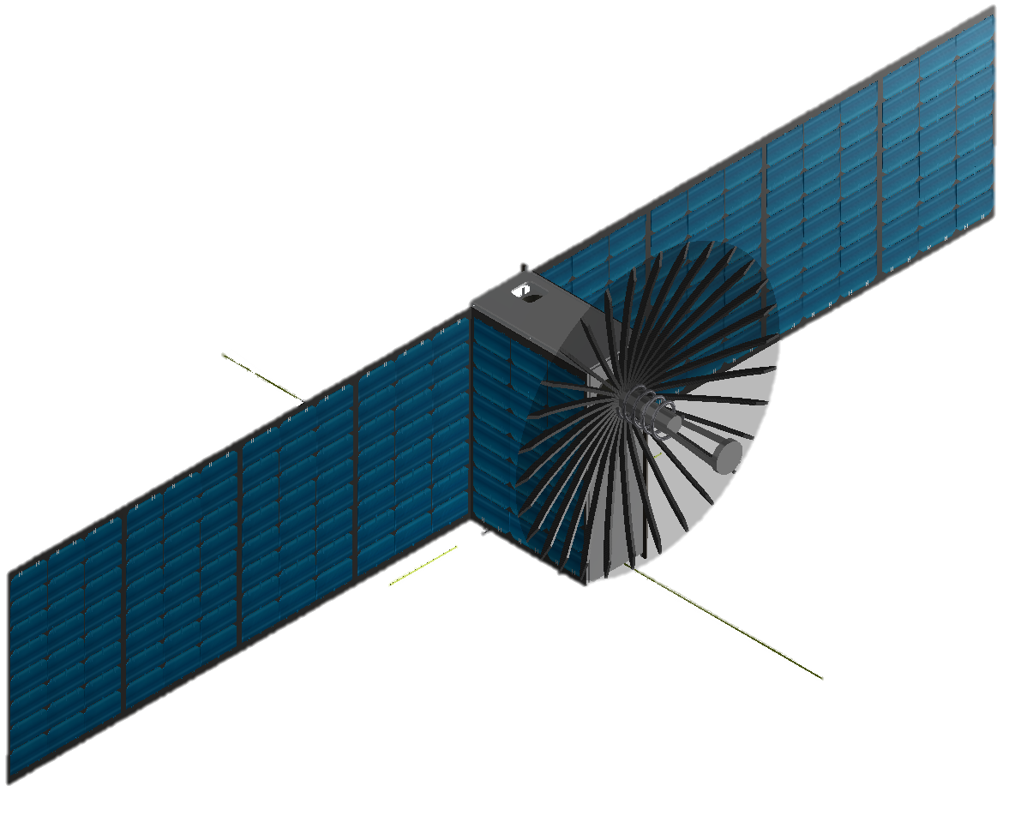
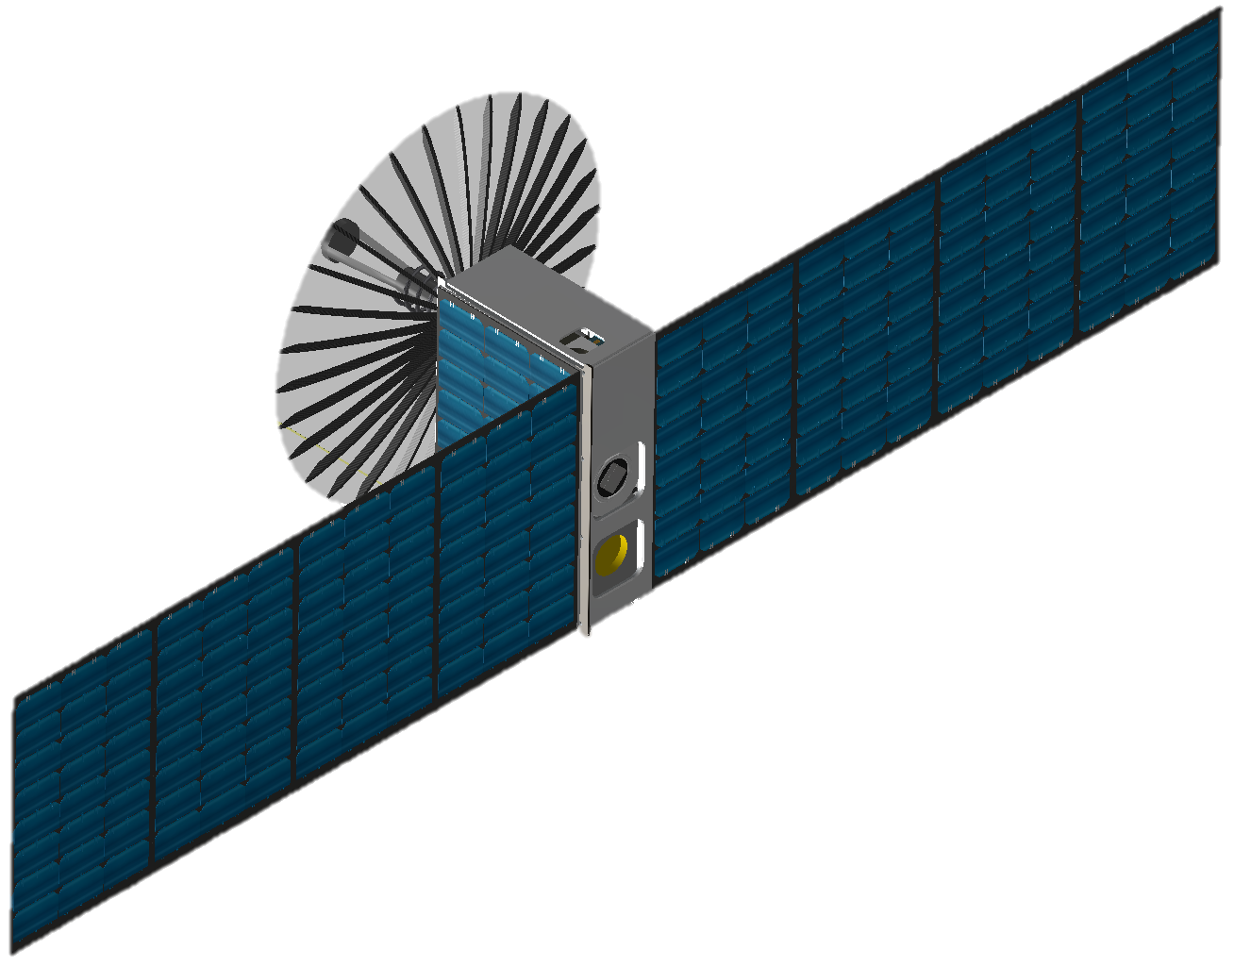
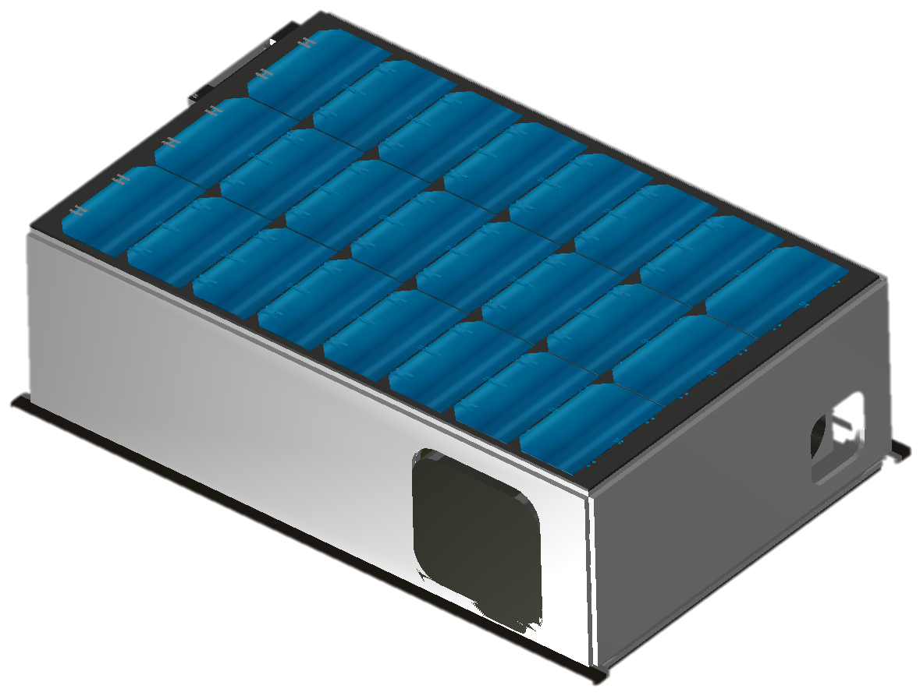
Flight System Deployed Configuration (KaPDA Version)
12.4 cm
35.7 cm
22.2 cm
Front Isometric View
Back Isometric View
Stowed Isometric View
Notes:
Here is a CAD model of the overall cubesat in its deployed configuration with its respective front and back isometric views.

Slide 39
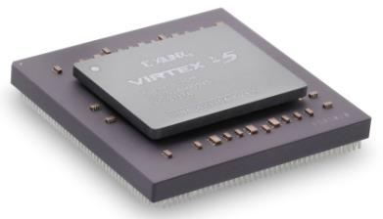
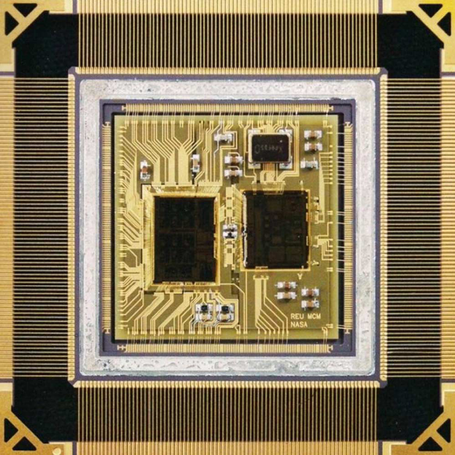
Radiation Mitigation
The Mars CubeSat design will advance the CubeSat standard for radiation tolerance to enable a two Mars-year baseline mission
Approaches to radiation mitigation:
  Shielding
  Radiation hardened electronics
  Selected hardware redundancy
  Software redundancy
  Memory scrubbing
  Fault tolerance by design
Image Credit: Xilinx
Source: Cressler, Radiation effects in SiGe Technology

Slide 40
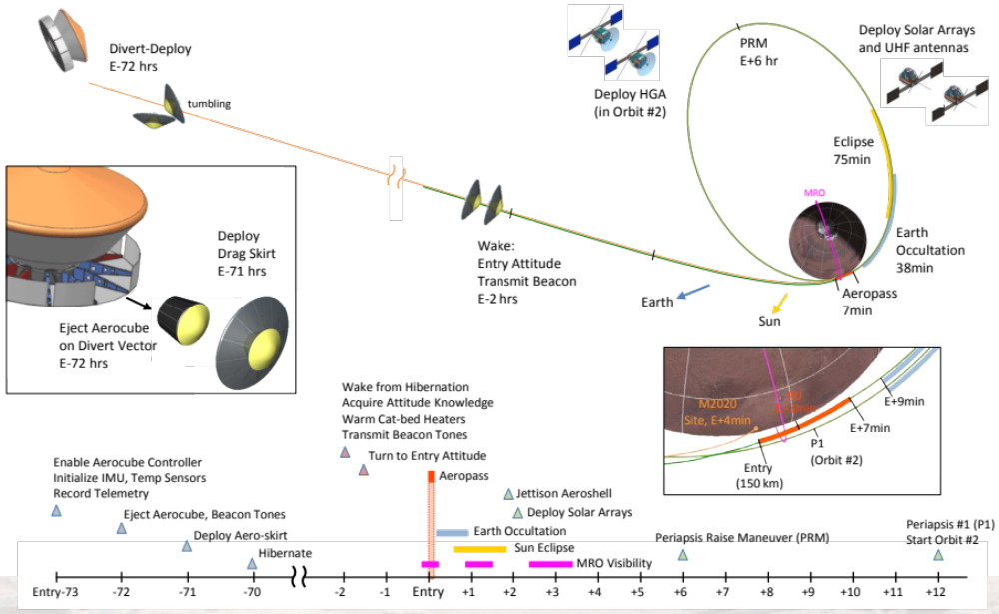
Mars Aerocapture Concept

Slide 41
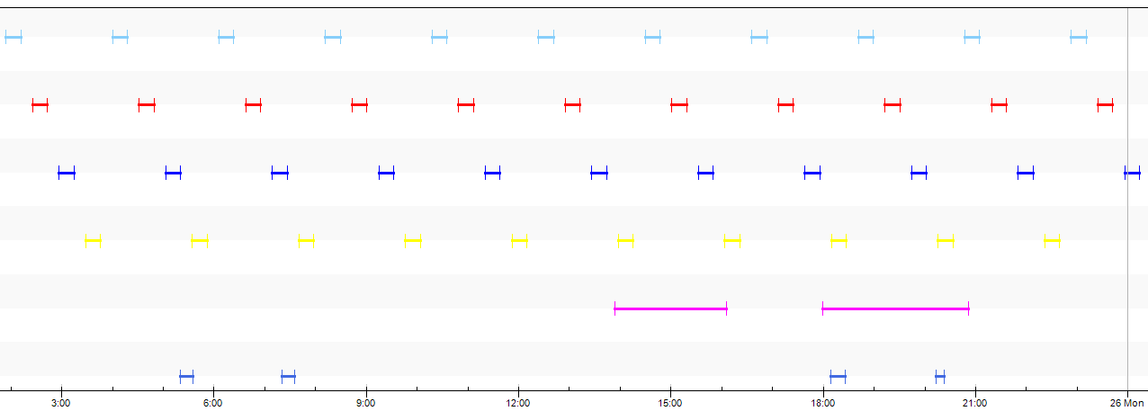
Equatorial Surface Asset Coverage Plot:
0° Inclination Constellation
CubeSat 1
CubeSat 2
CubeSat 3
CubeSat 4
MAVEN
MTO
Full coverage of equatorial surface assets
  Maximum access gap time of 14 mins between different relays
CubeSat Relay averages 45 passes/Sol compared to MTO, 4 passes/Sol
Notes:
CubeSat <-> Earth: Worst Case is 2% of Best Case Total Data Throughput
CubeSat <-> Surface: Worst Case is 62% of Best Case Total Data Throughput
CubeSat <-> Orbiter: Worst Case is 20% of Best Case Total Data Throughput

Slide 42
Mars Ephemeris Data Analysis
Max Earth-Mars Distance (AU) | 2.64
Min Earth-Mars Distance (AU) | 0.41
Max Phase Angle (°) | 46.594

