Slide 1
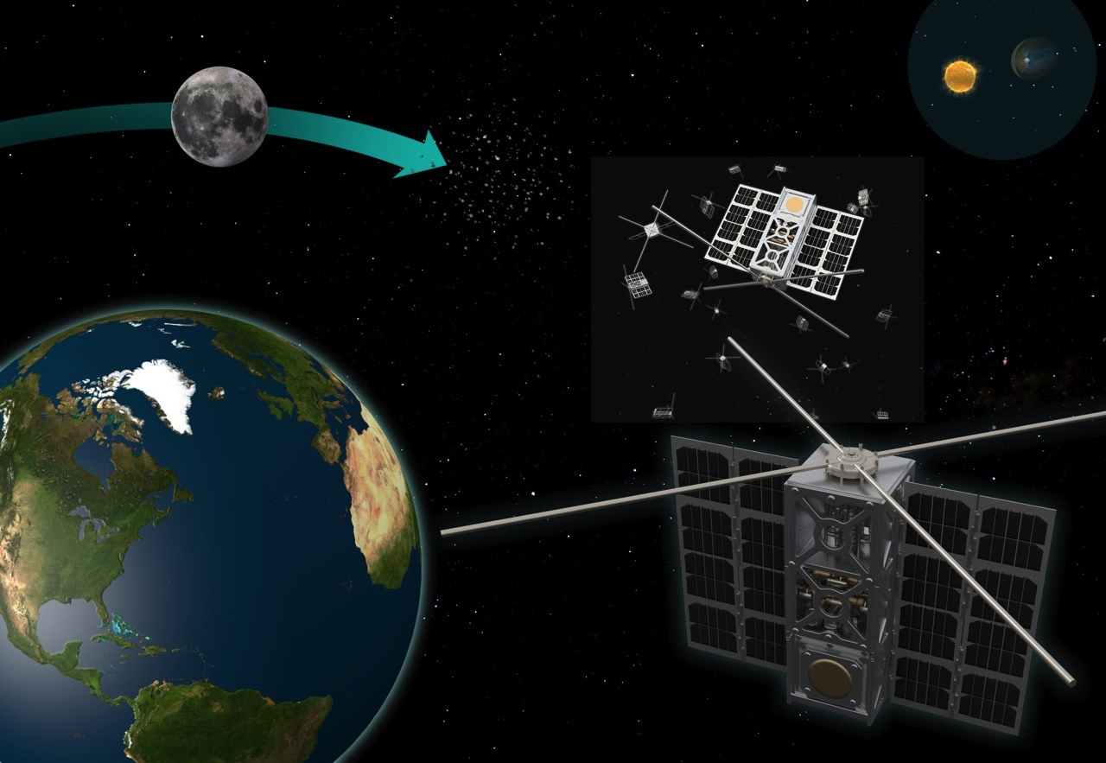
Constellations of Cubesats SmallSats
T. Joseph W. Lazio
J. Castillo-Rogez, K. Belov, S. Broschart, N. Chahat, S. Chien, L. Clare, C. Duncan, J. Sauder, T. Sweetser, M. Thomson, & Jay Wyatt
Interplanetary Small Satellite Conference
© 2016. All rights reserved.

Slide 2
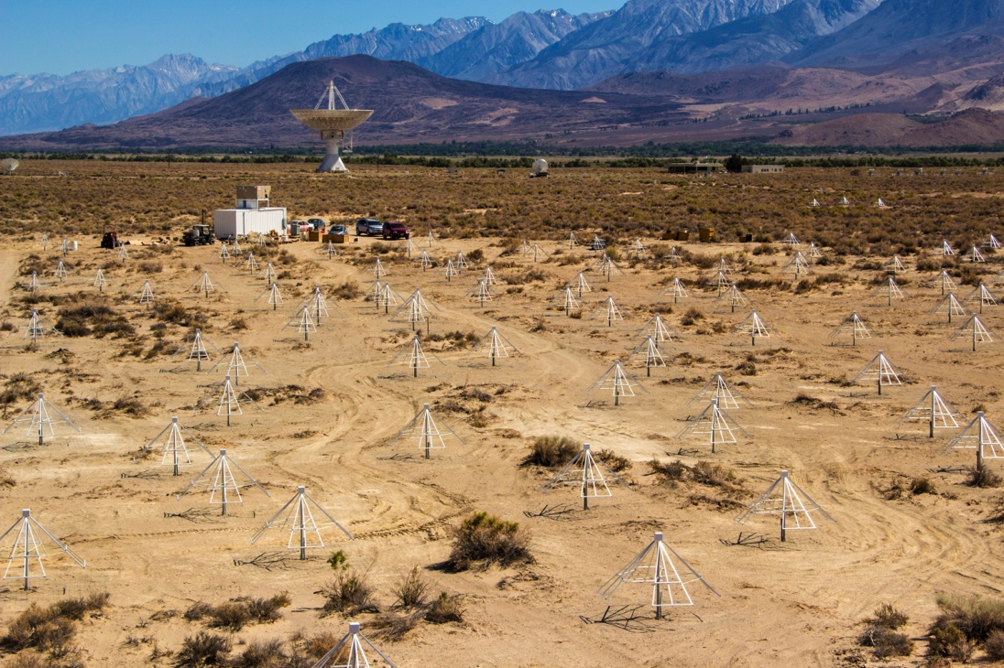
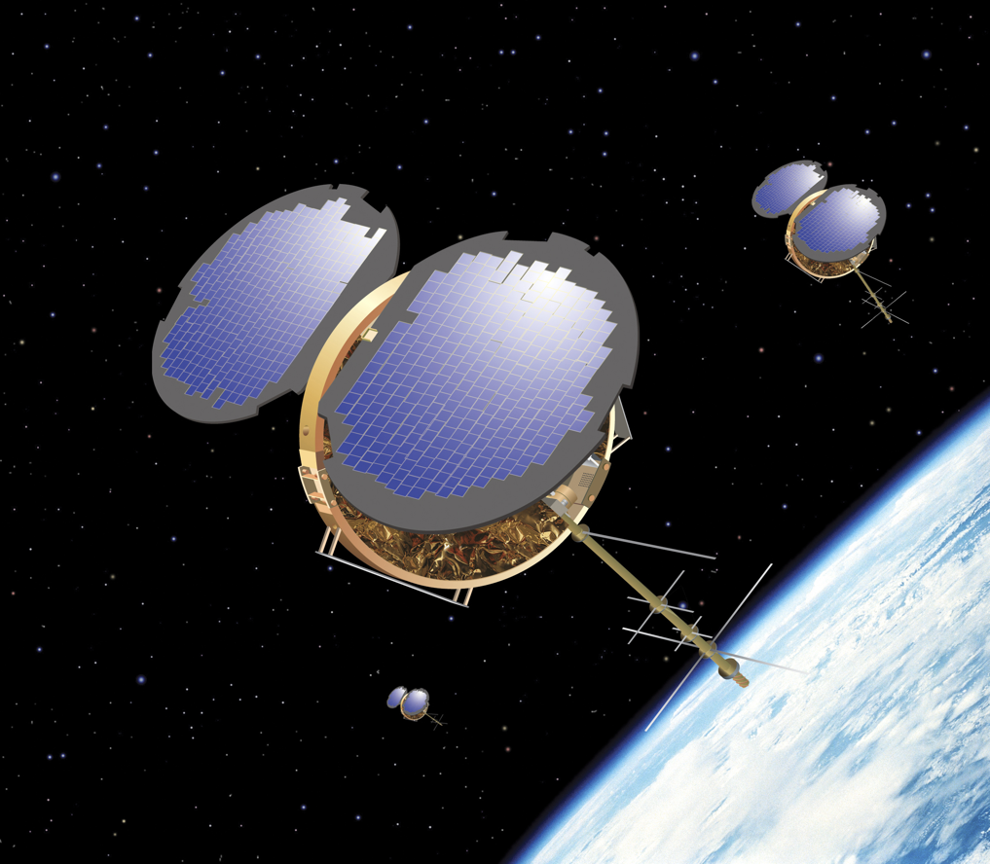

Terrestrial Constellations
Radio astronomy arrays
GPS radio occultation constellations
(Image credit: Orbital Sciences Corp.)
LOCUST (Image credit: U.S. Navy)

Slide 3
Constellations
Raison d’être
Track dynamics of distributed, evolving systems
Single sensor implausible
Redundancy and/or resistance to failure

Slide 4
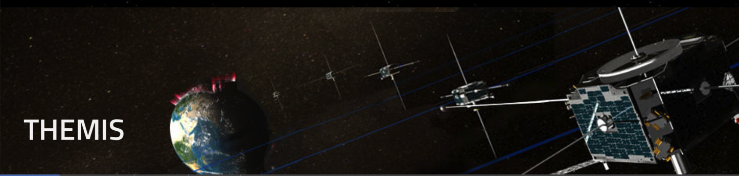
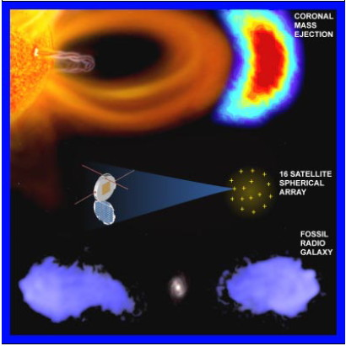
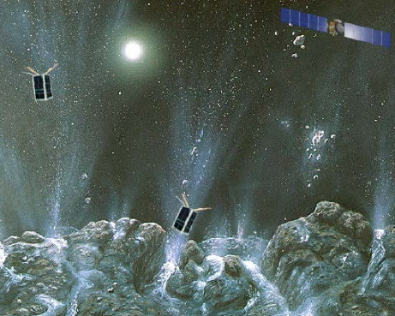

Planetary and Space Science Constellations
An Incomplete List …
ARTEMIS
cf. lunar laser retroreflectors, Lunar Geophysical Network, Mars Geophysical Network

Slide 5
Planetary and Space Science Constellations
Sensor Web Architectures
Pixelization/Voxellation
Beamforming
Tomography | (seismic networks)
THEMIS / ARTEMIS

Slide 6
Technical Challenges
In no priority order …
Communication
Guidance, navigation, and control
Miniaturization and robustness of components
Propulsion
Thermal control
Data storage
Optimization of design
Mission operations
…
Smallsats have potential to be mission enabling!

Slide 7
Technical Challenges
In no priority order …
Communication
Guidance, navigation, and control
Miniaturization and robustness of components
Propulsion
Thermal control
Data storage
Optimization of design
Mission operations
…
Smallsats have potential to be mission enabling!

Slide 8
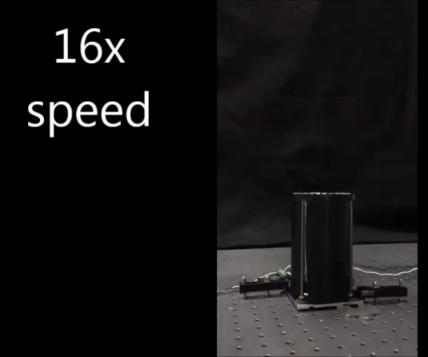
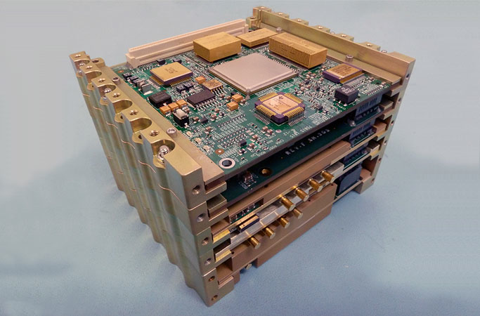
Communication Technologies
… and Navigation!
KaPDA
Ka-band Parabolic Deployable Antenna
Iris
DSN-compatible FPGA Transponder for cubesats

Slide 9
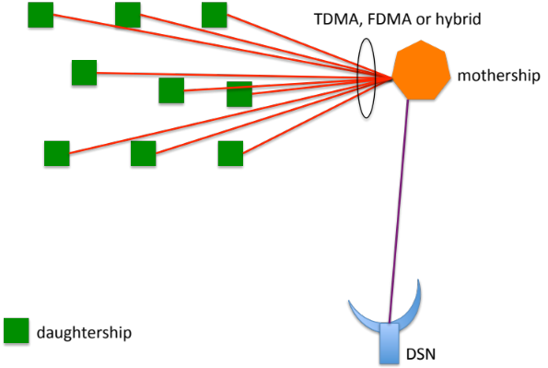
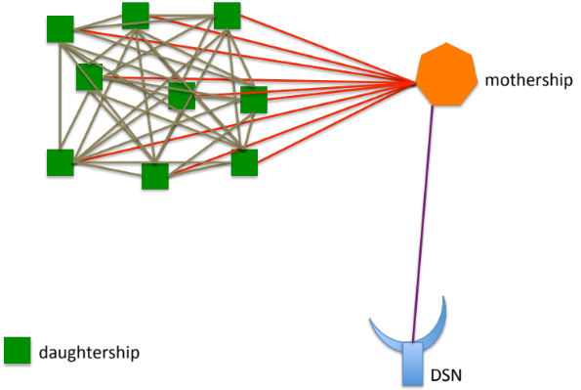
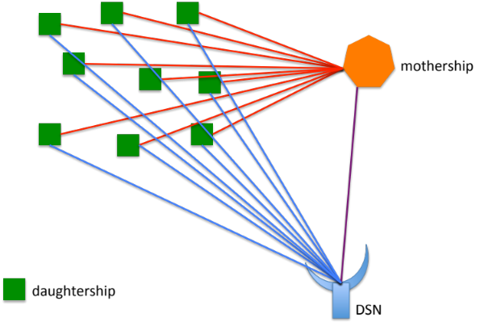
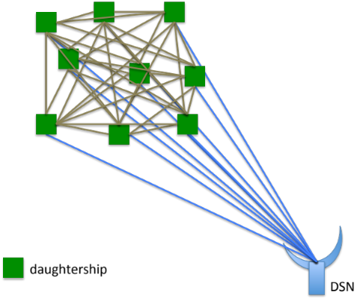
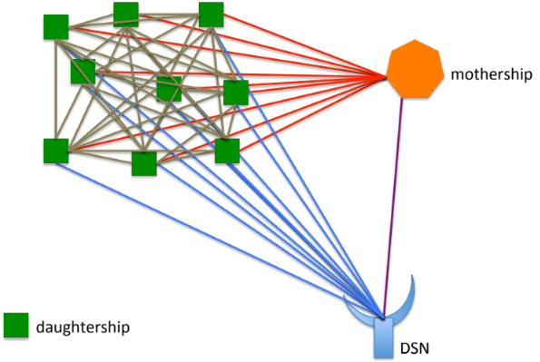
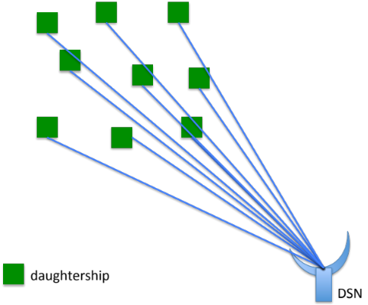
Networked Constellation Communications Technologies
High-level alternative physical communications architectures

Slide 10
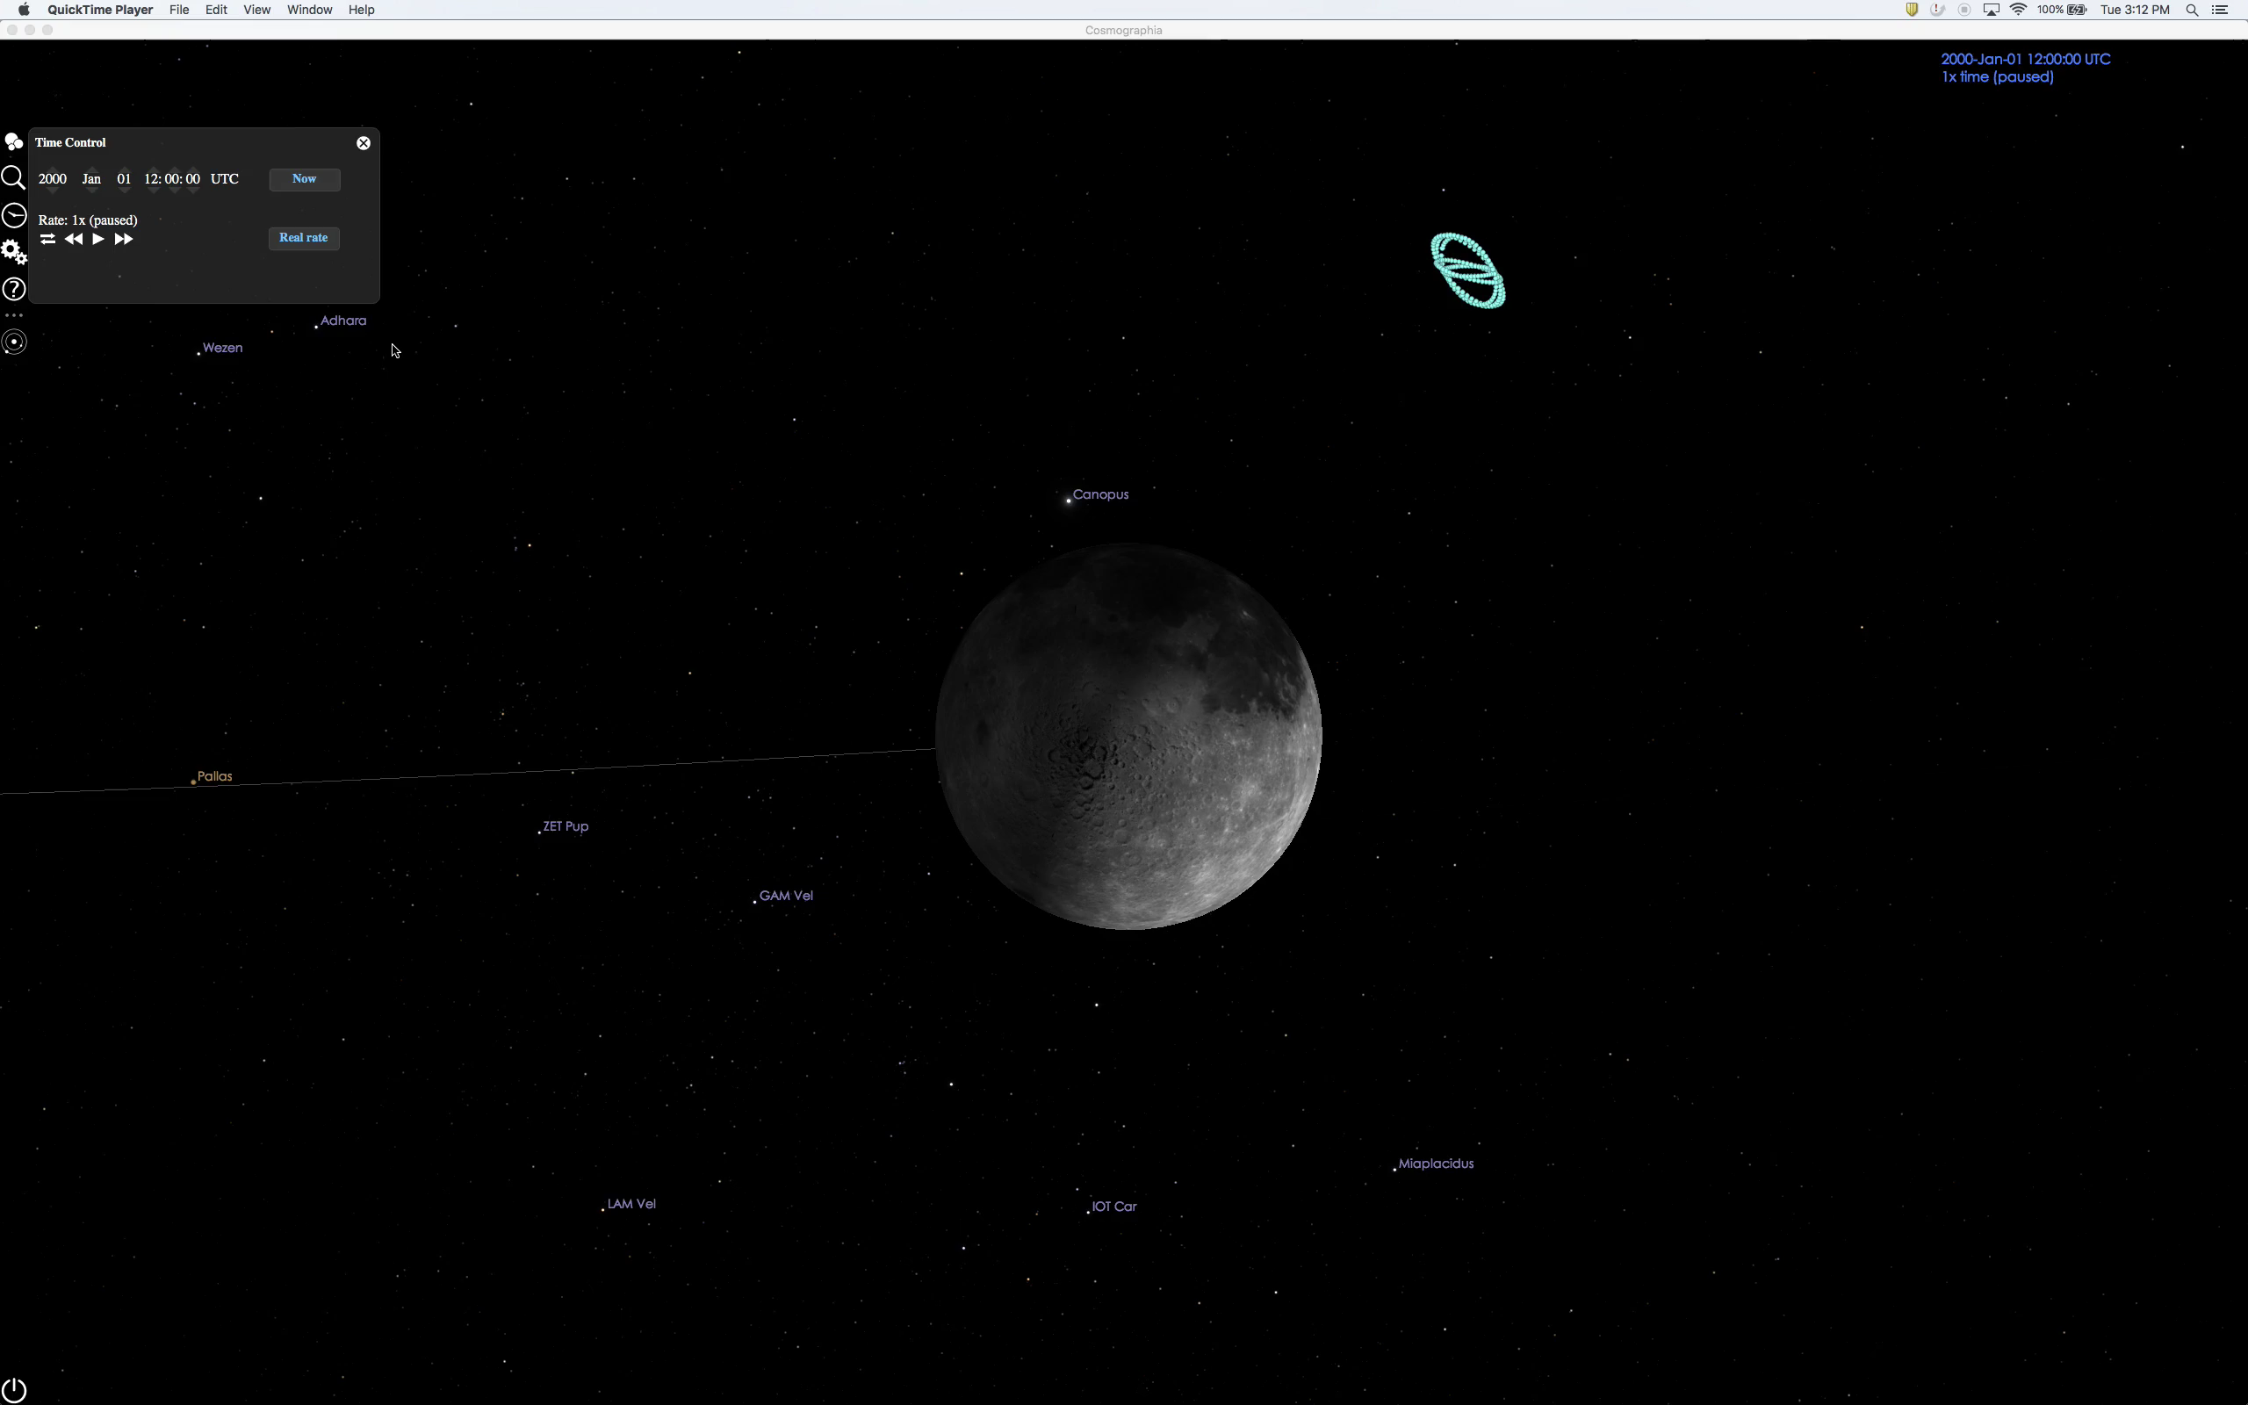
Navigation
Constellations of Cubesats
10

Slide 11
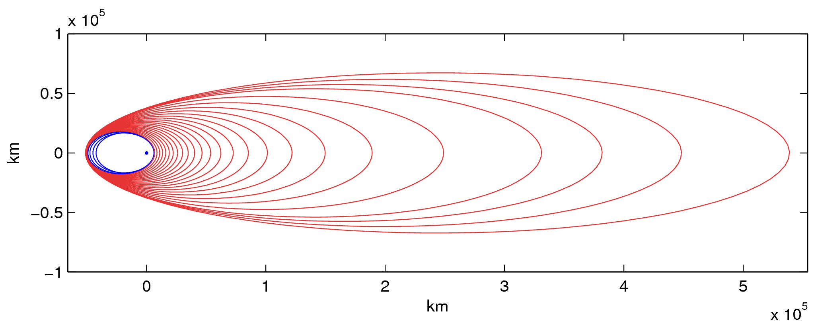
Families of Orbits
Originally developed in context of planetary departure
… also relevant for swarms around a planet

Slide 12
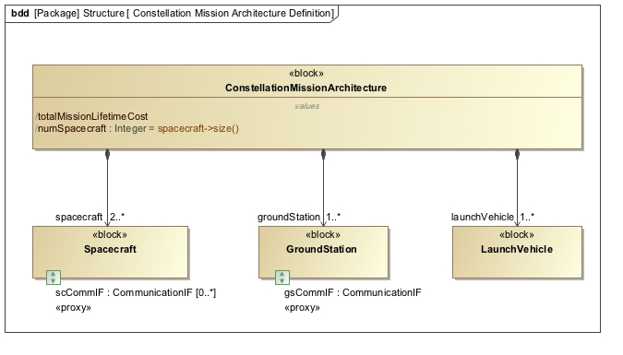
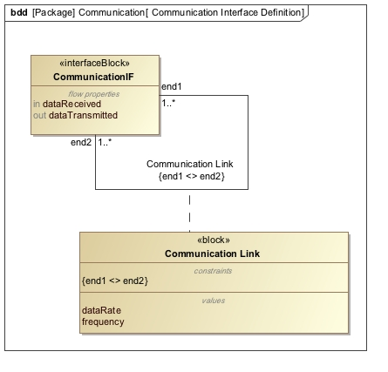
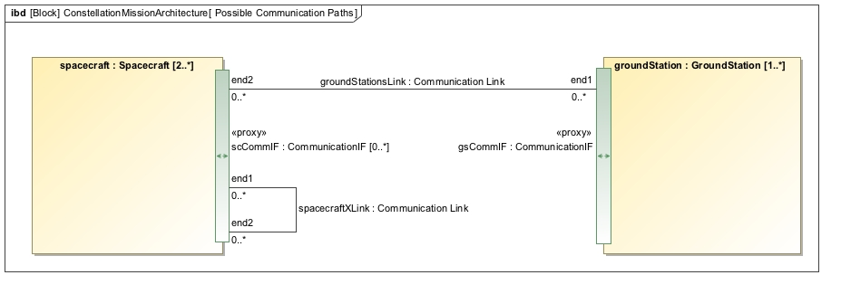
Networked Constellation Optimization
Any constellation mission is defined to have at least 2 spacecraft
Constraint: components cannot communicate with themselves
Spacecraft can communicate with one another and / or ground
Notes:
* Capture possible design choices
* Basic idea: construct a language for constellation missions: valid utterances of this language represent point designs (specification only - whether they are good or not depends on further analysis)
* Think of it as specifying the set of all possible point designs
* Comm knowledge: Clare (mostly topological constraints); operations: Chien (mostly state machines with transitions, activities)
* Why SysML+OCL? Want to capture structure, function, behavior, requirements -> all aspects of SysML. Addition of OCL allows us to further restrict the set of valid point designs
* Knowledge for this captured based on a “strawman architecture” -> what are the interesting aspects to focus on, where are the hidden challenges?

Slide 13
Summary
Smallsats/cubesats offer plausible means of implementing affordable deep space constellations
  a.k.a. “sensor webs,” swarms, fleets, …
Many technologies starting to mature
  e.g., Telecommunications
Operations and optimization likely to remain (or appear to remain) significant challenge

