Slide 1
Adapting a sophisticated Ground Data System for use by a Deep Space Cubesat Mission
Peter Di Pasquale, Jet Propulsion Laboratory, California Institute of Technology, Presented for:
Dave Santo, Jet Propulsion Laboratory, California Institute of Technology
George Rinker, Jet Propulsion Laboratory, California Institute of Technology
Andy Klesh, Jet Propulsion Laboratory, California Institute of Technology
Approved for US and foreign release: CL#15-0534
© 2015 California Institute of Technology. Government sponsorship acknowledged.

Slide 2
Overview
Every mission must perform Mission Control functions through its development, integration, and operations lifecycle
  Finding cost effective software can be a challenge for severely cost-constrained small missions
  Cubesats do not typically need to interface with the NASA Deep Space Network
INSPIRE chose the Advanced MultiMission Operations System (AMMOS) application AMPCS for Mission Control
  Currently used on missions significantly more complex (and expensive) than a cubesat
  Flexible, adaptable, and typically customized for unique mission requirements
  Designed to operate across mission phases and environments, from initial development to operations
  Designed to scale from a single workstation environment to a high performance, multi-node server environment
INSPIRE: Interplanetary NanoSpacecraft Pathfinder In Relevant Environment
AMPCS: AMMOS Mission Data Processing and Control System

Slide 3
Objectives
This briefing describes how this Ground Segment software was adapted and used for flight software development, system integration and test, and DSN compatibility testing
Lessons learned are presented, both for the adaptation process and for working with a small and agile spacecraft development team

Slide 4
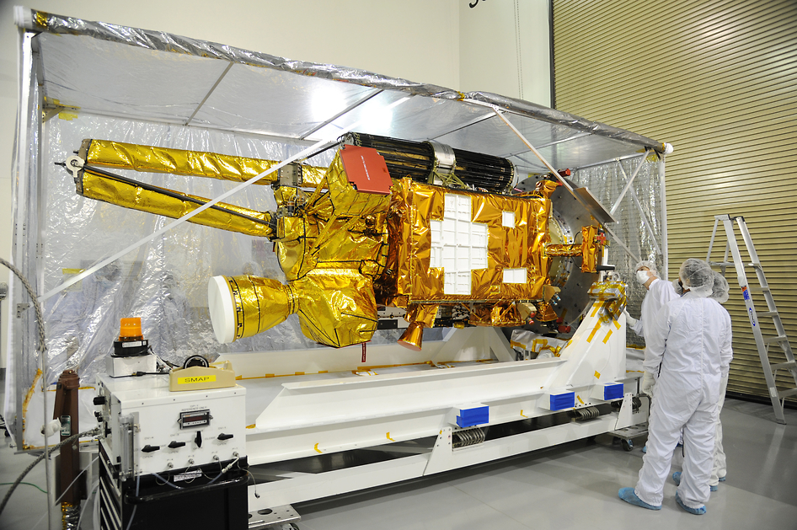
Typical AMPCS-supported Mission: SMAP
Large, complex, multi-year development
GDS responds to the needs of flight software
  Many custom features added to AMPCS during Mission Phase C/D
Multiple test / verification environments and activities before being connected to the hardware
Image URL: http://www.nasa.gov/jpl/smap/2014-4268/#.VMrMmkhD9pZ
SMAP: Soil Moisture Active / Passive
GDS: Ground Data System

Slide 5
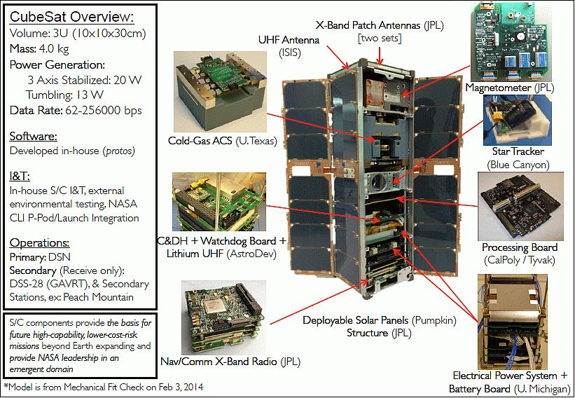
INSPIRE Mission Background
Deep space cubesat pair
Tech demo and characterization
Embraced TAYF to reduce risk to operations
Tiny team, everyone does everything
Image URL: https://directory.eoportal.org/documents/163813/1489551/INSPIRE_Auto4
TAYF: test as you fly

Slide 6
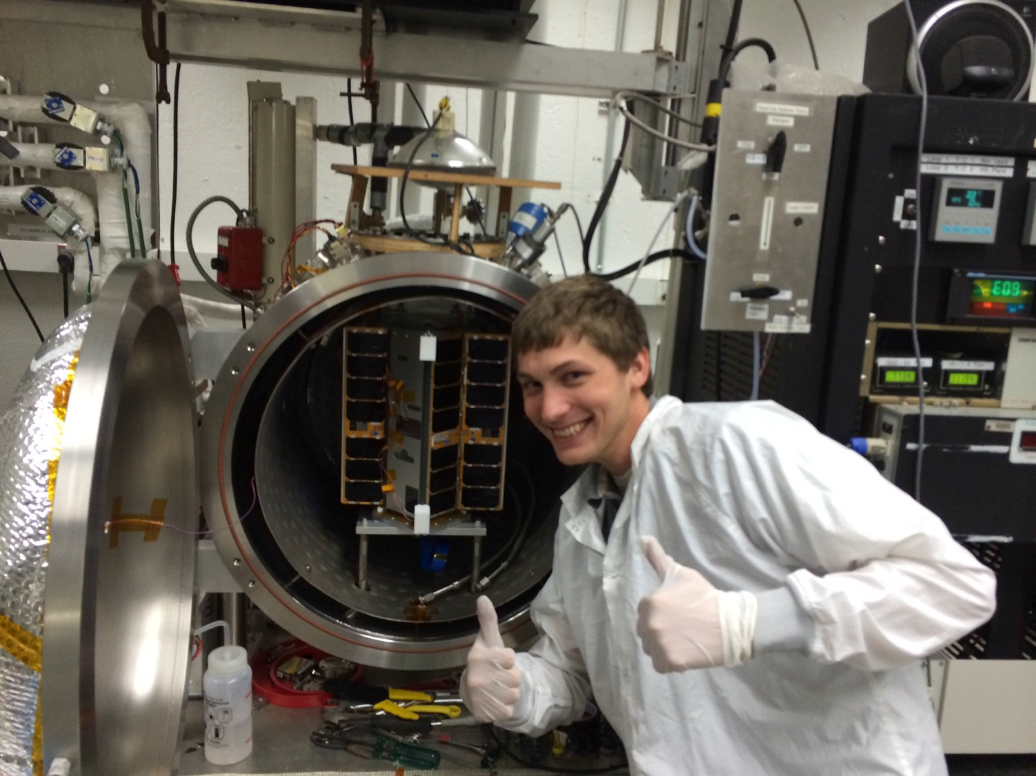
Really tiny …
from: “INSPIRE (Interplanetary NanoSpacecraft Pathfinder In a Relevant Environment)” [2]

Slide 7
AMPCS Functional Overview
AMPCS is a scalable, full function, real-time telemetry processing and display system
  During Phase E Operations: Provides real time S/C telemetry display, telemetry product distribution with user query support (primarily for downlink operations)
  During FSW Development, TestBed and ATLO operations: Provides the test tool for spacecraft integration and test (for both uplink and downlink operations)
Accepts CCSDS formatted in-sync frames or packets
  Sources: DSN, NEN/SN, a station emulator, files, or from the AMPCS Database
Processes frames or packets into telemetry products (channelized data, EVRs, Products, etc.) for delivery to real time and non-real-time customers
Supports testbed and ATLO telemetry processing and commanding
  Test Session Orientation allows quick access to each test session’s pertinent data
    Captures all incoming and processed data, logs, FSW version used, and dictionary version used, etc.
    Allows cross-test session analysis
  Special test tool features to assist spacecraft integration and test (e.g. command fault injection, test session management, frame and packet watch displays, frame quality displays)
  AMPCS Test Automation Toolkit (MTAK) for spacecraft test scripting and general automation
Provides real-time telemetry display
Stores all telemetry artifacts allowing post-pass (and -test session) analysis
  Frames, Packets, EVRs, EHA, product metadata, logs, etc.
ATLO: Assembly, Test, and Launch Operations

Slide 8
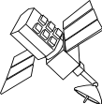
AMPCS Overview
GDS
Automation
Tool
(MTAK)
Real Time
Non-
Real Time
Web Access
To R/T
Telemetry
Listener Applications
Real Time Monitors
Query
Applications
Python
Scripts
Message Bus
Transaction Buffer
Mission File System
User
Queries
Downlink Processing
frames, packets, data products, channels,
alarms, channel derivations, EVRs
Products
Frames or
packets
Load
DB
Merge
Query
DB
chill_get_*
DSN,
NEN/SN
Station Emulator,
FSW SoftSIM,
Frames in Files,
Frames from DB
Uplink
Processing
SCMFs
Transaction Buffer
chill_get_*
CLTUs
User
Tools &
reports
Files
Mission
Dictionaries
Local
Queries
Immediate Commands
= AMPCS component
= non AMPCS component

Slide 9
INSPIRE GDS Adaptation Strategy
Accept constraints imposed by existing software to reduce cost, schedule, and risk
  Avoid requiring features not already available
    Follow CCSDS telecommand standards
  Use AMPCS existing dictionary schemas
    Still allowed full customization of dictionary content for: transfer frame definitions, telecommand packet definitions, APID definitions, decomm maps, channel definitions, channel derivation and calibration algorithms, command definitions
Autogenerate software command handlers in the flight software from the ground system command dictionary at compile-time
Establish portable and replicable environments, each rapidly reconfigurable
  Both workstations and Virtual Machines

Slide 10
Cubesat-focused Lessons
Small team, almost no funding
  Take every opportunity to reduce risk – no way to recover
  Test As You Fly reduces risks
      … but don’t go overboard and lock everything down too early
  Evolve the development environment with an eye on the operational configuration / environment
    Use the same core applications from development through operations
Accepting GDS-imposed constraints positively affected both cost and schedule
Large complex applications can be difficult for a small team to configure and operate
  Plan and budget for training, help, and consulting from the developers
Don’t let processes designed for big missions prevent you from getting your job done
  Example: delivery from CM

Slide 11
Acknowledgements
The work described was carried out at the Jet Propulsion Laboratory (JPL), California Institute of Technology (Caltech), under a contract with the National Aeronautics and Space Administration (NASA). The work was funded by the Multimission Ground System and Services Office (MGSS) and the INSPIRE mission
This presentation heavily draws on a paper delivered at SpaceOps 2014 (citation below)
References
  [1] William L. Quach, Lloyd R. DeForrest, Andrew T. Klesh, Joshua B. Schoolcraft, “Adapting a Large-Scale Multi-Mission Ground System for Low-Cost CubeSats,” SpaceOps 2014, 13th International Conference on Space Operations, Pasadena, CA, USA, May 5-9, 2014, URL: http://arc.aiaa.org/doi/pdf/10.2514/6.2014-1634
  [2] “INSPIRE (Interplanetary NanoSpacecraft Pathfinder In a Relevant Environment),” Proceedings of the 11th Annual CubeSat Developers’ Workshop - The Edge of Exploration,” San Luis Obispo, CA, USA, April 23-25, 2014, URL: http://www.cubesat.org/images/cubesat/presentations/Developers-Workshop2014/Klesh_INSPIRE.pdf

Slide 12
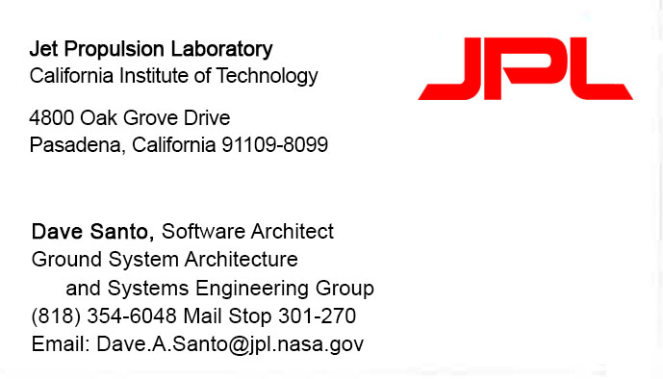
Questions?

