Slide 1
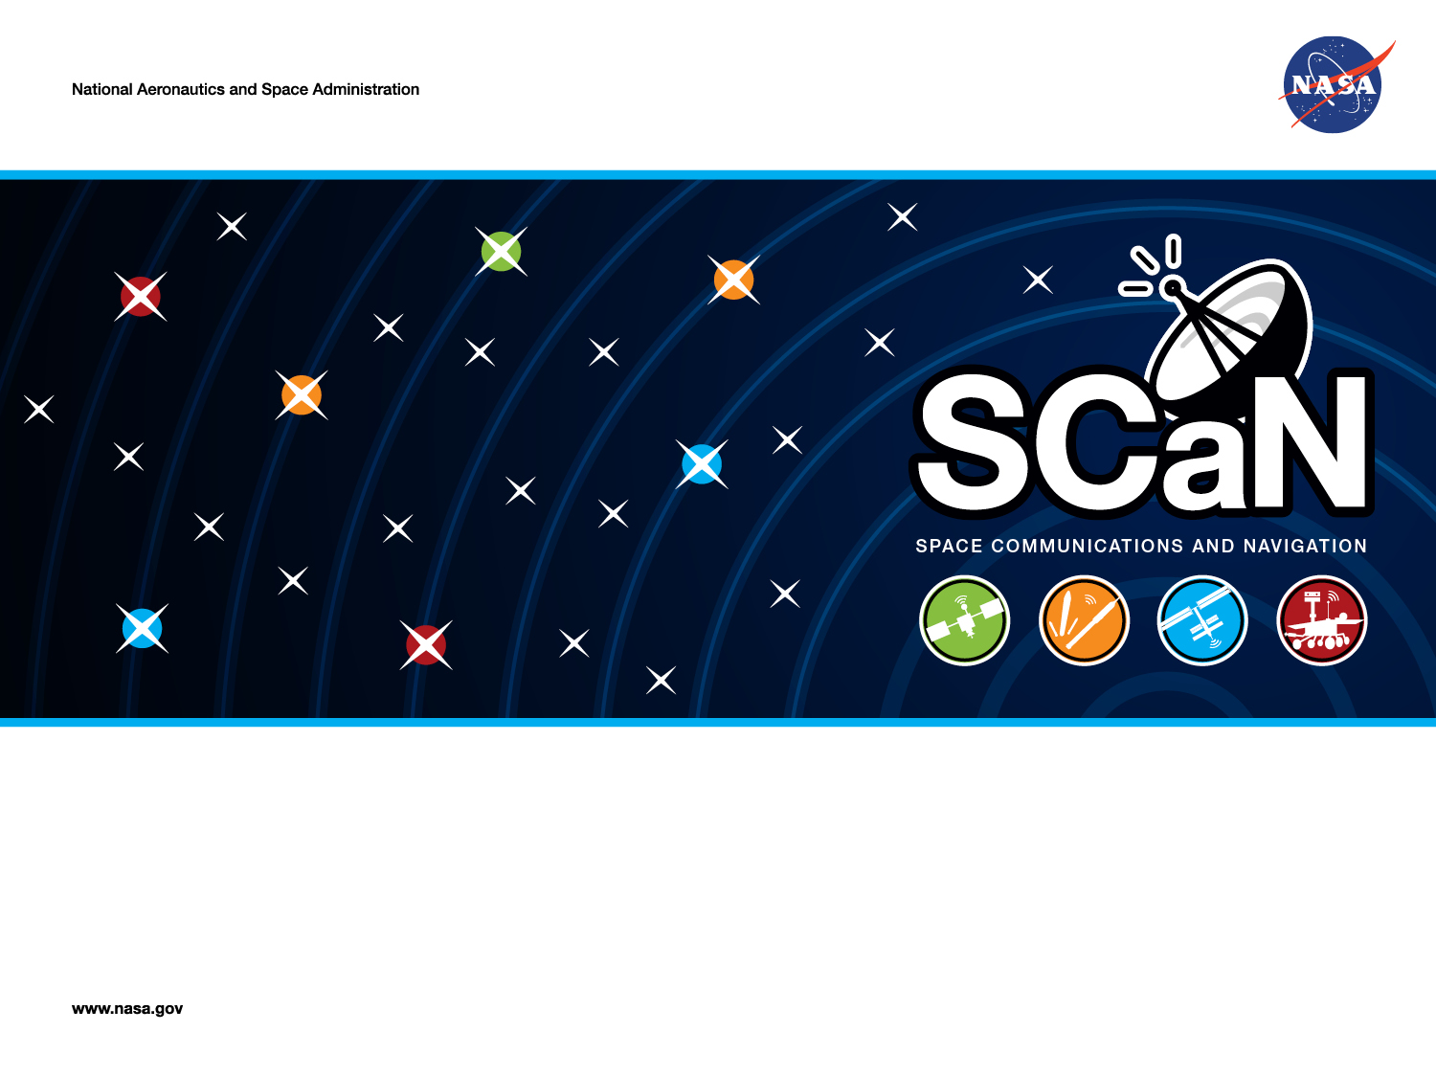
Working Toward More Affordable Deep Space Cubesat Communications: MSPA and OMSPA
Douglas S. Abraham, Bruce E. MacNeal, and David P. Heckman
Jet Propulsion Laboratory, California Institute of Technology
2016 Interplanetary Small Satellite Conference
Pasadena, CA
April 25, 2016
Copyright 2016. California Institute of Technology. Government sponsorship acknowledged.

Slide 2
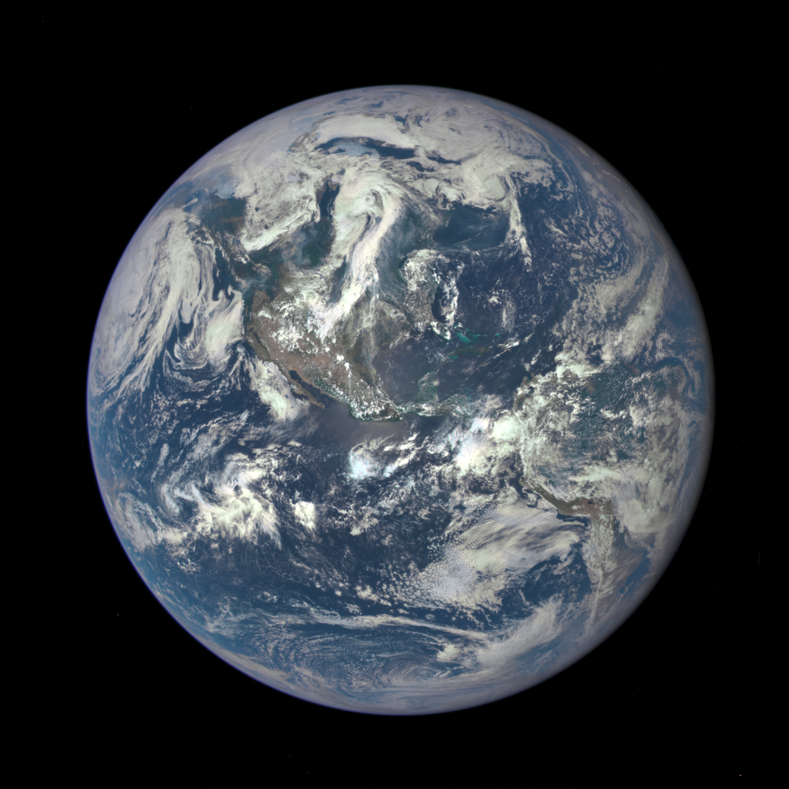
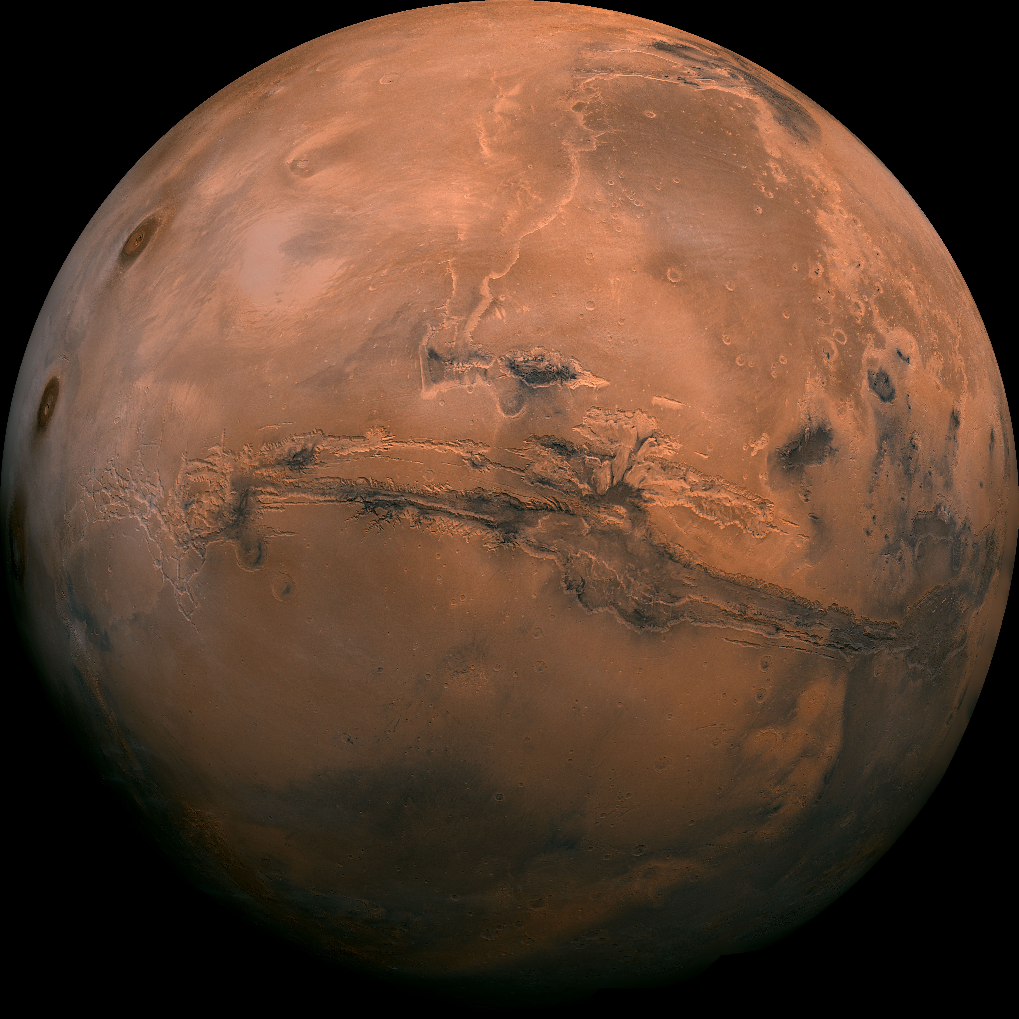
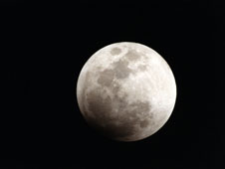
The Deep Space Challenge
P_{t} G_{t} A_{e}
Received power is inversely proportional to the square of the distance.
P_{r} =
4π R²
Mars Distance:
~225,000,000 km
LEO: ~400 km
Lunar Distance:
~382,500 km
P_{r} = ~1 millionth
P_{r} from LEO
GEO: ~35,786 km
P_{r} = ~3 trillionths
P_{r} from LEO
P_{r} = ~1 ten thousandth P_{r} from LEO
Communicating beyond GEO takes large antennas, low-noise receivers, and powerful transmitters.
1

Slide 3
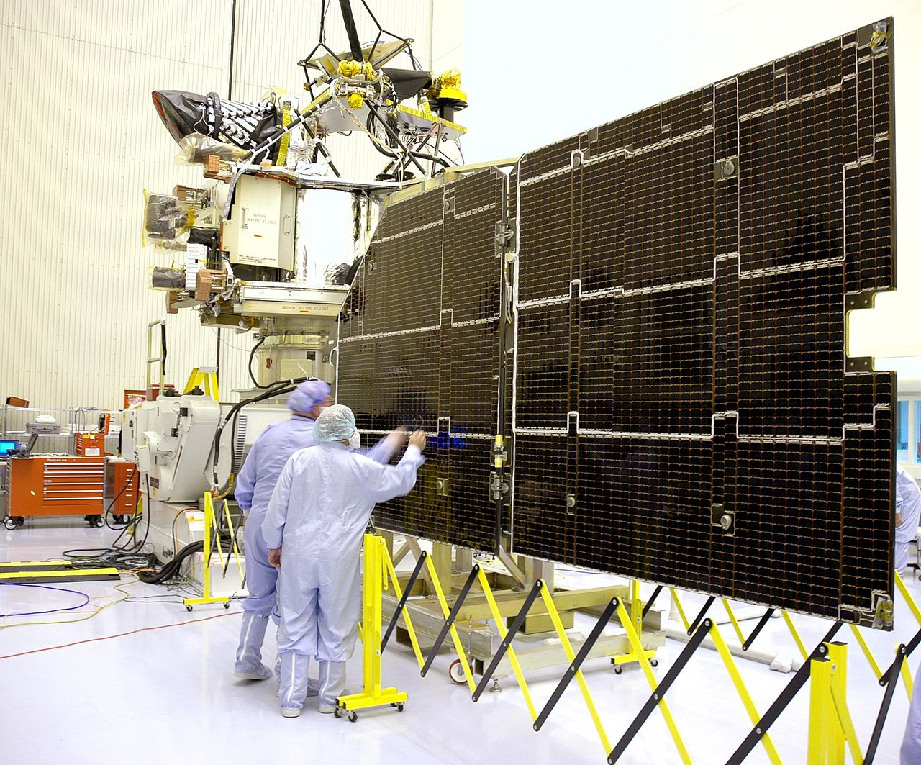
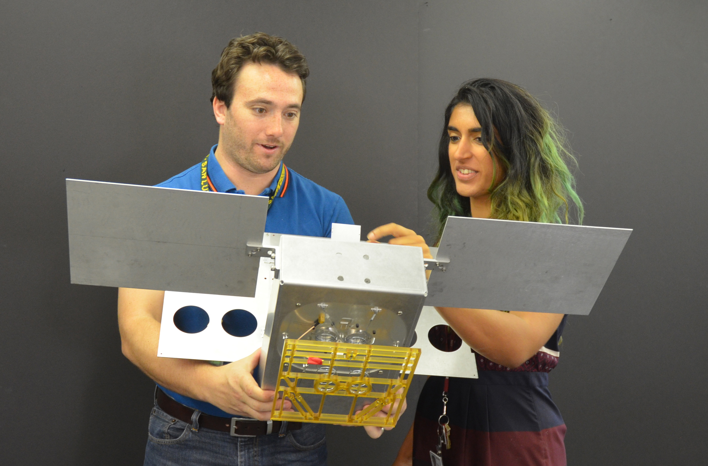
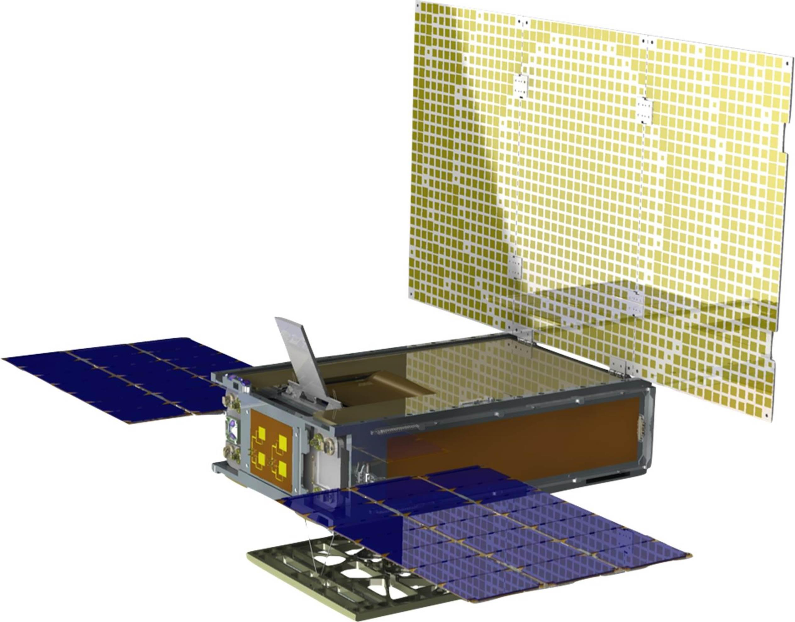
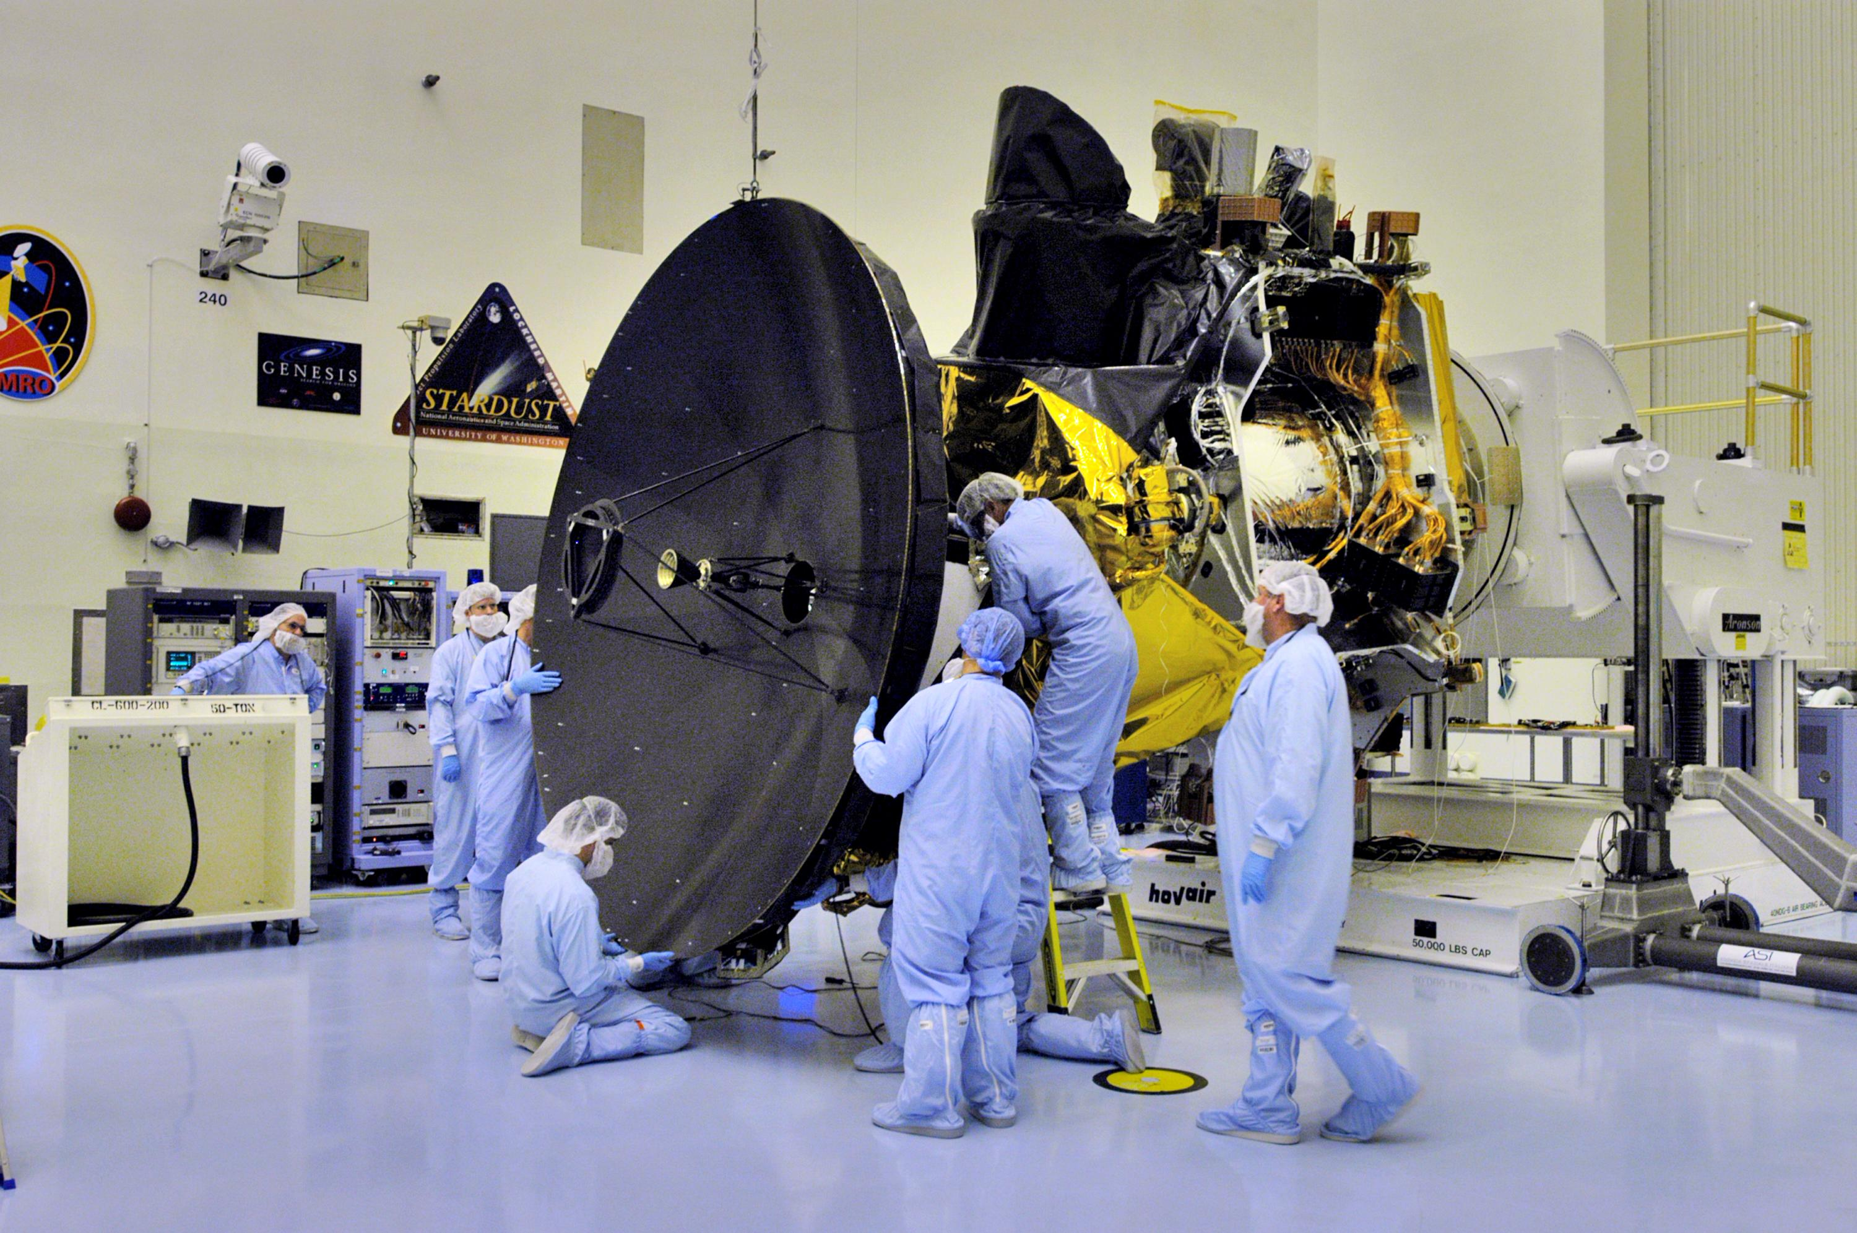
The Scaling Problem
Mars Reconnaissance Orbiter
Smaller spacecraft are generally cheaper to build and launch. But,
Mars Cubesat One
Smaller solar arrays mean less available transmitter power.
Smaller spacecraft have less area to devote to antennas.
Credit: Images from jpl.nasa.gov/cubesats.
The ground-side communications burden must increase to compensate.
Credit: Images from mars.jpl.nasa.gov/MRO.
2

Slide 4
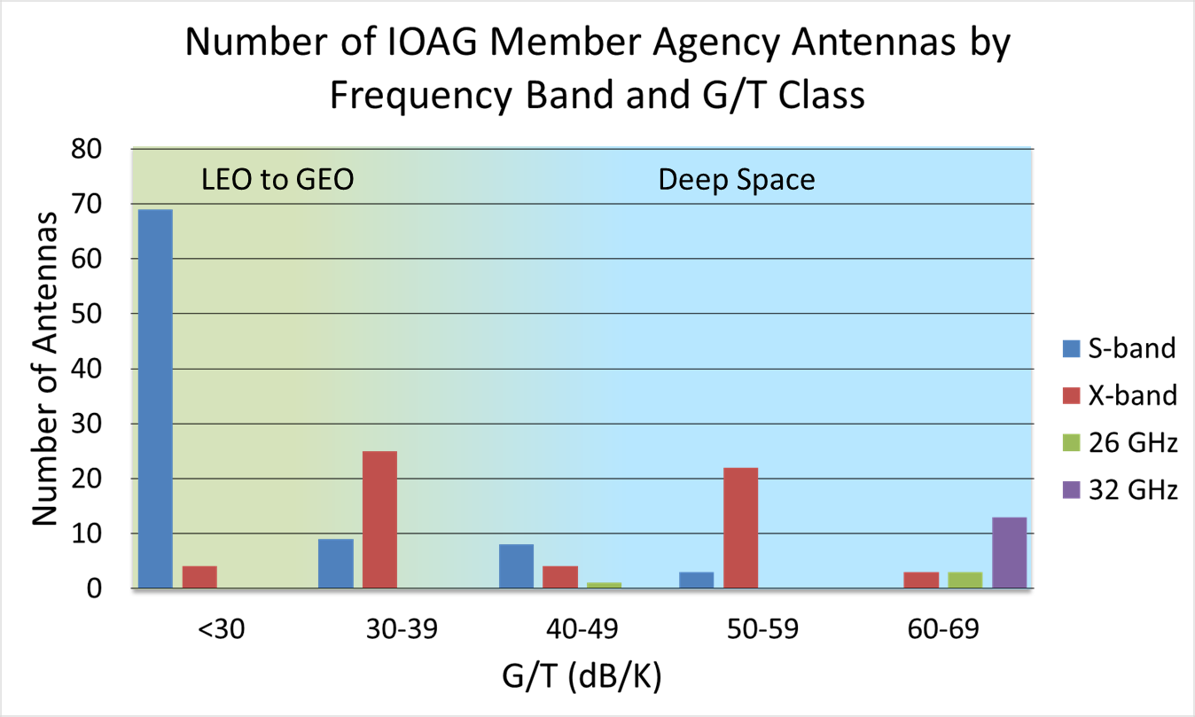
Ground Antenna Supply
Data Source: Interagency Operations Advisory Group (IOAG), “Aggregate Communication Assets 2014-02-07 (IOAG-18)_v2” at ioag.org/Public Documents.
The world’s supply of deep-space-capable antennas is limited. We need to make efficient use of what we have.
3

Slide 5
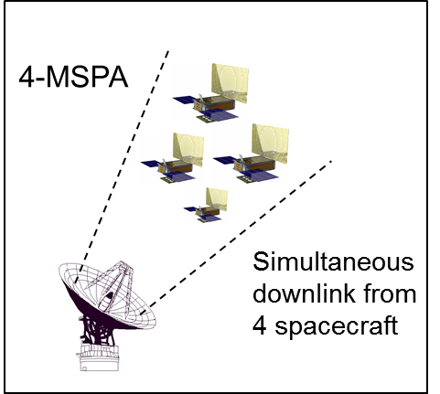
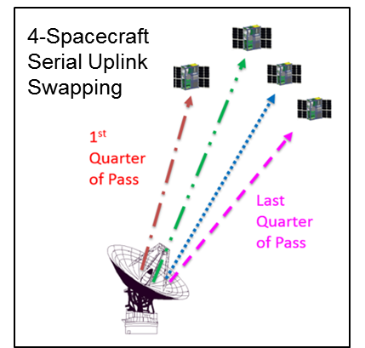
Multiple Spacecraft Per Antenna
2-MSPA is a scheduled downlink event where two spacecraft simultaneously transmit down through the same antenna to two separate receivers, one for each spacecraft.
The DSN is moving to a 4-MSPA capability.
4

Slide 6
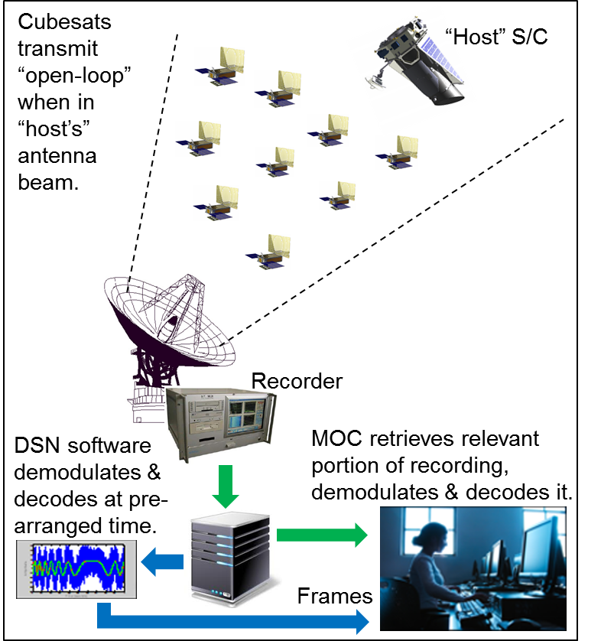
Opportunistic MSPA
OMSPA is a proposed future DSN capability.
Two service modes:
Self-service
Frame service
Would enable user base to be larger than the “scheduled” user base, without a proportional increase in DSN costs.
Would have a higher downlink data latency than MSPA.
5

Slide 7
Benefits to Cubesat Users
Enhanced Antenna Availability
  4-MSPA for critical events where low-latency is important.
  OMSPA for routine science downlink.
Reduced Antenna Scheduling Coordination
  OMSPA occurs outside the scheduling system; depends only on being in the beam of a scheduled spacecraft.
  No scheduling contention with other missions during OMSPA.
Reduced Aperture Fees
  While NASA missions do not actually pay these fees, they do factor into a mission’s bottom-line cost during the proposal phase.
  While not yet decided, 4-MSPA will likely enable downlink-only at ¼ the base fee.
  While not yet decided, OMSPA might ultimately involve a nominal, flat monthly charge to recover the costs of the recorders, secure internet server, and their maintenance.
6

Slide 8
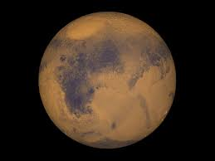
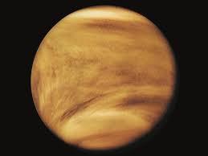
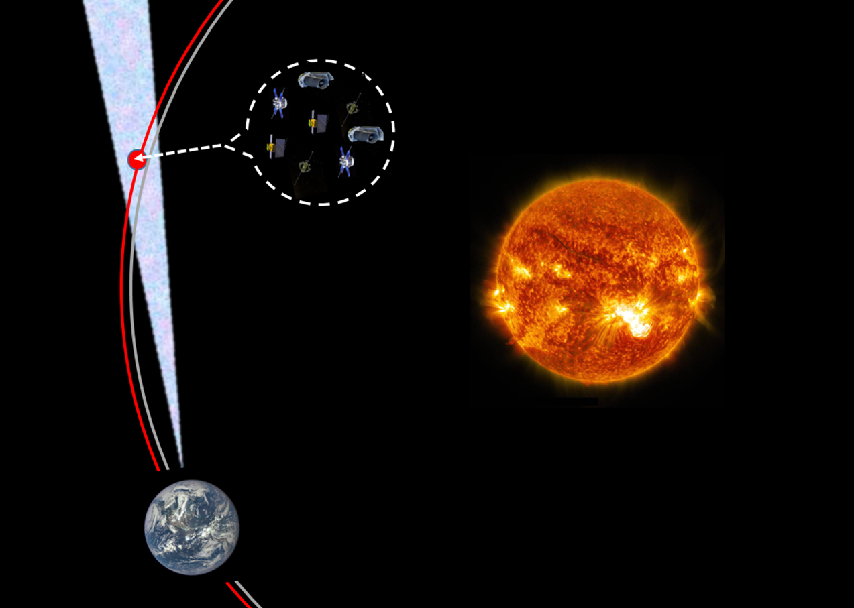
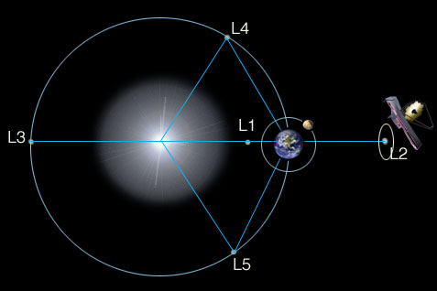
Example In-Beam Destinations
Cubesats at Mars or Venus are always in the beam of other spacecraft at these locations.
A constellation or “flotilla” of cubesats deployed into an Earth Trailing Orbit (ETO) will remain in beam of one-another with few maneuvers and little navigation.
Very low-energy trajectories can take cubesats into SEL1 or SEL2 halo orbits timed to reside in proximity with (and in beam with) large observatory spacecraft.
7
Credit: http://jwst.nasa.gov/orbit.html

Slide 9
Data Rate & In-Beam Range
Assumed Spacecraft Telecom Design | Transmitter Power(W) | Antenna Gain (dBi) | Band (Frequency, GHz) | Location | Earth→SC Range (AU, average) | Earth→SC Range (km, average) | Supportable Downlink Data Rate (bps) | Max Range from OMSPA Host (km)
Lunar Flashlight (earlier design) | 1 | 5 | X-Band (8.48) | Moon | 0.0026 | 388,954 | 280,000 | 224
Lunar Flashlight (earlier design) | 1 | 5 | X-Band (8.48) | SEL 1,2 | 0.01 | 1,495,979 | 19,000 | 862
Lunar Flashlight (earlier design) | 1 | 5 | X-Band (8.48) | ETO | 0.1 | 14,959,787 | 100 | 8,616
MarCO | 4.5 | 28 | X-Band (8.43) | Mars | 1.7 | 254,316,380 | 1000 | 146,476
MarCO | 4.5 | 28 | X-Band (8.43) | Venus | 1.1 | 164,557,658 | 2200 | 94,778
MarCO | 4.5 | 28 | X-Band (8.43) | ETO | 0.1 | 14,959,787 | 318,000 | 8,616
MarCO | 4.5 | 28 | X-Band (8.43) | SEL 1,2 | 0.01 | 1,495,979 | 31,000,000* | 862
MarCO | 4.5 | 28 | X-Band (8.48) | Moon | 0.0026 | 388,954 | 480,000,000* | 224
Mars Reconnaissance Orbiter | 100 | 46 | X-Band (8.43) | Mars | 1.7 | 254,316,380 | 1,300,00 | 146,476
Calculations assume a DSN 34m ground antenna.
*Of course, the spacecraft electronics won’t support this rate.
Cubesats at the example destinations are capable of quite useful data rates and can still stay reasonably far from other spacecraft sharing the beam.
8

Slide 10
Conclusions
4-MSPA and OMSPA minimize the requirement for building expensive new antennas while potentially offering prospective user missions enhanced antenna availability and reduced attributed aperture fees.
OMSPA also potentially offers prospective user missions freedom from antenna scheduling contention over the time periods that it is applied.
Cubesat mission designers can realize these benefits by selecting destinations that maximize their in-beam time with other spacecraft.
For the example destinations in this study, cubesats can achieve very useful data rates and remain reasonably far from the other in-beam spacecraft.
9

