Slide 1
What the Deep Space Network (DSN) Can do for you!
Caltech Interplanetary Small Satellite Conference 2016
Interplanetary Network Directorate
Deep Space Network
Jet Propulsion Laboratory
DSN Mission Commitments Office
DSN Mission Interface Manager
Steve Waldherr
Stefan.Waldherr@jpl.nasa.gov
© 2016 California Institute of Technology. Government sponsorship acknowledged.

Slide 2
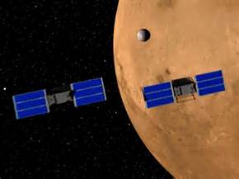
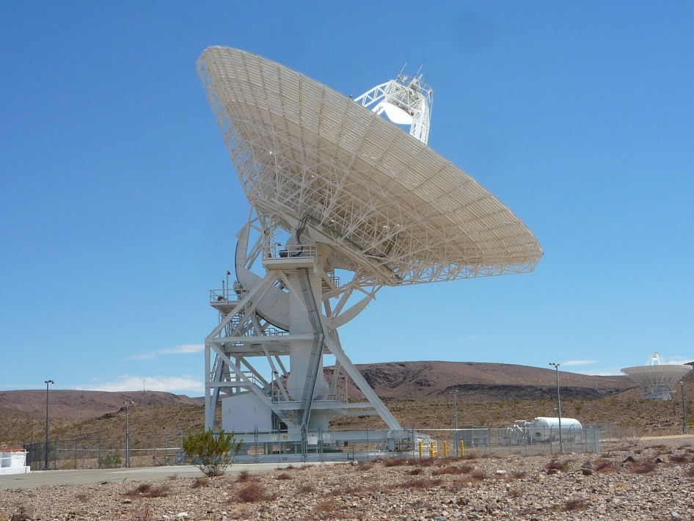
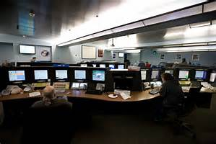
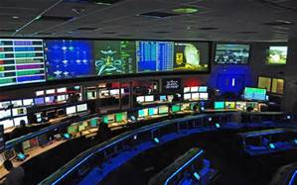

Use the DSN to communicating and operating your CubeSat
Your Spacecrafts
DSN Antenna
DSCC Signal Processing Center (SPC) located at each DSN complex
JPL Pasadena California Deep Space Operations Center (DSOC)
Your CubeSat Mission Operations Center (MOC)

Slide 3




Where Are the DSN Complexes?
Goldstone
Madrid
MADRID
Canberra
Conveniently located about 120 degrees apart for full maximum coverage of your spacecrafts

Slide 4



DSS-14
70m
Signal Processing
Center SPC-10
Signal Processing
Center SPC-60
Signal Processing
Center SPC-40
Madrid,
Spain
Canberra,
Australia
MIL-71
DSN’s
KSC
Network
Operations
Control Center
at JPL,
Pasadena , CA

Slide 5
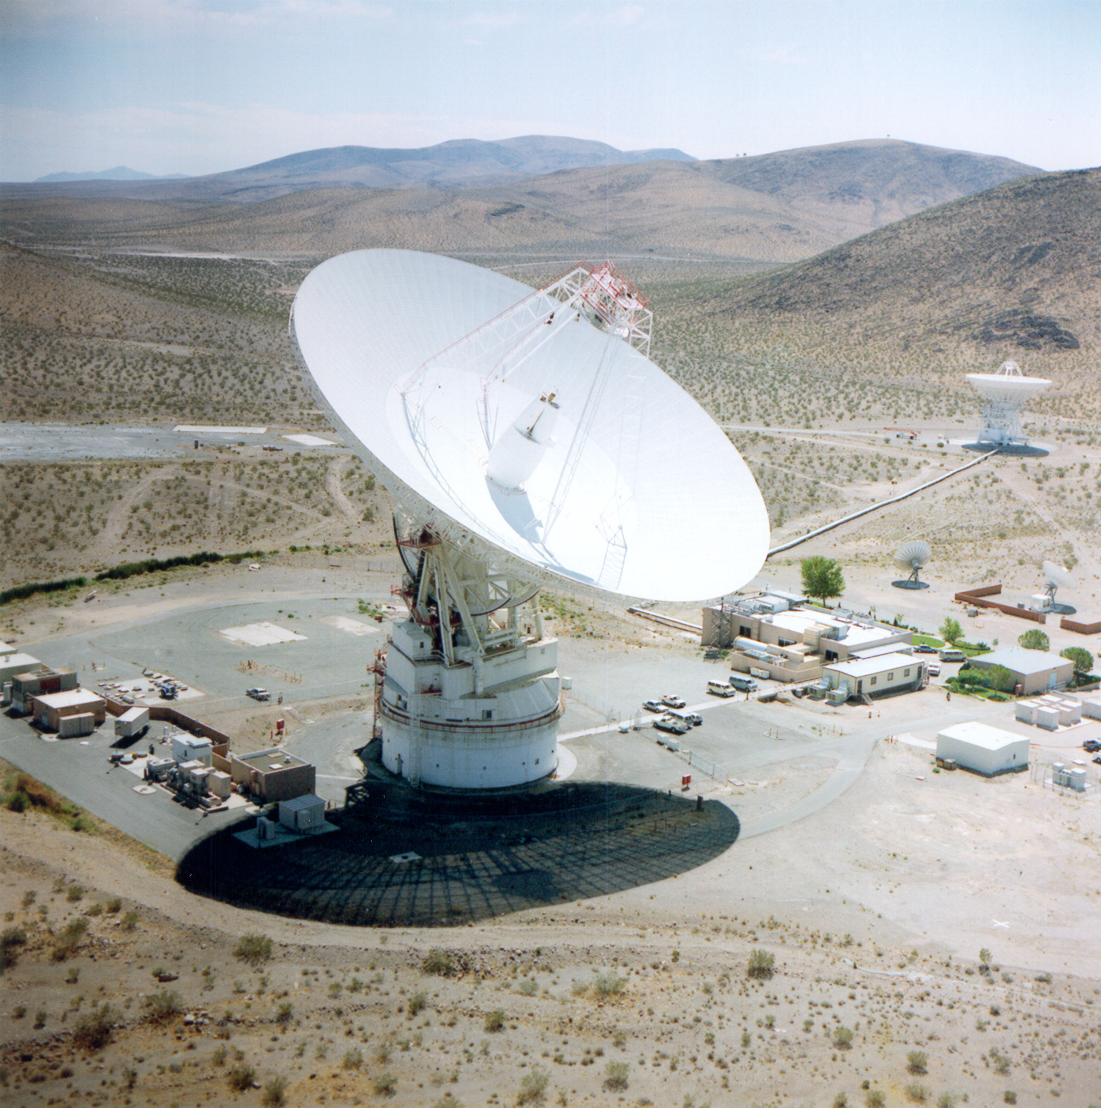
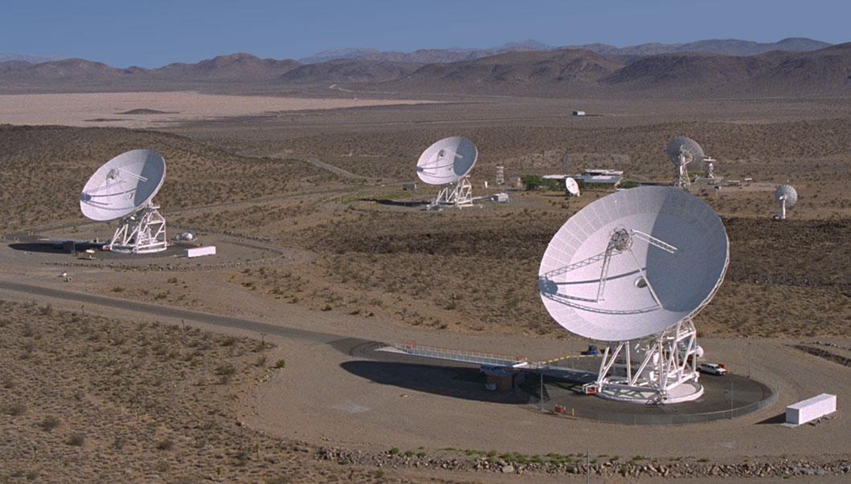
Goldstone California Complex, California, USA
Operated and maintained by
Harris, under contract to JPL

Slide 6
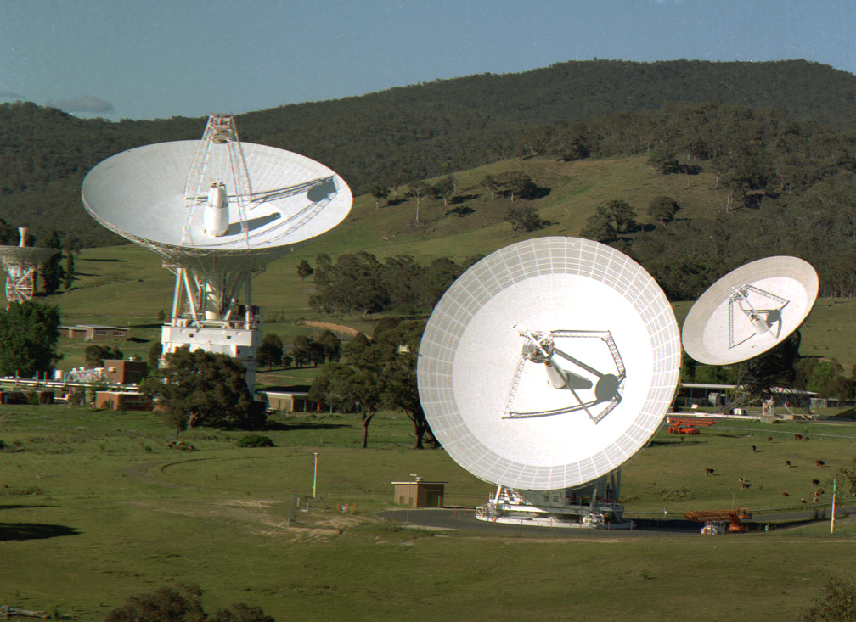
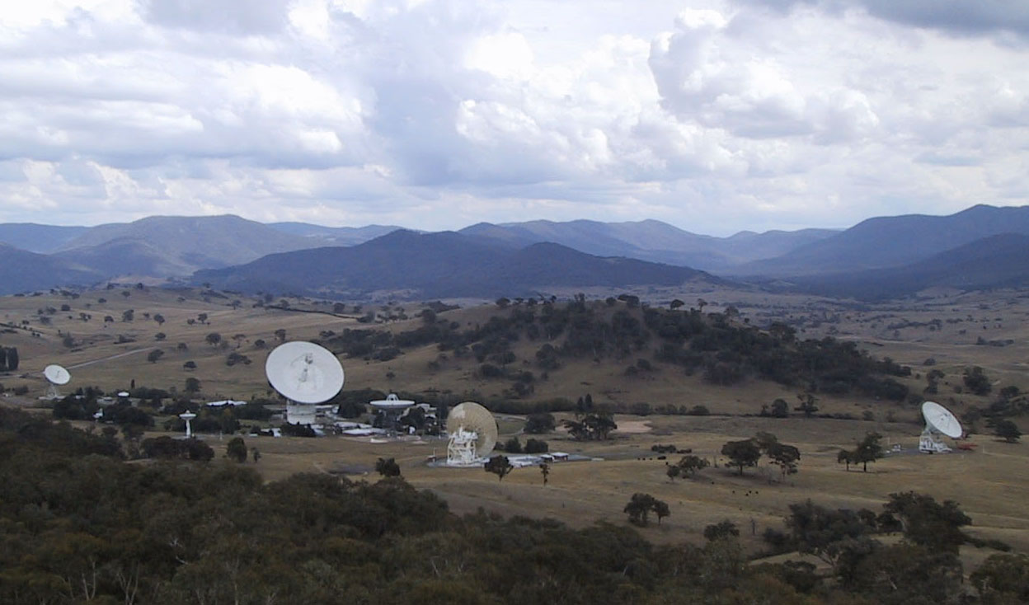
Canberra Complex, Australia
Operated by Raytheon for Australian Commonwealth Scientific and Industrial Research Organization (CSIRO), under contract with JPL

Slide 7
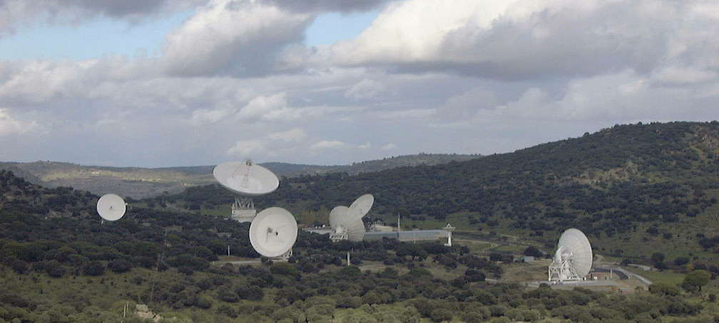
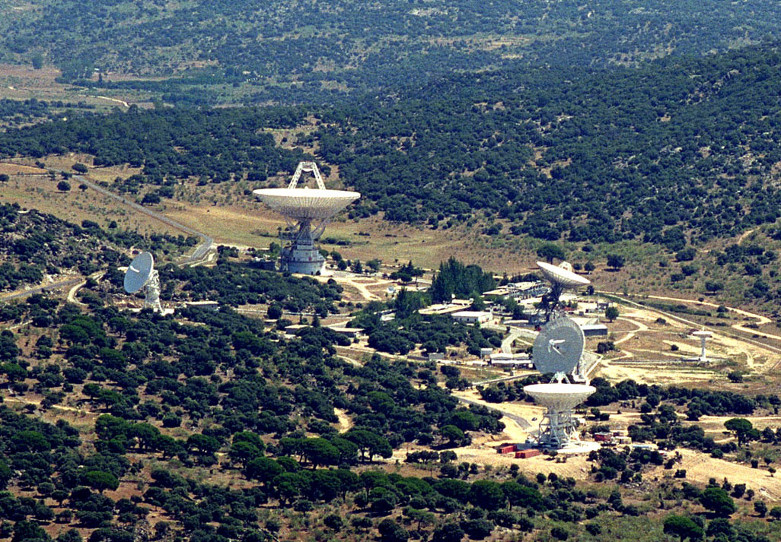
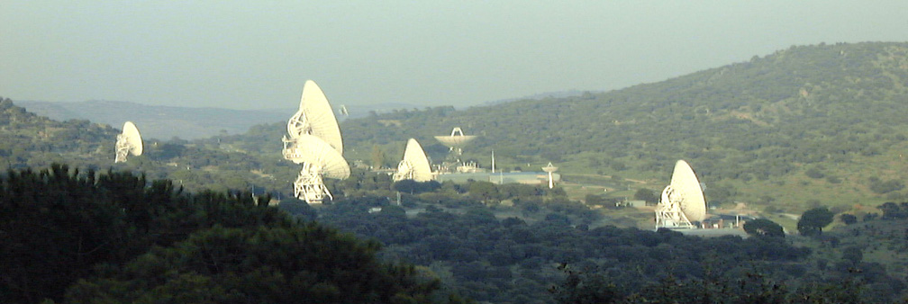
Madrid Complex, Spain
Operated by Ingeniería de Sistemas para la Defensa de España (Isdefe), under contract with Instituto Nacional de Técnica Aeroespacial (INTA) and JPL

Slide 8
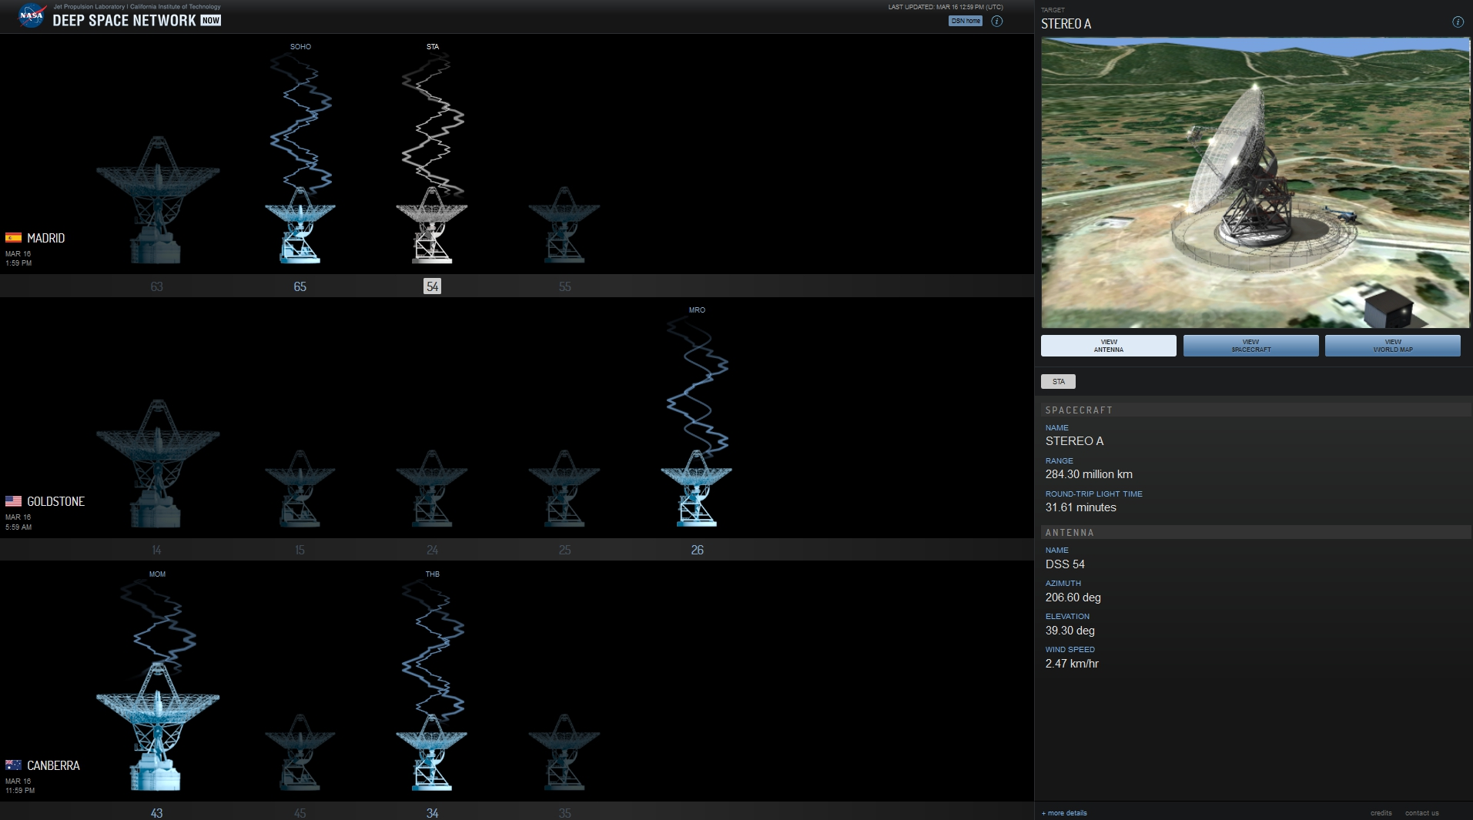
Visit DSN NOW
See what we are communicating with in real time
http://eyes.nasa.gov/dsn/dsn.html

Slide 9
DSN Station Capabilities
DSS No. | Antenna Type | Location | Agency / Ops Org | S-Band Uplink Frequency (MHz) | S-Band Downlink Frequency (MHz) | X-Band Uplink Frequency (MHz) | X-Band Downlink Frequency (MHz) | Ka-Band Downlink Frequency (MHz)
14 | 70m | Goldstone, California | NASA/DSN | 2110 - 2118 | 2270 - 2300 | 7145 - 7190 | 8400 - 8500 | -
15 | 34HEF | Goldstone, California | NASA/DSN | 2025 – 2120 | 2200 - 2300 | 7145 - 7190 | 8400 - 8500 | -
24 | 34B1 | Goldstone, California | NASA/DSN | 2025-2120 | 2200 - 2300 | 7145 - 7190, 7190 - 7235 | 8400 - 8500 | 25500 - 27000
25 | 34B2 | Goldstone, California | NASA/DSN | - | - | 7145 - 7190, 7190 - 7235 | 8400 - 8500 | 31800 - 32300
26 | 34B3 | Goldstone, California | NASA/DSN | - | - | 7145 - 7190, 7190 - 7235 | 8400 - 8500 | 31800 - 32300
34 | 34B1 | Canberra, Australia | NASA/DSN | 2025-2120 | 2200 - 2300 | 7145 - 7190, 7190 - 7235 | 8400 - 8500 | 25500 - 27000, 31800 - 32300
35 | 34B2 | Canberra, Australia | NASA/DSN | - | - | 7145 - 7190, 7190 - 7235 | 8400 - 8500 | 31800 - 32300
36 | 34B3 | Canberra, Australia | NASA/DSN | - | - | 7145 - 7190, 7190 - 7235 | 8400 - 8500 | 31800 - 32300
43 | 70M | Canberra, Australia | NASA/DSN | 2110 - 2120 | 2270 - 2300 | 7145 - 7190 | 8400 - 8500 | -
45 | 34HEF | Canberra, Australia | NASA/DSN | 2025-2110 | 2200 - 2300 | 7145 - 7190 | 8400 - 8500 | -
54 | 34B1 | Madrid, Spain | NASA/DSN | 2025 - 2110 2110 - 2120* | 2200 - 2300 | 7145 - 7190, 7190 - 7235 | 8400 - 8500 | 25500 - 27000, 31800 - 32300
55 | 34B2 | Madrid, Spain | NASA/DSN | - | - | 7145 - 7190, 7190 - 7235 | 8400 - 8500 | 31800 - 32300
63 | 70m | Madrid, Spain | NASA/DSN | 2110-2118* | 2270 - 2300 | 7145 - 7190 | 8400 - 8500 | -
65 | 34HEF | Madrid, Spain | NASA/DSN | 2025 - 2110 | 2200 - 2300 | 7145 - 7190 | 8400 - 8500 | -

Slide 10
DSN Service Overview
The DSN supports telecommunication and tracking operations with multiple deep space scientific missions
The DSN also supports near-Earth missions above low earth orbit, including those at lunar distances, the Sun-Earth LaGrange points, and in highly elliptical Earth orbits
The DSN offers services to a wide variety of mission customers, at multiple frequency bands, through all phases of a mission’s lifetime
Customers NASA Other Government Agencies International Partners | Mission Phases Launch and Early Orbit Phase (LEOP) Cruise Orbital In-situ
Mission Orbits Geostationary or Geosynchronous Earth Orbit (GEO) Highly Elliptical Lunar La Grange Earth Drift-Away Planetary | Frequency Bands S-Band (2 GHz) X-Band (7, 8 GHz) Ka-Band (26, 32 GHz)

Slide 11
Characteristics of DSN Standard Data Services
Standard Interfaces
  DSN-provided data services are accessed via well-defined, standard data and control interfaces
    the Consultative Committee for Space Data Systems (CCSDS),
    the Space Frequency Coordination Group (SFCG),
    the International Telecommunication Union (ITU),
    the International Organization for Standardization (ISO),
    de facto standards widely applied within industry,
    and common interfaces specified by the DSN
  Data service interface standards enable interoperability with similar services from other providers
  Mitigates the need for additional development effort on the part of both the DSN and the customer
  Maximizes the customer's opportunities to reuse
  Helps keep costs down
"Pick & Choose”
  DSN standard data services are independent of each other
"Plug & Play”
  DSN standard data services are multi-mission in nature and generally require table adaptations
  No development is required on the part of the DSN beyond configuration, parameter updates, mission service validations and interface testing
  Development on the customer’s side is limited to using the standard service and meeting its interfaces

Slide 12
Standard DSN Services
For communicating and operating CubeSats
Command Services
  Forward Space Link Extension (SLE)
    Command Link Transmission Unit (CLTU) Radiation
Telemetry Services
  Return Space Link Extension (SLE)
    Frame service
Tracking Services (Trajectory)
  Validated Radio Metric Data
  Delta-DOR (Differential 1-way ranging)
Calibration and Modeling Services (Earth info)
  Platform Calibration
  Media Calibration
Radio Science Services ( Radio Wave Experiments)
  Experiment Access
  Data Acquisition
Service Management
  Allocation and scheduling of assets
  Configuring, monitoring, and controlling the DSN asset
  Reporting service execution results

Slide 13
DSN Mission Interface Management
DSN Mission Support Definition and Commitments Office (9021) functions as the service provider gateway for all projects and is located at JPL Pasadena, California
  DSN Mission Interface Manager (MIM) is responsible for interfacing with the customers from pre-project planning through design, development, testing, flight operations, and closeout
  Mission Interface Manager Contact Info:
  Steve Waldherr
  JPL Interplanetary Network Directorate
  Deep Space Network
  Stefan.Waldherr@jpl.nasa.gov
  (818) 354-3416 office
  (909) 921-7456 cell
  Alternate: Glen Elliott
  JPL Interplanetary Network Directorate
  Deep Space Network
  Glen.Elliott@jpl.nasa.gov
  (818) 393-6373 office
  (818) 235-4162 cell

Slide 14
Important References for using the DSN
DSN Commitments Office Website
  http://deepspace.jpl.nasa.gov/advmiss/index.html
DSN Documents applicable to all mission using the DSN
  DSN Mission Service Interfaces, Polices, and Practices (MSIPP) (875-0001)
  DSN Services Catalog (820-100)
  DSN Telecommunications Link Design Handbook (810-005)
    http://deepspace.jpl.nasa.gov/advmiss/missiondesigndocs/

