Slide 1
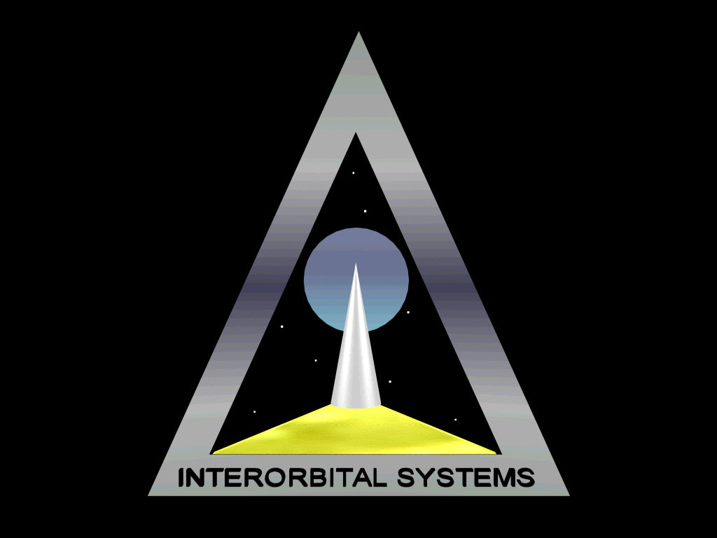
Interorbital Systems
www.interorbital.com

Slide 2
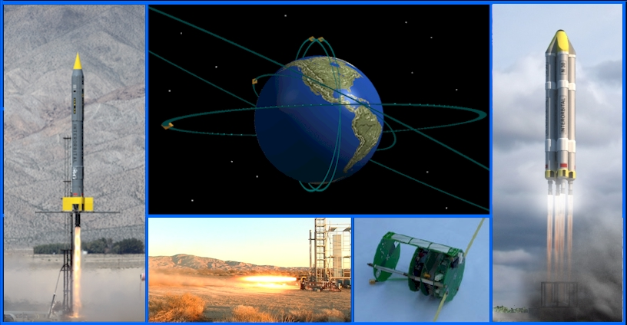
INTERORBITAL SYSTEMS: LAUNCH SERVICES TO LEO, LUNA, AND BEYOND INTERPLANETARY SMALL SAT CONFERENCE, CAL TECH, April 25, 2016
Presenter: Randa Milliron, CEO/CoFounder, Interorbital Systems and Trans Lunar Research
Interorbital Systems
www.interorbital.com

Slide 3

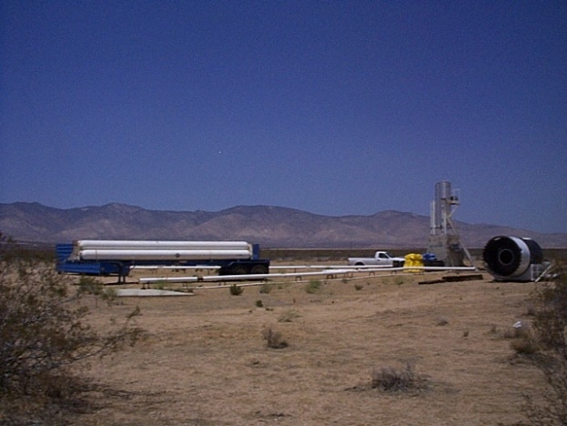
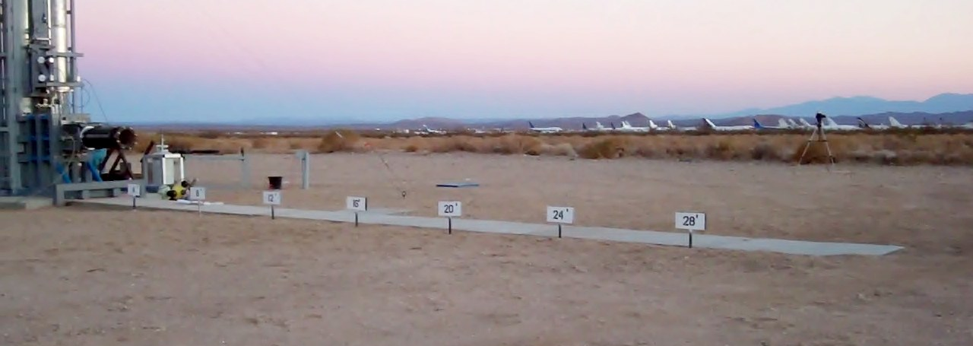
ABOUT INTERORBITAL SYSTEMS
Interorbital: California C Corporation founded in 1995
Location: Mojave Air and Space Port, Mojave, California
R&D and manufacturing facilities
Two rocket engine test sites
Launch locations land/sea worldwide
Launch Provider for GLXP TEAM SYNERGY MOON
Interorbital Systems
www.interorbital.com

Slide 4
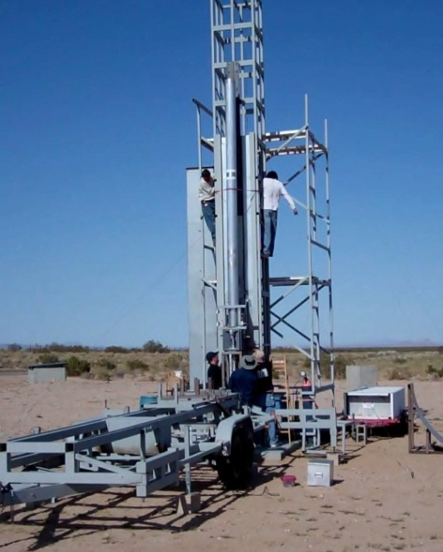
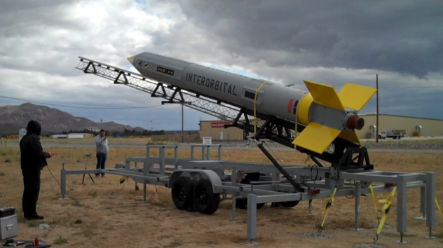
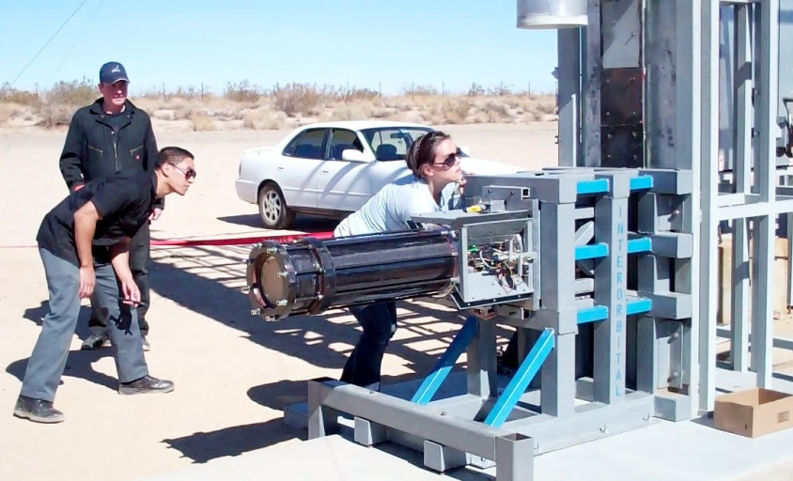
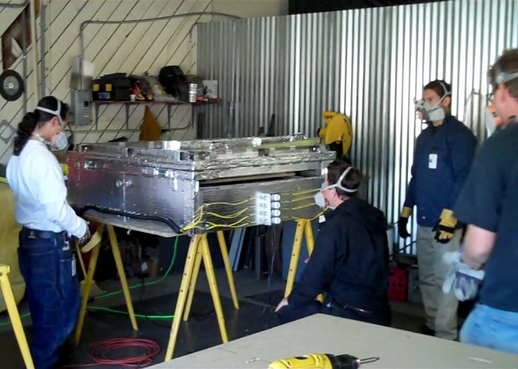
PROTOTYPING & TESTING
PROTOTYPING & TESTING
Interorbital Systems
www.interorbital.com

Slide 5
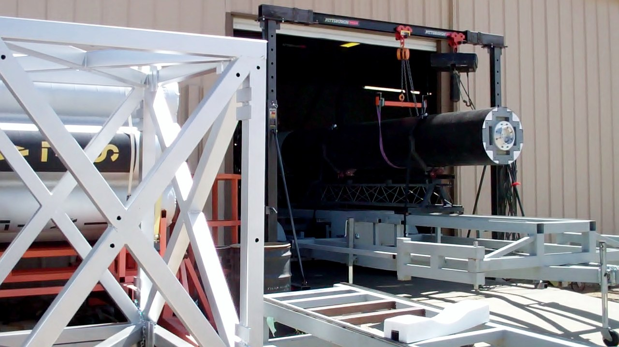
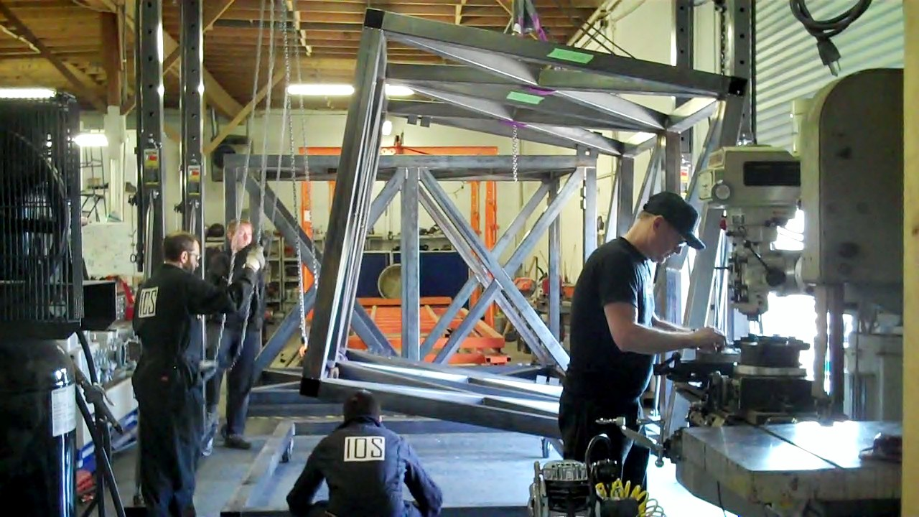
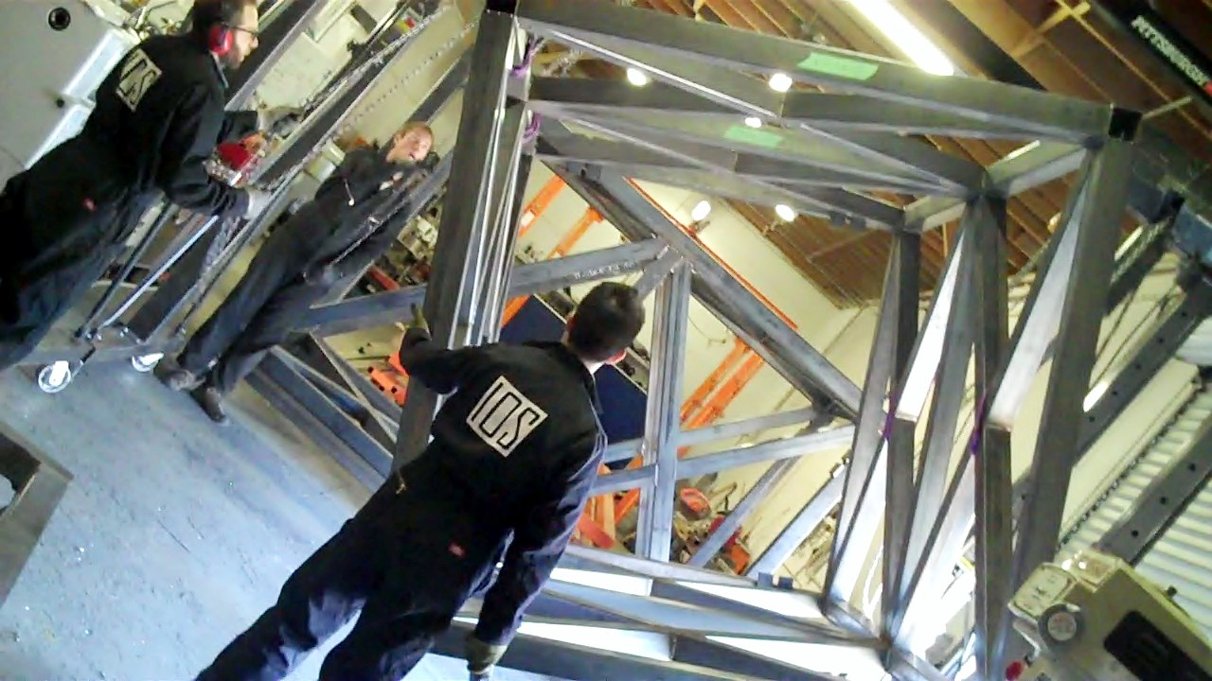
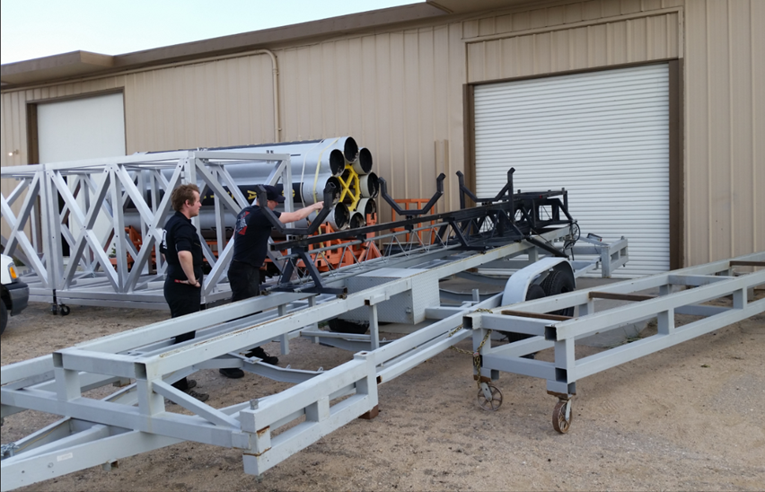
Sea/Land Launch: IOS Mobile SpacePorts under Construction at MASP
Interorbital Systems
www.interorbital.com

Slide 6
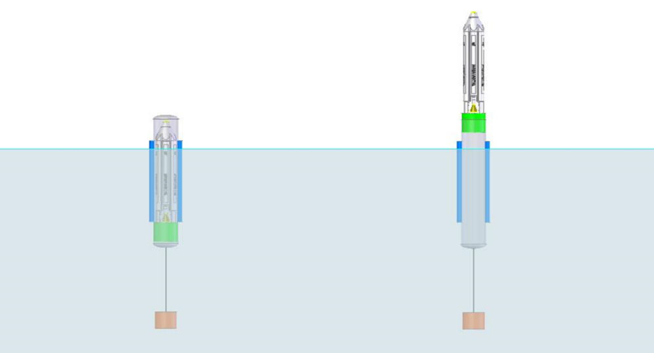
FLOATING Launch ADVANTAGES
-- Complete flexibility in choosing orbit and inclination
-- Makes Launch-on-Demand possible
-- Launch site, trajectory, and schedule can be set to
customer’s requirement
-- Requires only a minimum of launch support hardware
-- Rapid-response; no waiting in a spaceport line
-- The most cost-effective launch method
Interorbital Systems
www.interorbital.com

Slide 7
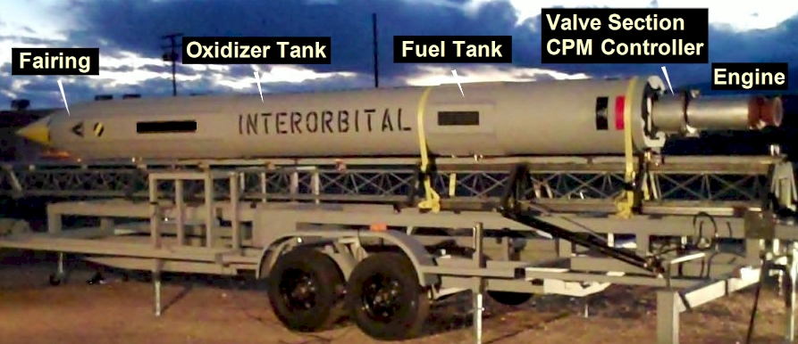
COMMON PROPULSION MODULE
The CPM is the basic building-block of the N-Series modular orbital launchers
Bi-propellant storable, high-density, hypergolic liquid rocket system
Blowdown propellant feed
CPMs clustered together in multiples to meet mission requirements for both small and large payloads
Stand-alone sounding rocket SR145:145-kg to 310km
Interorbital Systems
www.interorbital.com

Slide 8
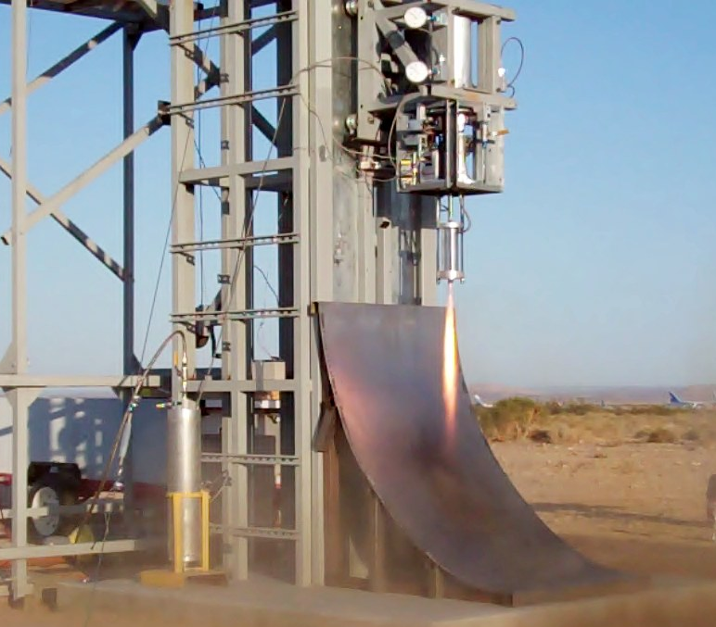
ROCKET THRUSTER
Storable-Propellant
Rocket Engine Technology
Test of rocket thruster engine and CPM controller at Mojave Spaceport
IOS is first in the US to use high-density nitric
acid, furfuryl alcohol, and turpentine as
propellants of choice
Substitutes for expensive, toxic hypergols
like hydrazine and nitrogen tetroxide
All rocket engines designed and built by Interorbital in the USA!
Interorbital Systems
www.interorbital.com

Slide 9
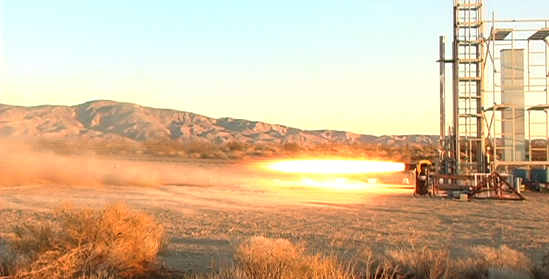
GPRE 7.5KNTA ROCKET ENGINE: CPM MAIN ENGINE TEST
-- Bi-propellant storable, high-density, hypergolic liquid rocket system: Nitric Acid / Turpentine
-- Thrust = 7,500 pounds at sea level
ISP 245 seconds (sea level); Density specific impulse 323 seconds (sea level); Vacuum ISP = 305 seconds
Blowdown propellant feed; hypergolic propellants; no ignition system or turbopumps required
State-of-the-art, all-composite combustion chamber and nozzle. Designed for rapid mass production
Replaceable ablative chamber cartridge yields plug-and-play engine reusability
Interorbital Systems
www.interorbital.com

Slide 10
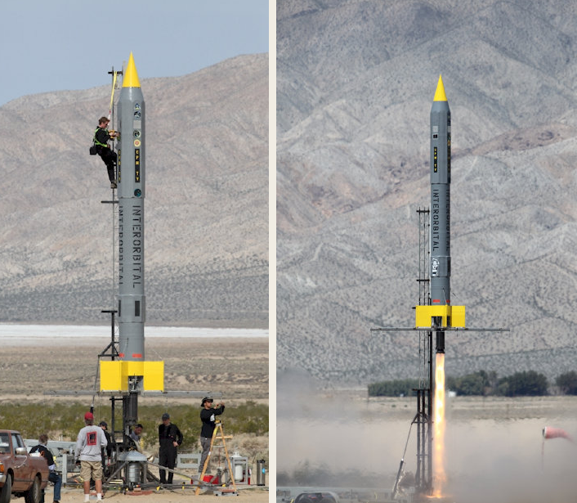
CPM TEST VEHICLE PRE-FLIGHT PREPARATIONS AND LAUNCH
Low-Altitude Suborbital Test Launch
First Commercial Mission
Specifications:
Length: 30.0 ft (9.1 m)
Diameter: 2.1 ft (0.64 m)
Weight Loaded: 1,200 lbs (544 kg)
Engine Thrust (SL): 7,500 lbs (33,360 n)
Payload: 2 CubeSats and 2 TubeSats
Date: March 29, 2014
Upcoming/Now Booking:
Full-Performance, Space Altitude Launch projected for mid-2016. Cost: $350,000 to lift up to 145 kg to apogee of 310 km.
Dedicated for small-sat payload testing and microgravity experimentation.
AST Launch Licensing in work
Interorbital Systems
www.interorbital.com

Slide 11
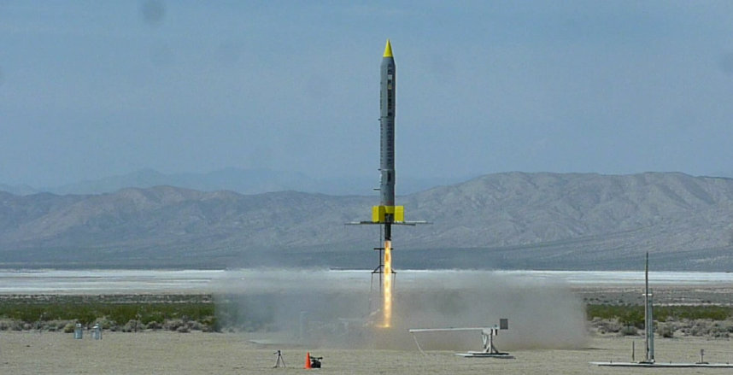
CPM TEST VEHICLE LIFT-OFF
CPM TV reached Mach 1.5 in under 5 seconds. Recovered rocket and all four payloads, intact and still functioning.
Interorbital Systems
www.interorbital.com

Slide 12
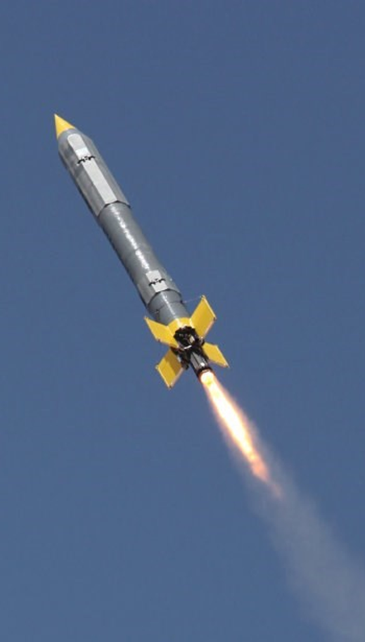
INTERORBITAL LAUNCHES 2016-2019
PAYLOADS on Low-Altitude Suborbital Test Flight II, Mid-2016. Sold Out
Boreal Space 3U CubeSat, Ames Research Center, CA
National University of Singapore,
Ulises I, Mexican Space Collective TubeSat
GLXP Team SYNERGY MOON, California/International
Team MILES, NASA CubeQuest Challenge
Miami School of Advertising/FNAZCA, Brazil
University of Zacatecas, Mexico 1U CubeSat
UNAM, Mexico City 3U CubeSat
Primary CPM Hardware to be Tested
Propulsion and Control Systems in flight Health and Recovery Systems, Wireless-Encrypted CPM Controller
Telemetry, Guidance System, Payload Deployment System
PAYLOADS on Space-Altitude Suborbital Test Flight III, Q4, 2016
SYNERGY MOON GLXP
Boreal Space 3-U CubeSat, Ames Research Center, CA, 3U CubeSat
Ulises I, Music Project, Mexico
SpaceBooth, Belgium
Team MILES, NASA CubeQuest Challenge
GLXP Team SYNERGY MOON, Mojave, CA
UNAM, Mexico; 3U Cubesat
100kg remaining payload capacity remaining on Flight III at $5,000/kg (Academic)
Interorbital Announces LEO, Lunar, and Interplanetary Missions!!!
2017, Q1:First NEPTUNE Orbital launch
2017: Project LUNAR BULLET in collaboration with Ed Belbruno of Innovative Orbital Design, Inc. and Interorbital Systems. RANGER-style MOON impact mission!!! Seeking addition of GLXP Bonus Prize for First GLXP Lunar Impact.’ Lunar Direct.
2017 GLXP Moon Landing NEPTUNE 36: TLI 1 metric ton; 191kg on landing approach; 32kg rover payload. Lunar Direct.
2018: Escape Velocity Mission for five 6U CubeSats (Orion Overflow)
2018/19: VENUS Atmospheric Mission
Interorbital Systems
www.interorbital.com

Slide 13
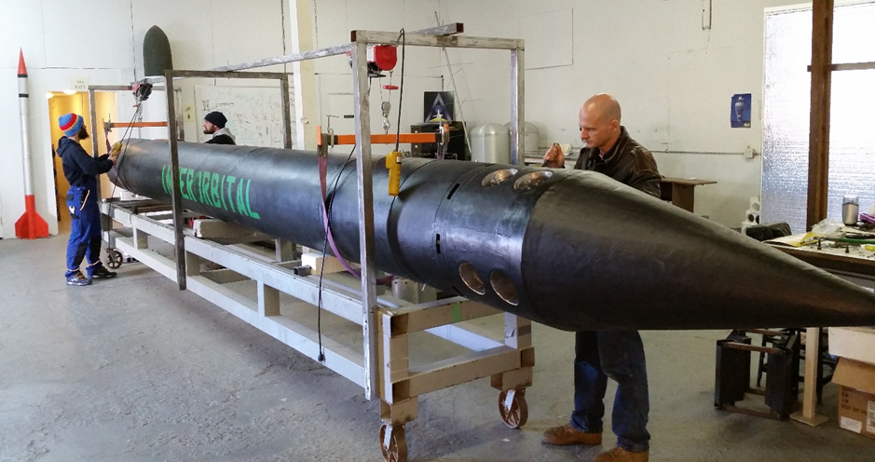
CPM-GTV: CPM GUIDANCE TEST VEHICLE
Recovered, refitted, and re-purposed CPM TV in its new life as the guidance system test vehicle, CPM GTV, for the NEPTUNE rocket series
Interorbital Systems
www.interorbital.com

Slide 14
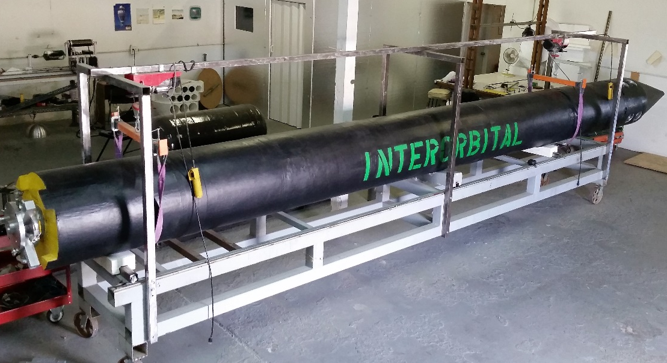
CPM-GTV: CPM GuidANCE Test Vehicle
IOS CPM GTV awaits integration of its 7,500-lb-thrust bi-propellant liquid rocket engine. In a fully-fueled version, this rocket becomes the SR 145: Suborbital Rocket with a 145kg lift and 310km apogee capability. IOS SR 145 is a rapid–response, launch-on-demand vehicle, offering 8+ minutes of excellent quality microgravity, with hardware and software space-qualifying/space-test flight profile. SR 145 also serves as a SCUD–signature target, with complete mobile functionality, launching from both land and sea
Interorbital Systems
www.interorbital.com

Slide 15
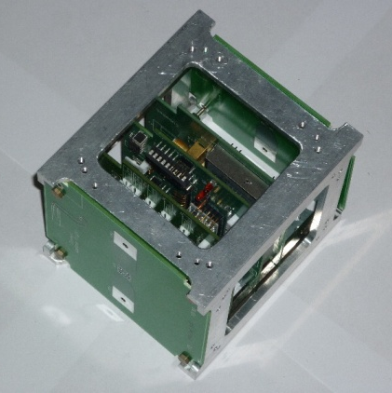
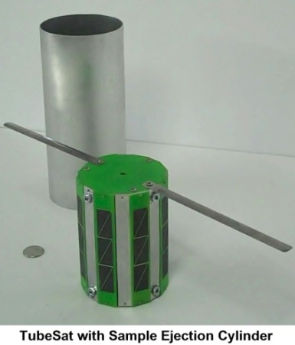
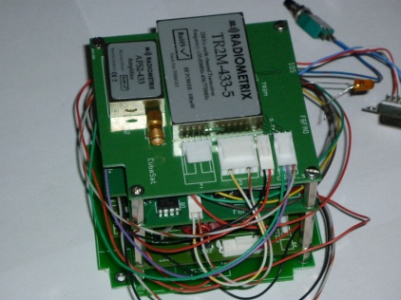
PERSONAL SATELLITE KITS
FEATUR
KIT FEATURES:
-- PCB Gerber Files
-- Solar Cells
-- Antennas
-- A Li-ion battery pack (3.7 V 5200 mAh)
-- Microcomputer (Arduino Mini)
-- Transceiver (Radiometrix) for Up and Downlink
-- Fasteners and Hardware
-- Complete instructions and assembly guide
-- Active Builders’ Forum
-- $8,000 Academic Price: Kit & Launch

Slide 16
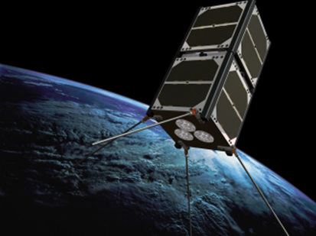
SATELLITE LAUNCH MANIFEST 128th Payload Booked!
CUBESATS
UC Irvine, UCISAT1
FPT University, Vietnam, F-1 CubeSat
Nanyang Technological University, Singapore VELOX-P CubeSat
Google Lunar X PRIZE (GLXP) Team PLAN B (Canada)
GLXP Team EuroLuna, Romit 1 (2-Unit CubeSat from Denmark)
NASA Independent Verification and Validation (IV&V) Facility, 1CubeSat
King Abdullah University, Saudi Arabia (KAUST) 2 CubeSats;1TubeSat
The Golden iPod: Voyager revisited; Earth to Sky,spaceweather.com, Bishop, CA STEM Program
Pakistan’s I CUBE-1 Series, Islamabad Institute of Science and Technology
Boreal Space, California / M2M2Sky, Brazil; Wayfinder I
Rufs the Space Lion, Sweden
Solarem (UK)
Ars Technica (3U)
Dave Cote, Vancouver, Canada (3U)
MITRE Corporation
Denmark’s GLXP Team Euroluna:
Romit 1 2U (2-Unit) CubeSat >>
Launch Cost: $12,500-$19,625, Academic

Slide 17
SATELLITE LAUNCH MANIFEST 128th Payload Booked!
TUBESATS
Morehead State University (Kentucky Space) (TubeSat and 2 suborbital payloads)
InterAmerican University of Puerto Rico
University of Sydney (2) i-INSPIRE (initial-INtegrated SPectrograph, Imager & Radiation Explorer)
Aslan Academy (Private LA High School) STEM Program
Project Calliope (Space Music Project)
Universidad de Puerto Rico/Marcelino Canino Middle School, STEM micro- meteoroid impact study
GLXP Team SYNERGY MOON Space-Qualifying Rover Team AUV’s Comms
GLXP Team Part-Time Scientists / Fluid & Reason Software (2) (US/Germany)
Naval Postgraduate School (3); TubeSats as ad-hoc orbital communication nodes
Defense Science and Technology Lab (DSTL) United Kingdom
Austrian Arts Group mur.at with MURSAT: Earth-as-Art Project
United States Military Academy at West Point (2)
Brazilian Space Institute/108 5th-7th Graders, Ubatuba, Sao Paulo, Brazil STEM Program
Mexican Satellite Project ULISES Sat from PLAY Festival’s Arts/Soccer Opera from Space
TriVector Services (Huntsville) TRACsat – TriVector Radiation and Attitude Control Satellite
La Despensa (The Pantry) Advertising Agency/Iniciativas en Idiomas (Madrid, Spain)
AKQA Advertising, San Francisco
Universidad de Chile, Santiago
Galaxy Global, 1 TubeSat, donated to NASA Educational Program
Mountain View/Los Altos School District
NASA Independent Verification and Validation (IV&V) Facility (5)
IBM (4)
Price: $8,000 Kit and Launch (Academic)

Slide 18
SATELLITE LAUNCH MANIFEST 128th Payload Booked!
TUBESATS
Institute of Advanced Media Arts and Sciences/The Science Project, Inc., Japan (7)
University of Sao Paulo, Brazil (2)
David Lawrence K-8 School, North Miami, Florida
RADG, Ohio---Undisclosed Advertising Project
Jose Virgilio Braghetto Neto/OMNI LABS, Brazil
Ute Mountain Ute/Colorado State University Extension 4H
KEN KATO---Personal Satellite Project, Japan
Ryerson University, Toronto, Canada
DOCTOR WHO TARDIS in Orbit: Robert Doyle and Team
Emmanuel Lesser, Spacebooth, Belgium
University Nova de Lisboa, Portugal
National University of Singapore, RSPL (3)
Manhattan Satellite Lab; NYCSAT-1
RMC s.r.o.; Popular SK, Slovakia
Penn State University, Wilkes-Barre Campus
Universidad Autónoma de Autónoma de Zacatecas, Mexico (2)
MEDO, South Africa
NoiseFigure Research
Technical University of Moldova
Harmony School of Excellence, Austin
Base 11/ West Los Angeles College (2)
Shasta College, California
Price: $8,000 Kit and Launch (Academic)

Slide 19
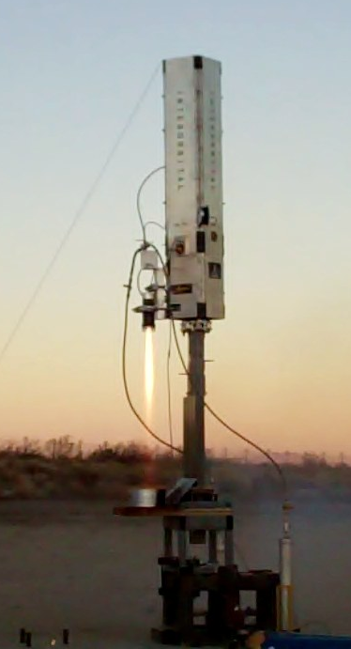
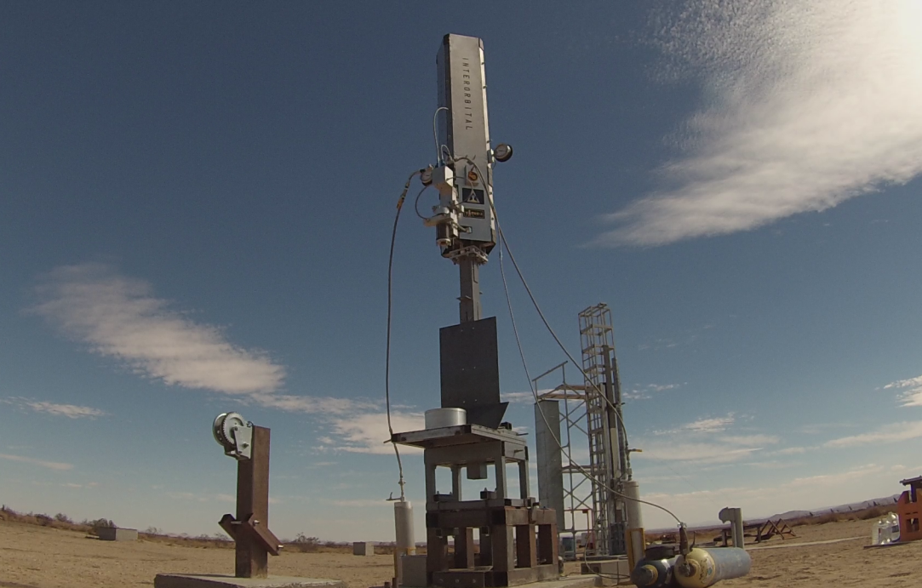
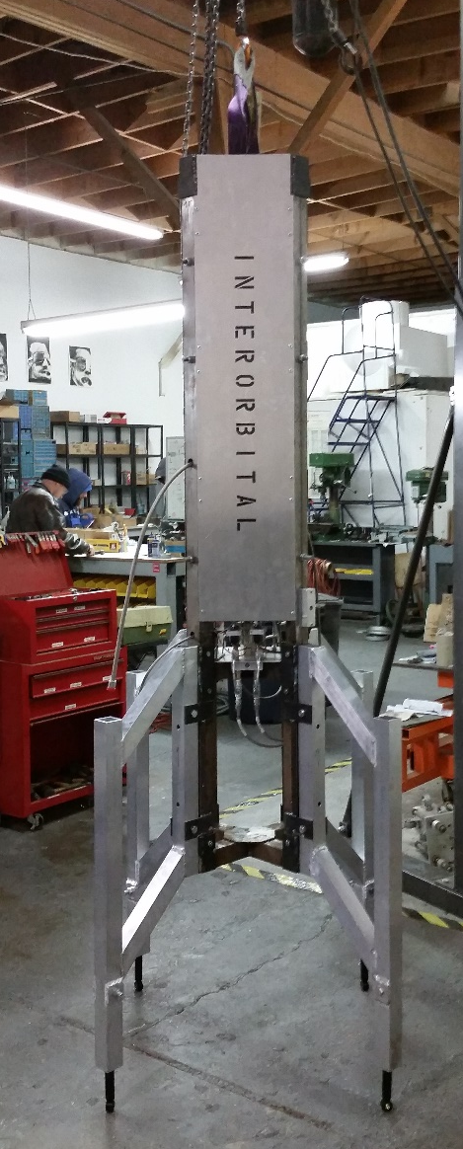

GOOGLE LUNAR X PRIZE LUNAR LANDING SYSTEM: INTERORBITAL/SYNERGY MOON
Interorbital Systems
www.interorbital.com

Slide 20
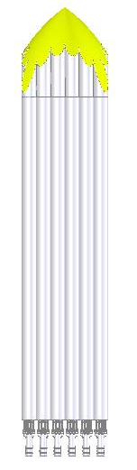
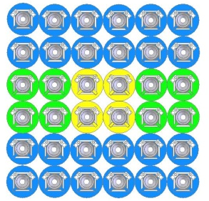
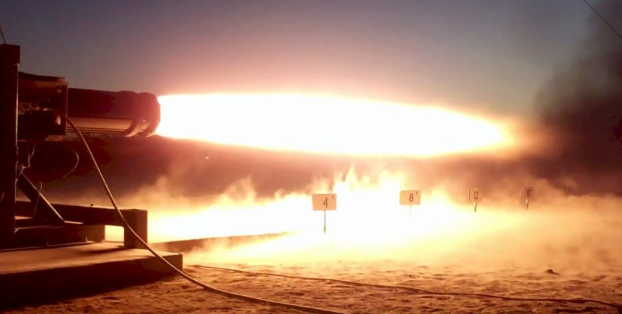
NEPTUNE 36 (N36) MEDIUM-LIFT ROCKET
Interorbital Systems / SYNERGY MOON
36 Common Propulsion Modules (CPMs)
36 Ablatively-Cooled Liquid Rocket Engines
Four Stages (Lunar Transfer Vehicle = Stage 4)
Gimbaled Steering ; Modular; Ocean-Launched
Alternate Approaches:
* 5 launches of smaller five-module rockets with rendezvous and docking on-orbit assembly to create an augmented vehicle
* Using larger CPMs to reduce number of modules needed
NEPTUNE 36: 1 Metric Ton (~2000 lbs) to LEO; 191 kg (421 lbs) to TLI; 32kg (70 lbs) to Lunar Surface
SYNERGY MOON GLXP Launcher
Lunar Direct; No Parking Orbit
Interorbital Systems
Interorbital Systems
www.interorbital.com
www.interorbital.com

Slide 21
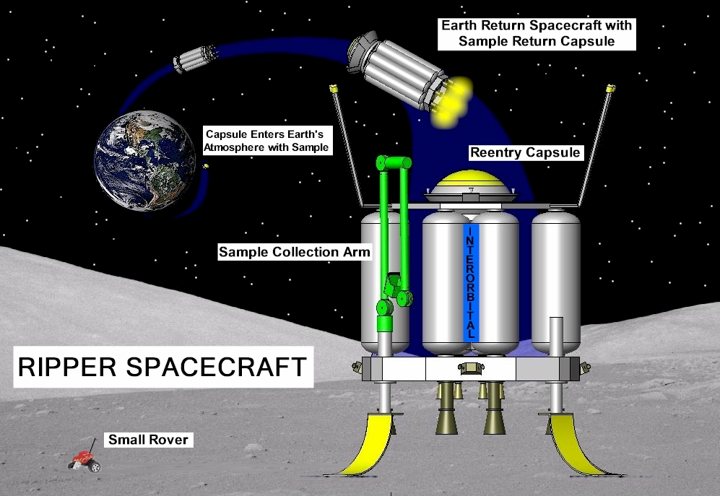
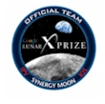
IOS LUNAR SAMPLE RETURN MISSION
X PRIZE FOLLOW-ON MISSIONS PRE-SALE OF LUNAR MATERIAL TO COLLECTORS AND RESEARCHERS
Dedicated and Ride-Share Launch Opportunities for Small Satellite Payloads to the Moon and Beyond
Interorbital Systems
Interorbital Systems
www.interorbital.com
www.interorbital.com

Slide 22
Interorbital Systems
www.interorbital.com

