Slide 1

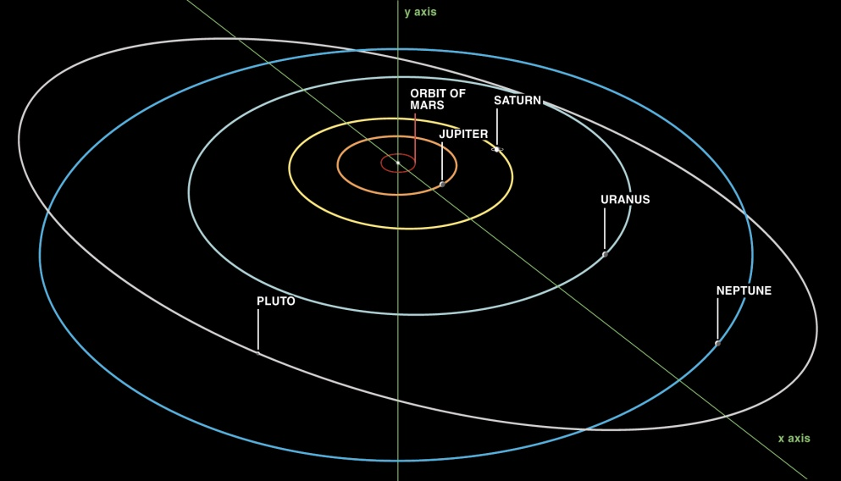
Optical Communications for Deep Space Cubesats
William Farr, Michael Ping, Michael Borden,
Abhijit Biswas, Joseph Kovalik
April-2016
Jet Propulsion Laboratory
California Institute of Technology
Copyright 2016 California Institute of Technology. Government Sponsorship Acknowledged.
Copyright 2012 California Institute of Technology. Government Sponsorship Acknowledged.

Slide 2
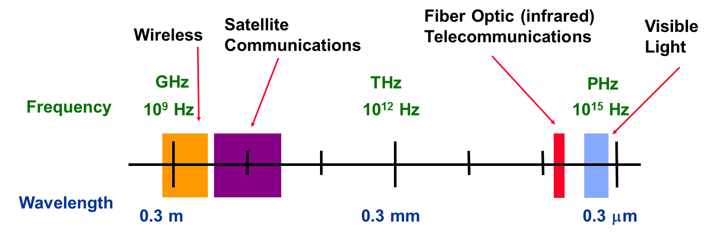
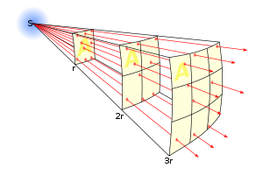
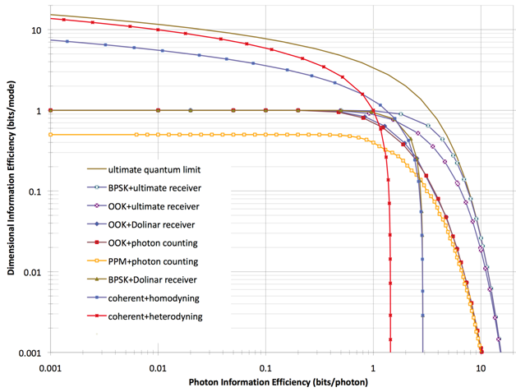
Why consider optical for cubesat telecom?
Versus RF telecommunications:
Freedom from spectrum regulations
  Limited spectral allocations limit data rates
  Long lead times for RF licenses
Smaller beam divergences from small transmitter apertures
  Higher Equivalent Isotropic Radiated Power (EIRP)
    Beam width = wavelength / antenna diameter
  In a well-designed system data rate is proportional to received power
Distance = 1
Brightness = 1
Distance = 2
Brightness = 1/4
Distance = 3
Brightness = 1/9
Fewer photons per bit required for direct detection than coherent detection
  Limit of 1.44 bits per photon for heterodyne
  Limit of 2.89 bits per photon for homodyne
  Unlimited bits per photon for direct detection
    17 bits per detected photon demonstrated at JPL

Slide 3
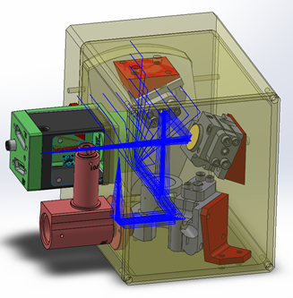
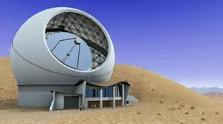
Challenge of Deep Space Telecom
International Telecommunication Union definition of deep space for RF spectrum allocation purposes is 2 million km
  The moon is about 0.4 million km away
  The Earth-Sun L1 and L2 points are
  about 1.5 million km away
However, interplanetary distances are much larger than that
  Mars at typical closest
  range is 60 million km
    3.6 billion times larger
    signal loss than LEO
  Venus at typical closest
  range is 40 million km:
    1.6 billion times larger
    signal loss than LEO
Range (R) |  | Additional 1/R² Loss Factor at 1 AU | Round-trip Light Time
LEO (1000 km) | 6.7x10⁻⁶ AU | 2.25x10⁻¹⁰ | 3.3 msec
GEO | .00024 AU | 17,400,000 | 0.24 secs
Moon | .0028 AU | 128,000 | 2.79 secs
Earth-Sun L2 | .01 AU | 10,000 | 10 secs
Deep Space | 1 AU | 1 | 16.6 mins

Slide 4
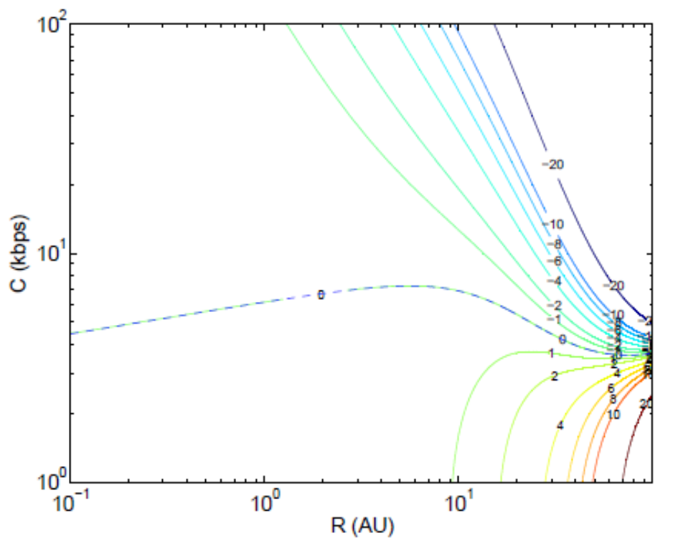
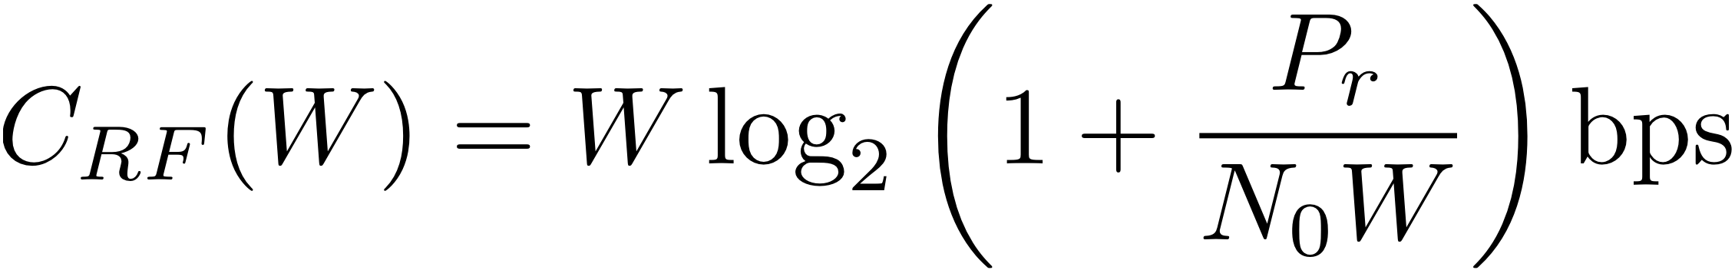
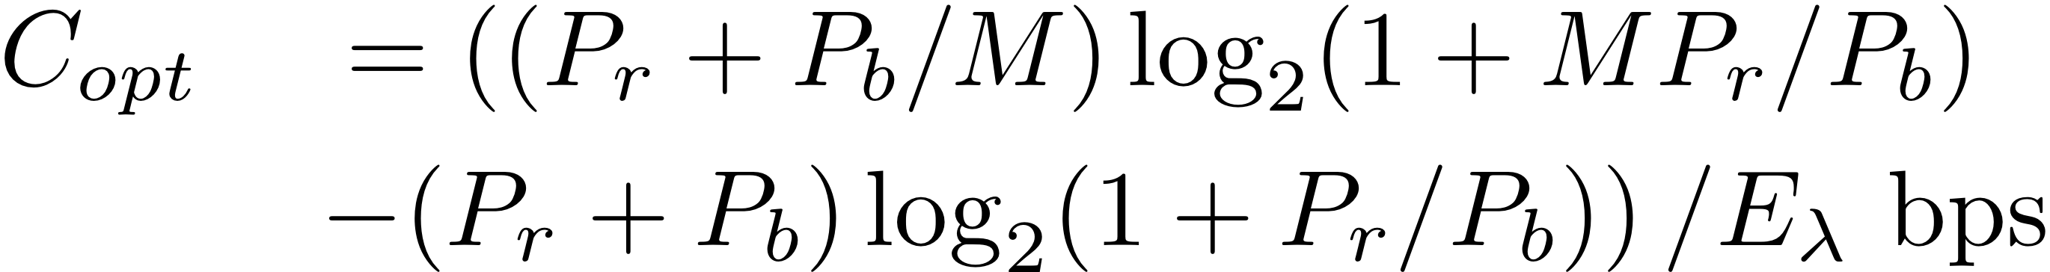
Telecom under mass & power constraints
Although optical outperforms RF at high data rates, RF can outperform optical at large ranges and under high background conditions
  With photon counting direct detection the capacity goes as 1/R² for P_{r} > 2 P_{b} ln M/M, and as 1/R⁴ for
  P_{r} < 2 P_{b} ln M/M
    with M as the peak-to-average power ratio of a symbol
  This also implies a maximum effective diameter for optical ground-based receivers
    Beyond this limit, doubling the antenna diameter only increases the achievable data rate by √2
Example mass difference contours, (m(o) − m(r)) (kg), to achieve specified (R,C). Positive (negative) contours denote the kg gain of an RF (optical) terminal.
Capacity
  Is the maximum information rate achievable across a channel with arbitrarily small probability of error
  Represents the maximum mutual information between the channel input and channel output
  Examples of units of capacity are bits per second and bits per channel use

Slide 5
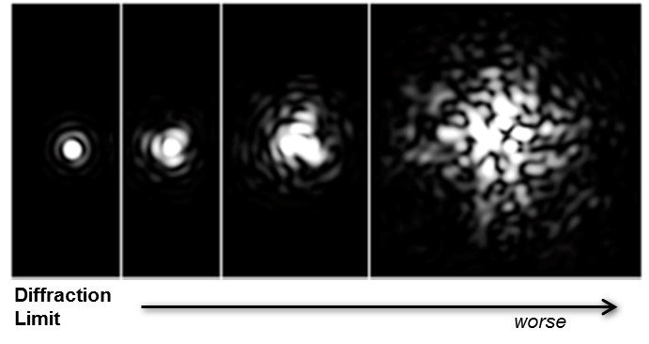
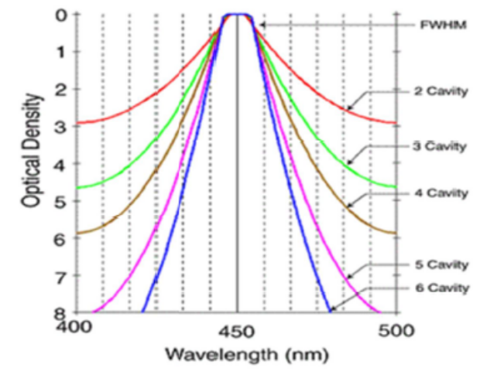
Optical Noise Rejection Challenge
When noise power dominates, capacity C scales as P_{s}²/P_{b}
  In this regime, data rate scales as 1/R⁴, and optical communications advantage from a narrower transmit beam are quickly lost
Background light in the optical receiver is traditionally rejected by either limiting the field-of-view or by optical bandpass filtering.
  An optical receiver located in the Earth’s atmosphere
  has a field-of-view limited by atmospheric turbulence,
  characterized by the Fried parameter r₀, unless
  adaptive optics (complex, bulky, and costly) is utilized.
    r₀ (few cm worst case, typically) represents the optical
    coherence length and the maximum receiver aperture
    diameter that can achieve a diffraction limited field of view.
  Narrowband optical interference filters with low
  transmission loss (< 1 dB) have tens of gigahertz
  bandwidths or greater.
    Alternate filter technologies such as atomic line filters and
    ring resonators have severe implementation challenges with
    respect to not only transmission loss, but also Doppler
    and/or effective field of view.

Slide 6
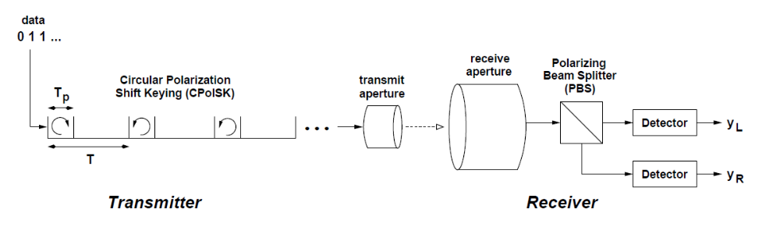
Noise Rejection in the Time Domain
With photon-counting direct detection optical background can also be rejected in the time domain
  Time-of-arrival of every individual detected photon at the receiver is tagged with sub-nanosecond precision
Simplest scheme: polarization modulate a fixed-rate pulsed laser
  For instance, right-hand circular polarization to represent "0" and
  left-hand circular polarization to represent "1“
  Single "tone" of direct detection signal allows time-gated rejection of non-signal photons
  Signal can still be acquired under high loss conditions, then forward error correction coding gains applied

Slide 7
Circular Polarization-Shift-Keying Terminals
Circular-Polarization-Shift-Keying (CirPolSK) laser transmitter is low complexity with small diameter aperture (few mm to few cm)
  Pulsed laser transform-limit bandwidth should be matched to receiver optical filter bandwidth
Data
Modulator
λ/4
local interfaces
Pulsed Fiber Laser
Polarization Modulator
Fiber Amplifier
Beam Director
Background rejection performance of the Photon Counting Detector (PCD) CirPolSK receiver is set by optical filter bandwidth and timing resolution of photon arrivals
  New generation near-infrared PCD arrays with readout can operate with <200 ps timing uncertainty, > 50% efficiency, and near-zero intrinsic noise rates
Receiver Telescope
< 2 nm BPF
P-pol detector
λ/4
PBS
Photon Counting Array
Gate Array Pre-Processor
DBS
Data Demodulator
interfaces
Photon Counting Array
Imaging Camera
Gate Array Pre-Processor
S-pol detector

Slide 8
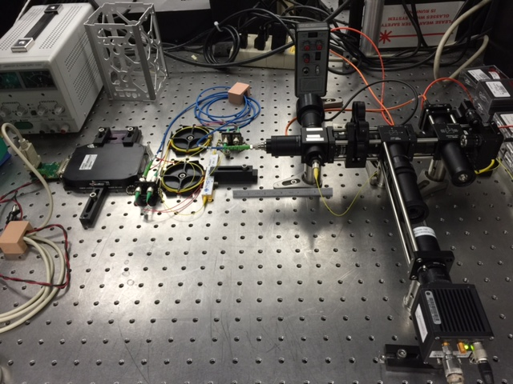
CubeSat PolSK Testbed
power meter
Laser Amp Out
1 W
ND wheel
S-pol
detector
Polarization Modulator
1550 nm 50:50 BS
P-pol
detector
Mode Locked Laser
1550 nm 90:10 BS
Seed Laser Tap
5 mW
1550 nm LED
(flood illumination)
InGaAs camera

Slide 9
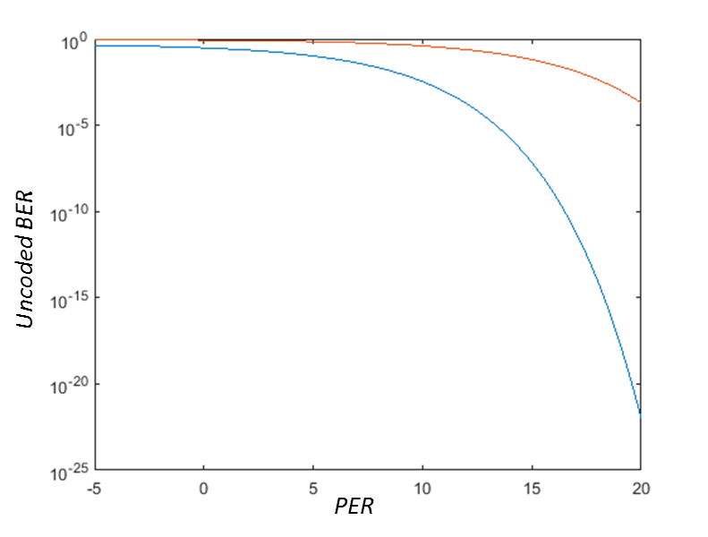
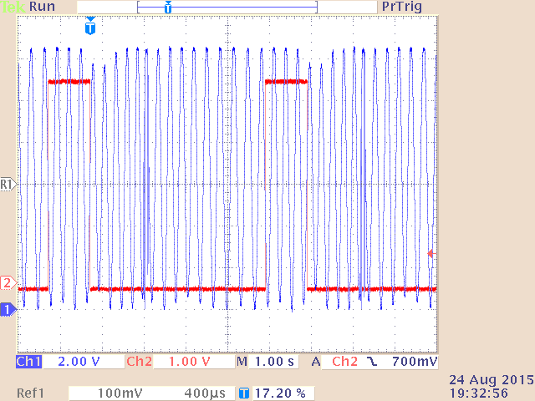
Initial PolSK Results
Measured performance > 8dB worse than theory due to poor polarization extinction ratio (PER) after the polarization modulator
  Obtained only 6 dB PER after modulator with mode locked laser pulses, versus measured 16.5 dB PER before modulator
  Measured 24 dB PER at modulator
  output with CW laser input
Established that low PER is the result of group velocity dispersion (GVD) in the polarization modulator
  The polarization modulator was implemented in a waveguide LiNbO₃ technology with 5V Vπ switching voltage
  Confirmed issue by scanning a narrowband laser signal below/above 1560 nm and observing the amplitude of a single polarization
Modeled BER for ideal versus measured PER. Performance is degraded by >8 dB at 10⁻³ BER
Measured polarization modulation by scanning narrowband CW laser. Full polarization switch occurs with a frequency shift of 0.3 nm. Measured FWHM of mode-locked laser was 0.24 nm.

Slide 10
Simplified PolSK Transmitter
Developed simplified laser transmitter with improved pulse rate flexibility by using “gain-switched” laser diodes (GS-LD)
  PolSK can be achieved by alignment of polarization axis of one laser to the “slow” axis of an output polarization maintaining fiber, and the other to the “fast” axis
  Simple non-linear transmission line circuit converts logic-level input pulses to sub-nanosecond, ~100 mA drive pulses with 10’s of mW average power dissipation
  Provides some redundancy in the event of a diode failure
Unlike a fixed rate mode-locked laser, can change pulse repetition frequency to accommodate different loss/background conditions
  Rate is set by external electronics
  Can also implement Pulse-Position Modulation (PPM) with demonstrated pulse rates from < 10 KHz to > 500 MHz
Gain-Switched Diode Lasers
Clock
and
Slow Axis
Dispersion Compensation Fiber
Data
PM
coupler
1
0
1
1
0
1
0
0
Fiber-based Amplifier
Laser Output
and
Fast Axis

Slide 11
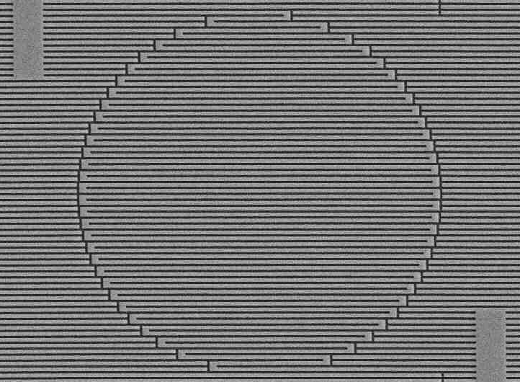
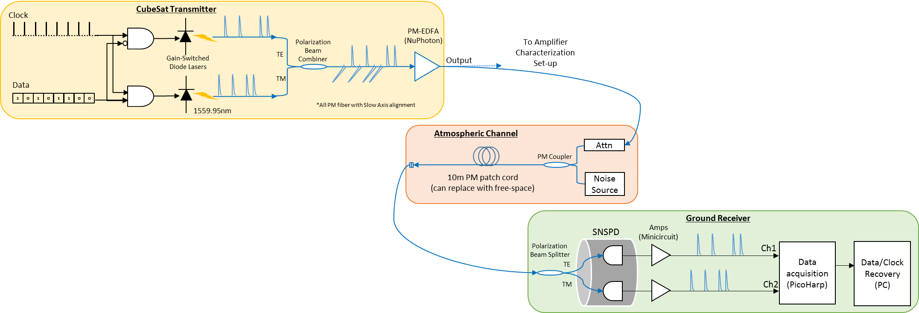
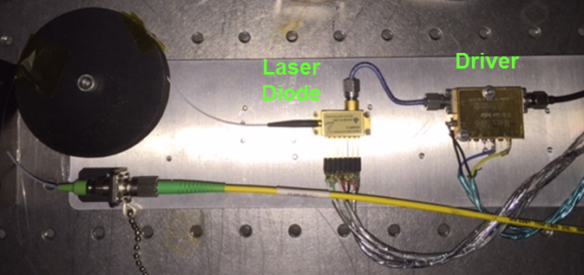
Improved PolSK Testbed
New testbed is distributed over lab, but allows more accurate emulation of expected link conditions and support use of state-of-the-art WSi superconducting single photon detectors
15 μm
Superconducting Nanowire Single Photon Detector (SNSPD). ~4 nm by ~100 nm superconducting wire biased just below the critical current. Absorbed photon creates a hot-spot: drop in current is read out as a voltage across a load resistor. Rise time is sub-ns, fall time is a few ns due to kinetic inductance. A meander placed in an optical cavity increases the detector area and probability of photon absorption. Arrays to 64 pixels and 320 µm diameter have been fabricated to date.
Gain switched laser diode. Version shown uses a electro-optic modulator driver to test wide range of pulse widths and repetition rates. <100 ps output pulse with Full Width Half Maximum spectral width of 0.1 nm at 35 dB extinction ratio.

Slide 12
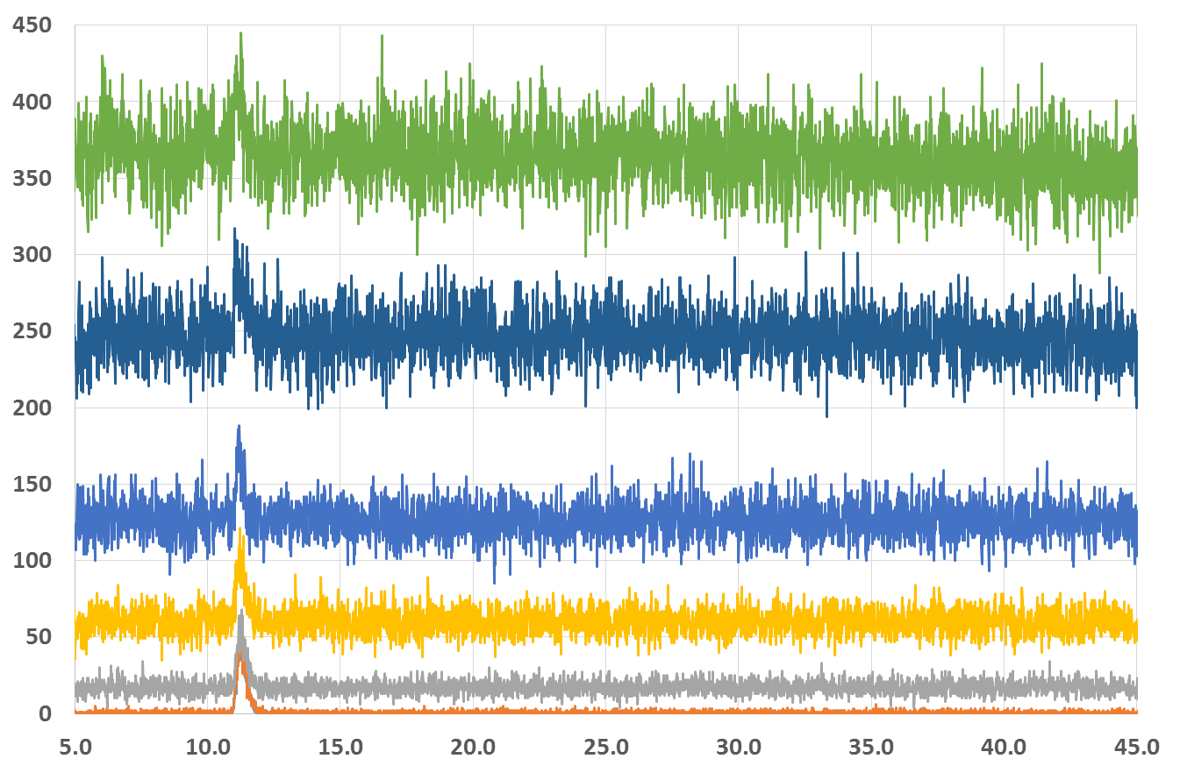
Negative SNR Photon Counting Acquisition
Demonstrated signal acquisition at -43.5 dB average signal power to average noise power ratio at 1550 nm using GS-LD at 1 MHz symbol rate and single pixel WSi SNSPD
  Signal acquisition
  window was 600 ps
  for a symbol period
  of 1000 ns
    32 dB background
    counts rejection
  Measured clock
  stability sufficient
  for100 ms
  integration
  Mean signal in
  acquisition window
  at 100 ms
  integration
  exceeds noise
  variance by
  3.2 standard
  deviations.
Detected signal window
SNR
-43.5 dB
-41.7 dB
-38.9 dB
-35.6 dB
-30.1 dB
-16.9 dB
Total Detected Photons
Correlator output with 12.2 ps binning
Delay (ns)

Slide 13
Estimated Error and Erasure Rates
Case for previous slide with fixed signal and increasing background
  Error rate is a bound estimated from a single detector for a PolSK system
99.8% Erasure
ErasureRate + ErrorRate + CorrectRate = 1
Fixed signal flux
Increasing background flux
High error and erasure rates will require combination of low-rate (<1/10) forward error correction codes along with spreading sequences

Slide 14
Summary
Polarization modulation of a high
peak-to-average power laser transmitter
combined with photon counting direct
detection can support deep space
cubesat optical telecom links
  Pointing remains a dominant challenge
Acquisition in highly negative average
signal power to average noise power
regimes has been demonstrated
Demonstration of low-rate forward error correction codes and spreading sequences for this channel is the next step
  Protograph-based Raptor-like (PBRL) codes or punctured-node protograph-based Raptor-like (PN-PBRL) codes?
  Simple repeats or pseudo-noise spreading codes?
5-cm TX dia,
1W @ 1550 nm
250 ps slot width
10 MHz repetition rate
5m RX dia. with SNSPD Array
The work described here was performed at the Jet Propulsion Laboratory (JPL), California Institute of Technology under contract with the National Aeronautics and Space Administration (NASA)

