Slide 1
Inflatable Antenna for CubeSats: X-band Design
Alessandra Babuscia, Jonathan Sauder, Nacer Chahat
(Jet Propulsion Laboratory, California Institute of Technology)
Aman Chandra, Jekan Thangavelautham
(Arizona State University)
Interplanetary Small Satellite Conference
25th April 2016
Part of this work was performed at the Jet Propulsion Laboratory, California Institute of Technology, under a contract with the National Aeronautics and Space Administration.
© 2016 California Institute of Technology. Government sponsorship acknowledged.

Slide 2
Outline
Introduction
Inflatable Antenna Concept
Structural design
Manufacture
Photogrammetry
Anechoic Chamber Test
Inflation and Rigidization
Conclusion and future work

Slide 3
Introduction
As CubeSats are becoming a way to explore deep space in a more affordable way than traditional spacecraft, new needs emerge: telecommunication systems must be able to sustain a severely increased path loss.
Different communication technologies are in development to approach this problem and to support interplanetary exploration with CubeSats and small satellites. Examples are: the IRIS radio, reflectarray antennas, deployable antennas , CDMA techniques, optical communication, MSPA (Multiple Spacecraft Per Antenna), and the inflatable antenna.
The first inflatable antenna for CubeSats was designed at the S-Band
We are currently designing it at X-Band

Slide 4
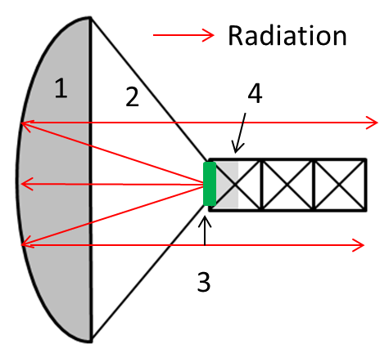
Inflatable Antenna Concept
The inflatable antenna is a parabolic dish reflector (1 m) made of one side metalized mylar, one side clear mylar, and with a patch antenna as the feed.
Initial simulations (without considering deformations due to over inflation and wrinkles) indicate a peak gain of 34 dBi.
The inflatable antenna is unique as it provides
  extremely high stowing efficiency (20: 1)
  low mass (<0.5 Kg)
  Scalability
  inflation with sublimating powder.

Slide 5
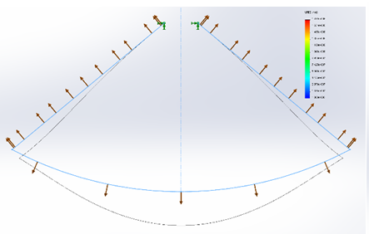
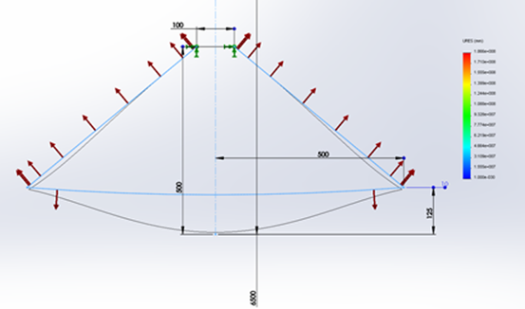
Inflatable antenna structural design
The structural design is really challenging due to the non-linearity, the very thin membranes and the difficulty of models to characterize low pressure inflations
Two initial designs were chosen for manufacturing from the simulation results.
An undersized curved paraboloid surface→ after pressurization it would deform to the spherical shape which approximated a parabola.
An entirely flat shape→ would be deformed by pressurization into a spherical surface which closed approximated a parabola. .

Slide 6
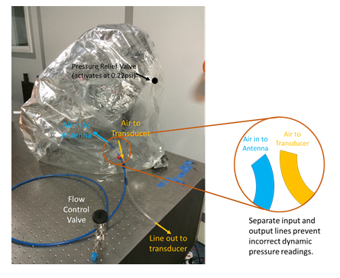
Antenna manufacturing
The inflatable antenna membrane was manufactured by Meteorological Product Inc.
A pressure input and pressure measurement couplings which connected to ¼” flex tubing were built into the antenna, along with a pressure relief valve to prevent over pressurizing the antenna.
The pressure relief valve was designed to activate at 0.22 psi.

Slide 7
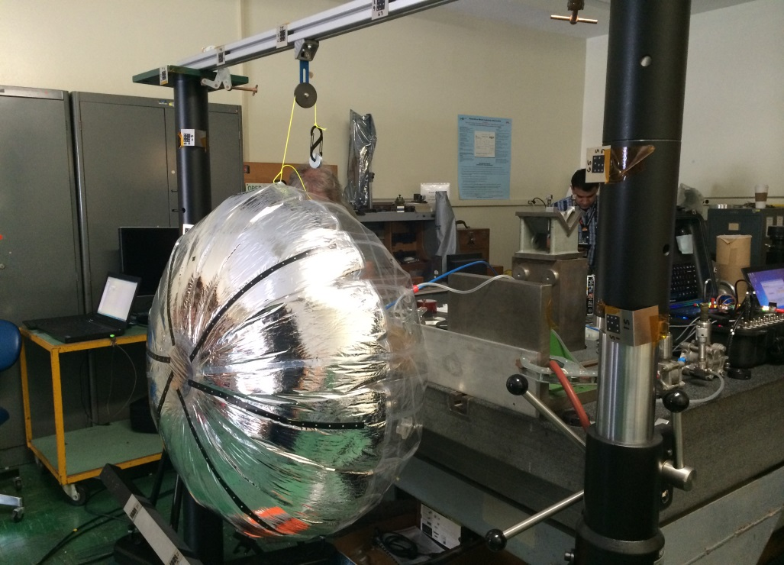
Photogrammetry
The photogrammetry test was designed to test the impact of different pressure ranges on the curvature of the antenna.
Pressure input was controlled manually, by a high sensitive valve, and pressure readings were made by using an Omega pressure transducer.
A set of 3 photogrammetry cameras were used to determine the position of various photogrammetry targets, which were attached to the face of the reflector
While the data was quite noisy, the flat antenna was found to have
  the most predictable pressure vs. displacement curves
  far less micro scale deformations (wrinkles) than the curved antenna.

Slide 8
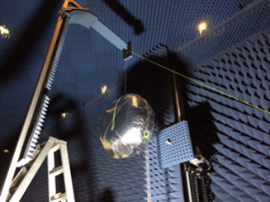
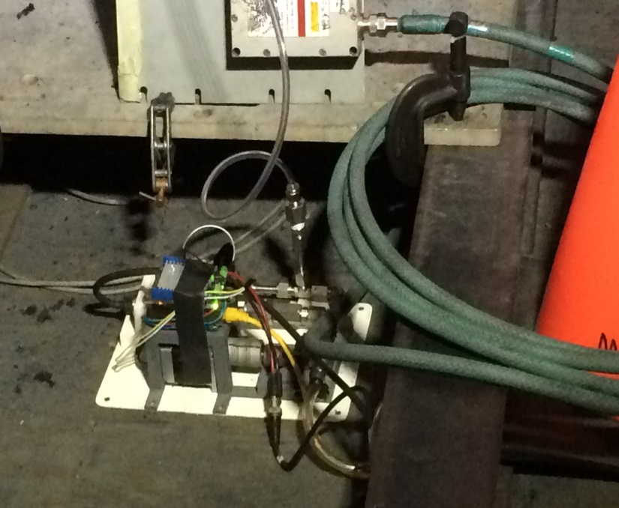
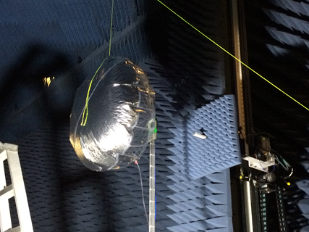
Anechoic Chamber Test: Setup
Setup

Slide 9
Anechoic Chamber Test: Results
The scan were taken at 0.197 psi.
The predicted peak directivity was 24.9
The measured peak was 24.2 dBi

Slide 10
Inflation and Rigidization
An initial study was performed to identify the best sublimating compound for the antenna
  Benzoic acid (baseline) was confirmed to be a good choice for sublimates
Tests in the vacuum chamber were performed to characterize the inflation
UV rigidization was studied to allow for in-flight rigidization of the reflector

Slide 11
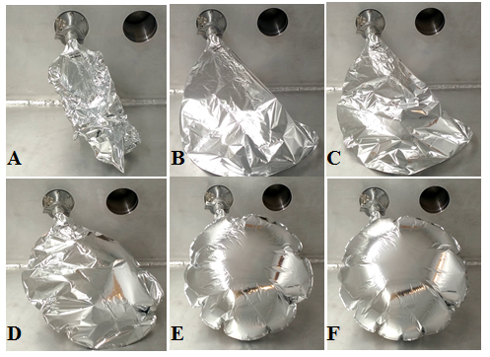
Vacuum Chamber Test
Test steps:
  The inflatable is evacuated of residual air at atmospheric pressure
  The inflatable is sealed and the vacuum chamber is then evacuated
  The chamber is held at a pressure of 10⁻⁵ torr.
Phases:
  A→ air evacuation
  B→ peak due to redistribution of air locked pockets formed in Phase A
  C→ progressively pressure lowering
  D→ sublimation begins
  E-F→ equilibrium is reached (0.0026 Torr)
The test has shown that inflation is achievable with 1 g of sublimating powder. Additional powder does not damage the antenna and can be used to generate additional gas in case of micrometeoroid perforation.

Slide 12
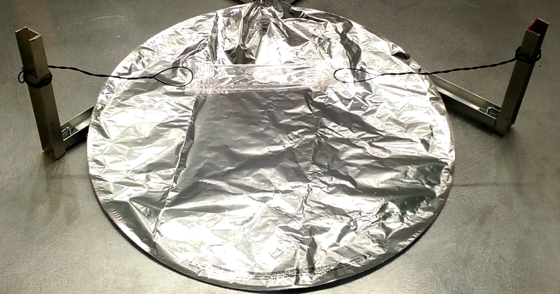
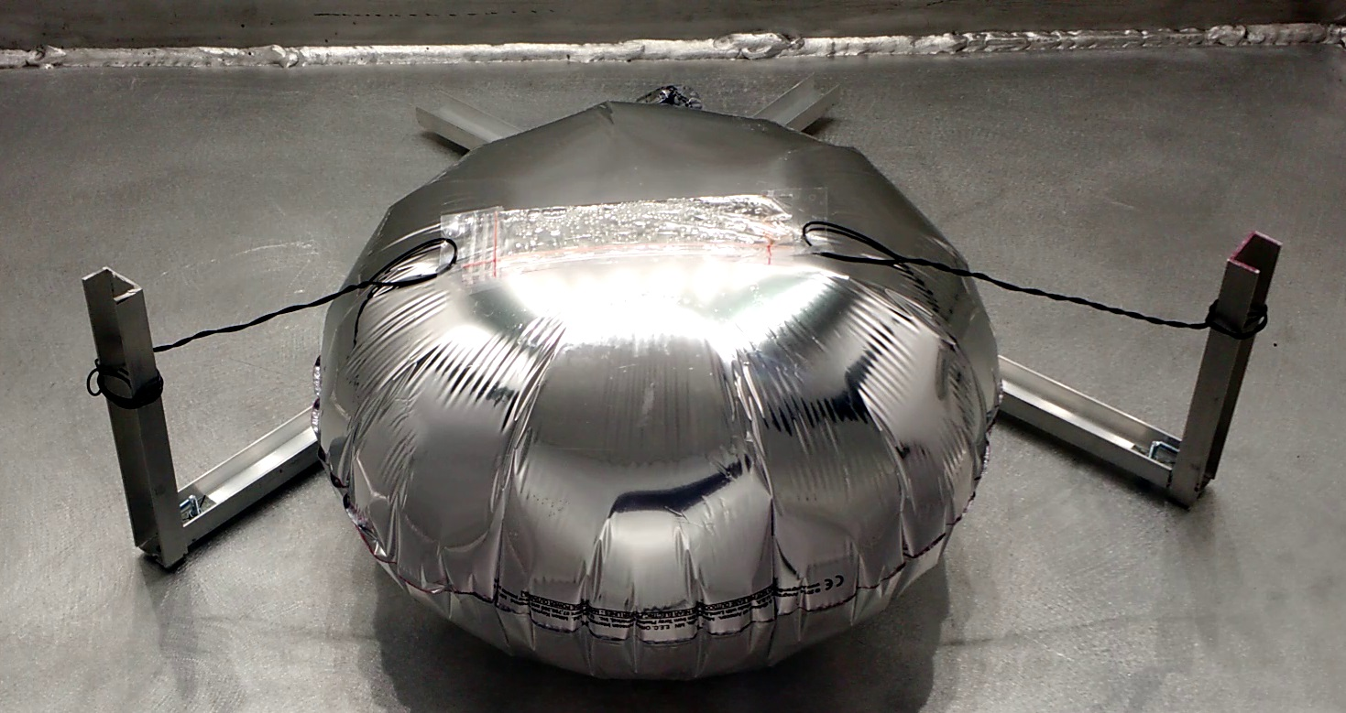
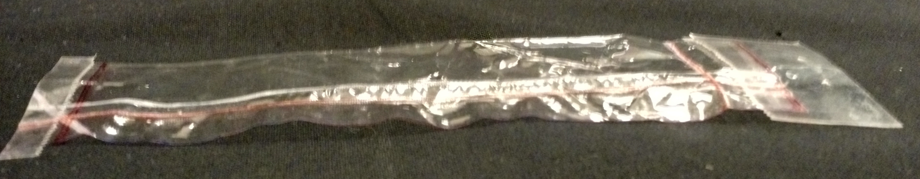
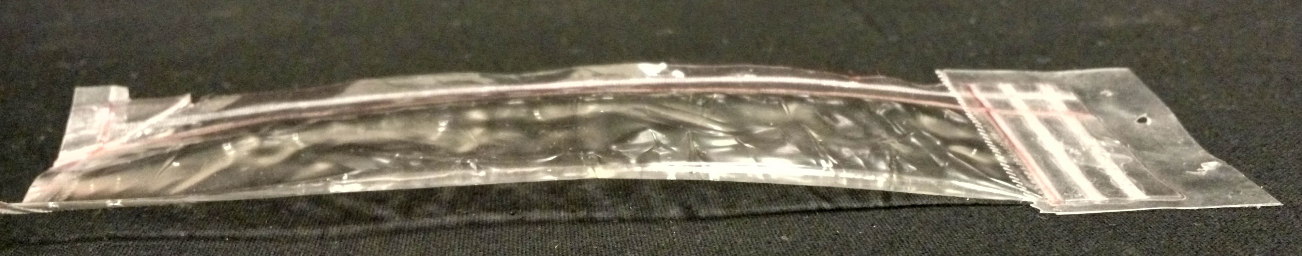
UV Rigidization
Clear Mylar envelope (15 cm x 3cm) injected with UV resin P 600.
The envelope was stretched and placed over a sublimate containing inflatable.
Upon reaching vacuum and completing inflation, the envelope takes the curved shape and it is exposed to UV radiation.
UV radiation takes up the induced curvature and forms a rigid glass like structure in approx. 2.5 hours.
Before inflation
After inflation
Before UV curing
After UV curing

Slide 13
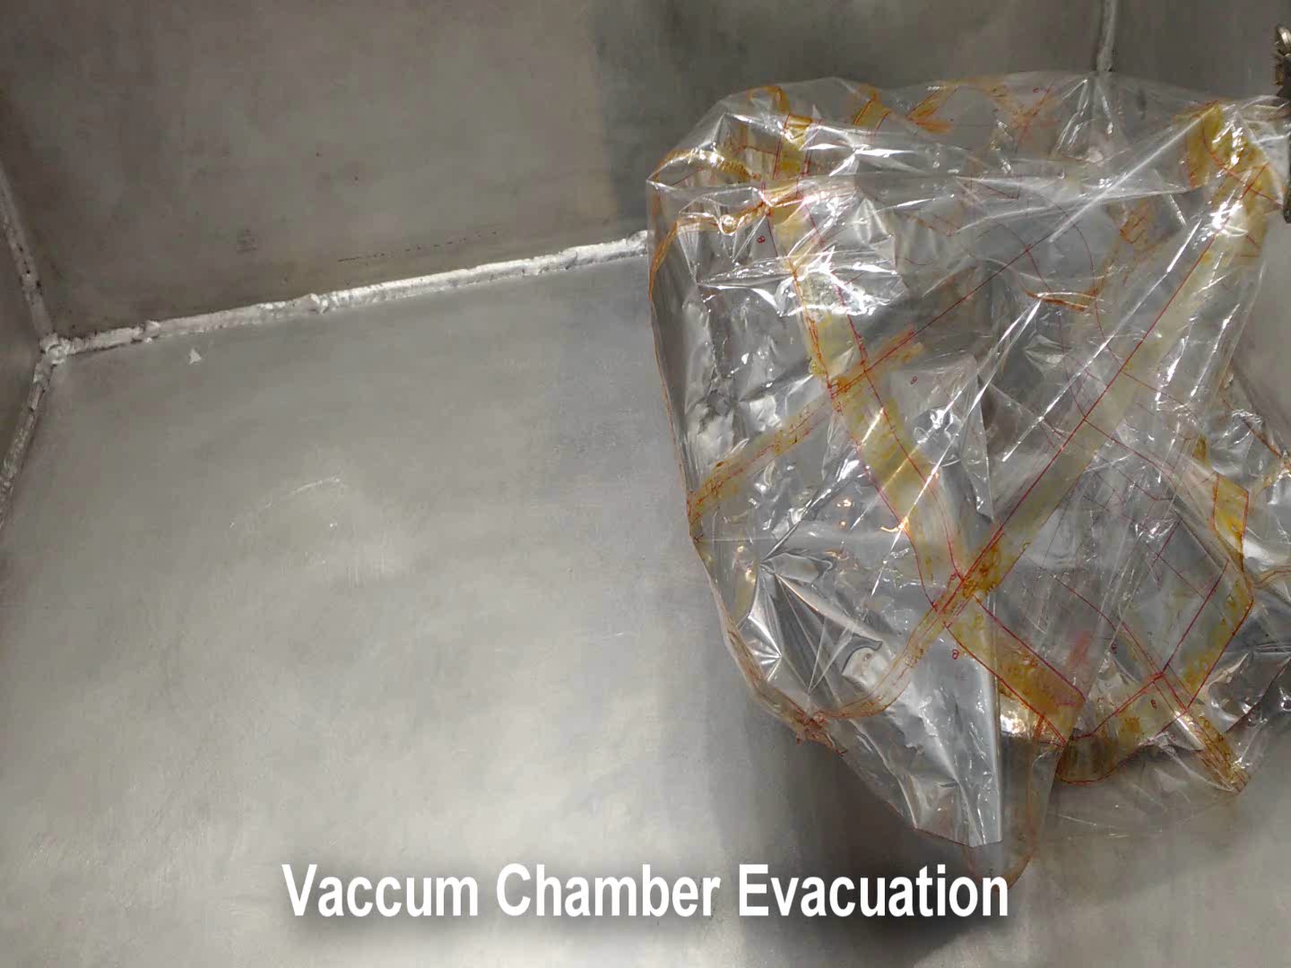
An attempt to rigidize the entire shape

Slide 14
Conclusions and Future Work
This paper describes the effort in developing an X-Band inflatable antenna for CubeSat.
The structural analysis looked at the correlation between pressure and shape, discovering that only a very minimal pressure is necessary to inflate the antenna.
The reflective part of the surface was designed as something less than parabolic.
Two shapes were manufactured and tested at the photogrammetry laboratory
The flat shape presented fewer wrinkles due to the differences in the manufacturing.
The flat reflector was further tested in the anechoic chamber were a directivity of 24.1 dBi was measured (very close to the simulated value of 24.9 dBi).
Regarding inflation, a review of the powders was performed to identify the most appropriate sublimate compound for the antenna and benzoic acid was chosen.
Test in the vacuum showed that it is possible to inflate the antenna using sublimating powder and provided measurements of the pressure differential.
The UV rigidization experiment is a preliminary effort in the process of rigidizing the antenna.
Future work is focused on
  Improving the EM characteristics of the antenna by trying to compensate for the lack of a perfect parabolic curvature on the reflector.
  More studies and experiments on the rigidization process
  A dynamic test to identify the effect of rotation and translation on the antenna structure

Slide 15
Thank you!

