Slide 1
A Scalable Deployable High Gain Reflectarray Antenna - DaHGR
Presented by: P. Keith Kelly, PhD
MMA Design LLC
1

Slide 2
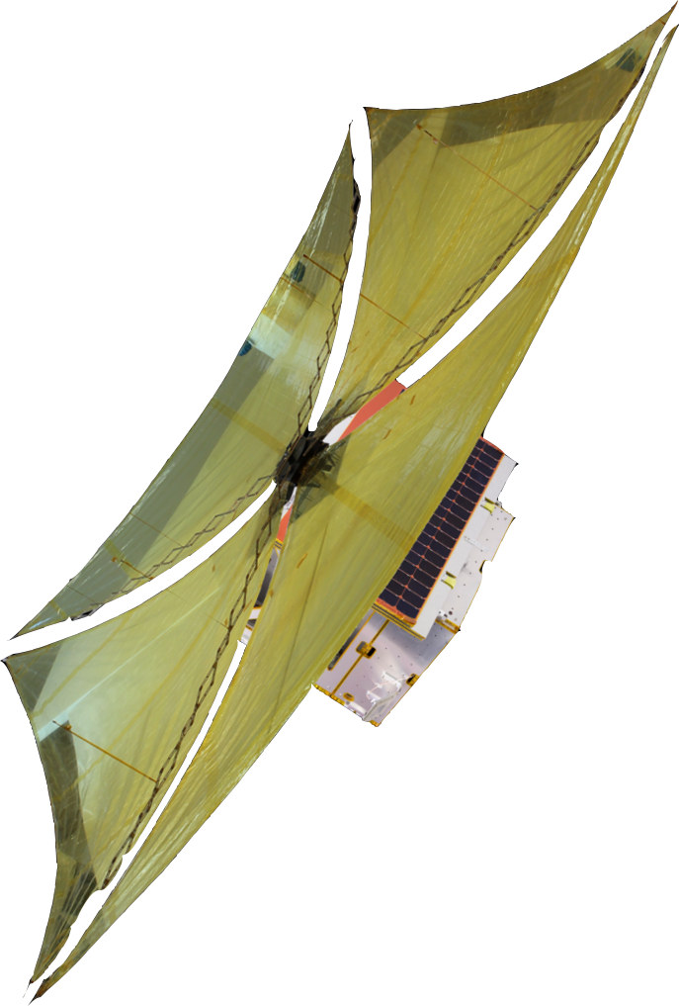

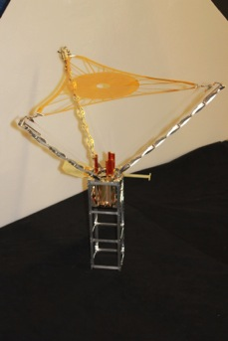

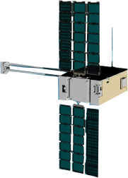
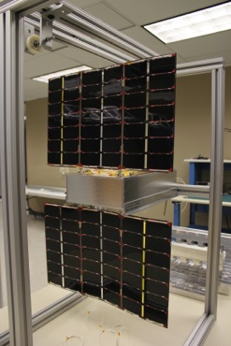

MMA Overview
Facilities in Boulder County Colorado
  10,000 SF facility
  Cleanroom / Flight Lab
  R&D Lab
  Machine Shop
Business Areas
  Solar Array Systems
  Deployable Antennas
  Deployable Apertures and Structures
Products
  HaWK High Performance Solar Arrays
  DaHGR high gain compact antenna
  CubeSat Systems
  dragNET De-orbit Modules
De-orbit System
FalconSat-7 CubeSat
HaWK CubeSat Solar Array
E-HaWK 72W
MMA Boulder Facility

Slide 3
Outline
DaHGR Overview
What is a Reflectarray?
Reflectarray Advantages
DaHGR Performance
Frequency range and Bandwidth
Mission Concepts
DaHGR Heritage/Risk
Conclusions

Slide 4

DaHGR Overview
MMA Design has been developing the DaHGR system under IR&D – multiple patents pending
  Our RF teams has heritage and world class expertise in reflectarray antennas
  MMA has world class deployable structures technologies and expertise
  Three DaHGR 1m to 3m antenna programs started in first quarter 2016
DaHGR is a product that competes with a parabolic wire mesh reflector high gain antenna
  Small stowed volume
  Similar area mass with feed included
  Fewer parts -1/3rd the parts
  Lower cost -1/3 the cost
Uses thin film reflectarray antenna and membrane technologies
  High TRL
  Leverages MMA’s TRL-9 membrane deployment experience
    TRL-9 dragNET De-Orbit system and launch restraints
    TRL-8 FalconSat-7 diffractive membrane deployment
    Flight heritage standoff boom composite tapes
  Multiple frequencies up to Ka-band
Printed reflectarray technology reduces cost and enables >3m² apertures on CubeSats
DaHGR

Slide 5
Deployable High Gain Reflectarray Antenna - DaHGR
Reflectarray Blanket
Assembly
Deployment Structure
Elements
Vehicle Mounted Feed
Stowage Volume
1.5U/m²

Slide 6
What is a Reflectarray?
First described in the 1960’s
1990’s-2000’s inflatable reflectarrays for space
Reflectarray
Collimation over narrow bandwidth (limited by electrical size, radiator properties, number of layers)
Single or multiple flat surfaces conducive to small stowed volume
Parabolic Reflector
Collimation over infinite bandwidth (limited by surface roughness)
Precise parabolic profile requires many physical control features limiting stowed volume/size
Reflectarrays support any polarization and high power

Slide 7
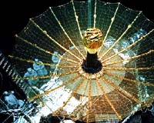
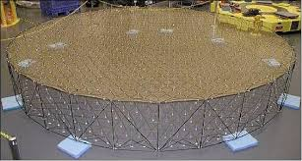
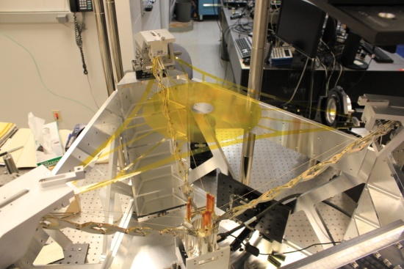
Thin Membrane Reflectarray Advantages
Cost
  Less complex mechanical deployment system
  Lower parts count
  Less touch labor to assemble
Small stowed size
  1 m diameter aperture in a 0.1m X 0.1m X 0.12m (1U) volume
Meeting RMS tolerances with flat membrane surfaces is inherently less difficult than mesh/parabola systems
  Increasing tension improves surface RMS
  RMS vs Membrane thickness and tension
NG AstroMesh
Harris Mesh
Reflector
MMA/USAFA FalconSat-7

Slide 8
DaHGR Mechanical Performance
Areal Compaction: approximately 1.5m²/L
Mass Density: 1.0kg/m² @10m² to 1.6kg/m² @0.78m²
First mode >1 Hz
Low CTE structure
On orbit adjustable feed to reflectarray geometry

Slide 9
Frequency Range and Bandwidth for Small Sats
Aperture sizes in development span 0.8 m to 5 m diameter
Lower frequency limited by electrical size conducive to spatial feeding with minimal spillover losses (~D/λ > 10)
  D=5m, λ=0.5m, lowest frequency is 0.6 GHz
  At smaller electrical size, the deployment methods described support constrained feed antenna architectures.
Highest frequency is limited by features controlling deployed flatness and allowance for Gain and sidelobe degradation
Reflectarrays are inherently band width limited

Slide 10
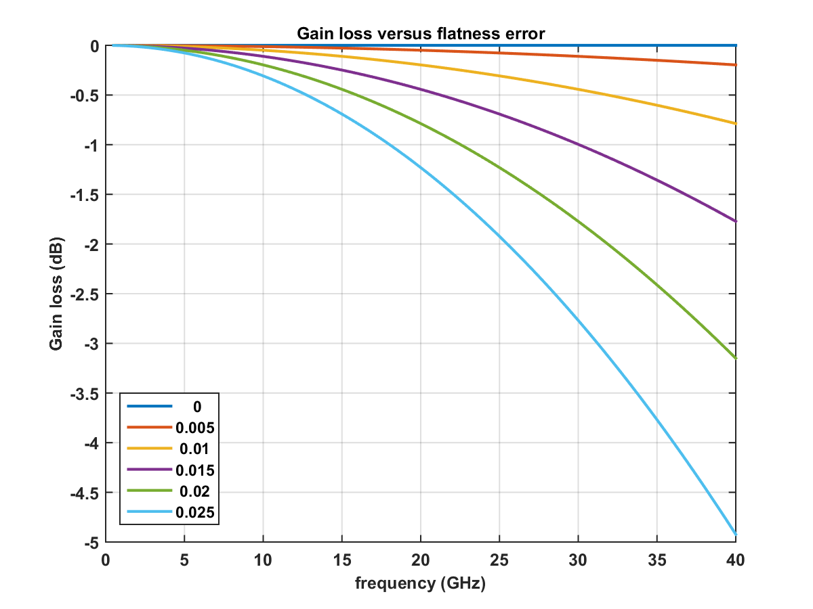
Ruze’s Equation for Reflectors
Active area of research driven primarily by material thickness (membranes and metal).
Current photogrammetry inspections of surfaces showing better than 25 mil rms.
Near term work will quantify performance at X-band; we expect Ka band applications to be viable
mils rms

Slide 11
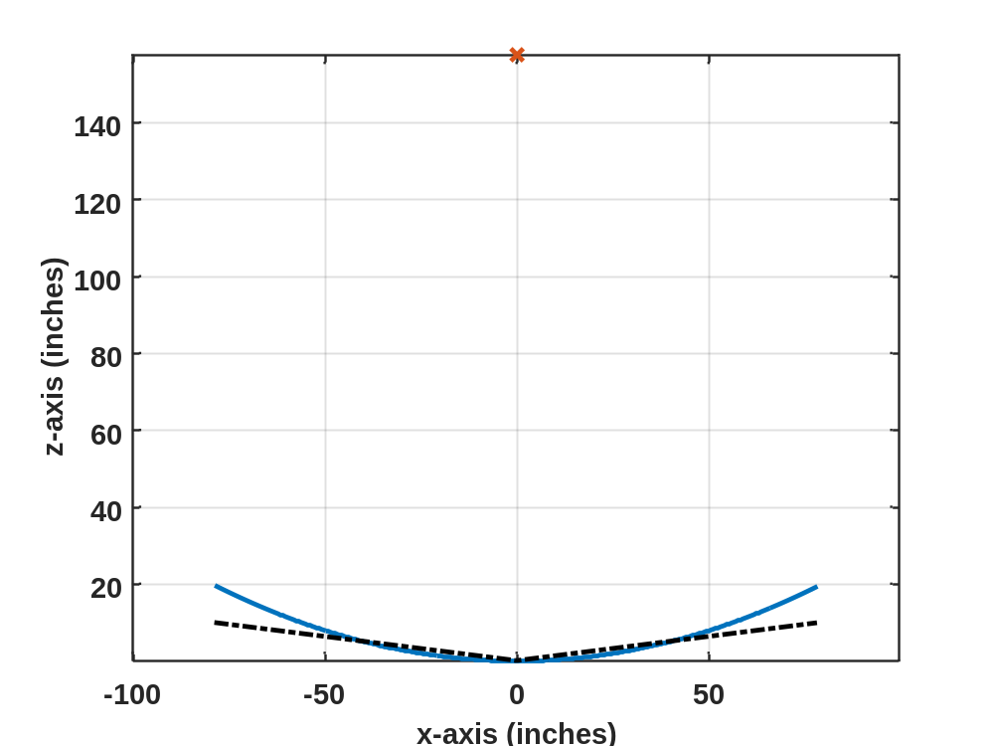
Bandwidth Analysis Method
R_{n}
f
D
Path length variation (Rn) drives bandwidth of the system

Slide 12
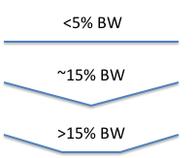
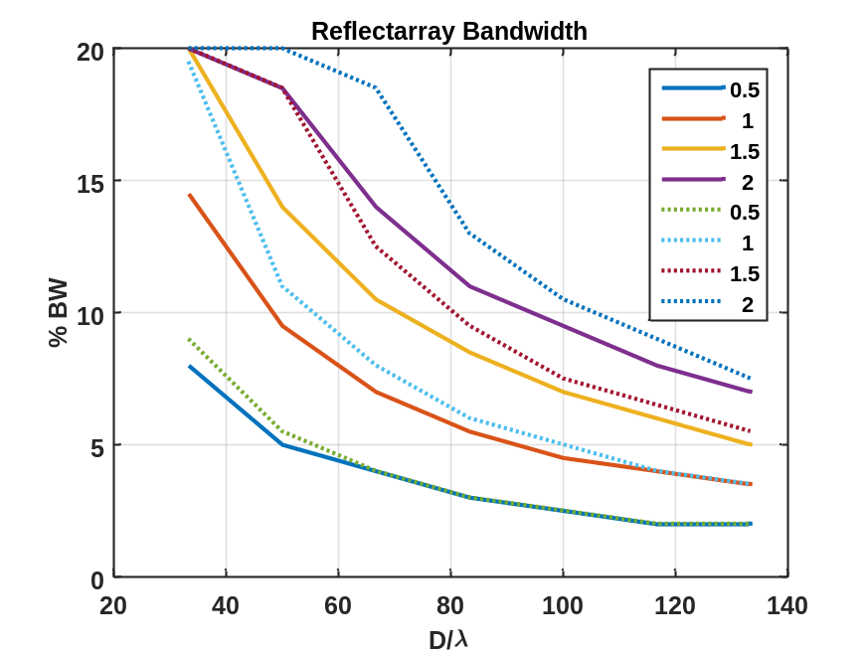
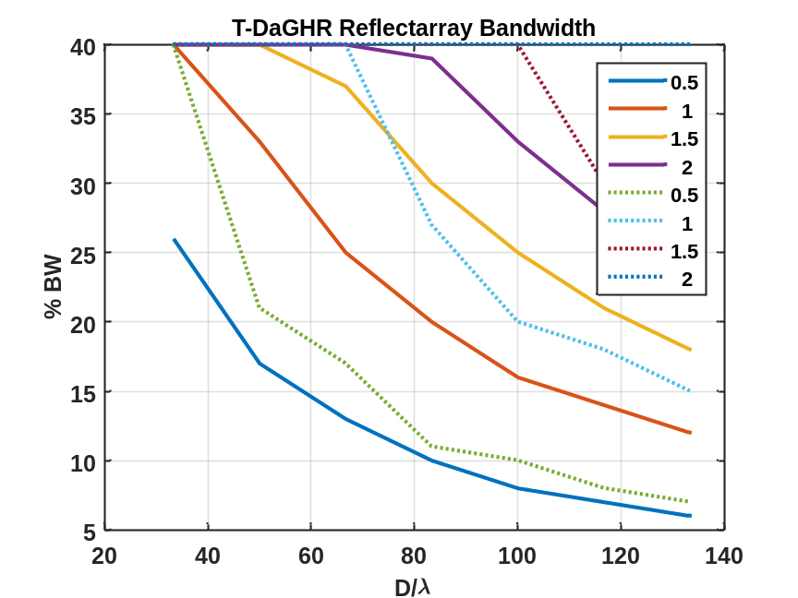
1.0 dB Bandwidth (DaHGR)
Single Facet
Two Facet
Reflectarray Bandwidth
f/D
f/D

Slide 13
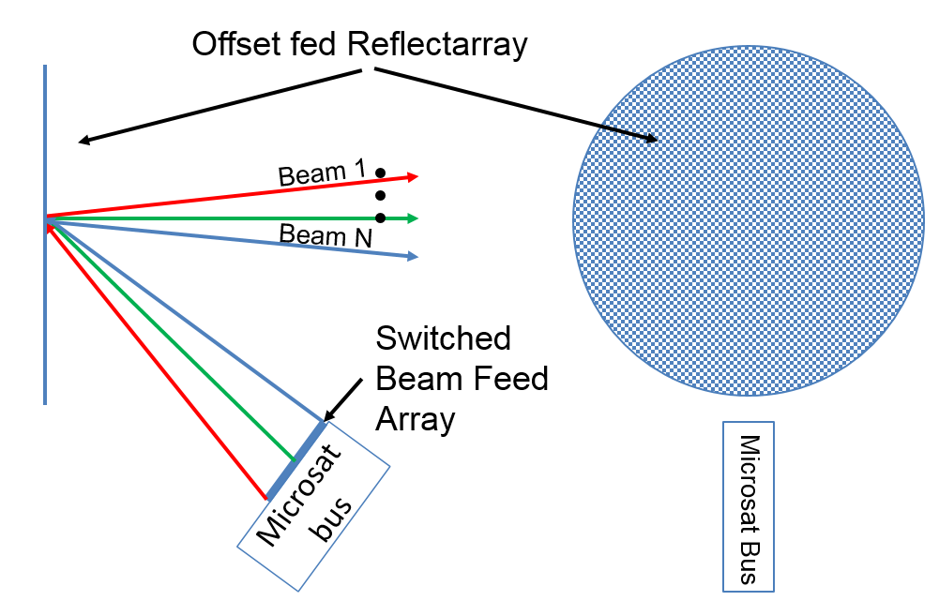
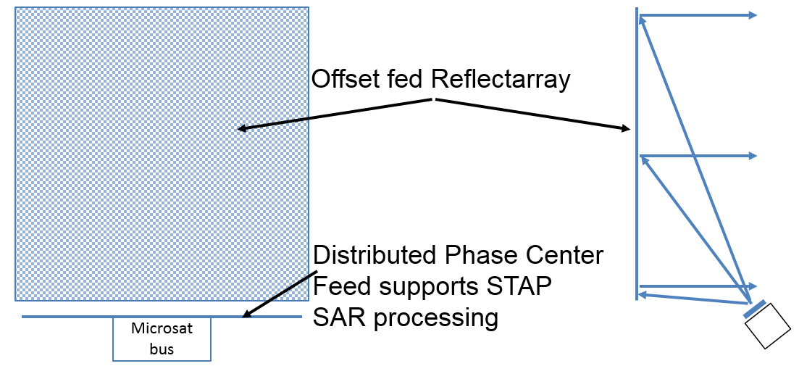
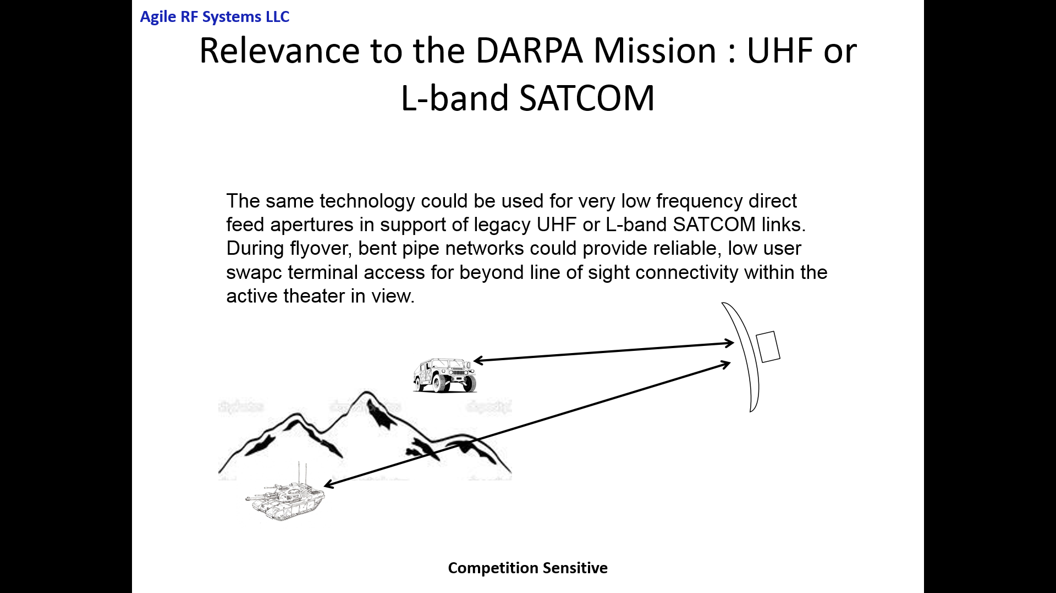
Mission Concepts
SAR/SATCOM
SAR with STAP
Aspect Ratios (H/W)>2 supported
W
H
Over the Horizon Comms

Slide 14
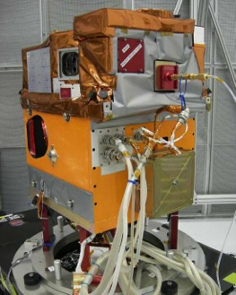
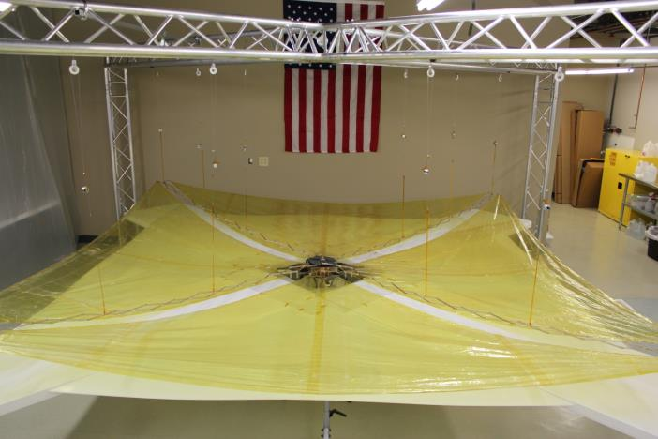
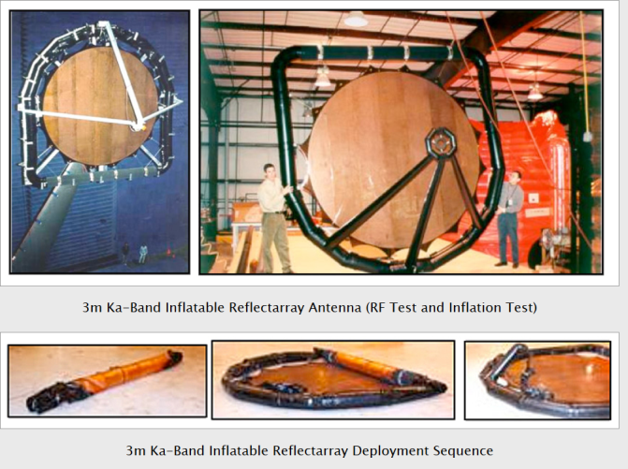
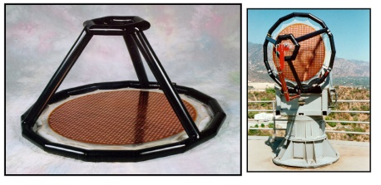
DaHGR Heritage/Risk
Combine two high TRL (9 and 7) to produce a high gain and cost effective antenna
The deployment system is based on the 14m² Flight heritage dragNet de-orbit system
Deployable thin film Ka and X band reflectarrays have been built and tested by NASA and its contractors
  They used inflatables to deploy the array
  The mechanical system in DaHGR is more robust
14m² dragNet De-orbit Module
1m X Band
3m Ka Band

Slide 15
Conclusion
Compared to conventional parabolic antennas-DaHGR is:
  1/3 the cost
  1/5th the volume
  1/3 the parts
Reflectarrays enable new/expanded missions for SmallSats:
  Expanded GEO communications
    2-4x RF aperture
    Expanded “real estate” for secondary payloads
  Enable High resolution/SmallSat DoD SAR/SIGINT missions and high capacity communications platforms
  Launch on ESPA, Minotaur, Pegasus, Taurus, Alasa, SuperStrypi, etc.
System TRL-9 expected in next 18-24 months on a CubeSat or other mission

