Slide 1
Interplanetary Small Satellite Conference
MIT KitCube
Angie Crews; Max Khatsenko; Prof. Kerri Cahoy
April 25th, 2016

Slide 2
Outline
Team
Mission Overview
Concept of Operations
Spacecraft Overview
Lasercom Payload
Propulsion Subsystem
Challenges
Vision
Questions

Slide 3
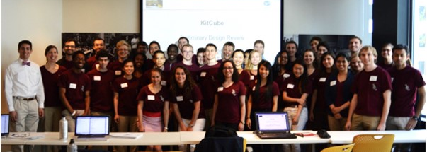
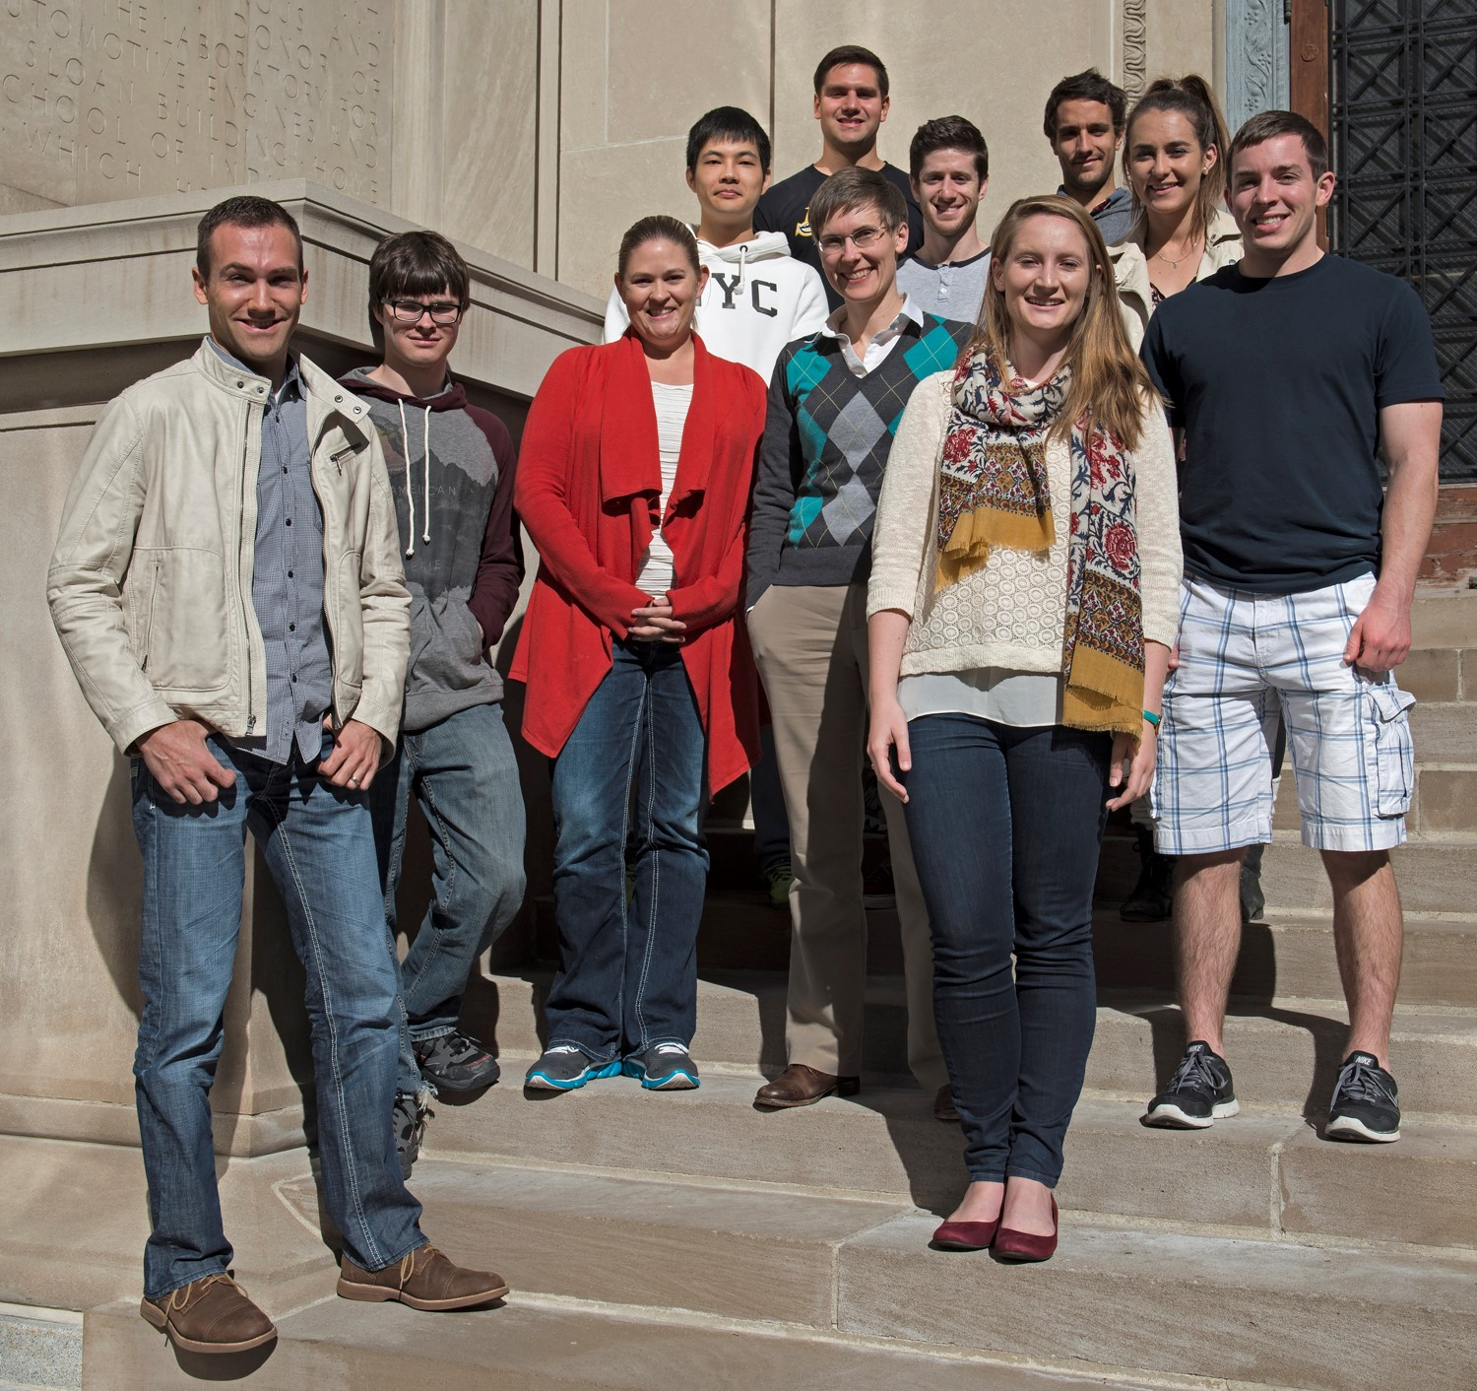
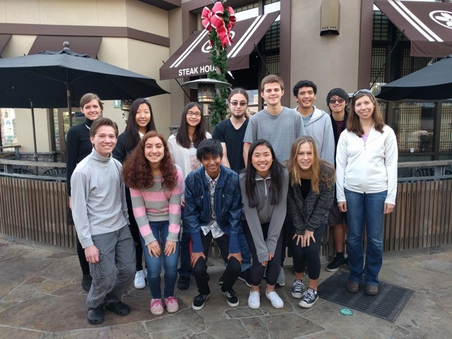
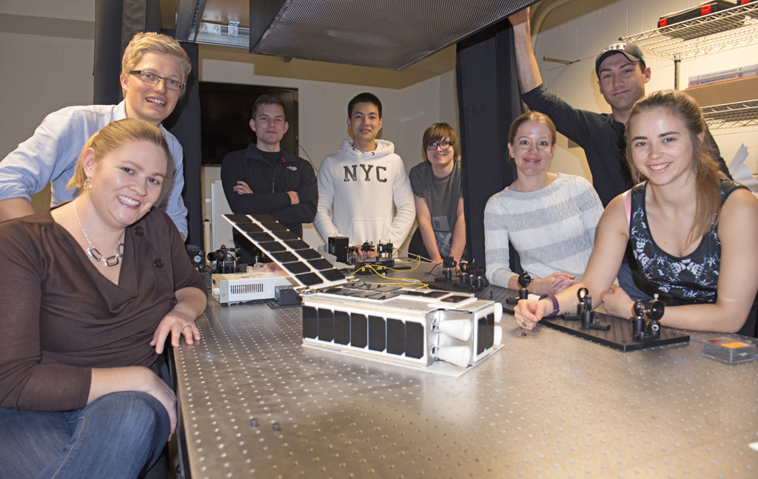
Student Team
Credit: MIT KitCube
Credit: Bill Litant
Spring 2015: KitCube began as a undergrad and grad space systems engineering design course
Fall 2015: KitCube continued as a grad satellite engineering course
Credit: Project Selene
Spring 2016: KitCube has over 45 active team members, many continuing from previous semesters
Fall 2015: KitCube joined by Project Selene students in Pasadena, CA
Credit: Bill Litant

Slide 4
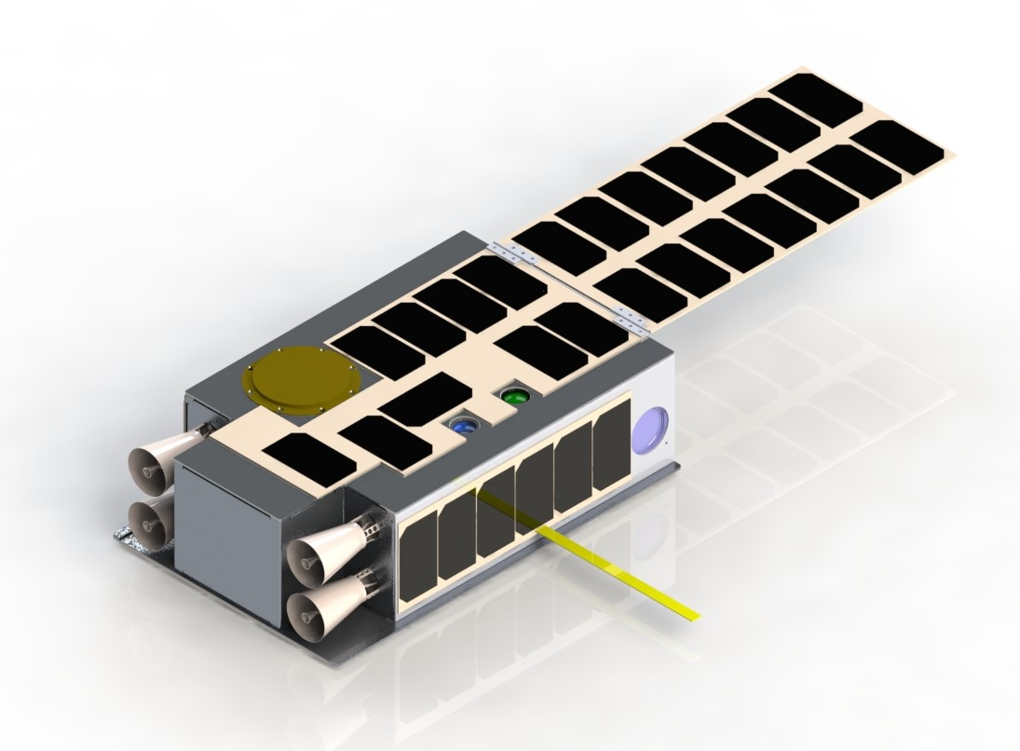
Mission Overview
  Video: https://vimeo.com/153068013
KitCube is a student-built, industry-funded 6U CubeSat that will fly to the moon and demonstrate:
  Green monopropellant propulsion
  Compact, power efficient free space optical communications with fine pointing capabilities
Part of NASA’s CubeQuest Challenge
  Top 3 in GT-4 will get a SLS launch to the moon
  KitCube has placed 2nd in GT-1 and GT-2. GT-3 will be Aug 2016, and GT-4 will take place Feb 2017
Credit: Max Khatsenko 02/16

Slide 5
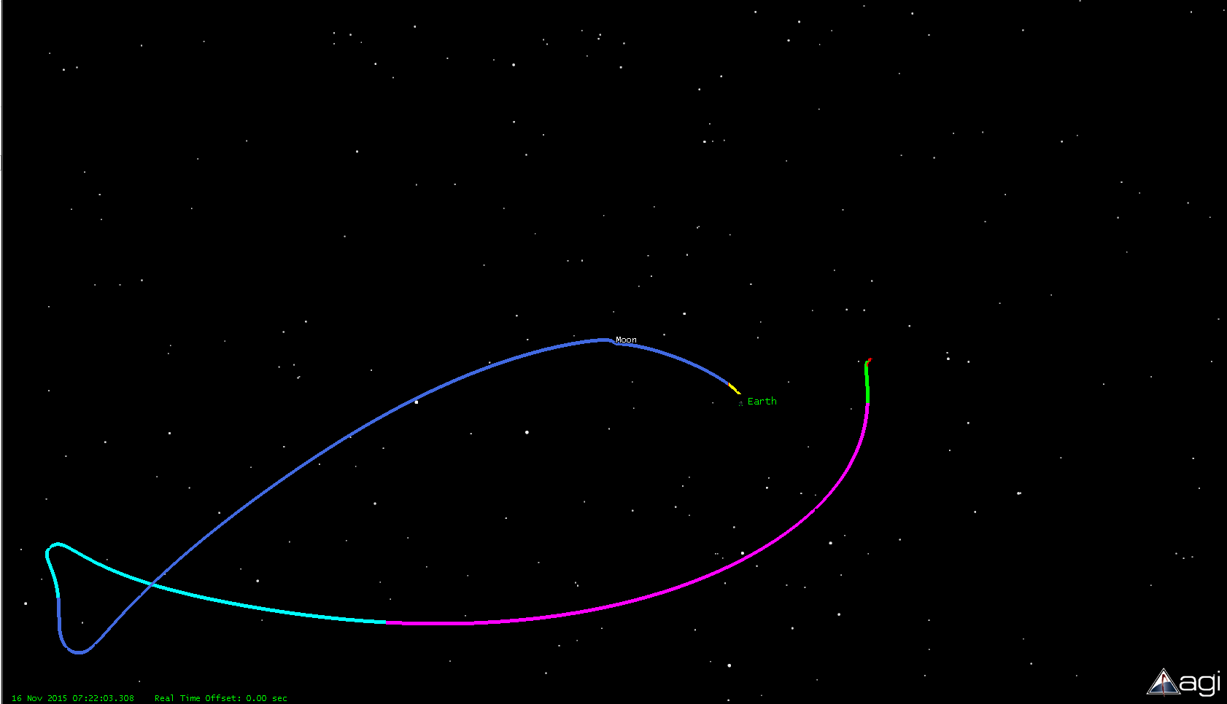
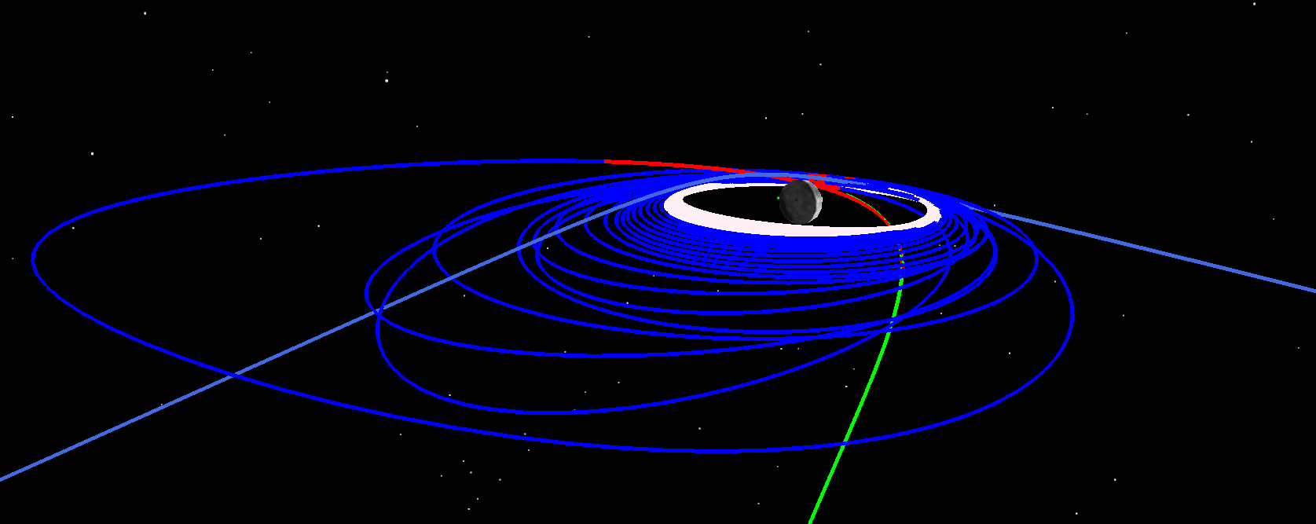
Concept of operations
0 | Separation & Boot (4-8 hrs after T0)
1 | Detumbling, Deployer Actuation, System Checkout (<8 hrs after separation)
2 | Outbound to Exterior Weak Stability Boundary (74 days)
3 | Falling Back to the Moon for Ballistic Capture (65.5 days)
4 | Corrected Ballistic Capture Trajectory (17 days)
5 | Inside Lunar Sphere of Influence, Targeting Periselene (23 hrs)
6 | Lunar Capture Maneuver, 150 m/s (9.7 hrs)
7 | Altitude Reduction, 180 m/s total (45 days)
8 | Final Orbit & Nominal Operations (204 days after separation)
Day 159
7
6
8
Day 204
Moon Flyby
2
5
1
0
Exterior Weak Stability Boundary (WSB) Solution^{[1]}
3
4
Distance from Earth:
1,721,796 km
Credit: Max Yates 02/16
Image credit: KitCube Team

Slide 6
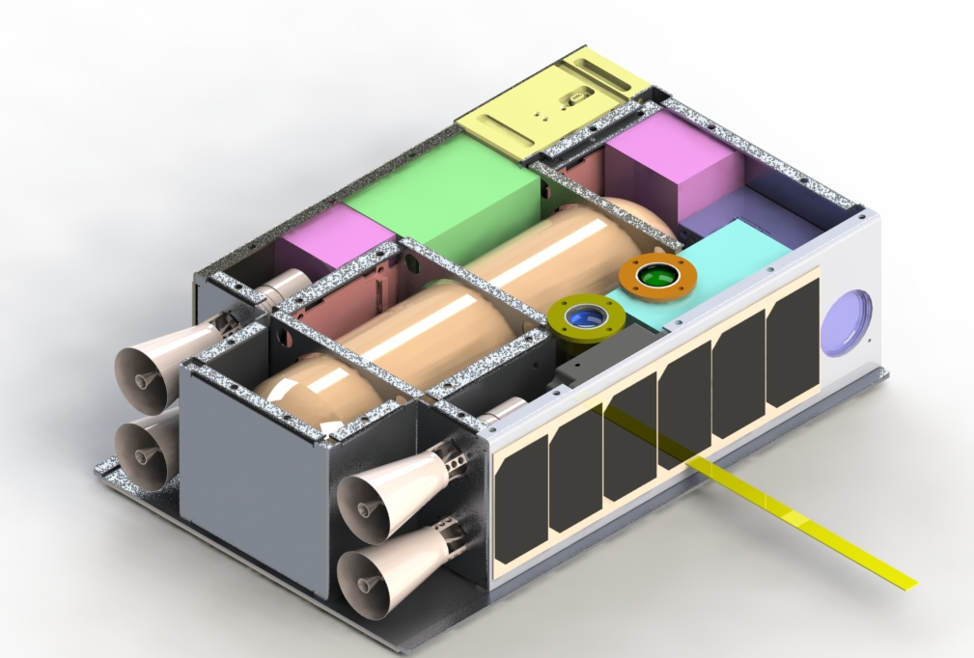
Spacecraft Overview
Communications: X band (in flux) & UHF radios, with lasercom
Pointing: 3-axis controlled with reaction wheels and star tracker
Power: Solar panels & batteries, with deployable 6U panel
Propulsion: Miniature green monopropellant thrusters (in flux)
Custom designed avionics & aluminum structure
Credit: Max Khatsenko 02/16

Slide 7
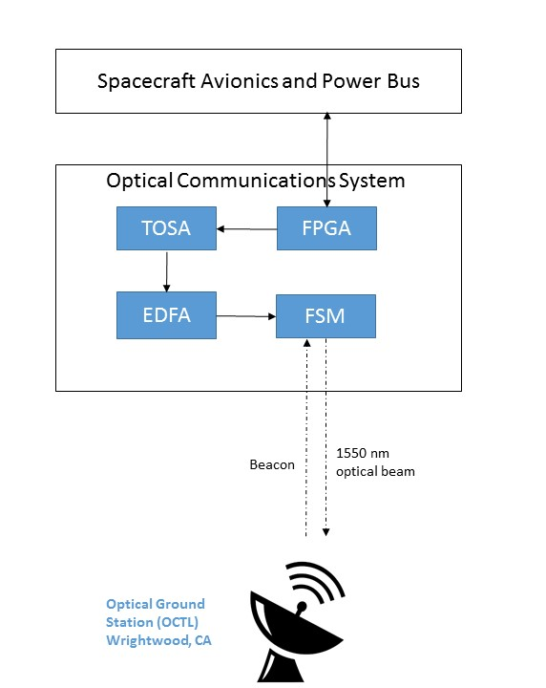
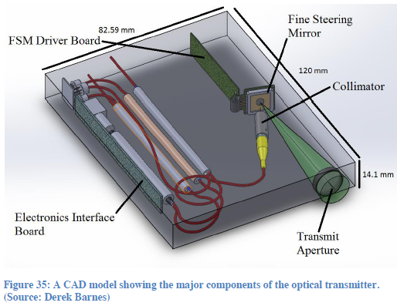
Laser Communications
Master Oscillator Power Amplifier (MOPA) configuration with custom 1550 nm Fiber Laser Module and optical fiber collimator
Volume: ~0.5U, Mass ~0.91 kg, Tx optical output power ~1.2W
Credit: Derek Barnes
Credit: Angie Crews

Slide 8
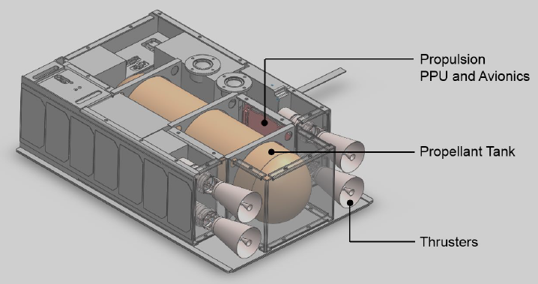
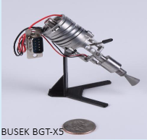
Green Monopropellant
AF-M315E: Stable, low-toxic propellant developed by the AFRL
4x Busek BGT-X5 as current baseline
Momentum desaturation using canted thrusters (2⁰)
Credit: Max Khatsenko 02/16
Nominal Thrust (mN) ^{[2]} | 500, throttle-able
Specific Impulse (s) ^{[2]} | 220-225 nominal at 400 psi feed
Propulsion Mass (kg) | 5.00 wet, 2.95 dry
Expected Delta-V (m/s) | 362.5
Duty Cycle | 2.7% (5 seconds on, 3 minutes off)
Number of Maneuvers | 23 (81,414s total burn duration)
Source: Busek 2016 ^{[2]}

Slide 9
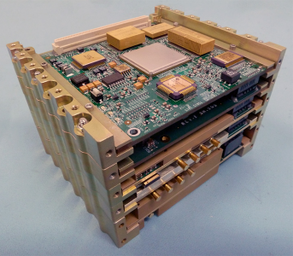
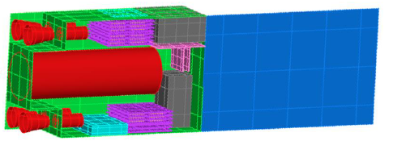
Challenges
Iris radio
  Size, cost, and availability timeline
Propulsion
  Low propellant margin & high cost
Navigation
  Exact SLS drop-off unknown
Thermal management
  Thrusters catalyst heating
Cost
  Fundraising only goes so far
Team Transitions
Credit: NASA ^{[3]}
KitCube Thermal Desktop Model, Credit: Pierre Bertrand 02/16

Slide 10
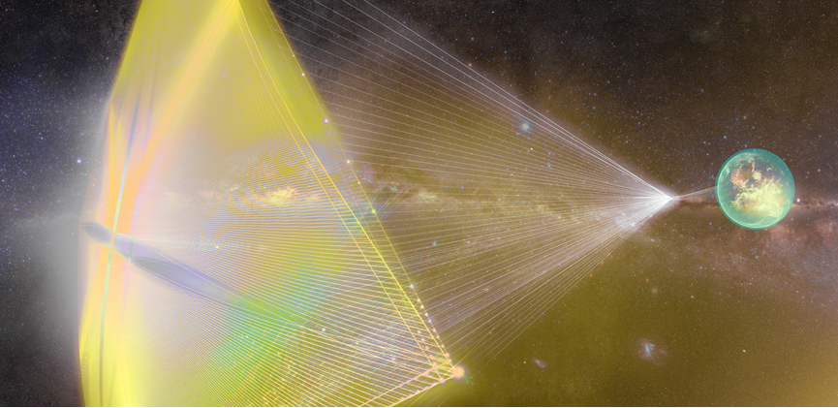
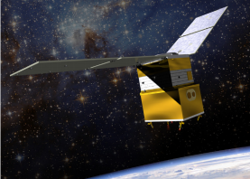
Vision
Mission enabler for small satellite missions that require improved pointing and lasercom capabilities
  BridgeSat- optical communications
  SkyBox- high data rate transfer
  CHOMPTT- optical time transfer
  StarShot- precise pointing and lasercom
CubeSat green monopropellant demonstration
  Low-cost interplanetary missions
  Constellations enabler
  GPIM* mission in late 2017 ^{[4]}
Training next generation of space engineers!
Source: Breakthrough Initiatives 2016 ^{[4]}
Source: NASA 2013 ^{[5]}
* Green Propellant Infusion Mission

Slide 11
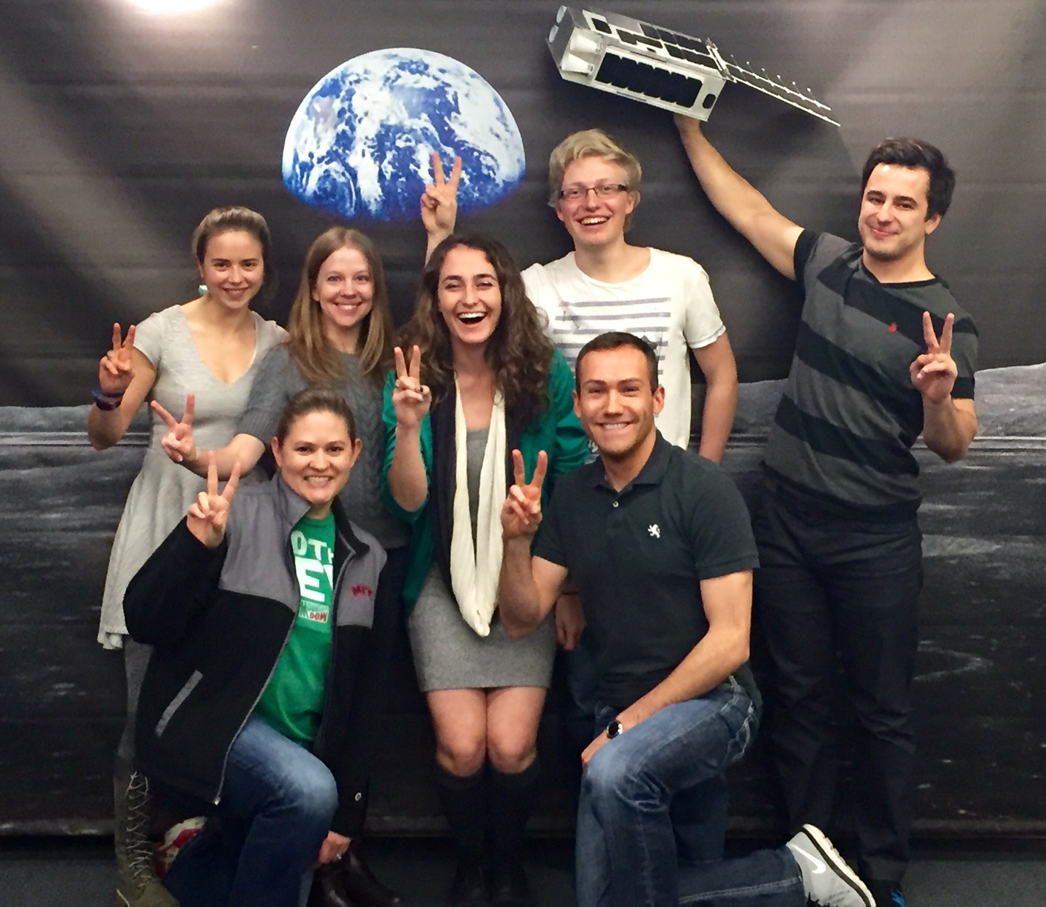






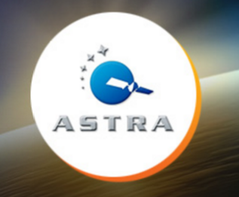



Questions
Kitcube.mit.edu
Facebook: MIT KitCube​
Twitter: @KitCubeQuest

Slide 12
References
[1] Yates, Max. Boundary(WSB) Solution assumptions: BGT-X5 Thrusters (2.7% Duty Cycle, ISP 220 sec), and S/C Mass: 11 kg dry + 2.2 kg fuel. 02 2016.
[2] Busek Space Propulsion and Systems, “BGT-X5 Green Monopropellant Thruster: 0.5N green monopropellant thruster delivers 565N-s in 1U CubeSat volume for high performance space applications,” Datasheet Rev D, 2016.
[3] NASA, “Iris V2 CubeSat Deep Space Transponder,” 07 2015.
[4] Breakthrough Initiatives, “StarShot,” 04 2016. http://www.breakthroughinitiatives.org/
[5] NASA, “Green Propellant Infusion Mission Project,” 03 2016.

