Slide 1
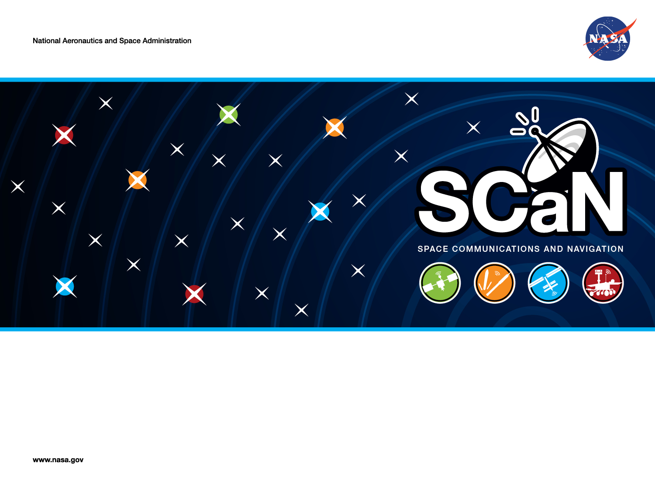
Tools for Identifying OMSPA Opportunities in the DSN
Bruce E. MacNeal, Ph.D. and David P. Heckman, Ph.D.
Jet Propulsion Laboratory, California Institute of Technology
Interplanetary Small Satellite Conference
Santa Clara University
April 28, 2015
Copyright 2015. California Institute of Technology. Government sponsorship acknowledged.

Slide 2
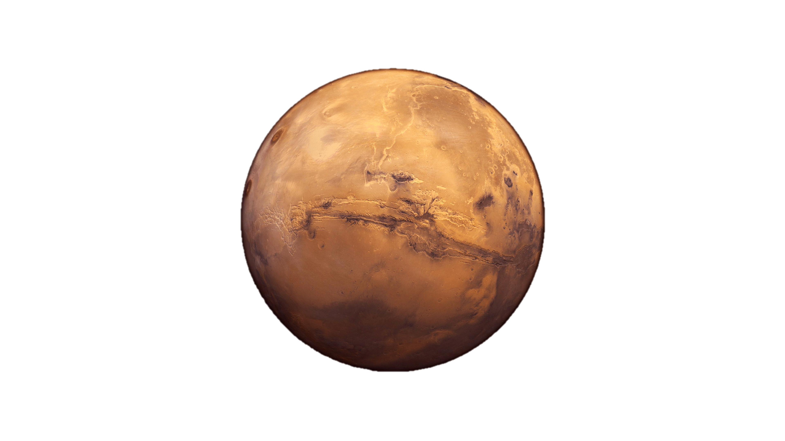
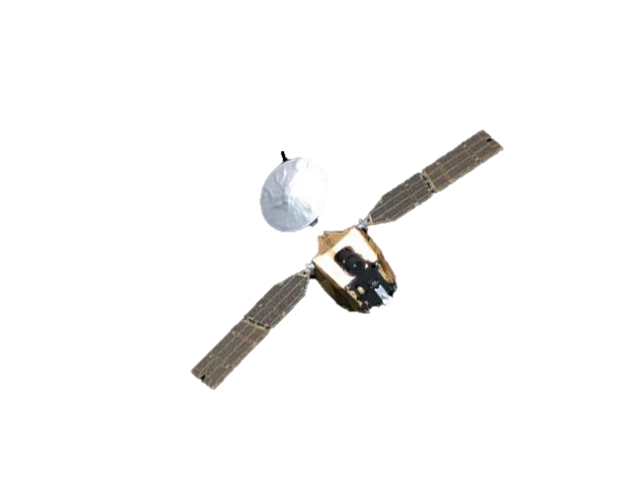

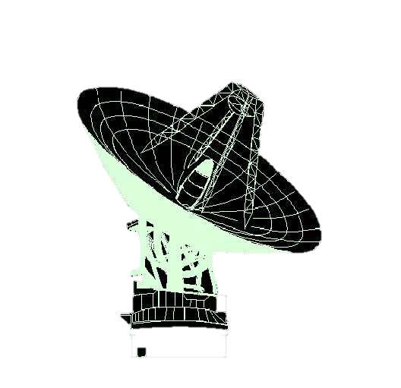
    Identifying OMSPA Opportunities for the Demonstration
The Problem
Must find precise time periods (± 1 min) when:
MRO (host) is scheduled to be tracked by DSN
M010 is in the downlink tracking beam for MRO
MO10 is scheduled to be tracked by DSN on a different antenna (and is therefore actually transmitting)
MRO
MRO
“Host” Spacecraft
Mars Odyssey
Mars Odyssey
(MO10)
In operational OMSPA, this link does not exist
Approach
Correlation of Time Data from DSN schedules and user ephemeris files
  current, accurate tracking schedules
  good knowledge of the host and OMSPA spacecraft positions

Slide 3
Solution Data Flow
User ephemeris files
ACCURATE location of spacecraft with time
SPS Database
(JPL)
Secure online database of current DSN tracking schedules
BIPS Tool
MATLAB
Latest tracking schedules for Host and OMSPA spacecraft
EXCEL file
EXCEL file
7-DSC
Simultaneous view periods (including occultation) for host and secondary spacecraft
EXCEL VBA
Accurate start/stop times when three demonstration conditions are met

Slide 4
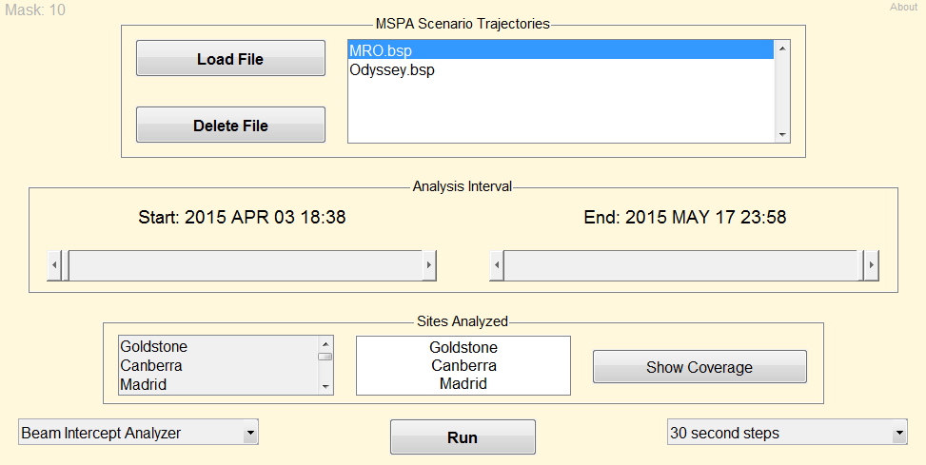
    Beam Intercept Planning System (BIPS)
    Tool Startup Interface
BIPS Startup Interface
Trajectory files loaded and scenario times set up here.
MRO
“Host” Spacecraft
Mars Odyssey
BIPS contains several tools and solvers. Focus is on the animated beam-intercept analyzer and the 3-D scenario animator.
Other features include:
OMSPA statistical metrics
Orbit parameter plotting & trajectory file diagnostics
Interactive bar plotting of OMSPA metrics over time
Interactive coverage analyzer

Slide 5
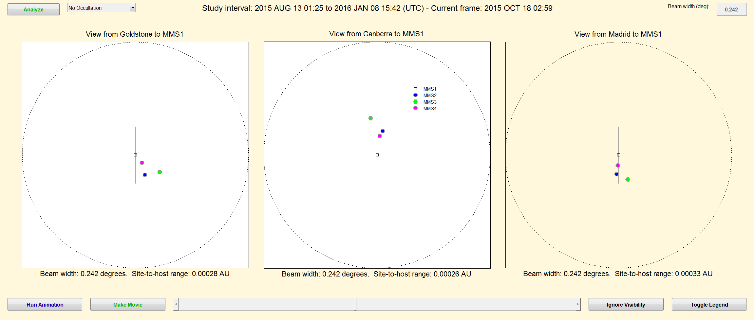
    Beam Intercept Planning System (BIPS)
    MMS Example Of Tool Ops
Analyze with or without occultation effects. “Mars occultation” used for Mars-orbiting scenarios.
In this MMS mission example, the “host” is the square (MMS 1). Colored dots represent the “opportunists” (MMS 2, 3, & 4.)
Set beamwidth value. Mousewheel scrolling changes it on the fly during animation for instant feedback!
MRO
optional legend
The beamwidth is always the full circle diameter. Dot motions scale accordingly.
“Host” Spacecraft
Mars Odyssey
MMS 2, 3, & 4
Axis pane shows white when the site has geometric visibility of the host.
Goldstone and Canberra simultaneous at 2015 OCT 18 02:59. No view from Madrid.

Slide 6
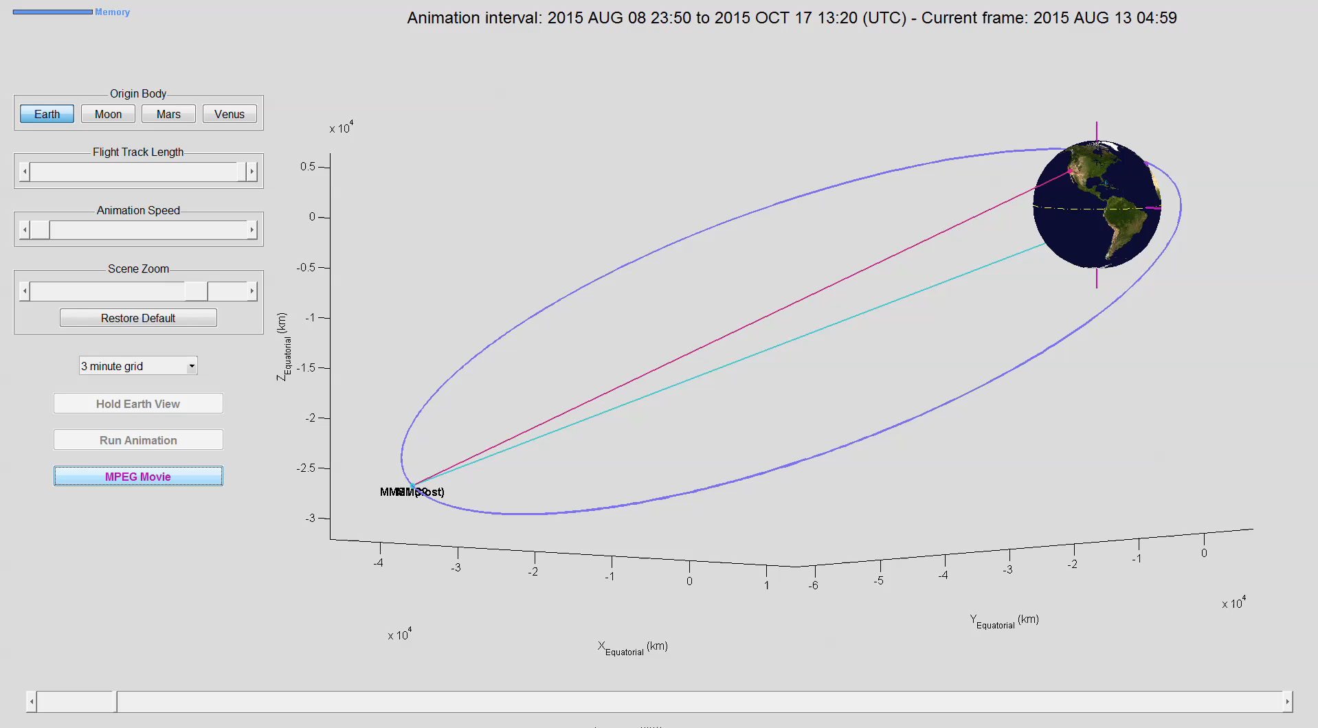
    Beam Intercept Planning System (BIPS)
    MMS Example Mission Orbits
MMS uses highly eccentric orbits. The apparent angular spacing between the spacecraft grows large near perigee as viewed from the Earth’s surface. Animation is to-scale:
MRO
Plotted at this scale, the 4 spacecraft remain a tight group most of the time.
“Host” Spacecraft
Mars Odyssey
From Earth, the 4 spacecraft appear more spread-out here.

Slide 7
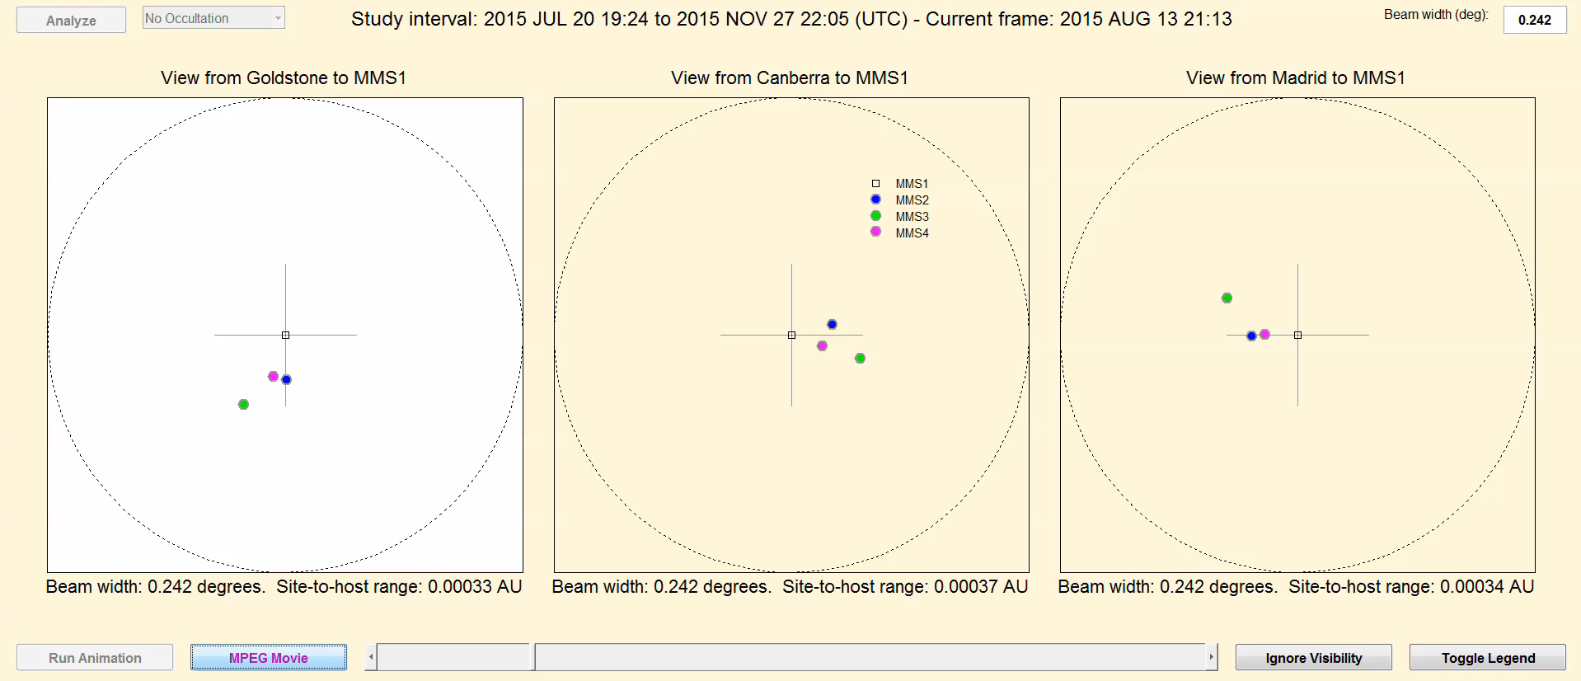
    Beam Intercept Planning System (BIPS)
    MMS Example Animation
The beam intercept motion animator applied to the MMS trajectories, with MMS 1 the “host” spacecraft. Beamwidth set to .242 degrees (S-Band, 34m antenna).
MRO
“Host” Spacecraft
Mars Odyssey

Slide 8
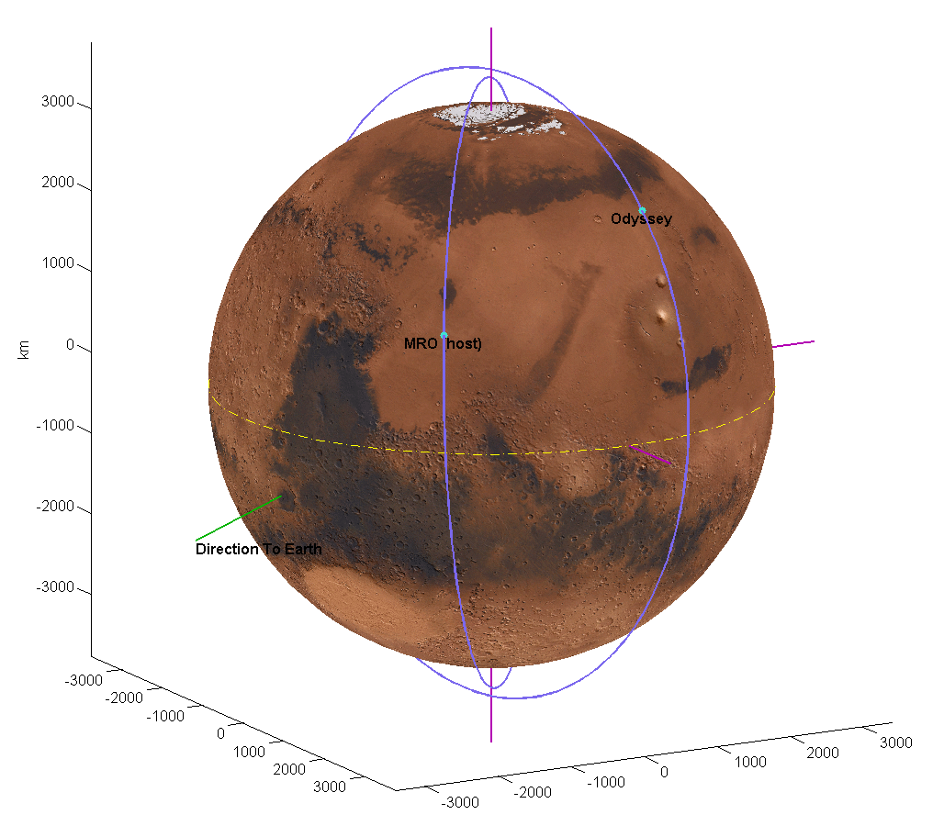
    OMSPA Demonstration:
    MRO and Mars Odyssey
MRO-Odyssey Orbits (Typical)
MRO
2015 APR 27 22:48 (UTC)
At all times, 34m X-Band beam width is much larger than orbits, so the spacecraft are always “in beam”
But
Both spacecraft are periodically occluded by planet, depending on season
Occlusion is modeled in BIPS
Signal outage timing used to check accuracy
Odyssey (larger orbit)
MRO
“Host” Spacecraft
Mars Odyssey
Direction to Earth

Slide 9
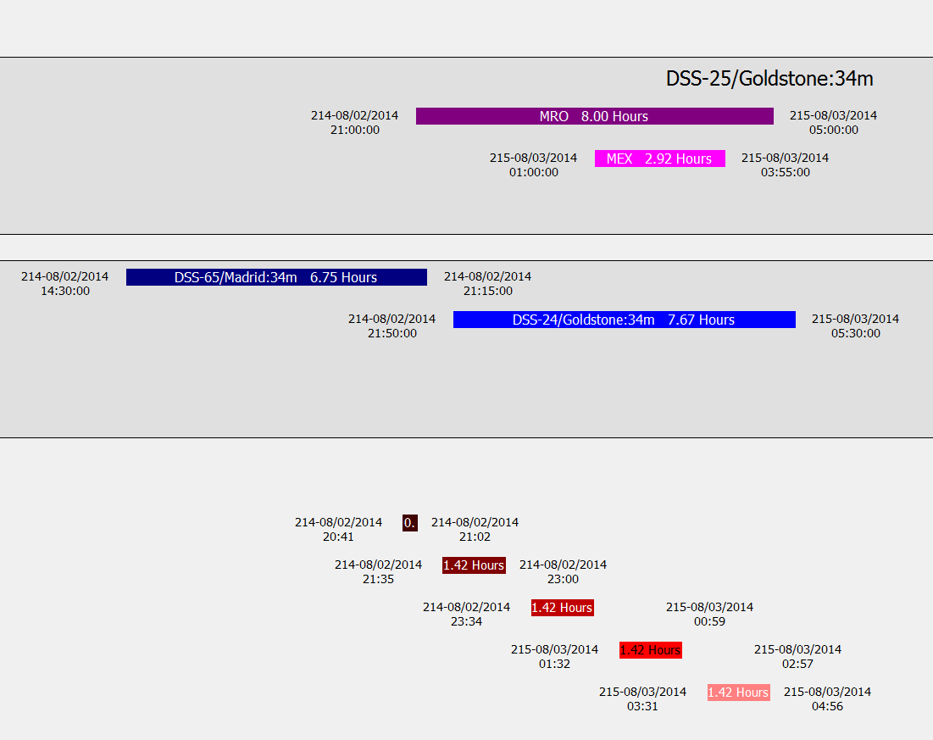
7-Day Schedule Cross-comparison Tool (7-DSC)
Results: Viable recording periods are identified to within one minute
SPS
Scheduled Host Tracking: MRO is MSPA’d with a third spacecraft, Mars Express
1. MRO is tracked
Scheduled Secondary Tracking: MO10 is tracked first in Madrid and then later at Goldstone
SPS
3. MO10 is tracked on a separate antenna
BIPS
2. MRO is in beam and not occluded
Several 1.5-hour periods are available
DOY-Date
hh:mm
With very fine time steps in BIPS, occultation times are accurate to about 10 seconds
Includes ≈ 9 min light time

Slide 10
    Conclusions and Recommendations
This approach provides recording windows for OMSPA with adequate accuracy
    Additional demonstrations needed with real cubesat users
Transition to “production” tools for Mission Users.
May involve:
    Online interfaces or tool executables
    Ephemeris file libraries

