Slide 1
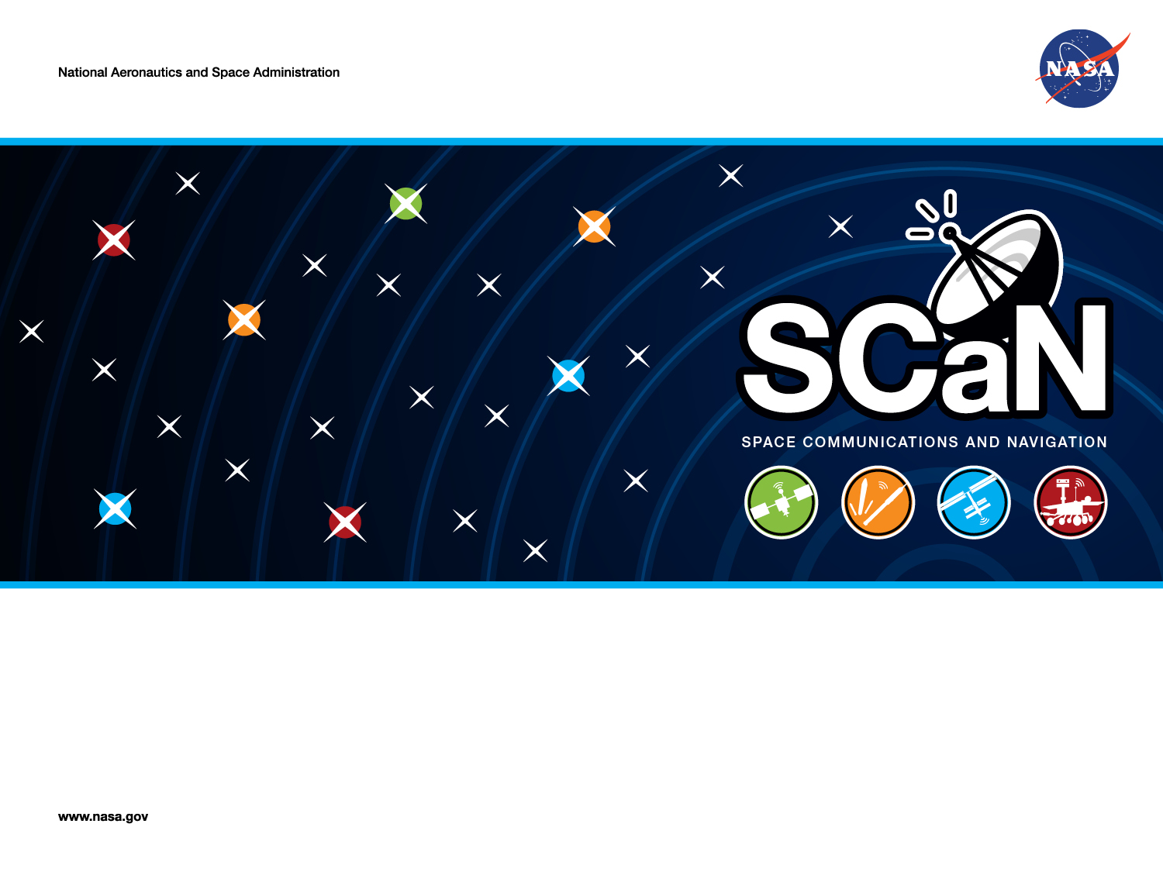
Opportunistic MSPA: An Overview of the Proof-of-Concept Demonstration
Douglas S. Abraham, Susan G. Finley, David P. Heckman, Norman E. Lay, Cindy M. Lush, and Bruce E. MacNeal
Jet Propulsion Laboratory, California Institute of Technology
Interplanetary Small Satellite Conference
Santa Clara University
April 28, 2015
Copyright 2015. California Institute of Technology. Government sponsorship acknowledged.

Slide 2
Topics
Review of OMSPA Concept
Demo Purpose & Objectives
Demo Methodology Overview
OMSPA Demonstration Tools/Systems
  Beam Intercept Planning System (BIPS)
  7-Day Schedule Cross-comparison Tool (7-DSC)
  VLBI Science Receiver (VSR)
  Server Repository (“lilypond”)
  OMSPA Software Demodulator (OSD)
Results
Conclusions & Recommendations
For Further Information …
1

Slide 3
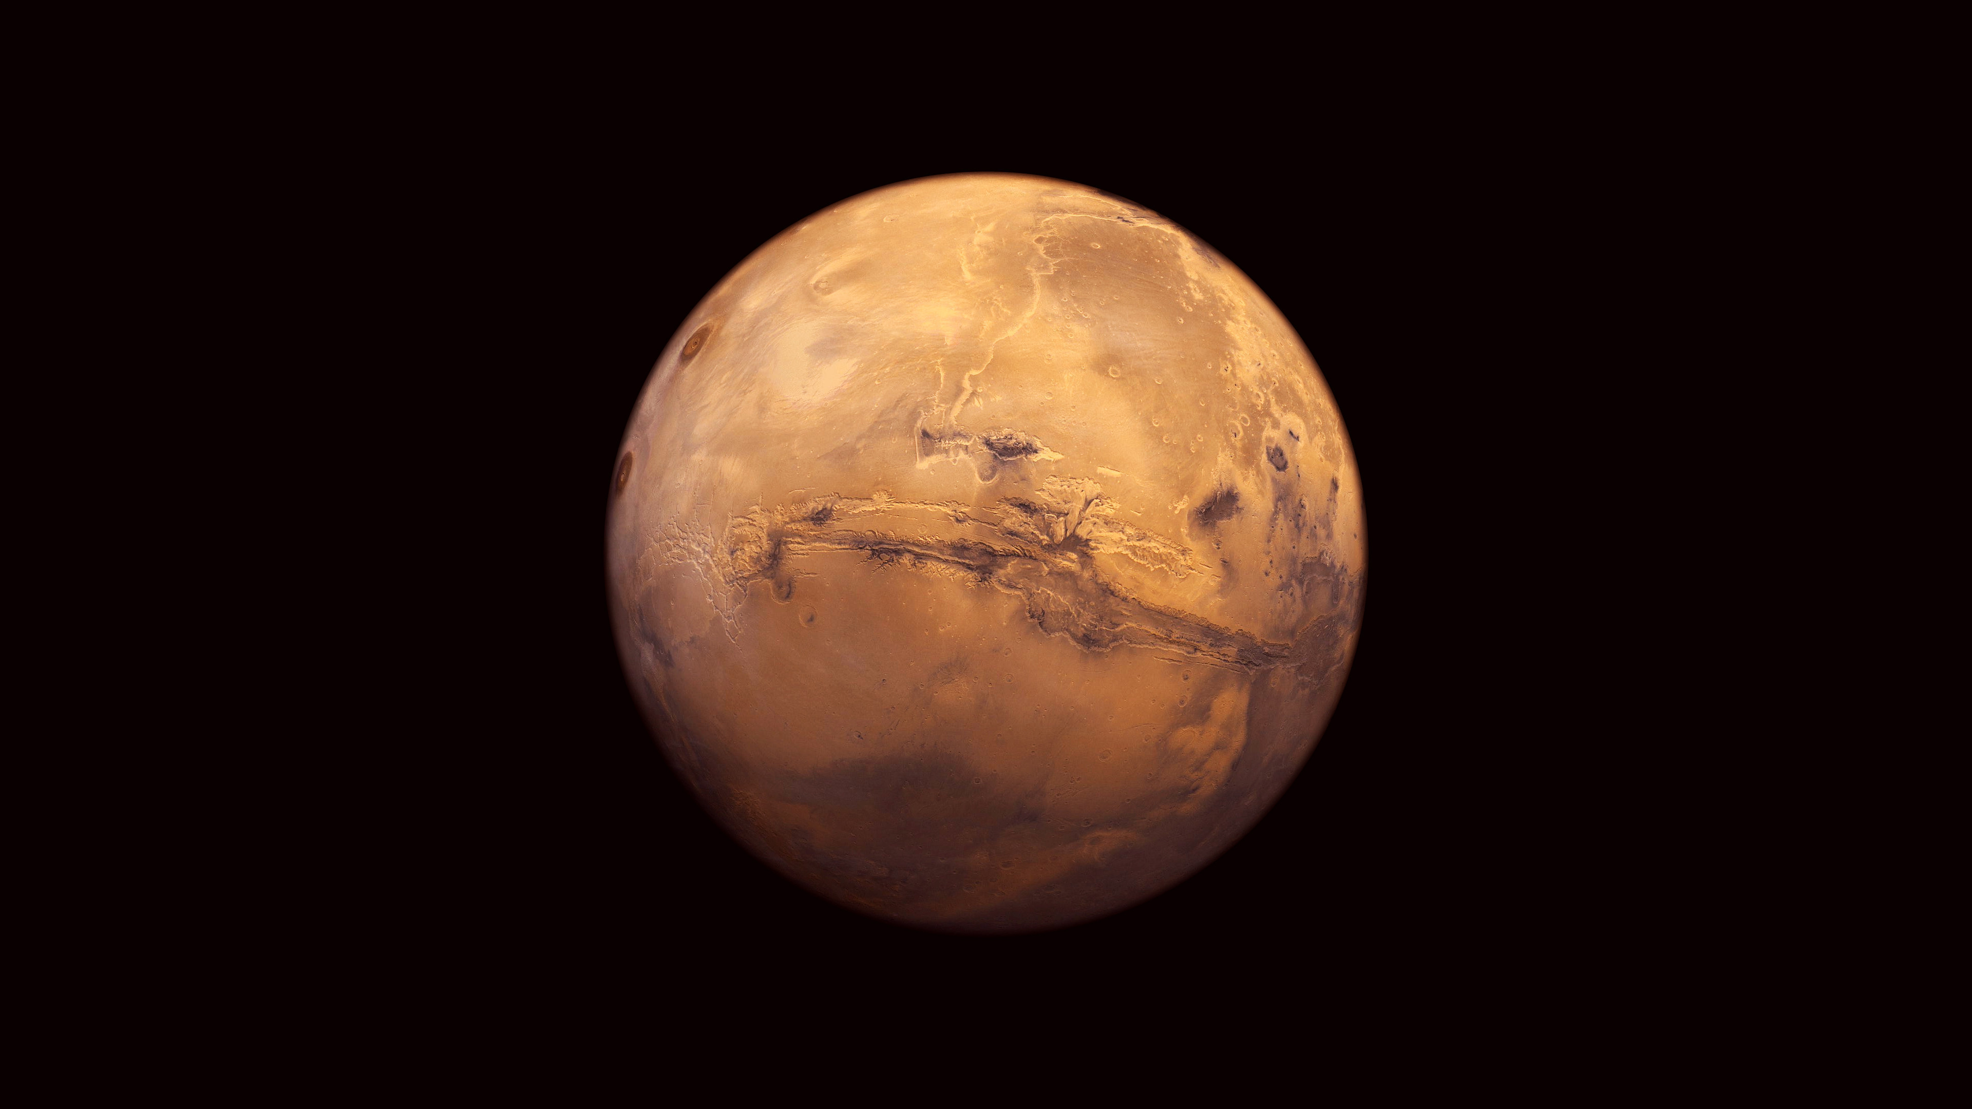
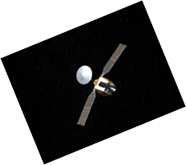
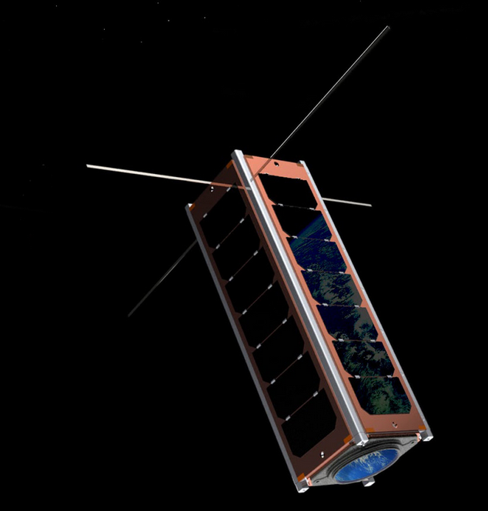

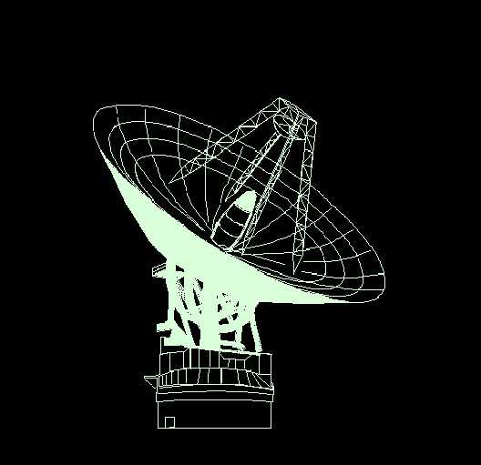
Review of Concept:
Multiple Spacecraft Per Antenna (MSPA)
Traditional MSPA
Opportunistic MSPA
“N” smallsats opportunistically transmit open loop while in beam of a “host” spacecraft.
2 spacecraft that will be in same beam formally schedule to share antenna.
“Host” spacecraft has a formally scheduled downlink to a receiver.
Each spacecraft downlinks to a separate receiver.
Currently, 2 receivers per antenna, allowing 2-MSPA.
DSN moving to 4-MSPA capability on selected antennas.
Smallsat open-loop transmissions are captured on a wideband recorder.
3

Slide 4
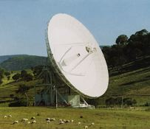
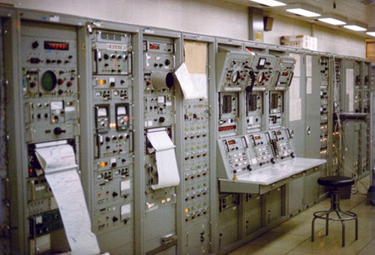

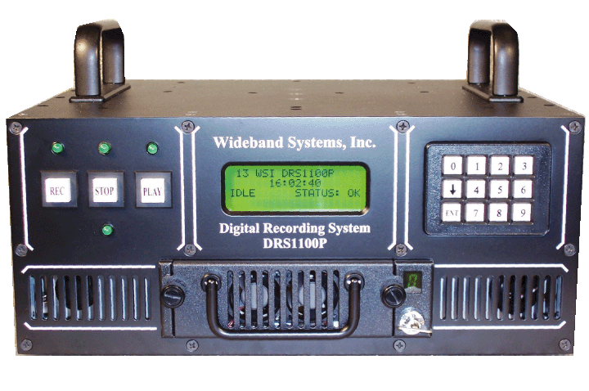

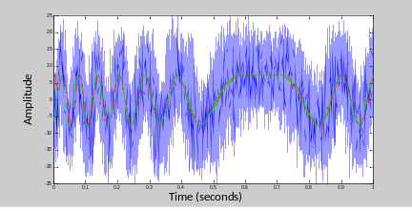
Review of Concept:
MSPA vs. OMSPA Feature Comparisons
Traditional MSPA
(Existing)
Opportunistic MSPA
(Proposed)
Secure Data Server
Self-Service OMSPA: MOC retrieves relevant portion of recording, demodulates & decodes it.
Wideband Recorder
Transfer Frames Delivered
To MOC
DSN Hardware Receivers & Associated Signal Processing
Scheduled DSN Software Demodulation & Decoding
Frame-Service OMSPA: Transfer frames delivered to MOC.
Key Features
Key Features
Downlink only
Reliable
Very low latency
Constrained number of users
Users subject to formal DSN antenna scheduling process
Downlink only
Reliability depends on implementation
Latency depends on implementation
Unconstrained number of users
Users not subject to formal DSN antenna scheduling process
3

Slide 5
Demo Purpose & Objectives
Purpose – show prospective users, and prospective service providers, that OMSPA is an operationally viable, low-cost means for obtaining routine downlink telemetry.
Objectives
  Demonstrate ability to compute beam intercept times and associated opportunities for opportunistic downlink.
  Demonstrate ability to capture an opportunistic downlink on a wideband recorder and retrieve the corresponding portion of the recording via a secure internet site.
  Demonstrate ability to demodulate, and decode the recorded signal in an operationally feasible timeframe.
  Demonstrate that all of these things can be done within ~1-2 days irrespective of which DSN complex is in view during a pass.
5

Slide 6
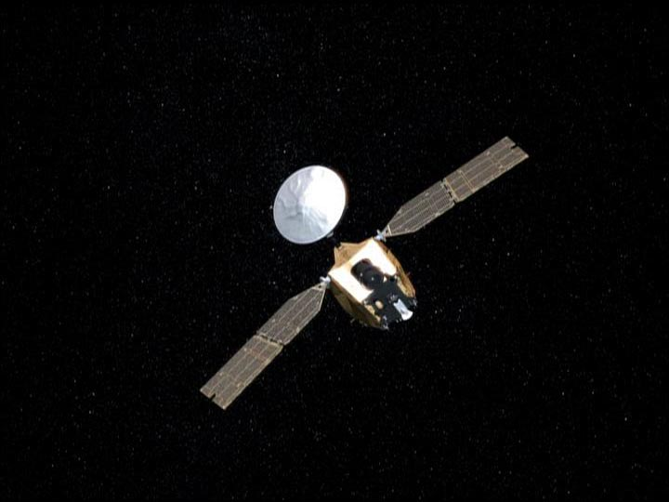
Demo Methodology Overview
Determine when Mars Odyssey will be in MRO’s antenna beam.
Record Odyssey’s transmission.
Retrieve recording.
Demodulate & decode recording.
MRO
“Host” Spacecraft
Mars Odyssey
Scheduled Downlink
Scheduled Downlink
“Smallsat”
Opportunistic Downlink
Validate recovered transfer frames by comparing to those recovered via Odyssey’s scheduled downlink.
Wideband Recorder
Mars Odyssey’s Antenna
MRO’s Antenna

Slide 7
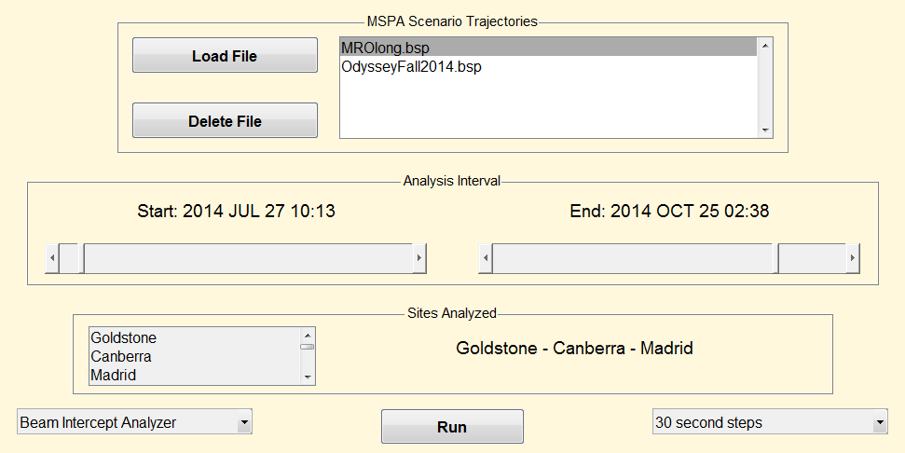
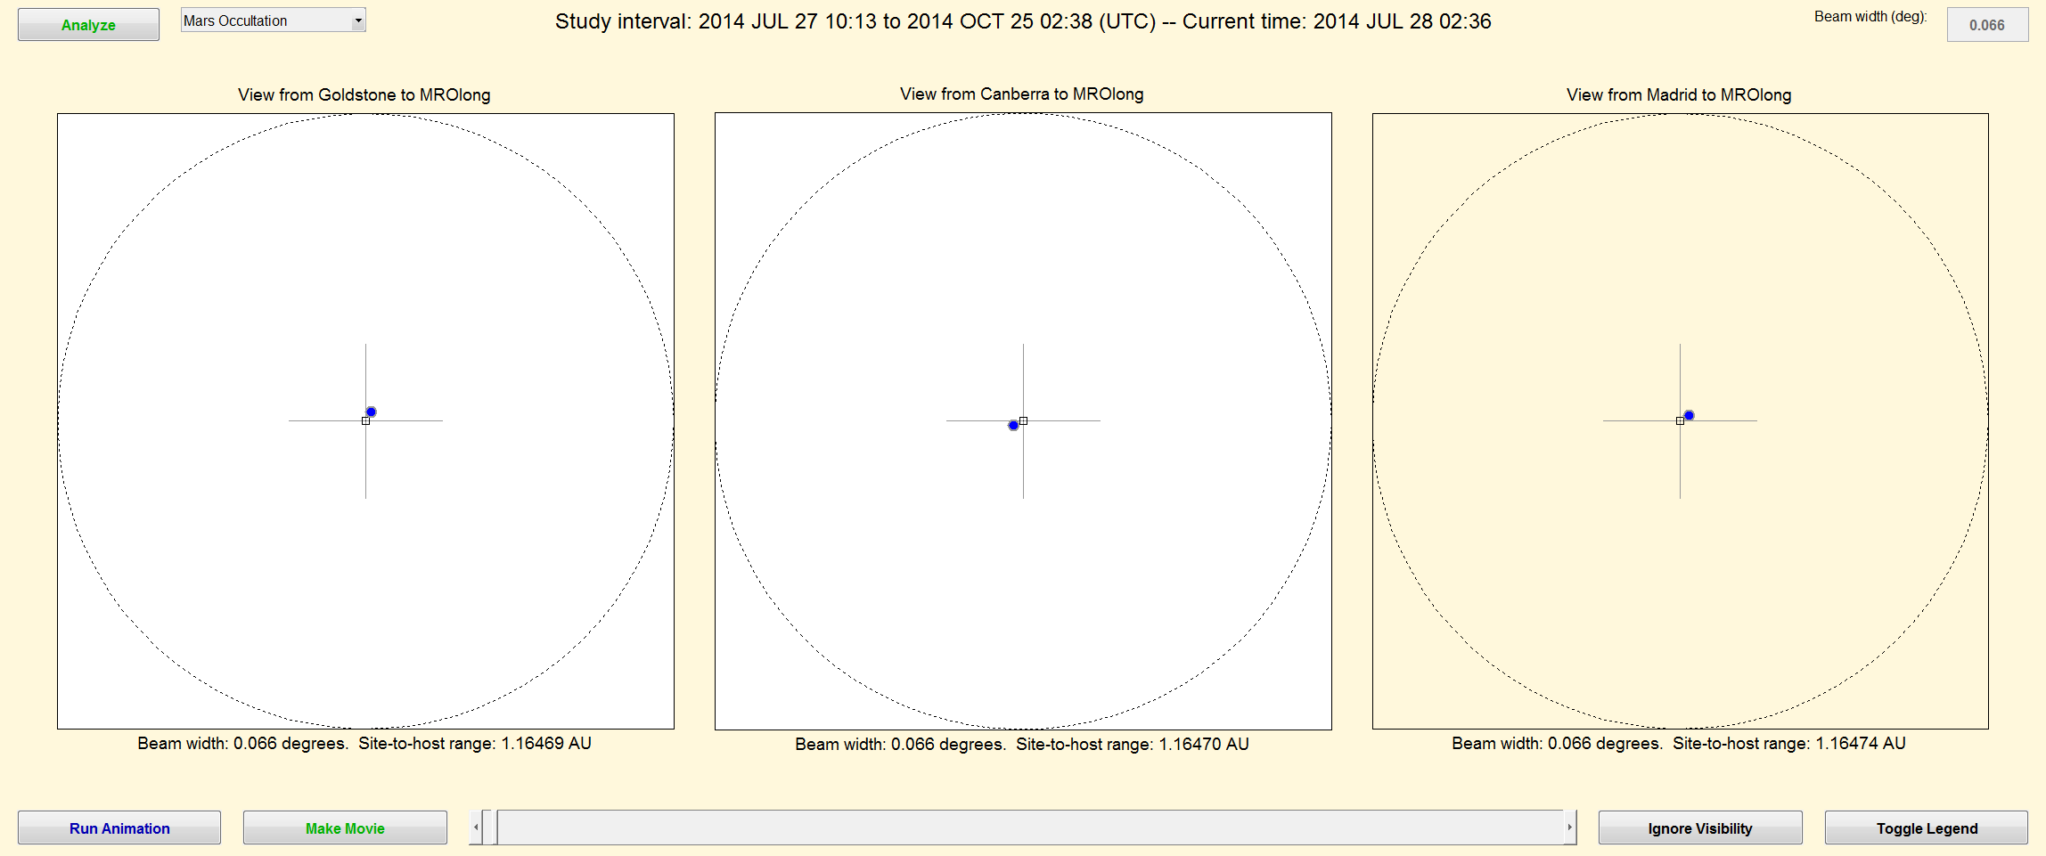
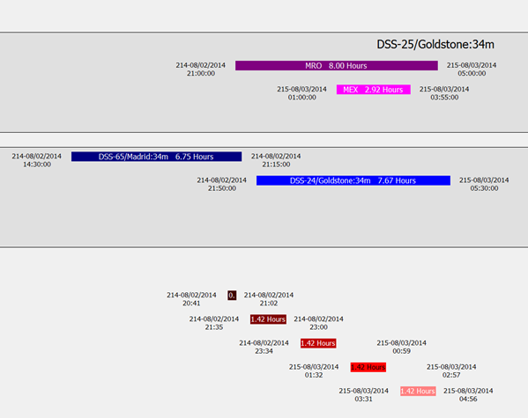
OMSPA Demo Tools/Systems (1/3)
Beam Intercept Planning System (BIPS)
  Compares smallsat and potential “host” spacecraft trajectories to identify beam intercept opportunities.
  Removes planetary occultation periods from the opportunity windows.
  Reports usable intercept timeframes and aggregate statistics.
7-Day Schedule Cross-comparison tool (7-DSC)
  Compares the BIPS-provided intercept timeframes to the “host” spacecraft downlink times reported in the DSN’s 7-day schedule.
  Identifies potential antenna record times.

Slide 8
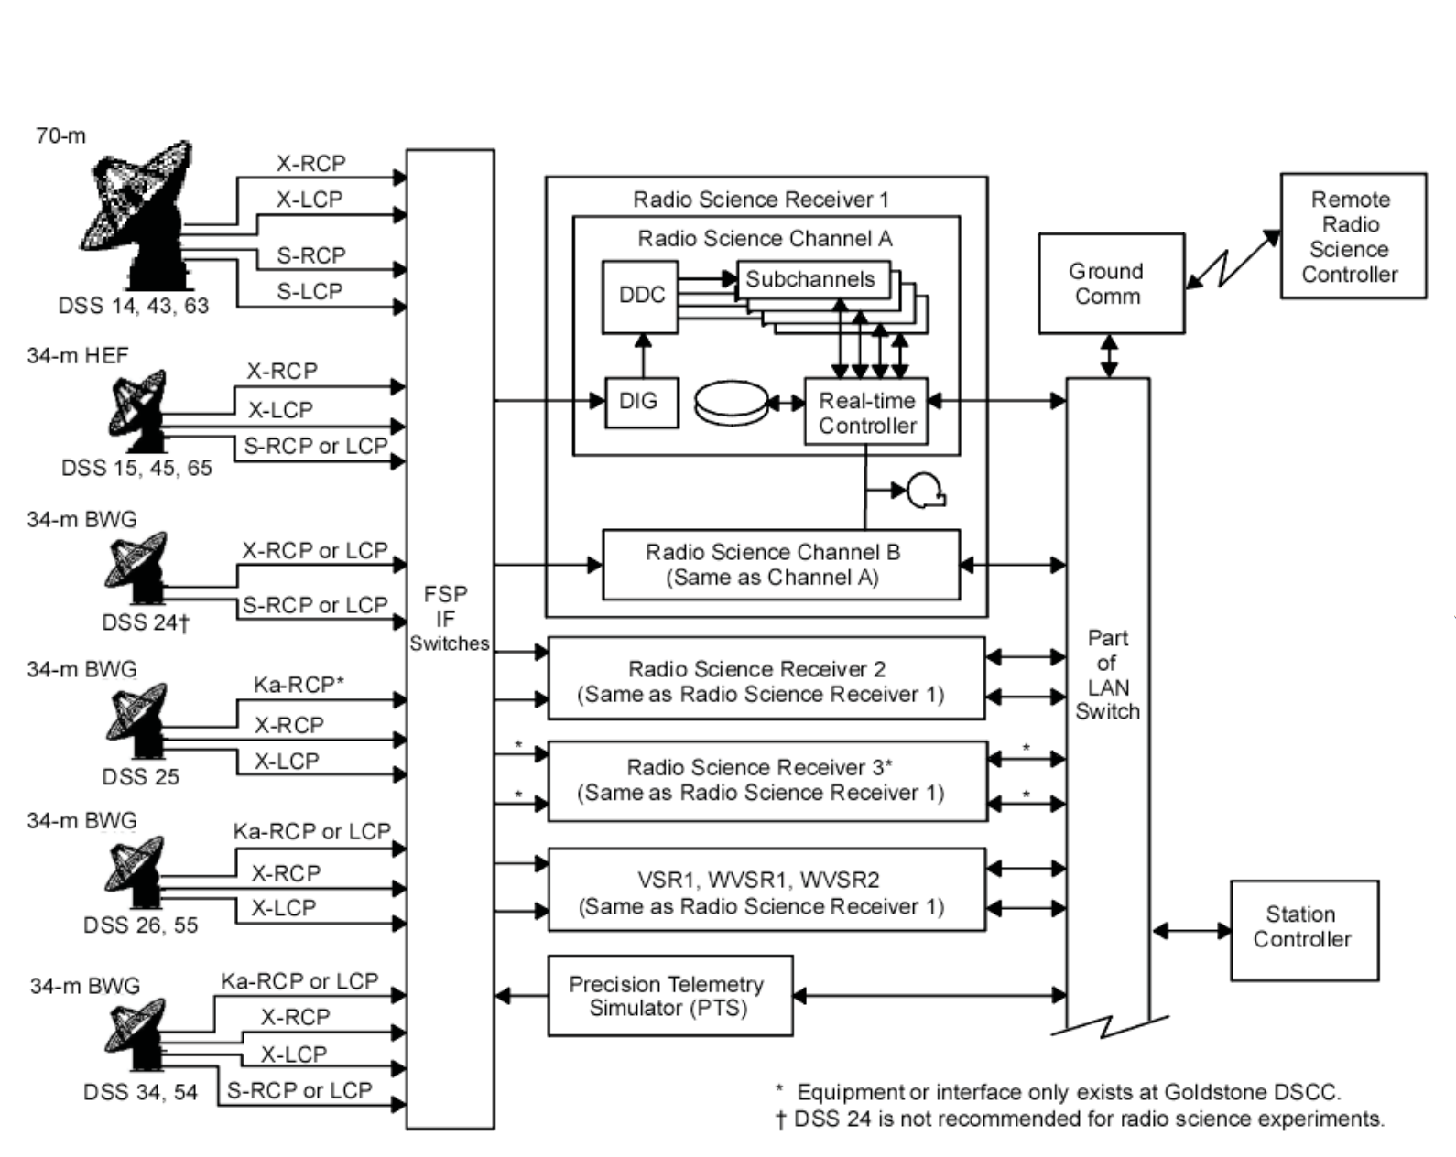
OMSPA Demo Tools/Systems (2/3)
Very-Long-Baseline-Interferometry Science Receiver (VSR)
  Converts analog IF signal into a digital format and, among other things, provides a recording capability.
  Based on the antenna(s) and recording times identified with 7-DSC, the VSR can be set to record the appropriate DSN station on the selected channel(s) with the appropriate start and stop times.
Server Repository (“lilypond”)
  Storage destination for playback of the VSR recording.
  Access point for signal processing team.

Slide 9
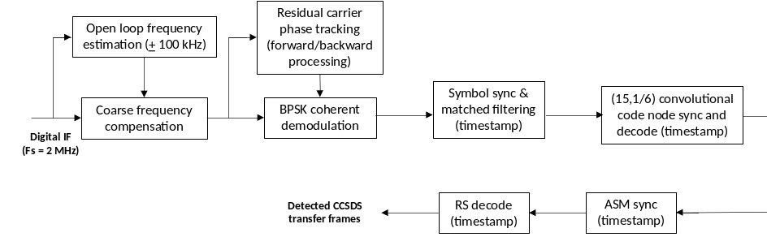
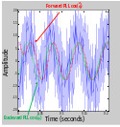
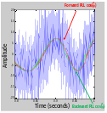
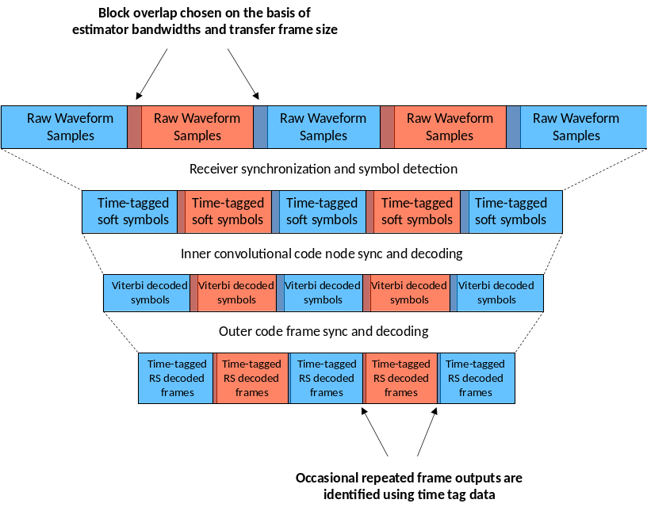
OMSPA Demo Tools/Systems (3/3)
OMSPA Software Demodulator (OSD)
  Based on prior and on-going investment by the DSN Advanced Engineering Office in an analysis tool for low-to-medium rate deep space telemetry downlink waveforms.
  Implemented in MatLab.
  Unlike real-time receivers, it is able to reprocess the recorded data multiple times for improved detection performance.
  The independent, block-oriented nature of its processing enables scalability for increasing the aggregate processing speed by allowing concurrent processing of different data blocks.

Slide 10
Results
Identification of OMSPA Opportunities
  BIPS and 7-DSC were able to compute beam intercept and associated record times to within a minute or so of the observed times.
Playback of Recordings from VSRs at Complexes to “lilypond”
  Transfer times were 1 hour 23 minutes from Goldstone, 6 hours 40 minutes from Canberra, and 9 hours 41 minutes from Madrid – each for ~14.4 GB of data.
Retrieval from “lilypond” to the OSD Workstation
  Transfer times consistently were on the order of 53 minutes, making the total time between VSR and workstation between 2.3 hours and 10.6 hours.
Processing via OSD
  For all passes, successfully demodulated and decoded the Mars Odyssey data in a timeframe 5 to 6 times longer than the recorded duration.
Data Validation
  Worst-case demonstration pass had only 11 unresolved frame errors out of 23,624 – equivalent to a 99.95% data return.

Slide 11
Conclusions & Recommendations
Conclusions
  The proof-of-concept demonstration successfully met all four of its objectives.
    Beam-intercepts and associated OMSPA opportunities were successfully identified.
    Recordings were successfully executed and transferred from the Complexes to JPL in less than half a day.
    Recordings were retrieved, demodulated, and decoded in less than half a day, with an accuracy of 99.95% or better.
    OMSPA was successfully executed from every Complex.
Recommendations
  Work to reduce the data transfer times between the Complexes and JPL.
  Evolve the OMSPA Software Demodulator to have a user-friendly GUI, enable Doppler extraction, and handle more modulations and codes.
  Conduct a follow-on demonstration with multiple OMSPA-user spacecraft.

Slide 12
For Further Information…
For further information about the proof-of-concept demonstration, see:
  Douglas S. Abraham, Susan G. Finley, David P. Heckman, Norman E. Lay, Cindy M. Lush, and Bruce E. MacNeal, “Opportunistic MSPA Demonstration #1: Final Report,” Interplanetary Network Progress Report, 42-200 (February 2015).
Available at:
http://ipnpr.jpl.nasa.gov

