Slide 1
Small Satellite Dynamics Laboratory (SSDT)
Laura Jones
Swati Mohan
4/28/15
Jet Propulsion Laboratory, California Institute of Technology.
© 2014 California Institute of Technology.
Government sponsorship acknowledged.

Slide 2
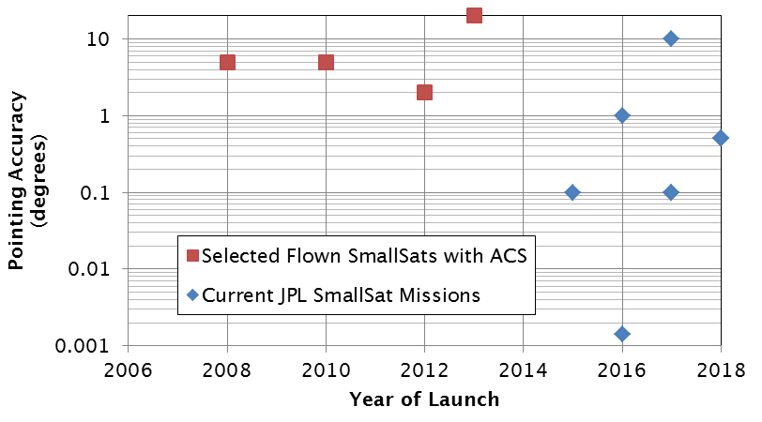
SmallSats and Attitude Control
DELPHI-n3XT [5]
Can X2[1]
AISSat-1 [2],
QbX [3]
CXBN [4]
Pre-Flight Pointing Estimates
In-Flight Pointing Accuracies
Required Pointing Accuracies
© 2015 California Institute of Technology. Government sponsorship acknowledged.

Slide 3
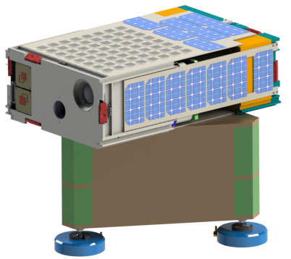
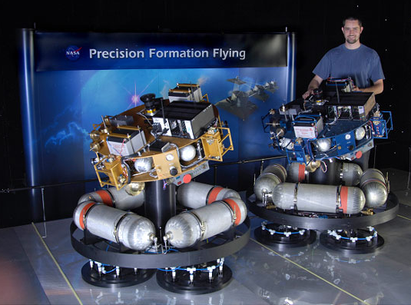
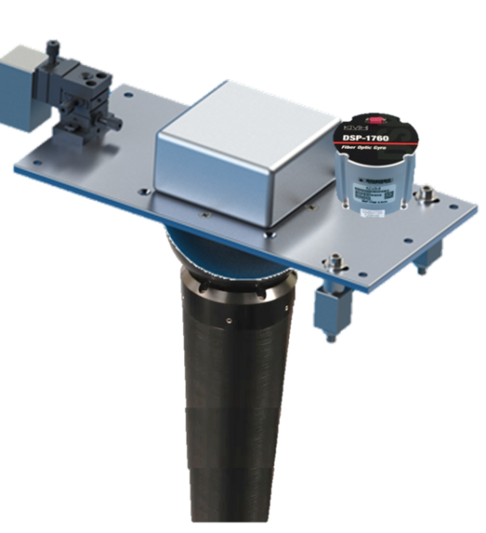
SmallSats and Verification/Testing
  Small Satellites have unique ACS testing needs:
  Different class of ACS hardware and software → Limited mass, power, processing
  Different dynamical regime → Testbeds must be smaller/lighter
  Short schedules and small budgets → Early hardware-in-the-loop testing critical
Understand what Verification & Validation activities are required based on the complexity of the mission
Use ACS testbeds designed specifically for Small Satellites needs
© 2015 California Institute of Technology. Government sponsorship acknowledged.
Notes:
Verification and Validation Activities:
Test
Analysis
Demonstration

Slide 4
Defining ACS Complexity
Structural Complexity | Environment/ Mission | Jitter/ Maneuvering Req. | Degree of ACS Customization & Vendor Complexity
Large flexible structures, flexible structures with tight pointing (Ka band antennas, instruments), risk of control-structure interaction | Unusual disturbance environments (NEA, Venus atmosphere, Jupiter, etc.) , or > 1 year | Highly precise systems with tight jitter over long durations, highly agile systems with rapid slews, timing drives mission success | Major modifications to COTS components, fully customized system, multi-stage control, foreign companies/ partnerships
Rigid bus with flexible components that don’t have tight pointing (deployable solar panels, S band or X band antennas) | Significant planetary body disturbances (Mars, lunar) or unique dynamics considerations (Lagrange points, etc.) or 6 months – 1 year | Tight jitter over short periods of time, loose jitter over long periods of time, regular maneuvering where timing is important | Small changes to COTS options, subcontracts with limited scope
Rigid body pointing, no control-structure interactions | Small disturbances (deep space), or common SmallSat environments (LEO), or <6 months | Short time durations for any jitter requirements, slow slewing with limited maneuvering, timing useful but not mission-critical | COTS performance acceptable, no modification, limited contract complexity (PO)
High
ACS Complexity
Medium
Low
© 2015 California Institute of Technology. Government sponsorship acknowledged.

Slide 5
ACS Complexity and Pointing Accuracy
Recommended Levels of Testing/Verification for SmallSat ACS Systems
For NASA-class SmallSats, Type II
Testing Level
Extensive
High
Moderate
Basic
Minimal
Medium
ACS Complexity
JPL Projects
Low
0.001
0.01
0.1
1
10
Required Pointing Accuracy, degrees
© 2015 California Institute of Technology. Government sponsorship acknowledged.

Slide 6
Flight SmallSats and ACS Testing and Verification
V&V Activity | Minimal | Basic | Moderate | Extensive
Modeling/ Pointing Performance Evaluation | None, or simple rigid-body models based on spec sheet or available data, simplistic disturbance modeling, simple sizing analyses | Analysis of key performance parameters, vendor analysis, models include key dynamics, simple trajectory modeling to evaluate disturbances over time, etc. | Independent analysis of key performance specs and nominal mission scenarios, models include test data for critical components, key elements of system are modeled at detailed level, more complex dynamics modeling, more integrated modeling with trajectory | Detailed analysis of performance across range of mission scenarios, models include test data across system parameters, complex dynamics modeling, fully integrated models with other subsystems, full STOP analysis, evaluate pointing with system-level tests
Hardware-in-the-Loop Algorithm Development | None | None | Basic timing checks | Detailed development or testing done with hardware
Mass Properties Characterization | CAD | CAD, weigh components | CAD, weigh system | Test, full mass properties
RWA Characterization | Spec Sheet | Spec Sheet | Vendor/Existing Test Data | Test
IMU/Gyro Characterization | Spec Sheet | Spec Sheet | Vendor/Existing Test Data | Test
SRU Characterization | Spec Sheet | Spec Sheet | Vendor/Existing Test Data | Test
Phasing | Test | Test | Test | Test at component and system levels
Functional ACS Testing | Component power/telemetry connectivity check | Component power/telemetry connectivity check, data integrity check | Component power/telemetry connectivity check, data integrity check, basic timing check | Component power/telemetry connectivity check, data integrity check, extensive timing check, system functional tests
Closed-Loop Demonstration | Yes, no performance measurements | Yes, no performance measurements | Yes, with performance measurements | Yes, with performance measurements
Maneuver Testing | None | None | Critical maneuvers /simplified testing | Complete maneuver set
Mission Scenario Testing | None | Key mode transitions (detumble, etc.) | Key mode transitions, some fault protection | Deployments, all mode transitions, fault protection
© 2015 California Institute of Technology. Government sponsorship acknowledged.

Slide 7
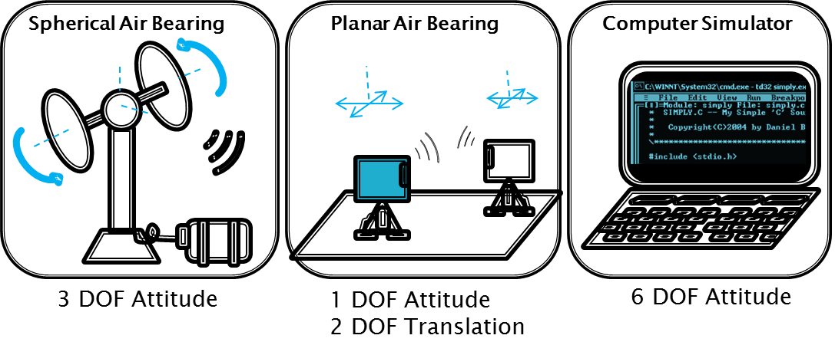
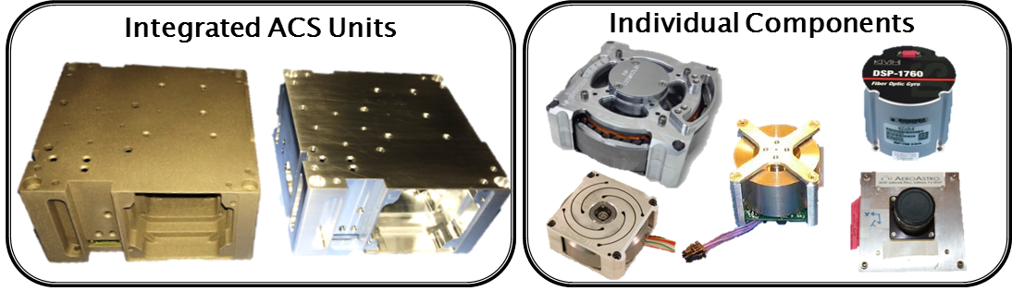

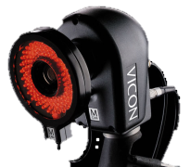

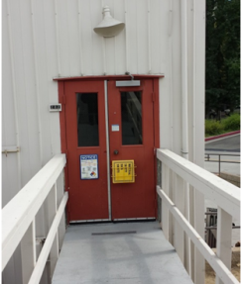
JPL’s SmallSat Dynamics Testbed
3 Environments
2 Payload Types
Up to 30 kg
1 FCT-SSDT Shared
Infrastructure
© 2015 California Institute of Technology. Government sponsorship acknowledged.

Slide 8
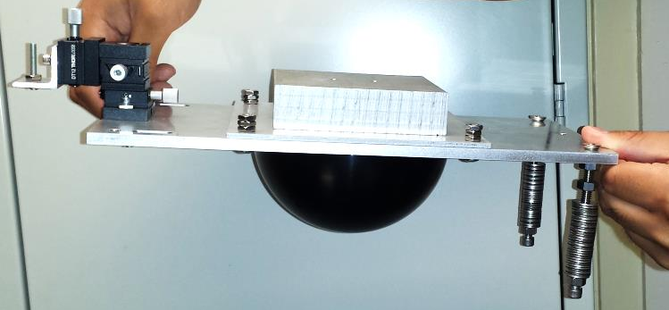
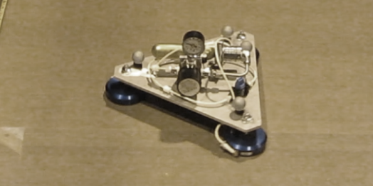
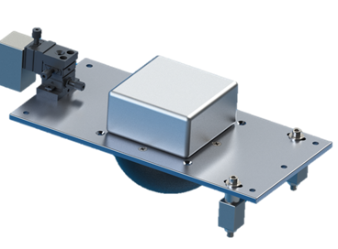
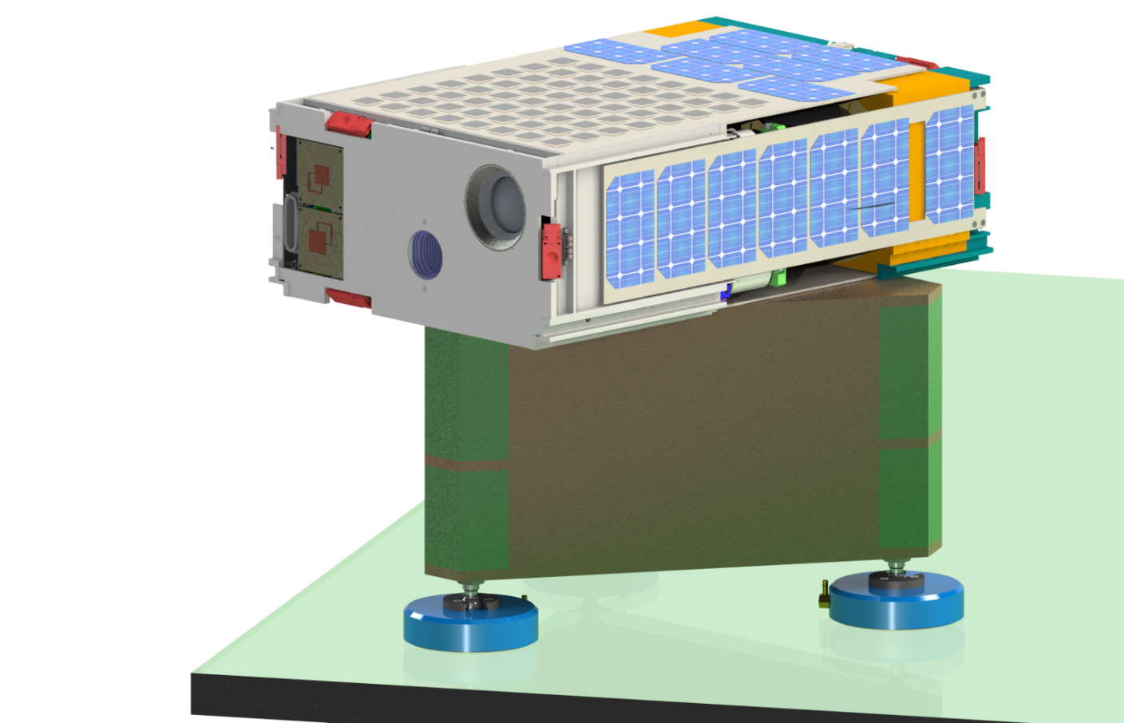
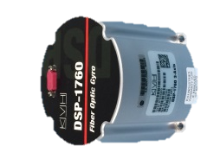
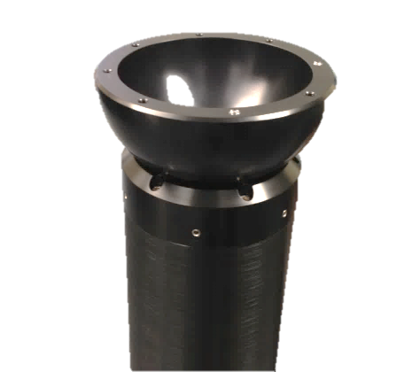


JPL’s SmallSat Dynamics Testbed
Spherical Air Bearing
Planar Air Bearing
11.6cm
24cm
36.5cm
16cm
30cm
© 2015 California Institute of Technology. Government sponsorship acknowledged.

Slide 9
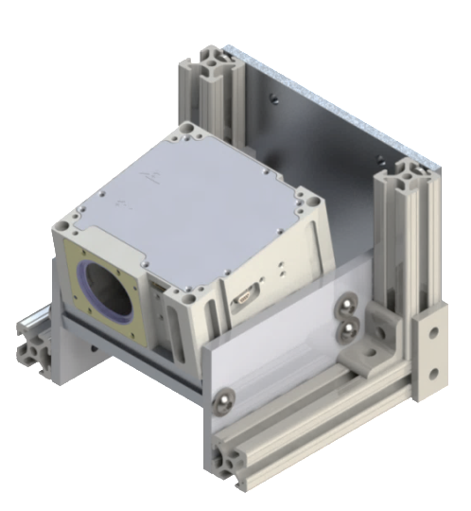
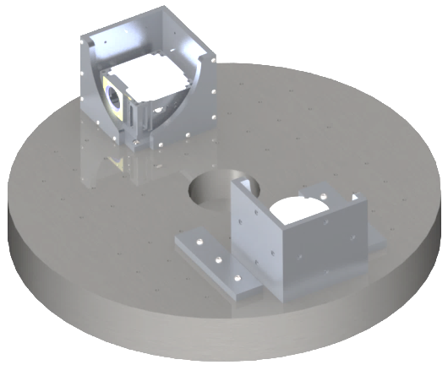
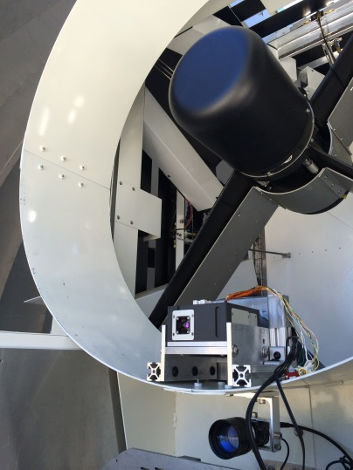
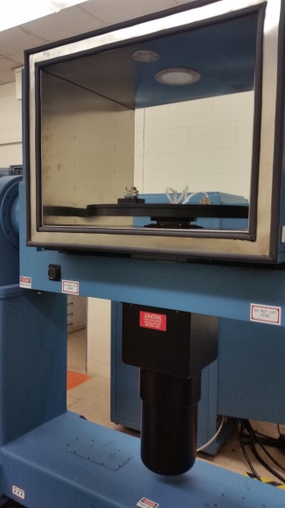
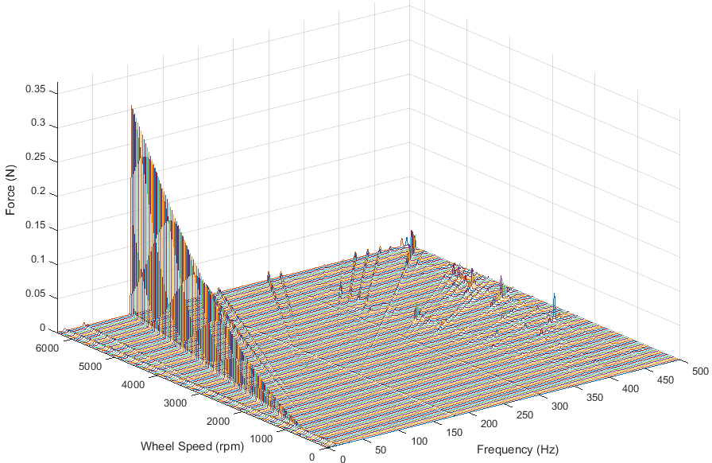
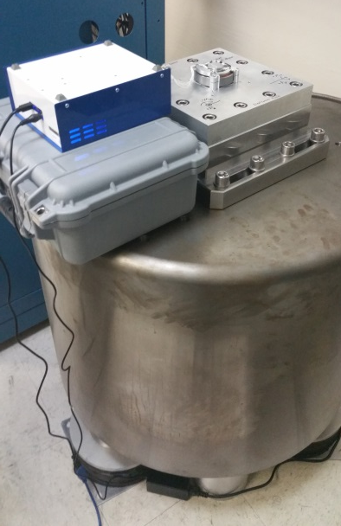
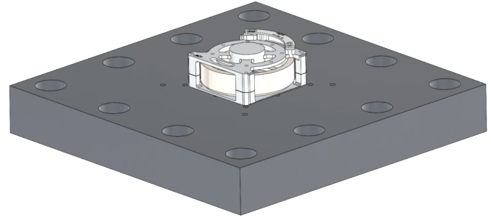
JPL’s SmallSat Dynamics Testbed
Gyro Characterization
Star Tracker & Sun Sensor Characterization
12.7cm
14cm
10cm
61cm
17.5cm
14.5cm
Measures angle random walk, rate random walk, angle white noise, quantization, bias repeatability, scale factor, and sense axis
Measures noise equivalent angle, low frequency error, and velocity constraints on tracking,
Measures estimate versus OCTL telescope truth
Reaction Wheel Characterization
Measures force and torque amplitude as a function of wheel speed and frequency.
2.5cm
6.6cm
3.8cm
24.5cm
24.5cm
© 2015 California Institute of Technology. Government sponsorship acknowledged.

Slide 10
Summary
Small satellite industry trending to higher performing ACS systems
Necessity of verification and validation activities depends on the complexity of the mission
Provided guidelines on how to ballpark the V&V activities based on the mission complexity
JPL’s SSDT supports V&V by being designed specifically for small satellites (limited support mass, component library, etc.)
References:
[1] Sarda, Karan; Grant, Cordell; Eagleson, Stuart; Kekez, Daniel; Shah, Amee; and Zee, Robert, “Canadian Advanced Nanospace Experiment 2 Orbit Operations: One Year of Pushing the Nanosatellite Performance Envelope,” 23rd Annual AIA/USU Conference on Small Satellites, Logan, Utah, August 2009, SSC 09-IV-6
[2] Sarda, Karan; Beattie, Alex; Kekez, Daniel; Zee, Robert, “In-flight Experience of the High Performance Attitude Determination and Control System of the Generic Nanosatellite Bus,” The 4S Symposium 2012
[3] Armstrong, James; Casey, Craid; Creamer, Glenn; Dutchover, Gilbert, “Ponting Control for Low Altitude Triple CubeSat Space Darts,” 23rd Annual AIA/USU Conference on Small Satellites, Logan, Utah, August 2009, SSC 09-X-4
[4] Brown, K. Z. et al., "The Cosmic X-Ray Background NanoSat (CXBN): Measuring the Cosmic X-Ray Background Using the CubeSat Form Factor", 26th Annual AIAA/USU Conference on Small Satellites, SSC12-VII-6, Logan, UT 2012.
[5] Reijneveld, J., and Choukroun, D., "Attitude Control System of the Delfi-N3xt Satellite", Progress in Flight Dynamics, GNC, and Avionics, 6, 189-208, 2013.
© 2015 California Institute of Technology. Government sponsorship acknowledged.

