Slide 1



Using Statistical Risk Assessment to Optimize the Design of Inflatable Membrane Structures in Low Earth Orbit
A. Chandra,
J. Thangavelautham
SpaceTREX Laboratory
School of Earth and Space Exploration
Arizona State University
A. Babuscia
Jet Propulsion Laboratory
California Institute of Technology

Slide 2
Inflatable Antenna - Motivation
Large surface area
Low storage volume
High packing efficiency
Low weight
Low cost

Slide 3
Challenges
Large uncertainties in outer space environment.
Complex interaction phenomenon.
Lack of understanding of underlying physics.
Robust inflatable design.
Adequate shape control.

Slide 4
Objectives
Use statistical methods to design robust inflatable structures.
  Quantify the advantage of the design choices by assessing risk.
  Comparison in terms of architecture, membrane layer, sublimate properties.

Slide 5
Objective
Robust Design
Optimization
Sensitivity Analysis
Definition of failure conditions Membrane Punctured
Critical leakage rate exceeded
Micrometeoroid distribution data
Preliminary design
Design Concepts

Slide 6
Outline of procedure
Optimization and robustness studies
Identification of critical design parameters – Sensitivity Analysis
Definition of failure conditions
Response functions and limit state analysis
Uncertainty quantification of space environment
Single bladder membrane
Multi-layer single bladder
Single-layer multi-bladder
Design Options

Slide 7
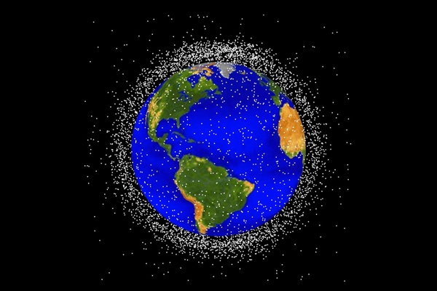
Space Environment
Micro-meteoroids and space debris
Mass and Velocity are the two parameters of primary interest

Slide 8
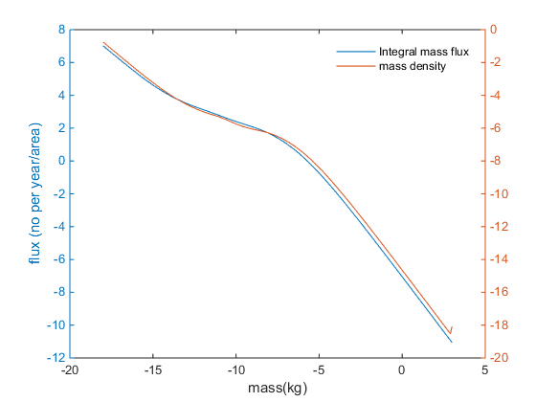
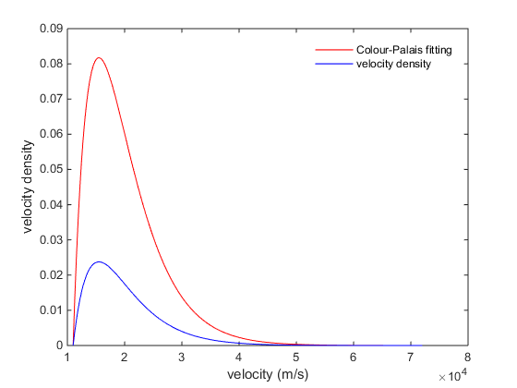
Micrometeoroid mass and velocity distribution
Probability density function for micro-meteoroid mass and velocity

Slide 9
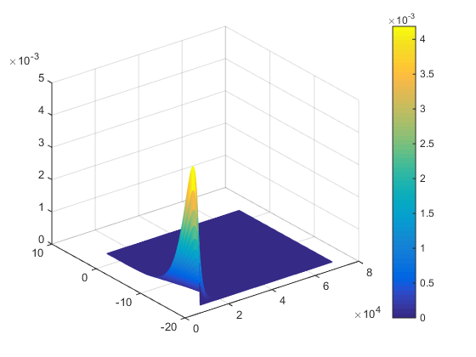

Joint Probability distribution
Mass and velocity distributions assumed independent events
Joint mass and velocity probability distribution

Slide 10
Outline of Analysis
Critical Parameters
Theoretical failure probability
Propagation of uncertainty
Response Function 1:
Penetration depth
Limit State Surface
Response Function 2:
Successive impacts
Response Function 3:
Maximum gas leak rate
External environment
meteoroid mass m_{M}, meteoroid velocity v_{M,}
Temperature T
Design parameters
material density ρ , vaporization heat ζ , thickness τ , no. of layers n_{l}
Sublimate properties
molecular mass m,
Eq vapour pressure P_{e}

Slide 11
Membrane Analysis – Definition of problem
Antenna
Cross sectional area facing earth is 1 m²
Tavg in LEO = 394K
h=370km
Earth

Slide 12
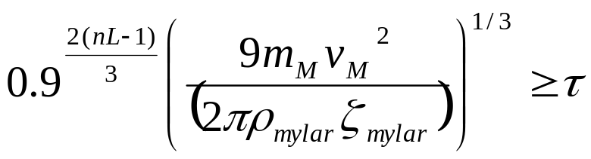
Penetration depth
Successful penetration condition (Babuscia, 2013)
θ
Layer 1
Layer 2
d
τ
d

Slide 13
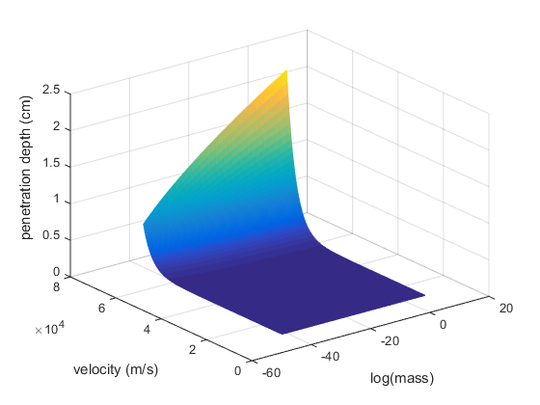
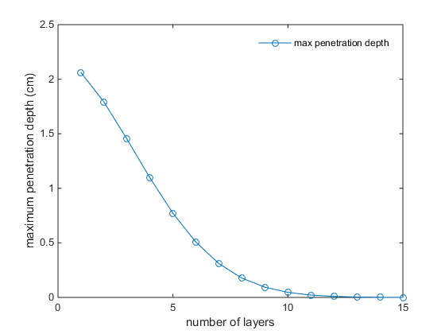
Penetration depth
P-depth as a function of mass and velocity
P-depth as a function of no. of layers

Slide 14
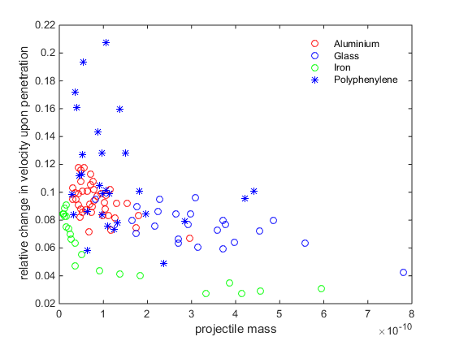

Successive Impact Deceleration
Correlation between deceleration, projectile mass and density
Hyper-velocity projectile deceleration (Pailer, 1980)

Slide 15
Maximum Gas Leak Rate
Qout
Qin
Qout
Before Impact
After Repeated Impacts

Slide 16
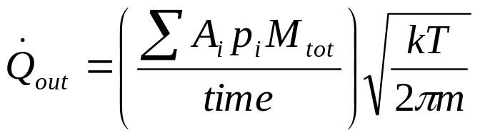
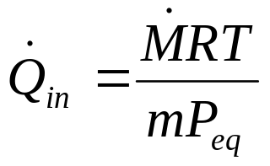
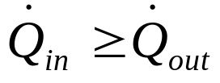
Maximum Gas Leak Rate
Max total leak area
Sublimate mobility
Condition for normal operation:

Slide 17
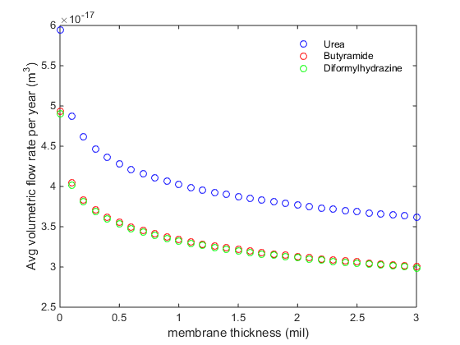
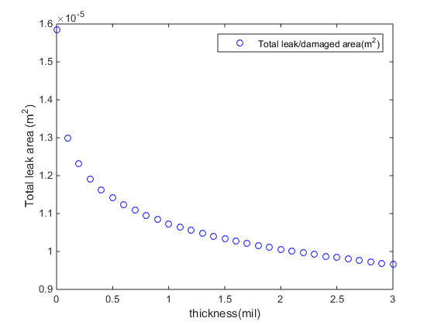
Maximum Gas Leak Rate
Avg. exit flow-rate vs. membrane thickness
Total leak area vs. membrane thickness

Slide 18
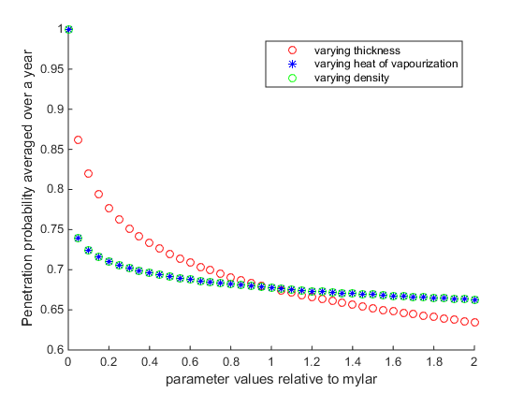
Theoretical probability of successful penetration
Probability of successful meteoroid penetration.

Slide 19
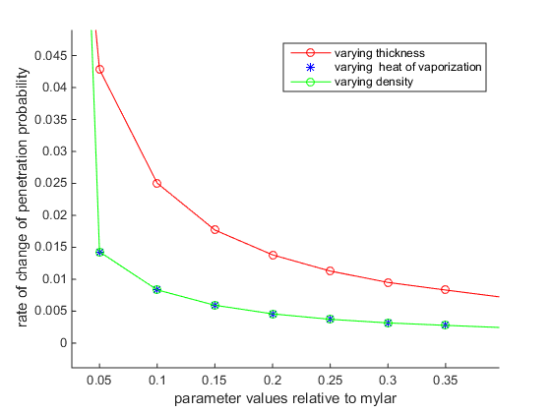
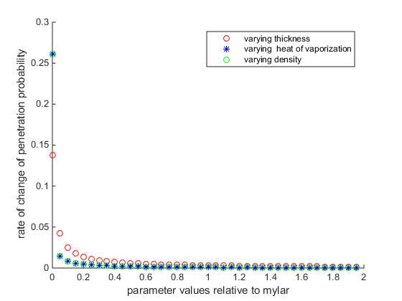
Sensitivity Analysis
Sensitivity analysis of material properties

Slide 20
Discussion
Yearly penetration probability converges to 65% above a membrane thickness of 2 mil
Penetration probability shows much higher sensitivity (about three times) to membrane thickness as compared to density and heat of vaporization

Slide 21
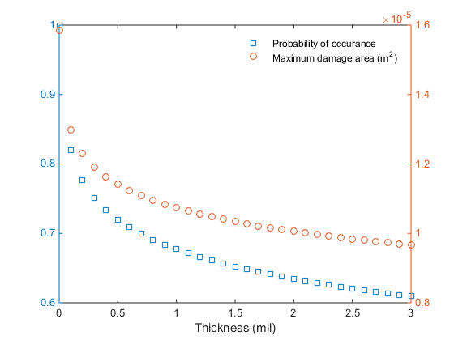
Theoretical probability for max damage area
Probability of failure and total leakage area vs. thickness

Slide 22
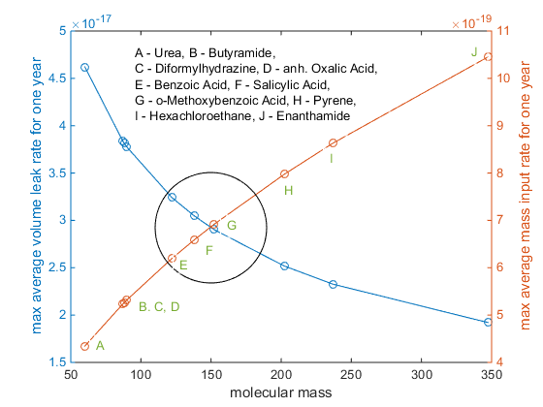
Volumetric Leak Rate
Volume and mass flow-rates for different sublimates

Slide 23
Conclusions
Multilayer membrane better than multi-bladder system.
Volume rate of leak shows stronger sensitivity to molecular mobility than molecular mass
At Tavg= 394K, the following studied sublimates were found to perform the best:
benzoic acid
salicylic acid
o-methoxybenzoic acid

Slide 24

Ongoing/further work
Inclusion of pre-stress into model
Promising areas: Diaphragm based actuation, Rigidization on command
Fig 12. Diaphragm based actuation (Ishimura, 2013)

Slide 25
References
Spenvis database at www.spenvis.oma.be
Babuscia, Alessandra, et al. "CommCube 1 and 2: A CubeSat series of missions to enhance communication capabilities for CubeSat." Aerospace Conference, 2013 IEEE. IEEE, 2013.
Meteoroid Environment Model:-1969:(near Earth to Lunar Surface). Clearinghouse for Federal Scientific and Technical Information, 1969.
Pailer, N. "The penetration limit of thin films." Planetary and Space Science28.3 (1980): 321-331.

