Slide 1
ACESat: Heliocentric Orbit Design
Sasha Weston, SGT Inc.
Mission Design Division
NASA Ames Research Center
Rus Belikov
NASA Ames Research Center
Eduardo Bendek, Bay Area Research Environmental Institute
NASA Ames Research Center

Slide 2
Agenda
ACESat Overview
Heliocentric Orbit Benefits
Proposed Mission Requirements
Heliocentric Orbital Design
Launch Opportunities
Orbit Optimization
Summary

Slide 3
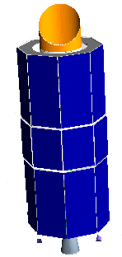
What is ACESat?
Alpha Centauri Exoplanet Satellite
  Look for exoplanets around local binary star system, Alpha Centauri
  Led by Rus Belikov and Eduardo Bendek
Payload
  Coronagraph to directly image spectra of exoplanet
    Exoplanets missions (Kepler and TESS) use transit photomerty
Why Alpha Centauri?
  Close proximity to Earth
    Current candidates are too far away to use foreseeable technology to detect biomarkers
  Recent Kepler data suggests a 40-50% chance one of the aCEN stars supports habitable exoplanet
Uninterrupted stare time
Coronagraph needs to have >90% access duration total mission duration
    Heliocentric orbit would be best option
Notes:
ACESat is a satellite that will use a coronagraph to look for an orbiting exoplanets around one of the Alpha Centauri. If an existing exoplanet is detected, the coronagraph will be able to directly measure the spectra of the orbiting exoplanet.
Alpha Centauri is a great candidate for a ACESat’s coronagraph to look at. First, it’s our closest binary star system. This close proximity allows for current/foreseeable technology to be used to detect an exoplanet. In addition, there have been suggestions from recent Kepler data that there is a 40-50 % chance one of the stars supports a habitable planet.

Slide 4
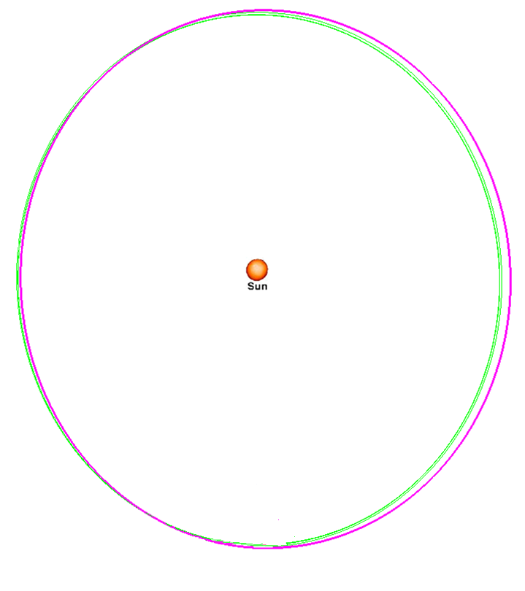

Benefit of Heliocentric Orbits
Pros:
  Has continuous, uninterrupted access to science target
  Provides stable thermal environment
  Requires little propulsion
    Does not require station keeping/decommissioning dV
    Can be obtained via single orbit insertion maneuver
      Good for instrument sensitivity
  DSN network for comms system
Cons:
  Eventually will drift away from Earth
    Comm requirement
  Only 50% launch availability from GTO
Earth orbit
ACESat orbit
Image: Sun inertial frame
Notes:
Decommissioning orbit = already in disposal orbit; safe from earth collisions.

Slide 5
Proposed Mission Requirements
Fall 2020 launch
2 year mission lifetime
Falcon 9 launch vehicle
  Could fit on Evolved Expendable Launch Vehicle (EELV)
Secondary payload integrated with SSL 1300 communications satellite
  Released in Geostationary Transfer Orbit
Notes:
Here are the ACESat overall mission requirements. To meet the SMEX proposal launch deadline, that ACESat was submitted to, the spacecraft must launch before December 2020 and have a maximum lifetime of 2 years.
The spacecraft is a smallsatellite with a wet mass of 238 kg (135 kg bi-propellant) and is planned to be a secondary payload on a SSL communications satellite. It will be released in a Geostationary Transfer Orbit, or GTO.

Slide 6
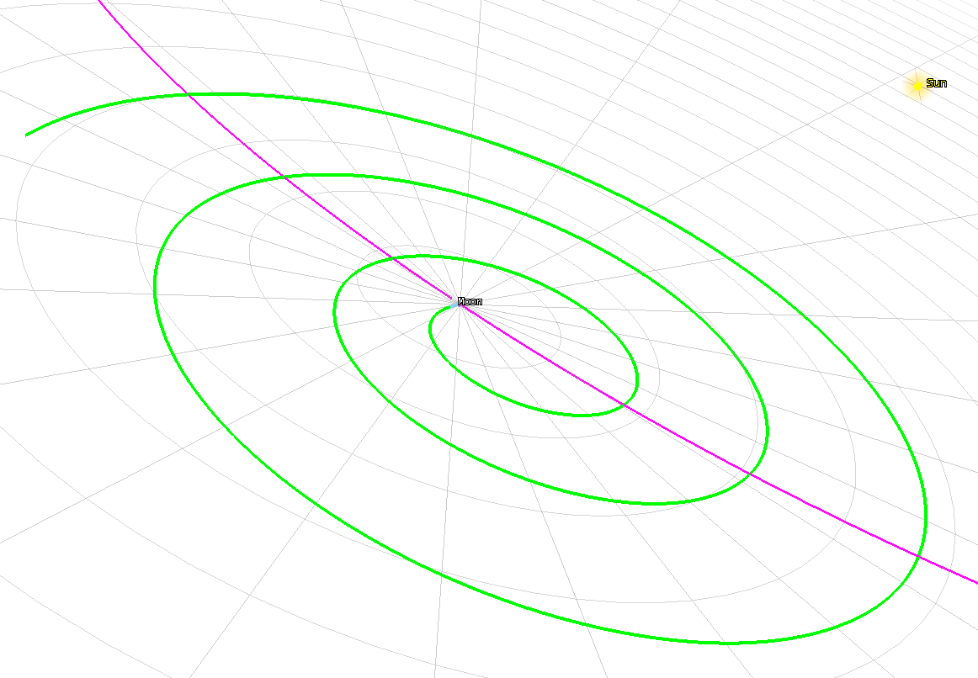
Earth Trailing Heliocentric Orbit Design
Launch opportunity
  Sufficient launch opportunities occur during 50% of possible GTO hours
Leave from GTO
  35786 x 300 km, 28.5 deg
  Launch = Fall 2020
  Falcon 9 launch vehicle
Single Orbit Insertion maneuver
  Total dV = 800 m/s at Perigee of GTO
  Bi propellant
Earth Trailing Heliocentric Orbit
  367 day period
  1.025 x 0.94 AU, 23.43 deg
  e = 0.042
  SC drift rate = 0.12 AU/year
0.11 AU
0.1 AU
0.15 AU
Image: Earth inertial frame
Earth orbit
ACESat orbit
Notes:
Launch site is still undetermined,
GTO launch time is acceptable for secondary payload nearly 50%

Slide 7
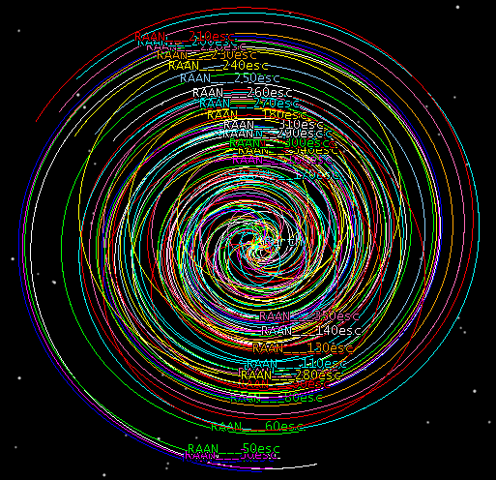
Leading vs Trailing Injection Points
Injection Design for Trailing vs Leading Orbit
  Midnight – 12 noon = Leading
  12 noon – midnight = Trailing
Earth
Notes:
This image shows the different launch injections for either Earth trailing or Earth leading orbit (two classes of escape trajectory that provide minimal distance from Earth) . Sun direction is bottom of page.
Different raans give different esc profiles, raan is determined by what time of day sc is launched.
This is how a leading or trailing solar orbit is attained.

Slide 8
Launch Opportunity
Earth Trailing Orbit design satisfies 50% of possible GTO launch hours
Two launch windows
  Leading orbit (midnight – 12 noon)
  Trailing orbit (12 noon – midnight)
Worst case ACESat can orbit in a WSB for up to 3 mo for RAAN optimization
  Will not cost more dV
  Out of radiation belts

Slide 9
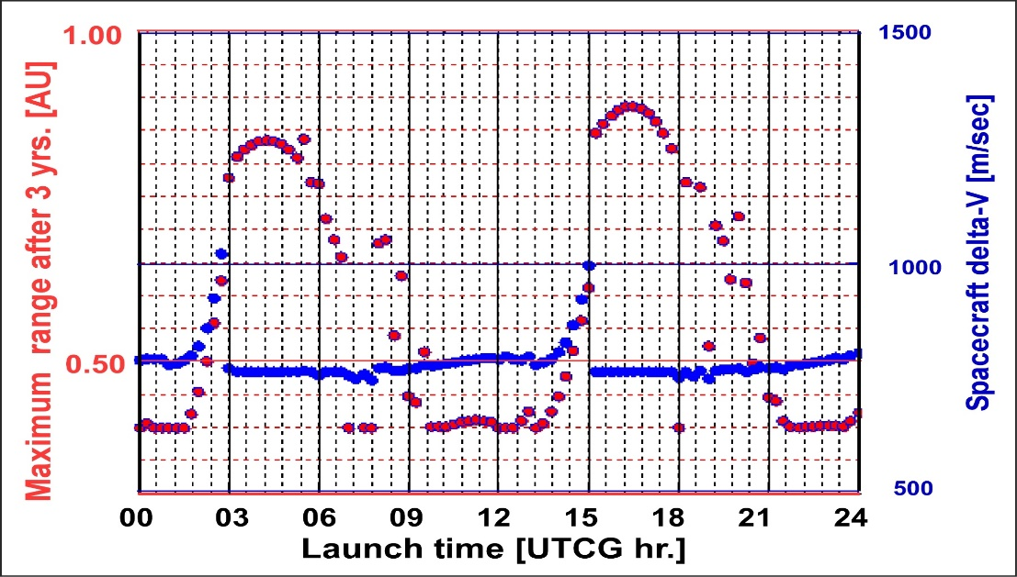
Two Launch Windows
Threshold for max Earth-SC range and max dV for single orbit insertion maneuver
**Optimal Heliocentric Orbit is highlighted**
Leading Orbit Window
Trailing Orbit Window
Notes:
Spacex launch for thaicom 6 at 22 UTGC and ASIASat 6 at 5 UTGC, CRS 7 at 6 pm,
**Desired heliocentric orbit under teal line satisfies max range condition of 0.5 AU after mission lifetime and 800 m/s dV maneuver

Slide 10
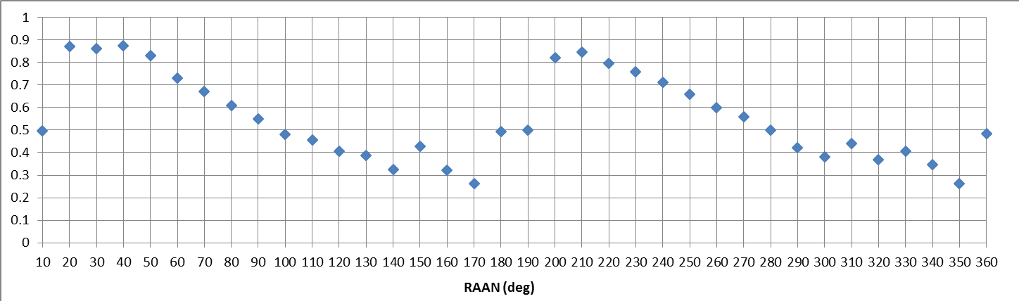
RAAN Sweet Spots vs Earth-SC Range
100 – 180 deg
280 – 360 deg
Leading Orbit
Trailing Orbit
**0.5 AU is max Earth-SC range after mission lifetime**
Notes:
This graph illustrates the ‘sweet spot’ of RAAN for obtaining a range btwn Earth and SC after 3 years. Anything under teal line represents desirable orbit that costs <800 m/s maximum dV.

Slide 11
RAAN Sweet Spots vs Earth-SC Range
Quadrant III
Quadrant I
Quadrant IV
Quadrant II
Earth escape trajectories can be thought of as being broken into 4 RAAN quadrants
Notes:
Earth escape trajectories can be thought of as being broken into 4 quadrants

Slide 12
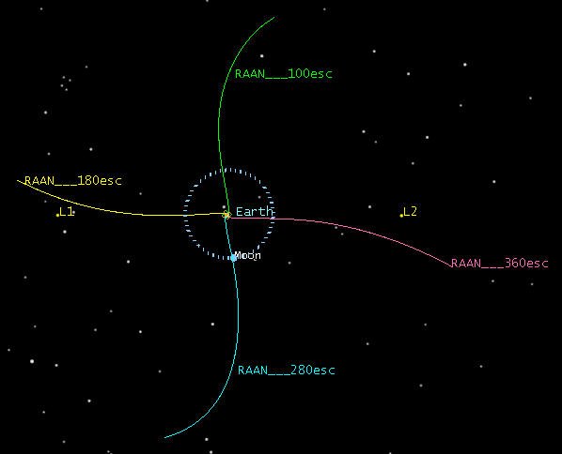
Available RAAN Quadrants
Sun’s position and Earth rotation changes RAAN values ~once every 3 months
Can change escape trajectory by allowing RAAN precession
Leading Orbit sweet spot
Trailing Orbit sweet spot
Notes:
Different launch times/RAAN values that give different escape trajectories
Frozen in earth centred sun rotating frame; sun – earth line is fixed.

Slide 13
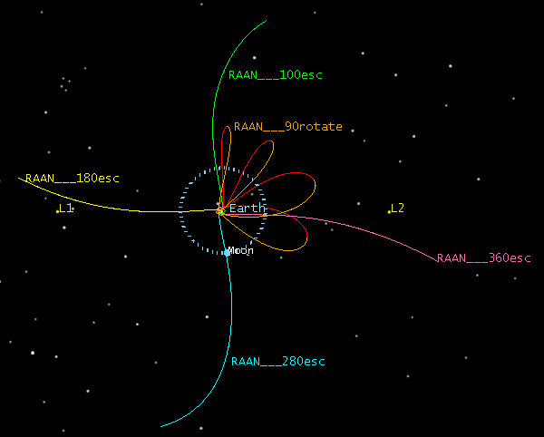
Worst Case Launch Option
Apply maneuver to raise apogee
Orbit for 3 months then use rest of propellant to escape
  Insert into Heliocentic orbit
Leading Orbit sweet spot
Trailing Orbit sweet spot

Slide 14
Orbit Optimization
Propulsion system
  Raise periapsis/lower apoapsis to match Earth’s heliocentric orbit
    PROS: Decrease drift rate which is easier for data volume budget, smaller antennaes
    CONS: require minimum of 1 km/s dV, minimum of 2 burns over course of a year which may result in perturbing instrument pointing
Launch Opportunity
  Find an different rideshare other than to GTO
    Where strategy does not involve waiting period
    Circular LEO parking orbit
Notes:
Active station keeping to keep SC close to Earth in heliocentric space will cost minimum of 1 km/s
If SC doesn’t get released into GTO (eccentric orbit, there exists line of apsides, therefore our escape options are limited to line of apsides direction)
Circular LEO parking orbit would be different, could launch at any time to obtain escape trajectory (CON: require a lot more engery to escape)

Slide 15
Summary
Potentially easiest next step in searching for Earth-like exoplanets may be to look around Alpha Centauri
  Closest star system utilizing foreseeable technology
    Kepler findings are too far to directly image
ACESat would be the first mission to perform direct imaging science around Alpha Centauri
The orbit of such a mission needs to go through iterations and satisfy all instrument/mission requirements
  Current orbit to be optimized in Phase A

Slide 16
Acknowledgements
BIG thanks to the following for helping with orbit research:
  Anthony Genova, NASA Ames Research Center
  Fan Yang, NASA Ames Research Center
  Benjamin Klamm, NASA Ames Research Center
  Jason Swenson, NASA Ames Research Center

Slide 17
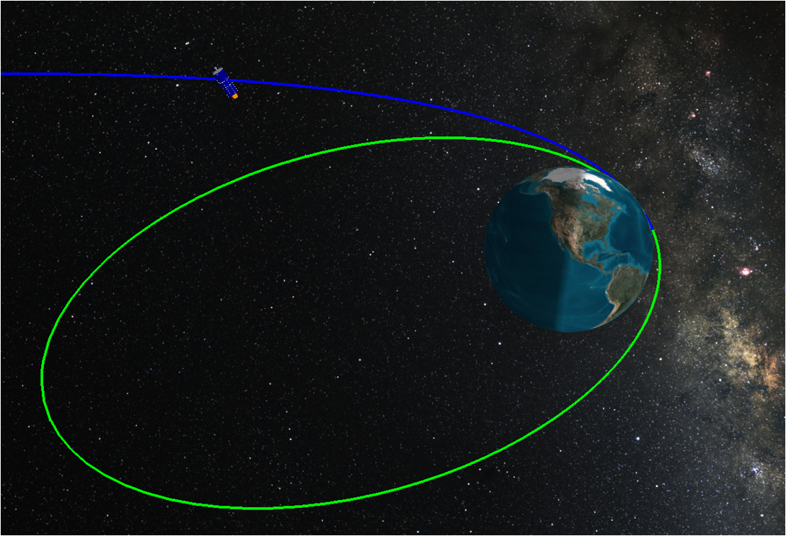
sasha.weston@nasa.gov

Slide 18
Backup Slides

Slide 19
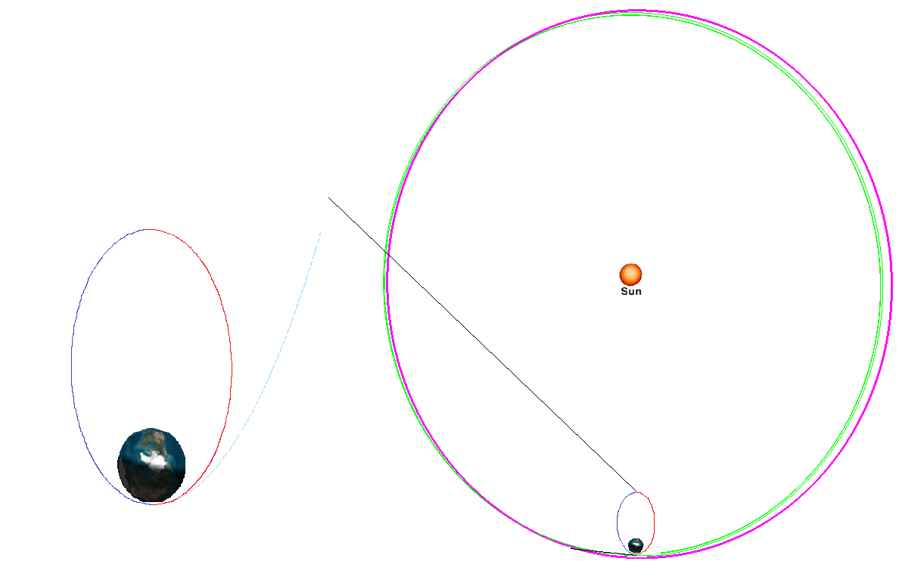
Earth Trailing Heliocentric Orbit
Earth orbit
ACESat orbit
Orbital direction
Winter Solstice
Δv = 800 m/s at GTO perigee
SC 3 year later on 1st Oct
Launch (Autumnal Equinox)
SC 1 year later on 1st Oct

Slide 20
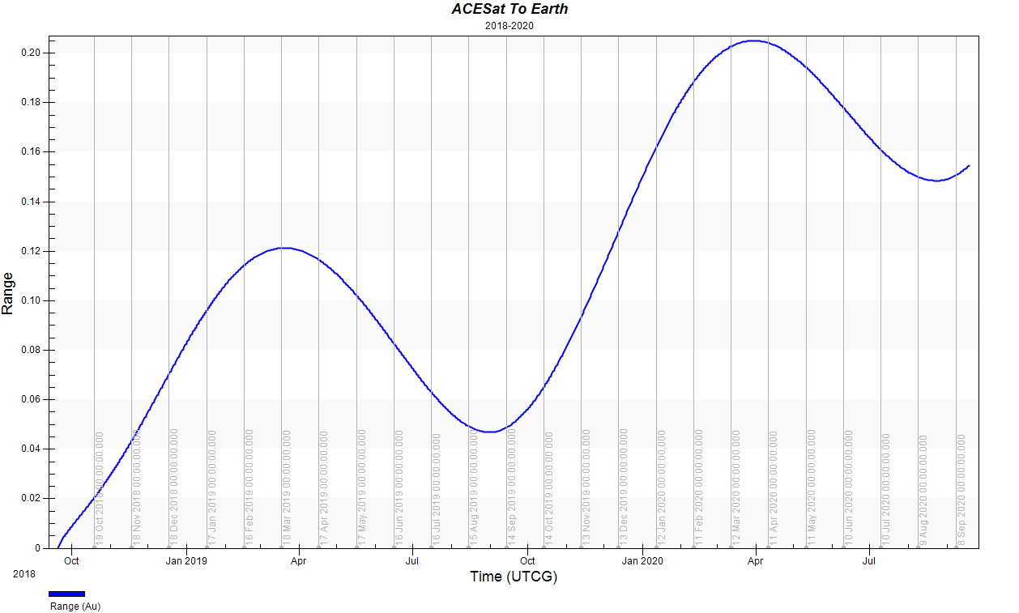
Range btwn Earth and ACESat
**the SC is about 0.28 AU from Earth after 2 yrs**
Notes:
0.28 AU ~ 41.5 million km

Slide 21
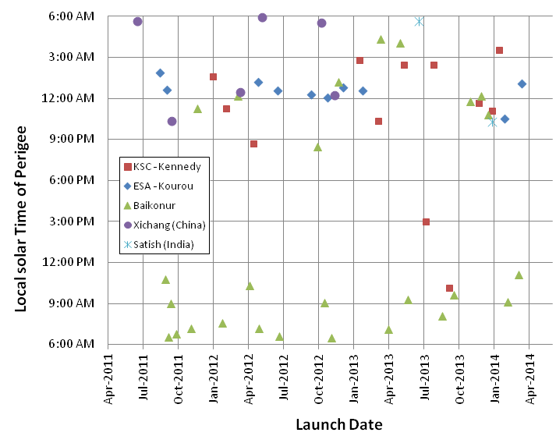
Notes:
Based off of two optimal launch windows for obtaining a Heliocentric orbit, this demonstrates the practicality of launching as a secondary payload;
This signifies that majority of launches occur during optimal launch hours/sweet RAAN spots for Earth Trailing Heliocentric ACESat orbit; will be American launch
***make sure it works for UTC******

