Slide 1




Europa Ice Penetrator
Towards a Hybrid Ice-Penetrating System
Interplanetary Small Satellite Conference
April 27 – 28, 2015
*Jason C. Swenson and †Alexandre M. Kling
* USRA Education Associate, Mission Design Division (Code RD), NASA Ames Research Center Bldg N202 Room 200.
† USRA Education Associate, Space Science and Astrobiology Division (Code SST), NASA Ames Research Center Bldg N245 Room 280.

Slide 2


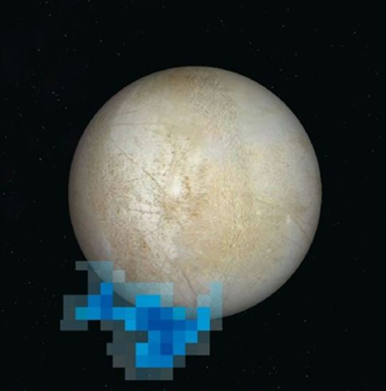
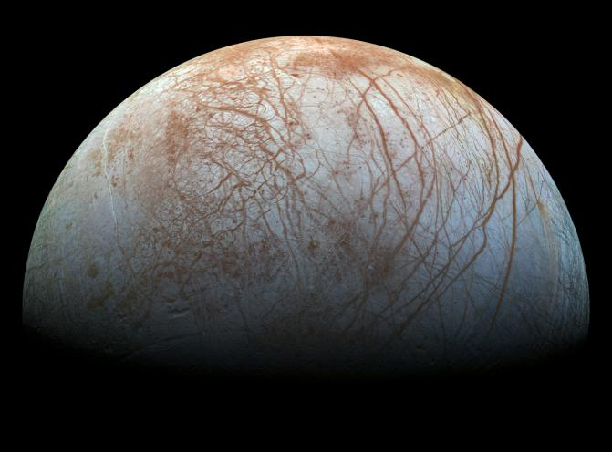
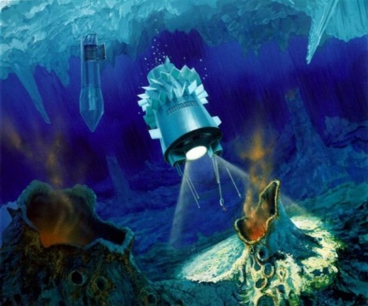
Accessing the Subsurface Constituents on Europa
A Hypothesized Subsurface Ocean
Evidence for life?
Method 1: Penetrate the surface
Method 2: Sample and analyze the plume
Credit: NASA
Adapted from NASA, ESA, and L. Roth

Slide 3




ConOps Possibilities
LANDER
1
2
3
IMPACTOR
A
B
C
* For conceptual purposes only. Not all potential mission sequences are discussed.

Slide 4
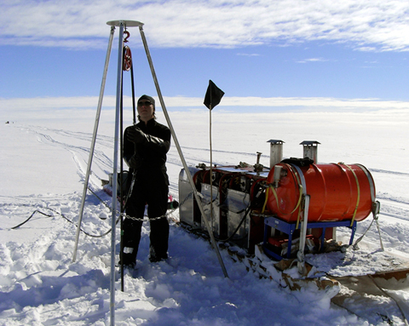
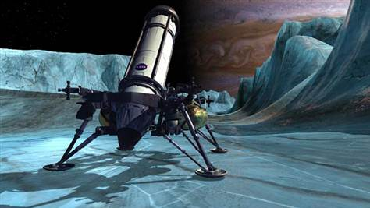
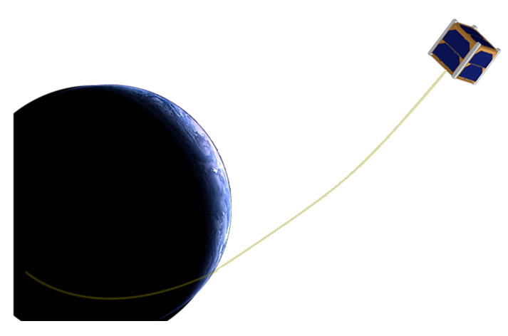
Use of Small Spacecraft?
Earth-based techniques Non-applicable due mass and volume constraints | Flagship-class mission Is this the way to go? (Perhaps…) | Small(er) spacecraft Can we do something? (requires understanding of payloads involved)
ISSC 2015
?
Courtesy Y. Bar-Cohen, K. Zacny
“Aliens of the Deep “, James Cameron
Low-cost scientific studies can be enabled with strict constraints on spacecraft mass and volume.

Slide 5
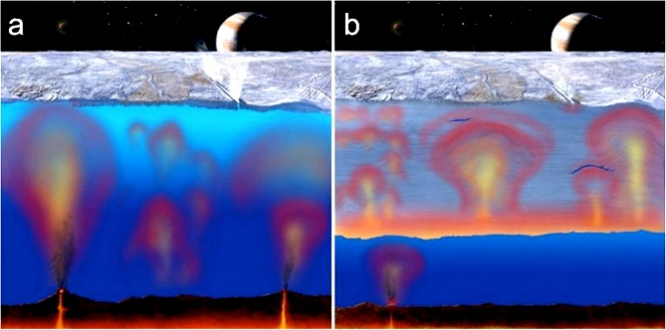
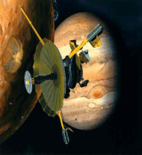

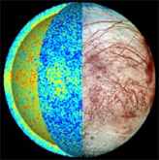
Global Ice Shell Discrepancies
Courtesy NASA/JPL.
Galileo’s Doppler & Magnetometer Data
Internal structure, thickness of H2O layer
Methods
Observation of geological features
Domes, pits, flexure, and craters
?
Thin conductive ice shell
Few km
Thin conductive shell over a thicker layer of convective warm ice
Tens of km
Thermal modeling
Tidal heating, heat dissipation
0
6
19
25
30
50
25 km is a plausible estimate
6-30 km: supported topography
Estimation
25-50 km: thermal modeling
19 - 25 km: impact craters

Slide 6
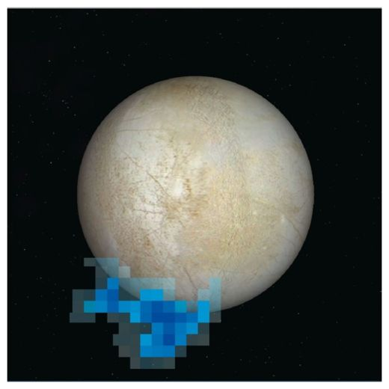
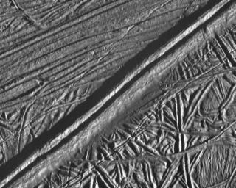
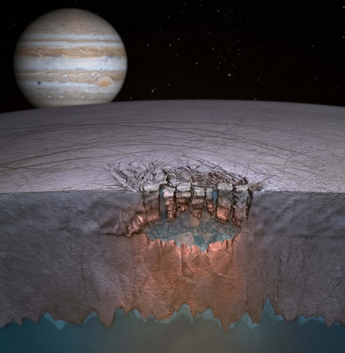
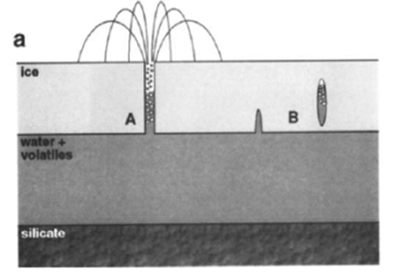
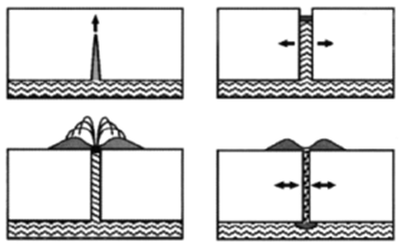
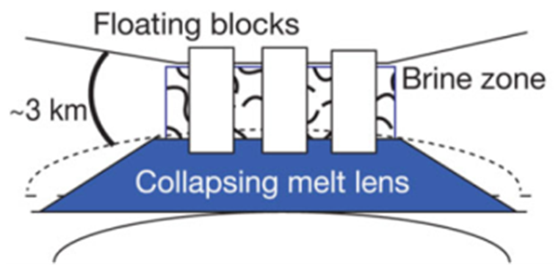
Local Ice Shell Discrepancies
 | Plumes | Ridges | Chaos Terrain
Observations
Models
*
†
Ϡ
†
†
†
‡
* Courtesy of NASA, ESA, and L. Roth
Ϡ Courtesy of University of Texas, Austin
† R.T.Pappalardo, 1999. Does Europa Have a Subsurface Ocean? Evaluation of the Geological Evidence. Journal of Geo. Research, Vol 104, pp. 24.015-14;055.
‡ Schmidt, B. E et al., 2011. Active Formation of 'Chaos Terrain' over Shallow Subsurface Water on Europa. Nature, 479(7374), pp. 502-504.
†

Slide 7
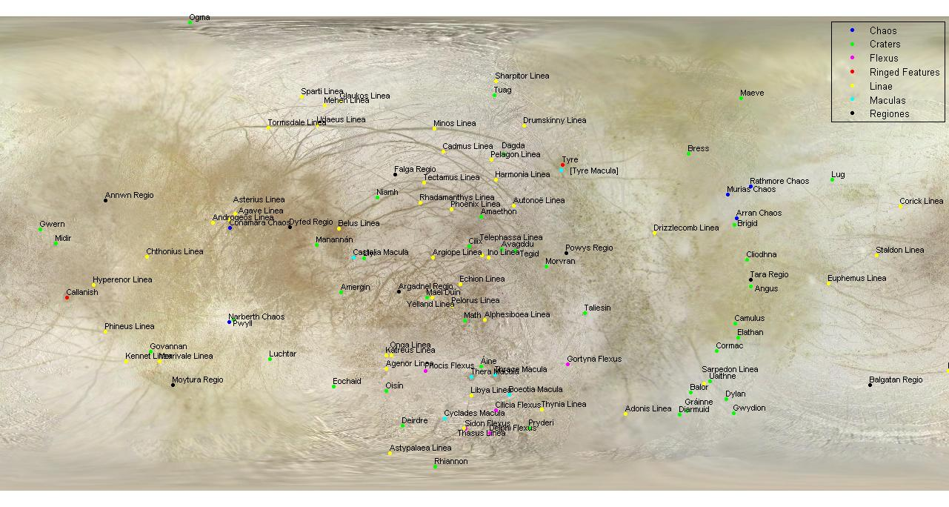
Deployment Sites
Nomenclature-approved geological features on Europa (USGS)

Slide 8
Ice-Penetrating System (IPS) Technology Review
Power requirement [W]
Max penetration rate [m/hr]

Slide 9
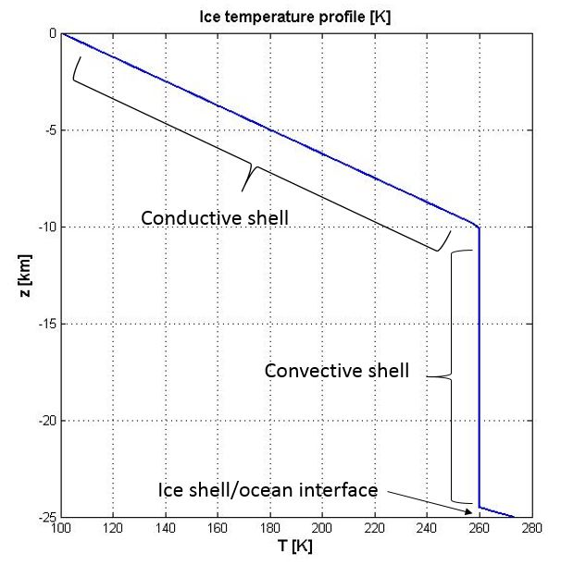
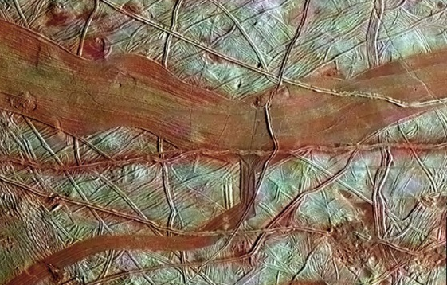
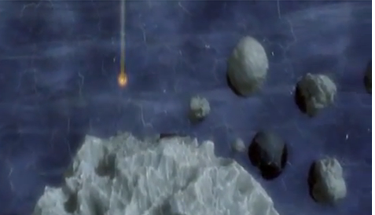
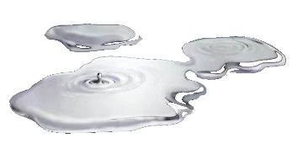
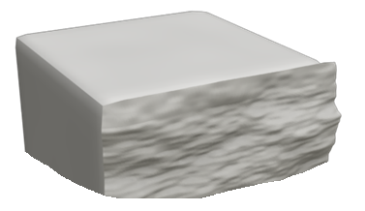
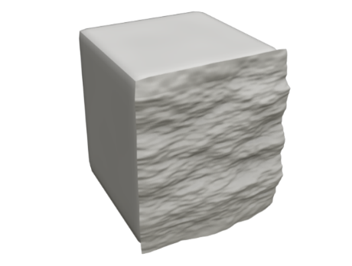
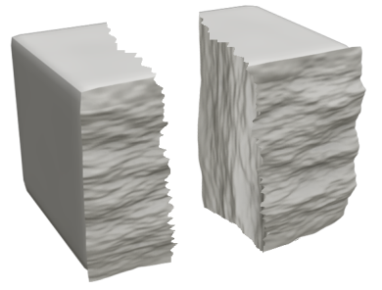
Dimensional Analysis
 | Presence of Salts | Presence of Rocks | Temperature Profile
Hypothesis | ~85% of Europa’s surface is ice or frost Probable non-ice candidates: (MgSO4·6H2O, MgSO4·7H2O,) or Na2Co3·10H2O Concentrations: 1%, 5%, 20%? ? | Presence of rocks unlikely Ecliptic impact probability of Europa relative to Jupiter: 6.6 x 10⁻⁵
Courtesy NASA/ JPL-Caltech/SETI Institute
Courtesy: National Geographic
.
S
}
Melting energy :
E_{melt} ≈ 450 MJ/m³ (surface)
L meters
  Energy, E, required to melt L meters of ice
  Power → time required to deliver E
  penetration rate
  T₀ = 100 K
Specific cutting energy:
E_{cut} ≈ 5 MJ/m³

Slide 10
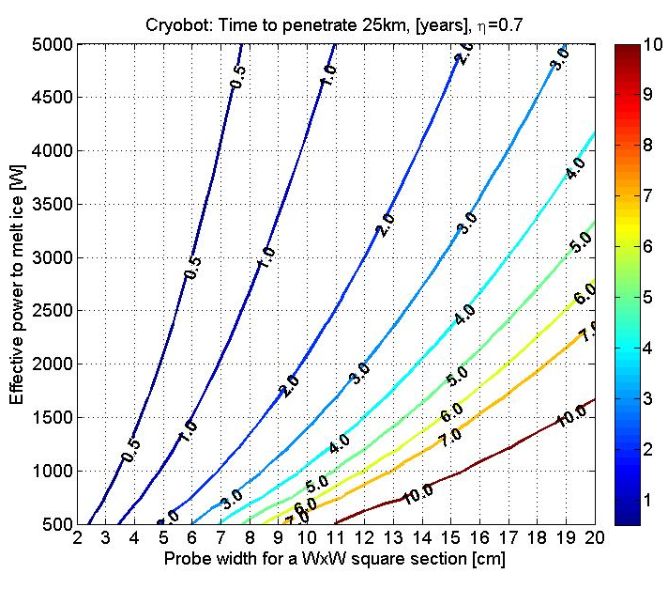

Thermal IPS
Lateral Heating Considered? | Input Power | Total Penetration Time (TPT)
NO | > 1 kW | < 2.75 years
YES | 2 kW | ~4.5 years
Pinput
In practice, 1000 W hardly initiated melt at the surface
Plateral
Chart derived from equations in the following reference: Aamot, H. W. C., 1967. Heat Transfer and Performance of a Thermal Probe for Glaciers; Thermal IPS chart does not consider lateral heating.
Pmelt

Slide 11
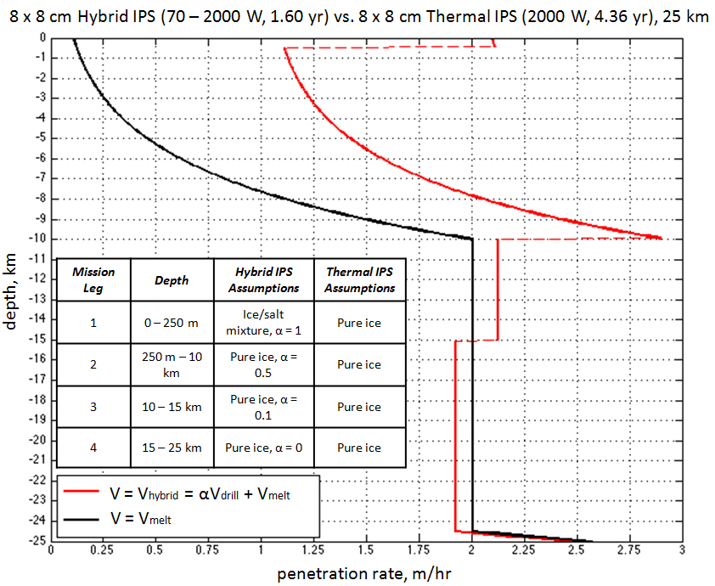
Hybrid IPS
Concept Only
Melting at the surface is highly inefficient
Mechanical drilling allows faster penetration rate at the surface
If convection is initiated within the crust, the ice shell is thick and temperatures rise quickly
(In our model, dT/dz = 16 K/km)
10 km
~100 K
~260 K
15 km
~273 K
Courtesy NASA/JPL.

Slide 12
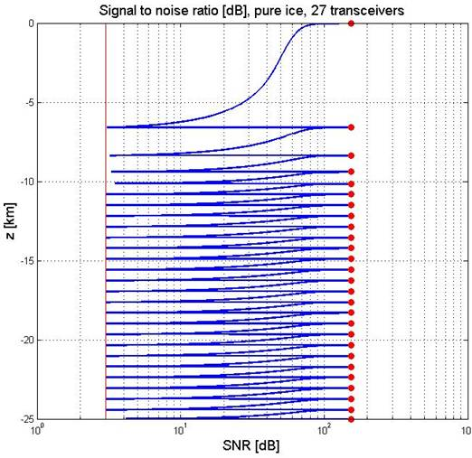
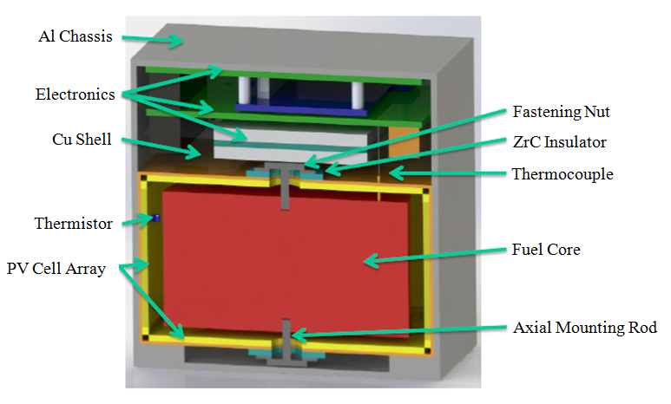
System Considerations:
Power Distribution and Communication
A. Goel, K. Schillo, B. Franz and S. Reddy, "Radioisotope Thermophotovoltaics (RTPV) Flight Demonstration," Idaho Falls, ID, 2014.
How to power an IPS traversing 25 km?
Surface-based power
  Large mass requirement
  Tethers limit achievable depth
Internal power
  RPS (e.g. RTPV) could provide 1.4 kW for a melthead / drill actuator
How to communicate through 25 km of ice?
Mini RF Ice Transceivers
?
A. Goel, K. Schillo, B. Franz and S. Reddy, 2014. "Radioisotope Thermophotovoltaics (RTPV) Flight Demonstration," Idaho Falls, ID, 2014.
Bryant, S., 2002. Ice-Embedded Transceivers for Europa Cryobot Communications. Big Sky, Montana.

Slide 13
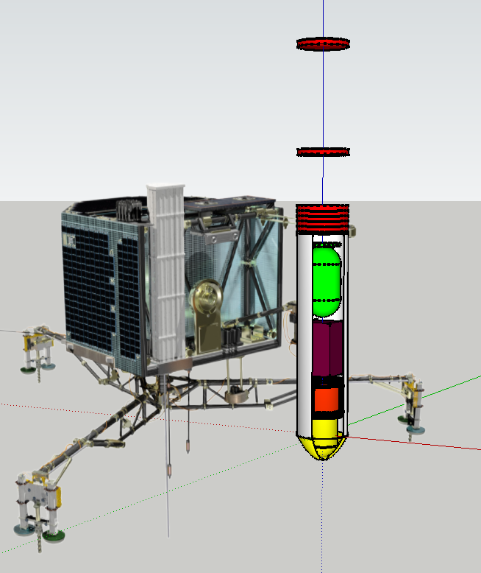
Concept: Hybrid IPS for 25 km Ice Shell
~ (8 cm x 8 cm)
 | Component | Remarks
 | Mini RF Ice Transceivers | Robust to ice shell motion and borehole refreezing
 | Science Payload | - “Lab on chip”(€) - Conductivity, Temp. and Depth Sensor (ð) - underwater vehicle
 | IPS Body | Lateral heating
 | Control Unit & Sensors | - IMU sensor - Ultrasound Sensor - Thermal/IR Imager
 | Melthead / Drilling Actuator | - Rotary drill - Hammer drill
 | Radioisotope Power Source (RPS) | If penetration depth >3km, otherwise tether may be possible
70 W < P < 2000 W
A
A
B
B
D
C
O (1 meter)
F
D
C
E
E
€ Butterworth, A.L. et al. Lab-on-a-Chip Organic Analyzer: Instrumentation and Methods for Detecting Trace Organic Molecules and Amino Acid Chirality in Planetary Science. 46th LPSC, 2015.
ð Jonsson, Jet al. Chip-Based Salinity Measurements for Small Submersibles and Biologgers. International Journal of Oceanography, 2013.
F

Slide 14
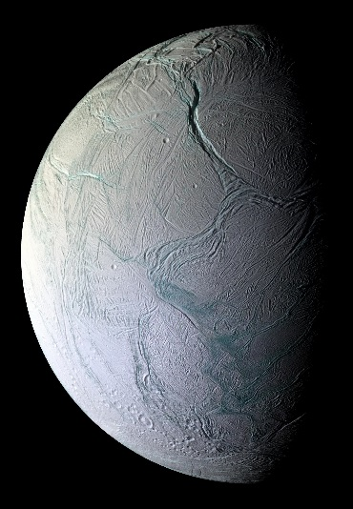
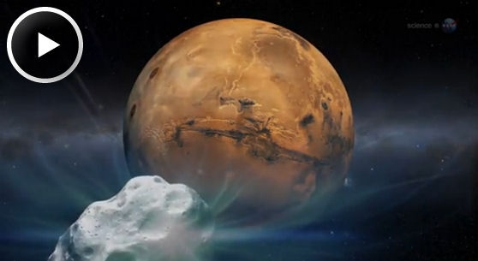
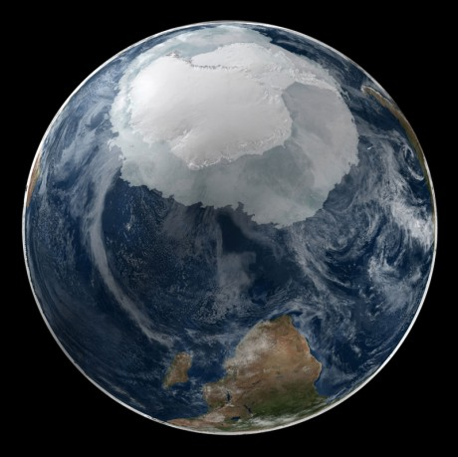
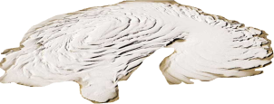
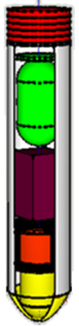
Need for an IPS Able to Penetrate Ice-rock Mixtures
Lake Vostok,
Antarctica
Mars polar caps
Ross Ice Shelf
Galilaen and jovian icy moons
Ross Ice Shelf
Credit: ESA
Comet nuclei
Adapted from NASA and NASA/Goddard/Space Flight Center

Slide 15
Conclusion
Hybrid (melting and drilling) system would enable drilling through cold surface ice and salts
A 70 – 2000 W hybrid IPS unit can theoretically complete its mission in approximately 1.6 years, nearly three times faster than a 2000 W thermal IPS with lateral losses included and of the same cross sectional area
RPS technology is required to achieve large (>> 3 km) penetration depths; 27 ice-embedded mini RF transceivers are required for communications at 25 km
Potential for a hybrid IPS to explore other icy bodies (moons, comet nuclei, Mars’ polar caps, etc.) or study subglacial environments (Antarctica, Arctic, etc.)
…

