Slide 1
Ice Cube Lunar Orbiter with
BIRCHES (Broadband InfraRed Compact High-Resolution Exploration Spectrometer)
NEXTSTEP LunarCubes Mission and Instrument Concept
P.E. Clark, IACS/CUA/NASA GSFC and Flexure Engineering, Science PI
B. Malphrus, Morehead State University, PI
Morehead State University: B. Twiggs, Jeff Kruth, Kevin Brown, R. McNeill, B. Kroll
NASA/GSFC: A. Mandell, R. MacDowall, C. Brambora, D. Patel, S. Banks, D. Folta, P. Calhoun, P. Coulter
Busek: K. Hohman, V. Hruby
Next Step Selectee Announced March 30, 2015!

Slide 2
Why Lunarcubes?
Using the Cubesat paradigm to build user requirements driven ‘pathfinders’ for low-cost multi-platform mission concepts that will ultimately provide next generation exploration through the use of temporal and spatially distributed measurements.
Providing access to deep space via the Moon as nearby analogue, technology testbed, and gateway to the solar system.
Providing a low-cost alternative for high science yield missions at a time of declining funding and increasing costs for conventional missions.
Taking advantage of the decade long evolution of the cubesat model from standardized kits to science-driven, multi-institutional, multi-platform collaborations for LEO applications.
Examining the use of cubesat hardware/software for missions that are a representative cross-section of lunar, Mars, and other applications at varying degrees of difficulty (flyby, probe, orbiter, lander).
identifying modifications and new technology needed to support a science-driven deep space mode.
Looking for NASA to expand the CubeSat Launch Initiative which provides launch opportunities for cubesats to LEO as secondaries at no cost, to GEO and beyond.
designing a deep space prototype bus, and prototype for a lunar orbiter missions.
Building on the exploding interest in cubesat as seen in growing popularity of our LunarCubes Workshops over the last 3 years.

Slide 3
Science Goals
Understanding the role of volatiles in the solar system
Enabling broadband spectral determination of composition and distribution of volatiles in regoliths (the Moon, asteroids, Mars) as a function of time of day, latitude, regolith age and composition.
Providing geological context by way of spectral determination of major minerals.
Enabling understanding of current dynamics of volatile sources, sinks, and processes, with implications for evolutionary origin of volatiles.
IceCube addresses NASA HEOMD Strategic Knowledge Gaps related to lunar volatile distribution (abundance, location, transportation physics water ice).
IceCube complements the scientific work of Lunar Flashlight by by observing at a variety of latitudes, not restricted to PSRs

Slide 4
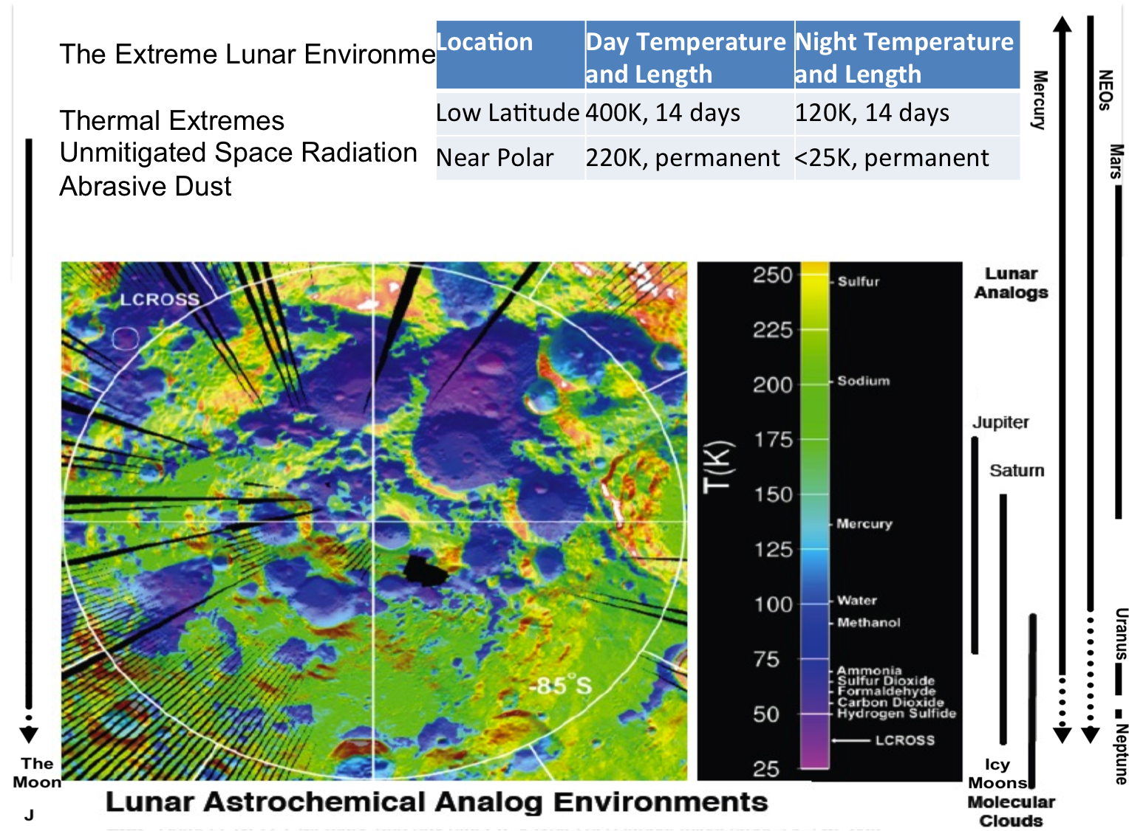

Slide 5
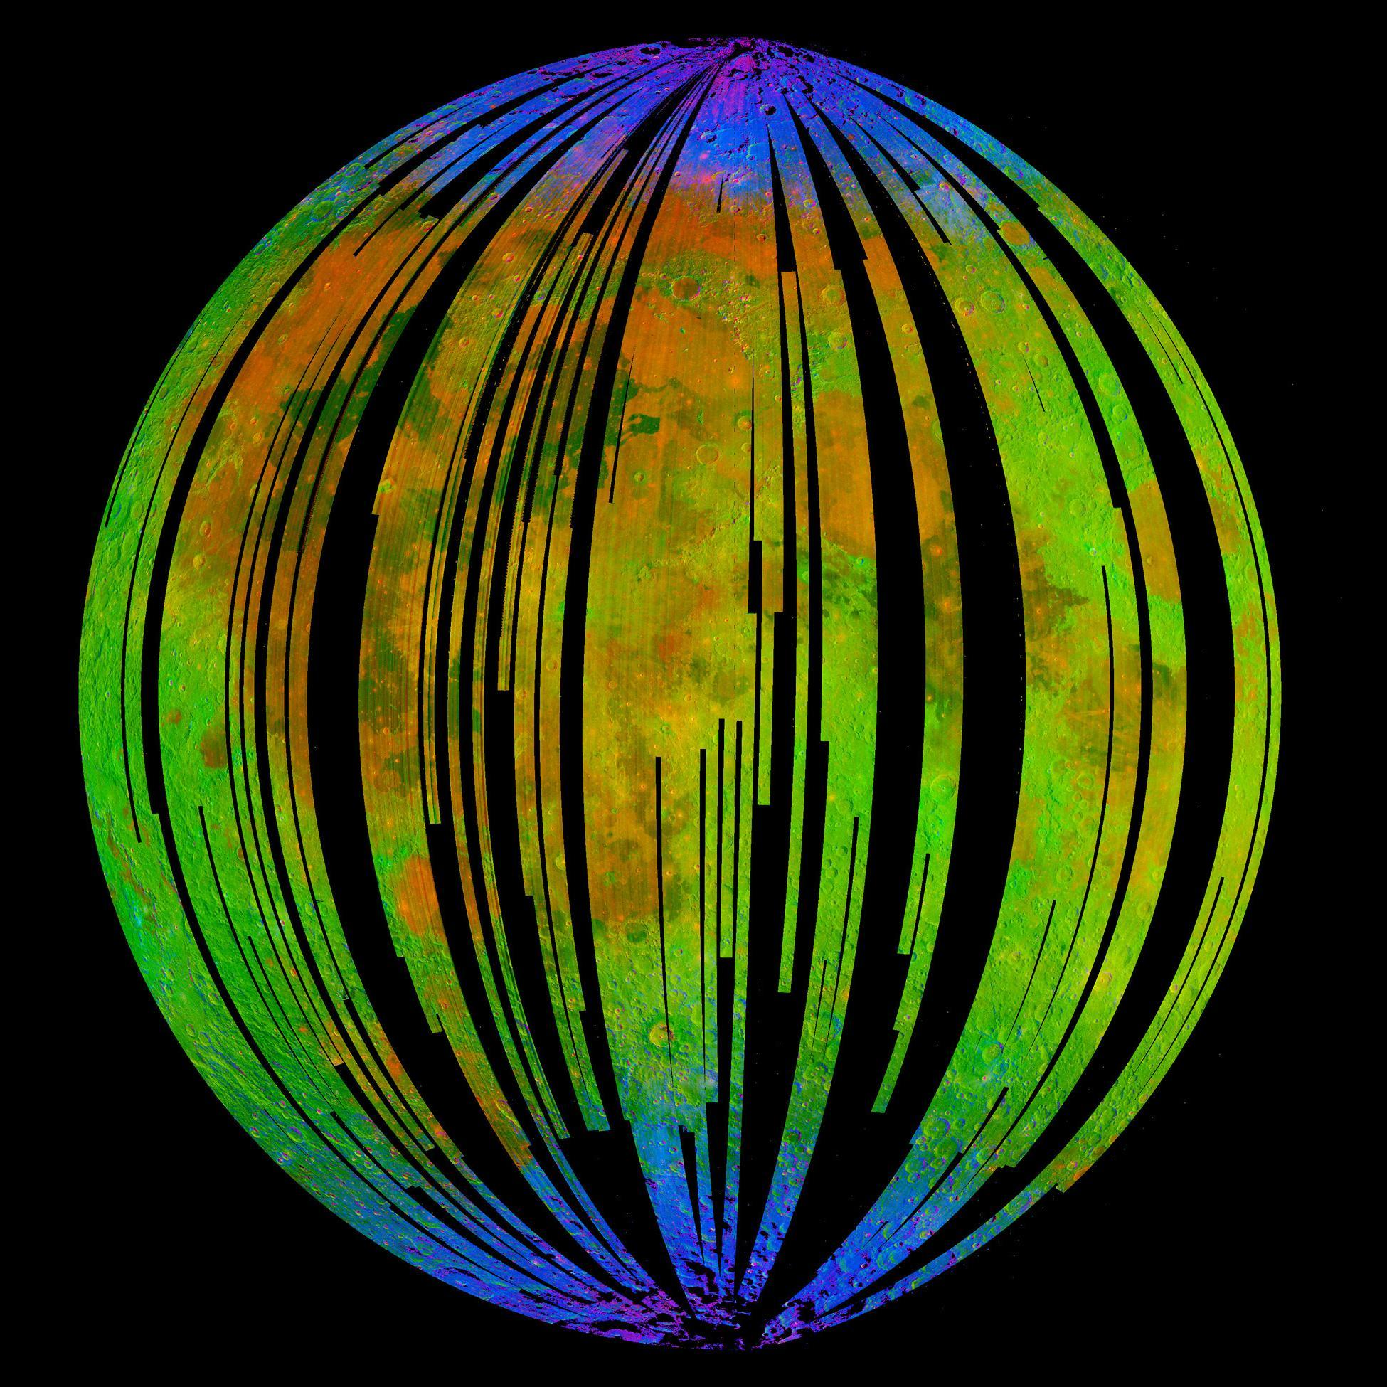
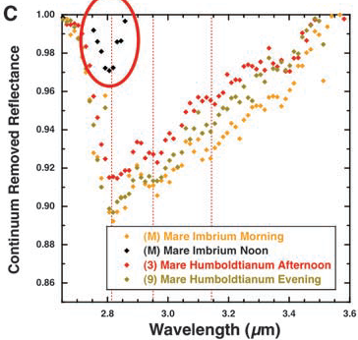
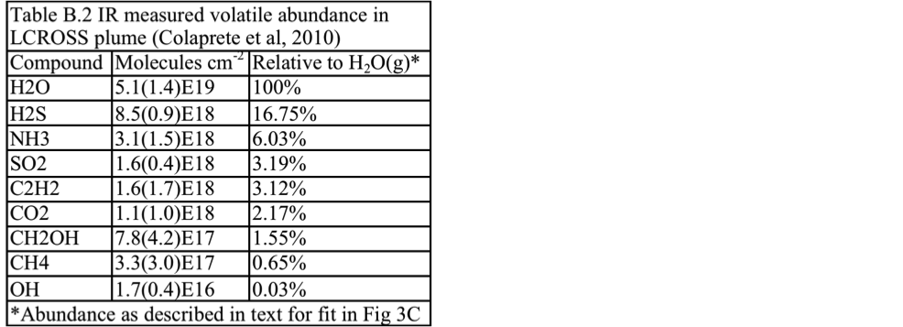
While M3 provided a ‘snapshot’ mosaic of lunar nearside indicating surface coating of OH/H₂O (blue) near the poles,
Early evidence for diurnal variation trend in OH absorption (Sunshine et al. 2009)
LCROSS provided evidence of additional subsurface volatiles.
IceCube will extend ‘snapshots’ to geospatially linked time of day and latitude coverage.

Slide 6
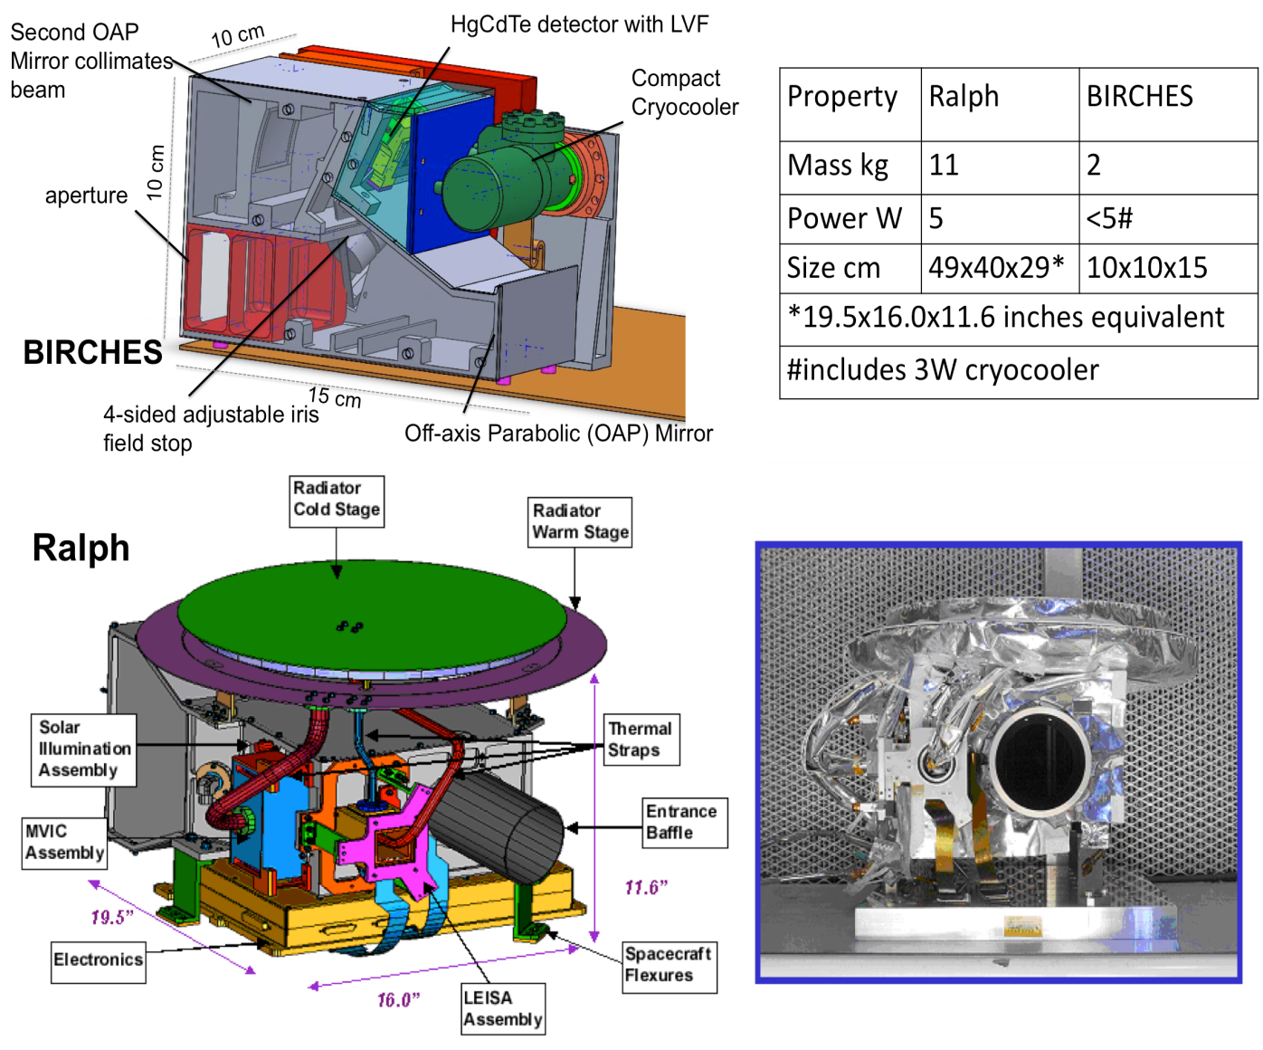
Broadband IR spectrometer with HgCdTe and compact line separation (LVF)
Compact microcrycooler to ≤ 120K to provide long wavelength coverage
compact optics box designed to remain below 220K
OSIRIS Rex OVIRS heritage design

Slide 7
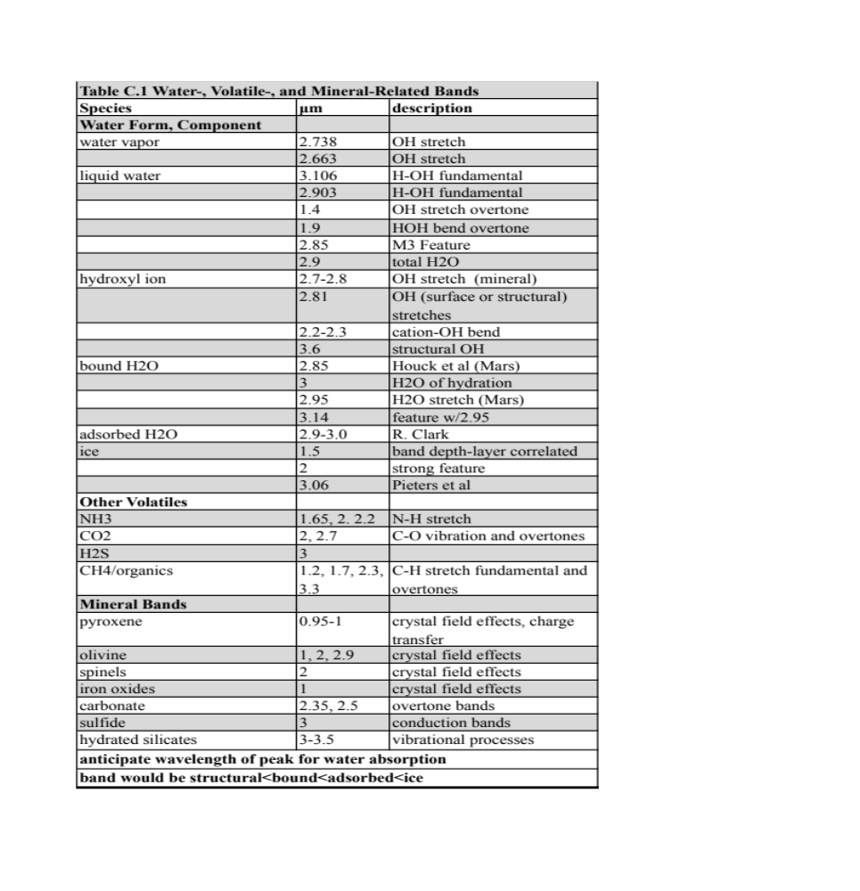
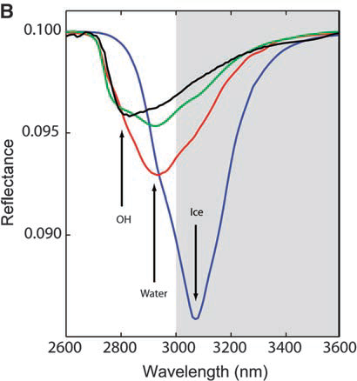
Ice Cube measurements will not cut off (Pieters et al. 2009) but encompass the broad 3 um band to distinguish overlapping OH, water, and ice features.

Slide 8
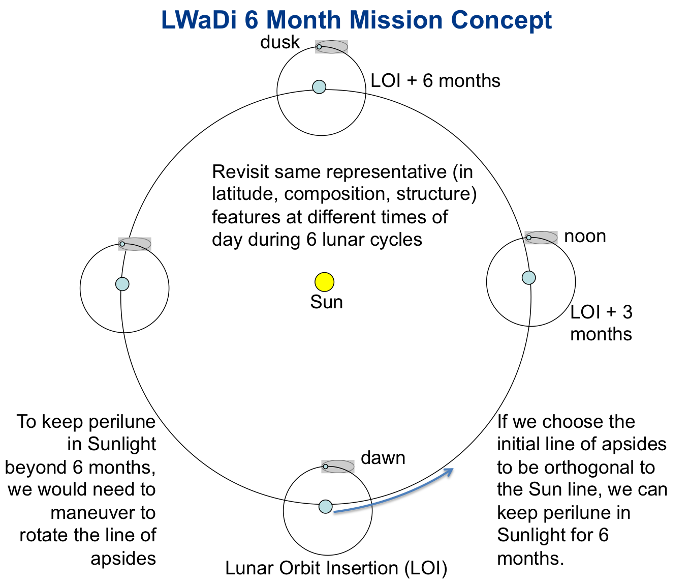
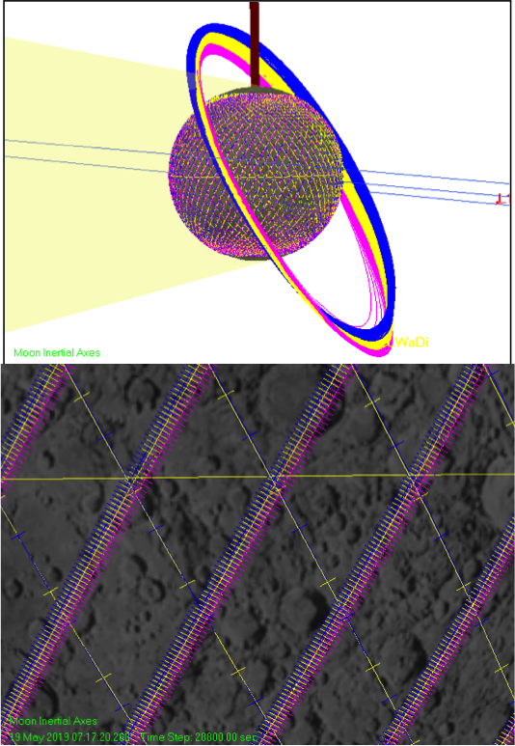

Slide 9
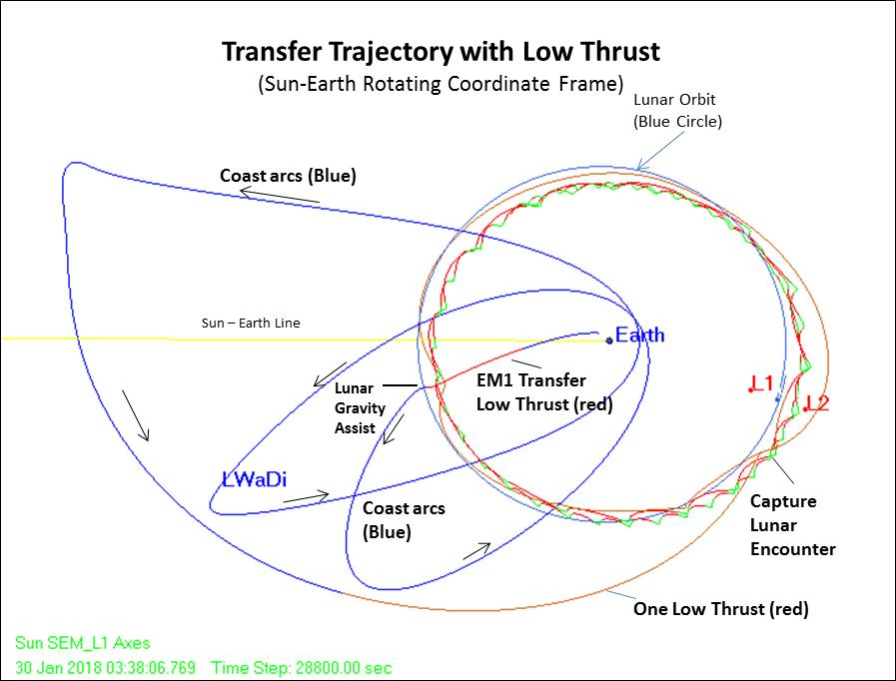
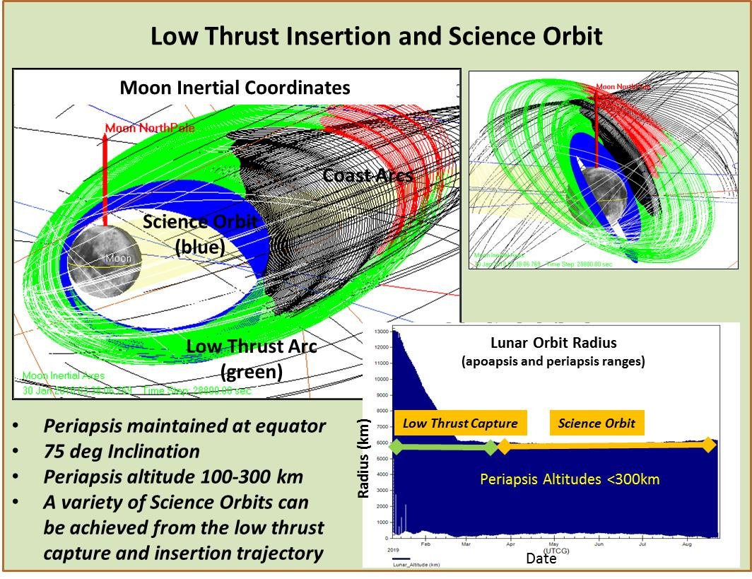
IceCube utilizes a minimal DV transfer trajectory harnessing expertise of GSFC flight dynamics.
IceCube lunar capture and science orbit designed by experienced GSFC flight dynamics team.

Slide 10
IceCube versus Previous Missions
Mission | Finding | IceCube
Cassini VIMS, Deep Impact | surface water detection, variable hydration | water & other volatiles, fully characterize 3 μm region as function of several times of day for same swaths over range of latitudes w/ context of regolith mineralogy and maturity, radiation and particle exposure, for correlation w/ previous data
Chandra M3 | H2O and OH (<3 microns) in mineralogical context nearside snapshot at one lunation
LCROSS | ice, other volatile presence and profile from impact in polar crater
LP, LRO, LEND LAMP DVNR LOLA LROC, LADEE | H+ in first meter (LP, LEND) & at surface (LAMP) inferred as ice abundance via correlation with temperature (DIVINER), PSR and PFS (LROC, LOLA), H exosphere (LADEE)

Slide 11
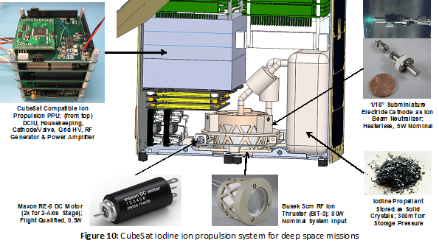
Busek Iodine ion propulsion system

Slide 12
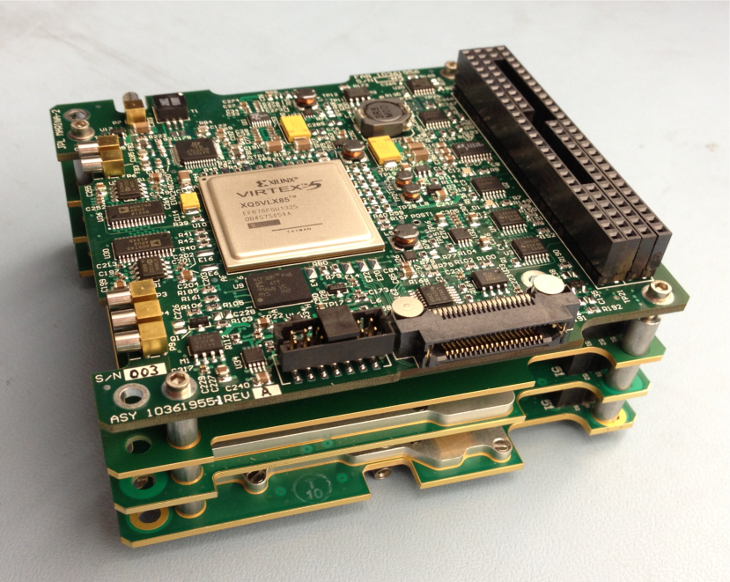
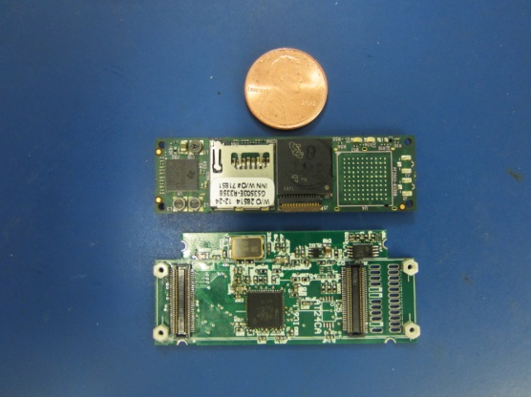
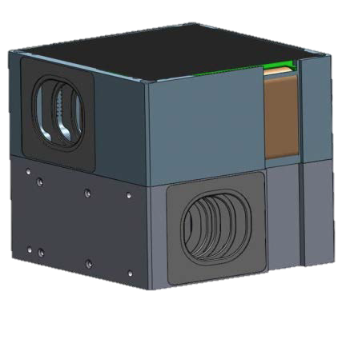
Bus Components
Thermal Design: with minimal radiator for interior the small form factor meant that interior experienced temperatures well within 0 to 40 degrees centrigrade, except for optics box which has a separate radiator.
Communication, Tracking: X-band, JPL Iris Radio, dual X-band patch antennas, X-band dish (trade availability, cost, dB, and DSN compatibility, live with the fact this hasn’t flown in deep space)
C&DH: very compact and capable Honeywell DM microprocessor, at least one backup C&DH computer (trade volume, complexity, cubesat heritage, live with the fact this hasn’t flown in deep space)
GNC/ACS: multi-component (star trackers, IMU, RWA) packages with heritage available, including BCT XB1, which can interface with thrusters (trade cost, volume, cubesat heritage, live with the fact this hasn’t flown in deep space)

Slide 13
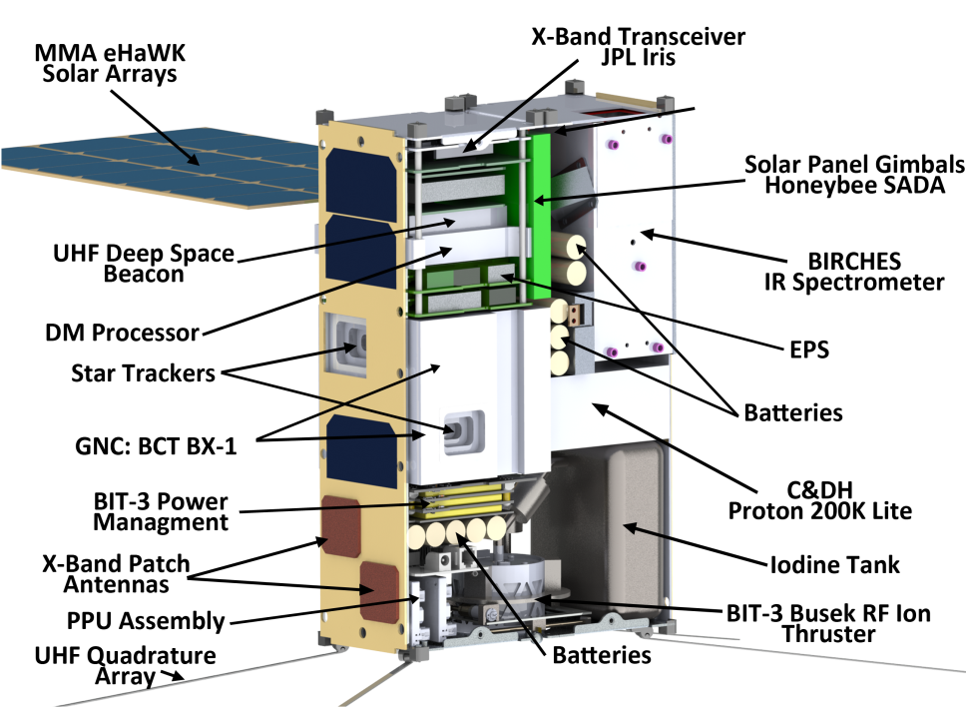
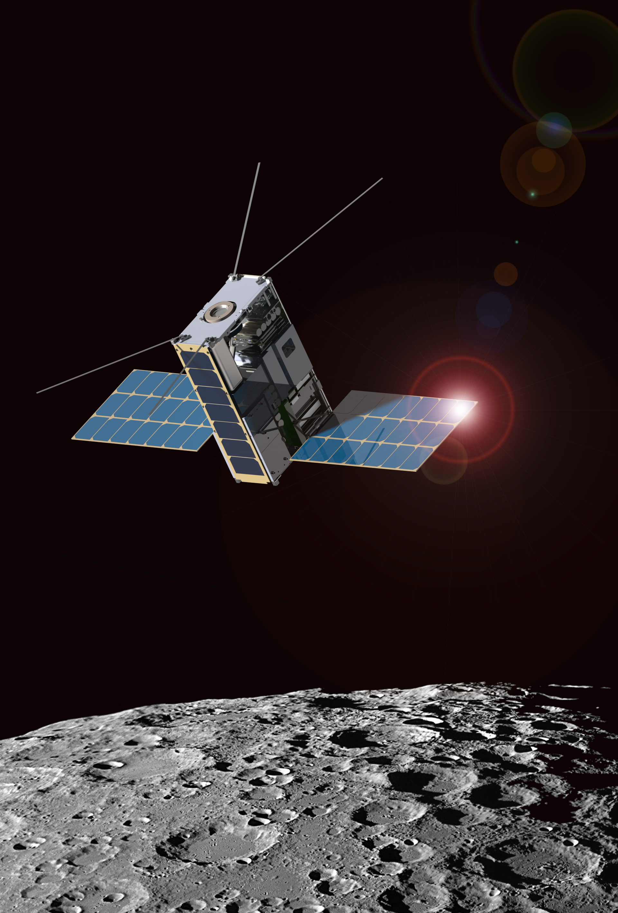
IceCube Concept: Morehead CubeSat Bus

Slide 14
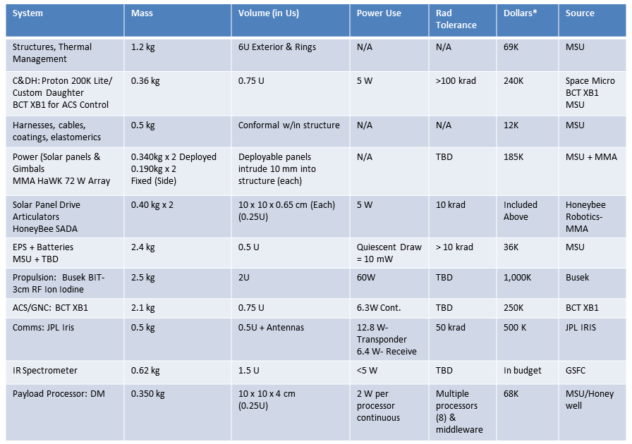
Table 4: Lunar IceCube Subsystems

Slide 15
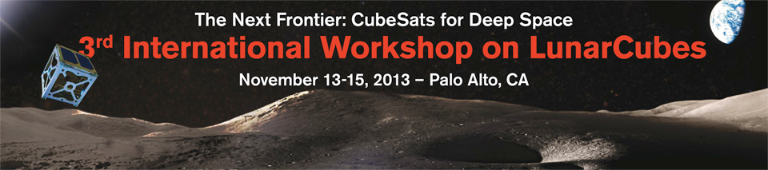
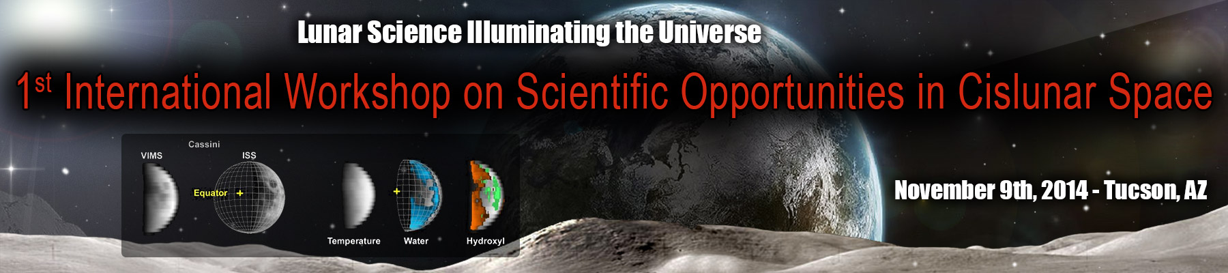

Slide 16
BACKUP SLIDES

Slide 17
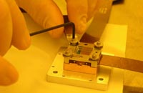
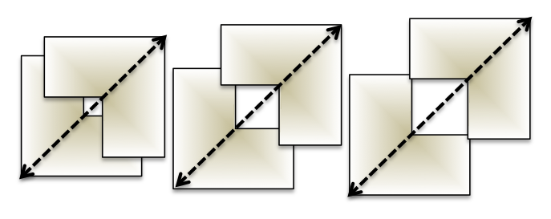
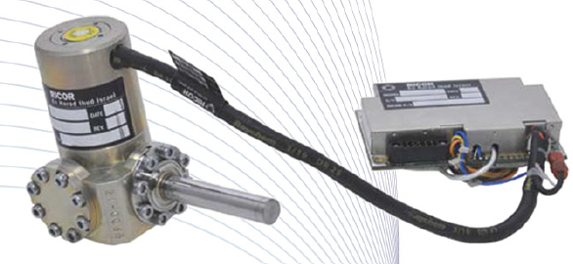
Spectrometer Components
CC controller
Cryocooler (CC)
Radiator
Detector Interface Electronics
Optics Box
OAP
LVF
HCT FPA
Adjustable Iris (AI)
AI controller (stepper motor)
Spacecraft C&DH
BIRCHES utilizes a compact Teledyne H1RG HgCdTe FPA and JDSU linear variable filter detector assembly leveraging OSIRIS REx OVIRS.
Spacecraft Power
Aperture
OAP
Special Radiator
BIRCHES block diagram illustrates simplicity and flexibility of design.
Off the shelf tactical cryocooler with cold finger to maintain detector at ≤140K
Adjustable Iris maintains footprint size at 10 km by varying FOV regardless of altitude

Slide 18
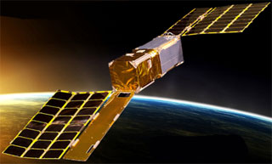
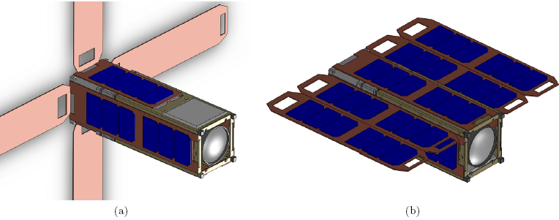
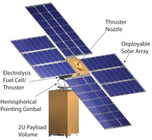
Bus Components
Power:
compactly packaged Li-based batteries (e.g., GOM) that provide adequate power storage for longest ‘eclipse’ of sun in orbit;
electrical power system, for which many cubesat heritage options are available
Deployable solar panels, for which a number of choices are available (from top to bottom, turkey tail, cross, table, gimballed version of cross). Producers include MMA Design, Honeybee Robotics) Require >50 W running an active propulsion system, which should be more than adequate for other needs when propulsion system isn’t running.
trade space cost, mass, reliablity, although volume of solar panels is in the ‘cheat space’ and doesn’t count against 6U total

Slide 19
EM1 Selectees to Date
Program | Target, Description | Payload | Lead
HEOMD NEXT STEP | Moon, orbiter, Ice Cube | broadband IR cryocooled. | Morehead State U/NASA GSFC/Busek
HEOMD AES | Lunar Flashlight orbiter. (Surface ices in permanently shadowed ‘cold traps’) | NIR instrument. | JPL
HEOMD AES | Near Earth Asteroid Scout | Imager to characterize asteroid dynamics and surface | JPL
HEOMD AES | BioSentinel | Radiation Exposure Induced Genetic Damage Experiment | NASA/Ames
HEOMD NEXT STEP | ?? | ??? | Lockheed Martin
SMD SIMPLEx
STMD Centennial Challenges

Slide 20
Overarching Question: Considering the science priorities and resulting range of science investigations, and the range of potential payloads, what does a 'lunarcube' platform look like? 6U, needs robust propulsion system (>1.5 km/sec delta V) mostly to achieve desired orbit from lunar capture, can carry up to 2U payload, >60W power desirable, needs robust thermal protection design, requires 1 year plus
Design Challenge 2 Cubesat Concepts to Cubesat Missions: Applied to this concept
1) Overview science, investigation, operational concept and principal drivers (needs) volatiles study, low periapsis elliptical inertially orbit, thermal design and mobility
2) Trade space (prioritized needs for which optimized capabilities are needed versus resources (volume, cost, bandwidth) available)? More robust and compact ACS, Comm, Power systems available but at cost.
3) What are your perceived performance limitations, risks, and descope options? Bandwidth limited (comm), delta V limited (but focused mission achievable), thermal design challenging and would be improved with ‘smart’ materials and mechanisms. Radiation exposure risk involving use of RHBD hardware/software and more reliable parts sources. Descope involves taking data on way down to final orbit, baseline is 3 months (rather than 6) in that orbit.
4) Link science objective, measurement, instrument requirements, mission requirements, science product (see chart)

