Slide 1

Citizens in Space

Slide 2
Testing Interplanetary
CubeSat Payloads
Using
Reusable Suborbital Spacecraft

Slide 3
Reusable Suborbital Spacecraft:
A New Paradigm
Cheap, frequent access to space
Aircraft-like" operations
Reusability -> affordability
  Reliability
  Maintainability
  "Save"-ability (intact abort)
  Operability (ready response, rapid turn times)
  Flexibility (many possible payloads)

Slide 4


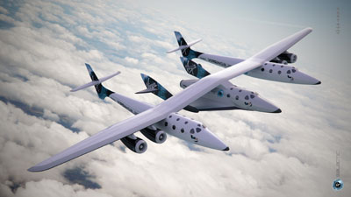
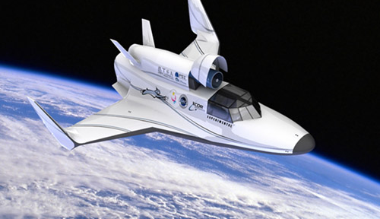


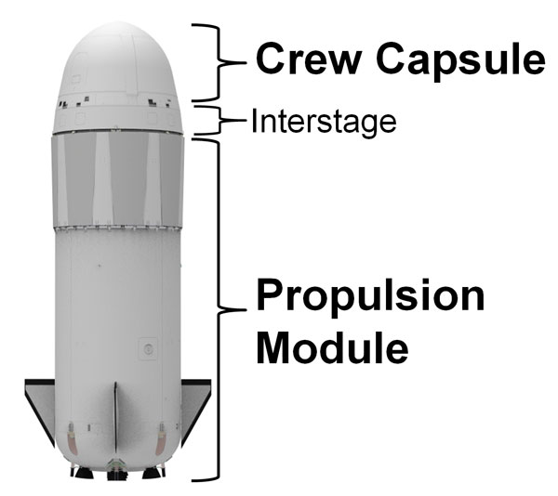
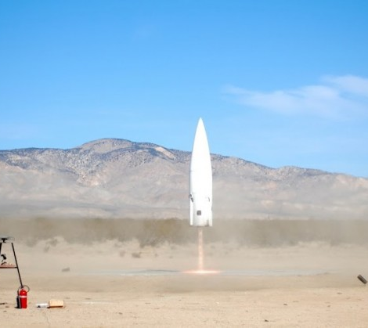
Commercial Competition
Virgin Galactic
XCOR Aerospace
?
Blue Origin
Masten Space
Exos Aerospace

Slide 5

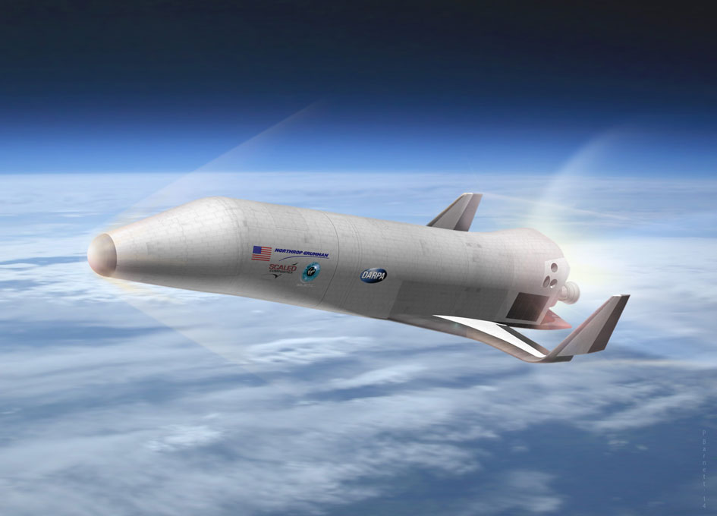

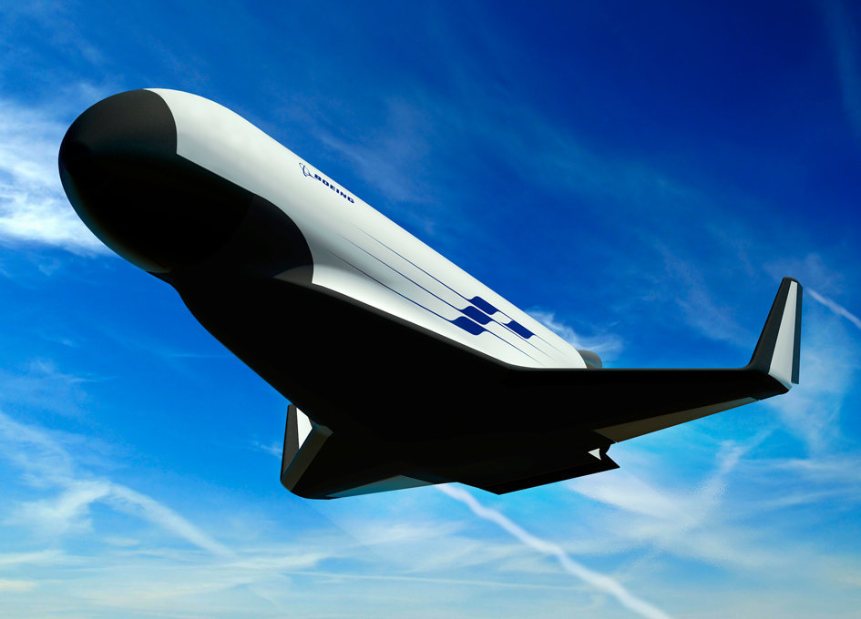
DARPA Experimental Spaceplane (XS-1)

Slide 6

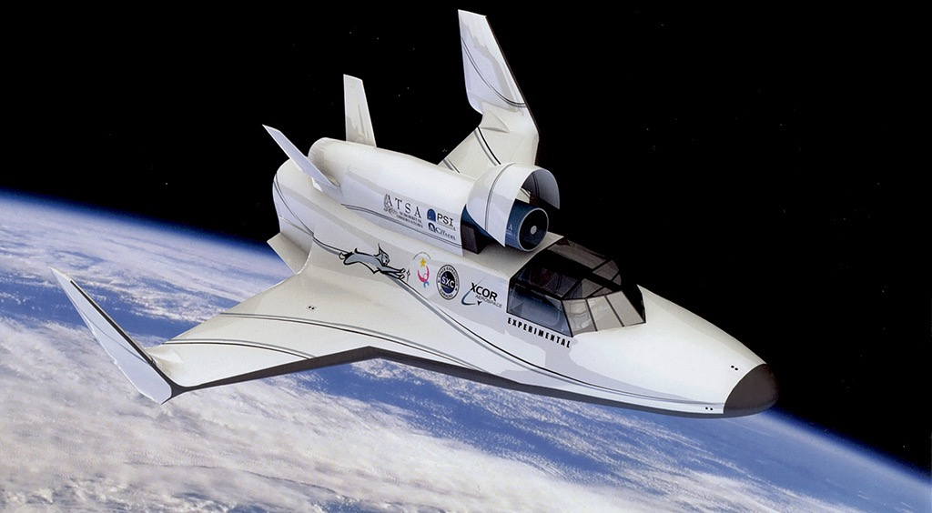
XCOR Lynx
Low Cost (~$100K / flight)
Rapid Turn-around / High Flight Rate (4x per day)
1 pilot, 1 payload operator / spaceflight participant

Slide 7

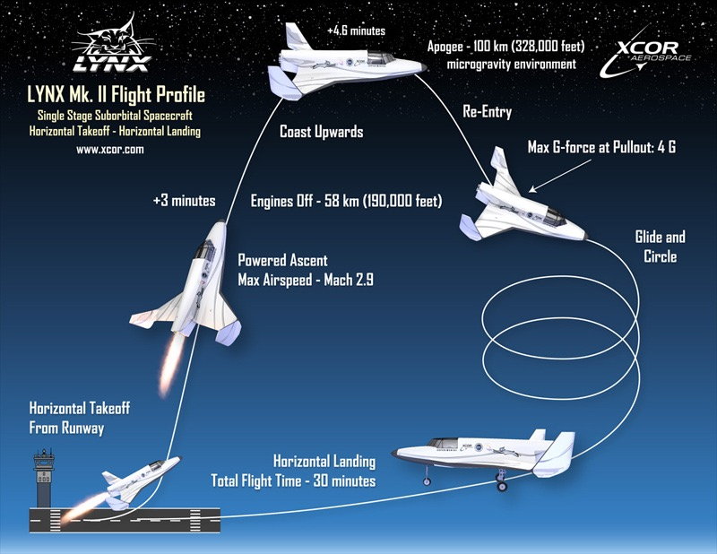
Lynx Flight Profile
Fully Reusable
Low Cost (~$100K / flight)

Slide 8

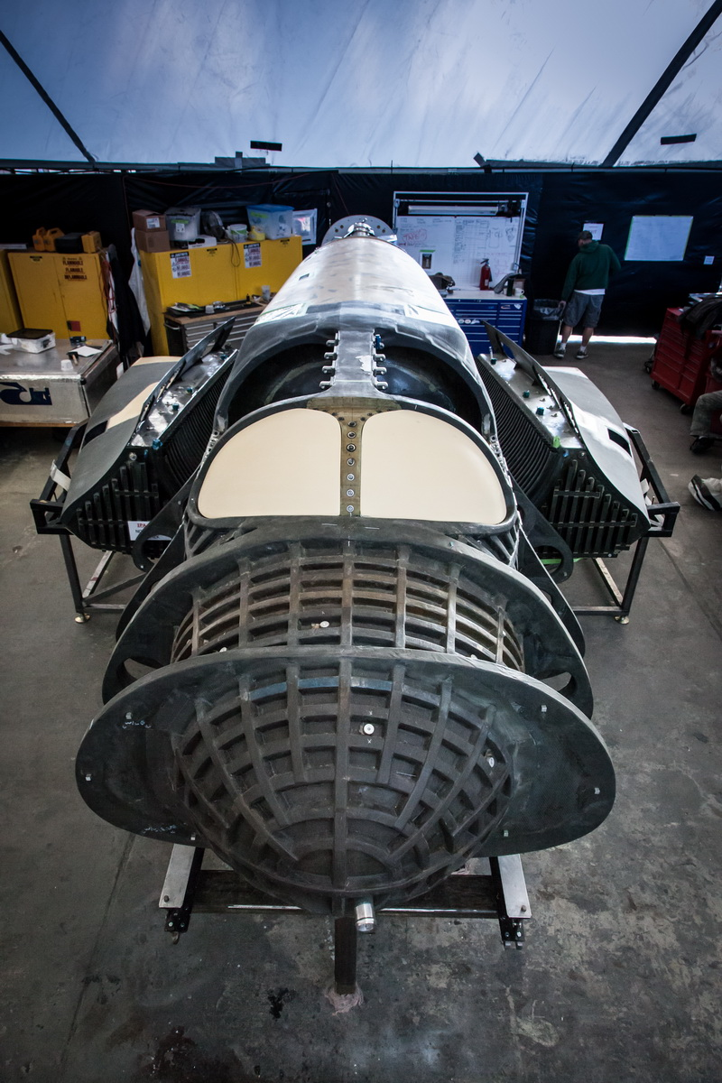
Lynx Spacecraft Status
Mark 1 (prototype) now under construction
First flight – 2015
12-18 month flight test program
The time to start building payloads is now

Slide 9

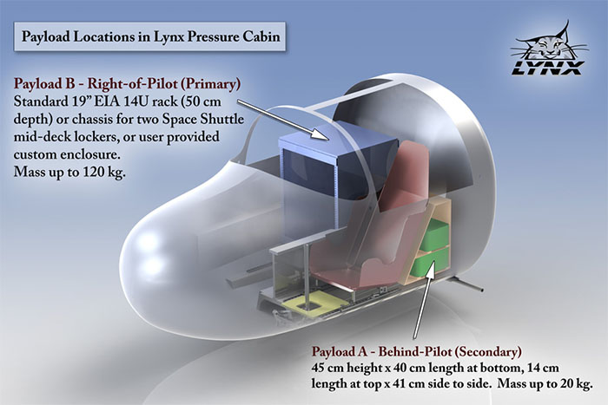
In-Cockpit Payloads
Pressurized environment
Short-duration microgravity, radiation
Low cost (~$3,000/U)
Repeatable

Slide 10


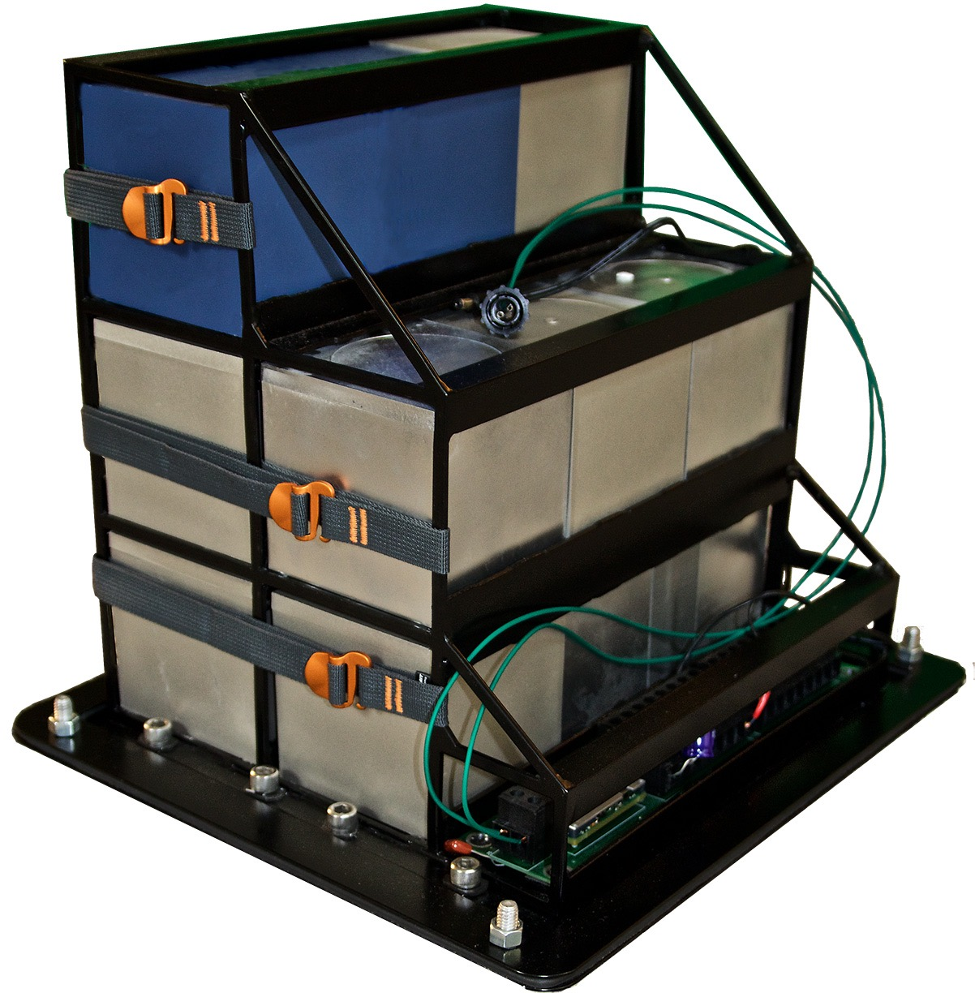
Lynx Cub Payload Carrier

Slide 11

Lynx Cub Payload Carrier
Accommodates 1U, 2U, 3U payloads
  Up to 15U total
  1 unit = 10 cm or 4”, 1 kg max
5V or 12V electrical power
  Configurable prior to flight
  2.1mm center-positive barrel connector
140W maximum electrical power
200W maximum thermal
Double containment (soft cover not shown)
Payloads can be autonomous or controlled by payload operator (wireless or wired; iOS, Android, or arm panel)

Slide 12

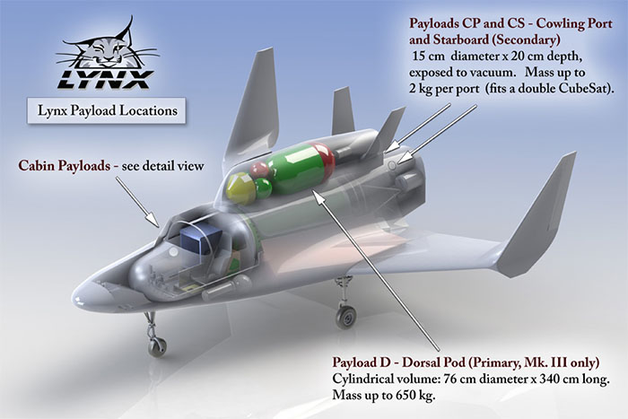
Aft Cowling Payloads
Fully Reusable
Low Cost (~$100K / flight)

Slide 13
Aft Cowling Payloads
Exposed to the space environment (temperature, pressure, radiation)
Hatch opens in flight, allowing
  Sensors -- direct view of Earth/space
  Extendable probes, antennas, etc.
Payloads are optionally ejectable

Slide 14
Example: High-Altitude
Astrobiology Challenge
Demonstrate the ability to collect microorganisms from extreme altitudes from a suborbital spacecraft
  Global epidemiology
  Bioprospecting
  Astrobiology
Enable repeatable science
Greater reliability than high-altitude balloons
Trajectory can be tailored to mission requirements
Automated or manual control (payload operator astronaut)

Slide 15

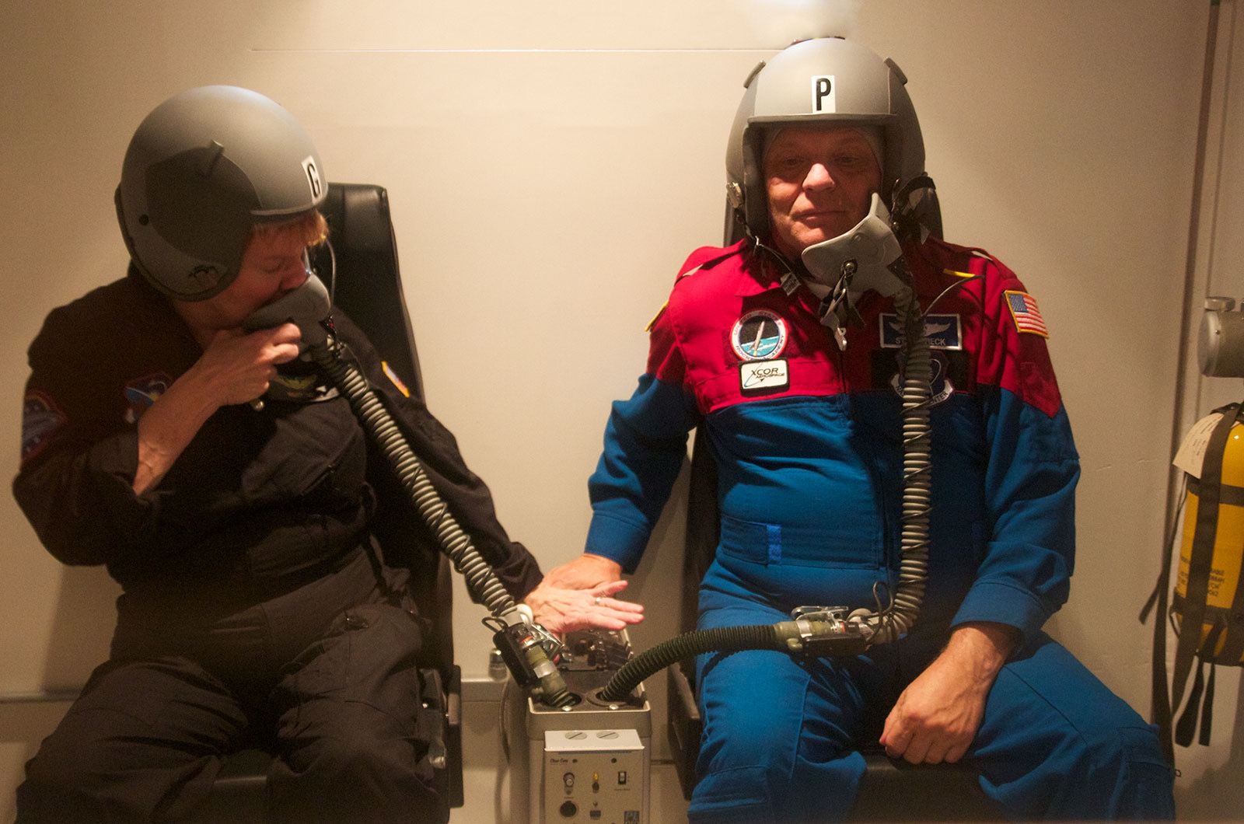

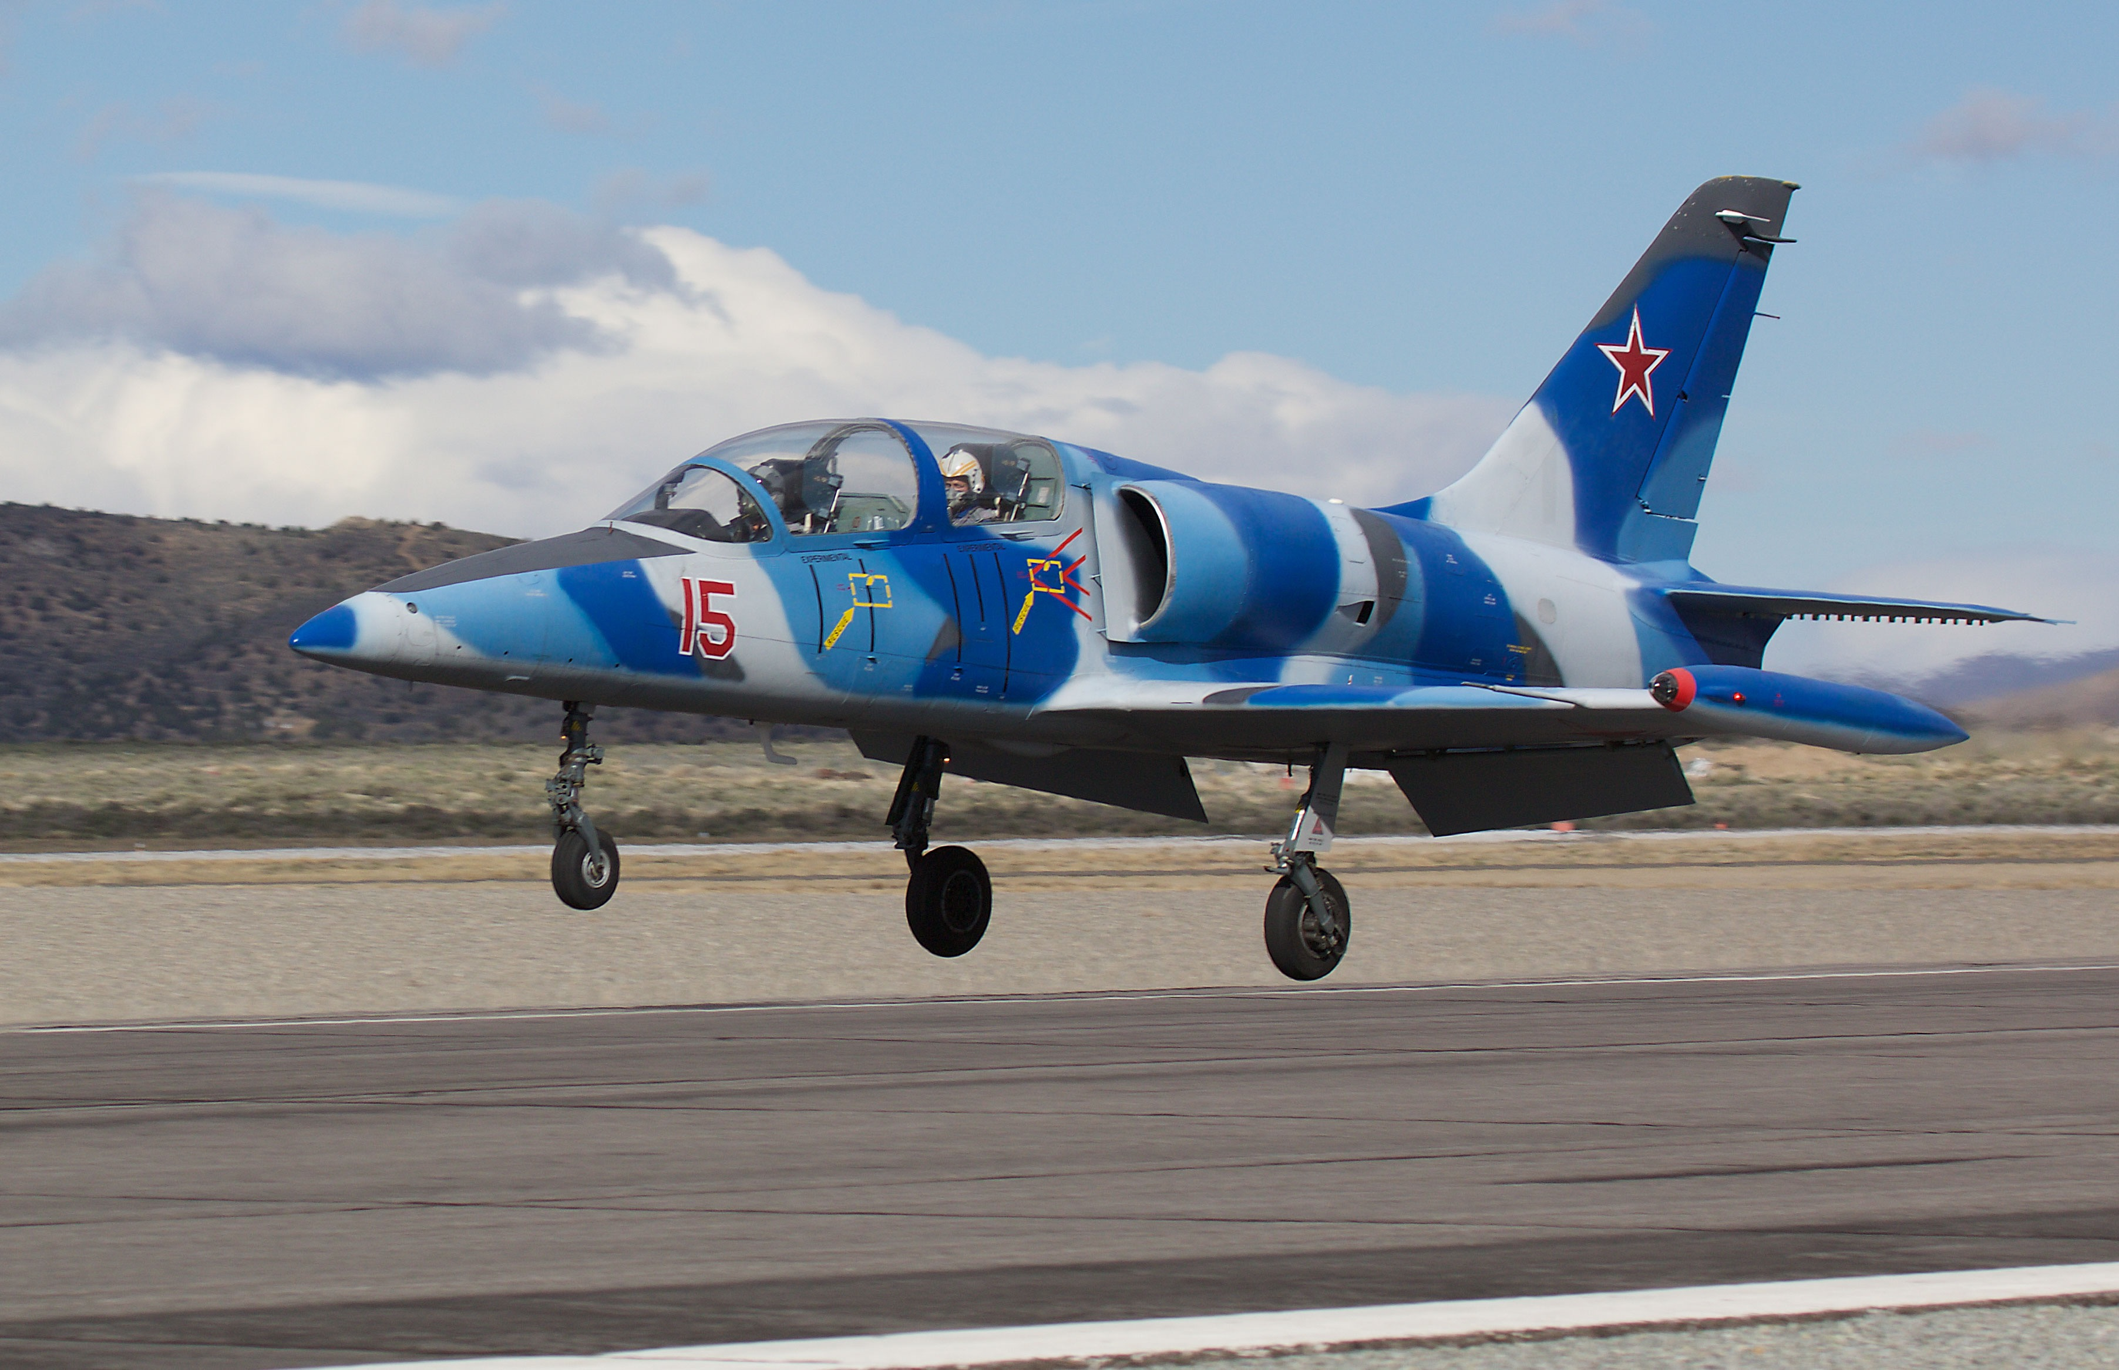

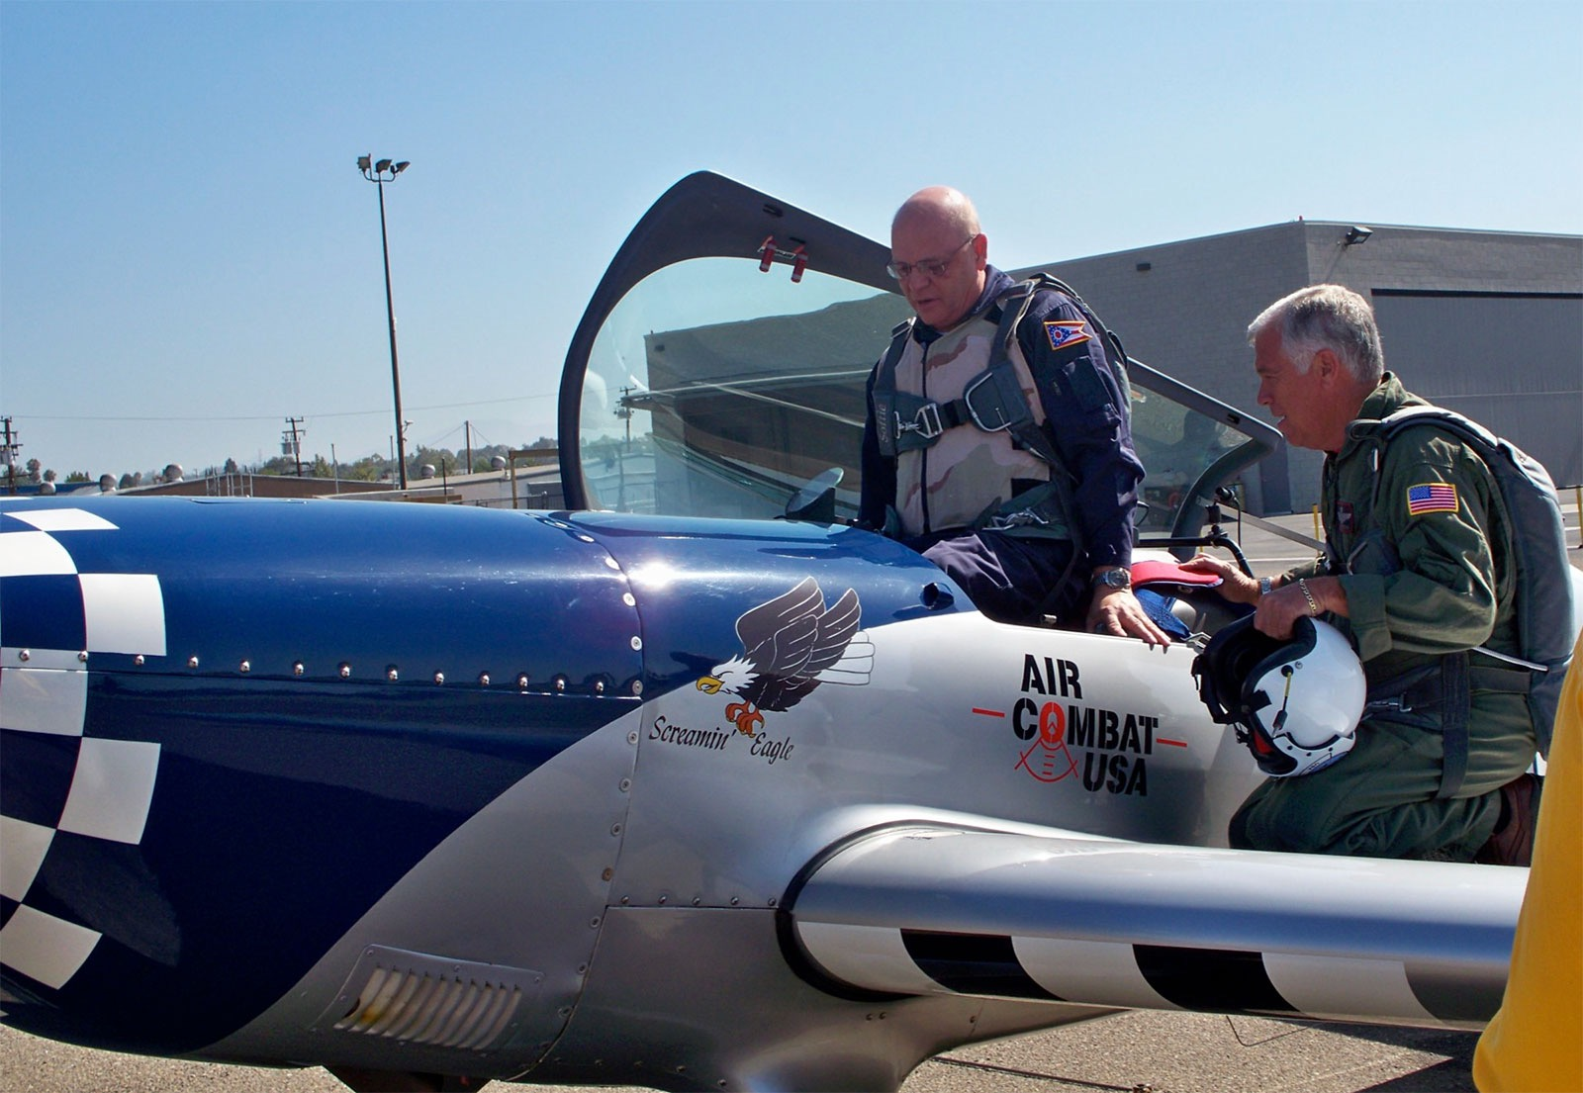

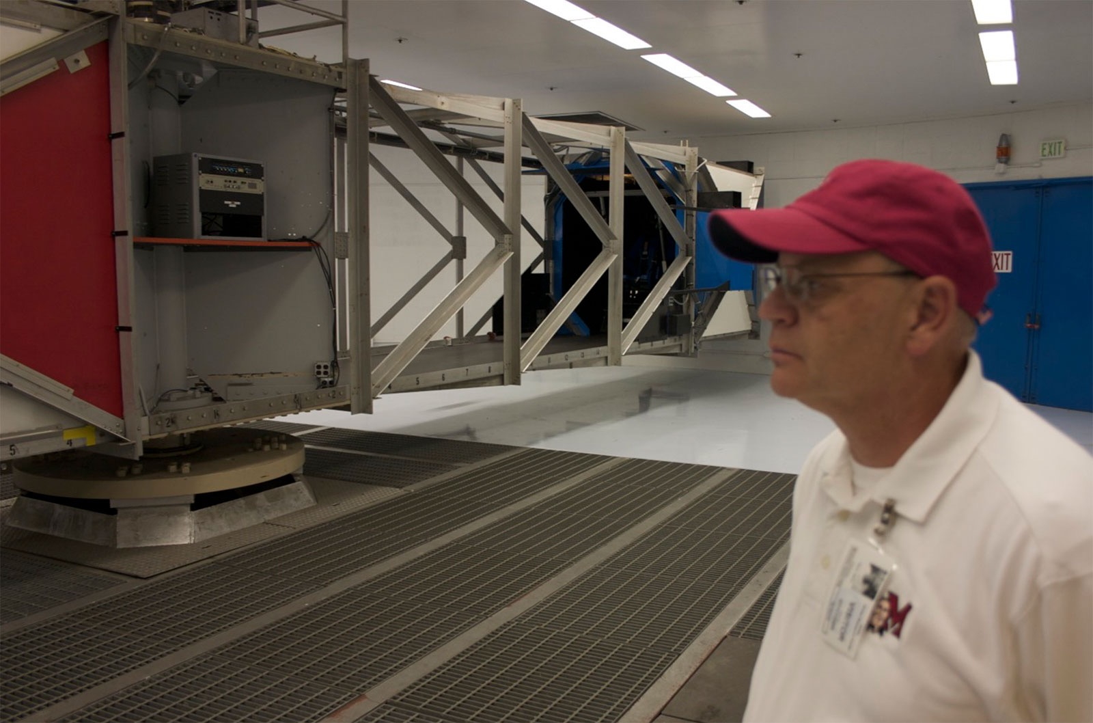

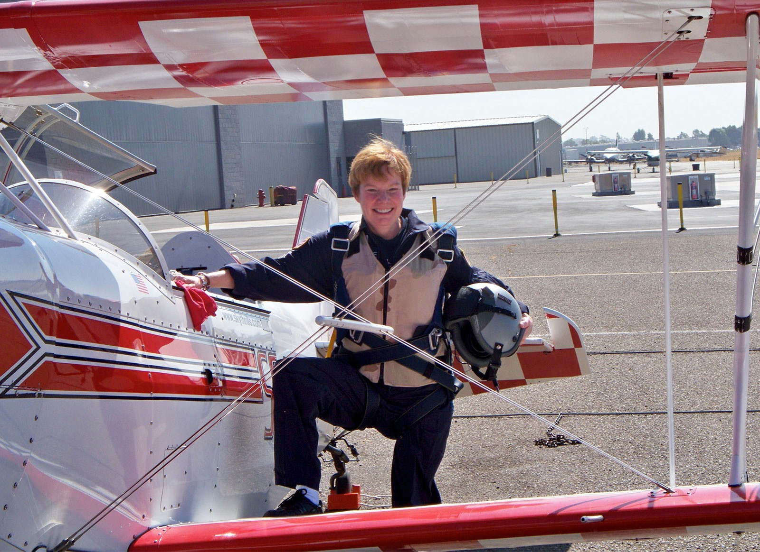
Citizen Astronaut Training

Slide 16
www.citizensinspace.org
@rocketacademy
Edward Wright
President/Project Manager
edward.v.wright@rocketacademy.org
Prof. Justin Karl
Chief Payloads Officer
justin.karl@rocketacademy.rog

