Slide 1
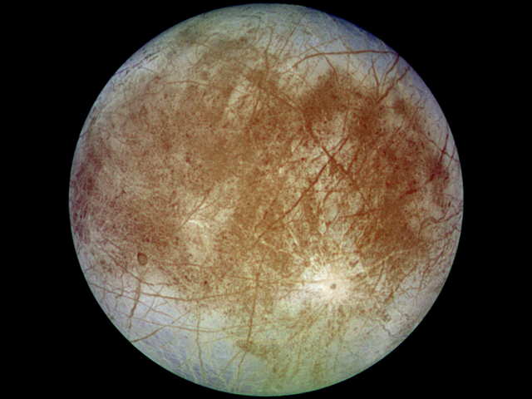
What is Europa?
Europa is :
Sixth closest moon of planet Jupiter .
Sixth largest moon in the Solar System .
A water ocean hypothetically exists
beneath a thick shell of ice surfacing
Europa.

Slide 2
Project Description
Explore a multi-node radio communications capability, such that multiple submersibles exchange information underwater with a lander and each other for the purpose of exploring Jupiter's icy moon Europa.
The exploration region of highest interest lies in the hypothesized sub glacial ocean.
Europa is a promising life harboring moon.

Slide 3
Project Description
Develop a concept of operations describing the exploration process as it is pictured to take place after the payload has been deployed underwater.
Prototype development to test the feasibility of the proposed concept of operations and the viability of RF communication underwater.

Slide 4
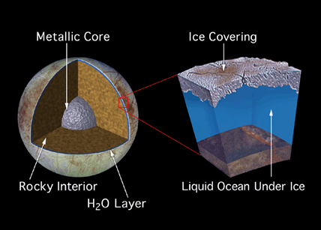
complex process of exploring

Slide 5
What are we looking for ?
Sign of life on Europa .
Water Properties and Measurements :
pH
Pressure
Salinity
Hardness
Dissolved oxygen
Specific conductance
Water temperature
Videos and images

Slide 6
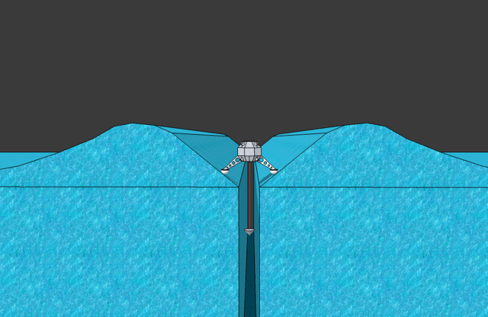
Mission concept of operations
The scenario consists of :
A lander
A tether
A casing

Slide 7
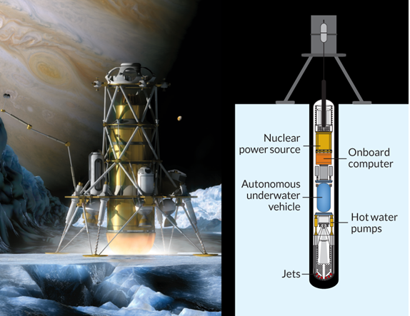
Mission concept of operation
The lander sends information back to earth.
The tether connects the casing with the lander.
The casing holds:
Two small autonomous
underwater vehicles.
Onboard computer.
Charging stations.
Main communication
node.

Slide 8

How will AUVs know where to explore?
AUVs are preprogrammed to explore ocean water and equipped with Artificial Intelligence (AI) to maneuver around obstacles.
AUVs measure data along circular paths increasing in diameter with depth.
Miniaturized side-scan sonar is used for mapping and navigating the environment.

Slide 9
Positioning and tracking system
AUVs’ functions require the presence of positioning system to identify a specific location and map the surroundings. The following positioning systems were chosen:
1)Inertial Navigation system

Slide 10
Positioning and tracking system
2)Acoustic system (Ultra short Baseline):
To mitigate the drifting problem of the Inertial navigation system.
It identifies the position in two dimensions only.
Main communication node holds an array of transducers.
Each AUV has a transponder mounted on it.

Slide 11
Positioning and tracking system
Pressure sensor is used to calculate the third dimension.
The AUVs are equipped with Artificial Intelligence (AI) to maneuver around obstacles.
The AUVs have obstacle avoidance capabilities.
Miniaturized side-scan sonar is used for mapping and navigating the environment.

Slide 12
The Communication System
The Communication System
Radio Frequency
Acoustic system
Short range
High data rate
For sending videos
and images
Long range
Low data rate
For sending simple
measurements

Slide 13


Steps of Exploration
Step1: Arrival and Release
Lander boots up the main communication node.
Main communication node turns on the 2 AUVs.
Chamber exits are open
AUVs release themselves in water.

Slide 14

Steps of Exploration
Step 2: Initial Readings
Each AUV covers the perimeter of half a circle of radius 10 cm and takes measurements instantly after exiting the chambers.

Slide 15

Steps of Exploration
Step 3:
The two AUVs dive to reach the same level.
They explore along a circle of 20 cm (numbers are generally subject to change but are representative of the pattern.)
20 cm

Slide 16

Steps of Exploration
4) Step 4:
AUVs dive an extra 50 cm.
AUVs cover a circle of radius 50 cm
50 cm

Slide 17
AUV 1 continues taking small steps.
AUV 2 starts taking larger steps both deeper and wider.

Slide 18
Steps of Exploration
5) Step 5:
AUV 2 increases its depth and circle radius exponentially: 10m,20m,50m,100m…

Slide 19
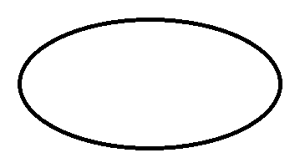
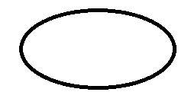
Steps of Exploration
6) Step 6:Heading Back
Same pattern will be followed in the reverse direction.
AUVs head back to the starting point, with radii of circles increasing with decreased depth.
Increased
radius

Slide 20
AUVs charge their batteries periodically from a charging station contained inside the casing connected to solar panel mounted on the surface of the moon.
Small obstacles are avoided (AI).
AUVs inspect the path
AUVs decide on totally new path in case of huge obstacles.

Slide 21
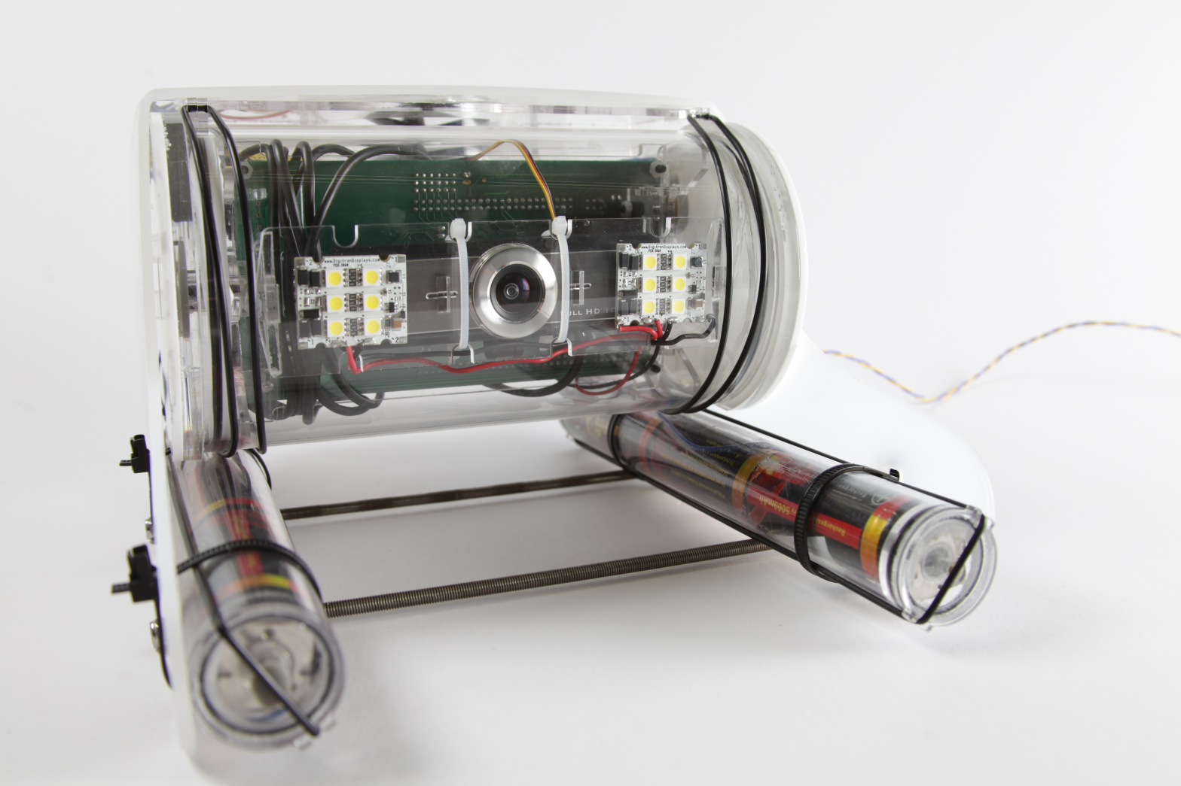
Prototyping : Open ROV
An ROV was assembled by our team to perform as a main communication node .
It simulates the motion capability of the AUVs in the CONOPs.

Slide 22
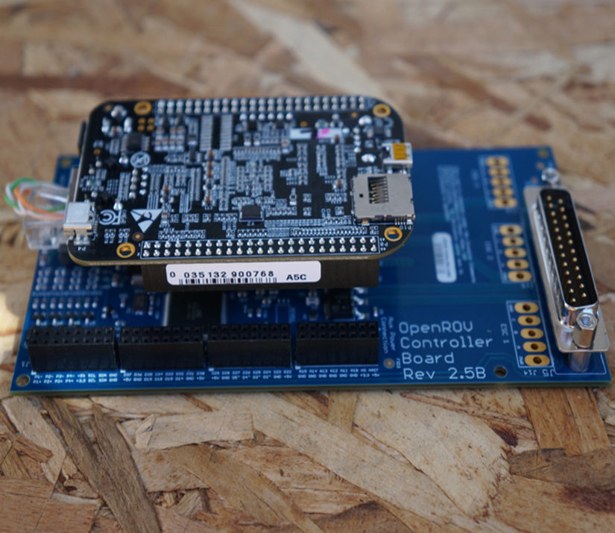
Open ROV Features
Control System
Beagle bone embedded
computer.
Controller board with an
Arduino microcontroller.

Slide 23
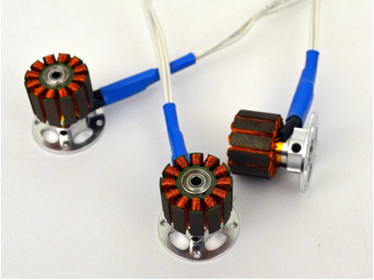
Open ROV Features
Motion and Maneuvering System:
Three Brushless DC motors with Propellers.
Electronic Speed Controllers.

Slide 24
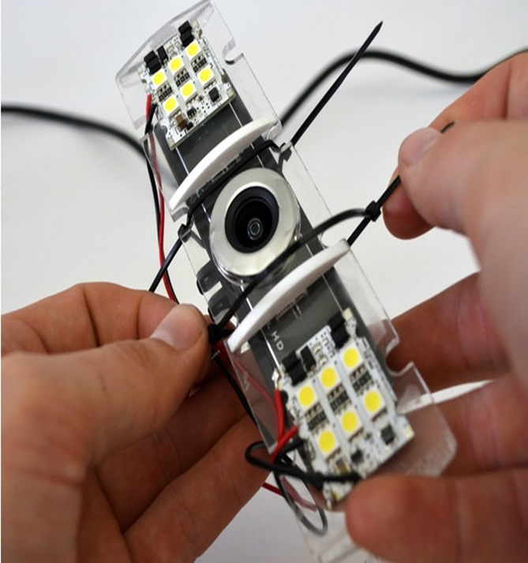
Open ROV Features
Imaging System:
HD Camera with Live streaming video
LED lights
Laser for measuring
distance.

Slide 25
The Submersibles Design
Three submersibles were designed and built by our team:
One mounted on the OpenROV (Main communication node ), while the other two are equipped with sensors and remain buoyant underwater collecting information and sending it back to the main communication node.

Slide 26
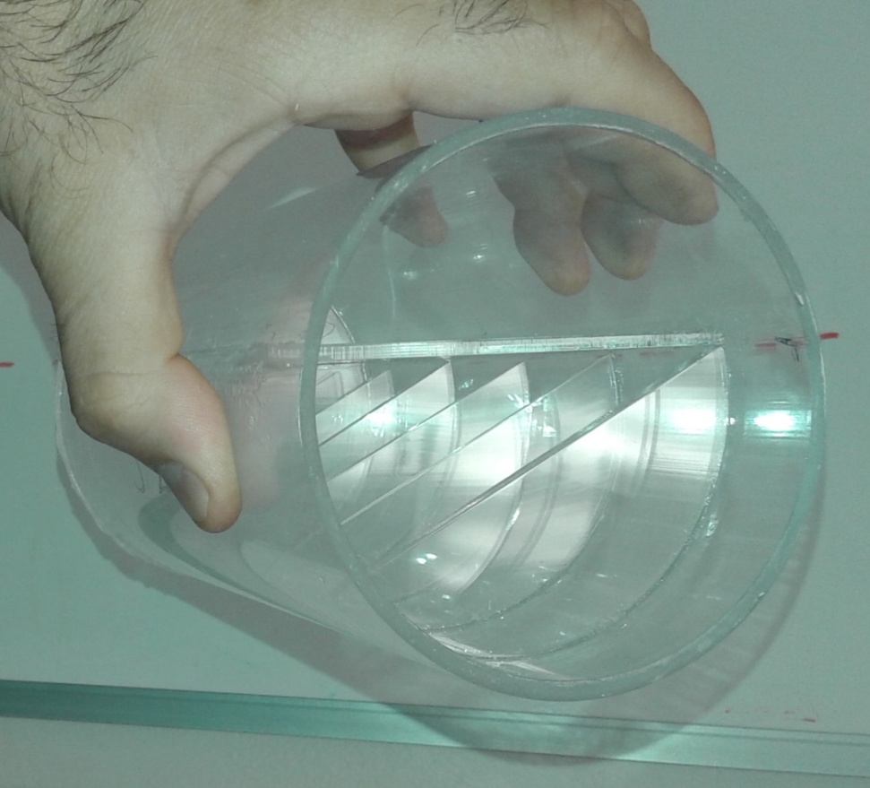
The Submersibles Design
The design is simple and very low cost:
The main body of the submersibles is a cylindrical Acrylic tube.
Upper plate for the electronics
Chambers for placing weights( to achieve buoancy

Slide 27
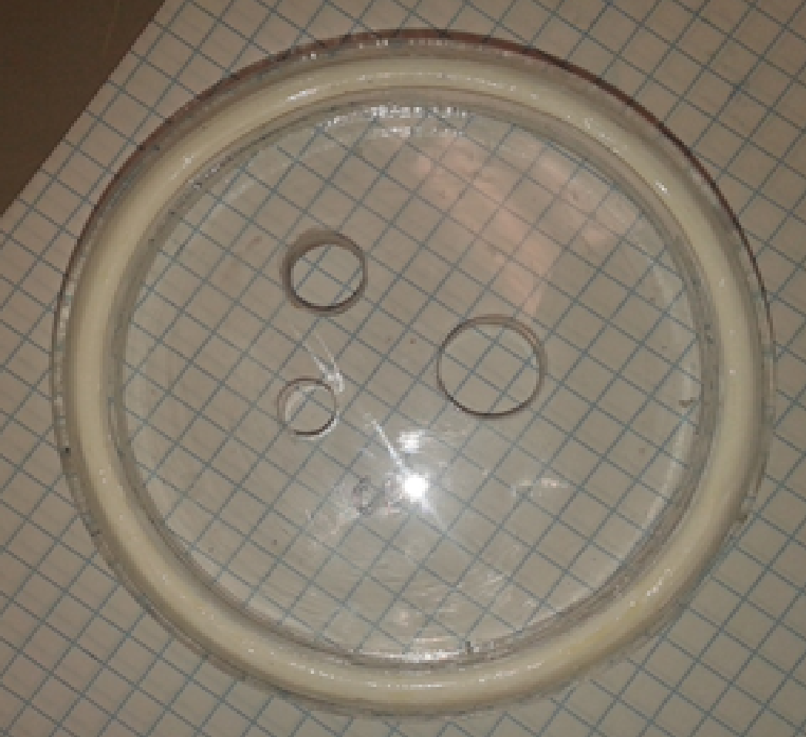
The Submersibles Design
Easy to build, and can do the job
Laser cutting was used to design the covers and the holes for sensors .
The sensor hole
The switch hole
The antenna hole

Slide 28
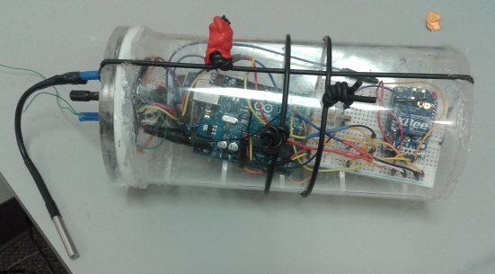
The Submersibles Design
Submersibles hold:
The communication system components in the inside, as well as the external parts ( sensors, antennas and switches) .
Clear Acrylic material was chosen for the following reasons:
1) The ability to see the electronic circuit inside the submersibles.
2) The possibility of checking for any leakage.

Slide 29
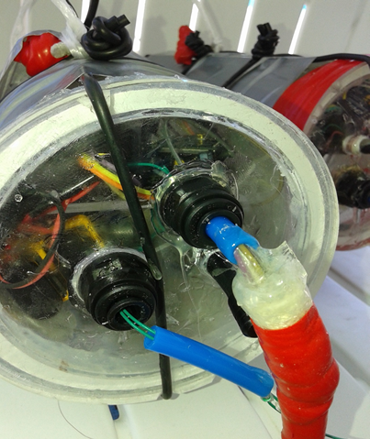
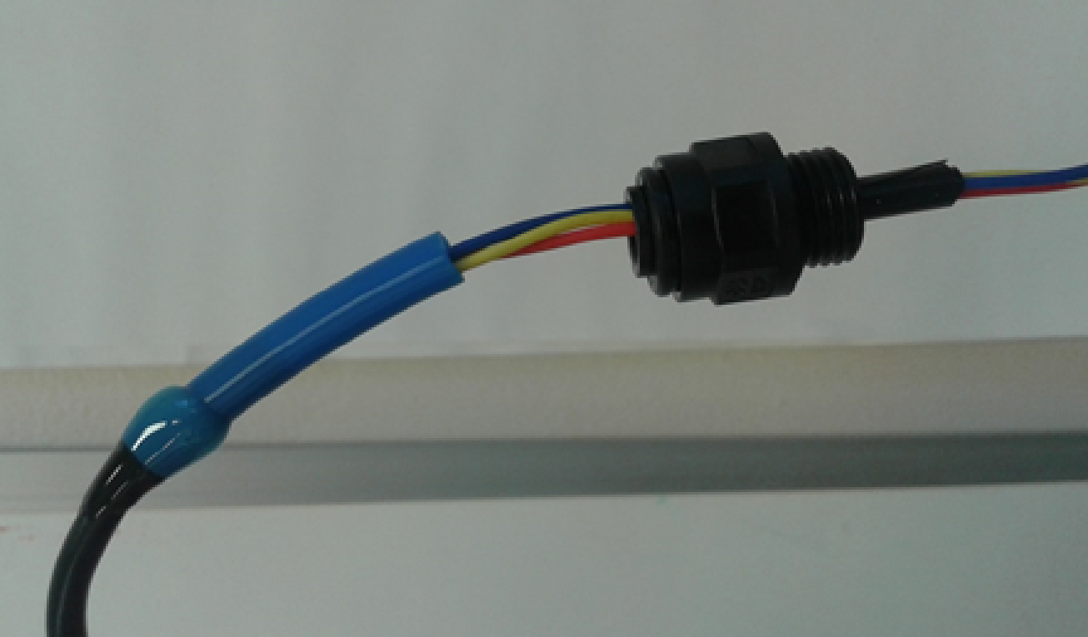
The Submersibles Design
External Parts
Antenna
Sensor
Switch
Pneumatic Fittings
Threaded to avoid leakage.
They form a sealed path for the sensors wires.
Used for pressure relief.

Slide 30
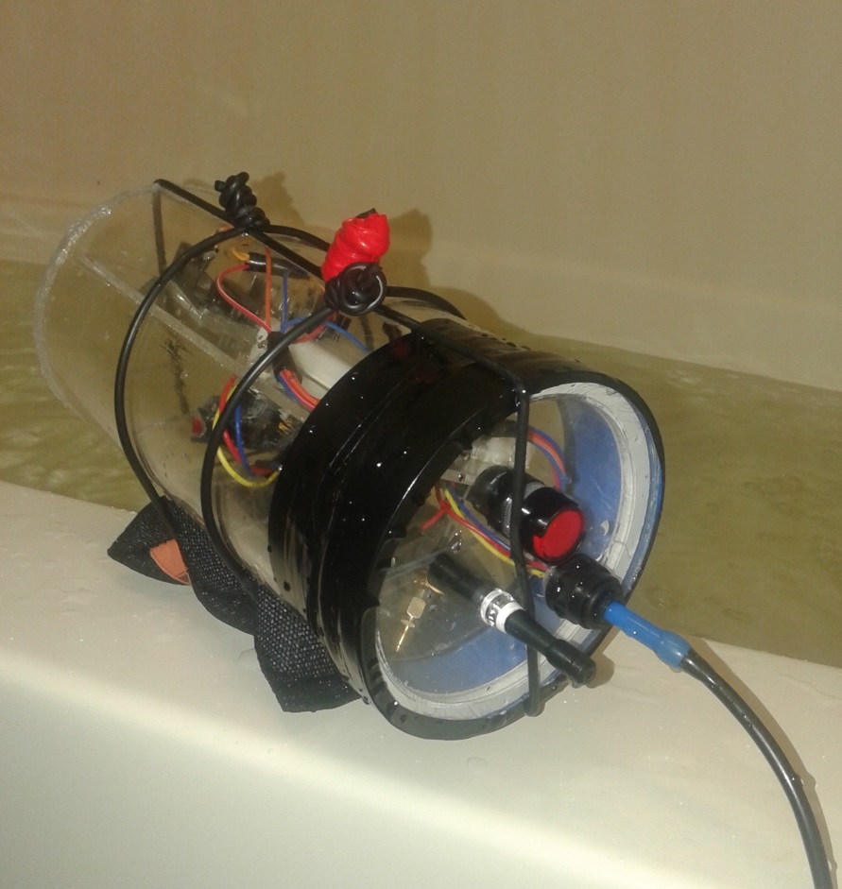
The Submersibles Design
Submersibles
Weight=1.96 Kg
Stones inside

Slide 31
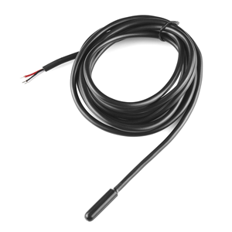
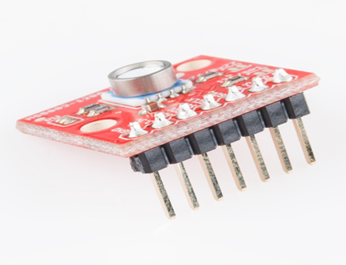
Sensor mounted on Submersibles.
Waterproof temperature sensor
Pressure sensor

Slide 32
Underwater RF Communication
Detailed and thorough research was conducted to explore the viability of RF communication underwater utilizing 1mw, 2.4 GHz Xbee modules.
Attenuation problems of RF led to minimal attention from scientists and engineers for usage in underwater applications.
Testing of RF communication showed promising results if it is to be used back to back with another communication system that allows for a longer range.

Slide 33
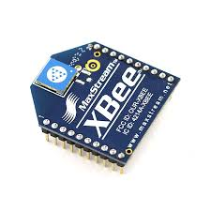
Why Xbee
Low cost
Low Power
Easy to configure
Reliable
Supports large number of nodes

Slide 34
Testing the communication system
First Test:
Objectives:
Find a correlation between the vertical/horizontal distance and the signal strength.
Study the effect of the antenna orientation on the signal strength.

Slide 35
Testing the communication system
The following test involved three submersibles, two of which were stationary and the third was mounted on the OpenROV.
Main communication node sends specific commands to the two stationary submersibles to get the sensors readings.

Slide 36

Testing the communication system
The tests involved having multiple testing points underwater.
Xbee modules were tested in different arrangements
across the points to get a relationship between depth,
distance and signal strength.
3 m
2 m

Slide 37
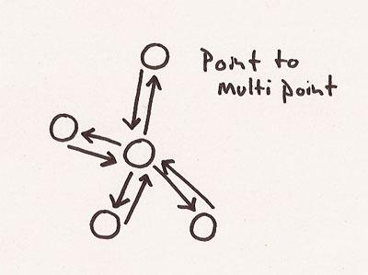
Point to multi point Network
One Master Xbee module.
Two slave Xbee modules.
Inside each submersible there is a Xbee module connected to an Arduino.

Slide 38
Pool test results
1mW Xbees were able to send data between each other when they are 35 cm apart underwater .
Using 100mW Xbee module will give a better communication range underwater.

Slide 39
Conclusion
The viability of radio frequency for Europa mission
RF technology applied in underwater communications is an excellent candidate for providing higher data rates than those achieved by acoustic systems.

Slide 40
Thank you

