Slide 1



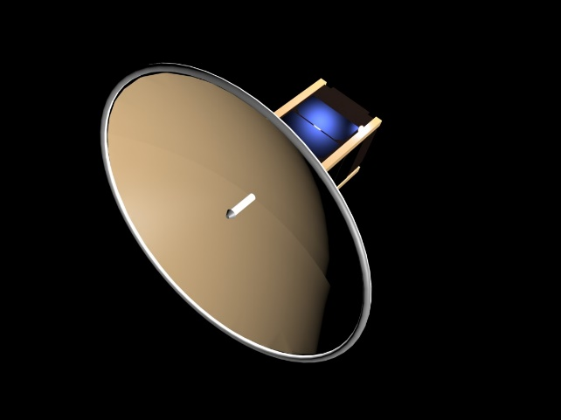
Development of an Inflatable Antenna Prototype for Interplanetary CubeSats
M. Ravichandran, A. Chandra
J. Thangavelautham
SpaceTREX Laboratory
School of Earth and Space Exploration
Arizona State University
A. Babuscia
Jet Propulsion Laboratory
California Institute of Technology

Slide 2
Motivation
Communication Capability
  At LEO or higher
  For Interplanetary missions
  Antenna requirements

Slide 3
Motivation
Inflatable offer a promising technology pathway for interplanetary CubeSat communication and tracking
  Very high deployed volume
  Very low mass
  High-packing efficiency
  Quick deployment
  Relative simplicity

Slide 4
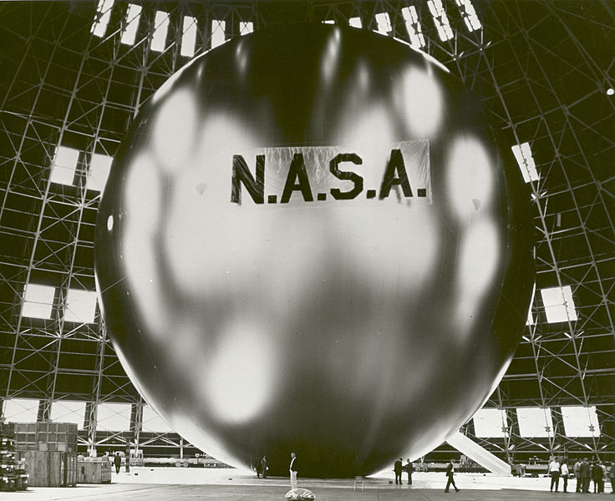
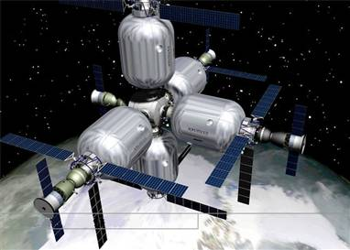
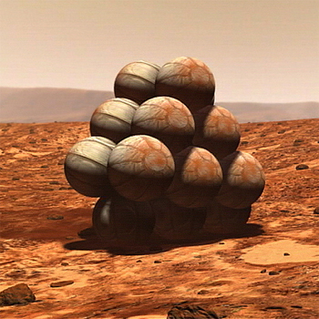
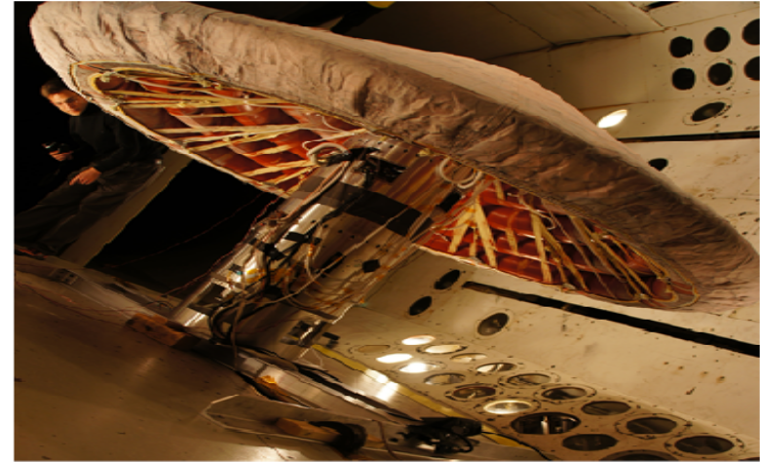
Inflatables
ECHO I MISSION
INFLATABLE HABITAT
MARS EXPLORER ROVER
INFLATABLE DECELERATOR

Slide 5
Challenges
Inflation System
  Optimum Inflation Pressure
  Passive Activation/Inflation
  Rigidization & Shape Conformance
  Micrometeorite Attack

Slide 6
Objective
Research inflation techniques and develop an inflation system for CubeSat platform
  Low mass, low cost system
  Passive activation
  Resistance to micrometeorite attacks
  Validate with physical models

Slide 7
Inflation Systems
ECHO I & II Satellite
  Sublimating Powder [Clemmons, 1964,Talentino,1966]
Mars Pathfinder
  Gas Generator [Cadogen et al., 2002]
Inflatable Aerodynamic Decelerators
  Gas Generator & Ram Air [Cruz et al., 2006, Hughes et al., 2011]

Slide 8
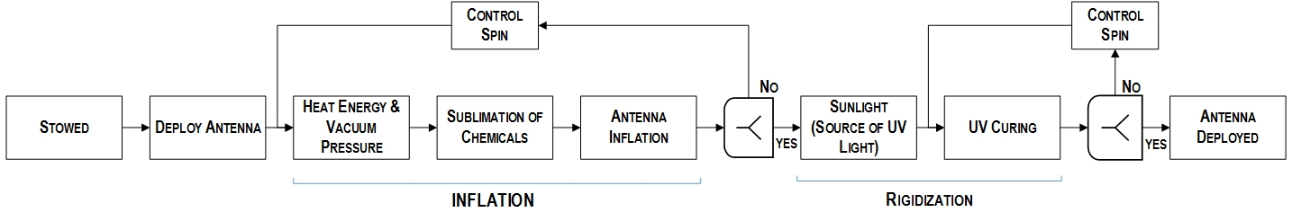
Proposed System

Slide 9
Sublimating Chemicals
Sublimation
  Phase transition from solid state to gaseous state without going through the liquid state
Features
  Chemicals: Powder or Crystalline form, less mass and easy packing
  Sublimate to release large volume of gas

Slide 10
Selection of Chemicals
Operating Temperature of Antenna [Babuscia et al., 2013]
Range: Average:
369K – 377K 373K
Sublimation Enthalpy:
  Depends on operating temperature
  Helps Passive Activation

Slide 11
Selection of Chemicals
Vapor Pressure
Pressure exerted by the gas on the inflatable surface
  High Pressure: Rapid inflation and rupture
  Low Pressure: Insufficient internal pressure for inflation
  [Clemmons, 1964,Talentino,1966]

Slide 12
Candidate Chemicals
  From an extensive list of sublimating chemicals the following were shortlisted [Jones, A.H, 1960]
SUBLIMATING POWDERS | CHEMICAL FORMULA | MOLECULAR MASS (g) | MASS REQUIRED (mg)
Benzoic acid | C7H6O2 | 122.12 | 0.86
Butyramide | C4H9NO | 87.12 | 0.62
Diformylhydrazine | C2H4N2O2 | 88.07 | 0.62
Hexachloroethane | C2Cl6 | 236.74 | 1.68
O-methoxybenzoic acid | C8H8O3 | 152.15 | 1.08
Oxalic acid (anhydrous) | H2C2O4 | 90.03 | 0.64
Pyrene | C16H10 | 202.25 | 1.43
Salicyclic acid | C7H6O3 | 138.12 | 0.98
Urea | CH4N2O | 60.06 | 0.43

Slide 13
Rigidization Techniques
  UV setting resins [Keller et al., 1964]
  Thermosetting resins [Cadogen et al., 2001]
  Glass transition resins [Lichodziejewski et al., 2005]
  Gas cured resins [Bernasconi et al., 1990]
  Stretched metal laminates [James et al., 1964, Bahiman et al.,1965]
  Evaporation hardened rigidizing foams[Schnell et al., 2002]

Slide 14
Rigidization Techniques
Proposed Technique
    UV Curable Ink sprayed over the antenna surface
    Curing through rapid polymerization
Advantages
    Rapid Curing (<20s) [Chattopadhyay et al., 2005]
    Flexible coating post curing [Schwalm et al., 1997]
    No hazardous vapors [Chattopadhyay et al., 2005]
    Low UV Energy requirement [Chattopadhyay et al., 2005]
    Clear coating possible [Seubert et al.,2004]
    Strong mechanical property [Chattopadhyay et al., 2005]

Slide 15
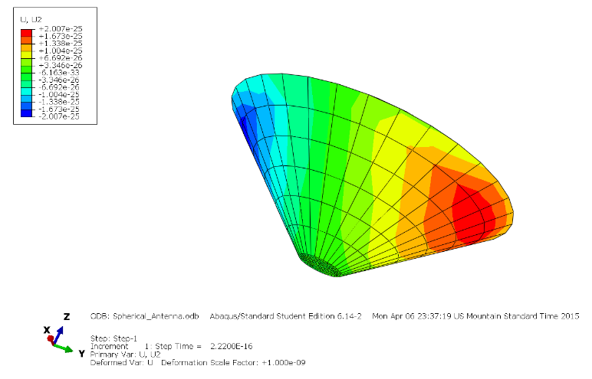
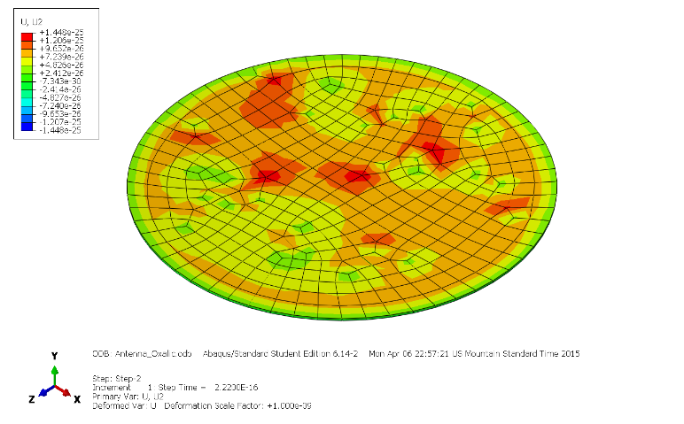
Analysis
    Verified structural integrity of 2 prototypes
    Forces applied
  Centrifugal Force
Radiation Force
Internal Vapor Pressure
Prototype-I
Prototype-II

Slide 16
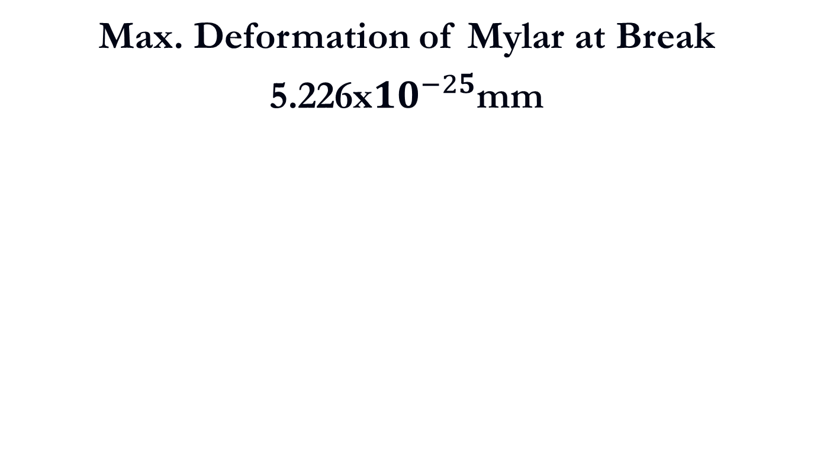
Results
Max. Deformation of Mylar at Break
5.226x${10}^{−25}$mm
SUBLIMATING CHEMICAL | VAPOR PRESSURE (Pa) | MAX DEFORMATION (mm)
 |  | Prototype-I | Prototype-II
Benzoic Acid | 9.33E-02 | 1.19E-26 | 1.01E-25
Butyramide | 5.21E-01 | 2.007E-25 | 5.66E-25
Diformylhydrazine | 6.67E+01 | 3.01E-27 | 7.24E-27
Hexachloroethane | 5.33E+01 | 1.69E-27 | 5.69E-27
Methoxybenzoic acid | 2.00E-01 | 1.018E-26 | 2.17E-25
Oxaclic Acid | 1.33E-01 | 5.04E-26 | 1.45E-25
Pyrene | 6.00E-04 | 3.28E-28 | 6.51E-28
Salicylic Acid | 1.09E-02 | 4.93E-27 | 1.19E-26
Urea | 1.60E-03 | 3.49E-28 | 1.74E-27

Slide 17
Discussion
Structural Feasibility:
  No structural failure (except Butyramide)
UV Curable Rigidity:
    Curing increases mechanical strength as temperature [Chattopadhyay et al., 2005]

Slide 18
Future Work
Experimental Validation in Vacuum Chamber
Sublimating Chemicals:
  Validation Pressure & Temperature points for Sublimation
  Time taken for Inflating the model
UV Curable Ink:
  Observation of chemical reactions with Mylar sheet
  Rigidity achievable measured with FTIR method
  Transparency of coat to electromagnetic radiations

Slide 19
References
Jones, A. H. "Sublimation Pressure Data for Organic Compounds." Journal of Chemical and Engineering Data 5.2 (1960): 196-200.
Clemmons, Dewey L. The Echo I inflation system. National Aeronautics and Space Administration, 1964.
Talentino, J. P. "Development of the fabrication and packaging techniques for the ECHO II satellite." (1966).
Cadogan, D., C. Sandy, and M. Grahne. "Development and evaluation of the Mars Pathfinder inflatable airbag landing system." Acta Astronautica 50.10 (2002): 633-640.
Calomino, Anthony M. "Hypersonic Inflatable Aerodynamic Decelerator (HIAD) Technology Development Overview." (2011).
Cruz, Juan R., and J. Stephen Lingard. "Aerodynamic decelerators for planetary exploration: past, present, and future." AIAA Paper 6792 (2006): 21-24.
Stein, James, and Charles Sandy. "Recent developments in inflatable airbag impact attenuation systems for Mars exploration." AIAA 1900 (2003): 7-10.
NASA Factsheet, HIAD, http://www.nasa.gov/HIAD
Babuscia, Alessandra, et al. "CommCube 1 and 2: A CubeSat series of missions to enhance communication capabilities for CubeSat." Aerospace Conference, 2013 IEEE. IEEE, 2013.
Mylar 814 Datasheet, Dupont Teijin Films, http://www.dupontteijinfilms.com/FilmEnterprise/Datasheet.asp?ID=301&Version=US
Klinkrad, H., and B. Fritsche. "Orbit and attitude perturbations due to aerodynamics and radiation pressure." ESA Workshop on Space Weather, ESTEC, Noordwijk, Netherlands. 1998.
L.B. Keller and S. Schwartz. Rigidization techniques for integrally woven composite constructions. Technical Report ML-TDR-64-299, Hughes Aircraft Corp., 1964.

Slide 20
References
D.P. Cadogan and S.E. Scarborough. Rigidizable materials for use in Gossamer Space Inflatable Structures. In 42nd AIAA/ASME/ASCE/AHS/ASC Structures, Structural Dynamics, and Materials Conference, number AIAA-2001-1417, Seattle, WA, USA, April 16–19 2001. doi: 10.2514/6.2001-1417
D. Lichodziejewski, R. Cravey, and G. Hopkins. Inflatably deployed membrane waveguide array antenna for space. In 44th AIAA/ASME/ASCE/AHS Structures, Structural Dynamics, and Materials Conference, number AIAA-2003-1649, Norfolk, VA, USA, April 7–10 2003. doi: 10.2514/6.2003-1649.
D. Lichodziejewski, B. Derb`es, R. Reinert, K. Belvin, K. Slade, and T. Mann. Development and ground testing of a compactly stowed scalable inflatably deployed solar sail. In 45th AIAA/ASME/ASCE/AHS/ASC Structures, Structural Dynamics and Materials Conference, number AIAA-2004-1507, Palm Springs, CA, USA, April 19–22 2004. doi: 10.2514/6.2004-1507.
F. H. Redell, D. Lichodziejewski, J. Kleber, and G. Greschik. Testing of an inflation-deployed sub-tg rigidized support structure for a planar membrane waveguide antenna. In 46th AIAA Structures, Structural Dynamics and Materials Conference, number AIAA-2005-1880, Austin, Texas, April 18–21 2005. doi: 10.2514/6.2005-1880.
D. Lichodziejewski, B. Derb`es, and T. Mann. Vacuum deployment and testing of a 4-quadrant scalable inflatable rigidizable solar sail system. In 46th AIAA/ASME/ASCE/AHS/ASC Structures, Structural Dynamics and Materials Conference, number AIAA-2005-2122, Austin, TX, USA, April 18–21 2005. doi: 10.2514/6.2005-2122.
Schenk, Mark, et al. "Review of inflatable booms for deployable space structures: Packing and rigidization." Journal of Spacecraft and Rockets 51.3 (2014): 762-778.
Chattopadhyay, D. K., Siva Sankar Panda, and K. V. S. N. Raju. "Thermal and mechanical properties of epoxy acrylate/methacrylates UV cured coatings." Progress in Organic Coatings 54.1 (2005): 10-19.
R. Schwalm, L. Ha` Eussling, W. Reich, E. Beck, P. Enenkel, K.Menzel, Prog. Org. Coat. 32 (1997) 191
Seubert, C. M., and M. E. Nichols. "Alternative curing methods of UV curable automotive clearcoats." Progress in organic coatings 49.3 (2004): 218-224.

