Slide 1
Iris Version 2
Deep Space
Communications,
Navigation, and
Radio Science for
Small Space Craft
Courtney Duncan
Jet Propulsion Laboratory – California Institute of Technology
Interplanetary Small Satellite Conference 4
Santa Clara University
2015 April 27
© 2015 California Institute of Technology.
Government sponsorship acknowledged.

Slide 2
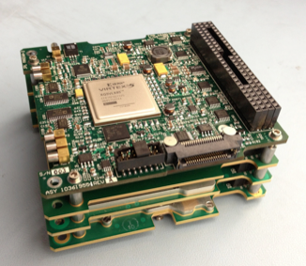
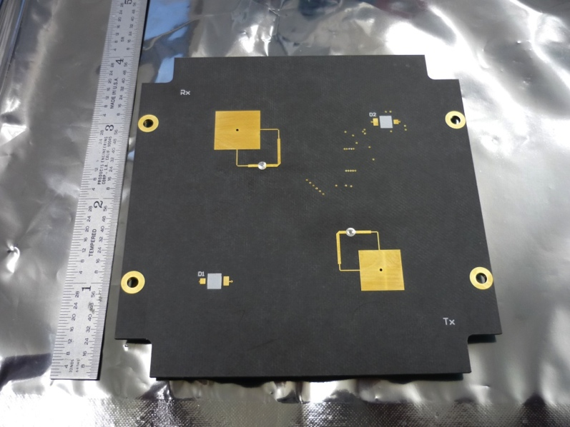
Iris Version 1 Transponder, 2014
Marina-2 Virtex 5 Modem Processor
Power Supply Board, 13 W @ 7.5 VDC
X-Band Receiver 7.2 GHz
X-Band Exciter 8.4 GHz
0.25 W RF output
Independent, selectable antennas
  (Amp power switching, not RF switching)
  2 transmit, 2 receive
Iris V1 Prototype Stack
Firmware Modems – CCSDS
  DSN compatibility certified
  Reed-Solomon and Convolutional Codes
SPI spacecraft interface
Full Duplex
  Coherent Doppler
  Range
  Command
  Telemetry
FireCode
JPL’s INSPIRE Mission
  Two 3U CubeSats
  10 M km deep space
  90 day max, COTS parts
In Hibernation June 2014
  Waiting launch opportunity
TX / RX LGA

Slide 3
Iris V2 from V1 Lessons Learned
Higher power output needed for truly deep space
  Hundreds of millions of km
  A few Astronomical Units
  More distant is likely better served by a larger mission using Universal Space Transponder (UST) and/or proximity operations
Missions of years rather than months, just to get there
  As much hardening as is ‘affordable’
C&DH interface
  Commands versus ‘peeks and pokes’
CubeSats are small for 10s of W of heat dissipation, requires intentional design
  Wedgelocks
  SSPAs on radiators – semi-custom spacecraft design

Slide 4
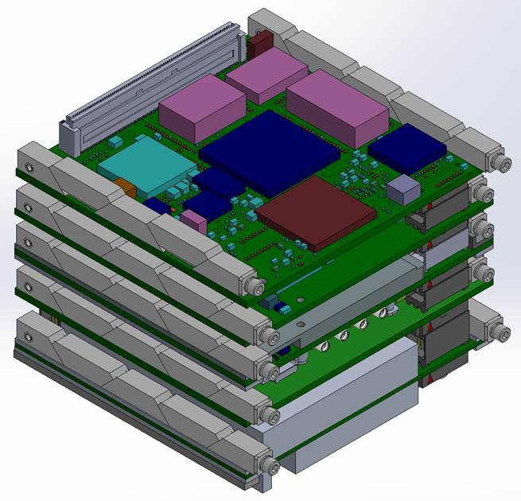
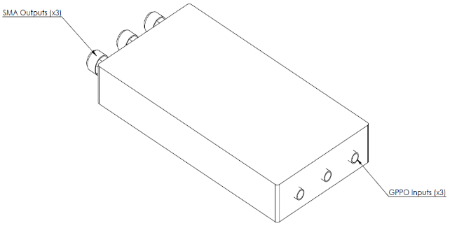
Iris V2 Description, 2015
Four Board Stack plus external SSPAs
  X-Band Exciter
    SSPA 4 W RF out
  X-Band Receiver
  UHF Receiver (slice architecture)
  RadiX Virtex-6 board
  Power Supply Board
    27 W input CBE @ 12 VDC
    RX-only, Digital-only lower powers
500 g, 0.5 U
  6U Spacecraft compatible
2-3 year design life
Iris V2 CAD Model
SSPA Drawing

Slide 5
Iris V2 Features
All Iris V1 Features, plus:
Delta DOR navigation support
  Plane of sky technique in cooperation with DSN
Direct carrier modulation with residual carrier
Turbo Codes, Manchester, and scrambling
Command and Telemetry Dictionary
Independent, selectable antennas
  Power switching to amplifiers, not radio frequency switching
  3 transmit
  3 receive

Slide 6
Iris V2 Features
CPU
  Gaissler LEON3-FT softcore on Virtex 6
Memory
  32 Mbit non-volatile NOR-Flash (radiation tolerant)
    Multiple FPGA bitfiles (8.8 Mbit each)
      Backup copies and future reprogramability
    Vector tables for TurboCoding, (2 Mb)
    Boot PROM and software image storage (for LEON)
    Boot PROM copies application to SRAM for execution
  20 Mbyte of volatile SRAM (radiation tolerant)
    One 16 Mbyte part / One 4 Mbyte part for EDAC
    LEON program execution, stack, and storage
    Data storage

Slide 7
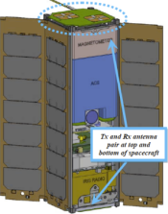
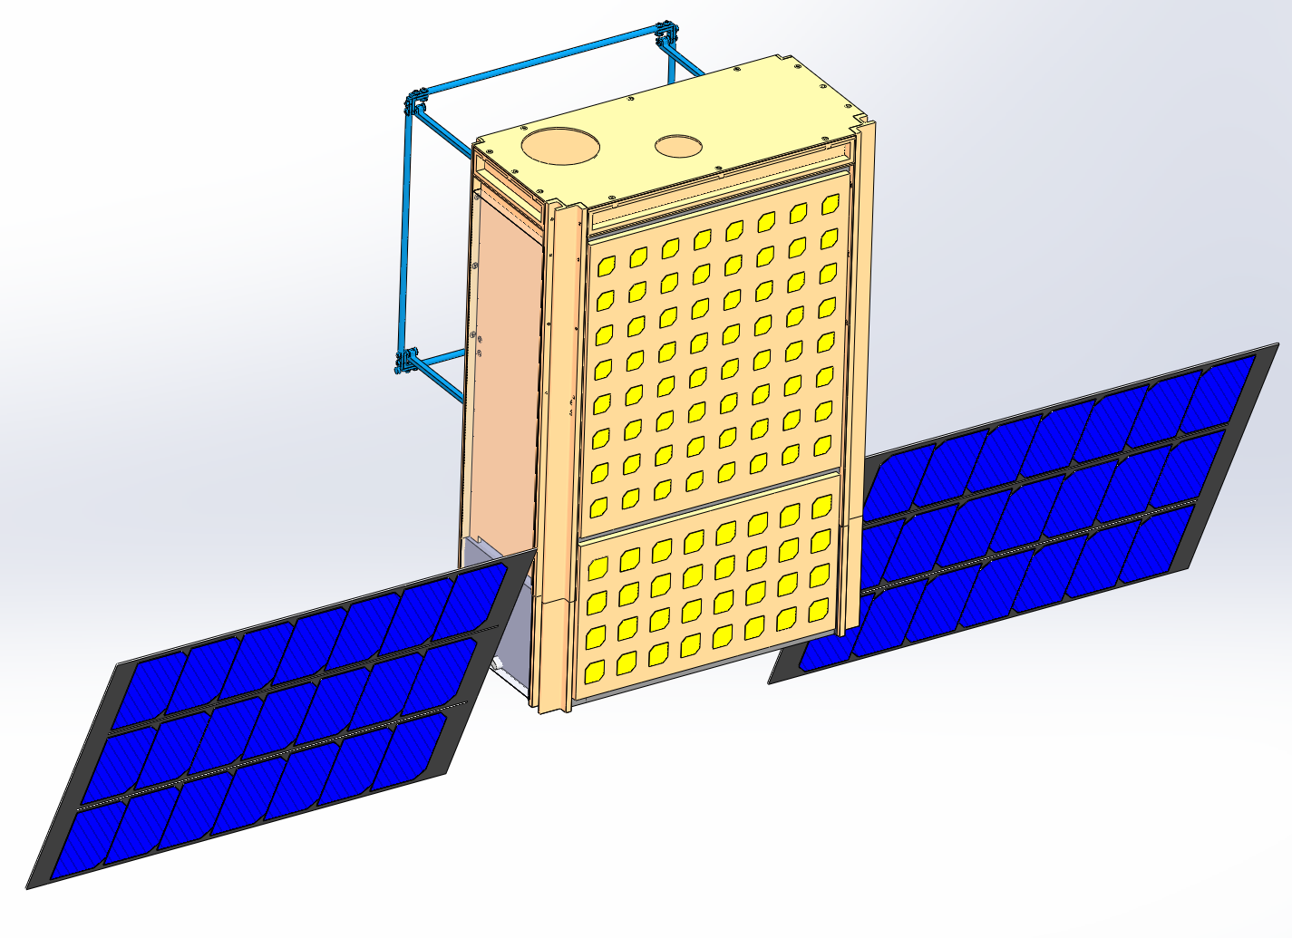
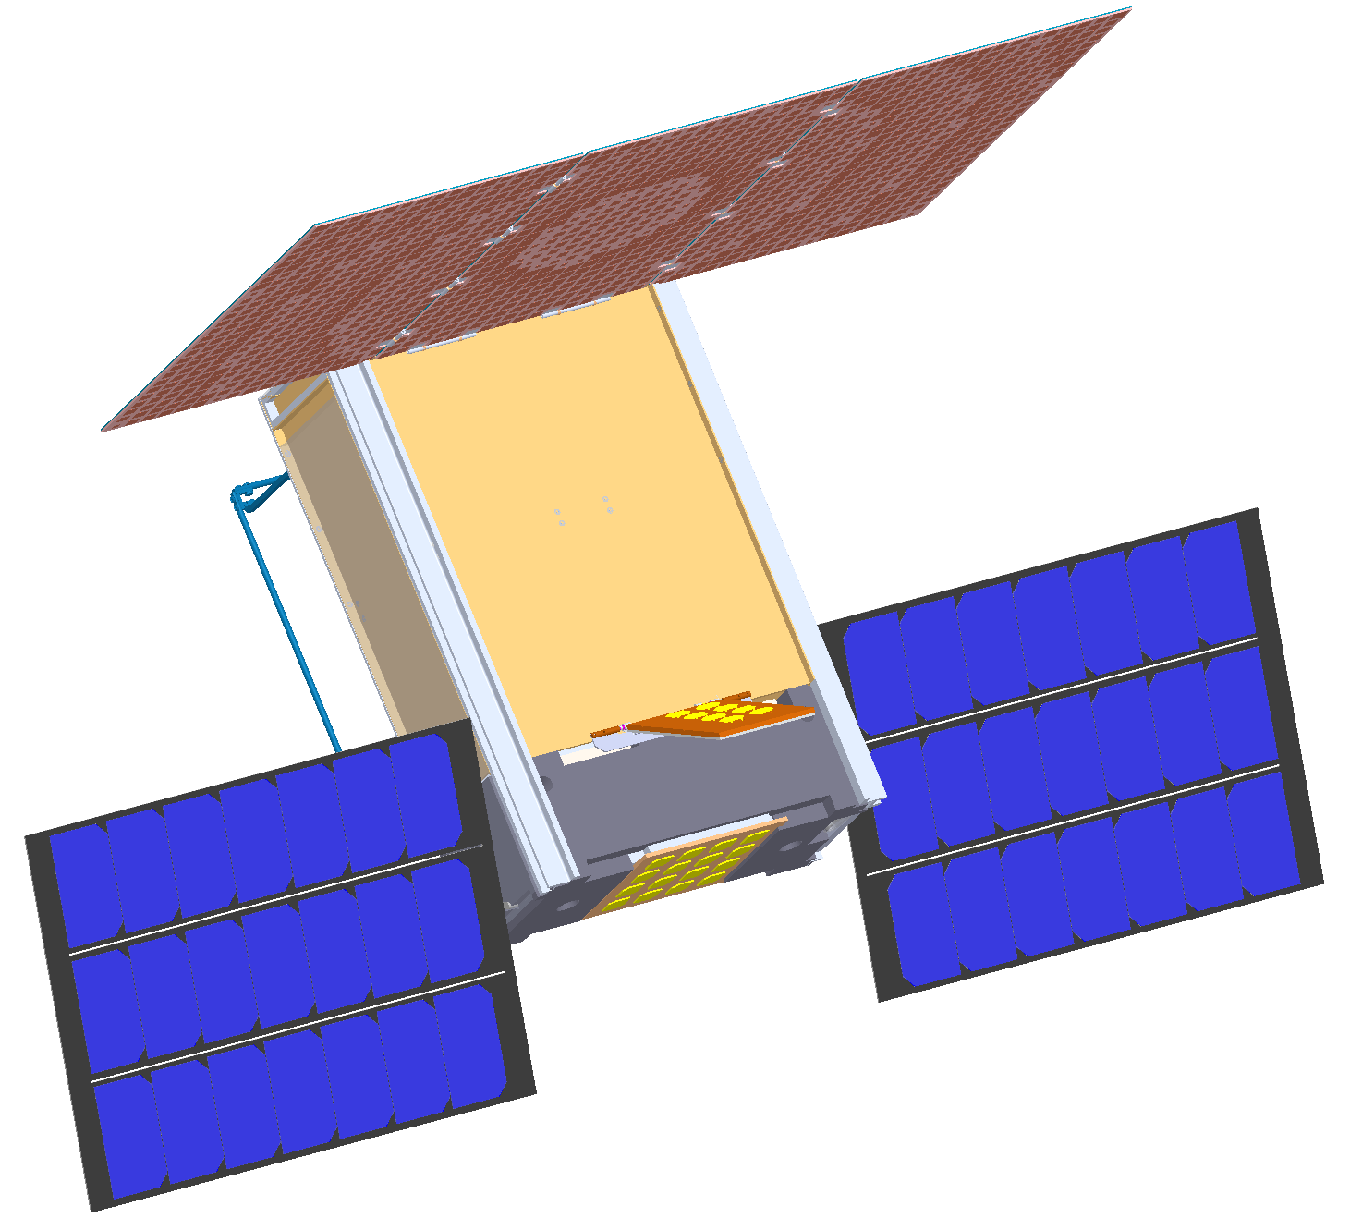
CubeSat X-Band Antennas
Estimates to DSN 34 m.
  For 20 m., 100 Kelvin, divide by 10
  For 70 m., multiply by 4
LGA, included with Iris
  10s of bps (semaphores) from Mars
    (at arrival ~1 AU)
MGA – side of a CubeSat
  Needs pointing
  Hundreds of bps from Mars
HGA – Deployable (MarCO)
  Needs good pointing
  2000 bps from Mars
    (at arrival ~1 AU)
  Ka-Band 3U Turkey Tail version also in development

Slide 8
Iris V2 Status and Availability
Missions
  MarCO flying prototypes, delivery August 2015 launch March 2016
  EM-1 secondaries, various, launch 2018
MarCo flight boards in work now
  Boards built and in test
  Firmware and software being written
  Delivery to MarCO and DSN compatibility August 2015
Ground Support Equipment (GSE) in progress
Production copies to be produced
  By a to-be-named partner company
Orders / Contracts expected third quarter 2015
  EM-1 and later missions
Early deliveries first quarter 2016
Cost is dependent on mission difficulty and market volume
  JPL is happy to help assess the cost

Slide 9
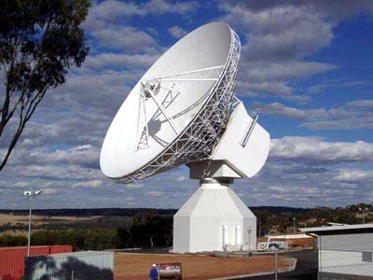
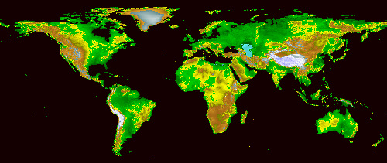
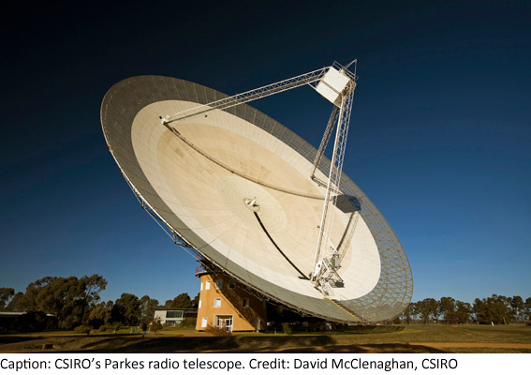
Summary
JPL and Deep Space Network (DSN) are committed to supporting deep space SmallSats and CubeSats
Initial Iris V2 testing for MarCO project has been successful
JPL working towards a commercial implementation
  Success depends on the market

Slide 10
Backup

Slide 11
Abstract
The Iris CubeSat Compatible, deep space transponder is now in Version 2 development for several planned deep space CubeSat missions. Iris V2 features X-Band power output of four watts, designed flight longevity of 2-3 years in deep space, and proper thermal management within a SmallSat context. These and other improved Iris features enable telecommand, telemetry, and radio science from destinations up to a few Astronomical Units from Earth.

Slide 12
Iris Downlink Rates

Slide 13

Iris (Iρις) – (not an acronym)
The goddess Iris is associated with:
communication, messages,
the rainbow,
new endeavors

