Slide 1
Current efforts in the development of telecommunication technologies and services for future interplanetary CubeSat missions.
Alessandra Babuscia
Kar-Ming Cheung, Steven Waldherr, Eleanor Basilio, Greg Welz, Jay Wyatt
Jet Propulsion Laboratory – California Institute of Technology
Interplanetary Small Satellite Conference (ISSC 2015)
27th April 2015
Santa Clara University, Santa Clara, CA
Part of this work was performed at the Jet Propulsion Laboratory, California Institute of Technology, under a contract with the National Aeronautics and Space Administration.
© 2015 California Institute of Technology. Government sponsorship acknowledged.

Slide 2
outline
Introduction
Telecommunication technologies
  Modelling
  Antennas
    Reflectarray
    Deploayble
    Inflatable
  Radio
Telecommunication services
  DSN support
  New techniques for simultaneous tracking
  Use of non-DSN antennas
  Ground data system

Slide 3
introduction
Currently, an increasing number of interplanetary missions is being planned and proposed.
As these missions become increasingly popular, several parallel efforts are being performed to overcome one of the key bottlenecks in CubeSat exploration using small platforms: telecommunication.
As the communication range increases, being able to provide a reliable communication link is always a challenge and this challenge can strongly condition how the mission is designed and operated.
This presentation aims to provide an updated review of the current status of technologies in development to provide telecommunication services to future interplanetary missions.
Recently, JPL Interplanetary Network Directorate commissioned a study related to the support of interplanetary small satellite missions. The main results of this study are included in a paper recently presented at the Calpoly CubeSat Workshop. Part of this presentation refers to the results of the study.

Slide 4
Telecommunication Modelling - teamxc
TeamXc is a facility for rapid development of mission concepts for Cubesats and small satellites
A telecommunication model specifically tailored for small spacecraft was developed as part of this effort
The telecommunication model handles: LEO and interplanetary missions, single satellites and constellations
Model features:
  Link analysis (Excel)
  Coverage analysis (STK-Matlab)
  Components database

Slide 5
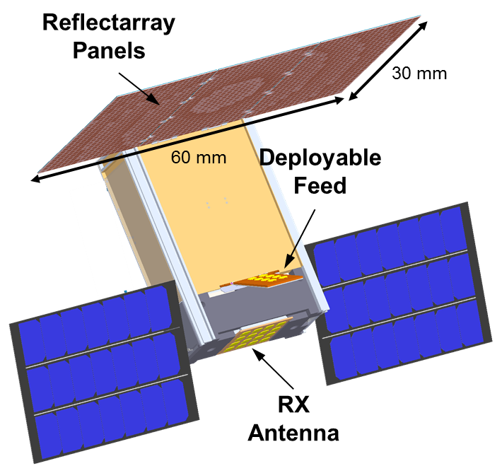
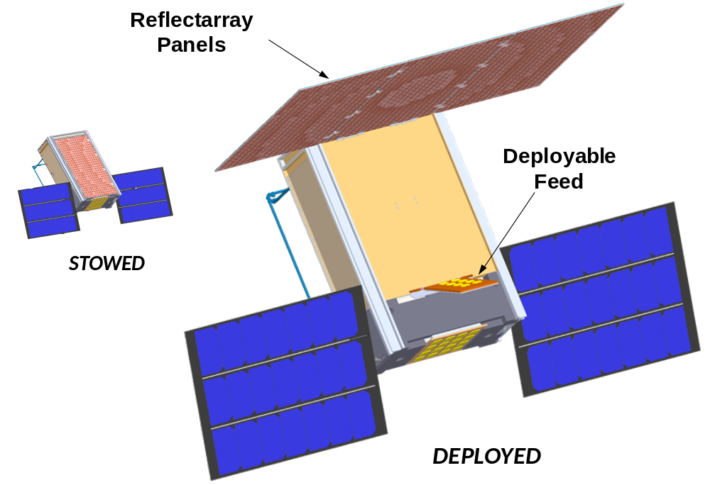
Antennas: reflectarray
Team: JPL (N. Chahat/R. Hodges)
X-band antenna
Antenna gain: 29.1 dBi (TX)
Stowage volume: 2x20x30 cm (6U)
Az beamwidth: 4.0°
El Beamwidth: 7.0°
Courtesy: N. Chahat, R. Hodges (JPL/Caltech)

Slide 6
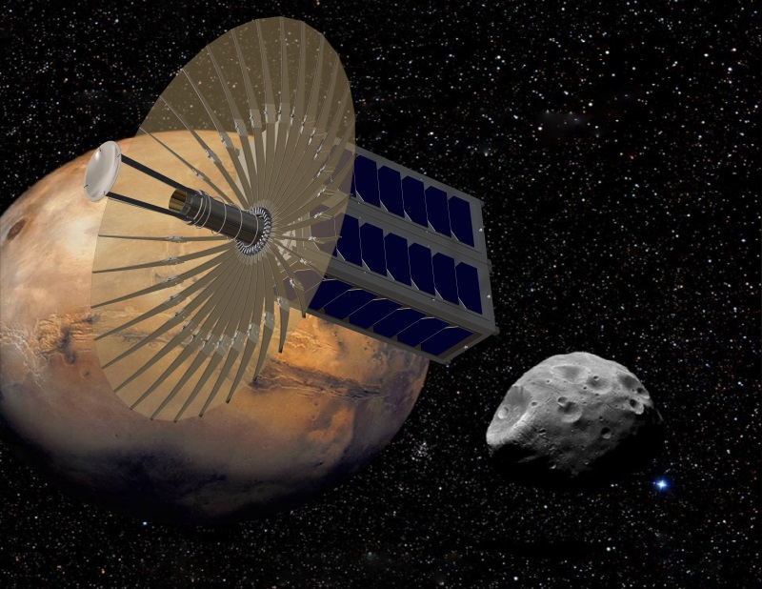
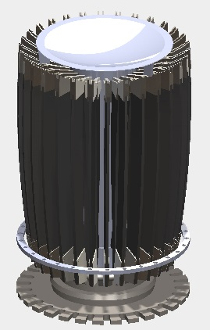
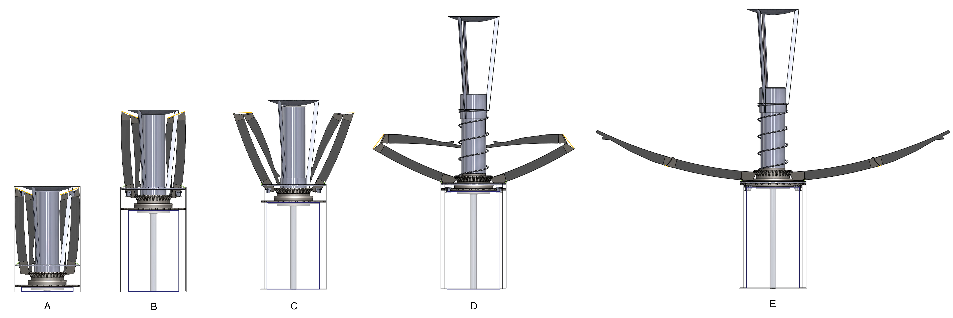
Antennas: deployable
Team: JPL (M. Thompson / J. Sauder / N. Chahat)
Ka-band antenna
Antenna gain: 42.5 dBi
Stowage volume: 1.5U
Az/El beamwidth: 1.2 deg
N. Chahat, J. Sauder, et al., “CubeSat deployable Ka-band reflector antenna for deep space missions”, IEEE MTT 2015.

Slide 7
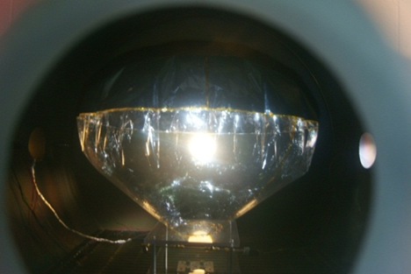
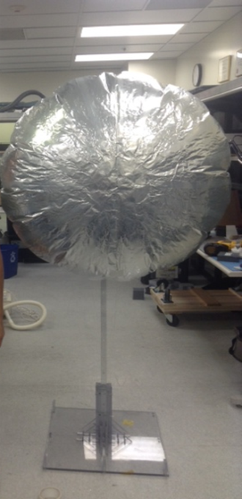
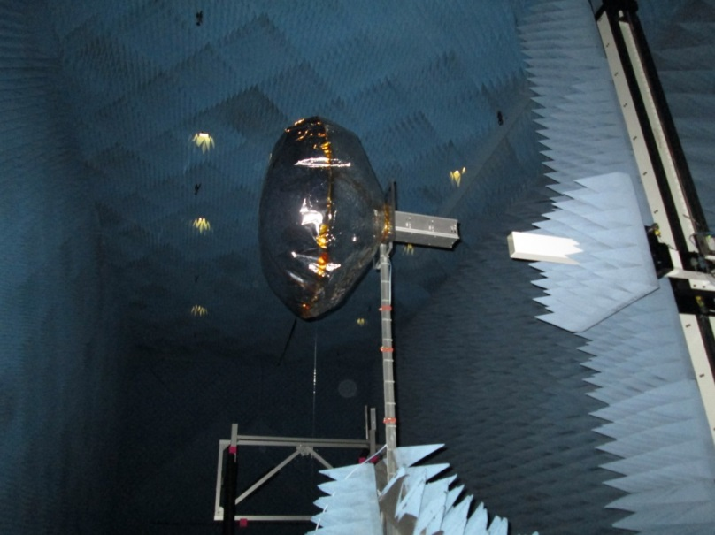
Antennas: inflatable
Team: JPL (A. Babuscia, R. Hodges, J. Sauder, L. Jones), MPI (J. Welinski), ASU (Prof. J. Thanga)
X Band antenna
Antenna gain: 34 dBi
Stowage volume: 0.5 U
Inflation: sublimating powder
Az/El beamwidth: 4 deg
Advantage: high scalability to larger sizes

Slide 8
Antenna Technologies summary
Antenna | Bands | Projected gain | Size | Advantages | Challenges
Reflectarray | X and Ka | 29 dBi (X-Band) | 2x20x30 cm | High efficiency (0.6), very limited volume | Limited scalability to higher gains
Deployable | X and Ka | 42.5 dBi (Ka –Band) | 1.5 U for 0.5 m | High efficiency (0.6) | Limited scalability Low stowing efficiency (5:1)
Inflatable | S and X | 21 dBi (S-Band), 34 dBi (X-Band) | 0.4 U for 1 m | High stowing efficiency (20:1), High scalability to larger structures | Wrinkles and shape maintenance

Slide 9
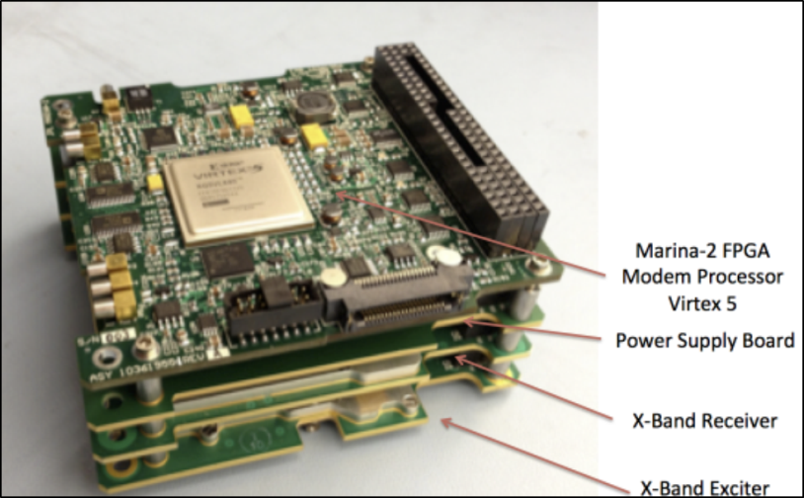
Iris radio
Development began in 2013 in support of JPL’s INSPIRE “First CubeSat to Deep Space” mission, and continues now for Lunar Flashlight, NEA Scout, Bio Sentinel, and MarCO.
Iris provides DSN- compatible communications and navigation services in a volume (0.4 U) and mass (0.4 kg) compatible with the smallest CubeSats.
Iris has RF slices for X-Band and UHF.
Supports CCSDS AOS framing, Turbo and convolutional coding.
Data rates from 62.5 to 256,000 bps in downlink
Navigation support includes coherent Doppler, ranging, and Delta-Differential One Way (Ddelta-DOR) tones.
At X-Band, 4 W of RF output correspond to a DC power input of about 20 W. The Iris receiver uses about 6.5 W of DC input..
DSN compatibility for version 1 has been formally verified at DTF–21
Iris Version 2 supports three sets of transmit and receive antennas, and it is intended for longer duration missions, up to 2.5 years.

Slide 10
Dsn support
DSN (13 antennas) provides high quality communications and tracking services for the commanding, telemetry, tracking, and monitoring of the health and safety of deep space spacecraft.
Interplanetary SmallSat missions are typically highly cost-constrained, and might not be able to afford the traditional high-end communications and tracking services provided by the DSN.
To reduce DSN costs for the interplanetary SmallSat missions, the Interplanetary Network Directorate (IND) is considering:
  A number of variations on the MSPA schemes
  CubeSat tracking packages. These package deals of one price (examples below), included all of the standard services included in the DSN aperture fee.
    Value Package of 50 hours total tracking (for one spacecraft or multiple spacecraft)
    Economy Package of 100 hours total tracking (for one spacecraft)
    Supersize Package of 100 hours plus total (pro-rated for hours after 100 hours, for one or multiple spacecraft)
  A reduced pre-launch testing when a CubeSat mission consists of several spacecraft.
    The DSN cost savings approach would be to configure for all the CubeSat spacecraft for the mission during pre-launch phase.
    The DSN would then only test one of the CubeSat spacecraft fully (i.e. RF compatibility testing, Ground Data System (GDS) testing.
    Only a subset of tests on the subsequent CubeSat spacecraft within that mission.

Slide 11
Simultaneous tracking
Multiple Spacecraft per Antenna (MSPA): multiple spacecraft that will be in view of the same ground antenna at the same time can schedule to share it for their downlink
The number that can share the antenna tends to be constrained by the number of deep space receivers affiliated with it (currently 2)
Uplink for spacecraft commanding and ranging measurement is shared between the two spacecraft via time multiplexing.
DSN has recently been investigating different approaches to increase the number of simultaneous spacecraft that MSPA
  4-MSPA
  Opportunistic MSPA: a wideband recorder, rather than additional receivers, is added to the ground antenna and run 24/7, recording whatever the ground antenna sees within the frequency bands of interest. While traditional links involving the antenna’s deep space receiver still get scheduled, smallsats and other spacecraft that will be within the same beam of the antenna, can opportunistically transmit open-loop, with their signals getting captured on the recorder.

Slide 12
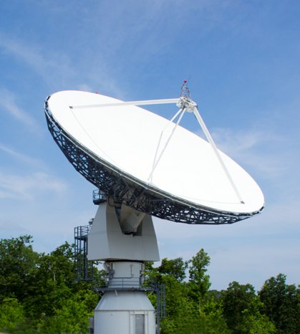
Use of non-dsn stations
One possible solution to guarantee support is the partnership of DSN with additional high gain ground stations operated by universities and other centers
One example is the Morehead State 21 m dish
The MSU 21 m Space Tracking Antenna was brought on -line in 2006 and provides telemetry, tracking, and command (TT&C) services for a wide variety of space missions
The 21-m system incorporates back-end (digital front-end) technologies that includes complete automation and control systems (for remote autonomous operation of the 21- m), software-defined radio/ DSP front-end
The 21-m is currently an effective system at S-Band, X-Bband, and Ku-bands. The system also supports remote operation by off-site operators, and it is capable of supporting the SLE data formatting and processing protocol.
The 21 m has been employed for: KySat-2, Planet Lab’s Dove-2 and Dove-3 satellites, and Morehead State’s Cosmic X-Ray Background NanoSatellite (CXBN), EduSat, UniSat-5 missions.
The system has been employed in the testing and calibration of the NASA Lunar Reconnaissance Orbiter synthetic aperture radar (mini-SAR) at X- and S-bands.
Work is currently in progress to evolve the facility into a DSN-compatible assets

Slide 13
Ground data system
The Advanced Multi-Mission Operations System (AMMOS) provides most of the ground data system functions needed to design, implement, and operate a Mission Operations System (MOS) for all mission types and classes.
Examples of AMMOS tools and services include: planning and sequencing, downlink, navigation and mission design, operations engineering, ground data system integration, test and deployment.
AMMOS adaptation for interplanetary small satellites started with INSPIRE: AMMOS Multi-mission Data Processing and Control System (AMPCS) was provided to the INSPIRE team
AMPCS allows to command and monitor their spacecraft in a way that is compatible with the DSN supported interfaces and protocols.
To support interplanetary small satellite missions Interplanetary Network Directorate (IND) Customer Assistance Package (ICAP) was created
The ICAP is a support package designed to provide mission GDS engineers with a set of telemetry and command capabilities on the first day of the mission, with little or no involvement from MGSS

Slide 14
conclusions
An overview of the current JPL efforts in the support of telecommunication for interplanetary small satellites is presented.
Modelling effort is ongoing and focusing on integrating more tools for fast design and prototyping
Antenna technologies is an active area of research: 3 different types of antenna simultaneously supported
Iris development is ongoing to include new capabilities
DSN is developing a plan to support future interplanetary mission
AMMOS AMPCS was adapted for small satellites
Future efforts will focus on: miniaturization of components, migration to higher frequencies, development of multiple access schemes (ongoing work in CDMA), routing schemes for multi-hop communication, cooperative communication techniques.

Slide 15
acknowledgments
This work was performed at the Jet Propulsion Laboratory, California Institute of Technology, under a contract with the National Aeronautics and Space Administration.
Thanks to Kar-Ming Cheung , Douglas Abraham, Belinda Arroyo, Eleanor Basilio, Nacer Chahat, Courtney Duncan, Dennis Lee, Kamal Oudrhiri, Timothy Pham, Jonathan Sauder, Robert Staehle, Stefan Waldherr, Gregory Welz, Jay Wyatt for their contributions.

Slide 16
references
K. Cheung et al., “Next-Generation Ground Network Architecture for Communications and Tracking of Interplanetary SmallSats”, CubeSat Developers Workshop, Calpoly, April 2015
N. Chahat, J. Sauder, et al., “CubeSat deployable Ka-band reflector antenna for deep space missions”, IEEE MTT 2015.
A. Babuscia, B. Corbin, M. Knapp, R. Jensen-Clem, M. Van de Loo, and M., S. Seager, “Inflatable antenna for CubeSats: Motivation for development and antenna design,” Acta Astronautica, vol. , 91, pp. 322–-332, 2013.

Slide 17
Thank you!

