Slide 1
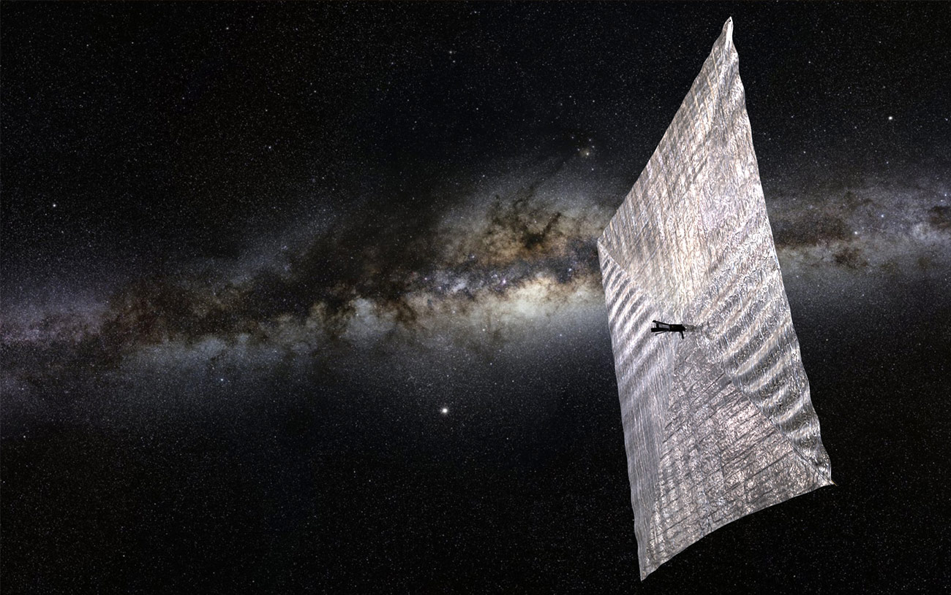








LightSail Program Update
Rex Ridenoure, CEO
Ecliptic Enterprises Corporation
Barbara Plante, President
Boreal Space
… and the LightSail Team
Interplanetary Small Satellite Conference
Santa Clara, CA
2015 Apr 27-28

Slide 2
LightSail Program Scope
Privately funded by members of The Planetary Society
Principal objectives
  Demonstrate feasibility of solar sailing from 3U CubeSat in Earth orbit
  Serve as pathfinder for future solar sail missions
Mission plans
  LightSail A (2015 launch on Atlas 5)
  LightSail B (2016 launch on Falcon Heavy)
  Mission-control ground segments in California and Georgia

Slide 3





LightSail Team
Overall program direction; funding; outreach
Program management
Lead system contractor; system I&T
Mission management; system analyses; mission ops
Launch integration; environmental test; mission ops
Systems engineering; ACS; flight software
Systems engineering; system I&T support
CubeSat design; initial construction; I&T support

Slide 4
LightSail History
Follow-on to previous solar sail mission attempt by TPS
  Cosmos 1 (2005)
3U CubeSat concept defined 2009-2011
  Two spacecraft constructed by end of 2011 (one partly tested)
~18-month program pause 2012-2013
Program resumed late 2013
  Two launch opportunities secured (LightSail-A and LightSail-B)
  New program and technical management team
LightSail-A I&T completed late 2014
LightSail-B I&T to be completed late 2015

Slide 5
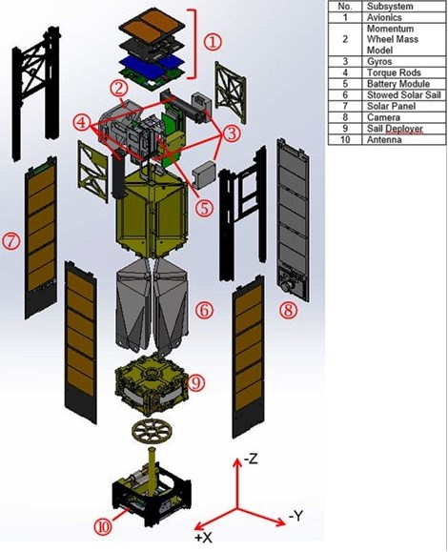
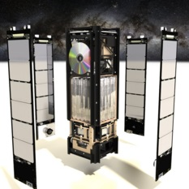
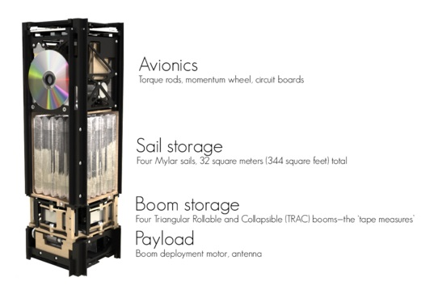
LightSail Spacecraft
LightSail A: 4.93 kg

Slide 6
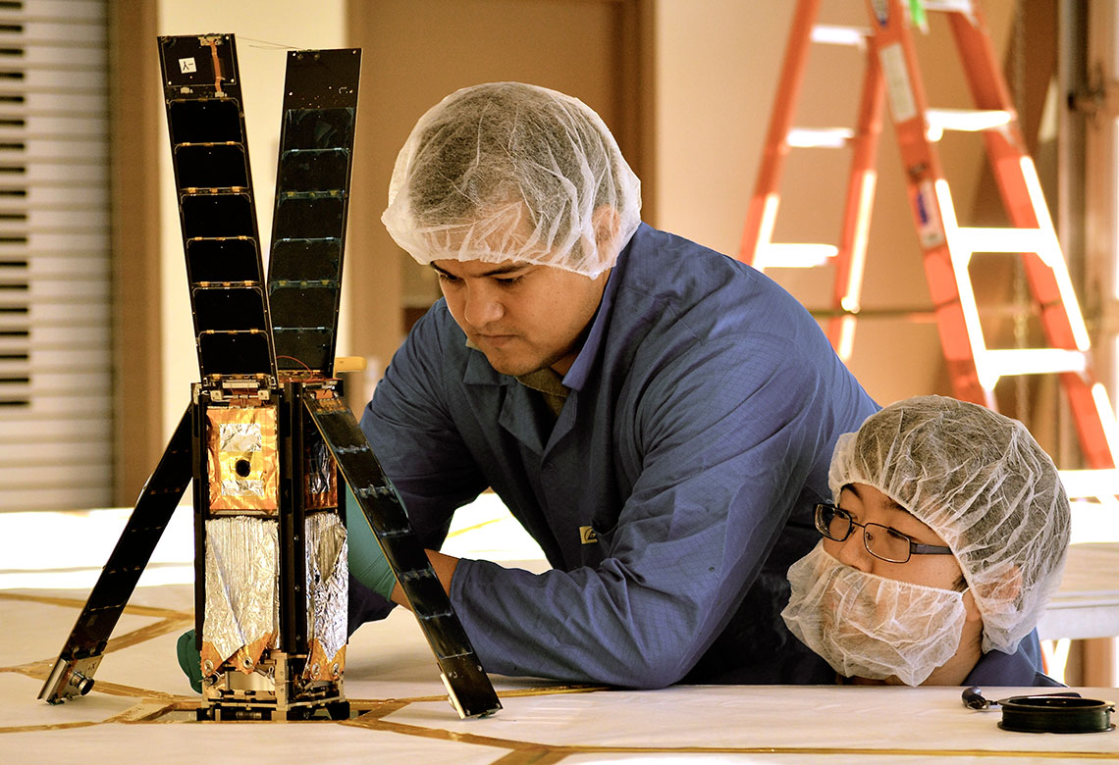
LightSail-A Spacecraft
(Mostly stowed)
LightSail A: 4.93 kg

Slide 7
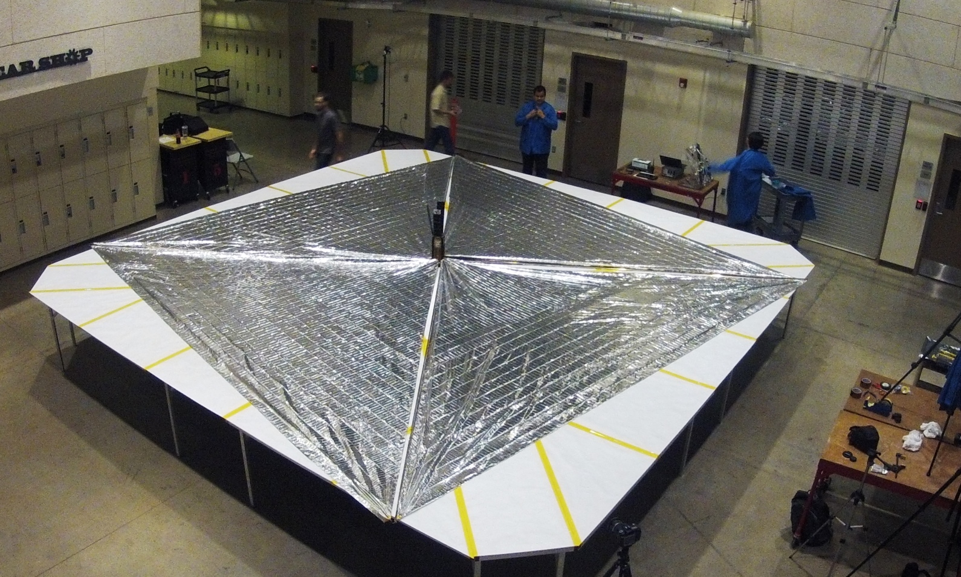
LightSail-A Spacecraft
(Fully deployed)
Sail area = 32 m²
Four 4-m booms
5.6 m on a side
LightSail A: 4.93 kg

Slide 8
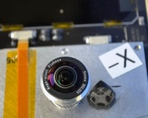
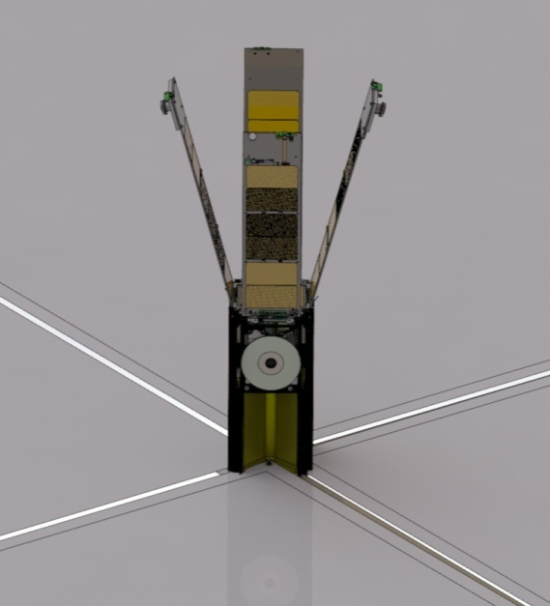
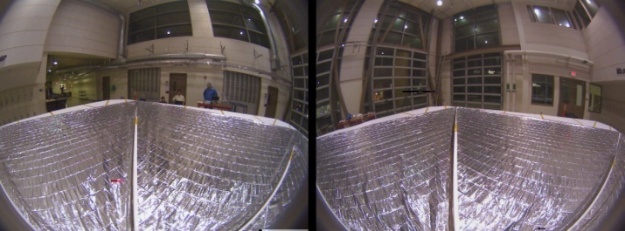
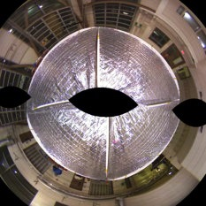
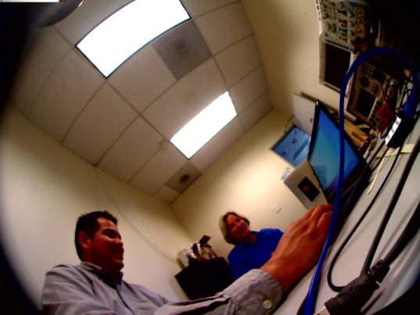
LightSail Cameras
PSCAM

Slide 9
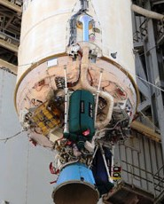





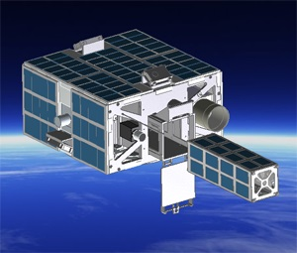



LightSail Launches
LightSail-A
  Atlas 5 / AFSPC-5 payload; from CCAFS;2015
  NASA ELaNa slot on ULTRASat (NPS CuL Lite)
  Low elliptical orbit
  2015 ~May 20
LightSail-B
  Falcon Heavy / STP payloads; from CCAFS
  Embedded target for Prox-1 spacecraft
  ~720-km LEO orbit
  2016 2Q-3Q

Slide 10

LightSail Mission Objectives
LightSail-A objective
  Successfully deploy solar sail from 3U CubeSat in Earth orbit and demonstrate key spacecraft functions (i.e., show design is sound)
LightSail-B objectives
  Successfully deploy solar sail
  Successfully control attitude before and after sail deployment
  Observably change orbit parameters (e.g., inclination)
  Capture engineering and CONOPS data relevant to future CubeSat-class solar sail missions
Mission collaborations
  NEA Scout
  Lunar Flashlight
Plus other program objectives of TPS …

Slide 11
LightSail-A Mission Operations
LightSail-A
  ~Launch+1 hr: Eject from ULTRASat
  Eject+15 sec: Boot-up complete; ACS ON
  Eject+55 min: RF antenna deploy; start beacon TLM
  Eject+4 days: Gyros and camera checkout
  Eject+28 days: Deploy solar panels, solar sails; image sail deployment and download images
  Sail deploy+2 to 10 days: Enter atmosphere

Slide 12
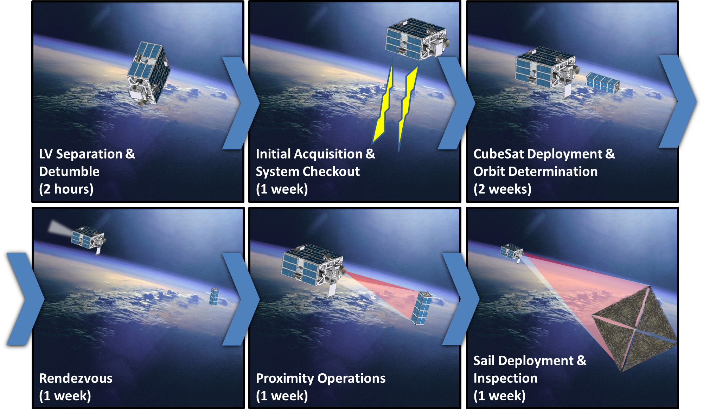
Prox-1 / LightSail-B CONOPS

Slide 13
LightSail-A Issues Resolved
(Partial List)
Hardware
  Re-design payload interface board (re-spin)
  Upgrade and mod flight computer board
  Upgrade and mod radio board
  Replace blown radios
  Re-tune/match and replace RF antenna
  Fix camera housing interference
  Stiffen solar panels
Software
  Major re-do of ACS CONOPS and software
  Resolve various telemetry issues
Test
  Fix vibe failures of burn wire assembly
  Deployment table facility
Ops
  Lower duty cycle of motor drive
  Wire staking
  Fastener staking
  Mod burn wire install
  Mod spectraline routing
  Re-grease motor
  Fix cracked cells
  Fix solar panel switch
  Work mode transitions
  Fix motor drive counter
  Breakout board issues
  Ground tracking

Slide 14
LightSail Schedule
(Since program pause in late 2011)
2012 Aug Program resumption assessment
2013 Aug Preliminary program review
2013 Dec Program review – and resumption
2014 Jan-Aug LS-A build-up, mods, functional testing
2014 Sep LS-A day-in-the-life test
2014 Oct-Nov LS-A system environmental testing
2014 Dec LS-A Mission Readiness Review
2015 Jan LS-A P-POD/ULTRASat integration; ship to Cape
2015 Apr LS-A ORT-1 and ORT-2
2015 May LS-A launch (expected)
2015 Jun LS-A mission ops
2015 Jan-Dec LS-B I&T
Mid-2016 LS-B launch (expected) and mission ops

Slide 15
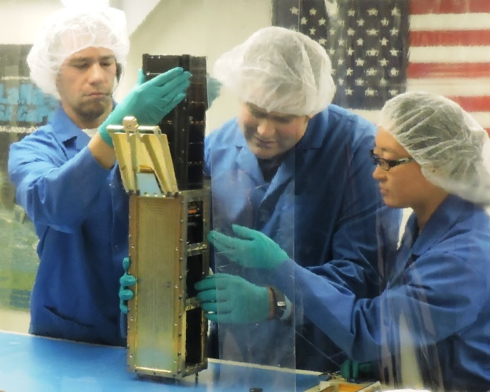
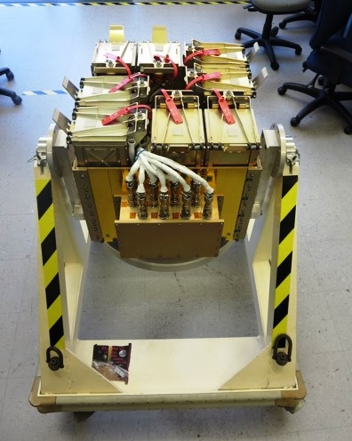
LightSail-A Ready for Launch!
LightSail A: 4.93 kg

Slide 16

LightSail Information
Intro
  http://sail.planetary.org/
Solar sail deployment (PSCAM view)
  planet.ly/unfurl
TPS updates by Jason Davis
  http://www.planetary.org/explore/projects/lightsail-solar-sailing/project-updates.html
And talk to us at the Ecliptic booth!
  Rex Ridenoure (Ecliptic)
  Barbara Plante (Boreal Space)
  SWAG -- !

