Slide 1
BioSentinel: Mission Development of a Radiation Biosensor to Gauge DNA Damage and Repair Beyond Low Earth Orbit on a 6U Nanosatellite
Vanessa Kuroda – Communications Subsystem Lead
2015 Interplanetary Small Satellite Conference,
Santa Clara, CA
4/27/15

Slide 2
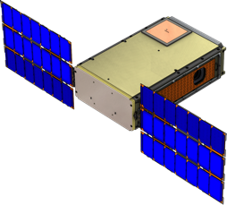
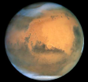


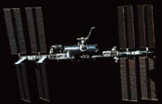

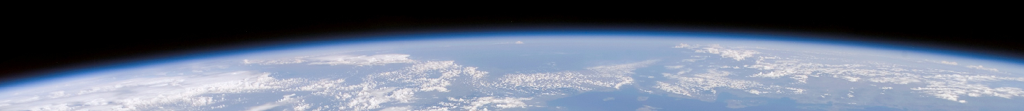
The 1st Biology Experiment beyond LEO since Apollo
The limits of life in space, as we know it, is 12.5 days on a lunar round trip or 1 year in LEO. As we send people further into space, we can use model organisms to understand the biological risks and how they can be addressed.
Beyond
BioSentinel
65 million mi
Mars
36 million mi
25 million mi
Millions mi
-BioSentinel is a 6U free-flying satellite that will be delivered by SLS EM-1 to a heliocentric orbit.
-It will operate in a deep-space radiation environment throughout its 12 to 18-month mission.
NEA
• L2
240,000 mi
Distance from Earth
Unknown
Known
180-300 mi
Extended ISS
62 mi
Minutes
6 Months
12 Months
18 Months
Mission Duration
3 Years
12.5 Days

Slide 3
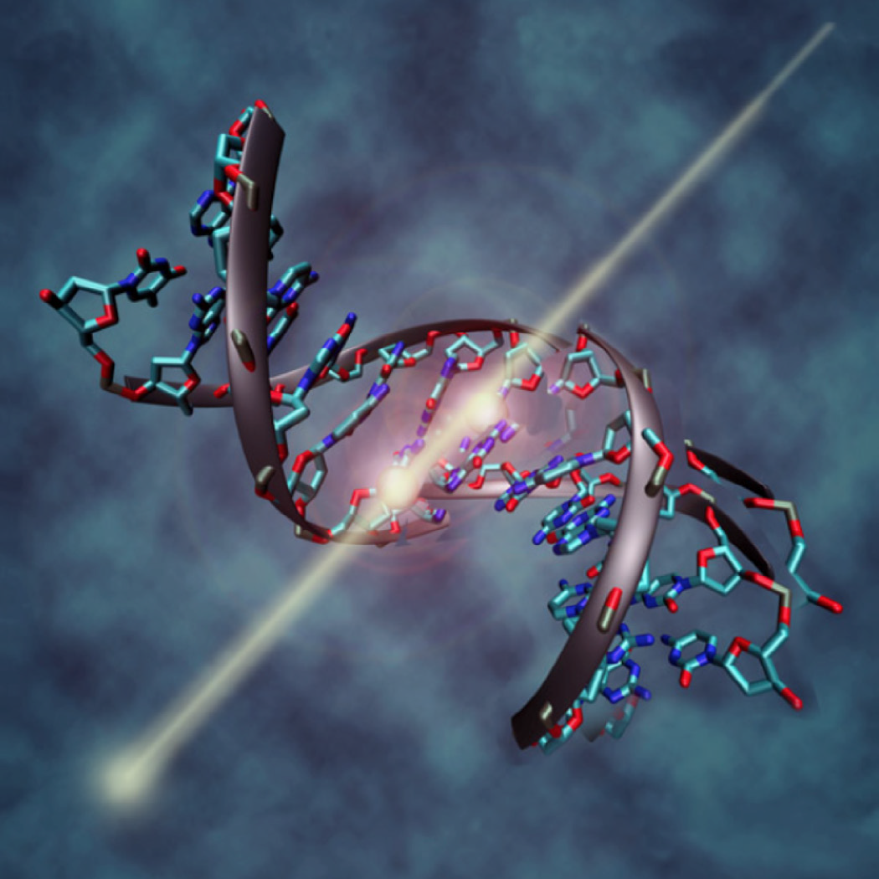
BioSentinel Project Objectives
Key BioSentinel Project Objectives
  Develop a deep space nanosat capability
  Develop a radiation biosensor useful for other missions
  Define & validate SLS (Space Launch System) secondary
  payload interfaces and accommodations for a biological
  payload
Advanced Exploration Systems (AES) Program Office selected BioSentinel to fly on the SLS Exploration Mission (EM-1) as a secondary payload
  Payload selected to help fill HEOMD Strategic Knowledge Gaps in Radiation effects on Biology
  Current EM-1 Launch Readiness Date: July 2018
AES also selected two other (non-biological) missions for EM-1
  Near Earth Asteroid (NEA) Scout (MSFC)
  Lunar Flashlight (JPL)

Slide 4

BioSentinel: A BioSensor in Space
What: BioSentinel is a yeast radiation biosensor that will measure the DNA damage caused by space radiation, specifically double-strand breaks (DSBs).
Why: Deep space radiation environment cannot be duplicated on Earth.
How: Engineered S. cerevisiae will sense and repair DNA DSBs.
Why yeast: Eukaryotic organism; easy genetic / physical manipulation; DNA repair mechanism in common with humans; availability of assays; extensive flight heritage; can be stored in long-duration stasis
Key Science Goals
Characterize rates of DNA DSB-and-repair events during spaceflight
Characterize DNA damage repair and cell survival in response to a solar particle event (SPE)
Use radiation-sensitive yeast strains to obtain survival data in
space
Correlate data of exposures using terrestrial radiation facilities to ambient space radiation
Notes:
*Make sure to emphasize correlating data, with TID and LET spectrometer

Slide 5
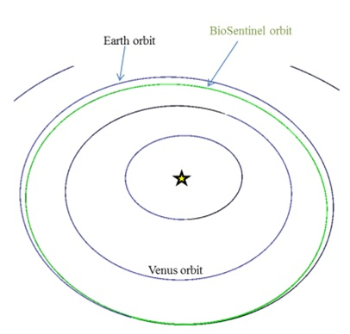
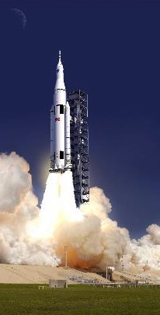
BioSentinel EM-1 Mission
Launch
Mission Orbit
Launched as a secondary payload on SLS EM-1
  Exploration Mission 1: 1st flight of NASA’s Space Launch System
  Pre-launch starts with loading of biology at L-6 months
Final orbit of secondary's to be finalized
BioSentinel will have Earth-interior, heliocentric orbit
Far outside the LEOs typically occupied by CubeSats
  Range to Earth of 0.73 AU at 18 months
  Far outside the protective shield of Earth’s magnetosphere
A representative orbit that BioSentinel might occupy
Artist’s rendering of the Space Launch System

Slide 6
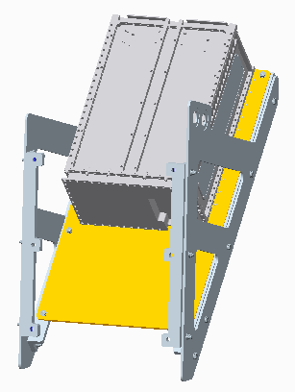
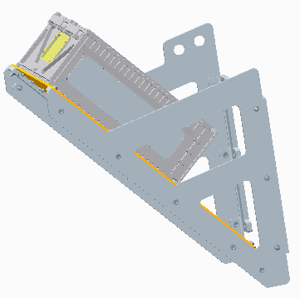
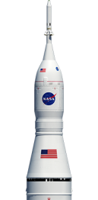
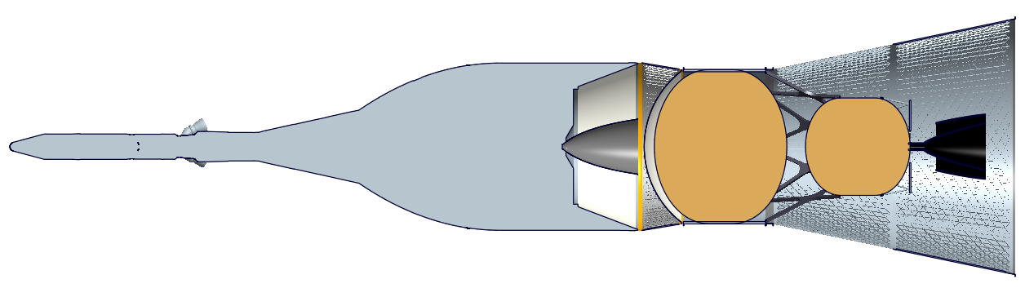
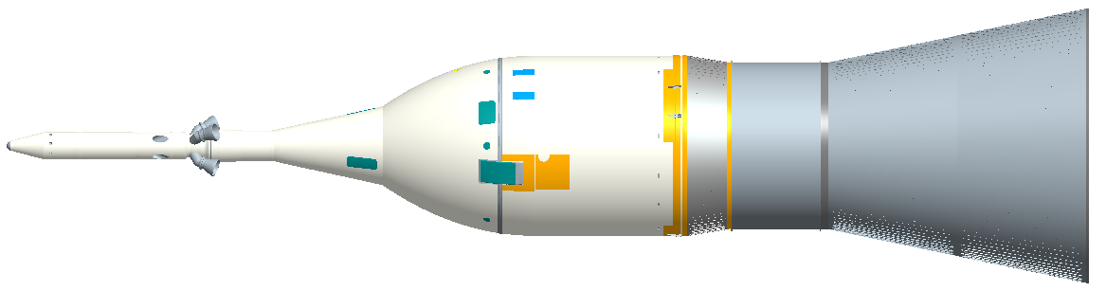
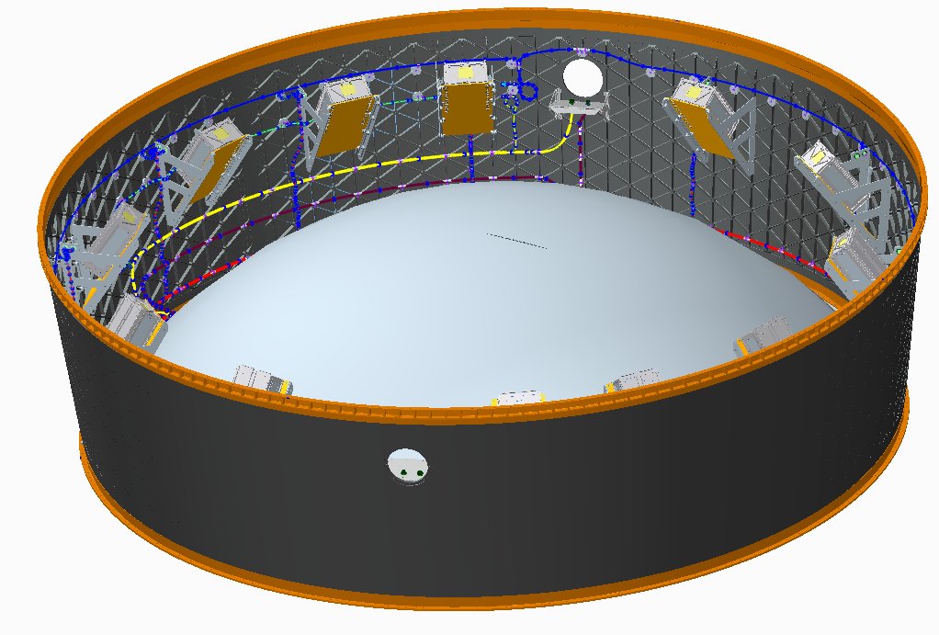
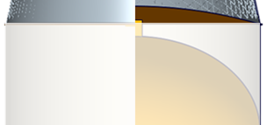
Secondary Payload Location on SLS EM-1
6U Dispenser
MPCV Stage Adapter (MSA)
Multi-Purpose Crew Vehicle (MPCV):
Orion Crew Vehicle
Interim Cryogenic Propulsion Stage (ICPS)
Bracket & Shelf
Launch Vehicle Adapter (LVSA)
Core Stage
11 - dispenser locations that each support a 6U (14 kg) secondary payload
1 - bracket location allocated to a sequencer
EM-1 only accommodates 6U; EM-2 may accommodate 12U payloads

Slide 7
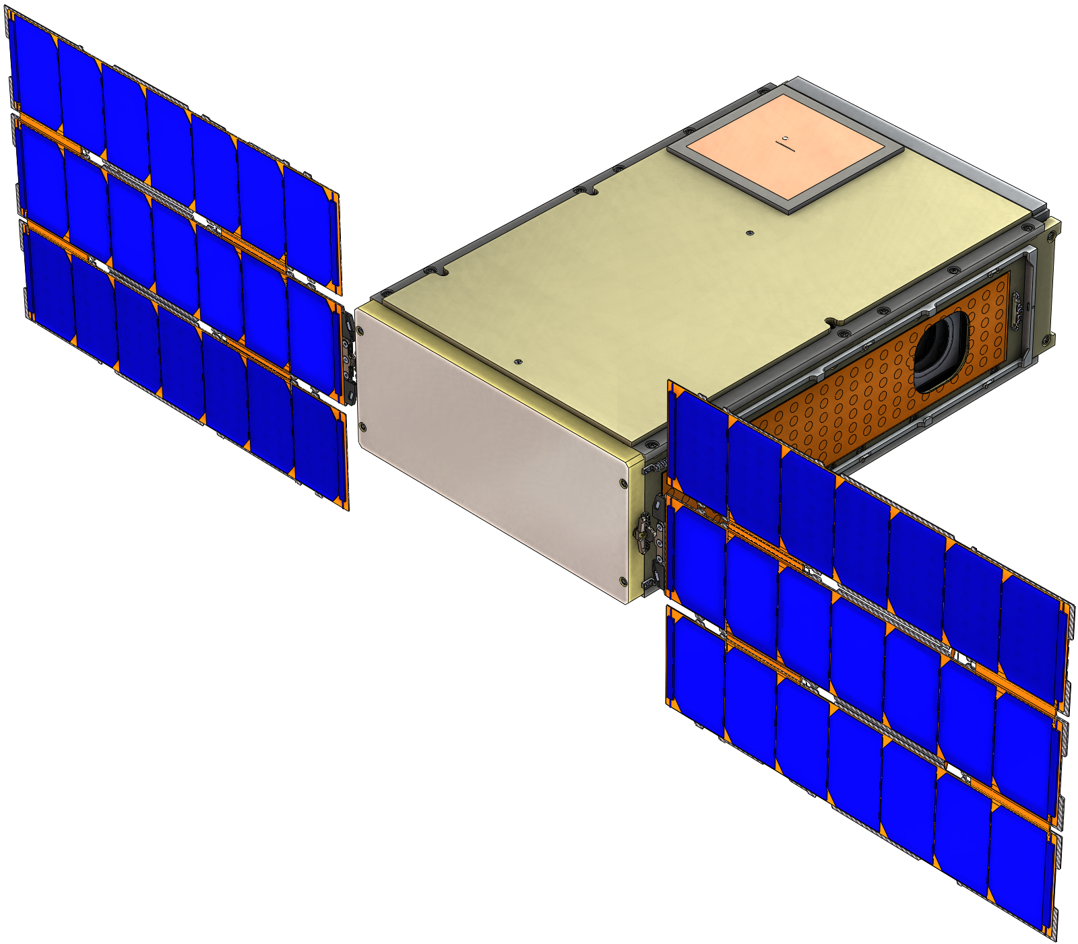
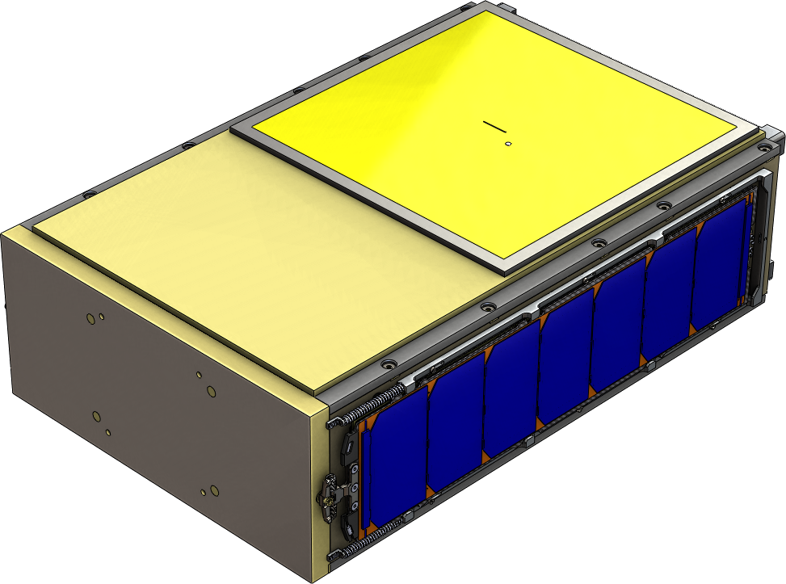
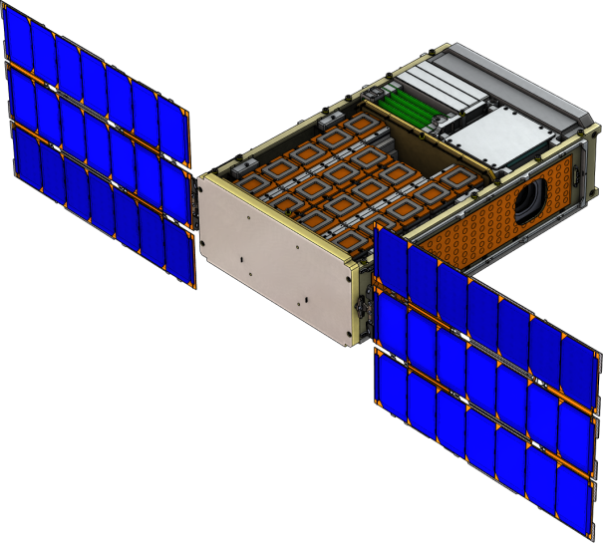
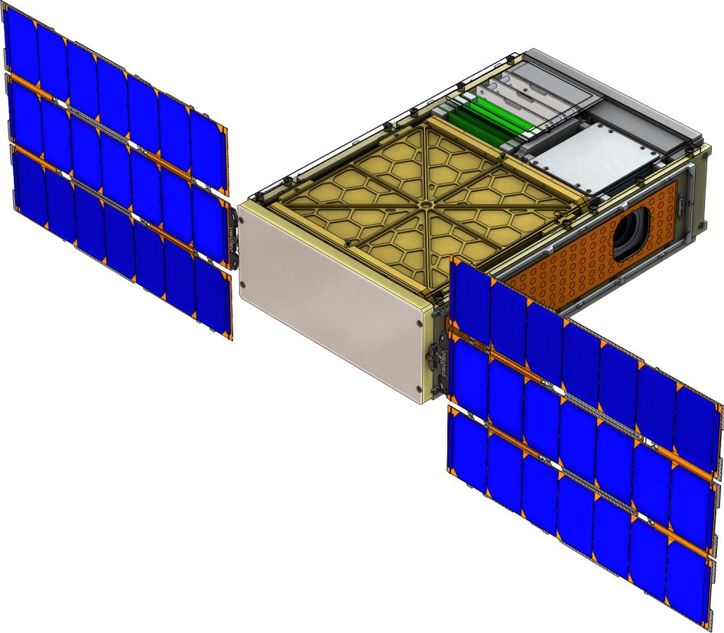
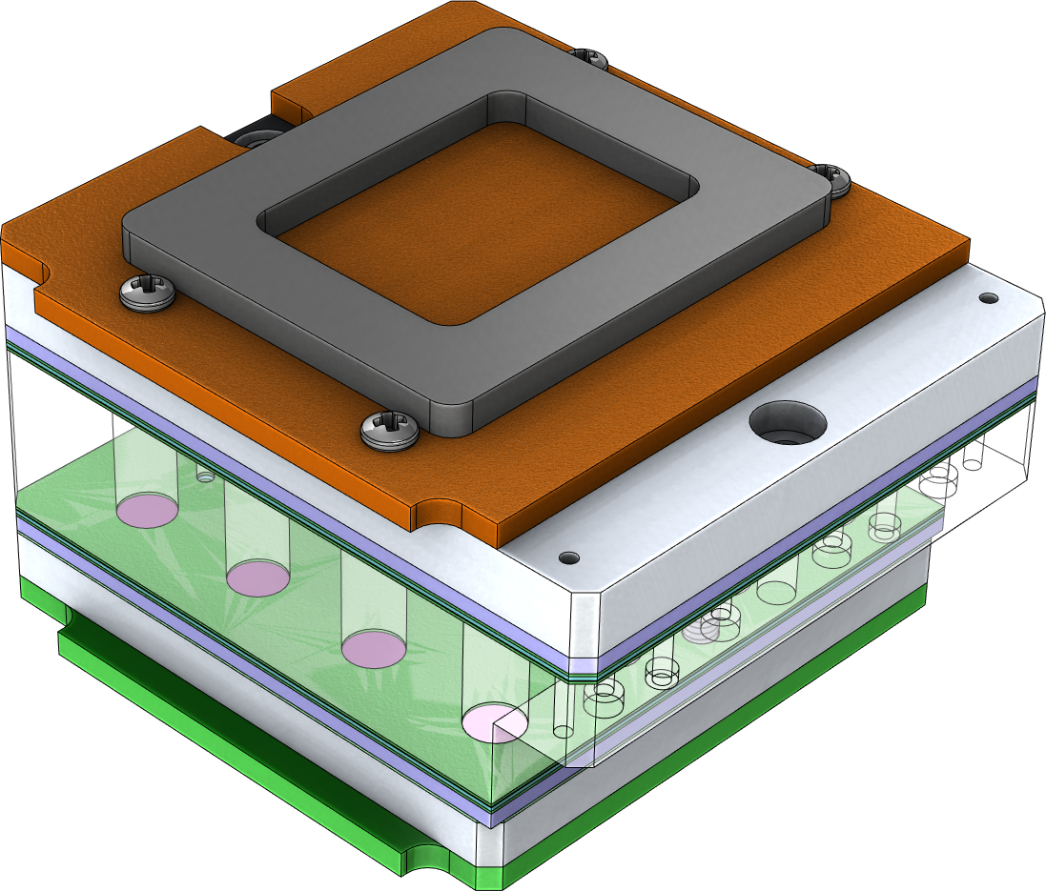
BioSentinel EM-1 Spacecraft
Stowed Configuration
Deployed Configuration
(underside)
Patch Antennas MGA (Tx), LGA (Rx)
Patch Antennas
LGA (Tx) & LGA (Rx)
Deployable/
Single Axis Gimbal Solar Arrays
Star Tracker (ST)
Transponder
Propulsion System
Avionics
Batteries
18 Coplanar Fluidic Cards
Fluidic Card
Each Card has a Set or Bank of 16 µwells
Payload

Slide 8
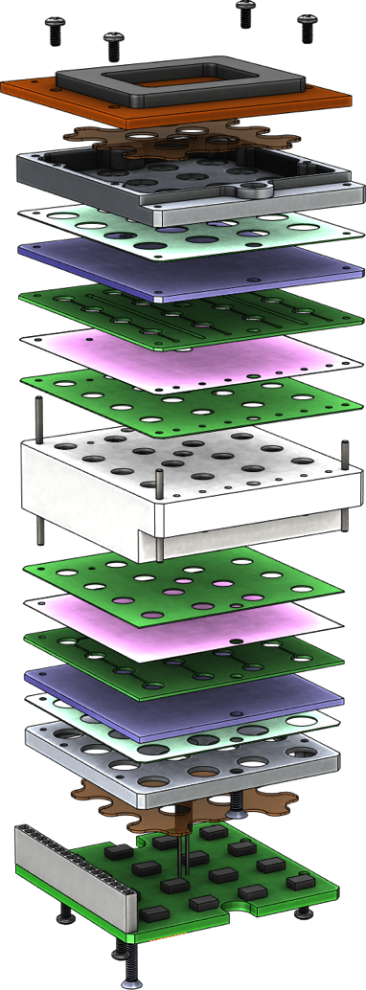
Payload Configuration ^{(cont’d.)}
16-well fluidic card
optical PCB/source
heater layer
fluidic card
heater layer
optical PCB/detection
(1 of 18)
  Optical absorbance measurement per well
    Dedicated 3-color optical system at each well
    Measure dye absorbance & optical density (cell population)
    Ground pre-calibration + in-flight “active” cal.
  Pressure & humidity sensors in P/L volume
  Dedicated thermal control system per card
    23°C with 1 °C uniformity, accuracy, stability
    1 temp. sensor per card: closed-loop control

Slide 9
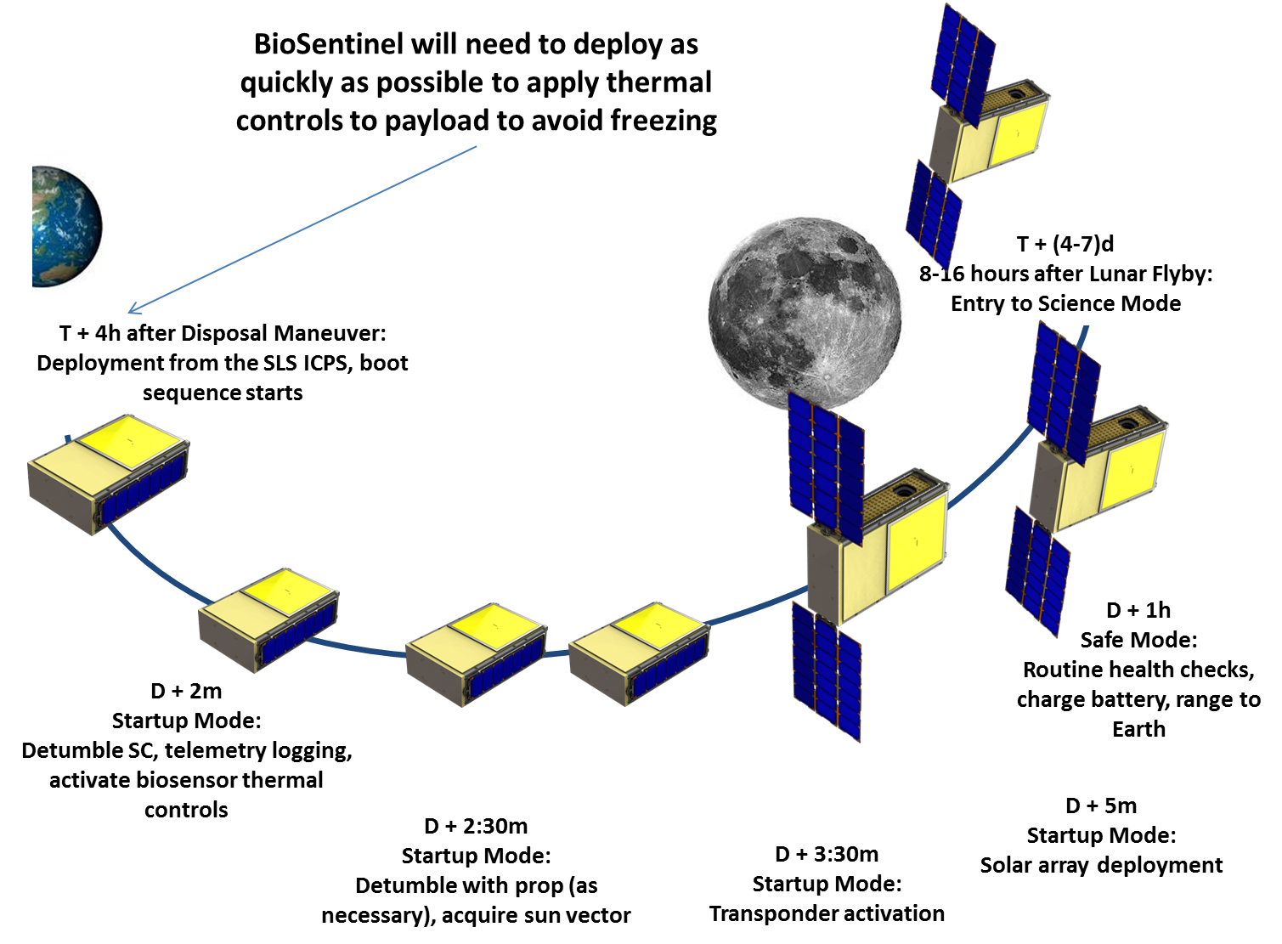
BioSentinel Launch and Deployment ConOps
Time | Events | BioSentinel State
T-0 | Launch | Powered off, 2X inhibits
T+90s | Ascent | Powered off, 2X inhibits
T+4h | Deployment window | Powered off, 2X inhibits
T+4h (TBD s) | BioSentinel Deployment | 2X Switches close, power applied
D+90s | FSW Boot | FSW boot sequence complete (First time switch commands viable)
D+1:45m | Interface App Initialization | Interface applications loaded on FSW framework
D+2m | BioSensor Activated | Thermal control applied to biologic payload
D+2:15m | GNC Unit Activated | GNC booted
D+2:30m | Detumble | Prop system commanded to detumble (as required)
D+3m | Acquire sun vector | GNC commanded to acquire sun vector
D+3:30m | Transponder activated | Transponder powered on, broadcasting telemetry, state-of-health
D+5m | Solar arrays deployed | Solar arrays commanded to deploy, reacquire sun vector
D+1h (TBC) | Ranging, Checkout | Initial checkout and ranging to system to establish ephemeris
D+(4-7)d | Lunar flyby | Flyby and entry to science mode

Slide 10





BioSentinel Month-in-the-Life ConOps
Monitor Bus Functions
1
2
1
3
Transmit to DSN
(2 to 4X per week, 2 – 4 hours per contact, ATS)
Wet new card
(1x per month, ATS)
Collect science data
(Continuous, RTS)
Refresh card
(1x per month, ATS)
1
2
3
Major Functions | Subfunctions
Select card | Determine fluidic card Select u-controller Select pump and valve set
Apply Fluids | Open inlet valve Open plate valve Open nutrient valve Activate Pump
Configure Thermal Control | Apply warm set points Apply cold set points to other cards
Close System | Close inlet valve Close plate valve Close nutrient valve De-active pump
Major Functions | Subfunctions
Readout BioSensor (15 min cadence) | Determine fluidic card Select u-controller Select and power well LEDs Select and readout sensor Iterate all wells
Readout TID sensor (15 min cadence) | Apply power to sensor Wait for stabilization Sample analog readouts
Readout LET Spectrometer sensor (1 sec cadence) | Acquire frame Store frame in file system Log frame stats (size, compression ratio)
Monitor for SPE | Sample TID readout Process individual LET frames Wet new card as required
Major Functions | Subfunctions
Align spacecraft | Determine vector to Earth Slew to Earth vector
Power Tx | Power transmitter
Broadcast data | Broadcast SOH On CFDP command, transmit BioSensor, TID data On CFDP command, transmit LET frames
Deactivate Tx | Power off transmitter
Realign spacecraft | Slew back to sun vector

Slide 11
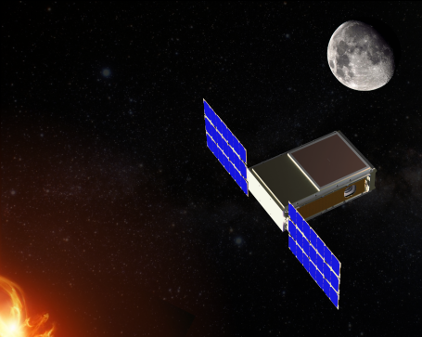
BioSentinel (Potential) Firsts & Challenges
1st Complement of 6U CubeSats to fly beyond LEO (on SLS EM-1)
  Challenges for communications and attitude control
1st NASA biology study beyond LEO in 4 decades
  Enabling comparison across multiple radiation & gravitation environments
1st CubeSat to combine a biology science payload with capable C&DH and FSW
  Payload includes autonomous measurement response to SPEs

Slide 12
Communications Challenges
1 year nominal mission life
6 months
12 months
18 months
Current challenge:
  Necessary antenna gain and size vs. payload considerations
    Thermal
    Uniform radiation shielding

Slide 13
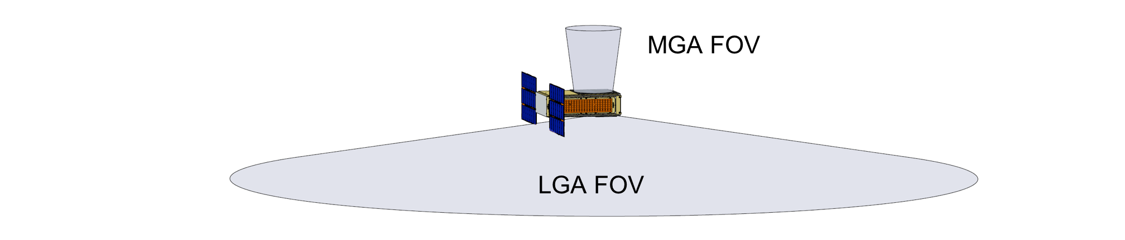
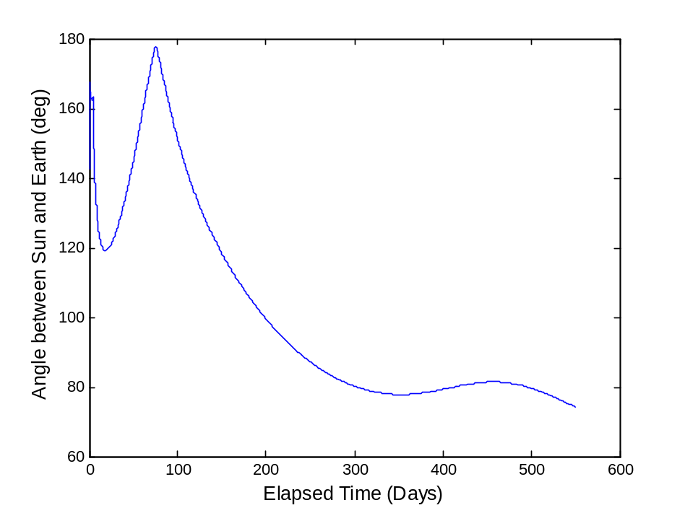
Antenna FOV & Achievable Data Rate
Sun-Probe-Earth Angle vs. Mission Days
1 year nominal mission life

Slide 14
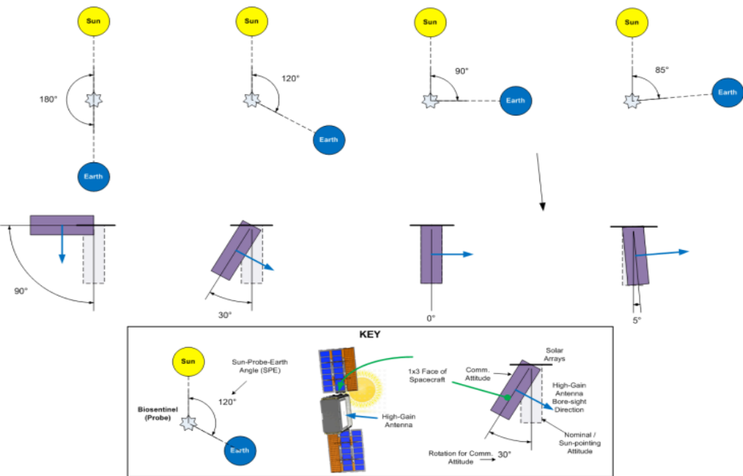
Attitude Pointing During Communication

Slide 15
BioSentinel (Potential) Firsts & Challenges
1st NASA biology studies beyond LEO in 4 decades
  Enabling comparison across multiple radiation & gravitation environments
1st Complement of 6U CubeSats to fly beyond LEO (on SLS EM-1)
  Challenges for communications and attitude control
1st CubeSat to combine a biology science payload with capable C&DH and FSW
  Payload includes autonomous measurement response to SPEs
Affiliations : NASA ARC, NASA JSC, NASA GRC, LLUMC, Univ. Saskatchewan
Support : NASA Human Exploration and Operations Mission Directorate (HEOMD)
Advanced Exploration Systems Division – Jitendra Joshi, Jason Crusan Program Execs.

Slide 16
Questions? vanessa.m.kuroda@nasa.gov
BioSentinel Mission
Affiliations : NASA ARC, NASA JSC, NASA GRC, LLUMC, Univ. Saskatchewan
Support : NASA Human Exploration and Operations Mission Directorate (HEOMD)
Advanced Exploration Systems– Jitendra Joshi, Jason Crusan Program Execs.

Slide 17
BioSentinel
BACK-UP

Slide 18
BioSentinel Teaming
The Project Team
Management
  Bob Hanel, Elwood Agasid, Andres Martinez, Debra Reiss-Bubenheim
Science
  Sharmila Bhattacharya, Macarena Parra, Tore Straume, Sergio Santa Maria, Diana Marina, C. Mark Ott, Sarah Castro, Greg Nelson, Troy Harkness
Payload
  Tony Ricco, Travis Boone, Ming Tan, Charlie Friedericks, Aaron Schooley, Charlie Ricco, Terry Lusby, Bobbie Gail Swan, Scott Wheeler, Susan Gavalas, Edward Semones
Spacecraft and Bus
  Brian Lewis, Matthew Sorgenfrei, Matthew Nehrenz, Vanessa Kuroda, Ben Klamm, Craig Pires, Shang Wu, Abe Rademacher, Josh Benton, Doug Forman, Hugo Sanchez, Brittany Wickizer
Affiliations NASA Ames, NASA JSC - RadWorks, LLUMC, Univ. Saskatchewan
Support NASA Human Exploration and Operations Mission Directorate (HEOMD); Advanced Exploration Systems Division – Jitendra Joshi, Jason Crusan Program Execs.

Slide 19
BioSentinel Relevance to SKGs
Goals:
Life science studies beyond Low Earth Orbit (LEO) relevant to human exploration
  Use simple organisms to inform us of greatest risks to humans beyond LEO, so that appropriate protection can be developed and dangers can be mitigated
  Provide critical advances to autonomous life support technologies for small organisms
Filling Strategic Knowledge Gaps (SKGs)
SKG documents | Gaps
Mars Precursor Strategic Analysis Group (P-SAG) SKGs, May 2012 | II-D Effects of radiation and effectively low g on biology and physiology III-G Radiation shielding, specifically for subsystems
P-SAG & MEPAG (Mars Exploration Program Analysis Group) | B3-2, Crew Health and Performance: place detector in orbit to measure energy spectra during Solar Energetic Particle Events (SPEs)
SBAG SKGs, Nov 2012 | III-B: Ionizing Radiation Environment at Small Body Surfaces
LEAG-SAT SKGs, March 2012 | A4-4: Autonomous systems tech demo A4-6: Life support tech demo A4-7: Mechanisms tech demo B3-6: Radiation shielding B5-3: Microbial survival, Mars conditions

Slide 20
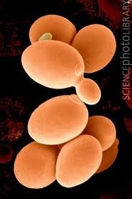
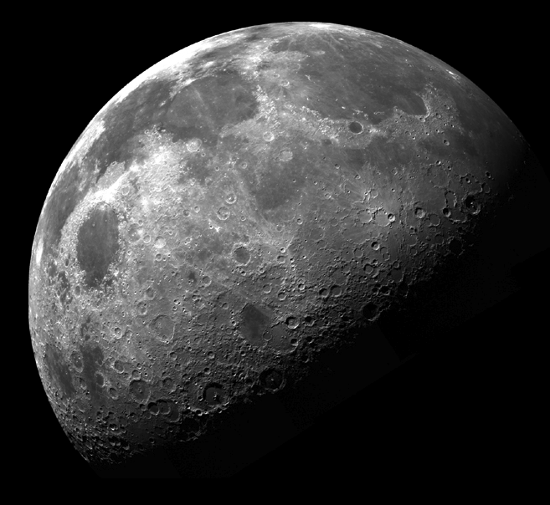

BioSentinel Science Concept
Quantify DNA damage from space radiation environment
  Space environment cannot be reproduced on earth
  Omnidirectional, continuous, low flux with varying particle types
  Health risk for humans spending long durations beyond LEO
  Radiation flux can spike 1000x during a solar particle event (SPE)
Correlate biologic response with LET and TID data
  BioSensor payload uses engineered S. cerevisiae yeast
  Measures rate of Double Strand Breaks (DSB) in DNA
  Linear Energy Transfer (LET) spectrometer measures particle energy and count
  Total Ionizing Dose (TID) dosimeter measures integrated deposited energy
Yeast assay uses microfluidic arrays to monitor for DSBs
  Three strains of S. cerevisae, two controls and engineered strain
  Wet and activate multiple banks of microwells over mission lifetime
  DSB and associated repair enable cell growth and division
  Activate reserve wells in event of a Solar Particle Event (SPE)

Slide 21
BioSentinel EM-1 Mission Overview
SLS EM-1 Pre-launch Integration flow starts ~L-6 months (biology in stasis)
Launch on SLS EM-1 in July 2018 as a secondary payload
Deployment from the SLS 2nd Stage will achieve a lunar flyby and place BioSentinel into an Earth-Interior Heliocentric orbit
  The BioSentinel-to-Earth Distance will increase over time
By being outside the Van Allen Belts, BioSentinel will be in a radiation deep space environment at a nominal 1-AU from the sun
Science Mission Duration (post launch) is 12-mo baseline, 18-mo extended, & 3-mo minimum
  Consistent with a typical 10-mo outbound flight to Mars or 6-mo Near Earth Asteroid (NEA) manned rendezvous mission
  The longer the mission, the greater the chance to observe a Solar Particle Event (SPE)
Spacecraft bus provides deep space capability
BioSentinel payload consists of:
  BioSensor
  Linear Energy Transfer (LET) Spectrometer (provided by JSC RadWorks)
  Total Integrating Dose (TID) Dosimeter

Slide 22
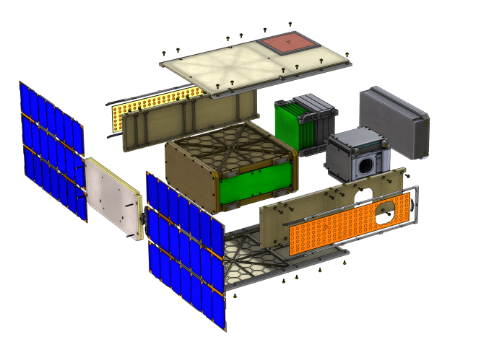
BioSentinel Spacecraft Internal Configuration
Patch Antennas
LGA (Tx) & LGA (Rx)
CDH / EPS / Transponder Stack
Propulsion System
Batteries
Integrated GNC Unit
Solar Array Gimbal
Star Tracker Cutout
Solar Arrays
BioSensor Canister

Slide 23
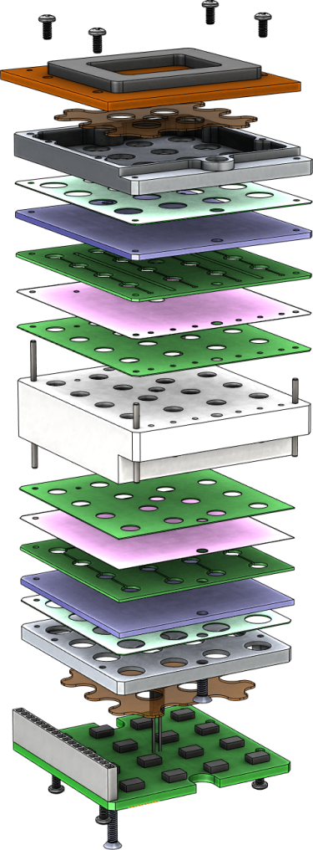
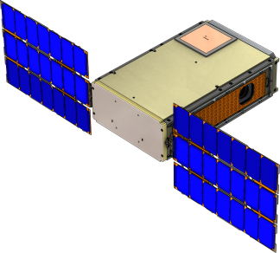

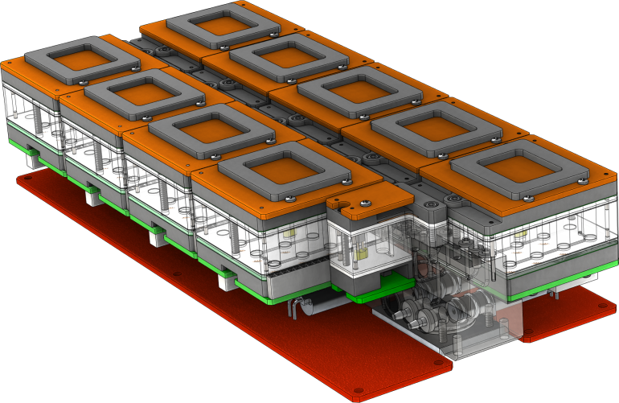
16-Well (4x4) Fluidic Card Stack
Gap Pad contacts Enclosure wall for thermal exchange
BioSentinel
6U Spacecraft
Card Stack Layers
Gap Pad
LED PCB
Heater
Spreader
Bond (thermal)
Fluidic Card
Block
4U BioSensor Enclosure
Fluid Inlets and Outlets
Bond (thermal)
Spreader
Heater
Detector PCB
9-card assemblies (2)
(pumps & bags beneath)
Fluidic Manifold
Temp Sensor embedded in block
Calibration Well
Control PCBs

Slide 24
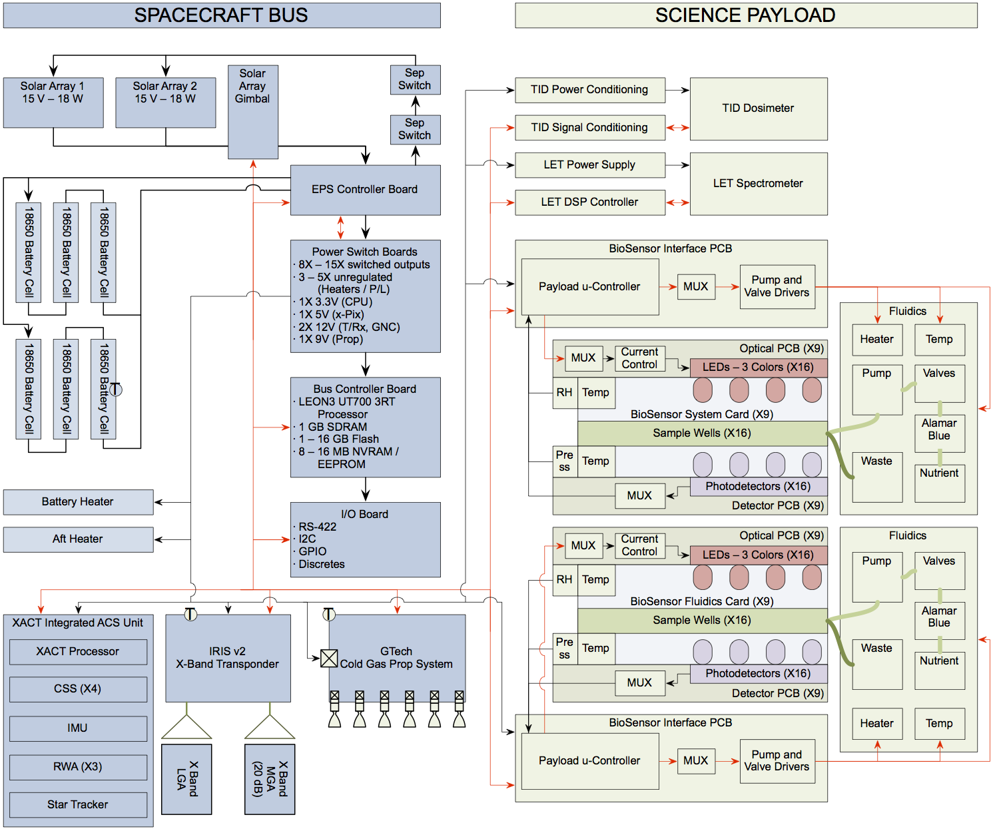
BioSentinel Spacecraft Functional Block Diagram

Slide 25
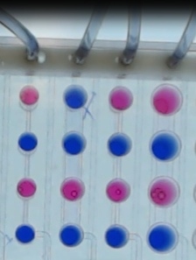
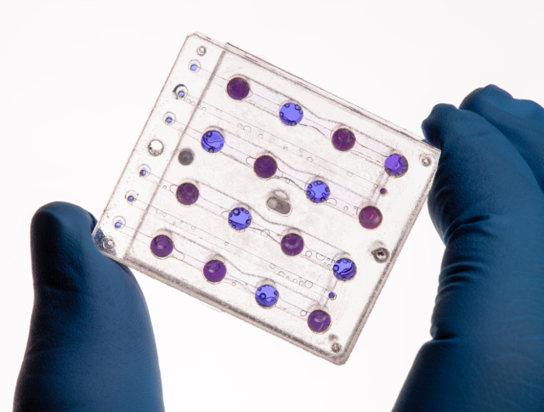
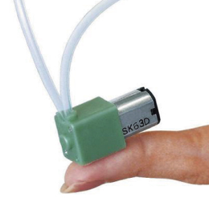
Biological Support & Measurement Systems
  support biology in stasis & growth
  enable & perform measurements
  compatible with multiple platforms
    free flyer (EM-1), Mars 2020, ISS, ground experiments
    robust, standard data & power interfaces
  Configuration: 4U hermetic containment vessel
    1 atm internal pressure, low RH
    Fluidics: 18 sets (cards) of 16 µwells each
      2 cards / month; 1 – 2 sets on “SPE standby”
    Pumps, Valves, Tubing, Media external to cards
      low-permeability materials to keep dry yeast dry

Slide 26
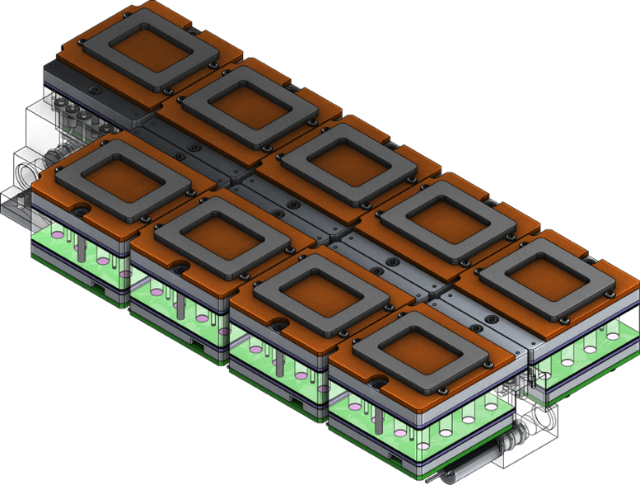
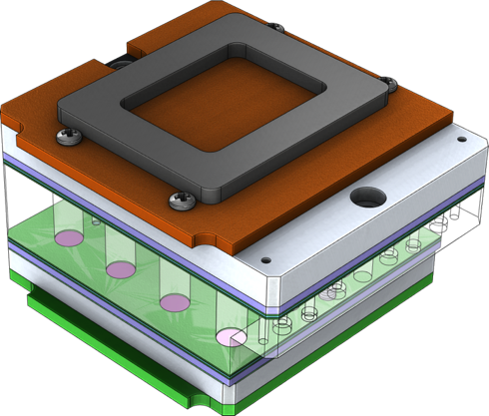
Biology / fluidics / optical / thermal configuration
thermal link (gasket)
optical PCB/source
heater layer
fluidic card
heater & thermal spreader
optical PCB/detection
16-well card
= 1 “set”
(18 sets total)
1 atm Payload Containment
~ 4U
p T
RH
Thermal exchange
card 1
card 3
… …
card 17
P/L Electronics
card 2
card 4
… …
card 18
to bus
LET
spectrometer
Hermetic fluid storage
& delivery (1-9)
Hermetic fluid storage
& delivery (10-18)
p T RH
to bus
TID sensor
to bus

Slide 27
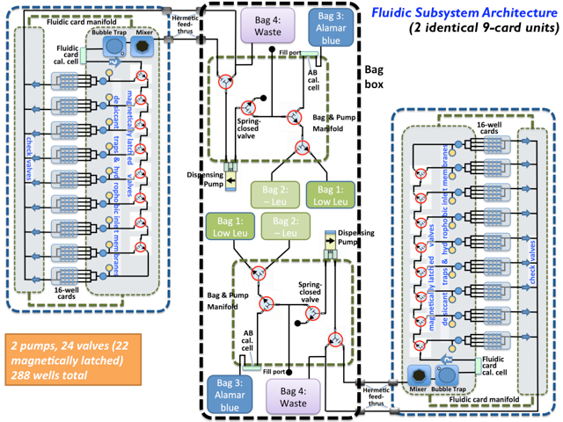
Fluidic Delivery System Block Diagram
Version - 3/10/15

Slide 28
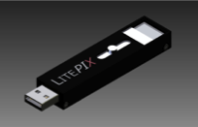
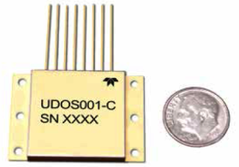
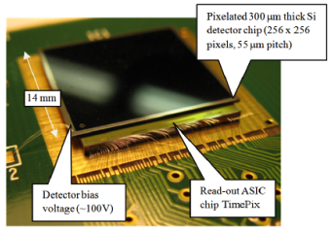
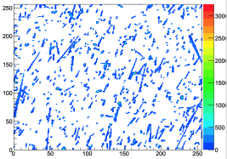
Payload Configuration: Radiation Dosimetry
  Radiation sensors
  LET spectrometer device: TimePix family solid-state device
    energy (LET) measured
    direction (crudely) determined
    frequent measurement & caching of results; selective downlink
    technology demonstration is underway on ISS (JSC)
  Total integrating dosimeter: Teledyne µDOS001
    15 µrad resolution; ranged analog outputs
    highly successful on LRO
Typical TimePix frame:
256 x 256 x 14 bits
0.25 – 150 keV/µm LET range
TimePix Chip
Teledyne dosimeter
28
28

Slide 29

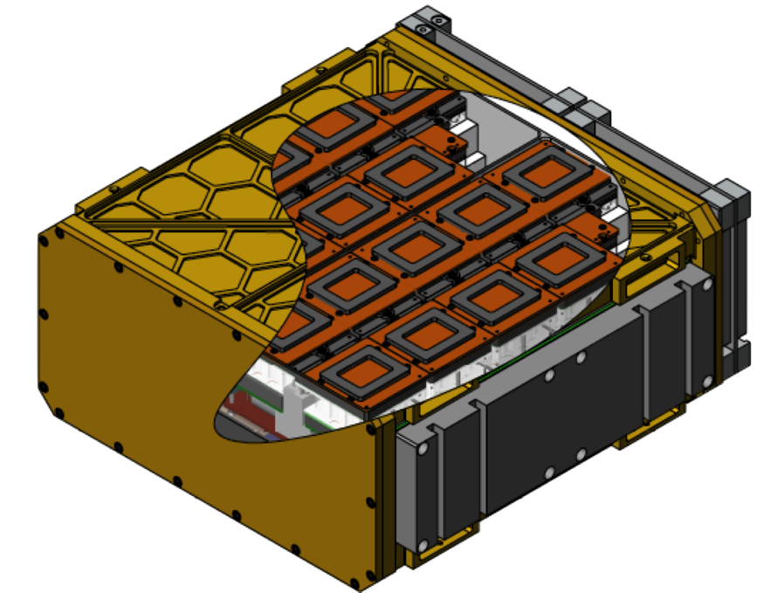
BioSentinel/Mars Instrument
Use the BioSentinel Payload currently in development for EM-1
  18-fluidic card BioSensor Payload; each card has 16 micro-fluidic wells
  Volume: ~4U (10 cm x 20 cm x 20 cm)
  Mass: 6 – 8 kg
  Power: 5 – 8 W
  Data Volume: 0.2-1 MB/week
  Linear energy transfer (LET) Spectrometer
  Total ionizing dose (TID) Sensor
Fluidic Card
1 of 18
Attach to Mars 2020 Cruise Stage for power and data relay data to Earth
Wet 1 card every ~ 2 weeks over the 9-month Cruise Phase
Record consequences of cosmic radiation including solar particle event(s) if they occur

