Slide 1


Pez Zarifian
April 29th, 2014
"(c) 2013 California Institute of Technology. Government sponsorship acknowledged."
"This document has been reviewed and determined not to contain export controlled technical data."
Notes:
Good afternoon, my name is Pez Zarifian and I am a Systems Engineer in JPL’s Advance Concept Group. This presentation is about Team Xc, which is JPL’s collaborative design team for CubeSats, NanoSats and SmallSats. Before I tell you about Team Xc, I’d like to tell you a bit about the Team X which is JPL’s concurrent engineering team for rapid design and analysis of space mission concepts.

Slide 2


Team X & Concurrent Engineering
Traditional Engineering– Serial
Concurrent Engineering – Parallel
Start
Provide Staff
Subsystem Design
System Trades
Cost
End
Delays, inconsistencies, high cost
Subsystem Design
Start
System Trades
End
Cost
Notes:
Back in 1995 the formulation office at JPL recognized the need for Team X when they recognized the potential of concurrent engineering as oppose to the traditional engineering methods. What happened at that time was that the program offices spun up a team of systems engineers and SMEs every time they needed to study a concept. They soon realized that…
Traditional method: working in cubicles, writing ICDs, occasional interaction with other design team members.
Concurrent engineering: Diverse specialists working in real time, in the same place, with shared data, to yield an integrated design
Benefits: Lower cost, much quicker, less chance for design inconsistencies.

Slide 3
What is Team X_{c}?
Agile, collaborative design team for CubeSats, NanoSats and SmallSats, built on Team X infrastructure
Customizable studies and products
  Feasibility
  Trade Space Exploration
  Point Design
Proposal-Ready Products
Fast Turnaround (2-4 weeks)
Cost Effective ($15K average)
Notes:
TeamXc’s business model matches the CubeSat paradigm in the sense that we are agile and cost effective

Slide 4
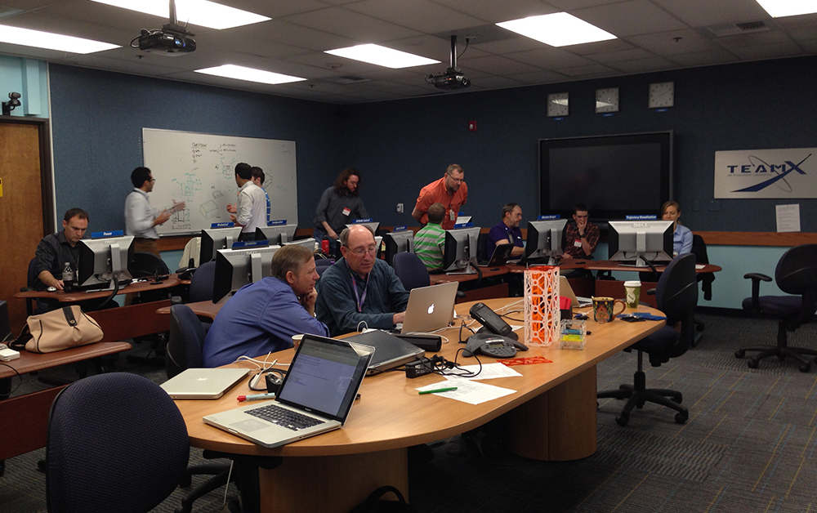
Why Team X_{c}?
Subsystem Design
Provide Staff
Subsystem Design
System Trades
Cost
Start
Start
System Trades
End
End
Cost
Delays, inconsistencies, higher cost

Slide 5
Feasibility Assessment Overview
Team X_{c}’s Feasibility Assessment aims:
Provide an answer to the following questions:
  Can the mission objective(s) be accomplished with a CubeSat/NanoSat?
  The reverse can also be asked – what can I do with a CubeSat/NanoSat?
Provide the following products:
Feasibility of mission objective / payload
Recommendations on design to ensure feasibility
Insight into constraints, drivers, and trade-offs
Notes:
Inputs: Customer may approach Team X_{c} with one following as examples:
Science / technology mission objective (e.g. science measurement, demo flight hardware)
Science / technology payload to fly
Spacecraft / Launch opportunity
Mission concept that was already proposed

Slide 6
Trade-Space Exploration Overview
Team X_{c}’s Trade-Space Exploration aims to:
Provide understanding of architectural trade space:
  What architecture options should be considered? Major drivers and/or sensitivities?
Provide the following products:
  Trade representations such as science value vs. cost or performance, Pareto Curves, etc.
  Recommendations for most promising concepts for further elaboration

Slide 7
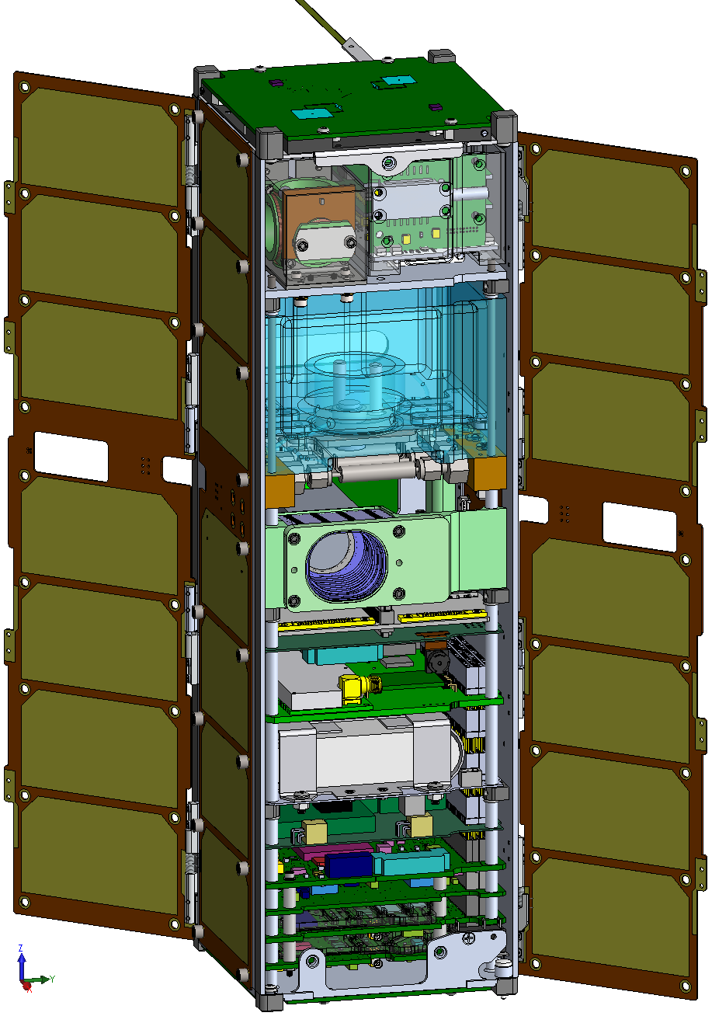
Point Design Overview
Team X_{c}’s Point Design aims to:
Provide customer with top-level point design that meets mission objectives and requirements
Provide the following products:
  Component List, MEL, PEL
  Orbit / Trajectory Design
  Con Ops, Power Modes
  Cost Analysis
  Science Requirements Traceability
  Schedule (Project Timeline)
  Risk Analysis
  Structure / CAD / Graphics
  Link budget(s), EEIS, Ground System
  Software (behavioral, new/old)
  Visualization / Animation
  Physical Representations (3D printed models)
  Similarity / differences to representative missions

Slide 8
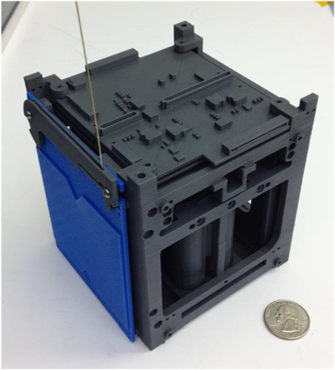
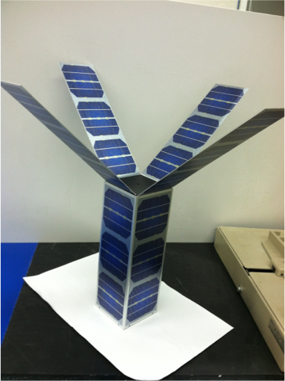
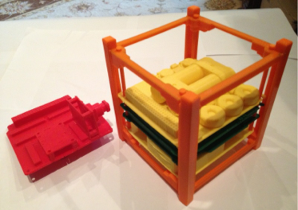
3D Printing and Models

Slide 9
Study Flow
Obtain mission requirements, study inputs/output, and desired list of products from customer
Hold planning meeting with customer
Recruit necessary SMEs and plan study sessions
Hold pre-session
Conduct study sessions with SEs and SMEs
Finalize study products and deliver briefing to customer

Slide 10
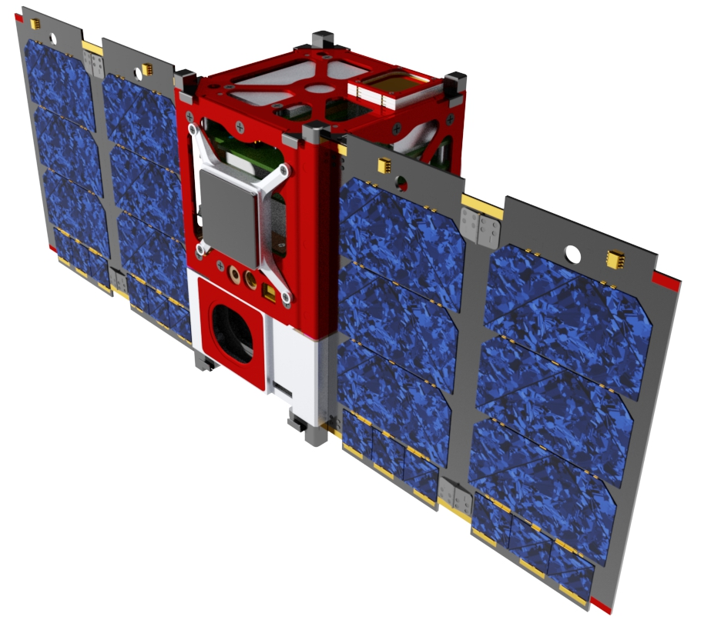
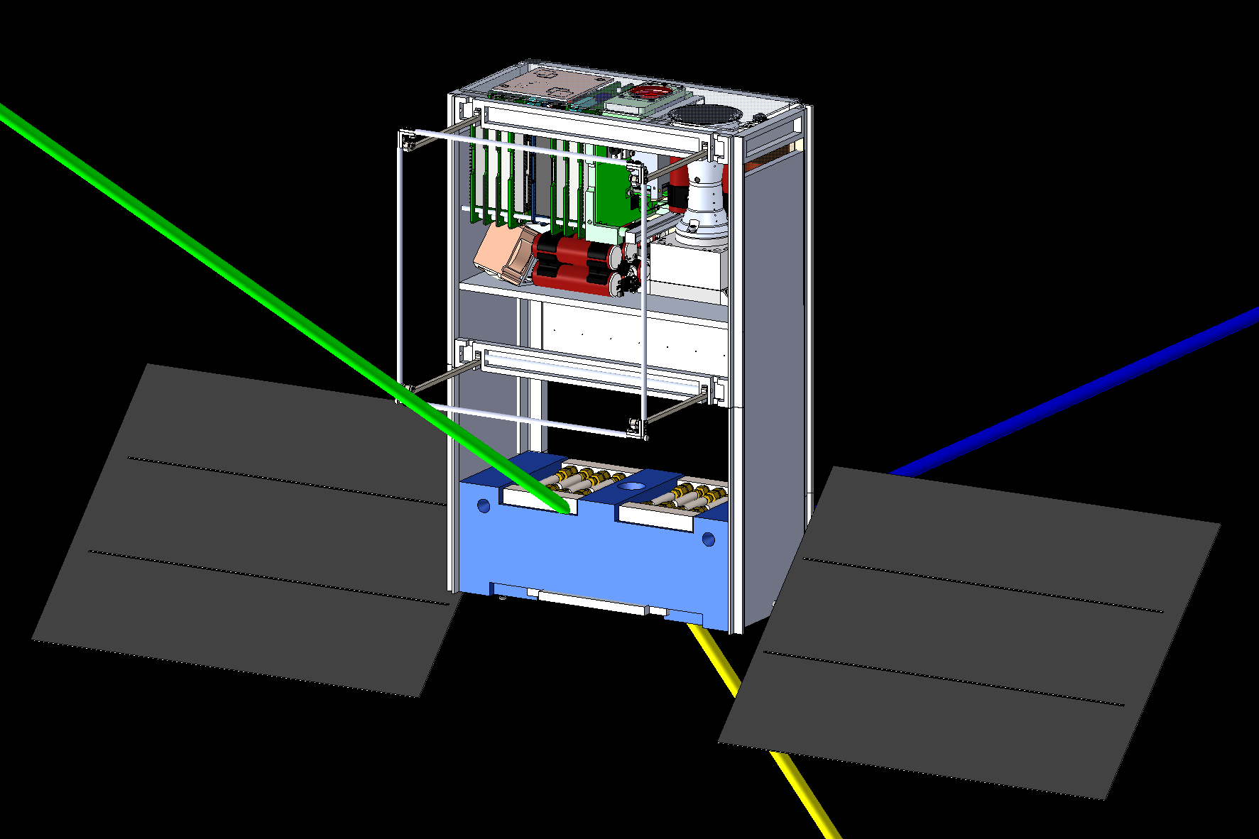
Pilot Studies
Ionospheric CubeSat
Swarm Pathfinder
Mars Relay CubeSat for Insight EDL

Slide 11
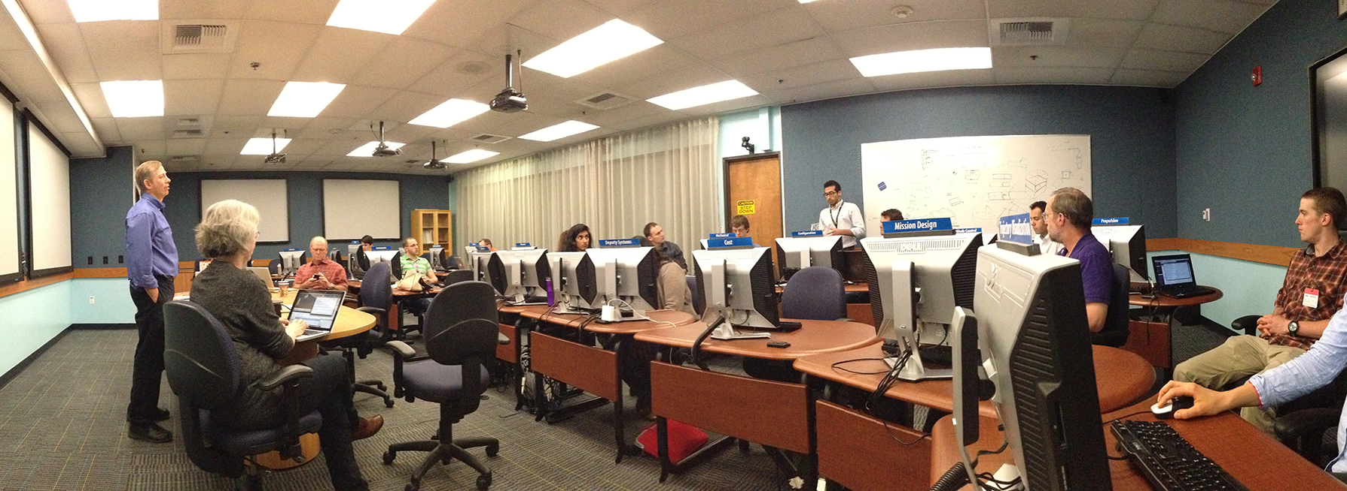
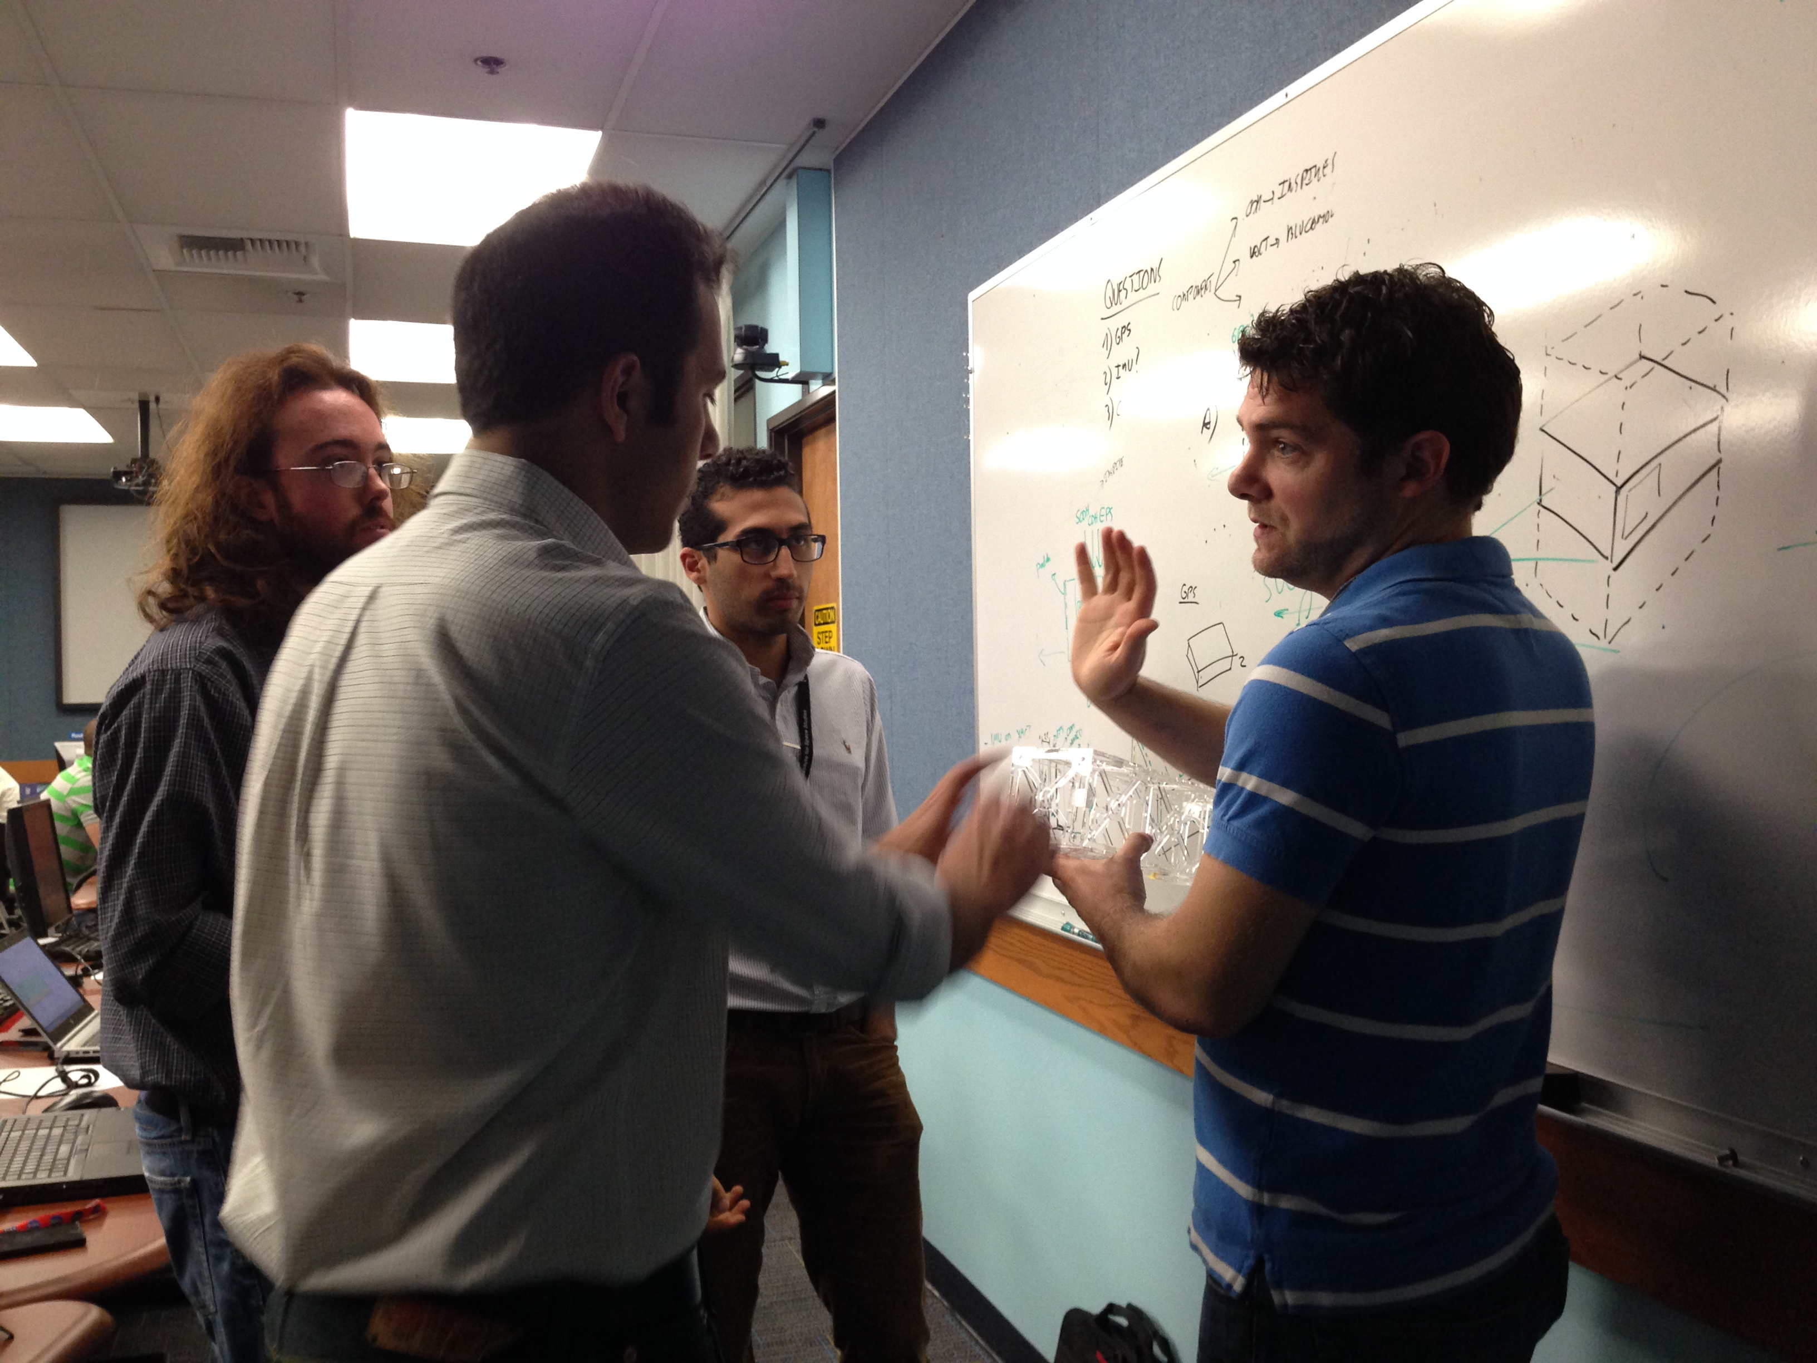
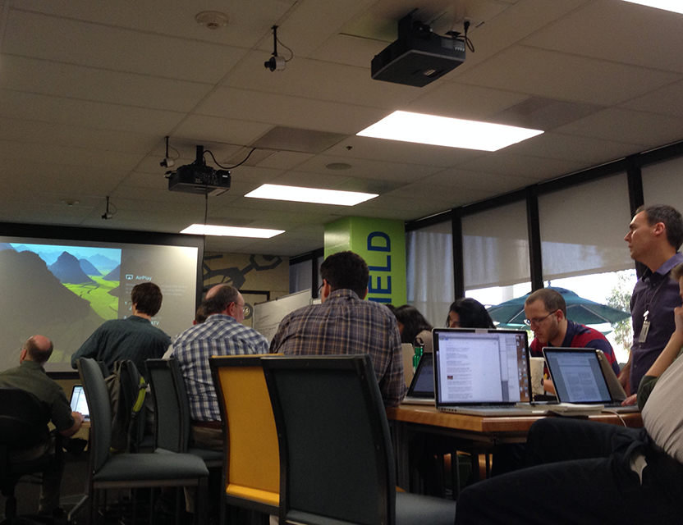

Pilot Studies

Slide 12
Contacts
Steve Matousek (TeamX_{c} Lead)
Email: Steven.E.Matousek@jpl.nasa.gov
Phone: (818) 354-6689
Pez Zarifian (TeamX_{c} Deputy)
Email: Pezhman.Zarifian@jpl.nasa.gov
Phone: (818) 354-1159
12

