Slide 1
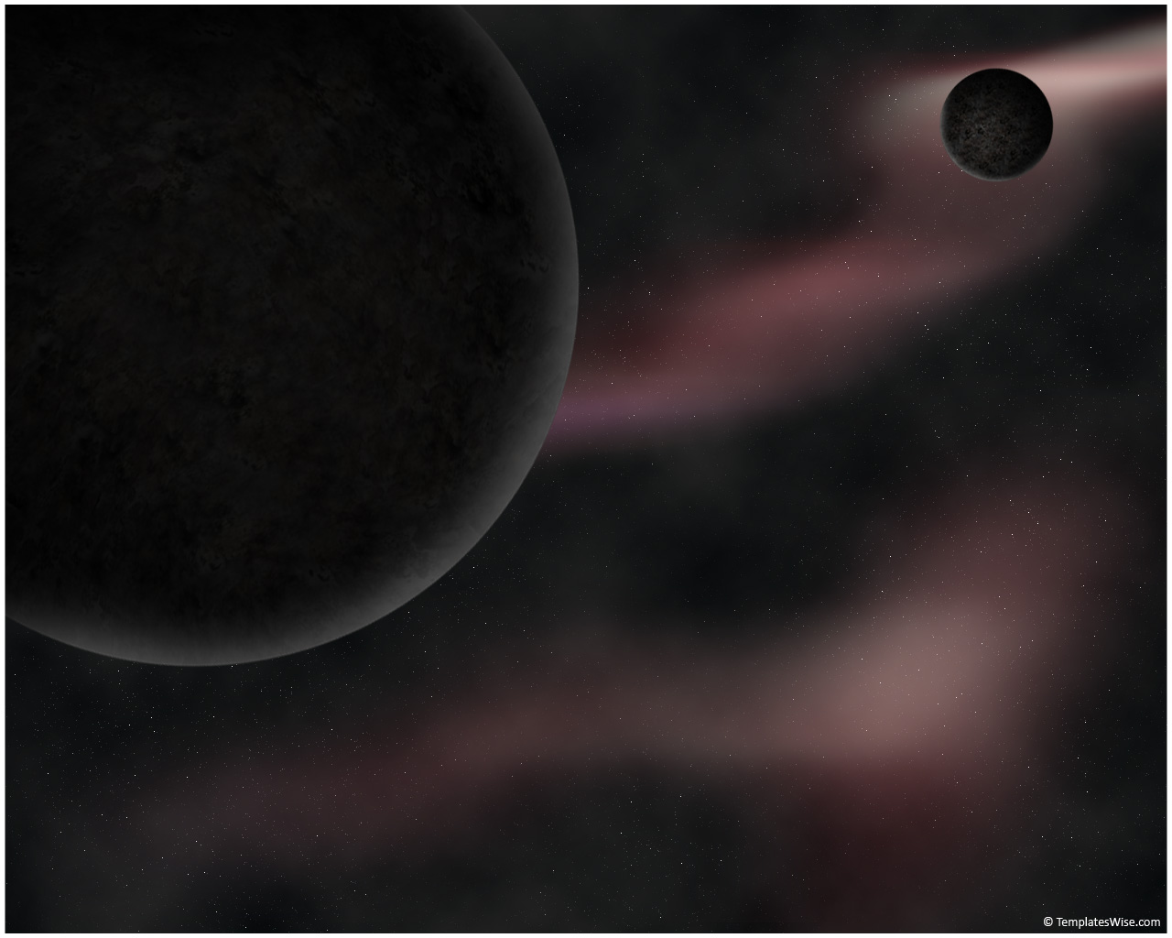
A Concept for a Constellation of CubeSats at the Lunar Lagrangian Point 1 (LL1) for radio aperture interferometry measurements: network analysis and simulation
Janna Finn
(California State University, Fullerton)
Alessandra Babuscia, Charles Lee, Kar-Ming Cheung
(Jet Propulsion Laboratory, California Institute of Technology)
Interplanetary Small Satellite Conference
April 28 2014
Part of this work was performed at the Jet Propulsion Laboratory, California Institute of Technology, under a contract with the National Aeronautics and Space Administration.
© 2014. All rights reserved.

Slide 2

Outline
Background
  Solara Mission Concept
  Communication Network of CubeSats
  Objectives of Communication Network Analysis
Simulation
  Outline of Simulation
  Results for the nominal case for different network configurations
  Statistical analysis in case of spacecraft failures
  Results for the statistical analysis
Conclusion

Slide 3
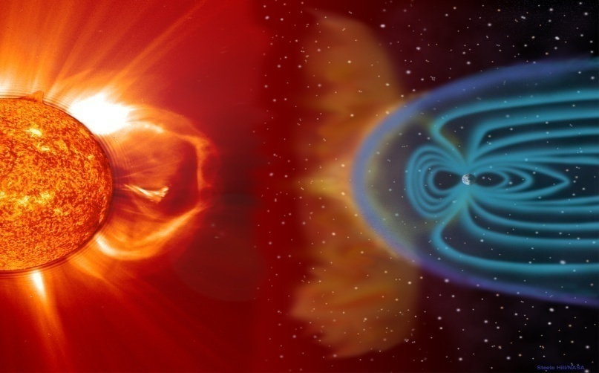
SOLARA Mission Concept
Space-borne radio aperture synthesis interferometer
Observes frequencies from 30 kHz to 30 MHz
Placed at LL1
Possible observations:
  Coronal Mass Ejections: dangerous to spacecraft, astronauts, and terrestrial power grids. Can be tracked in 3D
  Giant Planet Magnetospheres (Earth, Jupiter, Saturn, Uranus, Neptune). Has not been done since Voyager S in 1973.
Image Credit: NASA/ESA

Slide 4
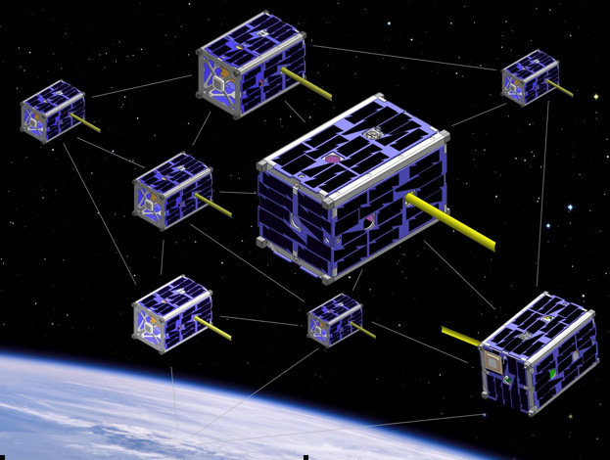
Communication Network of CubeSats
The concept is composed by 20 six-unit CubeSat spacecraft arranged in a rough 10-100 km configuration
Collect data using dipoles and a distributed correlator for aperture synthesis imaging.
Image Credit: NASA

Slide 5
Objectives of Communication Network Analysis
Compare different configurations:
  Peer to Peer
  Master/Slave
  Hierarchical
Determine the best strategy for
  Contention
  Congestion
  Power consumption
Account for potential failure of CubeSats:
  Maximize data return while minimizing communication time and data losses if one or more CubeSats fail.

Slide 6
Outline of Simulation
Inputs:
Constellation Configuration, Data rate, Network Configuration, Acquisition Policy, Bandwidth of scientific observation (30 KHz -3 MHz)
Peer to Peer
Simulate direct link to Earth (nominal case)
Failure profile
Simulate in case of failure
Master/Slave
All gather data, slaves send to master, master link to Earth
Failure profile
Simulate in case of failure
Hierarchical
All gather data, slaves send to respective masters, masters link to Earth.
Failure profile
Simulate in case of failure
Parent communicates information back to Earth
Outputs:
Buffer Sizes
Total Data Transferred over time

Slide 7
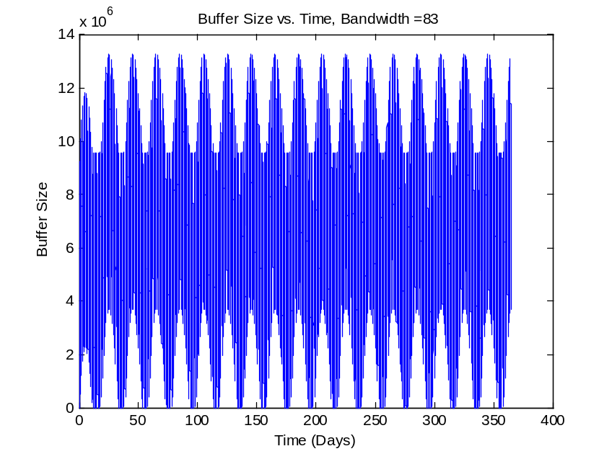
Results for the nominal case
Peer to Peer
Each satellite gathering information and sending to earth.
Simulation run for 365 days, gathering data for 1 hour per day
Maximum data rate: 125 kbps
Maximum bandwidth possible: 83 KHz
Bandwidth (KHz) | 30 | 40 | 50 | 60 | 70 | 80 | 83
Total Data Transferred by 20 peers for a year (Tera Bits) | 25.22 | 33.64 | 42.05 | 50.46 | 58.87 | 67.28 | 69.8

Slide 8
Results for the nominal case
Master/Slave
All satellites gather data, then slaves send to one master which transmits to earth
Data rates:
  From slave to master: 6000 kbps
  From master to earth: max 3125 kbps
Simulation run for 365 days, gathering for 1 hour per day
Acquisition policy: TDMA
  Each slave has a fixed time (6 minutes) to communicate with the master
Maximum bandwidth possible: 109 kHz
Bandwidth (KHz) | 30 | 40 | 50 | 60 | 70 | 80 | 90 | 100 | 109
Total Data Transferred (Tera Bits) | 25.22 | 33.64 | 42.05 | 50.46 | 58.87 | 67.28 | 75.68 | 84.09 | 91.55

Slide 9
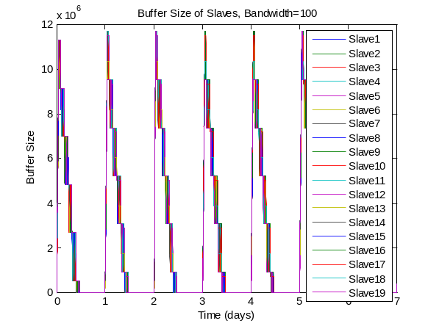
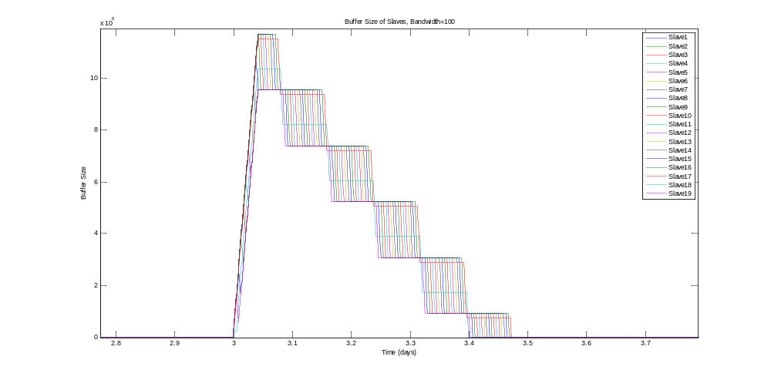
Results for the nominal case
Master/Slave cont’d
Bandwidth of 100 kHz
Slave Buffers zoomed in for one day

Slide 10
Results for the nominal case:
Hierarchical
All satellites gather data and send to respective masters, then masters transmit to earth
Data rates:
  From slaves to masters: 6000 kbps
  From master to earth: max 3125 kbps
Simulation run for 365 days, gathering for 1 hour per day
Acquisition policy: TDMA both for slaves and masters
Table of Total Data Transferred approximately the same as with one master.

Slide 11
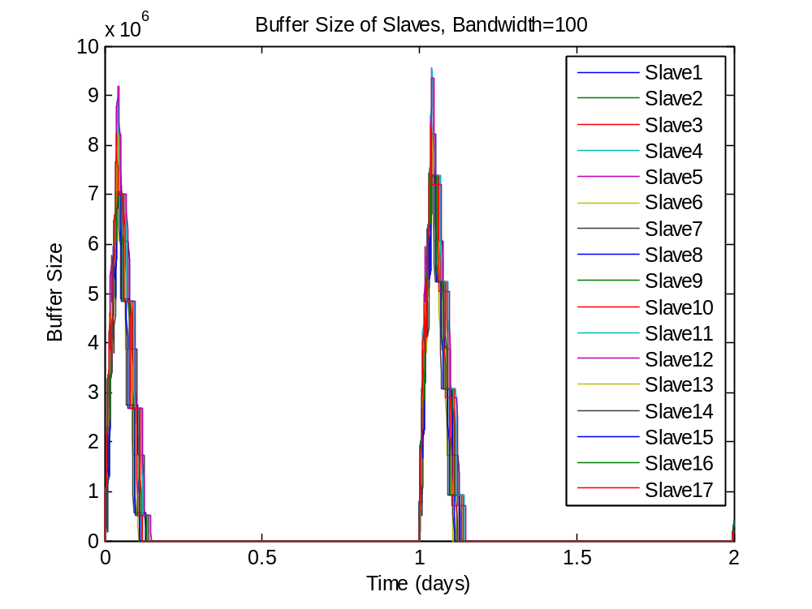
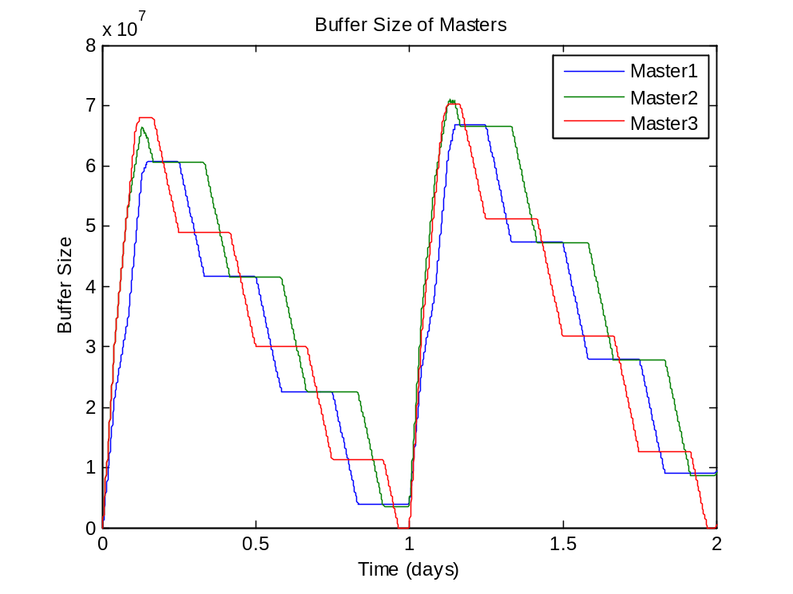
Results for the nominal case:
Hierarchical
Example: 3 Masters, Bandwidth 100 KHz over a 2 day period

Slide 12
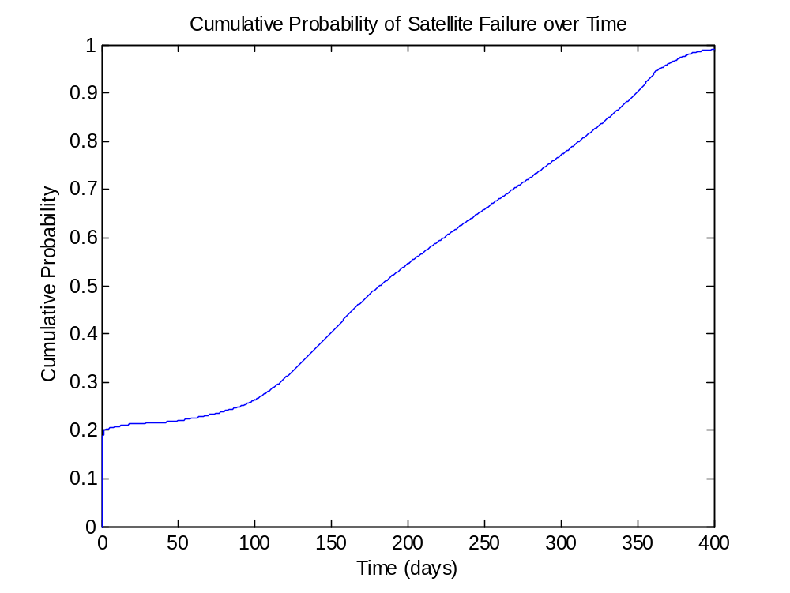
Failure Profile
Assumptions:
  Initial failure in launch or setup of approximately 20%
  Fairly stable until 3 months, then failure rate increases up to 6 months
  Steady failure rate until most have failed by the end of a year

Slide 13
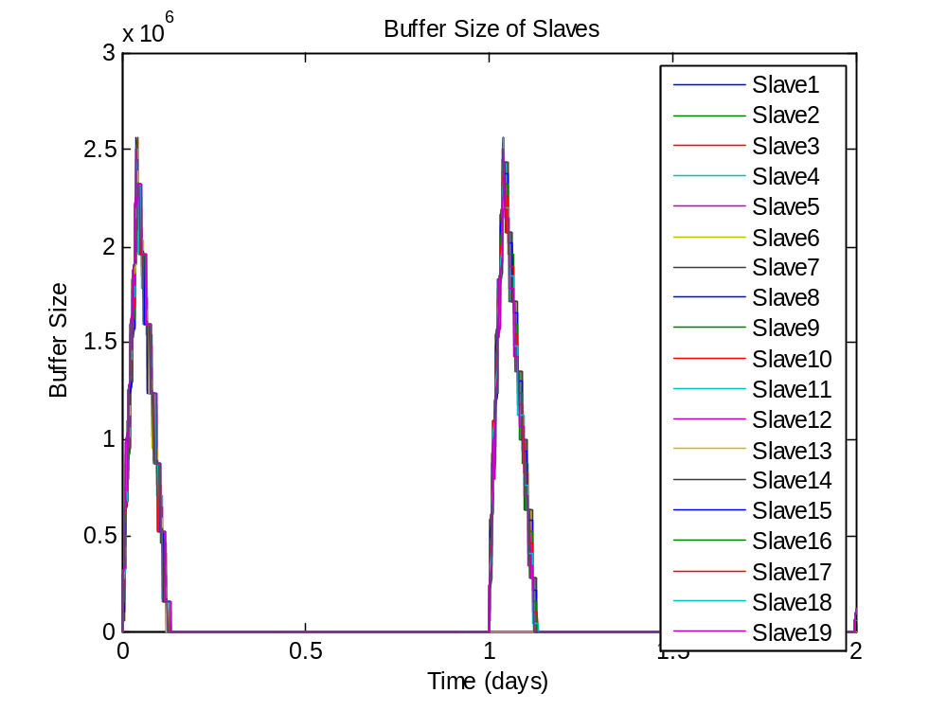
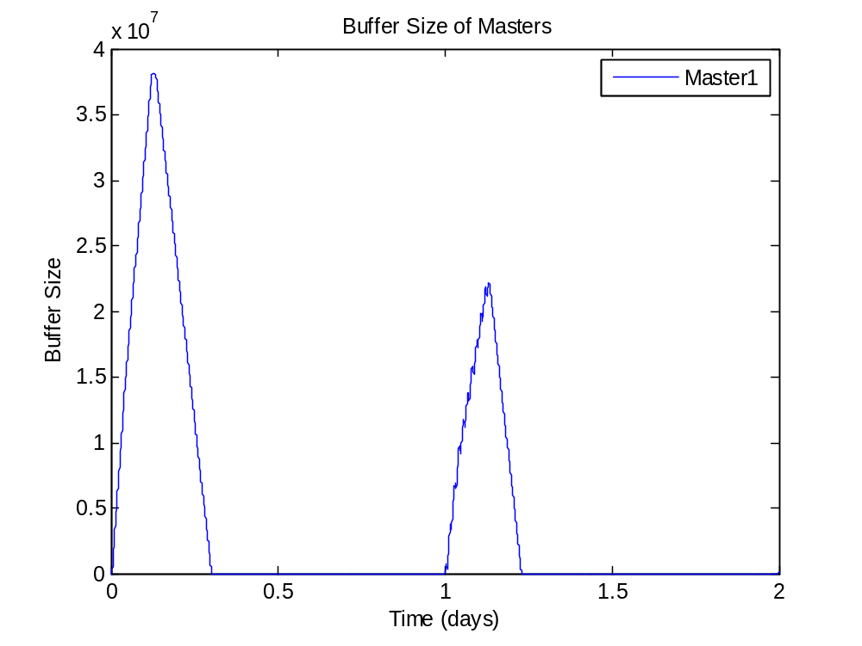
Results with Failure:
Master/Slave
Example: 2 days, Bandwidth 30 KHz

Slide 14
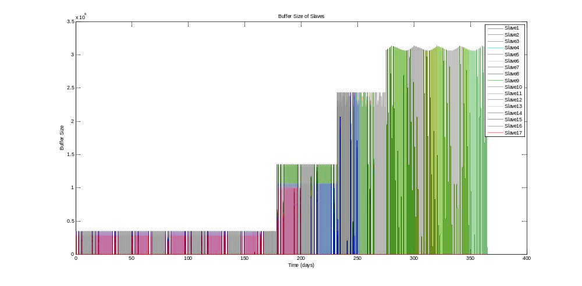
Results with Failure:
Hierarchical
Example: 1 year, 3 Masters, Bandwidth 30 KHz

Slide 15
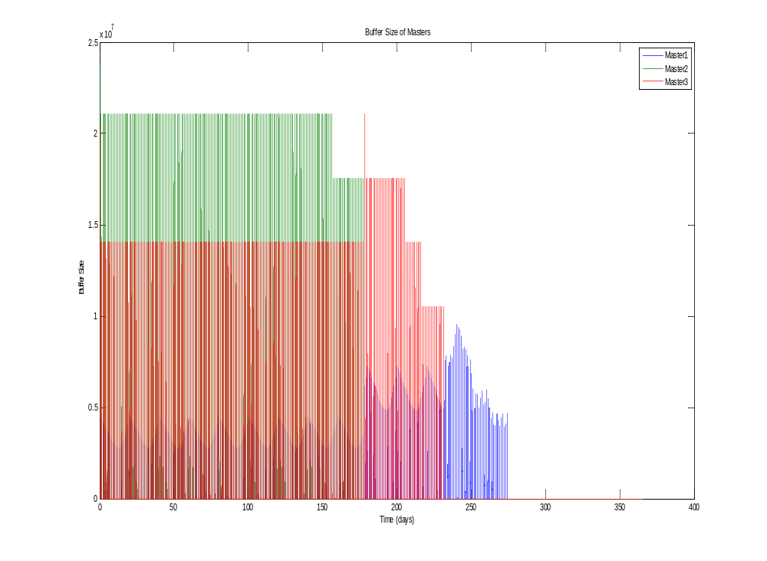
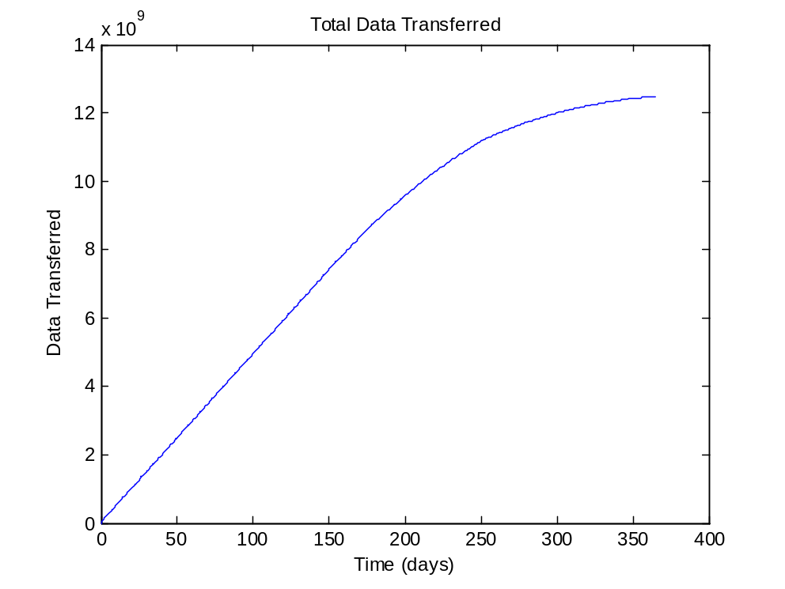
Results with Failure:
Hierarchical
Example: 1 year, 3 Masters, Bandwidth 30 KHz
Notes:
A slave has failed
16 79
A slave has failed
10 210
A slave has failed
12 582
A master has failed
2 131494
A slave has failed
3 132850
A master has failed
1 161562
A slave has failed
9 174588
A slave has failed
13 195616
A slave has failed
14 213205
A slave has failed
8 233844
A slave has failed
7 252765
A master has failed
3 255795
A slave has failed
2 287178
A slave has failed
4 308824
A slave has failed
11 422134
A slave has failed
17 474964
A slave has failed
15 496752
A slave has failed
6 501816
A slave has failed
5 510471
TotalData =
1.291900998015317e+10

Slide 16
Analysis of Results:
Maximum Bandwidth Sizes
Fixed: 8 samples
Without Failure
Number of Masters | Sampling for 60 min and transmitting continuously | Sampling for 60 min and transmitting for 12 hours | Sampling for 30 min and transmitting continuously | Sampling for 30 min and transmitting for 12 hours | Sampling for 15 min and transmitting continuously | Sampling for 15 min and transmitting for 12 hours
1, 2, 4, 5 | 109 | 54 | 218 | 108 | 436 | 217
3 | 104 | 51 | 208 | 103 | 416 | 207
With Failure
(Mean, Standard Deviation) Based on 10 trials
1 | (85.2, 3.79) | (49.4, 16.4) | (177.4, 0.02) | (115, 0.8) | (382.4, 0.95) | (227.8, 1.49)
2 | (85.2, 3.79) | (44.8, 1.03) | (194.8, 0.52) | (117.6, 0.8) | (412.2, 1.26) | (274.6, 1.98)
3 | (85.2, 3.79) | (46.6, 4.12) | (179.2, 0.04) | (126, 0.78) | (383.4, 0.94) | (229, 1.48)
4 | (88.2, 5.69) | (61.8, 24.6) | (211.6, 0.71) | (144, 0.86) | (423.2, 1.28) | (292.4, 1.97)
5 | (89.6, 7.23) | (57.2, 21.6) | (269.6, 0.89) | (152, 1.09) | (459.6, 1.48) | (344.8, 2.29)

Slide 17
Analysis of Results:
Maximum Number of Samples
Fixed Bandwidth 30 kHz
Without Failure
Number of Masters | Sampling for 60 min and transmitting continuously | Sampling for 60 min and transmitting for 12 hours | Sampling for 30 min and transmitting continuously | Sampling for 30 min and transmitting for 12 hours | Sampling for 15 min and transmitting continuously | Sampling for 15 min and transmitting for 12 hours
1, 2, 4, 5 | 29 | 14 | 58 | 28 | 116 | 57
3 | 27 | 13 | 55 | 27 | 110 | 55
With Failure
(Mean, Standard Deviation) Based on 10 Trials
1 | (26.4, 7.59) | (12, 0) | (47.2, 0.42) | (25.2, 1.55) | (102.3, 0.25) | (48.3, 1.63)
2 | (26.4, 7.59) | (21.6, 15.8) | (47.5, 0.70) | (31.9, 21.16) | (95.5, 2.27) | (61.1, 40.7)
3 | (26.5, 7.56) | (13.2, 1.61) | (61.6, 21.0) | (34.5, 23.13) | (111.8, 0.33) | (74.6, 52.46)
4 | (26.8, 7.86) | (19.7, 14.9) | (68.9, 22.3) | (38, 24.5) | (112.9, 0.34) | (77.9, 52.4)
5 | (35.7, 13.5) | (20.2, 15.2) | (58.1, 18.4) | (38.9, 28.54) | (118.8, 0.34) | (89.2, 50.77)

Slide 18
Conclusion
Even if the satellites do not fail, the data collected is seriously restricted by the maximum bandwidth or number of samples.
Hierarchical model is ideal, especially with failure, since other masters can still transmit data quickly to earth.
Since the buffers overflow significantly more once all masters have failed, the best configuration to use is one with the most initial number of masters.

Slide 19
Acknowledgements
Part of this work was performed at the Jet Propulsion Laboratory, California Institute of Technology, under a contract with the National Aeronautics and Space Administration

Slide 20
Thank you

Slide 21
Questions

Slide 22
References
A.W. Gunst, L. B. Venema, and A. Bos. “Distributed Correlator for Space Applications.” 19th International Symposium on Space Terahertz Technology, Groningen, 28-30 April 2008.
M. Knapp, A. Babuscia, R. Jensen-Clem, F. Martel, S. Seager. “SOLARA/SARA: Solar Observing Low-Frequency Array for Radio Astronomy/Separated Antennas Reconfigurable Array”, 2nd Mission Idea Context, Nagoya, 2012 (classified in the 1st place in the competition).
A. Babuscia, C. Hung, D. Divsalar, K. Cheung. “Code Division Multiple Access communications systems for CubeSats at Lunar Lagrangian L1.”, IEEE Aerospace Conference, Big Sky, MT, 2014.

Slide 23
Back up

Slide 24
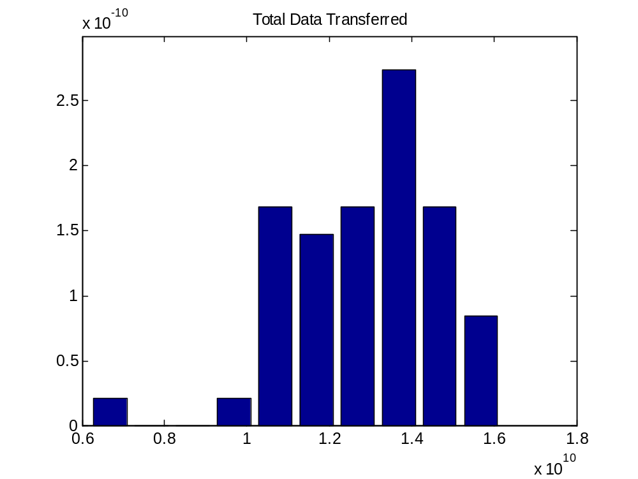
Statistics
3 masters, Bandwidth 30 KHz, with failure

Slide 25
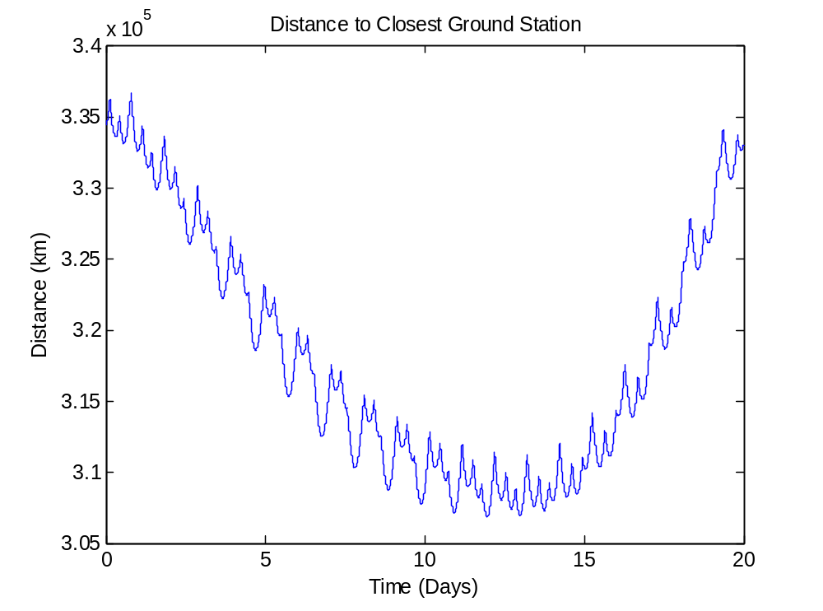
Distance from Earth

Slide 26
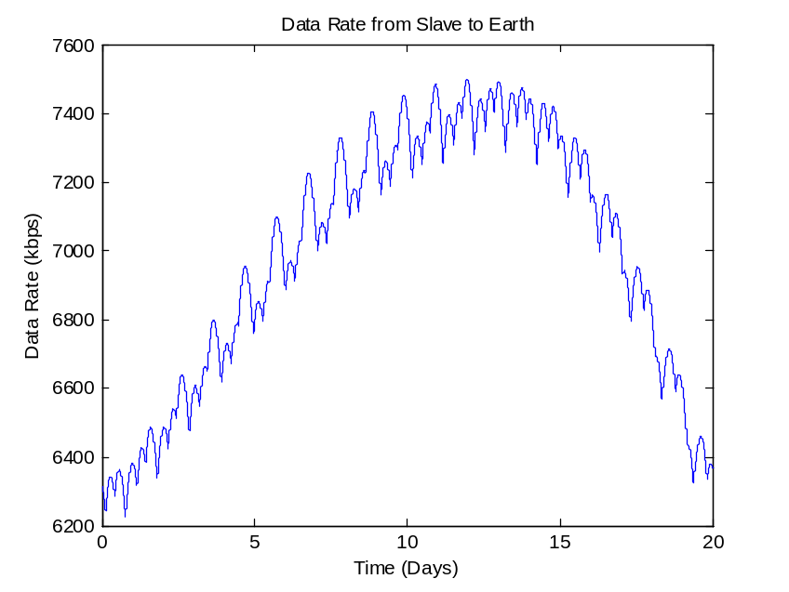
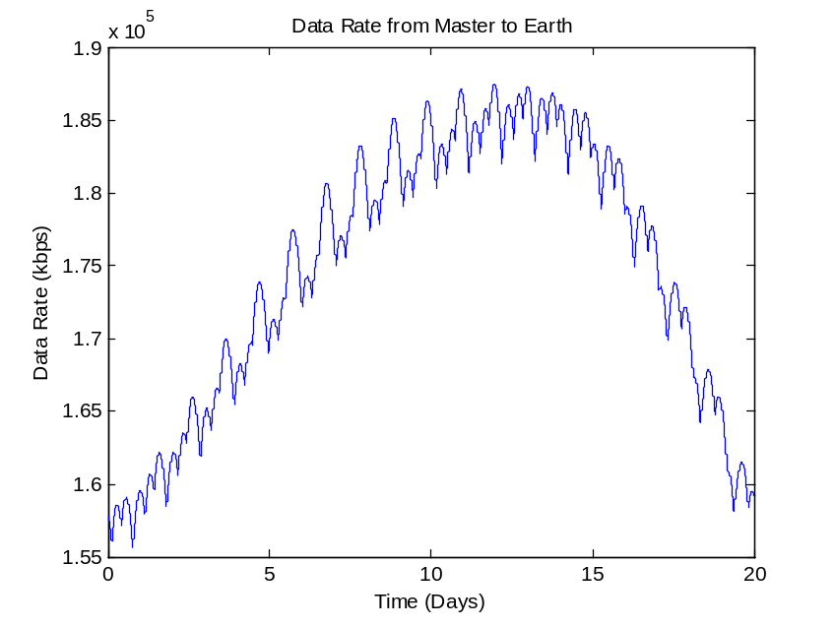
Data Rates over Time

