Slide 1


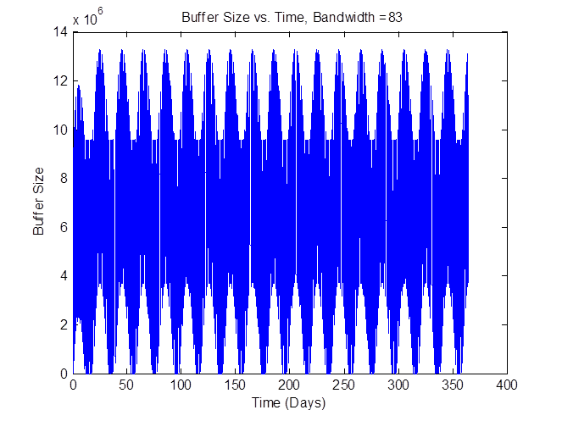
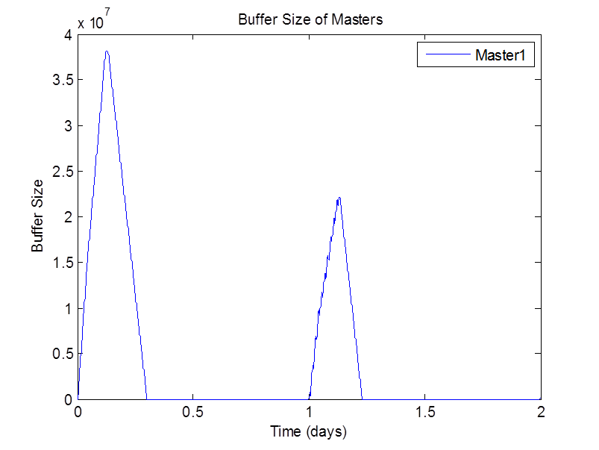
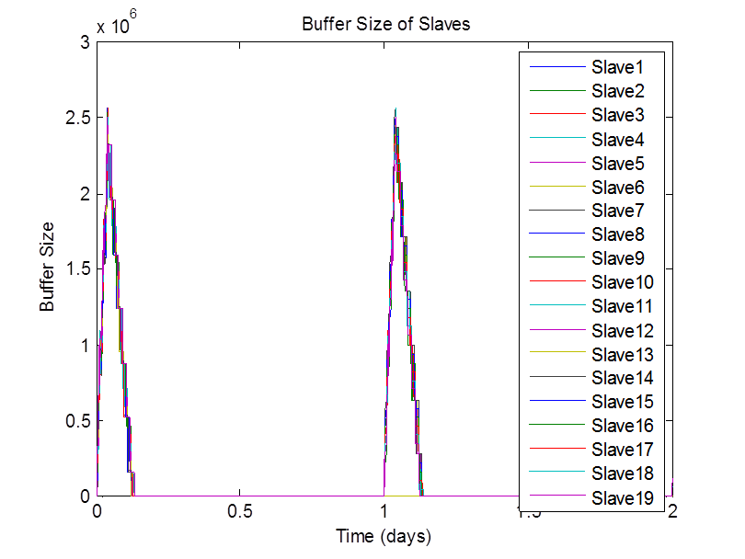
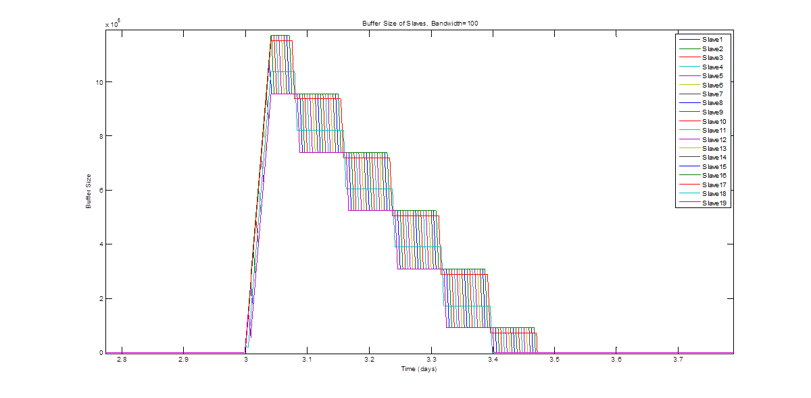
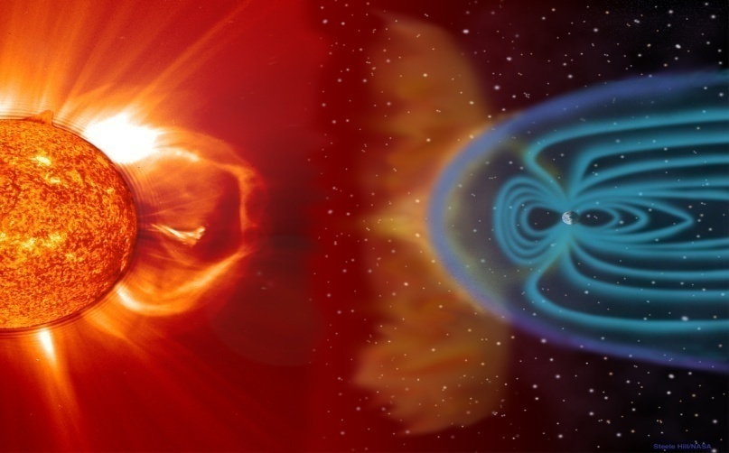
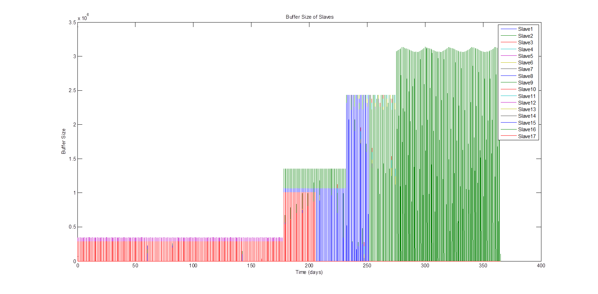
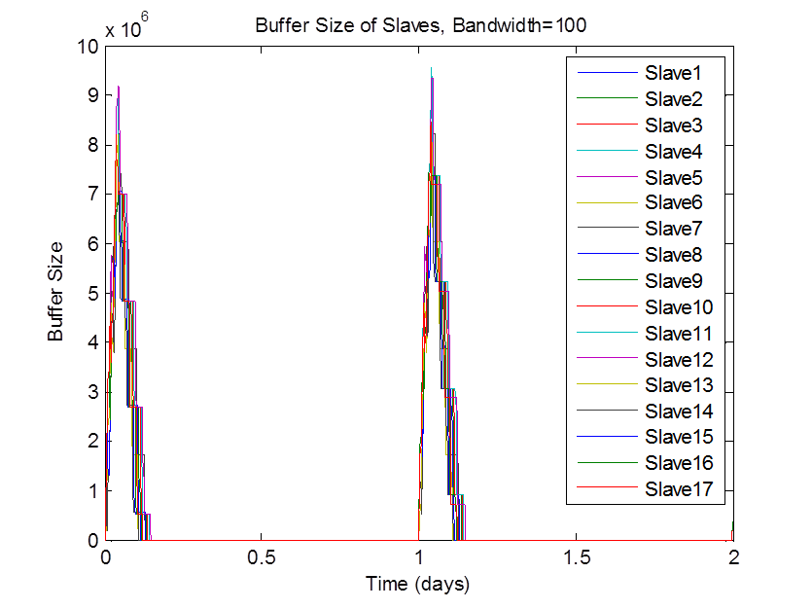
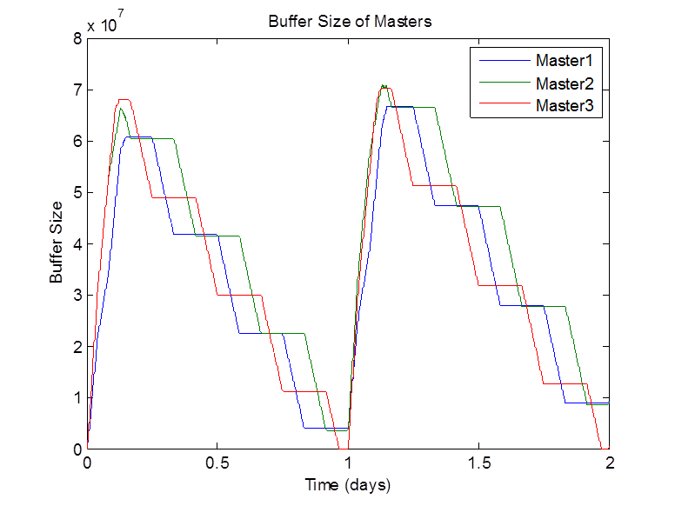
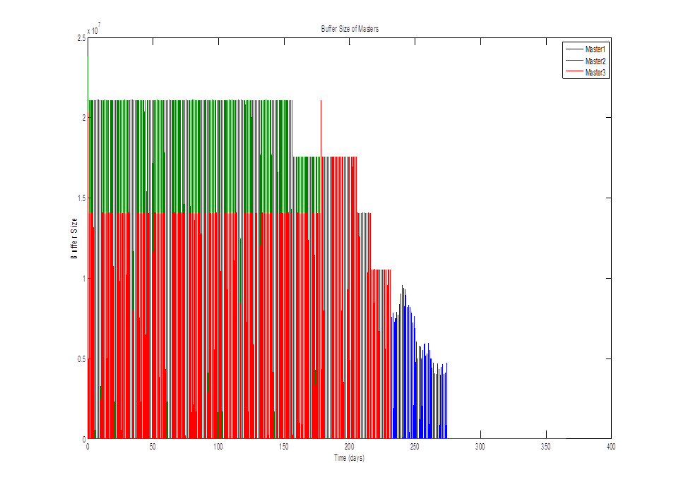
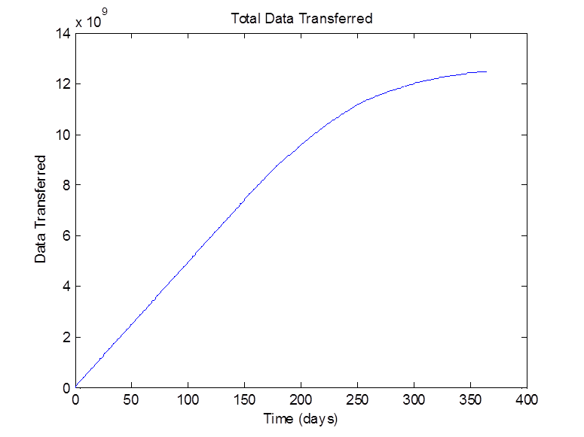
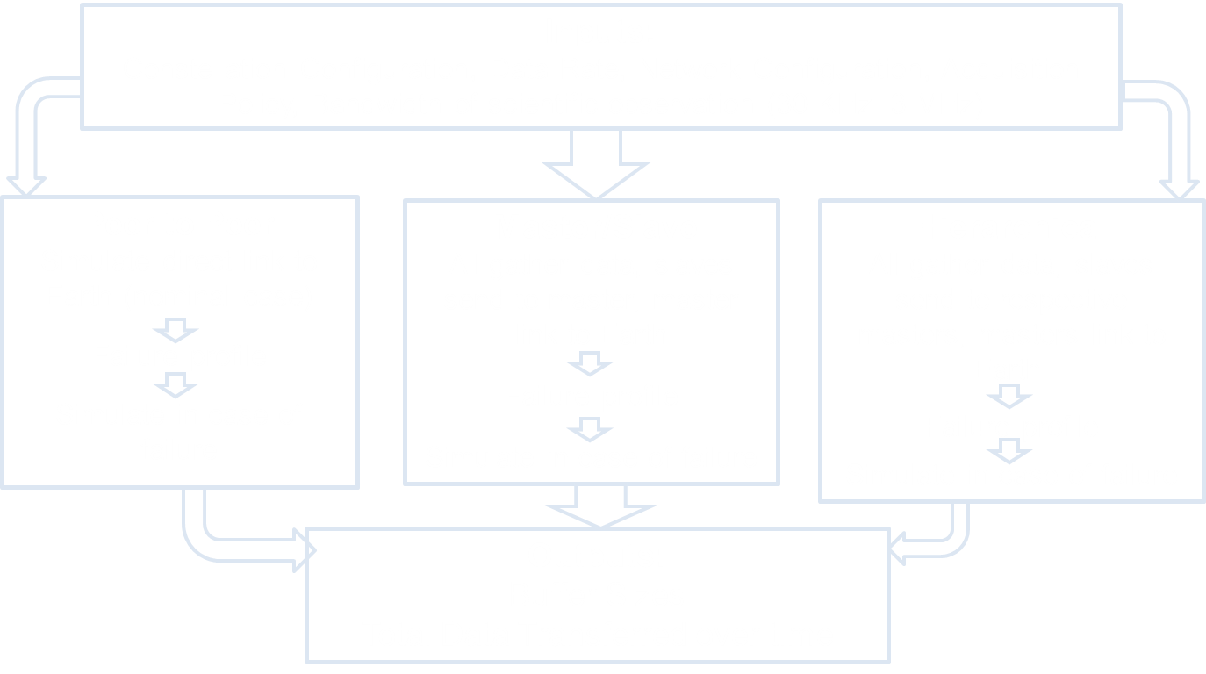
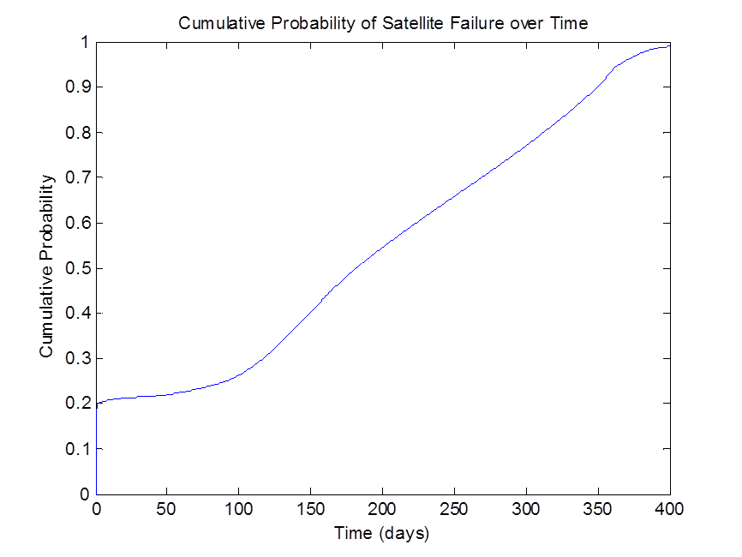
A Concept for a Constellation of CubeSats at the Lunar Lagrangian Point 1 (LL1) for Radio Aperture Interferometry Measurements: network analysis and simulation
Janna Finn (California State University, Fullerton)
Alessandra Babuscia, Charles Lee, Kar-Ming Cheung
(Jet Propulsion Laboratories, California Institute of Technology)
Motivation:
SOLARA mission of 20 CubeSats in rough 10-100 km configuration placed at LL1 to observe frequencies from 30 KHz to 30 MHz.
Collecting data using dipoles and a distributed correlator for aperture synthesis imaging.
Could possibly observe:
  Coronal Mass Ejections, which are dangerous to spacecraft, astronauts, and terrestrial power grids
  Giant Planet Magnetospheres, which has not been done since Voyager S in 1973.
Nominal Case (without Failure) Results:
Results with Failure:
Peer to Peer
Each satellite gathering information and sending to the earth
Maximum data rate from satellite to earth is 125 kbps
If gathering for 1 hour per day, maximum possible bandwidth: 83 KHz
Master/Slave: The decrease in buffer size of the master satellite is clear in the first couple of days.
Master/Slave example:
2 days
Bandwidth 30 KHz
Master/Slave
All gather data, slaves send to one master that transmits to earth at max 3125 kbps
Slave to master rate: 6000 kbps
TDMA: each slave has fixed time with master
If gathering 1 hour per day, maximum possible bandwidth: 109 KHz
Hierarchical
The buffers of the slaves increase as the masters successively fail, eventually leading to peer to peer.
Hierarchical
All gather data, slaves send to respective masters that transmit to earth at max 3125 kbps
Slave to master data rate: 6000 kbps
TDMA: each slave has fixed time with master, each master has fixed time with earth
If gathering 1 hour per day, maximum possible bandwidth: 109 KHz
As each master fails, the buffers of the other masters initially rise, then drop as more slaves fail. The rate at which the data is transferred slowly decreases over time.
Goals:
Compare different configurations (peer to peer, master/slave, hierarchical)
Determine the best strategy for contention, congestion, and power consumption
Account for potential failure of CubeSats
  Maximize data return while minimizing communication time and data losses if one or more CubeSats fail.
Hierarchical example:
3 masters
Bandwidth 100 KHz
2 day period
Failure Profile:
Assumptions:
  Initial failure in launch or setup of approximately 20%
  Fairly stable until 3 months, then failure rate increases up to 6 months
  Steady failure rate from 6 months until most have failed by the end of the year.
Table of Maximum Bandwidth Possible (with Failure)
Fixed: 8 samples
(Mean, Standard Deviation)
Outline of Simulation:
Number of Masters | Sampling for 60 min and transmitting continuously | Sampling for 60 min and transmitting for 12 hours | Sampling for 30 min and transmitting continuously | Sampling for 30 min and transmitting for 12 hours | Sampling for 15 min and transmitting continuously | Sampling for 15 min and transmitting for 12 hours
1 | (85.2, 3.79) | (49.4, 16.4) | (177.4, 0.02) | (115, 0.8) | (382.4, 0.95) | (227.8, 1.49)
2 | (85.2, 3.79) | (44.8, 1.03) | (194.8, 0.52) | (117.6, 0.8) | (412.2, 1.26) | (274.6, 1.98)
3 | (85.2, 3.79) | (46.6, 4.12) | (179.2, 0.04) | (126, 0.78) | (383.4, 0.94) | (229, 1.48)
4 | (88.2, 5.69) | (61.8, 24.6) | (211.6, 0.71) | (144, 0.86) | (423.2, 1.28) | (292.4, 1.97)
5 | (89.6, 7.23) | (57.2, 21.6) | (269.6, 0.89) | (152, 1.09) | (459.6, 1.48) | (344.8, 2.29)
As the number of masters increases, so does the maximum bandwidth possible.
Conclusion:
Amount of data collected is severely restricted by the maximum bandwidth or number of samples.
Hierarchical model is ideal, especially with failure, since other masters can still transmit data quickly to earth
Since buffers overflow significantly more once all masters have failed, the best configuration is with the most possible number of masters (5).

