Slide 1
Iris DSN Compatible Small Satellite Navigation and Communications Transponder
Courtney Duncan, Amy Smith
Jet Propulsion Laboratory
California Institute of Technology
Interplanetary Small Satellite Conference
Pasadena, California
2014 April 28

Slide 2
Transponders vs. Transceivers
LEO CubeSats use half or full duplex transceivers
  Commands and data only
  Limited duty cycle – very low power “monitor” mode (like cellphone)
  GPS for navigation
Deep Space
  Slant range is orders of magnitude greater
  Higher power and highly directional gain antennas needed
  Long, equilibrium 100% duty cycle transponder sessions for weak signals
    Low rate commands and data supported, (more Eb)
    Navigation arcs
  Many spacecraft transmit continuously throughout their missions
Bottom line
  Much higher average power than CubeSat transceivers
  And much higher nominal heat dissipation – must equilibrate
  Tougher environments: radiation, temperatures, longevity

Slide 3
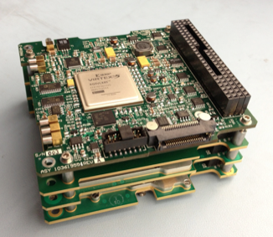
Iris Transponder
Marina-2 FPGA Modem Processor
Virtex 5
Power Supply Board
X-Band Receiver
X-Band Exciter
Iris Prototype Stack
3

Slide 4
Iris Transponder Overview
CubeSat Compatible – DSN Compatible
Architecture supports
  micro- and nano-spacecraft deep space missions
  Direct To Earth (DTE) and Proximity Operations
Communications and Navigation
  Uplink and Downlink – various rates – CCSDS
    Wide range of data rates needed for wide range of distances
  Doppler, Ranging and Delta-DOR
    No GPS in deep space – even at the moon

Slide 5
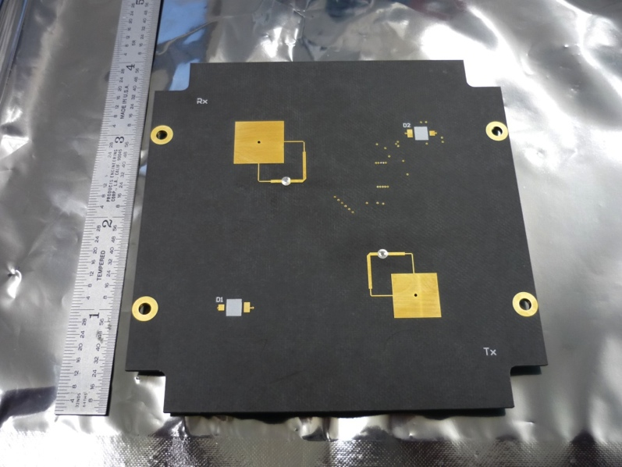
Iris Patch Antennas
TX/RX Antennas
  (also hosts spacecraft sun sensor)
1 on each end of S/C
  4 patches total
  Independently selectable
X-Band Frequencies
  Receive: 7.145-7.235GHz
  Transmit: 8.400-8.500 GHz
  Deep Space and Near Earth
    All channels supported
Prototype Test Results:
  Return Loss > 18dB
  TX/RX Isolation > 35dB
Prototype Mass = 40g (each)
TX Antenna
RX Antenna

Slide 6
Iris Specs
CubeSat Compatible
  < 0.5 U + antennas
  < 500 g
  12.8 W DC in for full transpond, 6.4 W receive only
DSN Compatible
  Navigation
    Full duplex Doppler, Ranging
    V2 to support Delta-DOR
  Telecomm performance
    62.5 – 256k bps telemetry, subcarrier, low rate tones to 8 Mbps available
    1000 bps command, other rates available when needed
    25 dBm transmit, higher power available for more DC input
    -130 dBm receive sensitivity
Software Defined Radio
  Future versions to be reconfigurable in flight
  SPI interface to C&DH
    C&DH thread performs framing and protocol
  Multimission Telecommunications Interface (MTIF) FPGA code
    Handles standard coding
COTS parts with “path to flight”
Developed January ‘13 – March ’14, first mission: INSPIRE

Slide 7
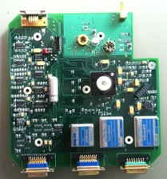
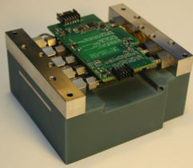
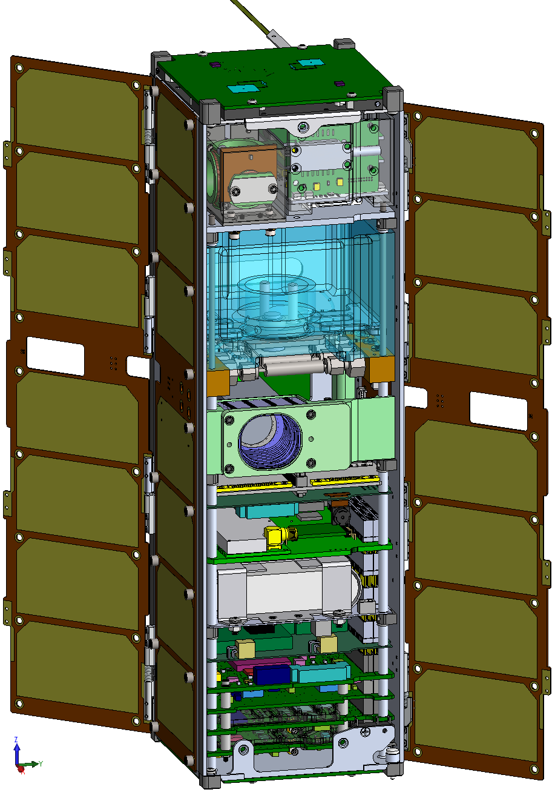
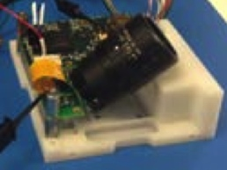
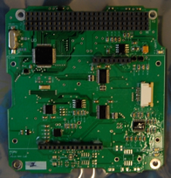
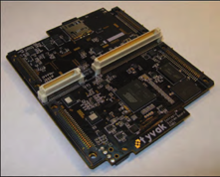
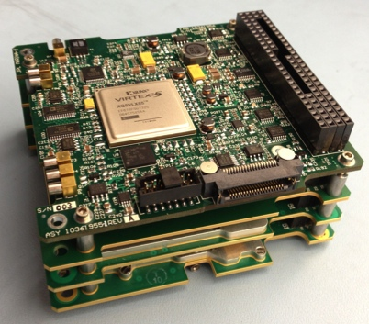
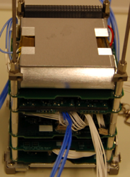
INSPIRE CubeSat
X-Band Patch Antennas (JPL)
[two sets]
UHF Antenna
Magnetometer
Overview:
Volume: 3U (10x10x30cm)
Mass: 4.4 kg
Power Generation:
3 Axis Stabilized: 20 W
Tumbling: 13 W
Data Rate: 62-256000 bps
Operations:
Primary: DSN
Secondary (Receive only): DSS-13 (JPL), & Peach Mountain (U. Michigan)
Cold-Gas ACS
Star Tracker
C&DH + Watchdog Board +
Lithium UHF
Processing Board
Deployable Solar Panels +
Structure
Iris Nav/Comm X-Band Radio (JPL)
Electrical Power System +
Battery Board

Slide 8
Future Missions in Study – Iris
(none yet approved)
Lunar Flashlight 6U – south pole of the moon
  Iris @ 1W to same patch antennas
NEA Scout 6U – to an asteroid ~ 0.3 AU
  Iris @ 2W out and patch array gain antenna for downlink (~20 W DC in)
Lunar Impactor 3U (UCSC)
  Iris @ 1W with live streaming data feature
Others in proposal or inquiry stage

Slide 9
Iris Downlink Rates

Slide 10
SmallSats in Deep Space
Current Iris design – power levels – patches <-> DSN
  lunar or L1 appears to be the “sweet spot”
Similar to proximity operations at planetary systems like Saturn or Jupiter
  UHF and S-Band variants are planned
DTE to DSN ~1 AU (Venus, Mars, NEAs)
  Enabled by higher gain antennas
    and consequent pointing requirements, driven by transponder, not necessarily the science
    Such antennas are in development at JPL
  Few hundred bps data rates and navigation
  Further out at higher frequency (2x distance at Ka-Band) and better codes
Smaller commercial / university apertures also possible
  Lower data rates than DSN
  “Transceiver mindset” – more ground equipment needed for navigation
JPL can help with
  DSN coordination
  Mission design, analysis, navigation, and science tools
  Iris

Slide 11
DSN
The earth station partner that makes deep space operations possible
34 and 70 m apertures – high gains
  Precision pointing
Quiet front ends – 45K system noise temperature
High uplink power – 20 KW
High performance coding and other modulation schemes, > 10 dB of further improvements
Worldwide, coordinated

Slide 12
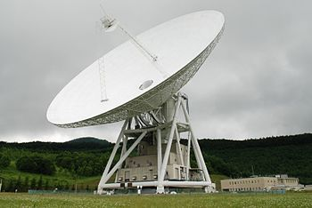
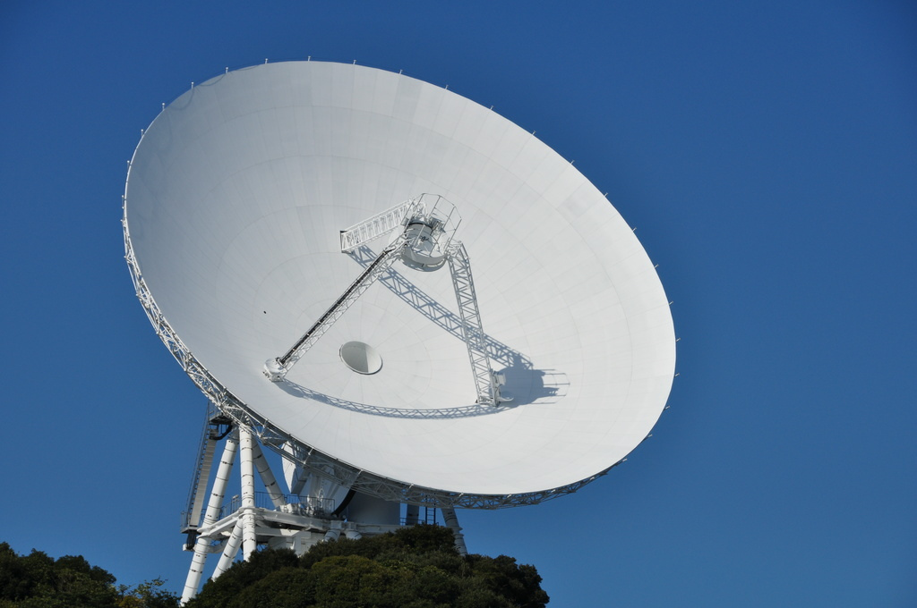
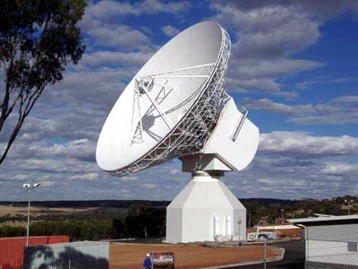
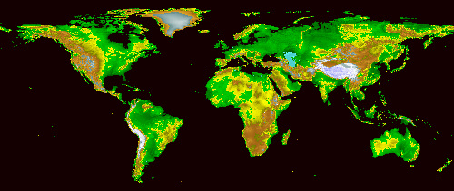
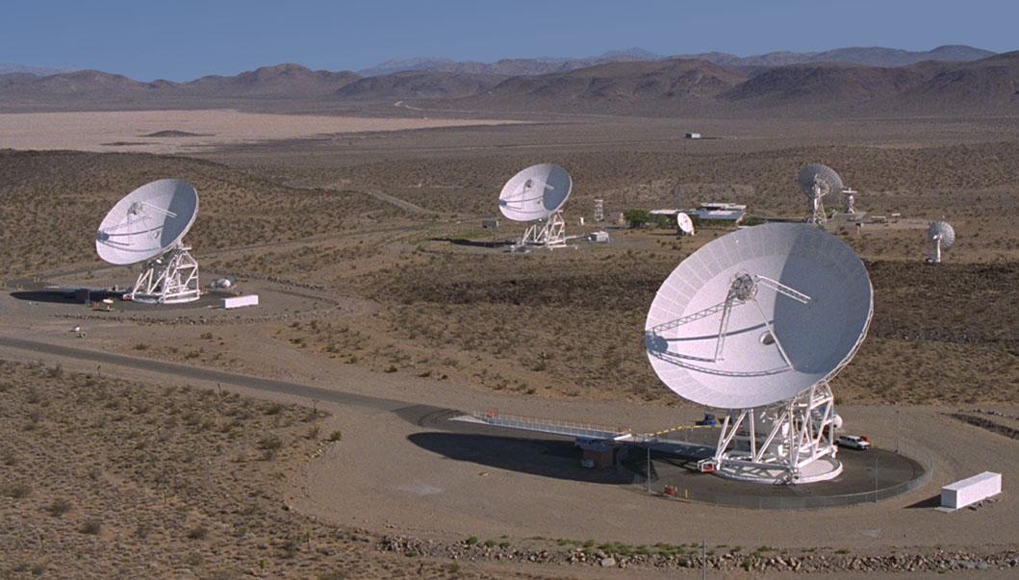
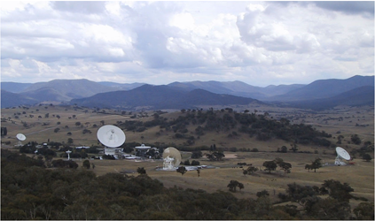
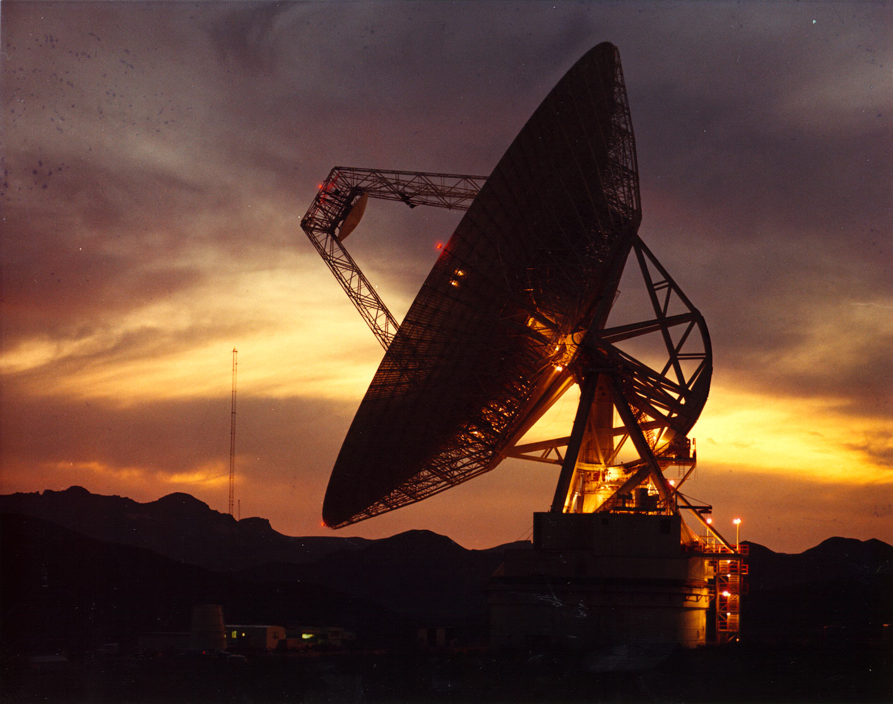
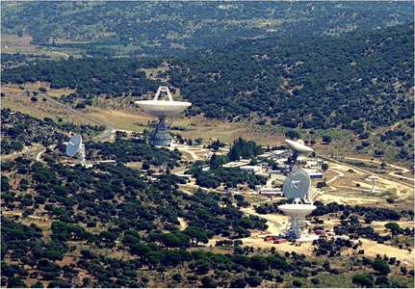
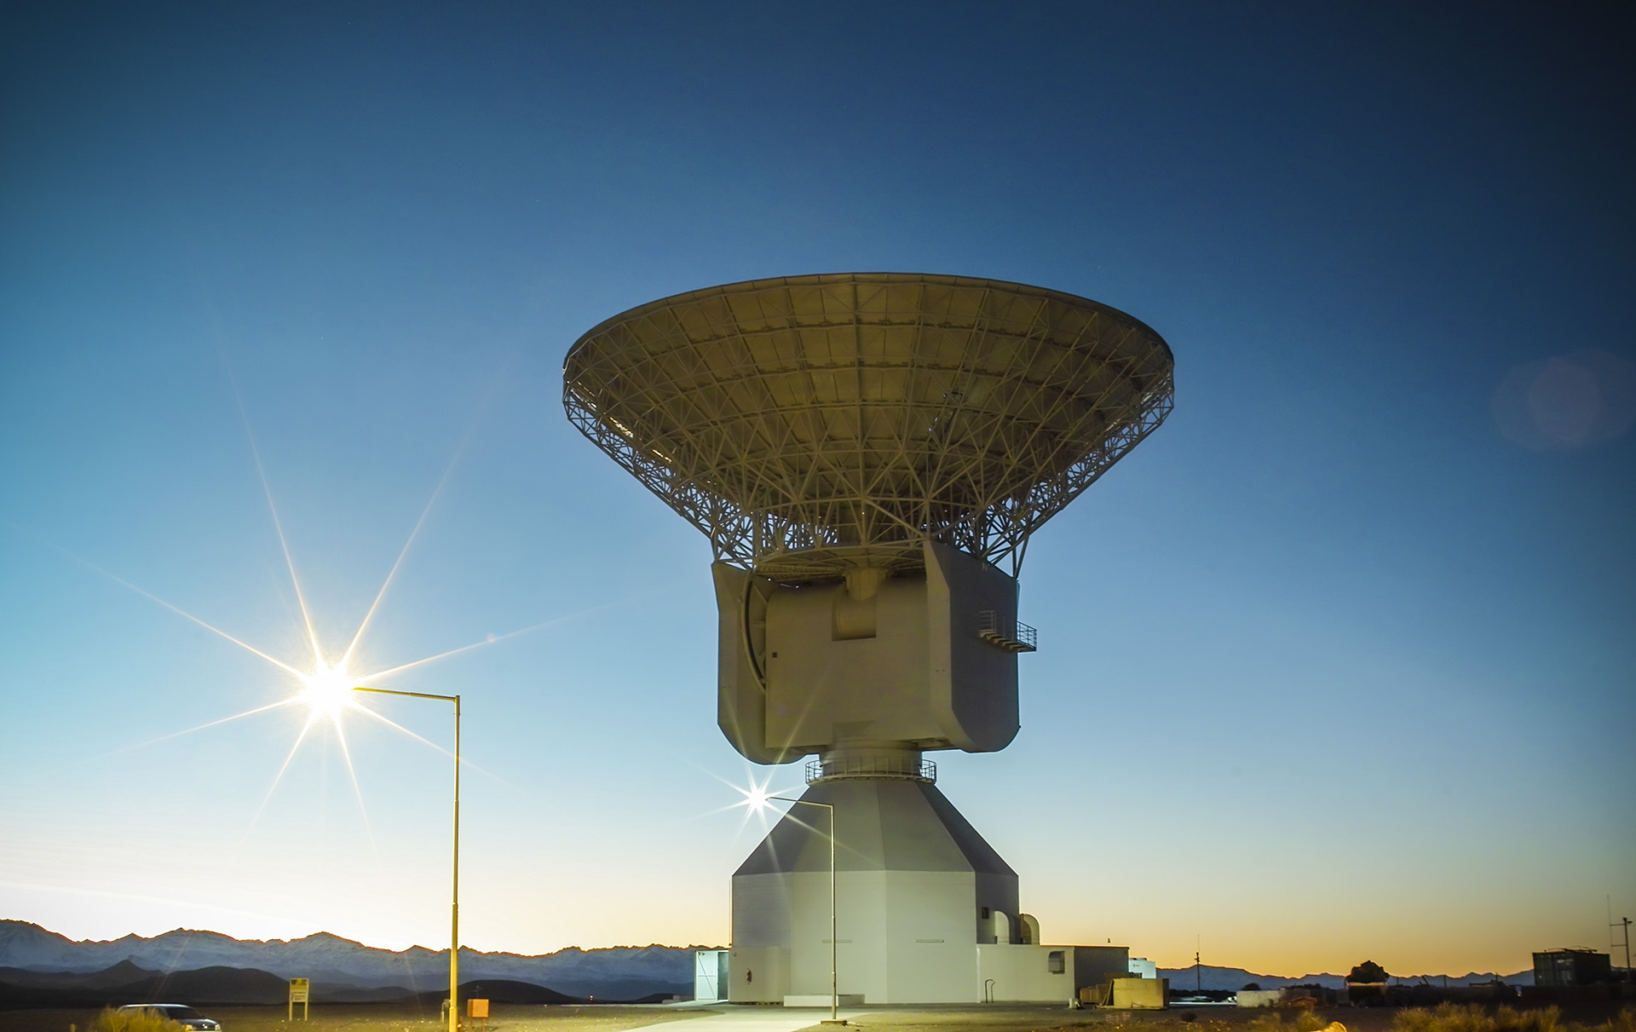
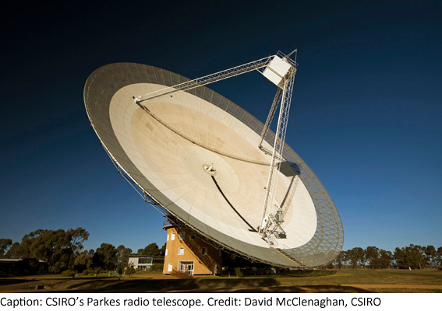
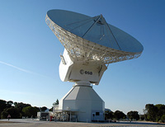
Deep Space Network (DSN): Comprises DSN and Partner 34-70m tracking sites around the globe to provide continuous communication and navigation support
JAXA Usuda
Kagoshima
ESA New Norcia
California
DSN Goldstone
Australia
DSN Canberra
Spain
DSN/CSIRO Parkes
Argentina
ESA Cebreros
DSN Madrid
ESA Malargue

Slide 13
Iris Architecture: Not Just X-Band DTE
RF boards for
  Ka-Band – high bandwidth and gain for future missions
  UHF & S-Band – proximity ops at planets, in formations
  “Exciter only” version can drive TWTs
Protocol (firmware / software) for
  Prox Ops – partners with other Iris, Electra, or UST
  DTE
  Earth Orbit high rate
Various antenna options, >= 30 dB
Reduced DC input power baseband in development
  PS, PA, CPU
  15 W system goal
JPL Heritage and Relatives
  UST, Electra MTIF, COVE, LMRST-Sat

Slide 14

Iris (Iρις) – (not an acronym)
The goddess Iris is associated with:
communication, messages,
the rainbow,
new endeavors

