Slide 1
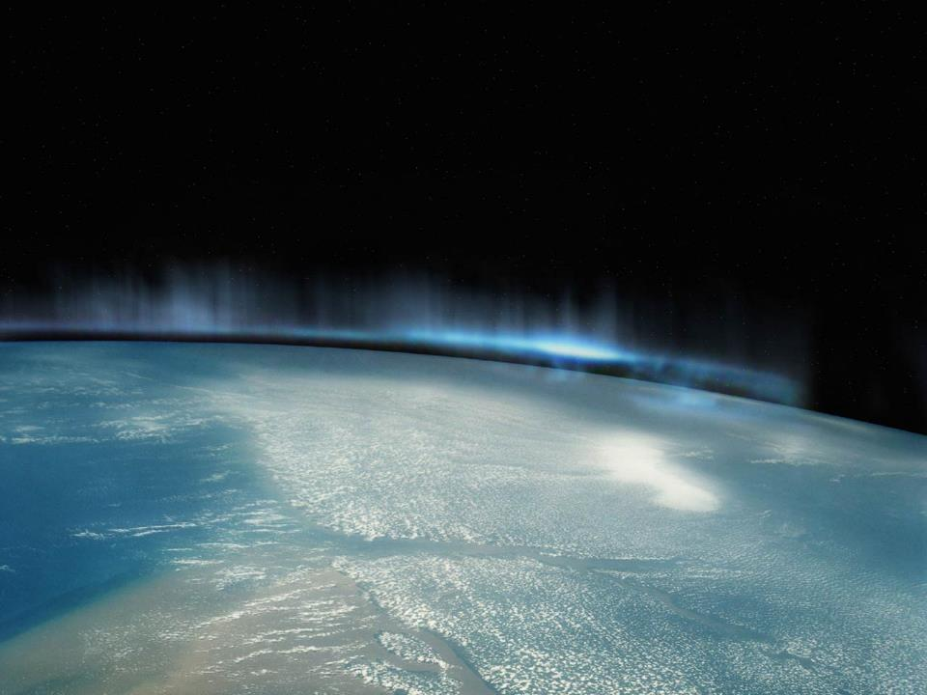
BioSentinel:
Enabling CubeSat-Scale Biological Research Beyond Low Earth Orbit
Matt Sorgenfrei, PhD
Stinger Ghaffarian Technologies
Intelligent Systems Division, NASA Ames Research Center

Slide 2
Outline
Introduction
Mission Overview
Spacecraft Concept
Design Challenges and Future Work

Slide 3
Introduction

Slide 4
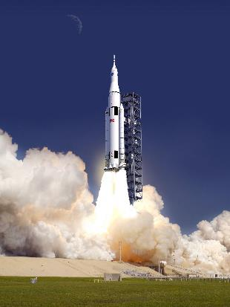
A Unique Launch Opportunity
NASA Advanced Exploration Systems (AES) is sponsoring 3 secondary payload slots on the first flight of the Space Launch System (SLS)
Secondaries will be deployed into a heliocentric orbit after separation of Orion CEV
Baseline design constraints allow for 6 cube volume and ~14 kg mass
Artist’s rendering of the Space Launch System

Slide 5
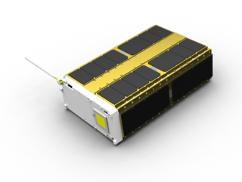
3 Distinct Missions
Marshall Spaceflight Center, Jet Propulsion Laboratory, and Ames Research Center are supplying spacecraft
MSFC NEAScout will inspect a NEA target, JPL LunarFlashlight will explore permanently shadowed craters on the moon, and Ames BioSentinel will characterize radiation environment
A visualization of one possible formulation of a 6U spacecraft to be used for the BioSentinel mission

Slide 6
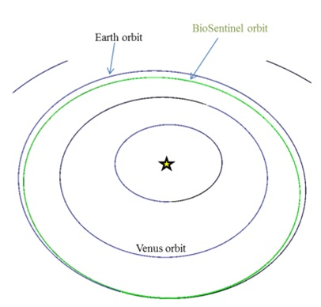
Where CubeSats Haven’t Gone Before
Exact deployment orbit of secondaries still being characterized
  Possible requirement for ΔV maneuver
Will likely be Earth-trailing, heliocentric orbit
Far outside the orbits typically occupied by CubeSats
A representative orbit that the BioSentinel spacecraft could occupy

Slide 7
Mission Overview

Slide 8
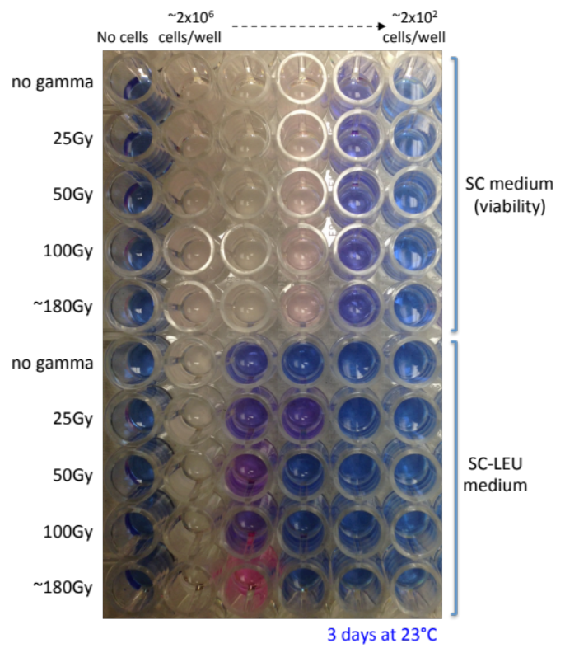
Valuable Access to the Space Environment
The space radiation environment cannot be duplicated on Earth, making research into its effects challenging
BioSentinel will measure a specific type of DNA damage resulting from exposure to this environment
Laboratory-engineered yeast cells will sense and repair direct damage to their DNA
  Specific damage is so-called double-strand breaks
  Gene repair will initiate cell growth in microwells within payload volume
Representative yeast growth cells similar to those that will be used in BioSentinel

Slide 9
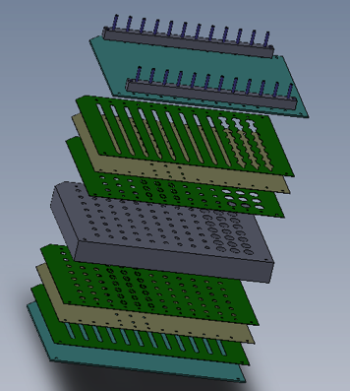
Foundational Research for Future Missions
Ionizing radiation presents a major challenge to human exploration of deep space
  Specific deleterious effects of long-term exposure are unknown
Challenging to replicate deep space radiation environment on Earth, particularly with SPEs
Eukaryotic yeast cells are a valuable analogy for future manned missions
BioSentinel will provide insight into shielding strategies and radiation countermeasure development
Visualization of the BioSentinel biology microwell stack-up

Slide 10
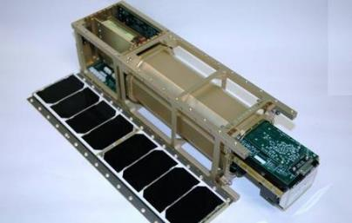
Building on Ames Heritage
Ames has previously flown biologically-focused CubeSats with the GeneSat, PharmaSat, and O/OREOS missions
Spacecraft make use of miniaturized life support systems to allow for growth of cells in microgravity environment
BioSentinel will leverage this heritage to build three separate payloads:
  Flight payload, module that can be integrated with ISS, and ground control
The PharmaSat 3U spacecraft, which carried a microwell and fluidics system similar to that which will be used in BioSentinel

Slide 11
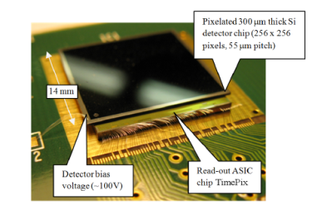
Bonus Payload: Radiation Sensor
In addition to biology payload BioSentinel will fly a stand-alone radiation sensor to provide direction measurement of galactic cosmic radiation
Requires linear energy transfer detection and integrating dosimetry (TID) capability
Future design work related to type of sensor and implementation, integration with spacecraft bus
Collaboration with JSC RadWorks group
The TimePIX linear energy transfer detector chip

Slide 12
A Wide Range of 6U “Firsts” for Ames
First 6U CubeSat to fly beyond LEO
First CubeSat to combine both active attitude control and a biology science payload
First CubeSat to integrate a propulsion subsystem for momentum management and (possibly) ΔV
First CubeSat to integrate a third-party deployable solar array
ADCS
Biosentinel
P/L
with Rad
Spectrometers
margin
Bus
Major BioSentinel subsystems shown with rough order-of-magnitude volume budgets

Slide 13
Spacecraft Concept

Slide 14
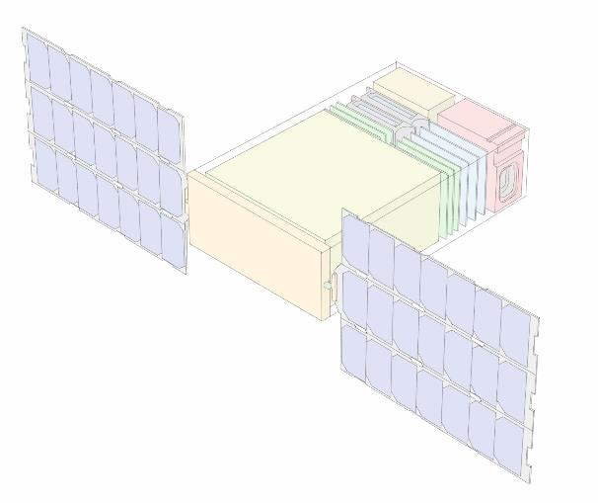
Current design concept for the BioSentinel Spacecraft

Slide 15
Environmental Considerations
Higher exposure to radiation than experienced by previous CubeSats operating in LEO
  Approximately 5 kRad total ionizing dose anticipated
  Non-destructive single events (such as SEUs) motivate > 20 MeV-cm² tolerance, destructive single events (SELs, SEBs) require > 37 MeV-cm² tolerance
Distance from Earth eliminates use of GPS for position determination, magnetometers for attitude determination, or torque coils/rods for attitude control
Solar radiation pressure will be largest disturbance torque

Slide 16
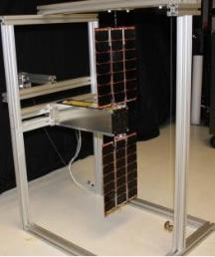
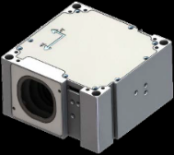
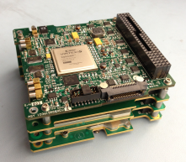
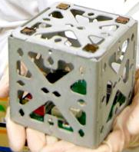
Subsystem Considerations
  Deployable solar panels required to generate sufficient power for all subsystems
  Traditional CubeSat S-band/UHF radios insufficient at mission operating orbit
    X-band under consideration for up and down communications
    Propulsion required for both detumble and momentum management
  Biology must be maintained at a specific temperature and acceleration range
Candidate components under consideration for the BioSentinel mission

Slide 17
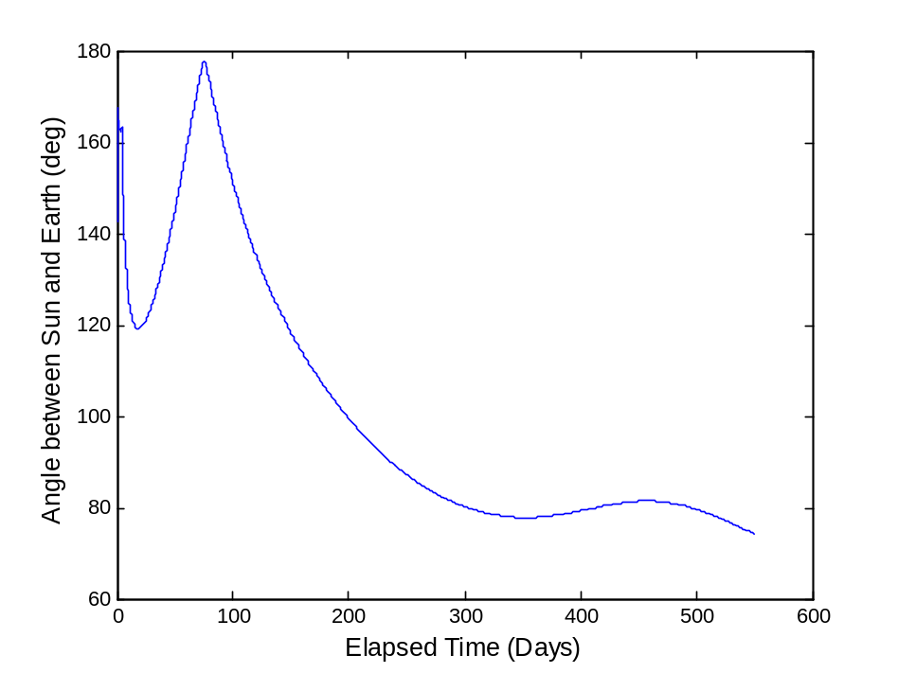
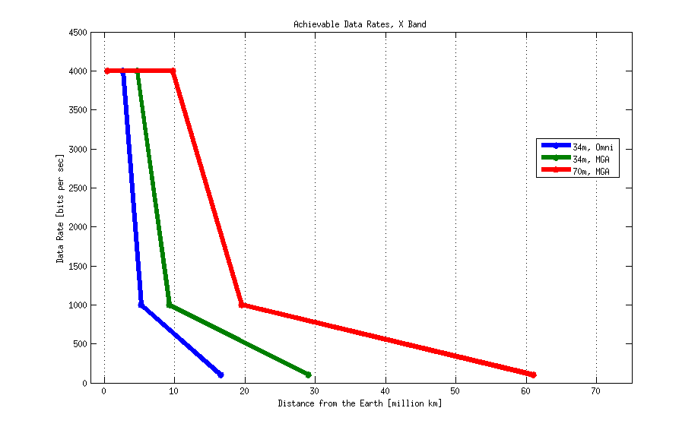
Communications Challenges
1 year nominal mission life
Data rate as a function of distance from Earth when using a 34m dish and an omni-directional or medium gain antenna
Angle between Sun and Earth as a function of mission day

Slide 18
Avionics Challenges
BioSentinel will require a command and data handling (C&DH) system that is much more capable than previously flown in CubeSat-class spacecraft
Simultaneously would like fairly inexpensive development boards for prototyping and testing campaigns
Radiation tolerance of high importance
  Radiation-hardened or phase-change memory, watchdogs, multiple or “golden” software loads, etc
Implications for GNC development strategy: auto-coding vs. hand-coding control schemes, schedulers, etc

Slide 19
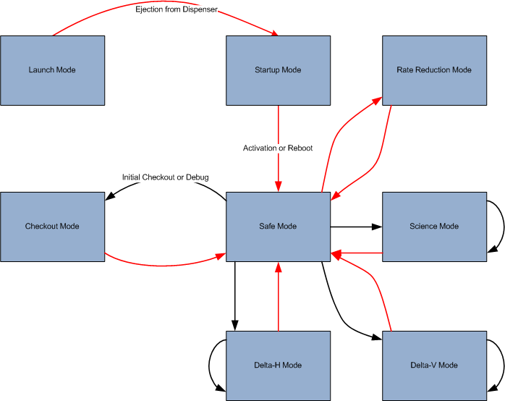
A representative mode transition diagram for the BioSentinel mission

Slide 20
Design Challenges/
Future Work

Slide 21
Tip-off conditions from SLS are a major unknown
  Initial body-fixed rates, potential need for a ΔV maneuver
Tip-off conditions help to define GNC system needs, which will drive other subsystem budgets
Detailed power budget assessment: ~30 W orbit-average power should allow for radio to be always on
  As opposed to traditional CubeSat missions in which subsystem cycling sometimes required
Need to define ground operations strategy
  DSN likely the most feasible approach, issues with availability and cost
  34m likely acceptable for majority of mission life, larger array required at end of mission

Slide 22
Questions?
Matthew.c.Sorgenfrei@nasa.gov

Slide 23
Back-Up Slides

Slide 24
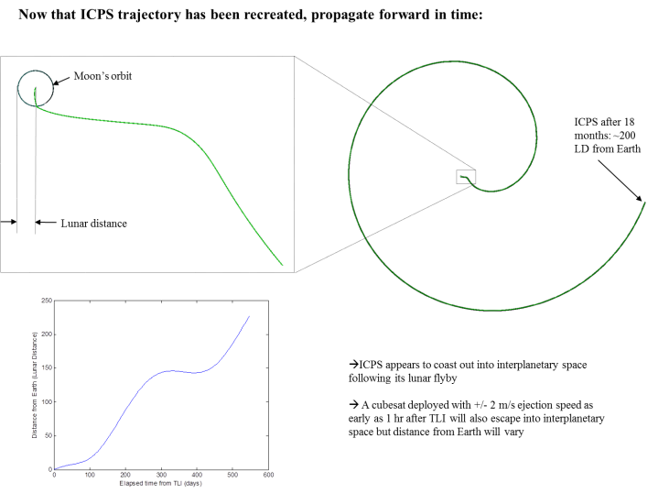
Location in Lunar Centered Space

Slide 25
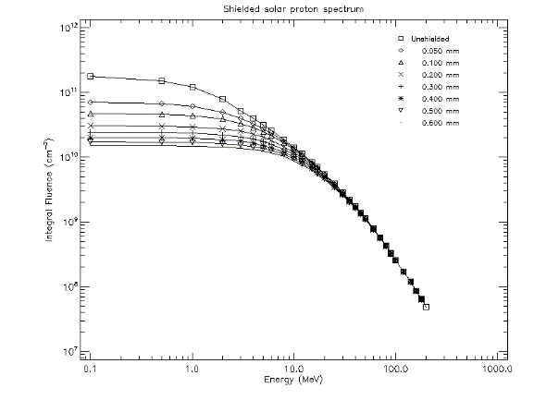
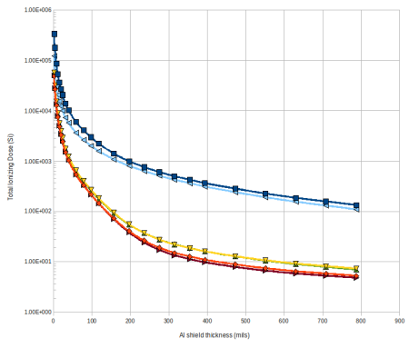
Radiation Environment
Total Ionizing Dose

Slide 26
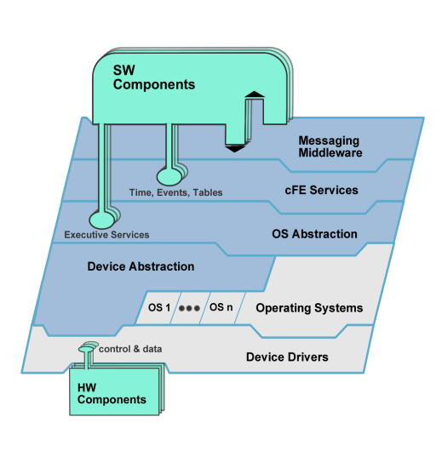

CFE/CFS Layered Architecture
Each layer “hides” its implementation and technology details.
Internals of a layer can be changed -- without affecting other layers’ internals and components.
Enables technology infusion and evolution.
Doesn’t dictate a product or vendor.
Provides Middleware, OS and HW platform-independence.
Files, Tables

